Slide 1


LAGOS BUSINESS SCHOOL · MEMBA 14 · EEGB · PART III
SESSION 12
Trade, Supply Chains
& Industrial Policy
From markets, to macro, to decisions that matter — in Nigeria and the world.
Reading: Sáenz & Revilla, Creating More Resilient Supply Chains (MIT Sloan Management Review) · Facilitator: Bongo Adi & Kelechi Nnamdi
Economic Environment of Global Business · Lagos Business School · Prof. Bongo Adi, Kelechi Nnamdi, Elvis Ozegbe
Notes:
Open by asking how many participants' firms export to another African country today. Then ask what stops the rest. The answers — logistics, payments, FX, trust — set up the whole session.

Slide 2




RECAP
Session 11 in Three Ideas
The trilemma
A country cannot have a fixed exchange rate, free capital flows and independent monetary policy all at once.
Capital flows
Hot money arrives in the good times and leaves in a hurry — a sudden stop hits reserves and the currency.
Mismatches
Borrowing in dollars while earning in naira turns a devaluation into a solvency problem.
SESSION 12 · TRADE & INDUSTRIAL POLICY
2

Slide 3



TODAY'S PLAN
Session 12 at a Glance — 75 Minutes
Why countries trade, who Nigeria trades with, and how to build a supply chain that survives the next shock.
10'
25'
20'
20'
Recap & Hook
Why Countries Trade
Supply Chains & Industrial Policy
Lab: Export Market Choice
The AfCFTA opportunity — and why it is not automatic
Comparative advantage and the gravity model
De-risking, friend-shoring and the return of the state
Gravity, 'missing trade' and an AfCFTA scenario
SESSION 12 · TRADE & INDUSTRIAL POLICY
3

Slide 4

BY THE END OF TODAY
Session 12 Learning Objectives
You will be able to:
01
02
03
Explain Why Trade Pays
Size Export Markets
Build Resilient Supply Chains
Use comparative advantage to show why both sides gain — and who inside each country loses.
Use the gravity model to estimate expected trade and spot under-served African markets for AfCFTA.
Measure supplier concentration and choose between diversifying, stockpiling and localising.
SESSION 12 · TRADE & INDUSTRIAL POLICY
4

Slide 5



THE HOOK
A Market of 1.3 Billion People Next Door
“AfCFTA opens a continent. Let's export everywhere next year.”
Before the board approves an export budget, ask three questions:
Can we get there?
Is anyone buying?
Is our own supply chain safe?
Distance, roads, ports and border delays often cost more than the tariff the agreement removes.
Market size matters: a rich, nearby market beats a poor, distant one — that is the gravity model.
Exporting more means importing more inputs. If one supplier country stops, so do we.
Notes:
The 1.3–1.4 billion figure is the commonly cited population of the AfCFTA area. Ask participants which African markets their firms already sell to, and why those.

Slide 6




NIGERIAN BUSINESS CASE
AfCFTA and a Nigerian Manufacturer
The situation
The decision question
A Lagos packaged-food manufacturer sells only in Nigeria. AfCFTA lowers tariffs on most goods traded between member states, and the board wants an export plan. Most of its packaging and machinery are imported.
Which African markets should it enter first — and how should it make its supply chain shock-proof before it grows?
The data we have
What a good answer looks like
ng_trade_partners.csv — Nigeria's exports and imports with 30 partners, plus partner GDP, distance, language, AfCFTA membership and tariffs. *Stylised teaching data.*
A ranked shortlist of three export markets with reasons, and two actions to reduce supply-chain concentration.
SESSION 12 · TRADE & INDUSTRIAL POLICY
6
Notes:
Trade values are stylised: they follow the broad pattern of Nigeria's trade (oil exports to Europe and Asia, manufactured imports from China) but are not official.

Slide 7
PART
01
Why Countries Trade
Specialise in what you do relatively best.

Slide 8

COMPARATIVE ADVANTAGE
Everyone Gains From Doing What They Do Relatively Best
IN PLAIN ENGLISH
THE FORMULA
opportunity cost of X = output of Y given up ÷ extra output of X
A country gains from trade by producing what it gives up least to make — its comparative advantage — and buying the rest. Even a country that is better at everything gains by specialising.
WHY A MANAGER CARES
Comparative advantage is not fixed. Nigeria moved from importing most of its cement to producing almost all of it once investment, gas and scale came together. Your firm's export opportunity lies where your cost relative to rivals is lowest.
EXAMPLE
If a Nigerian worker can make 10 bags of cement or 2 phones a day, and a Chinese worker 12 bags or 6 phones, Nigeria gives up 0.2 phones per bag; China gives up 0.5. Nigeria has the comparative advantage in cement, China in phones — even though China is better at both.
SESSION 12 · TRADE & INDUSTRIAL POLICY
8
Notes:
The numbers are illustrative. The real-world cement story: large domestic investment in the 2000s–2010s made Nigeria close to self-sufficient in cement.

Slide 9


WINNERS AND LOSERS
Trade Raises the Total — Not Everyone's Share
Who gains
Who can lose
Usually many, spread thinly
Usually few, hit hard
Consumers: cheaper and more varied goods
Exporters: bigger markets and scale
Firms buying cheaper imported inputs
The economy as a whole: higher income
Firms competing directly with imports
Workers in those firms and towns
Producers who relied on protection
These losers lobby — which is why trade is political
Good trade policy grows the pie and helps the losers adjust. Ignoring the losers is how trade agreements lose public support.
SESSION 12 · TRADE & INDUSTRIAL POLICY
9

Slide 10
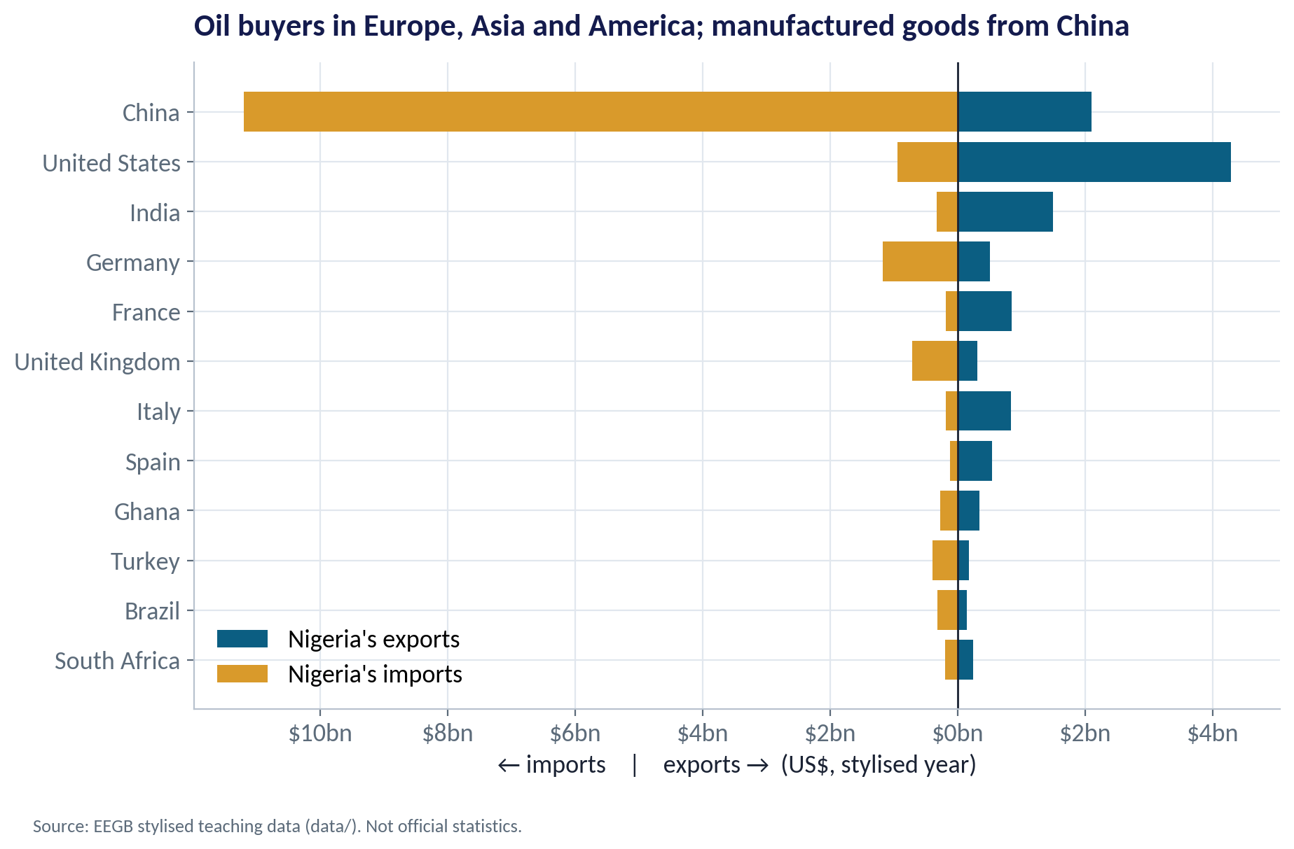
THE PATTERN
Who Nigeria Trades With
WHAT TO SEE
Exports go mainly to oil buyers: the United States, India and European refiners.
Imports come overwhelmingly from China: machinery, phones, textiles, inputs.
Total trade in this stylised year is about $31bn; trade with African partners is only 7.6% of it.
That low African share is the gap AfCFTA is meant to close.
Fig S12-F01 · replicate: s12_figures.R / .py
SESSION 12 · TRADE & INDUSTRIAL POLICY
10

Slide 11
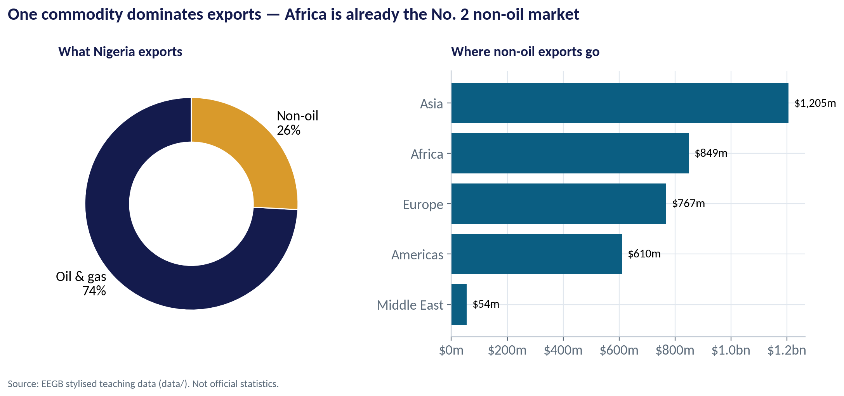
ONE COMMODITY
Export Concentration: Oil Still Dominates
WHAT TO SEE
Oil and gas make up about 74% of exports in these data.
When oil prices or output fall, export earnings — and dollars for importers — fall with them.
Non-oil exports are about $3.5bn; Africa already takes $849m of them, second only to Asia.
Manufactured and processed goods are more likely to sell in Africa than in Europe.
Fig S12-F05 · replicate: s12_figures.R / .py
SESSION 12 · TRADE & INDUSTRIAL POLICY
11
Notes:
Real-world note: crude oil and gas have long been the large majority of Nigeria's goods exports; the exact share moves with prices.

Slide 12
THE GRAVITY MODEL
Trade Behaves Like Gravity
IN PLAIN ENGLISH
THE FORMULA
log(trade) = a + b₁·log(GDP) + b₂·log(distance) + extras
Countries trade more with partners that are big and close, and less with those that are small and far — just as gravity pulls more strongly between heavy, nearby objects. Shared language, borders and history add to the pull; being landlocked subtracts.
WHY A MANAGER CARES
Gravity is the most reliable model in international economics. It tells you what trade should be with each market — so you can spot where trade is missing and where the opportunity is real.
EXAMPLE
In our data b₁ = 0.98 and b₂ = −1.08: a partner 10% bigger trades about 10% more with Nigeria; one 10% further away trades about 11% less.
SESSION 12 · TRADE & INDUSTRIAL POLICY
12
Notes:
Coefficients near +1 for GDP and −1 for distance are typical across many studies. 'log' lets us read coefficients as percentage effects.

Slide 13
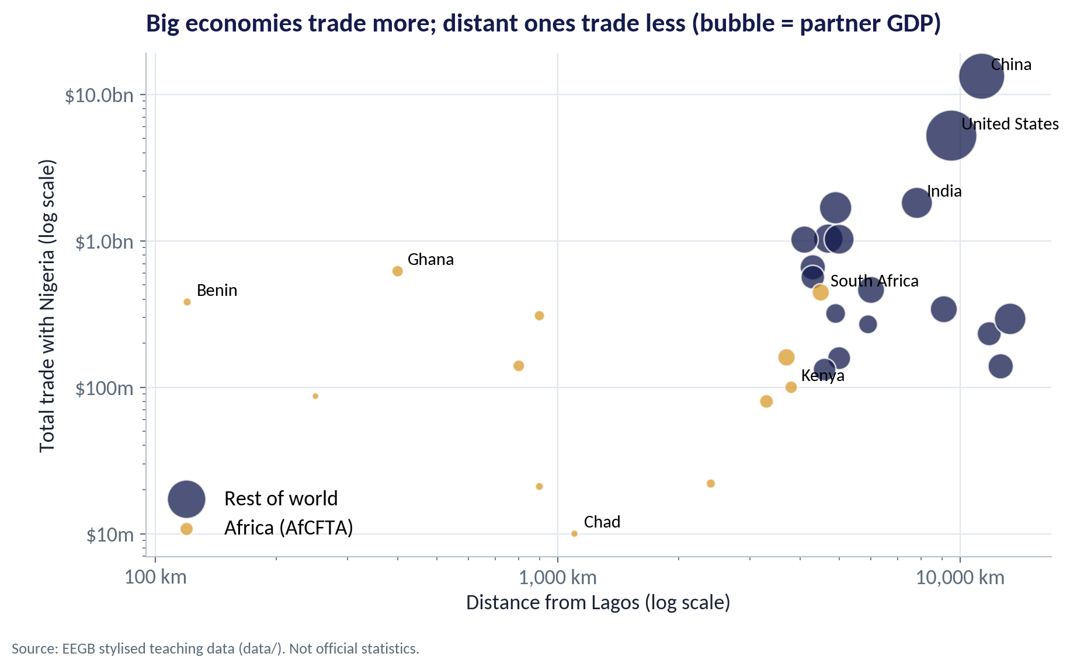
GRAVITY IN ONE PICTURE
Size Pulls, Distance Pushes
WHAT TO SEE
Each bubble is a partner; bigger bubble = bigger economy.
Distant giants (China, the US) still trade heavily with Nigeria because of their size.
Neighbours like Benin and Ghana trade a lot for their size — they are very close.
Small, landlocked and distant partners such as Chad trade very little.
Fig S12-F02 · replicate: s12_figures.R / .py
SESSION 12 · TRADE & INDUSTRIAL POLICY
13

Slide 14
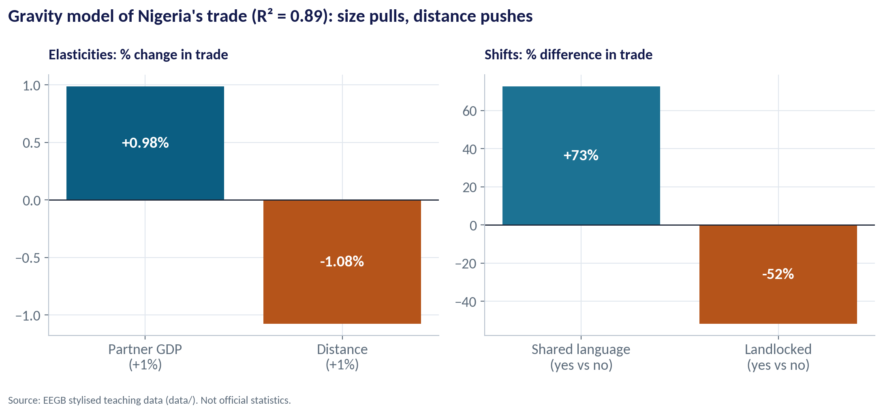
THE REGRESSION
What Drives Nigeria's Trade?
WHAT TO SEE
GDP elasticity ≈ 0.98; distance elasticity ≈ −1.08.
A shared language goes with about 73% more trade.
Landlocked partners trade about 52% less — every border and truck adds cost.
Four variables explain 89% of the variation (R² = 0.89).
Fig S12-F03 · replicate: s12_figures.R / .py
SESSION 12 · TRADE & INDUSTRIAL POLICY
14
Notes:
With 30 observations, treat these as illustrative. Language may also proxy for shared colonial history, legal systems and diaspora networks.

Slide 15
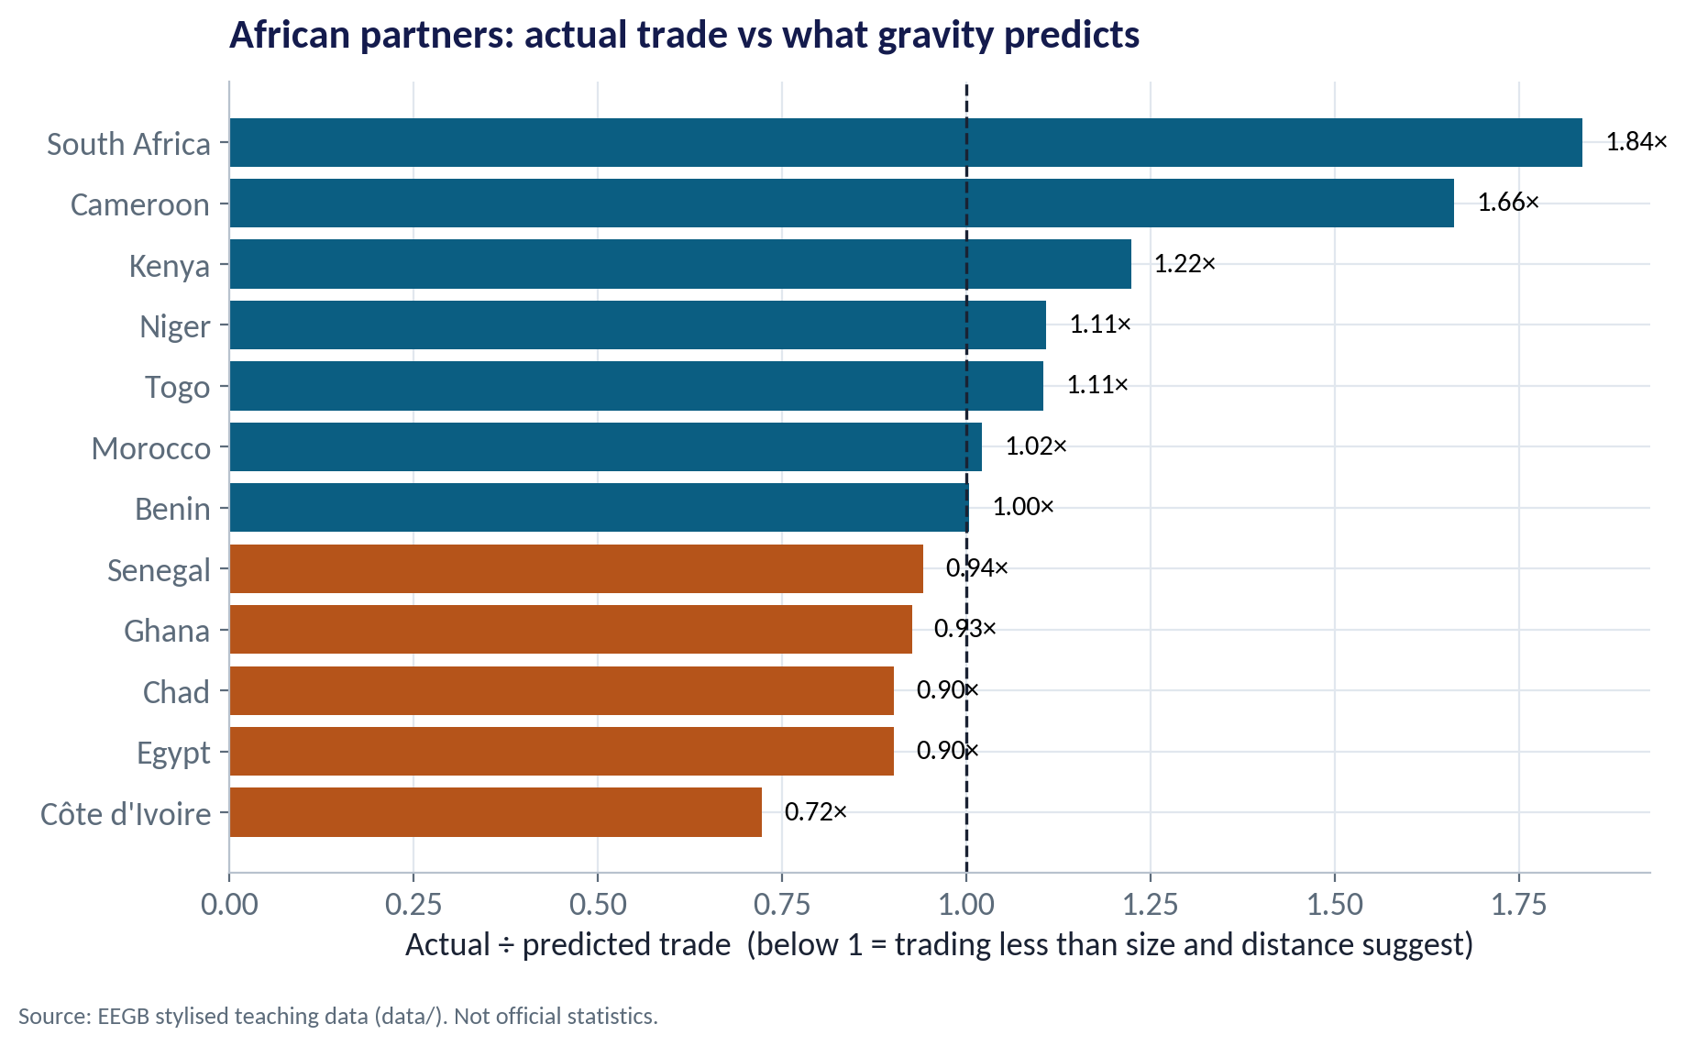
MISSING TRADE
Where Is Trade Below What Gravity Predicts?
WHAT TO SEE
A ratio below 1 means Nigeria trades less than size and distance suggest.
Côte d'Ivoire (0.72×), Egypt and Ghana sit below the line — potential room to grow.
South Africa (1.84×) and Cameroon (1.66×) already trade more than predicted.
Missing trade is a clue, not a verdict: check non-tariff barriers, payments and competition first.
Fig S12-F04 · replicate: s12_figures.R / .py
SESSION 12 · TRADE & INDUSTRIAL POLICY
15

Slide 16
CONCEPT CHECK
Quick Check: What Would You Say?
The gravity model says Nigeria trades only 0.72 times the predicted amount with Côte d'Ivoire. What is the best interpretation for an exporter?
A
Ivorians do not like Nigerian products
B
There may be unexploited potential — investigate the barriers (language, logistics, payments, rules) before investing
C
The model is wrong and should be ignored
D
Côte d'Ivoire is too far away to matter
Discuss with your neighbour for 60 seconds — answer and reasoning in the speaker notes.
SESSION 12 · TRADE & INDUSTRIAL POLICY
16
Notes:
ANSWER: B. B. 'Missing trade' signals possible potential relative to size and distance. The reason could be language (French), currency (CFA franc), logistics or rules — each is fixable at a cost. A and D are not supported; C throws away a useful benchmark.

Slide 17
PART
02
AfCFTA: Promise and Practice
Tariffs are only part of the cost of trading.

Slide 18
THE AGREEMENT IN BRIEF
The African Continental Free Trade Area
Feature | What it means for a Nigerian firm
Coverage | Nearly all African Union members have signed; Nigeria signed in 2019 and ratified in 2020. Trading under the agreement began in January 2021.
Tariffs | Most tariff lines are phased down to zero over several years; sensitive and excluded lists remain.
Rules of origin | Goods must be 'made in Africa' to qualify — assembling imported kits may not count.
Beyond goods | Protocols on services, investment, competition and digital trade are being negotiated and implemented in stages.
Payments | The Pan-African Payment and Settlement System (PAPSS) aims to let firms pay in local currencies instead of dollars.
Implementation is gradual and uneven. Check the current schedules for your product before you plan prices.
SESSION 12 · TRADE & INDUSTRIAL POLICY
18

Slide 19
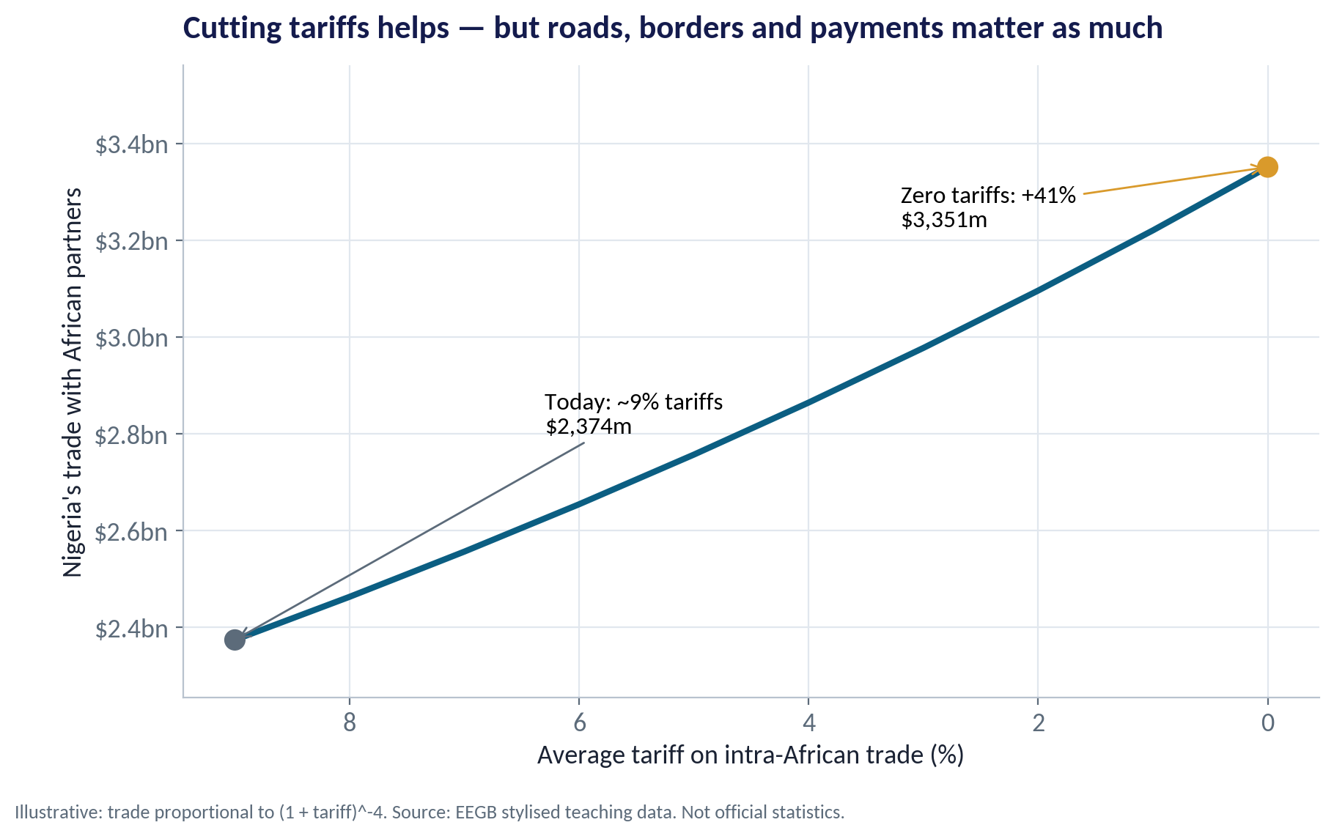
AN ILLUSTRATIVE SCENARIO
What Removing Tariffs Could Do
WHAT TO SEE
Trade with African partners: about $2.4bn today in these data.
If average tariffs fell from 9% to zero and trade responds with an elasticity of 4, trade rises about 41% to $3.4bn.
The elasticity is uncertain — estimates often range from 3 to 6 — so treat this as a range, not a forecast.
Poor roads, slow borders, checkpoints and payment frictions can cost more than the tariff itself.
Fig S12-F07 · replicate: s12_figures.R / .py
SESSION 12 · TRADE & INDUSTRIAL POLICY
19
Notes:
The 9% tariff is a stylised average. Elasticity of 4 means a 1% fall in the tariff-inclusive price raises trade about 4%.

Slide 20


WHERE MANAGERS GO WRONG
How Firms Get AfCFTA Wrong
THE TRAP
THE BETTER HABIT
“Tariffs are gone, so our prices will be competitive.”
Add up landed cost: freight, border delays, informal payments, FX conversion and distribution.
Assuming every product qualifies.
Check rules of origin and the tariff schedule for your exact product code.
Choosing markets by population alone.
Use gravity: income, distance, language and existing trade links.
Ignoring currency: pricing in naira for CFA or cedi markets.
Plan invoicing currency and FX risk; explore local-currency payment rails.
Going everywhere at once.
Start with two or three markets, learn, then expand along trade corridors.
SESSION 12 · TRADE & INDUSTRIAL POLICY
20

Slide 21
PART
03
Supply Chains and Industrial Policy
Efficient was yesterday's goal. Resilient is today's.

Slide 22
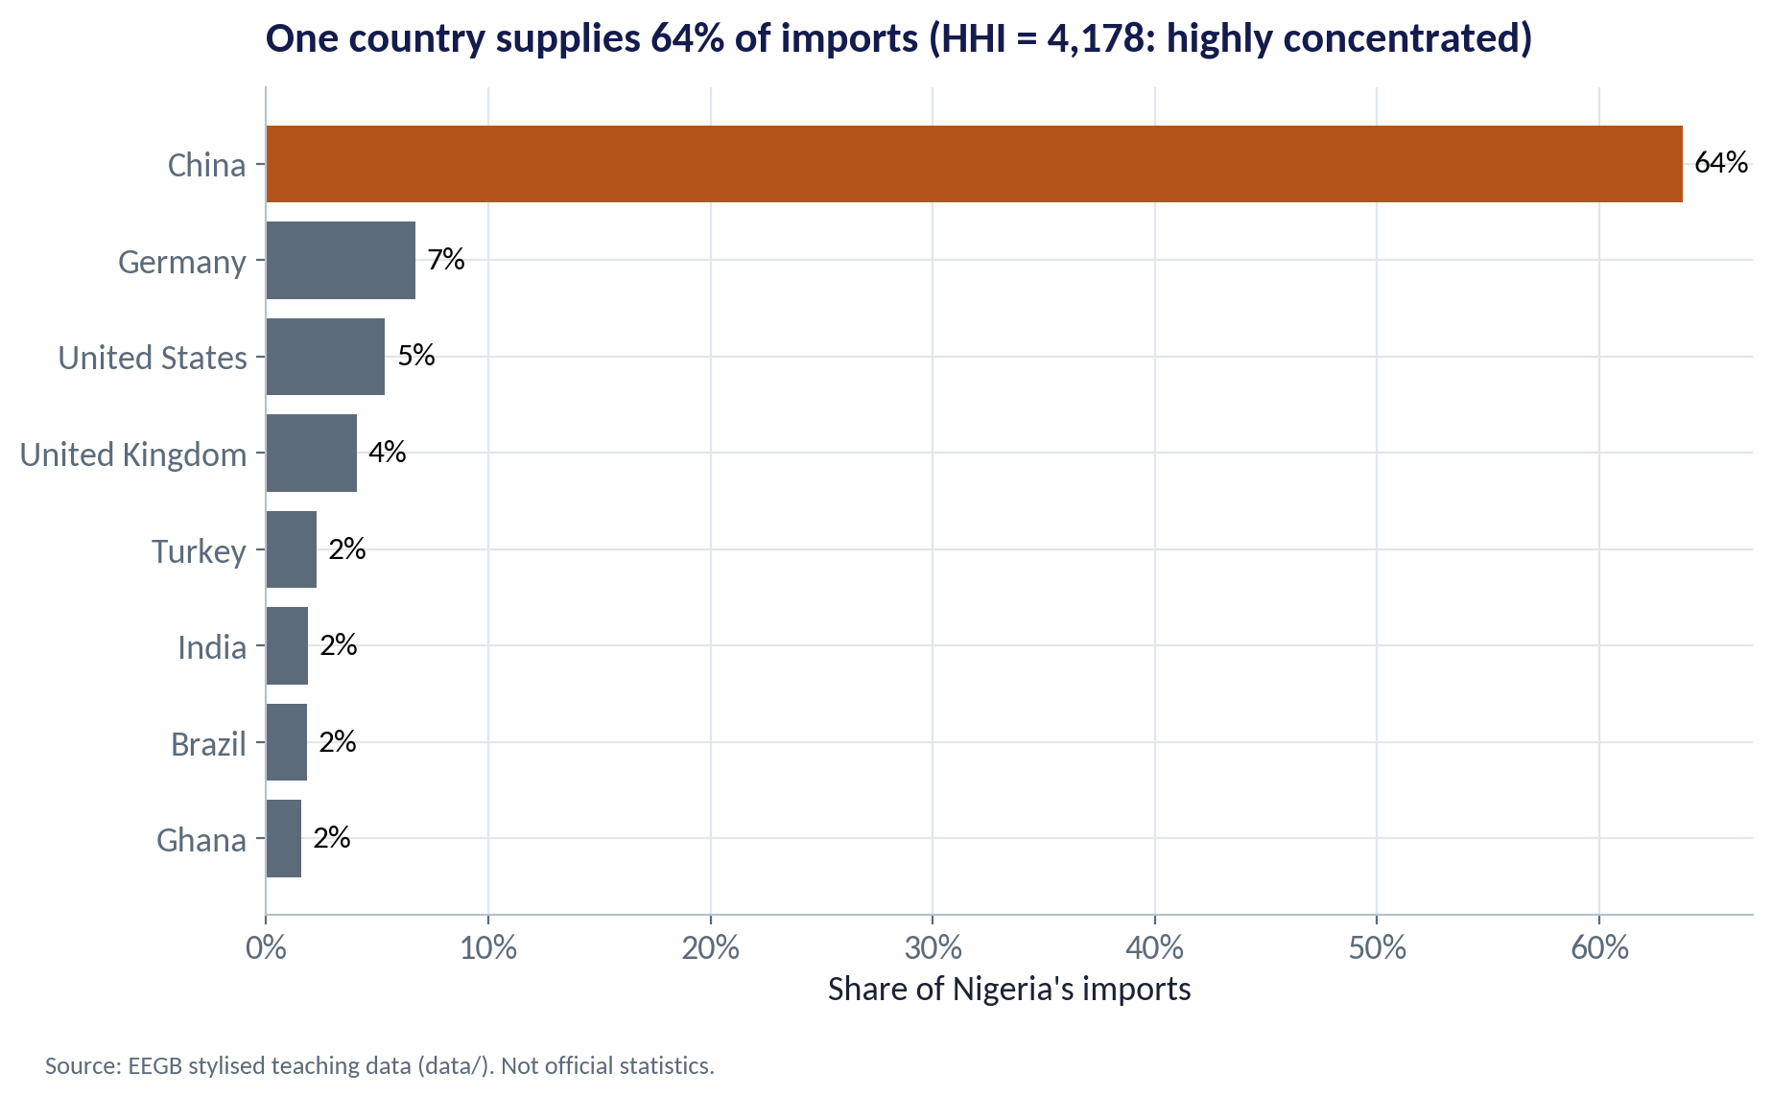
CONCENTRATION RISK
One Supplier Country, One Point of Failure
WHAT TO SEE
China supplies about 64% of Nigeria's imports in these data.
The Herfindahl–Hirschman Index (sum of squared shares) is 4,178 — above 2,500 is commonly treated as highly concentrated.
The top three sources supply 76% of imports.
A port closure, export ban or freight spike in one place can stop Nigerian factories.
Fig S12-F06 · replicate: s12_figures.R / .py
SESSION 12 · TRADE & INDUSTRIAL POLICY
22

Slide 23

MEASURING CONCENTRATION
The Herfindahl–Hirschman Index
IN PLAIN ENGLISH
THE FORMULA
HHI = s₁² + s₂² + … + sₙ² (shares in %)
Square each supplier's percentage share and add them up. One supplier = 10,000. Many small suppliers = close to zero. The higher the number, the more your supply depends on a few sources.
WHY A MANAGER CARES
Run this on your own purchase ledger by country and by supplier. An HHI above 2,500 on a critical input is a board-level risk.
EXAMPLE
64% from China, 7% from Germany, 5% from the US and many small sources → HHI ≈ 4,178. Splitting China's share across two countries of 32% each would roughly halve that contribution.
SESSION 12 · TRADE & INDUSTRIAL POLICY
23

Slide 24


THE RESILIENCE TOOLKIT
Four Ways to Make a Supply Chain Shock-Proof
Diversify suppliers
Hold strategic stock
Qualify a second source in another country (e.g. Turkey or India alongside China). Costs more per unit, but buys insurance.
Keep more inventory of critical, slow-to-replace inputs. Ties up cash — expensive when interest rates are 25%+.
Localise or regionalise
See the whole chain
Source within Nigeria or AfCFTA partners. Shorter routes and no FX for intra-Nigerian supply, but capability takes time.
Map tier-2 and tier-3 suppliers. Many 'diversified' firms discover their suppliers all depend on the same factory.
Sáenz and Revilla's core point: resilience must be designed in — visibility, flexibility and collaboration — not bolted on after a crisis.
SESSION 12 · TRADE & INDUSTRIAL POLICY
24

Slide 25
THE NEW GEOECONOMICS
De-risking, Friend-Shoring and Industrial Policy
Trend | What it is | Implication for Nigeria
De-risking | Reducing dependence on one country without cutting trade off entirely | Western buyers may look for alternative suppliers — an opening for African producers
Friend-shoring | Moving supply chains to politically aligned countries | Alignment and stability start to matter as much as cost
Export controls | Restrictions on selling strategic goods (e.g. advanced chips) | Technology access can be cut by decisions taken far away
Industrial policy | Subsidies and rules to build strategic industries (e.g. US CHIPS Act and Inflation Reduction Act) | Rich-country subsidies compete for the same investment Nigeria wants
Local content & backward integration | Policies requiring or rewarding local production | Can build industries (cement) — or protect inefficiency if never phased out
SESSION 12 · TRADE & INDUSTRIAL POLICY
25

Slide 26


INDUSTRIAL POLICY
When Does Industrial Policy Work?
More likely to work
More likely to fail
Discipline and competition
Protection without discipline
Support tied to exports or clear performance targets
Time-limited, with a sunset clause
Builds on real comparative advantage (gas, agriculture, scale)
Firms still face competition
Import bans that last indefinitely
Support captured by a few connected firms
Goes against cost reality (no inputs, no power)
No measure of success
Ask of any policy: what would make it end, and how would we know it worked?
SESSION 12 · TRADE & INDUSTRIAL POLICY
26

Slide 27
CONCEPT CHECK
Quick Check: What Would You Say?
Your firm imports 70% of a critical packaging input from one country. Interest rates are 27%. Which response is most sensible first?
A
Triple inventory immediately
B
Qualify a second supplier in another country and map who your current supplier depends on
C
Stop importing and wait for local supply to appear
D
Do nothing — diversification is too expensive
Discuss with your neighbour for 60 seconds — answer and reasoning in the speaker notes.
SESSION 12 · TRADE & INDUSTRIAL POLICY
27
Notes:
ANSWER: B. B. Qualifying a second source and mapping the deeper tiers reduce concentration without the large cash cost of tripling stock at 27% interest (A). C risks stopping production; D ignores a board-level risk.

Slide 28



HANDS-ON LAB
Lab: Where Should We Export First?
1
Rank partners by total trade and compute Africa's share.
YOU WILL NEED
Data
2
Fit the gravity model: log trade on log GDP, log distance, language and landlocked.
data/ng_trade_partners.csv
3
Compare actual vs predicted trade for each African partner.
R script
sessions/s12/R/s12_lab.R
4
Run the AfCFTA tariff scenario with elasticities of 3, 4 and 6.
Python script
Compute the HHI of import sources and propose two de-risking actions.
sessions/s12/python/s12_lab.py
5
Deliverable: a ranked shortlist of three export markets and two supply-chain actions, one line of reasoning each.
⏱ 20 minutes
SESSION 12 · TRADE & INDUSTRIAL POLICY
28

Slide 29
WORDS TO OWN
Today's Vocabulary in Plain English
Comparative advantage
Producing what you give up least to make, relative to others.
Rules of origin
Rules on how much of a good must be made locally to qualify.
Opportunity cost
What you give up to produce or buy something.
Non-tariff barrier
Any cost of trading other than a tariff: delays, permits, quotas.
Gravity model
Trade rises with partner size and falls with distance.
HHI
Sum of squared shares; measures concentration.
Elasticity
% change in one thing for a 1% change in another.
Friend-shoring
Moving supply chains to politically aligned countries.
AfCFTA
The African Continental Free Trade Area.
Industrial policy
Government support to build particular industries.
SESSION 12 · TRADE & INDUSTRIAL POLICY
29

Slide 30
KEY TAKEAWAYS
Session 12 in 5 Ideas
01
Countries — and firms — gain by specialising in their comparative advantage.
02
Trade follows gravity: big and close partners matter most; use it to spot missing trade.
03
AfCFTA cuts tariffs, but logistics, rules of origin, payments and FX decide whether you can compete.
04
Measure supplier concentration; diversify, stock, localise and map deeper tiers.
05
Industrial policy works best with discipline, competition and an exit date.
NEXT › Session 13: Climate & Energy Transition
Before next session: Read Stern, The Economics of Climate Change (summary chapters) and skim the KPMG / IFRS Foundation guide on ISSB and TCFD. List your company's three largest sources of emissions.

