Slide 1


LAGOS BUSINESS SCHOOL · MEMBA 14 · EEGB · PART IV
SESSION 13
Climate & Energy-
Transition Economics
From markets, to macro, to decisions that matter — in Nigeria and the world.
Reading: Stern, The Economics of Climate Change · KPMG / IFRS Foundation guides on ISSB / TCFD · Facilitator: Bongo Adi & Kelechi Nnamdi
Economic Environment of Global Business · Lagos Business School · Prof. Bongo Adi, Kelechi Nnamdi, Elvis Ozegbe
Notes:
Open with the cement-versus-solar comparison. The message is not moral but financial: climate policy moves value between firms, and boards that measure first move first.

Slide 2




RECAP
Part III in Three Ideas
The trilemma
No country can have a fixed exchange rate, free capital flows and independent monetary policy all at once.
Trade follows gravity
Countries trade most with big, nearby partners; AfCFTA aims to lower the barriers that keep intra-African trade small.
Industrial policy is back
Governments now shape supply chains openly — firms must plan for de-risking, friend-shoring and export controls.
SESSION 13 · CLIMATE & ENERGY TRANSITION
2

Slide 3



TODAY'S PLAN
Session 13 at a Glance — 75 Minutes
Climate change is an economic problem with a price tag — and that price is starting to reach Nigerian balance sheets.
10'
25'
20'
20'
Recap & Hook
The Economics of Carbon
Exposure & Disclosure
Lab: Carbon Stress Test
Same carbon price, two very different firms
Externality, carbon price, border adjustments
Who pays, CBAM, TCFD/ISSB, stranded assets
Your sector at US$25, 50 and 100 a tonne
SESSION 13 · CLIMATE & ENERGY TRANSITION
3

Slide 4


BY THE END OF TODAY
Session 13 Learning Objectives
You will be able to:
01
02
03
Explain Carbon Pricing
Size the Exposure
Plan the Response
Explain why emissions are an externality, and how carbon taxes, trading schemes and border adjustments put a price on them.
Turn emissions and a carbon price into a naira cost, and compare it with EBITDA by sector and by firm.
Use pass-through, abatement and disclosure to build a credible transition plan for a Nigerian business.
SESSION 13 · CLIMATE & ENERGY TRANSITION
4

Slide 5



THE HOOK
Same Price, Different Fates
“Carbon pricing is a European problem. We sell in Nigeria.”
Three reasons a Nigerian board should still care:
Exports
Capital
Home policy
The EU's Carbon Border Adjustment Mechanism (CBAM) will charge importers of cement, steel, aluminium and fertiliser for embedded carbon.
Lenders and investors increasingly price climate risk into the cost of funds and ask for disclosure.
Nigeria's Climate Change Act (2021) commits the country to net zero by 2060 and provides for carbon budgets.
Notes:
Run a quick poll: which participants' firms already report emissions? Usually very few — which makes the point.

Slide 6


NIGERIAN BUSINESS CASE
Cement vs Solar Under a Carbon Price
The situation
The decision question
A board is comparing two holdings: a cement producer with coal- and gas-fired kilns and a solar installer. Both are profitable today.
If a carbon price of US$25, US$50 or US$100 a tonne applied, how much EBITDA would each lose — and what can management do about it?
The data we have
What a good answer looks like
firm_carbon_exposure.csv — 40 fictional Nigerian listed firms in 9 sectors: revenue, EBITDA, scope 1 and 2 emissions, EU export share, TCFD disclosure. *Stylised teaching data.* We assume ₦1,500 per US$.
A carbon stress test by sector and firm, plus a response plan: pass-through, abatement and disclosure.
SESSION 13 · CLIMATE & ENERGY TRANSITION
6
Notes:
Nigeria has no economy-wide carbon price today. The stress test is a scenario, not a forecast — exactly how TCFD and ISSB ask firms to think.

Slide 7
PART
01
Why Carbon Needs a Price
The biggest externality of all.

Slide 8


BACK TO SESSION 5
Emissions Are an Externality
IN PLAIN ENGLISH
THE FORMULA
social cost = private cost + damage to others
When a kiln or generator emits CO₂, the damage — floods, heat, crop losses — falls on other people, mostly in the future. The emitter does not pay, so the market produces too much pollution.
WHY A MANAGER CARES
When governments correct an externality, costs that were hidden on someone else's books move on to yours. Planning for that is risk management, not politics.
EXAMPLE
Nigeria's 2022 floods displaced over a million people. No cement plant, power station or car owner paid for its share of the emissions that make such events more likely.
SESSION 13 · CLIMATE & ENERGY TRANSITION
8
Notes:
Link to Session 5's Pigouvian tax: a carbon price is a Pigouvian tax on CO₂. Nicholas Stern called climate change 'the greatest market failure the world has seen'.

Slide 9

TWO WAYS TO PRICE CARBON
Carbon Tax or Cap-and-Trade?
Carbon tax
Cap-and-trade (ETS)
Government fixes the price
Government fixes the quantity
Certain price, uncertain emissions
Simple to run through the tax system
Revenue can fund transfers or cut other taxes
Examples: South Africa, Singapore
Certain emissions, uncertain price
Firms trade permits: cheapest cuts happen first
Needs strong monitoring and a market
Examples: EU ETS, China's national ETS
Either way, the firm faces a price per tonne. Our stress test works for both.
SESSION 13 · CLIMATE & ENERGY TRANSITION
9

Slide 10
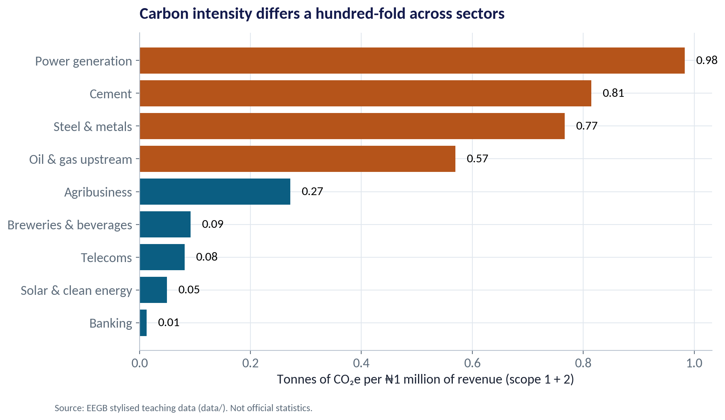
WHERE THE CARBON IS
Carbon Intensity Differs Enormously by Sector
WHAT TO SEE
Power generation (0.98) and cement (0.81) emit most per ₦1 million of revenue.
Steel (0.77) and upstream oil & gas (0.57) follow.
Banking (0.01) and telecoms (0.08) emit very little directly — but they lend to and serve the heavy emitters.
Intensity, not total emissions, tells you how a carbon price hits margins.
Fig S13-F01 · replicate: s13_figures.R / .py
SESSION 13 · CLIMATE & ENERGY TRANSITION
10

Slide 11
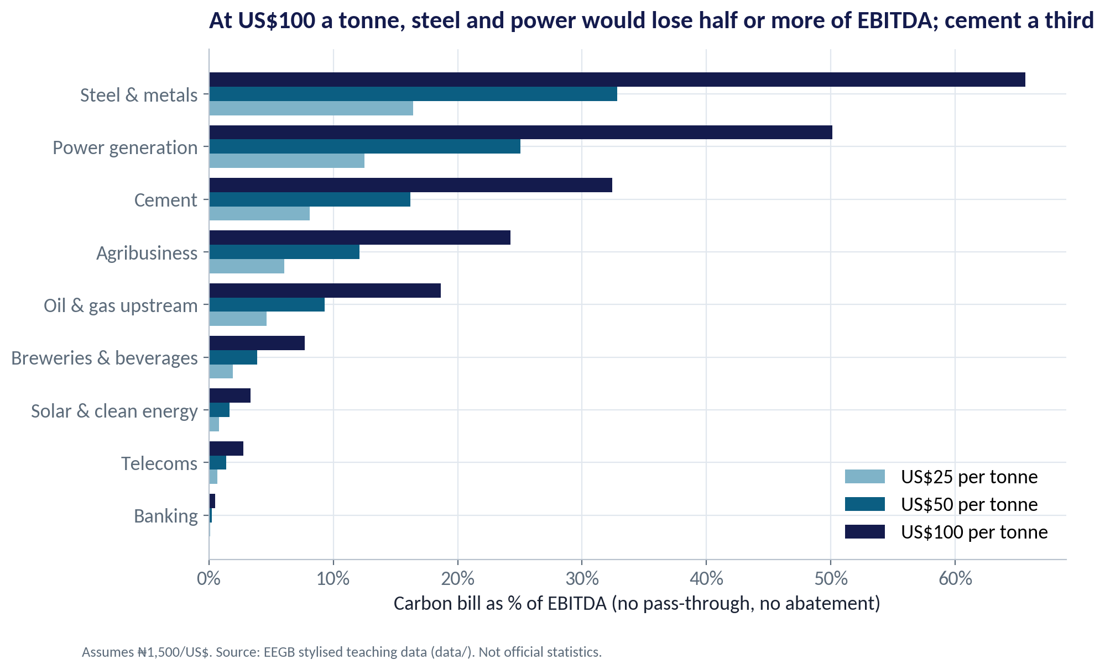
THE STRESS TEST
The Carbon Bill as a Share of EBITDA
WHAT TO SEE
At US$50/t: steel loses about 33% of EBITDA, power 25%, cement 16%.
At US$100/t: steel 66%, power 50%, cement 32%.
Banking, telecoms and solar lose under 3% even at US$100.
These are worst cases: no pass-through and no abatement.
Fig S13-F02 · replicate: s13_figures.R / .py
SESSION 13 · CLIMATE & ENERGY TRANSITION
11

Slide 12
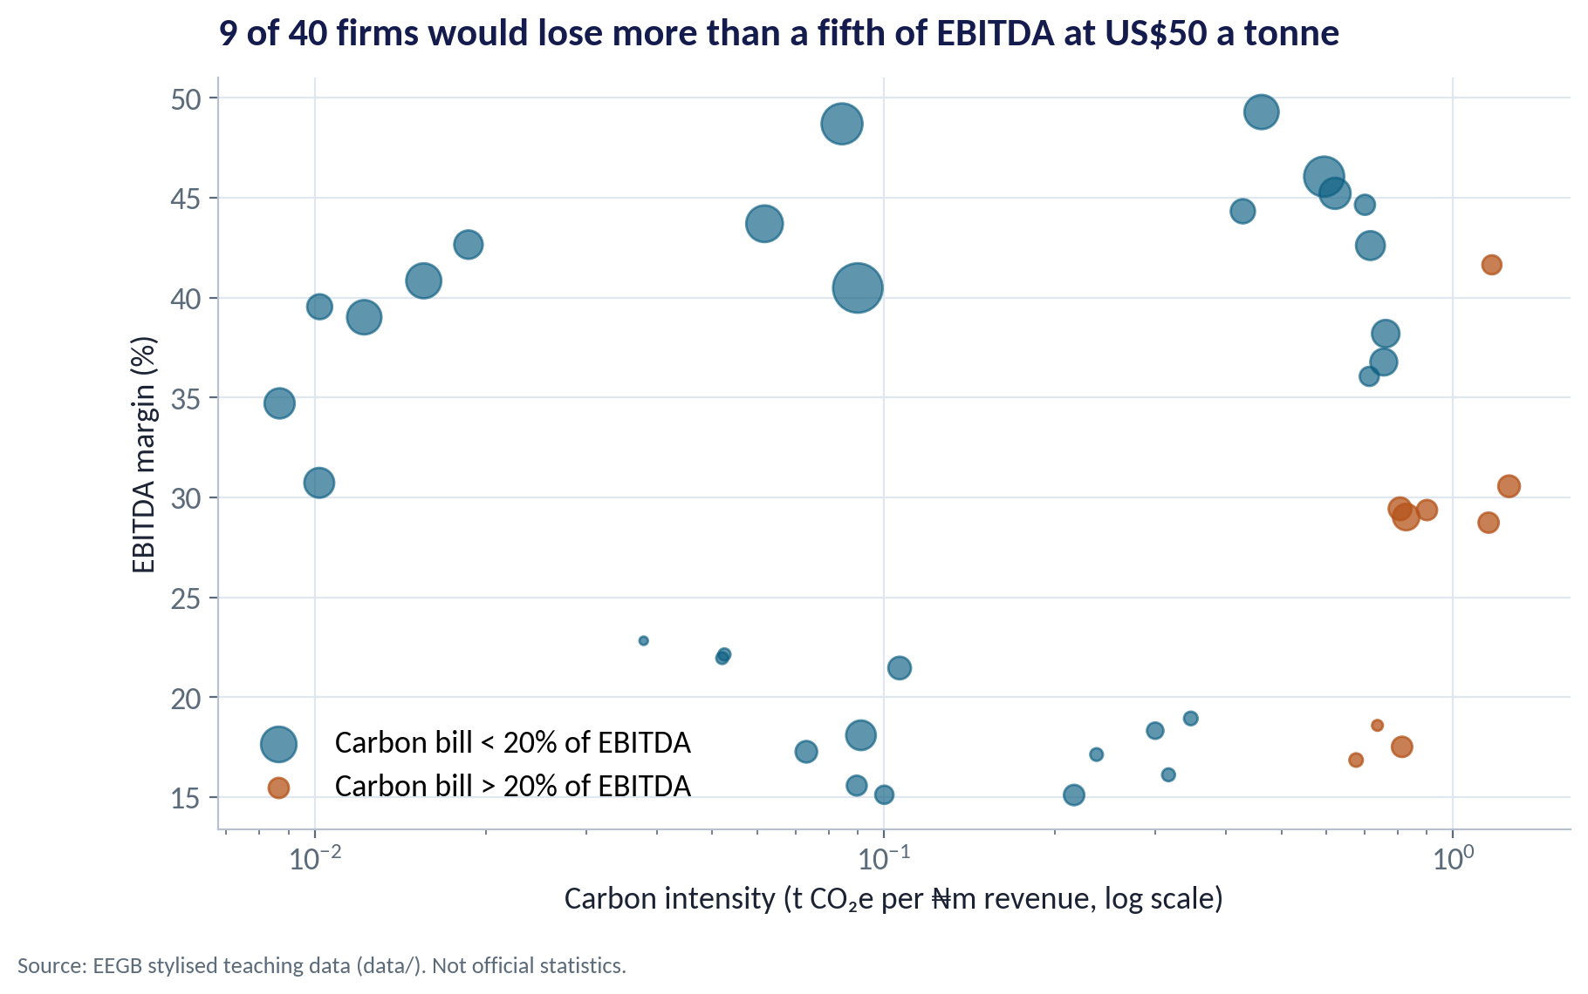
FIRM BY FIRM
Who Is Really Exposed?
WHAT TO SEE
High intensity and a thin margin is the danger zone.
9 of 40 firms would lose more than a fifth of EBITDA at US$50/t.
Firms within one sector differ — the best cement plant is far cleaner than the worst.
Investors will reward the clean firms within dirty sectors.
Fig S13-F03 · replicate: s13_figures.R / .py
SESSION 13 · CLIMATE & ENERGY TRANSITION
12

Slide 13
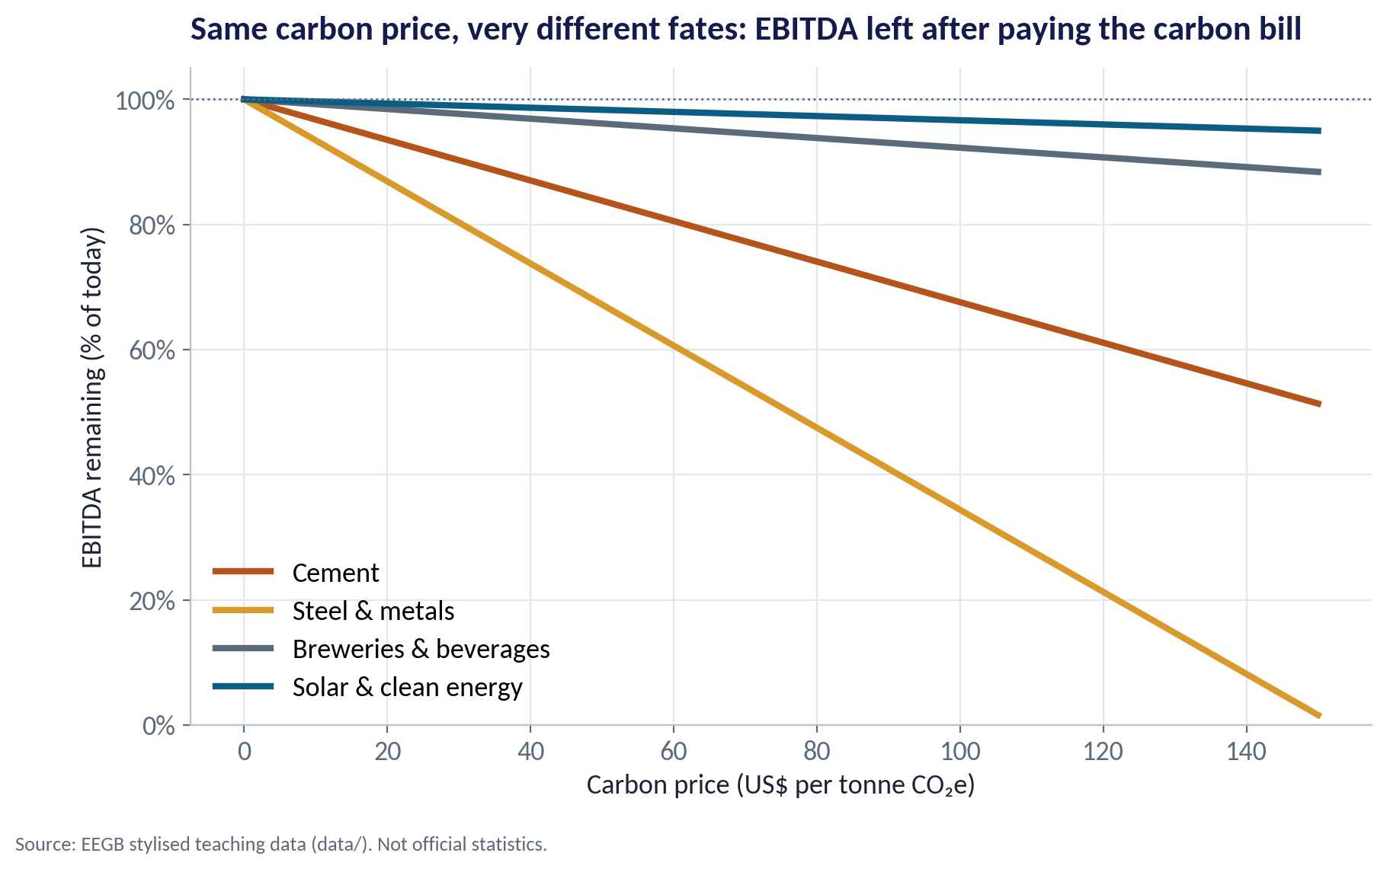
THE CASE
Cement vs Solar as the Carbon Price Rises
WHAT TO SEE
Cement EBITDA falls steadily as the price rises — about 16% lower at US$50.
Solar is almost unaffected — and may gain if it sells power to emitters.
The same policy moves value from high-carbon to low-carbon businesses.
This is what investors mean by transition risk.
Fig S13-F04 · replicate: s13_figures.R / .py
SESSION 13 · CLIMATE & ENERGY TRANSITION
13

Slide 14
CONCEPT CHECK
Quick Check: What Would You Say?
At US$50 a tonne, the stylised cement sector's carbon bill is about ₦252bn, or 16% of its EBITDA. A director says: 'That is only 6% of revenue — not a big deal.' What is the best reply?
A
Agreed — what matters is revenue
B
The relevant comparison is profit: losing a sixth of EBITDA, before any pass-through, is material for valuation and debt covenants
C
The bill is zero because Nigeria has no carbon price
D
Carbon costs are always passed on fully to customers
Discuss with your neighbour for 60 seconds — answer and reasoning in the speaker notes.
SESSION 13 · CLIMATE & ENERGY TRANSITION
14
Notes:
ANSWER: B. B. A cost of 6% of revenue is 16% of EBITDA, and more of net profit. C ignores the scenario purpose and CBAM on exports. D depends on competition and demand elasticity — see the next part.

Slide 15
PART
02
Borders, Prices and Disclosure
How carbon policy abroad reaches Nigerian firms.

Slide 16
CARBON AT THE BORDER
The EU's Carbon Border Adjustment Mechanism
IN PLAIN ENGLISH
THE FORMULA
CBAM charge ≈ embedded tonnes × (EU price − carbon price paid at home)
CBAM makes EU importers pay for the carbon embedded in certain goods — cement, iron and steel, aluminium, fertilisers, electricity and hydrogen — at roughly the EU carbon price, minus any carbon price already paid where the goods were made.
WHY A MANAGER CARES
Reporting started in October 2023; payment obligations begin for imports from 2026. Exporters that measure and cut their emissions keep their EU customers.
EXAMPLE
For the stylised cement and steel exporters, an EU price of US$80/t costs about 8–14% of EU export revenue — but only 2–11% of total EBITDA, because most sales are domestic.
SESSION 13 · CLIMATE & ENERGY TRANSITION
16
Notes:
If Nigeria introduced its own carbon price, the CBAM charge would fall and the revenue would stay in Nigeria — an argument often made for domestic carbon pricing in exporting countries.

Slide 17
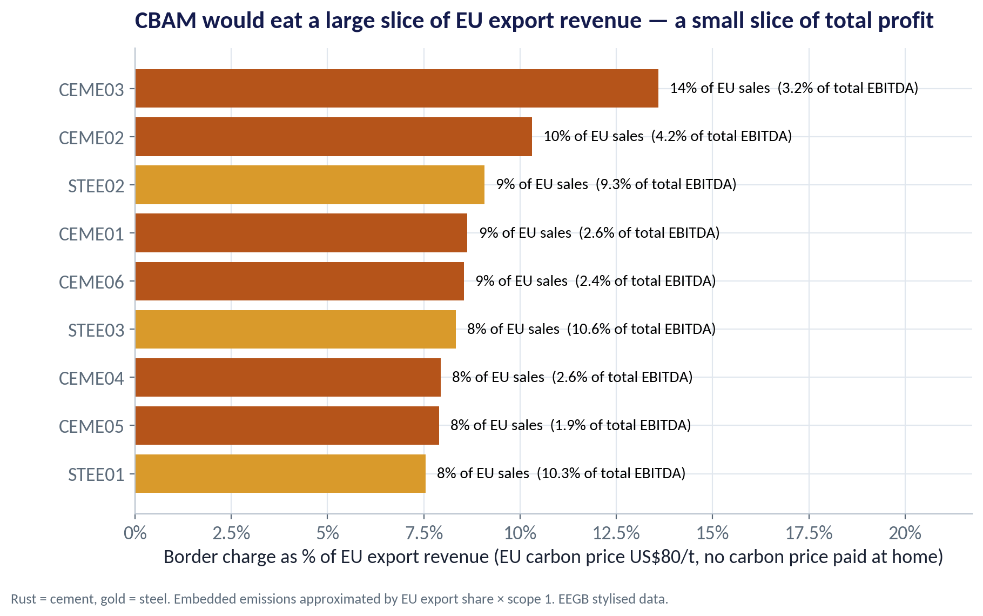
CBAM
Big Slice of EU Sales, Small Slice of Profit
WHAT TO SEE
Cement and steel are the Nigerian sectors most directly covered.
The charge equals 8–14% of EU export revenue for these firms.
Because EU sales are a small share of total sales, the hit to group EBITDA is smaller.
But the EU price is the benchmark other markets may follow.
Fig S13-F05 · replicate: s13_figures.R / .py
SESSION 13 · CLIMATE & ENERGY TRANSITION
17

Slide 18
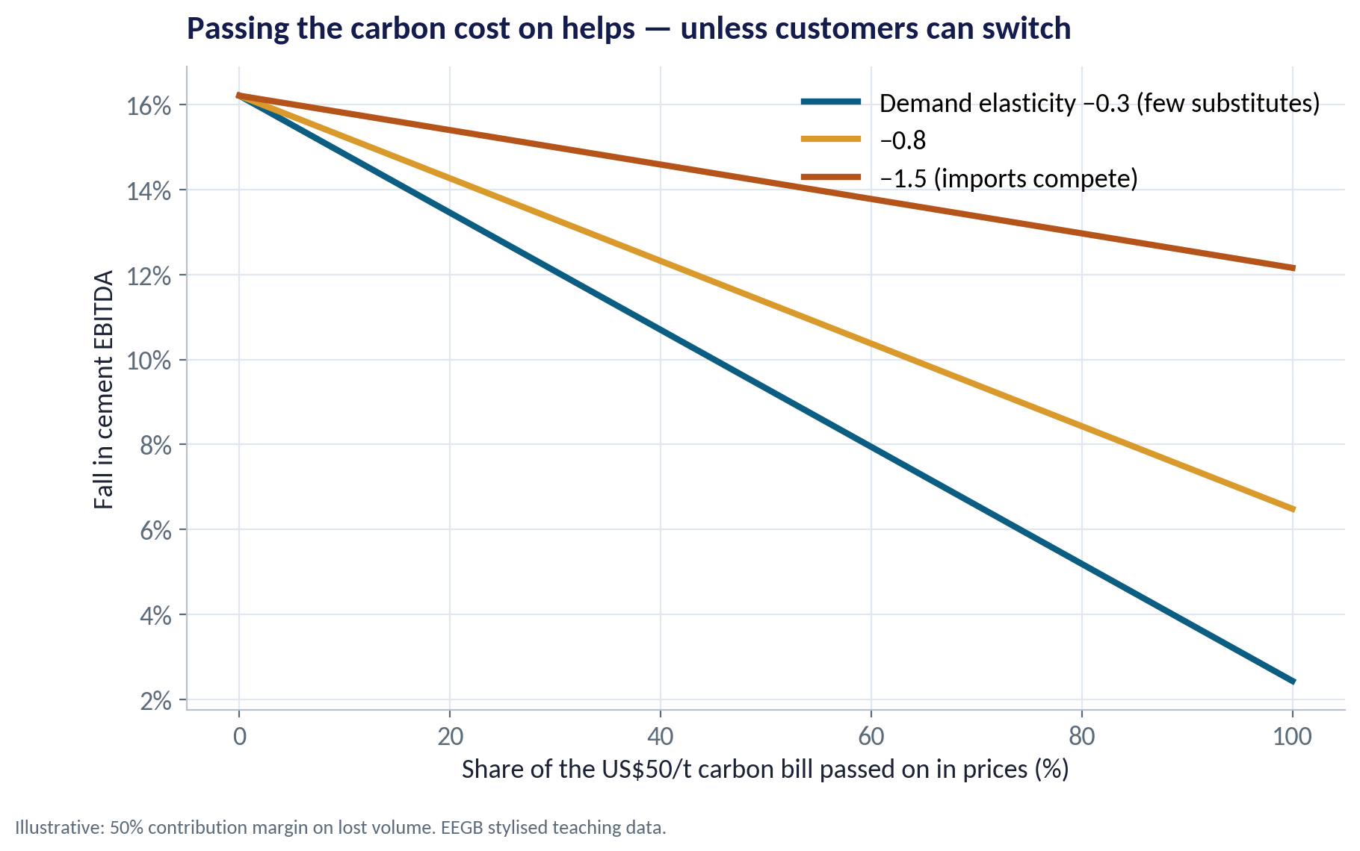
PASS-THROUGH
Can Cement Pass the Cost On?
WHAT TO SEE
Passing the bill on in prices protects margin — if customers stay.
With few substitutes (elasticity −0.3), full pass-through leaves EBITDA only about 2% lower.
If imports compete (elasticity −1.5), lost volume still costs about 12% of EBITDA.
Session 2's elasticity is the key to any carbon strategy.
Fig S13-F07 · replicate: s13_figures.R / .py
SESSION 13 · CLIMATE & ENERGY TRANSITION
18

Slide 19
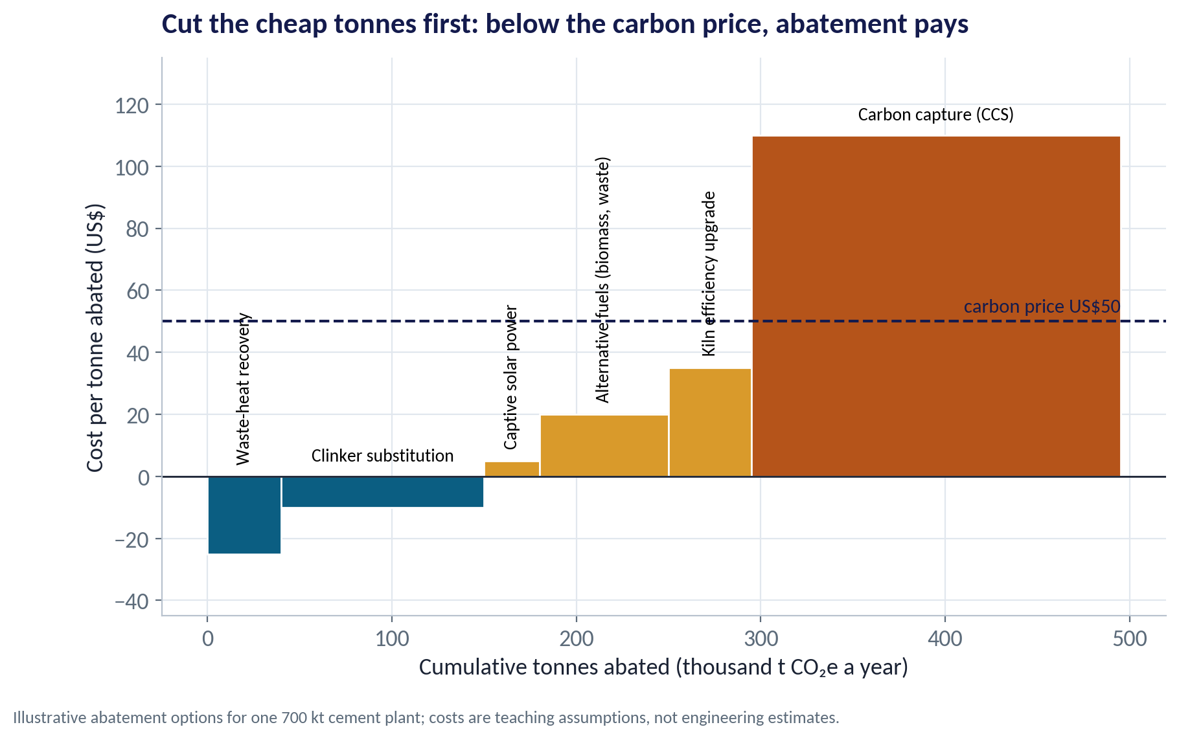
ABATEMENT
Cut the Cheap Tonnes First
WHAT TO SEE
A marginal abatement cost curve ranks options by cost per tonne saved.
Waste-heat recovery and clinker substitution save money even with no carbon price.
Below a US$50 price, about 295 of 495 thousand tonnes can be cut profitably.
Carbon capture is the expensive last resort.
Fig S13-F08 · replicate: s13_figures.R / .py
SESSION 13 · CLIMATE & ENERGY TRANSITION
19
Notes:
The costs are teaching assumptions, not engineering estimates. The point is the method: rank options, start from the left.

Slide 20
DISCLOSURE
From TCFD to ISSB: What Investors Will Ask
Pillar | The question | What a Nigerian firm should show
Governance | Who oversees climate risk? | Board committee and management owner named
Strategy | How could climate change hurt or help us? | Scenarios such as US$25 / 50 / 100 per tonne; physical risks (floods, heat)
Risk management | How do we find and manage these risks? | Climate in the risk register, with owners and limits
Metrics & targets | How much do we emit and what is the plan? | Scope 1 and 2 (later 3), intensity, and dated reduction targets
The ISSB's climate standard (IFRS S2, 2023) builds on these four TCFD pillars. Nigeria's Financial Reporting Council has set out a roadmap to adopt ISSB standards.
SESSION 13 · CLIMATE & ENERGY TRANSITION
20

Slide 21
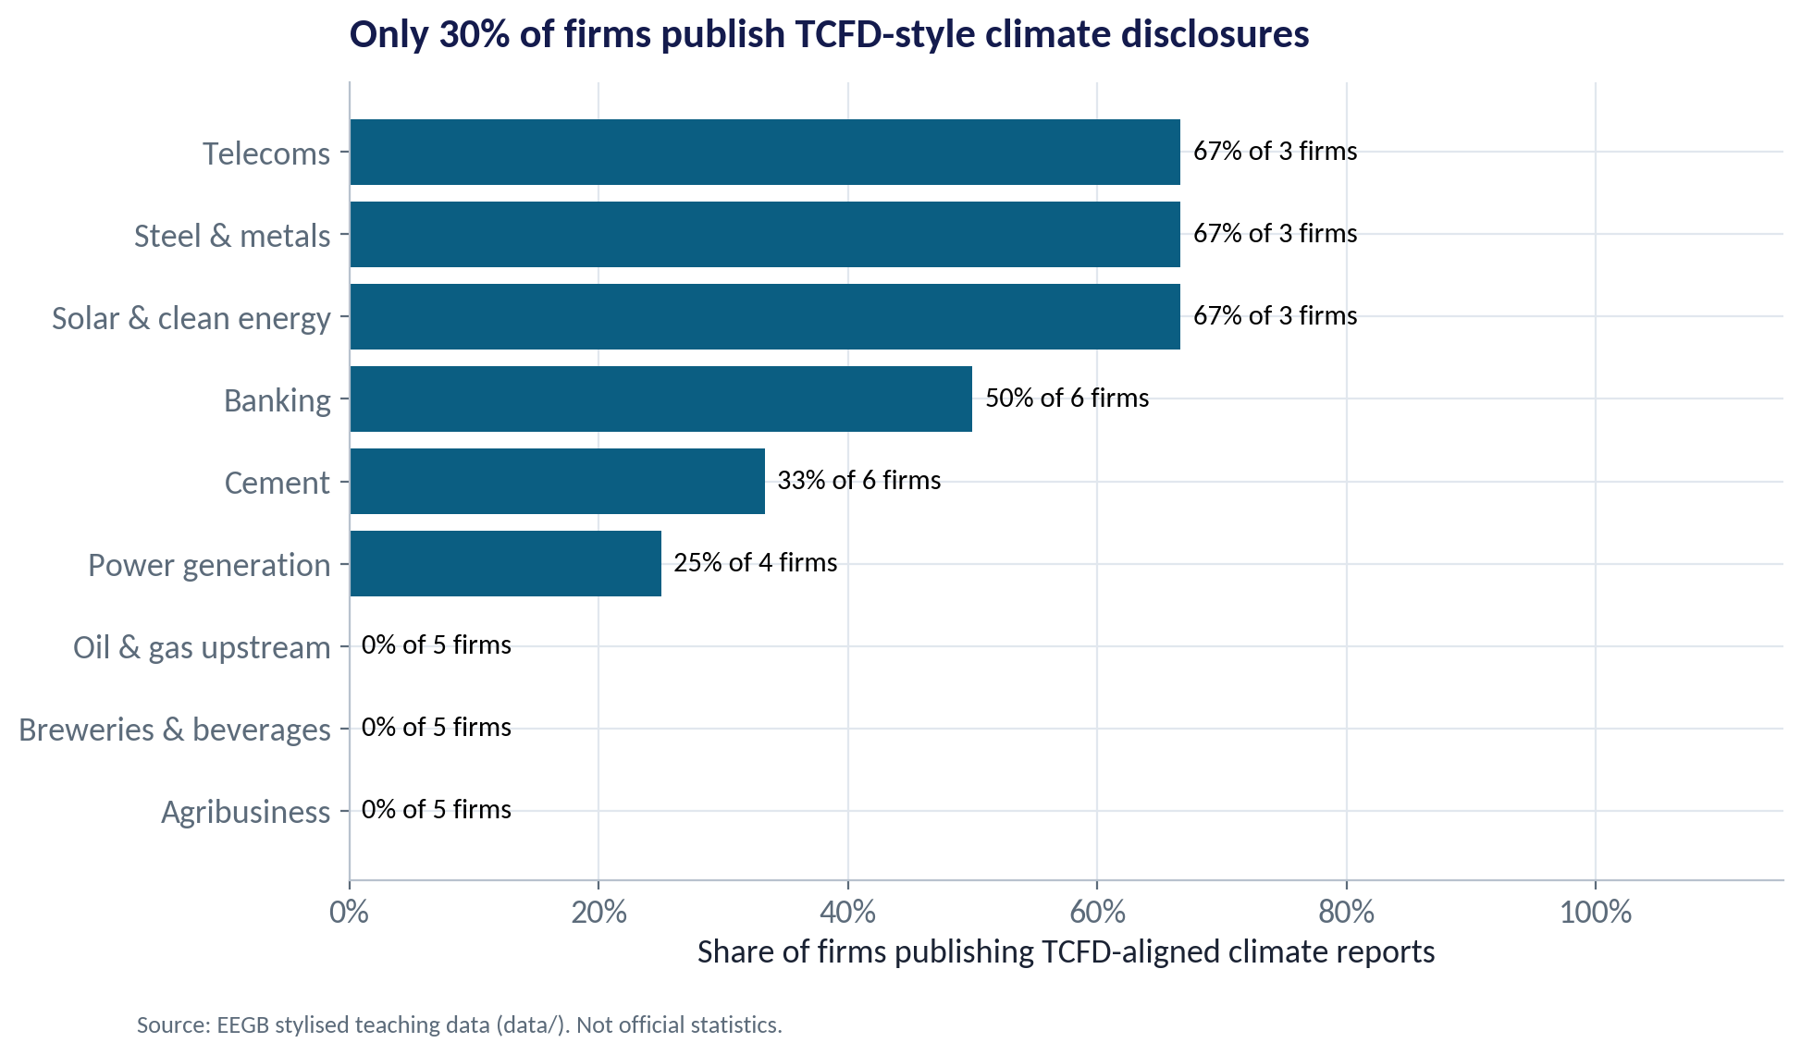
WHO DISCLOSES?
Only a Minority Report Today
WHAT TO SEE
About 30% of the stylised firms publish TCFD-style reports.
Disclosure is highest in telecoms, solar and steel (2 of 3 firms each).
None of the upstream oil & gas firms disclose — exactly where investors most need data.
Early movers gain credibility with lenders and DFIs.
Fig S13-F06 · replicate: s13_figures.R / .py
SESSION 13 · CLIMATE & ENERGY TRANSITION
21

Slide 22
PART
03
Africa's Transition Story
Risk, but also opportunity.

Slide 23



BEYOND RISK
Where the Opportunities Are
Energy access
Critical minerals
Tens of millions of Nigerians lack reliable grid power. Solar mini-grids and home systems replace costly diesel and petrol generators.
Lithium, cobalt and other minerals in Africa feed global battery supply chains. Value lies in processing, not only mining.
Gas as a bridge
Adaptation & green finance
Nigeria's Energy Transition Plan treats gas as a transition fuel. Firms must plan for when that bridge ends.
Green bonds, adaptation funds and DFI lending lower the cost of capital for credible transition projects.
SESSION 13 · CLIMATE & ENERGY TRANSITION
23

Slide 24


WHERE MANAGERS GO WRONG
How Boards Get Climate Risk Wrong
THE TRAP
THE BETTER HABIT
“There is no carbon price in Nigeria, so it doesn't affect us.”
Run scenarios: CBAM, lender requirements and future domestic policy.
Measuring only total emissions.
Track intensity per unit of output and revenue — that drives margins.
Assuming every carbon cost can be passed on.
Check elasticity and import competition first.
Treating disclosure as a PR exercise.
Use TCFD/ISSB as a management tool: owners, metrics, targets.
Ignoring physical risk.
Floods and heat already disrupt plants, roads and harvests in Nigeria.
SESSION 13 · CLIMATE & ENERGY TRANSITION
24

Slide 25
CONCEPT CHECK
Quick Check: What Would You Say?
A cement firm can cut 110 thousand tonnes of CO₂ by substituting clinker, at a cost of –US$10 a tonne (it saves money). Why might it not have done so already?
A
Because the option saves money, it must already have been done
B
Upfront capital, management attention, technical risk or customer acceptance can block profitable cuts — a carbon price or disclosure pressure tips the balance
C
Abatement only makes sense when the carbon price is above US$100
D
Clinker substitution increases emissions
Discuss with your neighbour for 60 seconds — answer and reasoning in the speaker notes.
SESSION 13 · CLIMATE & ENERGY TRANSITION
25
Notes:
ANSWER: B. B. Negative-cost options often stay undone because of financing constraints, habit or perceived risk. A carbon price raises their payoff further; disclosure makes inaction visible. C misreads the curve.

Slide 26



HANDS-ON LAB
Lab: Carbon Stress Test for Your Sector
1
Compute each firm's total emissions (scope 1 + 2) and intensity per ₦1 million of revenue.
YOU WILL NEED
Data
2
Compute the carbon bill at US$25, 50 and 100 a tonne (₦1,500/US$).
data/firm_carbon_exposure.csv
3
Express it as a % of EBITDA by sector and rank the sectors.
R script
sessions/s13/R/s13_lab.R
4
List the ten most exposed firms and check whether they disclose.
Python script
Rerun with a different exchange rate and with a 30% abatement.
sessions/s13/python/s13_lab.py
5
Deliverable: three sentences for a cement board: our exposure, what customers will bear, and our first two actions.
⏱ 20 minutes
SESSION 13 · CLIMATE & ENERGY TRANSITION
26

Slide 27
WORDS TO OWN
Today's Vocabulary in Plain English
Externality
A cost or benefit that falls on people outside the transaction.
Carbon intensity
Emissions per unit of output or revenue.
Carbon price
A charge per tonne of CO₂ emitted, via a tax or permits.
Transition risk
Losses from policy, technology and market shifts to low carbon.
ETS
Emissions trading system: a cap on emissions with tradable permits.
Physical risk
Losses from floods, heat, drought and storms.
CBAM
The EU's charge on embedded carbon in certain imports.
Stranded asset
An asset that loses value early because of the transition.
Scope 1 / 2
Direct emissions / emissions from purchased electricity.
MACC
Marginal abatement cost curve: emission cuts ranked by cost per tonne.
SESSION 13 · CLIMATE & ENERGY TRANSITION
27

Slide 28
KEY TAKEAWAYS
Session 13 in 5 Ideas
01
Emissions are an externality; a carbon price makes the emitter pay.
02
Exposure depends on intensity and margins, not on total emissions alone.
03
CBAM brings EU carbon prices to Nigerian cement and steel exports.
04
Pass-through depends on elasticity; abatement should start with the cheapest tonnes.
05
Disclosure under TCFD/ISSB is becoming the price of access to capital.
NEXT › Session 14: Country Risk & Scenarios
Before next session: Read India: Liberalise in the Face of Crisis? Note the warning signs before 1991 and how policymakers responded. Bring one indicator you would watch to judge a country's risk.

