Slide 1
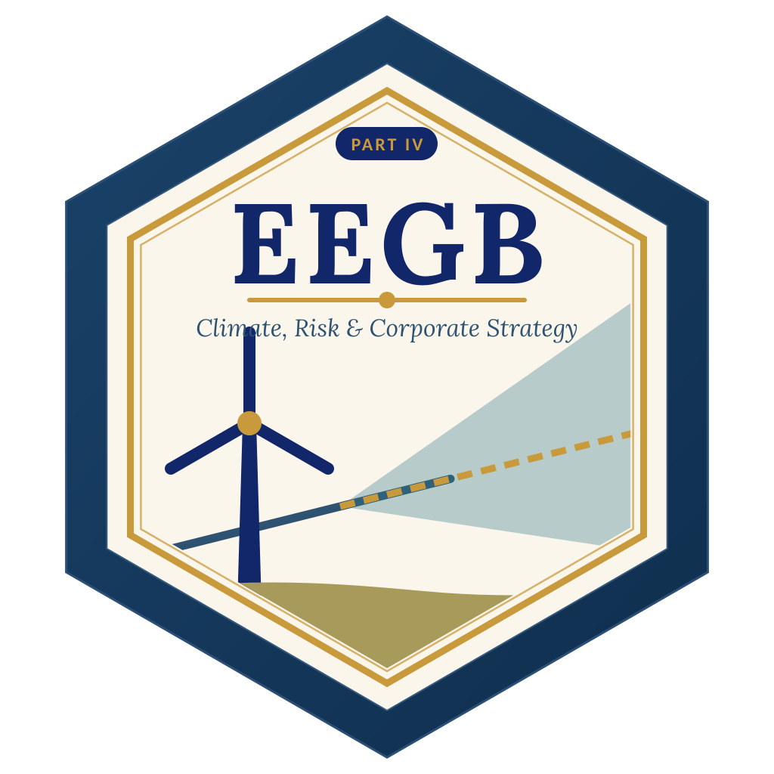

LAGOS BUSINESS SCHOOL · MEMBA 14 · EEGB · PART IV
SESSION 14
Country Risk &
Scenario Planning
From markets, to macro, to decisions that matter — in Nigeria and the world.
Reading: India: Liberalise in the Face of Crisis? (P86) · Facilitator: Sumendra Dash
Economic Environment of Global Business · Lagos Business School · Prof. Bongo Adi, Kelechi Nnamdi, Elvis Ozegbe
Notes:
Start with the expansion question and let the room rank the eight markets by gut feel. Then show the model — and show how the weights move Nigeria from 3rd to 8th.

Slide 2





TODAY'S PLAN
Session 14 at a Glance — 75 Minutes
How to compare countries honestly — and how to plan when you cannot forecast.
10'
25'
20'
20'
Recap & Hook
Country-Risk Scoring
Scenarios & Stress Tests
Lab: Rank & Stress-Test
Where should we expand next?
Indicators, z-scores, pillars and weights
Scenario trees, signposts, tornado charts
Eight markets, one Nigeria plan
SESSION 14 · COUNTRY RISK & SCENARIOS
2

Slide 3

BY THE END OF TODAY
Session 14 Learning Objectives
You will be able to:
01
02
03
Score Country Risk
Plan with Scenarios
Stress-Test a Plan
Build a transparent country-risk score from political, policy, external, fiscal and banking indicators.
Replace a single forecast with a few plausible scenarios, probabilities and signposts.
Find the shocks that hurt a business plan most, and decide what to do about them in advance.
SESSION 14 · COUNTRY RISK & SCENARIOS
3

Slide 4



THE HOOK
Where Should We Expand Next?
“Nigeria is our biggest market, so it must be our best market.”
Size is only one side of the question. A regional CEO also asks:
How risky is it?
Risky compared with what?
What if we're wrong?
Can we get dollars out? Will policy change overnight? Will the currency halve?
A score means little alone. Rank markets against each other using the same yardstick.
No-one forecast the size of the 2023–24 naira move. Plans must survive surprises.
Notes:
Ask for a show of hands: whose company has a written country-risk framework? Whose plan has more than one scenario?

Slide 5



NIGERIAN BUSINESS CASE
Eight Markets, One Expansion Budget
The situation
The decision question
A Lagos-based consumer-goods group will expand into one more African market and must also defend its Nigerian business, which earns ₦18bn EBITDA on ₦120bn revenue with 45% of costs imported.
How do the eight candidate markets rank on risk, does the ranking survive different weightings, and how badly could the Nigeria plan be hit next year?
The data we have
What a good answer looks like
country_risk_panel.csv — eight African markets × ten indicators: growth, inflation, debt, reserves, current account, governance, FX depreciation, Eurobond spreads. *Stylised teaching data.* Plan model assumptions are stated on each chart.
A ranked shortlist with the weighting stated openly, a three-scenario plan for Nigeria, and a signpost board that tells management when to switch plans.
SESSION 14 · COUNTRY RISK & SCENARIOS
5
Notes:
Link to the India 1991 case: reserves fell to a few weeks of imports before the crisis forced liberalisation. Good risk frameworks would have flashed red well before.

Slide 6
PART
01
Scoring Country Risk
Make your judgement explicit — then test it.

Slide 7
WHAT TO MEASURE
Five Families of Country Risk
Risk family | The question | Indicators used here
Macro | Is the economy growing with stable prices? | Real growth, inflation
External | Can the country pay for imports and service foreign debt? | Reserves in months of imports, current account, 12-month FX depreciation
Fiscal & market | Can the government pay its bills; what do lenders charge? | Public debt / GDP, Eurobond spread
Political & policy | Will rules stay stable and be enforced? | World Bank governance indicators: political stability, regulatory quality
Banking | Is the financial system sound? | Not scored here — add capital ratios, NPLs, credit growth (Session 10)
Rating agencies, export-credit agencies and banks use richer versions of the same logic.
SESSION 14 · COUNTRY RISK & SCENARIOS
7

Slide 8


SAME YARDSTICK
Turning Different Indicators into One Score
IN PLAIN ENGLISH
THE FORMULA
z = (value − group average) ÷ standard deviation
Inflation is in %, reserves in months and governance on a −2.5 to +2.5 scale. To combine them, express each as a z-score: how far a country is from the group average, in standard deviations. Flip the sign where high is good, so higher always means riskier.
WHY A MANAGER CARES
Writing the method down makes your judgement auditable. Colleagues can argue about the weights instead of arguing about gut feel.
EXAMPLE
Nigeria's political-stability score (−1.9) is well below the group average, giving a high risk z-score. Its reserves (7 months) are above average, giving a low one.
SESSION 14 · COUNTRY RISK & SCENARIOS
8

Slide 9
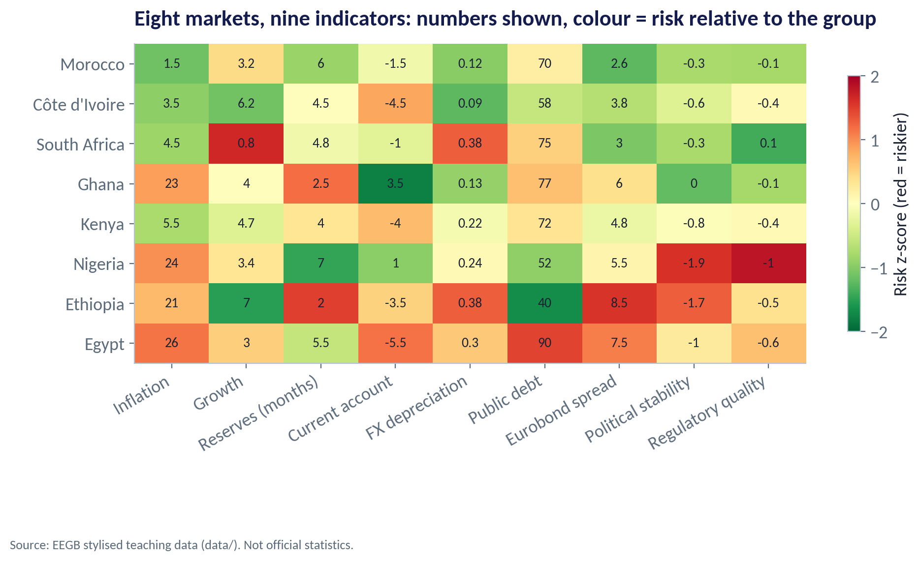
THE RISK HEATMAP
Eight Markets at a Glance
WHAT TO SEE
Rows are markets, columns indicators; the number is the raw value, the colour its relative risk.
Morocco and Côte d'Ivoire are green across most columns.
Nigeria is red on governance and inflation, but green on reserves and debt.
Egypt and Ethiopia are red on debt, spreads and FX.
Fig S14-F01 · replicate: s14_figures.R / .py
SESSION 14 · COUNTRY RISK & SCENARIOS
9

Slide 10
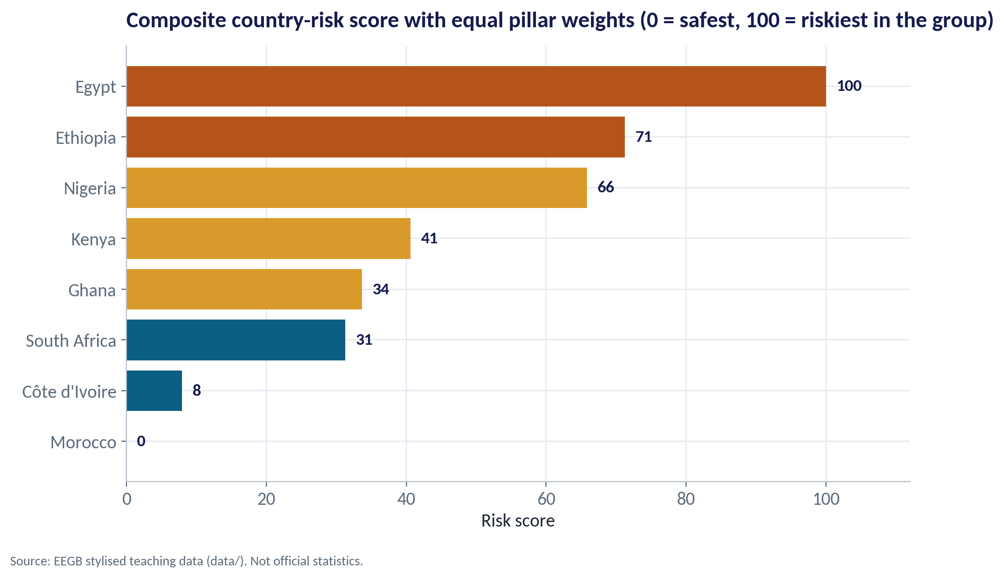
THE COMPOSITE SCORE
Equal Weights: Who Is Riskiest?
WHAT TO SEE
Averaging the four pillars equally and rescaling to 0–100.
Morocco (0) and Côte d'Ivoire (8) are the safest in this group.
Nigeria scores 66, behind Ethiopia (71) and Egypt (100).
A score is relative to this group, not an absolute probability of default.
Fig S14-F02 · replicate: s14_figures.R / .py
SESSION 14 · COUNTRY RISK & SCENARIOS
10

Slide 11
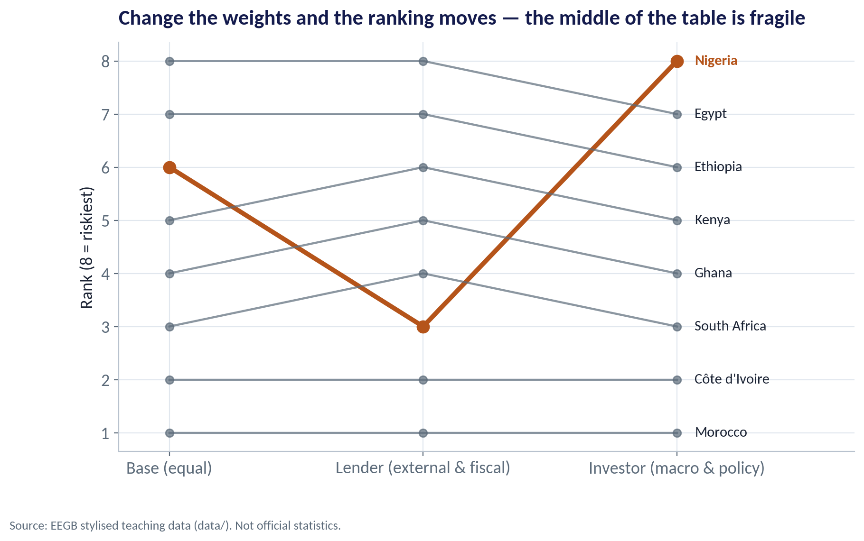
SENSITIVITY
Change the Weights, Change the Answer
WHAT TO SEE
A lender cares most about external and fiscal risk: Nigeria rises to 3rd safest thanks to reserves and moderate debt.
An investor cares most about macro and policy: Nigeria becomes the riskiest of the eight.
The ends of the table are stable; the middle is fragile.
Always report the weights — and test whether your decision changes if they change.
Fig S14-F03 · replicate: s14_figures.R / .py
SESSION 14 · COUNTRY RISK & SCENARIOS
11
Notes:
This is the single most important lesson of the session: a ranking without its weights is an opinion dressed as a number.

Slide 12
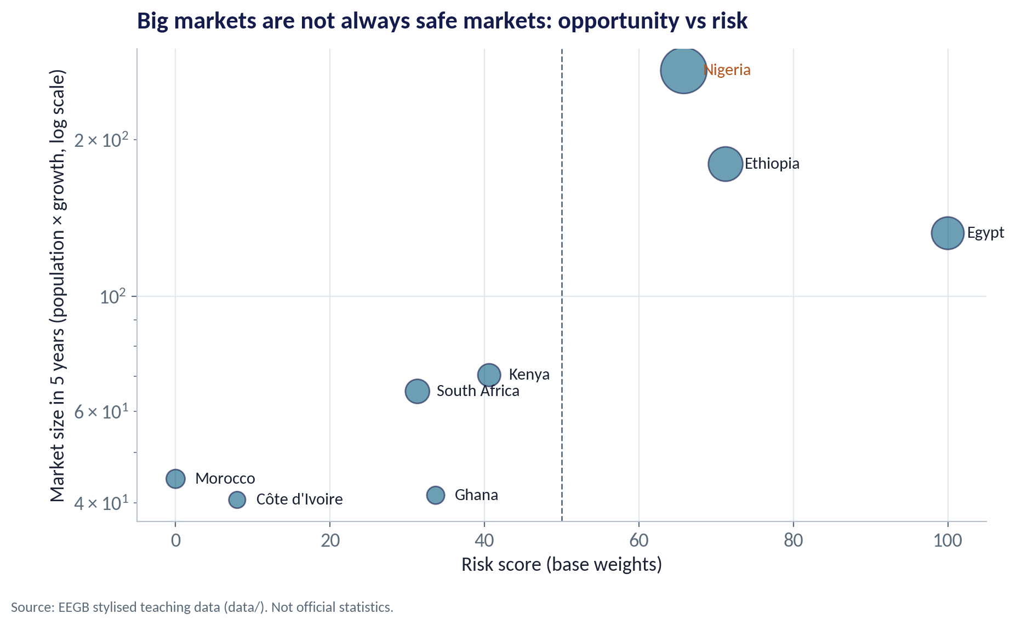
RISK AND RETURN
Big Markets Are Not Always Safe Markets
WHAT TO SEE
Vertical axis: market size in five years (population grown at the real growth rate).
Nigeria, Ethiopia and Egypt are the big prizes — and among the riskiest.
Morocco and Côte d'Ivoire are safer but smaller.
Strategy is choosing where on this map your firm can earn a premium for the risk it takes.
Fig S14-F04 · replicate: s14_figures.R / .py
SESSION 14 · COUNTRY RISK & SCENARIOS
12

Slide 13
CONCEPT CHECK
Quick Check: What Would You Say?
A colleague's spreadsheet ranks Nigeria 3rd safest of eight markets; yours ranks it 8th. Both use the same data. What is the most likely explanation?
A
One of you made an arithmetic error
B
You used different weights: hers stresses reserves and debt, yours stresses inflation and governance
C
Nigeria's data are unreliable
D
Country risk cannot be measured
Discuss with your neighbour for 60 seconds — answer and reasoning in the speaker notes.
SESSION 14 · COUNTRY RISK & SCENARIOS
13
Notes:
ANSWER: B. B. With these data, a lender-style weighting puts Nigeria 3rd and an investor-style weighting puts it 8th. The disagreement is about priorities — which is a useful conversation once it is made explicit.

Slide 14
PART
02
Scenarios, Signposts and Stress Tests
Plan for several futures, not one forecast.

Slide 15

TWO WAYS TO PLAN
A Single Forecast vs Scenario Planning
Single-point forecast
Scenario planning
“The naira will be ₦1,550 next year.”
“Three plausible worlds, with probabilities.”
One number, false precision
Plan breaks when the number is wrong
Invites optimism bias
Hard to know when to change course
A few coherent stories (FX, inflation, rates, demand together)
Actions prepared for each
Signposts tell you which world you are in
Probability-weighted value guides investment
Scenarios are not forecasts. They are a disciplined way to ask 'what would we do if…?' before it happens.
SESSION 14 · COUNTRY RISK & SCENARIOS
15

Slide 16
THE NIGERIA PLAN
Three Scenarios for Next Year
Scenario | Probability | Naira | Real demand | Price pass-through | Policy rate
Reform pays off | 35% | 5% weaker | +10% | 80% | −3 points
Muddle through | 45% | 25% weaker | +1% | 60% | unchanged
Relapse | 20% | 80% weaker | −4% | 40% | +6 points
Each scenario moves several variables together, the way real economies do. Probabilities are judgement — write down why.
SESSION 14 · COUNTRY RISK & SCENARIOS
16

Slide 17
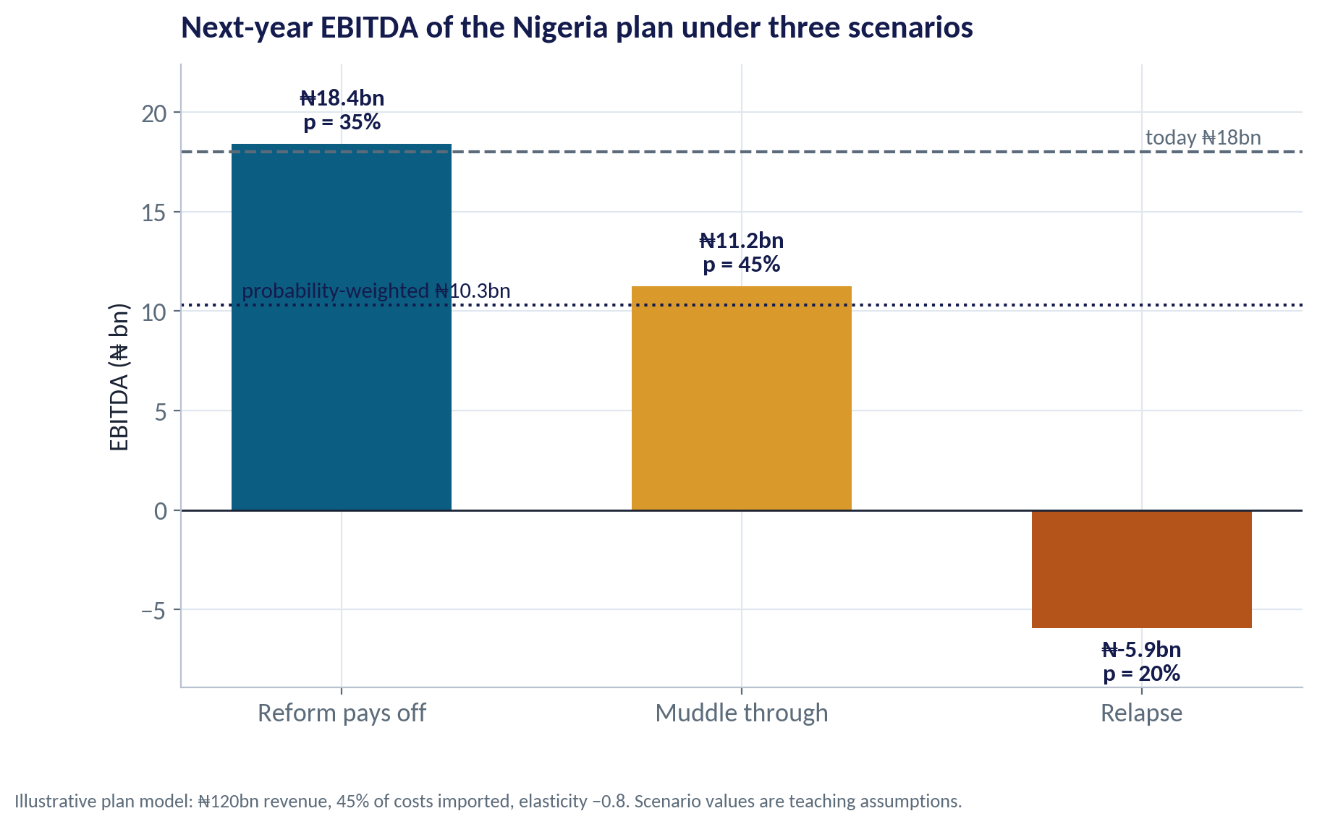
SCENARIO OUTCOMES
The Plan's EBITDA Under Three Worlds
WHAT TO SEE
Today's EBITDA: ₦18bn.
Reform: ₦18.4bn. Muddle through: ₦11.2bn. Relapse: a loss of ₦5.9bn.
Probability-weighted EBITDA: ₦10.3bn — well below today.
The relapse case decides how much debt and fixed cost the plan can carry.
Fig S14-F05 · replicate: s14_figures.R / .py
SESSION 14 · COUNTRY RISK & SCENARIOS
17
Notes:
The plan model is deliberately simple: imported costs rise with the naira, domestic costs by 15%, part of the cost rise is passed on, and demand responds with elasticity −0.8.

Slide 18
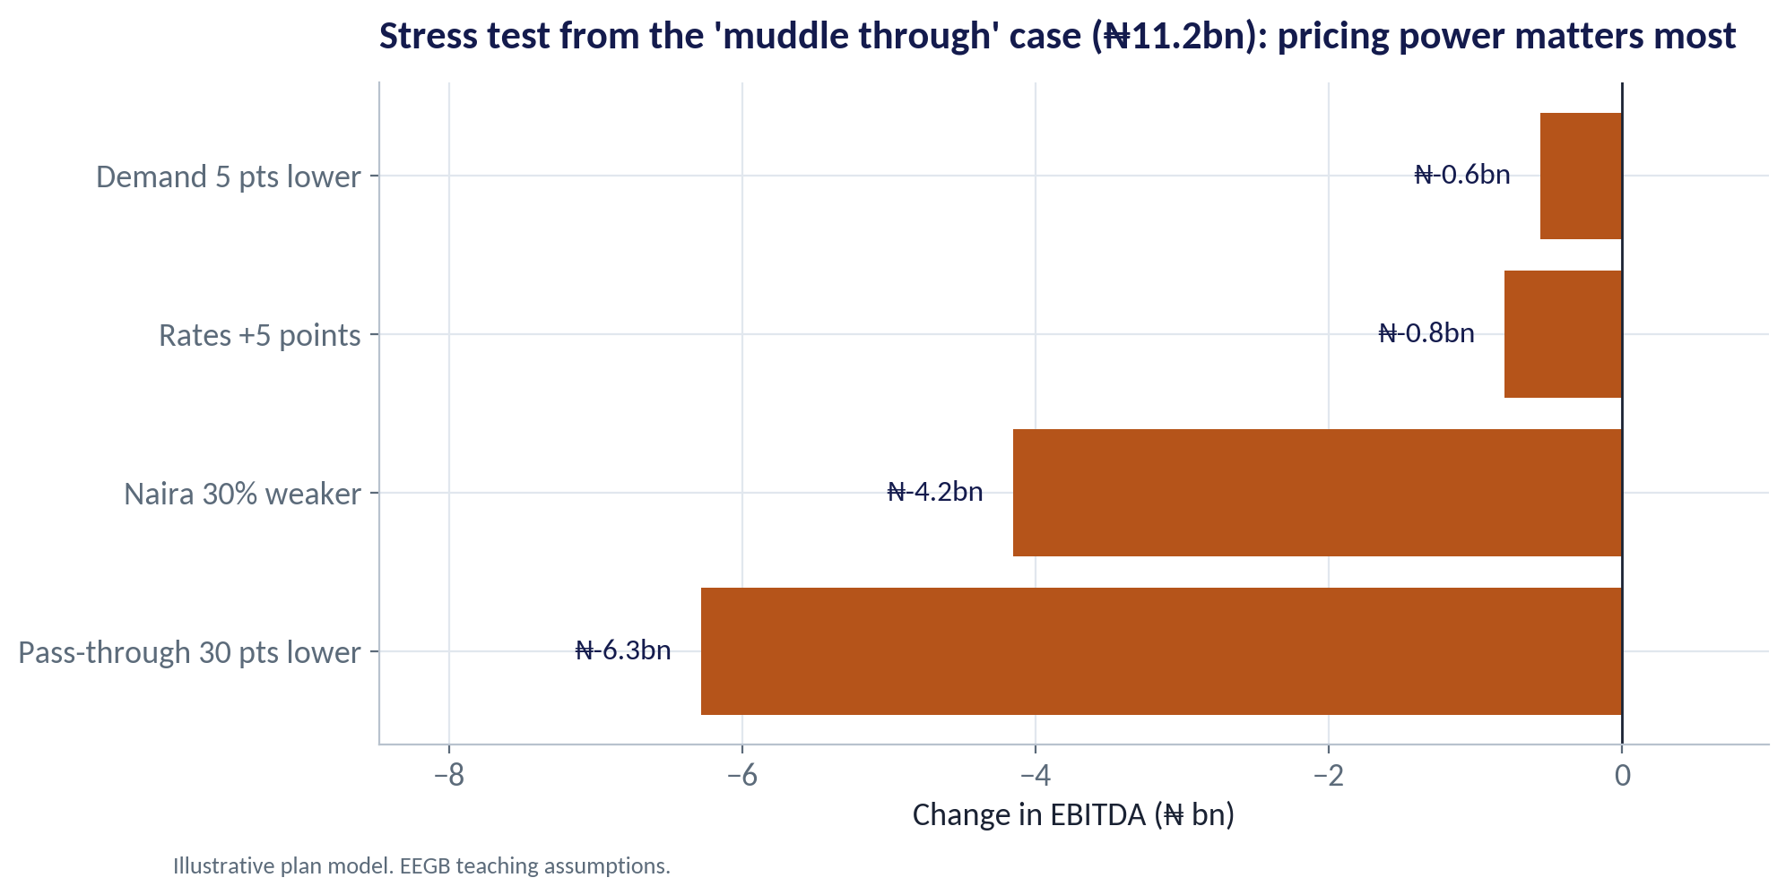
STRESS TEST
Which Shock Hurts Most?
WHAT TO SEE
Starting from 'muddle through' (₦11.2bn), apply one shock at a time.
Losing 30 points of pricing power costs about ₦6.3bn — the biggest hit.
A further 30% naira fall costs about ₦4.2bn.
Rates and demand matter less for this firm — so focus hedging and pricing strategy there.
Fig S14-F06 · replicate: s14_figures.R / .py
SESSION 14 · COUNTRY RISK & SCENARIOS
18

Slide 19

KNOWING WHICH WORLD YOU ARE IN
Signposts and Triggers
IN PLAIN ENGLISH
THE FORMULA
signpost crosses trigger → pre-agreed action
A signpost is an indicator that tells you which scenario is unfolding. A trigger is the level at which you act — agreed in advance, so the decision is not made in panic.
WHY A MANAGER CARES
Most firms see the warning signs and still react late. Pre-agreed triggers turn foresight into action.
EXAMPLE
If 12-month naira depreciation passes 30% (red), switch to the relapse playbook: raise prices faster, cut dollar inventory, delay capex.
SESSION 14 · COUNTRY RISK & SCENARIOS
19

Slide 20
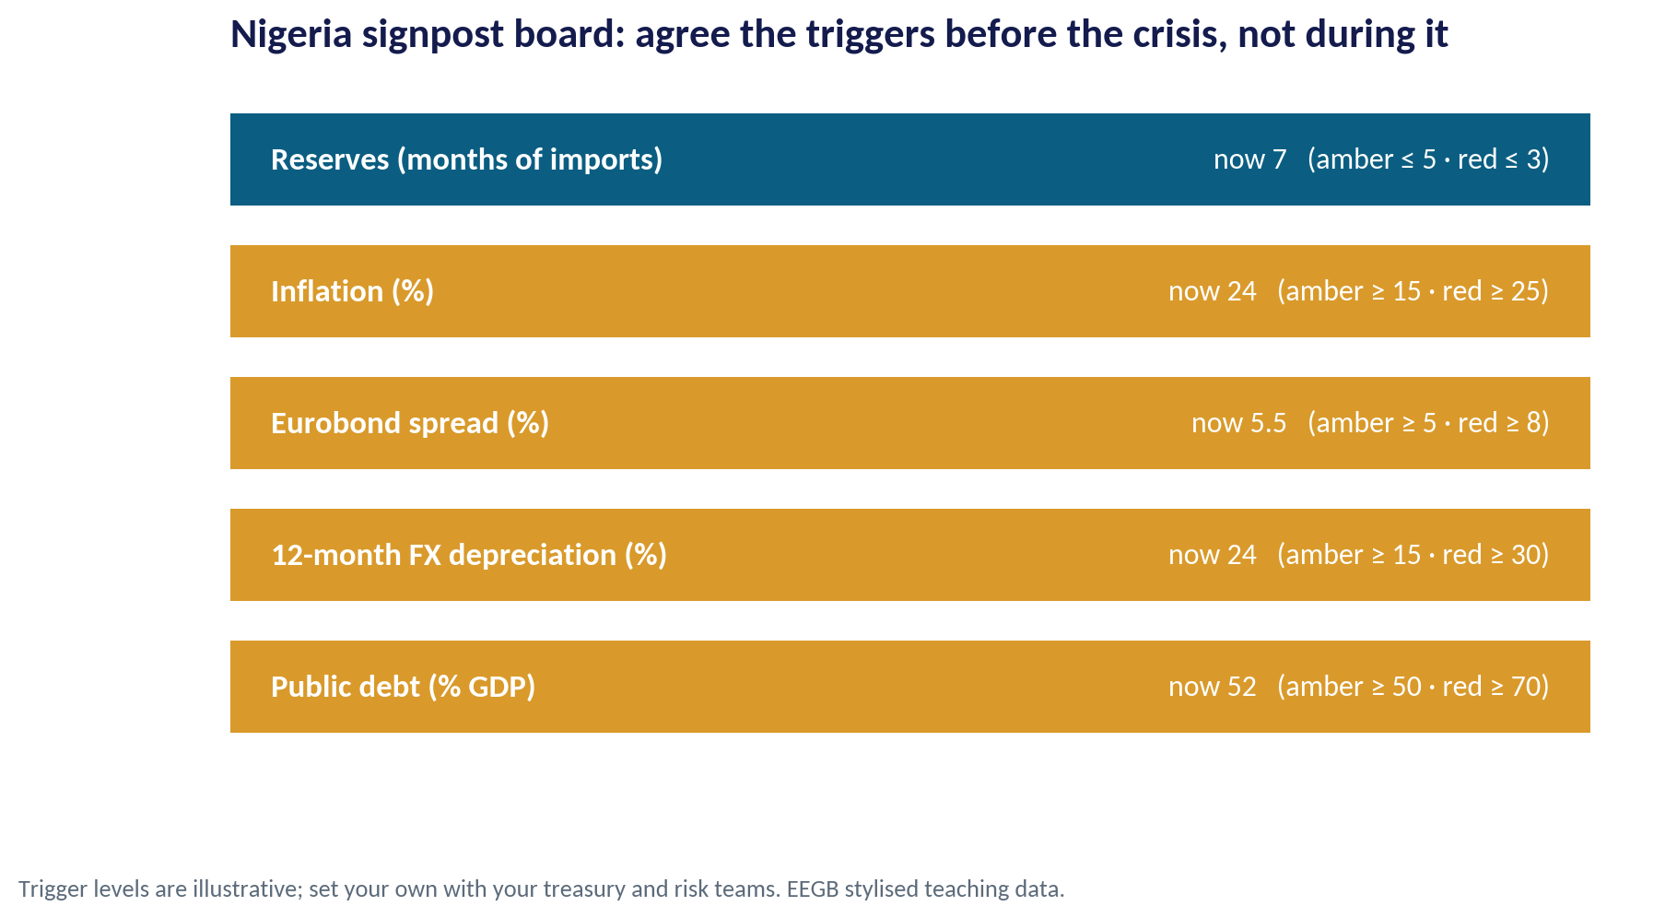
THE SIGNPOST BOARD
Nigeria Today: Green, Amber or Red?
WHAT TO SEE
Reserves at 7 months of imports: green.
Inflation (24%), Eurobond spread (5.5%), FX depreciation (24%) and debt (52% of GDP): amber.
No indicator is red — consistent with 'muddle through'.
Review monthly with the dashboard from Session 1.
Fig S14-F07 · replicate: s14_figures.R / .py
SESSION 14 · COUNTRY RISK & SCENARIOS
20

Slide 21


WHERE MANAGERS GO WRONG
How Country-Risk Analysis Goes Wrong
THE TRAP
THE BETTER HABIT
Ranking countries without stating the weights.
Publish the weights and show how the ranking changes.
Using one 'base case' forecast for the budget.
Use three scenarios that move FX, inflation, rates and demand together.
Assigning a tiny probability to the bad case so it can be ignored.
Ask what the bad case does to debt covenants and liquidity.
Watching dozens of indicators.
Pick five signposts with agreed triggers.
Treating a high-risk market as a no-go.
Ask whether the return and your capabilities justify the risk.
SESSION 14 · COUNTRY RISK & SCENARIOS
21

Slide 22
CONCEPT CHECK
Quick Check: What Would You Say?
The stress test shows that losing pricing power hurts the Nigeria plan more than a further 30% naira fall. Which action follows most directly?
A
Buy more dollar forwards
B
Invest in brand strength, product mix and pricing processes so price increases stick
C
Exit Nigeria
D
Ignore the result because the naira is the bigger headline risk
Discuss with your neighbour for 60 seconds — answer and reasoning in the speaker notes.
SESSION 14 · COUNTRY RISK & SCENARIOS
22
Notes:
ANSWER: B. B. The tornado shows where the plan is most fragile. Protecting pricing power (brand, mix, route to market) addresses the largest exposure; hedging (Session 15) addresses the second.

Slide 23



HANDS-ON LAB
Lab: Rank Eight Markets, Stress-Test Nigeria
1
Convert the nine indicators into risk z-scores (flip the sign where high is good).
YOU WILL NEED
Data
2
Average them into four pillars.
data/country_risk_panel.csv
3
Rank the markets under equal, lender and investor weights.
R script
sessions/s14/R/s14_lab.R
4
Compute the plan's probability-weighted EBITDA across three scenarios.
Python script
Choose three signposts and the trigger levels that would change your plan.
sessions/s14/python/s14_lab.py
5
Deliverable: a ranked shortlist with your weights stated, and a one-paragraph scenario note for the Nigeria plan.
⏱ 20 minutes
SESSION 14 · COUNTRY RISK & SCENARIOS
23

Slide 24
WORDS TO OWN
Today's Vocabulary in Plain English
Country risk
The chance that conditions in a country hurt an investment or business.
Scenario
A coherent, plausible story about the future.
Transfer risk
The risk of not being able to convert or move money out.
Scenario tree
Scenarios with probabilities and outcomes laid out together.
z-score
Distance from the group average, in standard deviations.
Signpost
An indicator showing which scenario is unfolding.
Pillar
A group of related indicators combined into one sub-score.
Trigger
A pre-agreed level at which management acts.
Weighting
How much each pillar counts in the final score.
Stress test
Measuring the impact of a severe but plausible shock.
SESSION 14 · COUNTRY RISK & SCENARIOS
24

Slide 25
KEY TAKEAWAYS
Session 14 in 5 Ideas
01
Country risk has several families: macro, external, fiscal, political and banking.
02
Put indicators on one scale (z-scores) and make the weights explicit.
03
Rankings can flip with the weights — test before you decide.
04
Plan with three scenarios and a probability-weighted outcome, not one forecast.
05
Agree signposts and triggers in advance so action is fast.
NEXT › Session 15: Hedging & Resilience
Before next session: Read Acharya, Almeida, Amihud & Liu, 'Corporate Resiliency and the Choice Between Financial and Operational Hedging' (NBER). Note one example of an operational hedge in your own company.

