Slide 1


LAGOS BUSINESS SCHOOL · MEMBA 14 · EEGB · PART IV
SESSION 15
Corporate Macro Strategy:
Hedging & Resilience
From markets, to macro, to decisions that matter — in Nigeria and the world.
Reading: Acharya, Almeida, Amihud & Liu — Corporate Resiliency and the Choice Between Financial and Operational Hedging (NBER) · Facilitator: Sumendra Dash
Economic Environment of Global Business · Lagos Business School · Prof. Bongo Adi, Kelechi Nnamdi, Elvis Ozegbe
Notes:
Open with a show of hands: whose company has a written FX policy? Whose board has ever approved a hedge ratio? Most firms hedge by accident — through pricing and stock — rather than by design. Today we make it deliberate.

Slide 2




RECAP
Session 14 in Three Ideas
Country risk
Score markets on political, policy, external and banking risk — then compare like with like.
Scenarios
Build three to four plausible futures, each with signposts you can watch.
Stress tests
Ask what the plan looks like in the bad scenario — and what you would do differently.
SESSION 15 · HEDGING & RESILIENCE
2

Slide 3



TODAY'S PLAN
Session 15 at a Glance — 75 Minutes
From knowing your macro risks to managing them — with contracts, operations and capital.
10'
25'
25'
15'
Recap & Hook
Measuring Exposure
Hedging Choices
Lab: Hedging Plan
Why a profitable miller nearly lost its margin
Which macro numbers really drive the P&L?
Natural vs financial hedges, forwards and real options
Heatmap, hedge ratio and dashboard
SESSION 15 · HEDGING & RESILIENCE
3

Slide 4

BY THE END OF TODAY
Session 15 Learning Objectives
You will be able to:
01
02
03
Measure Macro Exposure
Choose the Right Hedge
Build Resilience
Trace how the exchange rate, commodity prices and interest rates flow into revenue, costs and margin.
Compare natural, operational and financial hedges, and pick a sensible hedge ratio — not automatically 100%.
Use a risk heatmap, real options and leading indicators to prepare before the shock arrives.
SESSION 15 · HEDGING & RESILIENCE
4

Slide 5



THE HOOK
Profitable — Until the Naira Moved
“We buy wheat in dollars and sell bread flour in naira. In February 2024 our gross margin was zero.”
The miller's managers did nothing wrong in the factory. Three macro questions decided the year:
How exposed are we?
What can we lock in?
What else can we change?
How much of our cost is set in dollars, and how fast can our prices follow?
Can we fix the naira cost of next quarter's wheat today — and at what price?
Sourcing, pricing, stock, debt — operations can hedge too.
Notes:
The company and data are stylised (miller_exposure_monthly.csv), calibrated to the broad path of the naira and world wheat prices. The zero margin month is February 2024 in the data.

Slide 6



NIGERIAN BUSINESS CASE
The Flour Miller's Hedging Plan
The situation
The decision question
A Lagos flour miller imports all its wheat, paid in US dollars about three months after ordering. It sells flour to bakers and noodle makers in naira, and can raise prices only gradually.
Which macro risks matter most, how much of its dollar cost should it hedge, and what else should it do to protect its margin?
The data we have
What a good answer looks like
miller_exposure_monthly.csv — 84 months (2019–2025): wheat price, exchange rate, volumes, costs, flour price, revenue and margin. Plus ng_macro_monthly.csv for rates and FX. *Stylised teaching data.*
A one-page hedging plan: a risk heatmap, a recommended hedge ratio with its cost, the operational hedges, and five leading indicators to watch.
SESSION 15 · HEDGING & RESILIENCE
6
Notes:
Forward prices are built from interest-rate differentials (covered interest parity). Real bank quotes will differ — the logic is what matters.

Slide 7
PART
01
Measuring Exposure
You cannot manage a risk you have not measured.

Slide 8


THREE KINDS OF EXPOSURE
How Macro Risk Reaches the P&L
Transaction exposure
Translation exposure
Economic exposure
A dollar bill you must pay, or receive, on a known date. Next quarter's wheat shipment is the miller's biggest one.
Dollar assets or debts on the balance sheet revalued in naira. A dollar loan grows overnight after a devaluation.
How the macro environment changes your competitiveness and demand over years — even if you never touch a dollar.
SESSION 15 · HEDGING & RESILIENCE
8

Slide 9
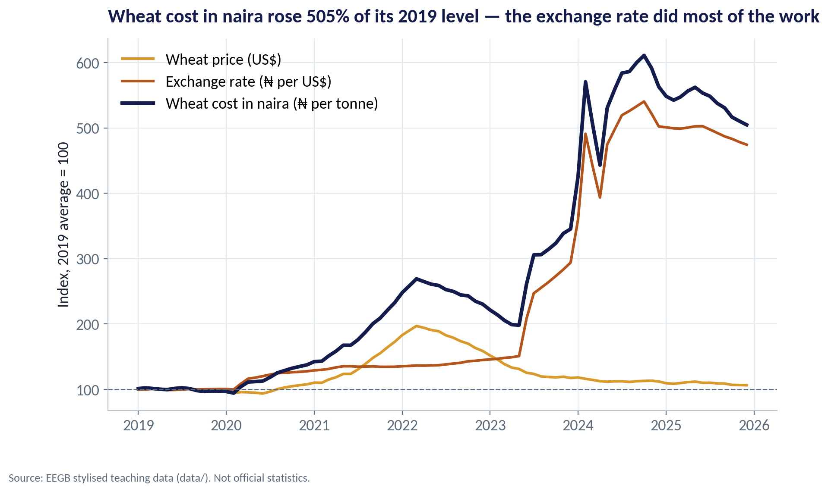
TWO SOURCES OF RISK
Wheat in Dollars, Dollars in Naira
WHAT TO SEE
By December 2025 the naira cost of a tonne of wheat was about five times its 2019 level (index 505).
The dollar price of wheat ended only 6% above 2019, after a spike in 2022.
The exchange rate index reached 474: the naira did most of the damage.
Lesson: the miller's real exposure is to the naira, not to wheat.
Fig S15-F01 · replicate: s15_figures.R / .py
SESSION 15 · HEDGING & RESILIENCE
9

Slide 10


DECOMPOSING A COST RISE
How Much Came From Each Source?
IN PLAIN ENGLISH
THE FORMULA
Δln(₦ cost) = Δln(US$ price) + Δln(₦ per US$)
A naira cost of an imported input is dollar price × exchange rate. In logs, the two parts simply add up, so you can split any rise into a 'commodity' part and a 'currency' part.
WHY A MANAGER CARES
It tells you which hedge matters. Buying wheat futures in Chicago would have done little; managing the naira exposure was everything.
EXAMPLE
2019 → 2025 averages: wheat +9 log-points, naira +160 log-points. Total rise 438%, of which the exchange rate explains 95%.
SESSION 15 · HEDGING & RESILIENCE
10
Notes:
Log points: 100 × ln(new/old). They add up exactly, unlike percentage changes. 169 log-points ≈ a 438% rise.

Slide 11
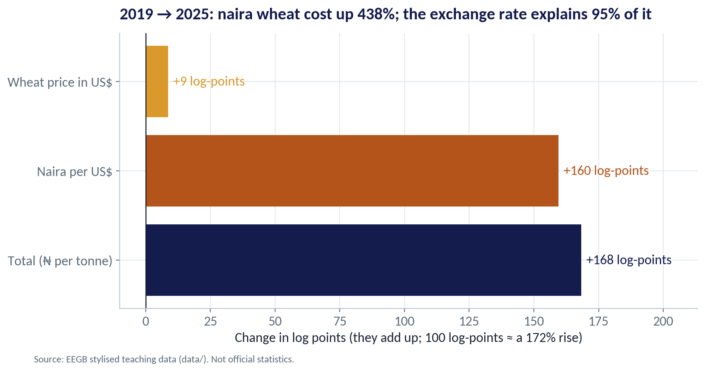
THE DECOMPOSITION
The Exchange Rate Did the Damage
WHAT TO SEE
Wheat price in US$: +9 log-points.
Naira per US$: +160 log-points.
Together: naira wheat cost up 438% between the 2019 and 2025 averages.
The currency explains 95% of the increase.
Fig S15-F02 · replicate: s15_figures.R / .py
SESSION 15 · HEDGING & RESILIENCE
11

Slide 12
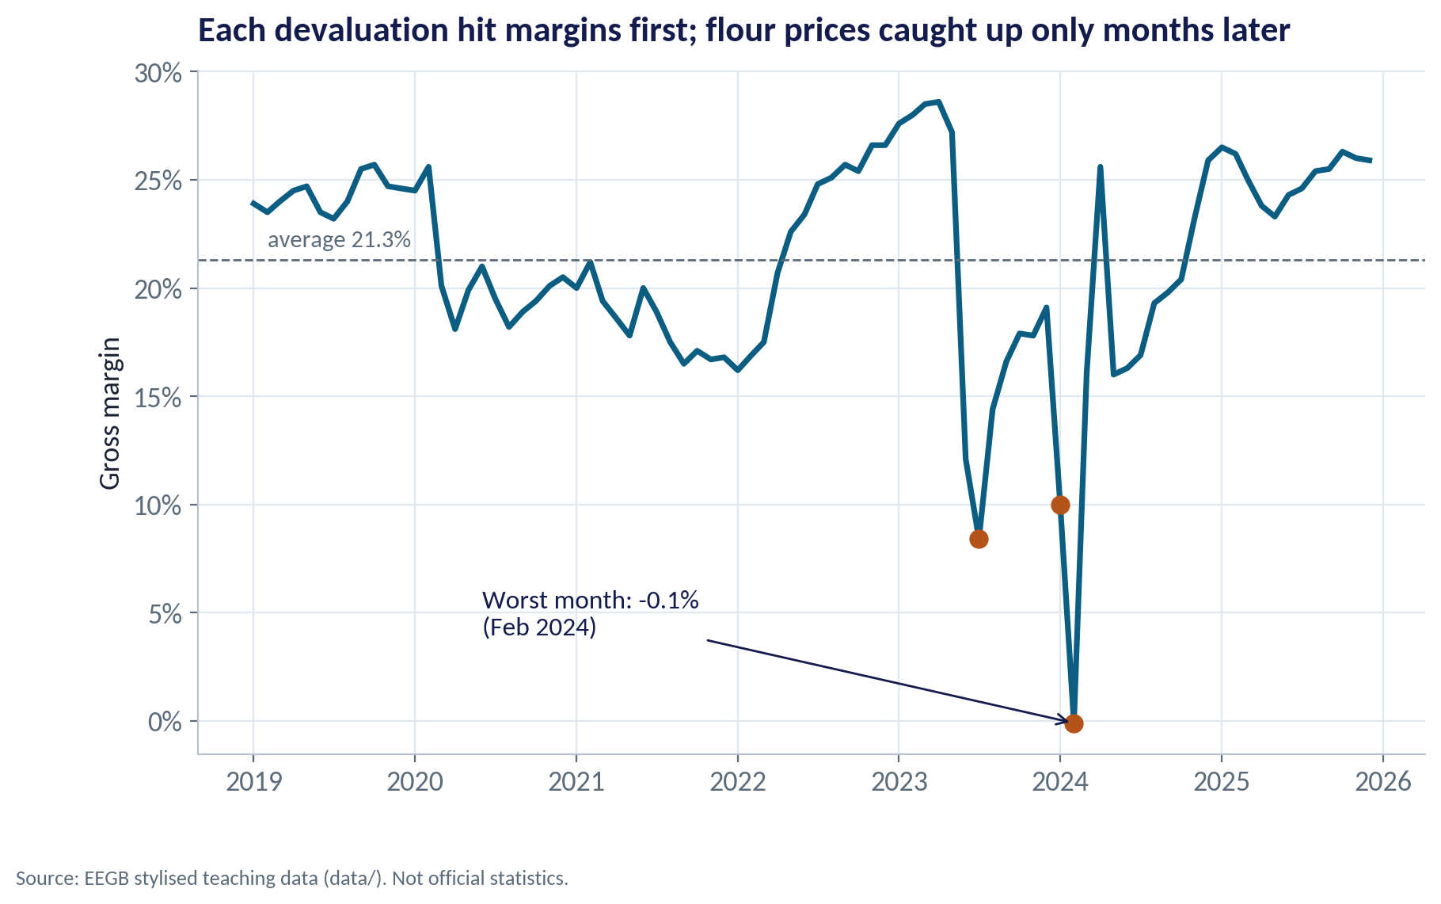
THE MARGIN SQUEEZE
Costs Move First, Prices Follow
WHAT TO SEE
Average gross margin 2019–2025: 21.3%.
Each devaluation hit the margin before flour prices could follow.
Worst months: −0.1% in February 2024, 8.4% in July 2023 and 10.0% in January 2024.
Margins recovered as prices caught up — a natural hedge, but a slow one.
Fig S15-F03 · replicate: s15_figures.R / .py
SESSION 15 · HEDGING & RESILIENCE
12
Notes:
This is the key insight for the hedge-ratio discussion: the miller already passes costs on, with a lag of a few months.

Slide 13
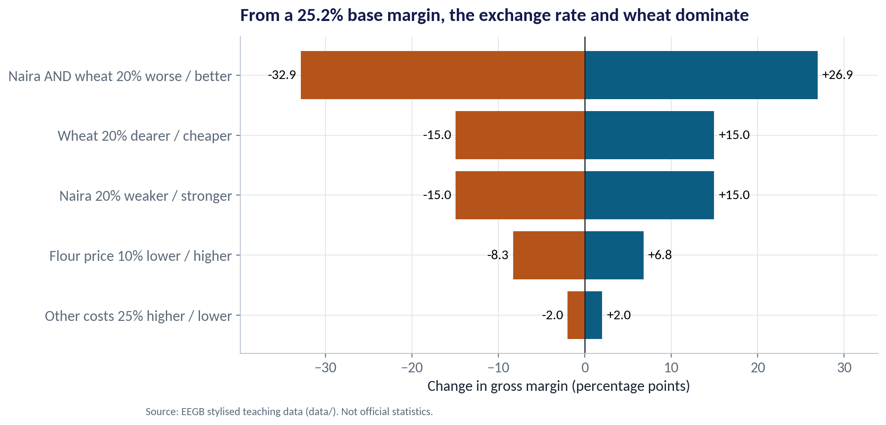
WHAT MOVES THE MARGIN MOST?
A Sensitivity 'Tornado'
WHAT TO SEE
Starting point: 2025 average margin of 25.2%.
A 20% weaker naira, or 20% dearer wheat, each cuts the margin by 15 points.
Both together: −32.9 points — the miller would make a loss.
Other costs matter far less (±2 points). Spend management time where the tornado is widest.
Fig S15-F06 · replicate: s15_figures.R / .py
SESSION 15 · HEDGING & RESILIENCE
13

Slide 14
CONCEPT CHECK
Quick Check: What Would You Say?
The miller's naira wheat cost rose 438% between 2019 and 2025. Wheat in dollars rose about 9%. Which hedge would have helped most?
A
Buying wheat futures to fix the dollar price
B
Fixing the naira cost of dollars in advance (FX forwards) and passing costs on faster
C
Borrowing more in dollars at low rates
D
Holding larger stocks of flour
Discuss with your neighbour for 60 seconds — answer and reasoning in the speaker notes.
SESSION 15 · HEDGING & RESILIENCE
14
Notes:
ANSWER: B. B. The currency explained 95% of the rise, so FX hedging and faster price pass-through matter most. A addresses the small part. C adds currency risk. D protects supply but not cost.

Slide 15
PART
02
Hedging Choices
Contracts, operations and capital.

Slide 16

TWO FAMILIES OF HEDGE
Natural Hedges vs Financial Hedges
Natural / operational hedges
Financial hedges
Change the business so risks offset
Sign a contract that pays off when the shock hits
Price flour off the dollar cost (faster pass-through)
Earn some revenue in dollars (export to ECOWAS)
Source local inputs (cassava, sorghum blends)
Hold more stock when the naira looks weak
Borrow in the currency you earn
FX forwards: fix the naira cost of future dollars
Futures and swaps (where markets exist)
Commodity futures for wheat
Options: insurance, for a premium
Cost, availability and tenor vary — ask your bank
Research on corporate resiliency finds firms often prefer operational hedges because financial hedges need cash or credit lines just when they are scarce.
SESSION 15 · HEDGING & RESILIENCE
16

Slide 17
PRICING A FORWARD
What a Naira Forward Should Cost
IN PLAIN ENGLISH
THE FORMULA
Forward ≈ Spot × (1 + (i₦ − i$) × months ÷ 12)
A forward fixes today the rate at which you will buy dollars later. Banks price it so nobody can earn a free profit: the naira forward is weaker than spot by roughly the interest-rate gap between naira and dollars.
WHY A MANAGER CARES
Hedging is not free: at a 27% naira rate, rolling three-month cover costs over 20% a year in calm times. It pays off only when the naira falls by more than the premium.
EXAMPLE
December 2025: spot ₦1,454, MPR 27%, US rate about 3.75% → 3-month forward ≈ ₦1,539, a premium of 5.8% a quarter.
SESSION 15 · HEDGING & RESILIENCE
17
Notes:
In Nigeria, banks offer FX forwards; a naira-settled OTC FX futures market has operated on FMDQ since 2016; offshore investors use non-deliverable forwards (NDFs). Liquidity, tenors and pricing change with CBN policy — always get live quotes.

Slide 18
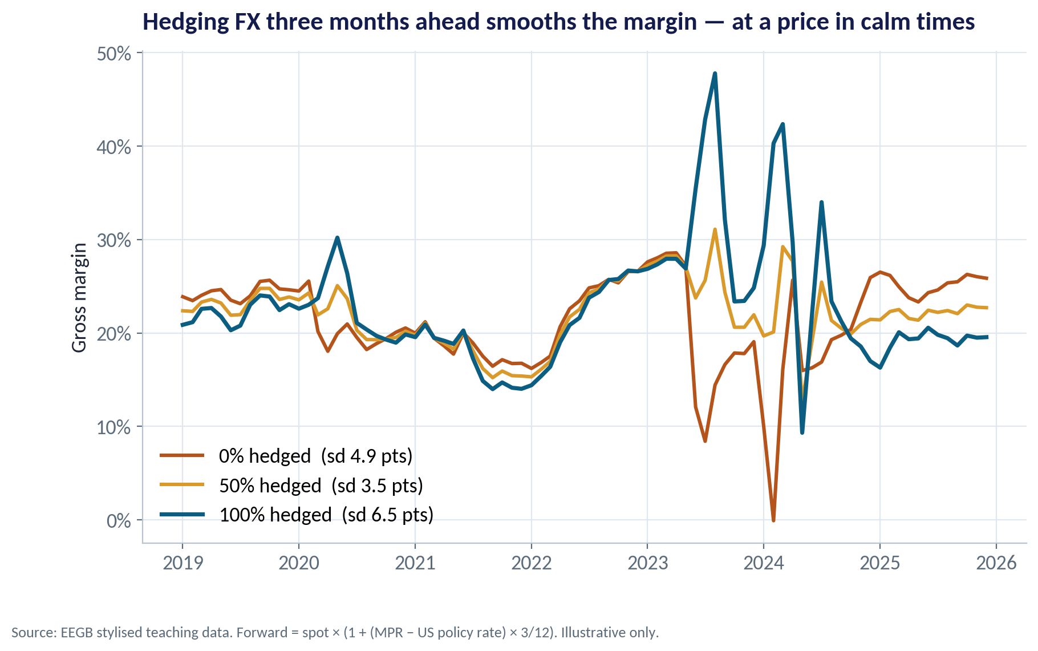
THE SIMULATION
Hedging 0%, 50% or 100% of Next Quarter's Dollars
WHAT TO SEE
Each month the miller can lock in the rate for wheat it will pay for in three months.
Unhedged, the margin fell to −0.1% in the 2024 devaluation.
Fully hedged, the margin jumped in the same months — prices rose while costs were locked.
In calm years hedging cost margin: average 21.8% unhedged vs 20.4% fully hedged.
Fig S15-F04 · replicate: s15_figures.R / .py
SESSION 15 · HEDGING & RESILIENCE
18

Slide 19
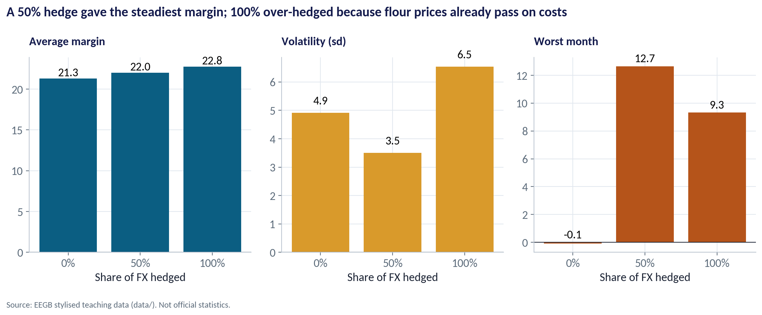
THE RESULT
Why 100% Is Not the Safest Hedge
WHAT TO SEE
50% hedged had the lowest volatility: 3.5 points vs 4.9 unhedged and 6.5 fully hedged.
Its worst month was 12.7%, against −0.1% unhedged.
100% over-hedged: flour prices already follow the naira, so a full hedge creates a new mismatch.
The right hedge ratio covers the exposure that your prices cannot pass on.
Fig S15-F05 · replicate: s15_figures.R / .py
SESSION 15 · HEDGING & RESILIENCE
19
Notes:
This is a stylised simulation. Average margins over the whole period are higher with hedging (22.0% at 50%) only because 2023–24 had large devaluations; with a stable naira the premium would be a pure cost.

Slide 20
REAL OPTIONS
Flexibility Is a Hedge Too
IN PLAIN ENGLISH
THE FORMULA
Value of flexibility = value with the option − value without it
A real option is the right, but not the obligation, to change course later — like having a second supplier ready, or a plant that can switch inputs. It costs something today and pays off when the world turns against you.
WHY A MANAGER CARES
Options to delay, expand, switch or exit are often cheaper and longer-lasting than financial contracts, which may not exist for long tenors in naira.
EXAMPLE
Testing a cassava-wheat blend costs ₦ today. If the naira falls 20%, switching 10% of wheat to local cassava cuts the dollar bill exactly when it hurts most.
SESSION 15 · HEDGING & RESILIENCE
20
Notes:
Link to the NBER paper (Acharya, Almeida, Amihud & Liu): operational flexibility and financial hedges are partly substitutes; firms with tight financing tend to rely more on operational resilience.

Slide 21
THE TOOLKIT
Matching the Hedge to the Risk
Risk | Financial hedge | Operational hedge | Capital buffer
Naira devaluation | FX forwards / futures for next 3–6 months | Faster price pass-through; dollar export sales | Cash buffer; avoid unhedged US$ debt
Wheat price spike | Wheat futures or fixed-price contracts | Blends with local grains; supplier diversity | Working-capital line
Interest-rate rise | Fixed-rate loans or rate swaps | Shorter credit to customers | Lower leverage
Port & shipping delays | Freight contracts, insurance | Higher safety stock; second port | Inventory finance
Demand slump | — | Smaller packs; product mix; cost flexibility | Liquidity to ride it out
Most firms use all three columns. Financial hedges buy time; operational hedges change the structure of the exposure.
SESSION 15 · HEDGING & RESILIENCE
21

Slide 22
CONCEPT CHECK
Quick Check: What Would You Say?
The miller's prices follow the naira with a lag of a few months. The board asks to hedge 100% of FX for the next year. What is the best response?
A
Agree — full hedging removes all risk
B
Hedge only the part of the exposure that prices cannot pass on, over the lag period — roughly half for a few months — and review quarterly
C
Refuse all hedging — the naira forward premium is too high
D
Hedge 100% but for five years to save on fees
Discuss with your neighbour for 60 seconds — answer and reasoning in the speaker notes.
SESSION 15 · HEDGING & RESILIENCE
22
Notes:
ANSWER: B. B. Because prices already pass on costs with a lag, a full hedge over-hedges and adds a new mismatch, as the simulation showed. C ignores real devaluation risk; D locks in a long, costly and probably unavailable contract.

Slide 23
PART
03
Building Resilience
Prepare before the shock arrives.

Slide 24
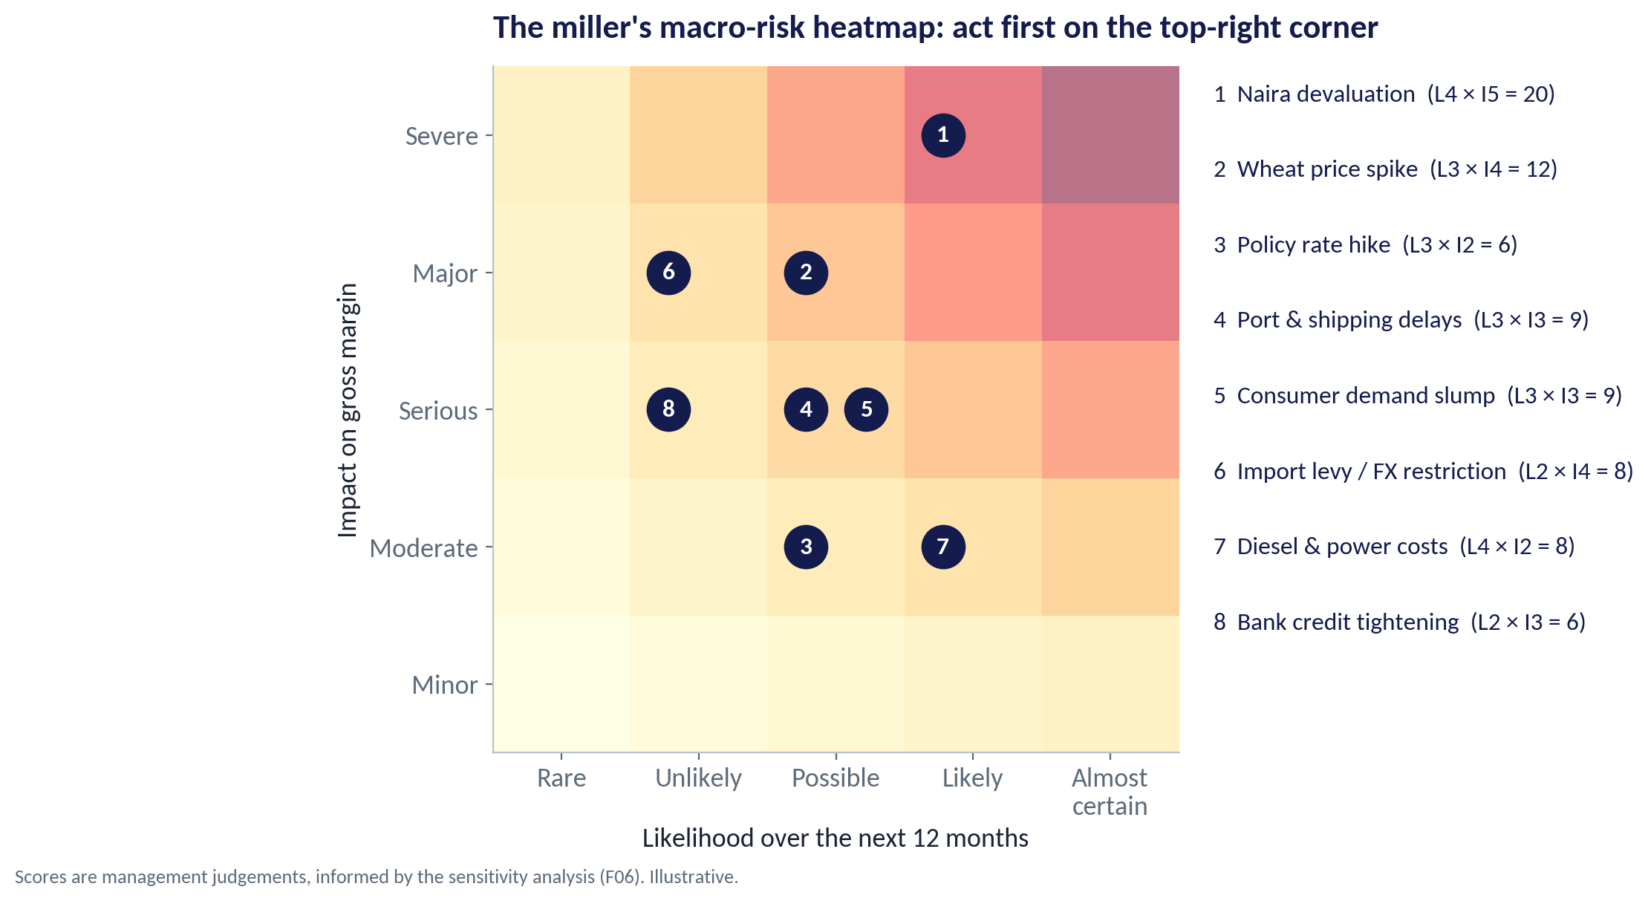
PRIORITISE
The Macro-Risk Heatmap
WHAT TO SEE
Score each risk for likelihood and impact (1–5); the product ranks them.
Naira devaluation (4 × 5 = 20) and wheat spikes (3 × 4 = 12) lead.
Impact scores come from the sensitivity tornado, not gut feel.
Review the map every quarter — scores change as signposts move.
Fig S15-F07 · replicate: s15_figures.R / .py
SESSION 15 · HEDGING & RESILIENCE
24

Slide 25
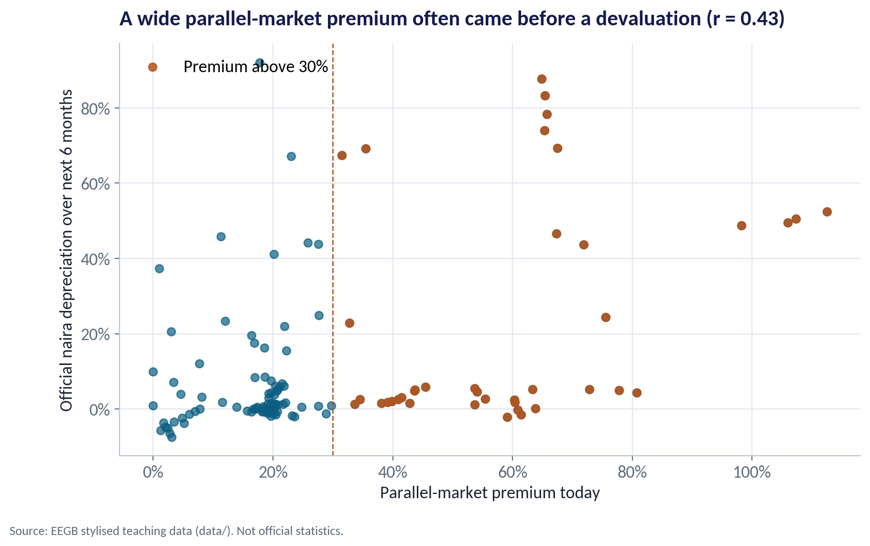
LEADING INDICATORS
Signals That Warn Before the Shock
WHAT TO SEE
When the parallel premium was above 30%, the naira fell on average 23.4% over the next six months.
When it was below 30%, the average was 7.0%.
The correlation is moderate (r = 0.43): a warning light, not a forecast.
Raise the hedge ratio, or stock up, when several warning lights turn on together.
Fig S15-F08 · replicate: s15_figures.R / .py
SESSION 15 · HEDGING & RESILIENCE
25

Slide 26



THE DASHBOARD
Five Leading Indicators for the Miller
FX premium
Reserves
Oil price
Rate gap
Wheat futures
Gap between parallel and official rates — a sign of dollar rationing.
CBN reserves and their trend: the central bank's ability to defend the naira.
Brent drives Nigeria's dollar earnings and reserves.
MPR minus US rates: sets the cost of a forward hedge.
Global wheat prices three to six months ahead.
SESSION 15 · HEDGING & RESILIENCE
26

Slide 27


WHERE MANAGERS GO WRONG
How Companies Get Hedging Wrong
THE TRAP
THE BETTER HABIT
Hedging 100% of everything, forever.
Hedge the residual exposure your prices cannot absorb, over the lag period.
Judging a hedge by whether it 'made money'.
Judge it by whether it reduced volatility and protected the plan.
Ignoring the forward premium at high naira rates.
Know the cost of cover and when it is worth paying.
Relying only on contracts that may not be available.
Build operational hedges: pricing, sourcing, stock, currency of debt.
Waiting for the devaluation before acting.
Watch leading indicators and set trigger levels in advance.
SESSION 15 · HEDGING & RESILIENCE
27

Slide 28



HANDS-ON LAB
Lab: A Hedging Plan for the Miller
1
Map the exposure: which costs are in dollars, and how did the margin behave?
YOU WILL NEED
Data
2
Decompose the rise in naira wheat cost into wheat and exchange-rate parts.
data/miller_exposure_monthly.csv
data/ng_macro_monthly.csv
data/global_policy_rates.csv
3
Build a 3-month forward price from the interest-rate gap.
R script
sessions/s15/R/s15_lab.R
4
Simulate hedge ratios of 0, 25, 50, 75 and 100% and compare average, volatility and worst month.
Python script
Run the sensitivity test and score your own company's top five risks.
sessions/s15/python/s15_lab.py
5
Deliverable: a one-page hedging plan: heatmap, hedge ratio with its cost, two operational hedges, five indicators.
⏱ 15 minutes
SESSION 15 · HEDGING & RESILIENCE
28

Slide 29
WORDS TO OWN
Today's Vocabulary in Plain English
Transaction exposure
A known foreign-currency payment or receipt on a future date.
Forward premium
How much weaker the forward rate is than spot; set by the rate gap.
Translation exposure
Revaluation of foreign-currency assets and debts on the balance sheet.
Hedge ratio
Share of an exposure covered by a hedge.
Economic exposure
Long-run effect of macro changes on competitiveness and demand.
Real option
The right to change course later: delay, expand, switch or exit.
Natural hedge
An offsetting exposure inside the business, e.g. dollar revenue against dollar costs.
Sensitivity analysis
How much an outcome moves when one input changes.
Forward contract
An agreement today on the rate for a future currency exchange.
Leading indicator
A signal that tends to move before the outcome you care about.
SESSION 15 · HEDGING & RESILIENCE
29

Slide 30
KEY TAKEAWAYS
Session 15 in 5 Ideas
01
Measure exposure first: decompose costs into commodity and currency parts.
02
For Nigerian importers, the exchange rate usually dominates.
03
Hedge the exposure your prices cannot pass on — 100% can over-hedge.
04
Forward cover costs roughly the interest-rate gap; know when it is worth paying.
05
Build operational resilience and watch leading indicators with pre-agreed triggers.
NEXT › Session 16: Capstone & Review
Before next session: Prepare for the capstone: choose your industry, draft the one-page macro memo to your board using the template on the course site, and bring three charts as evidence.

