Slide 1


LAGOS BUSINESS SCHOOL · MEMBA 14 · EEGB · PART IV
SESSION 16
Capstone &
Integrative Review
From markets, to macro, to decisions that matter — in Nigeria and the world.
Reading: All sessions — micro to macro, domestic to global, policy to profits · Facilitator: Bongo Adi, Kelechi Nnamdi & Elvis Ozegbe
Economic Environment of Global Business · Lagos Business School · Prof. Bongo Adi, Kelechi Nnamdi, Elvis Ozegbe
Notes:
Capstone day. Keep presentations to time and ask every team the same board questions: what is your recommendation, what is the downside, and what would make you change your mind?

Slide 2




TODAY'S PLAN
Session 16 at a Glance — 75 Minutes
Connect micro to macro, domestic to global, policy to profits — and say it to a board in one page.
35'
20'
20'
Capstone Presentations
Integrative Review
Exam Preparation
Executive macro memos to a board, by industry
Sixteen sessions on one page
Format, practice questions, common traps
SESSION 16 · CAPSTONE & REVIEW
2

Slide 3




WHERE WE ARE
Course Roadmap — 16 Sessions, 4 Parts
Pre-module and intra-module online sessions, sixteen on-campus sessions, and a closed-book final exam.
YOU ARE HERE
Part I
Part II
Part III
Part IV
Sessions 1–5
Sessions 6–10
Sessions 11–12
Sessions 13–16
Micro & markets
Macro, policy & risk
Open economy
Strategic frontiers
Data literacy, demand and elasticity, forecasting, market structure and platforms, market failures
AD–AS and inflation, national accounts, monetary policy, fiscal policy and debt, financial stability
Exchange rates, capital flows and the trilemma; trade, supply chains, industrial policy and AfCFTA
Climate economics, country risk and scenarios, hedging and resilience, capstone memos
SESSION 16 · CAPSTONE & REVIEW
3

Slide 4

BY THE END OF TODAY
Session 16 Learning Objectives
You will be able to:
01
02
03
Write a Board Memo
Connect the Course
Prepare for the Exam
Turn macro evidence into a one-page recommendation a board can act on.
Trace how a single policy or global shock flows through markets, prices, rates and the exchange rate to your P&L.
Know the format, practise the core reasoning, and avoid the common traps.
SESSION 16 · CAPSTONE & REVIEW
4

Slide 5



THE HOOK
The Board Has Ten Minutes
“Don't give me forty slides on the economy. Tell me what to do, why, and what would change your mind.”
That is the brief for your capstone. A good memo does three things:
Leads with the answer
Shows the evidence
Admits uncertainty
A recommendation in the first sentence — price, invest, hedge, wait.
Three or four numbers that matter for this industry, with their direction.
Scenarios, signposts and the trigger that would change the plan.
Notes:
Each team presents for no more than 8 minutes plus Q&A. The board (faculty) will interrupt, as real boards do.

Slide 6



NIGERIAN BUSINESS CASE
Your Capstone: A Macro Memo to the Board
The situation
The decision question
Each team chooses an industry (cement, flour milling, banking, consumer goods, telecoms, power…) and acts as its strategy team.
Given the economy today and the plausible paths for the next 12 months, what should the board do — on pricing, investment, financing and risk?
The data we have
What a good answer looks like
Any course dataset plus official sources (CBN, NBS, IMF, World Bank, FRED). The capstone starter script builds a four-panel evidence pack. *Course data are stylised.*
A one-page memo and an 8-minute presentation: recommendation, evidence, scenarios with probabilities, signposts and triggers, and owned actions.
SESSION 16 · CAPSTONE & REVIEW
6

Slide 7
PART
01
Writing the Memo
One page, one recommendation.

Slide 8
THE TEMPLATE
Six Paragraphs, One Page
Section | What to write | Course tools
1. Recommendation | One sentence: what the board should decide, and when | —
2. What has changed | Three or four macro numbers that matter to your industry, with direction | Dashboard (S1), inflation (S6), FX (S11)
3. What it means for us | Effect on prices, volumes, costs and financing | Elasticity (S2), rates (S8, S10)
4. Scenarios | Upside / base / downside, with probabilities and P&L impact | Scenarios (S14), forecasts (S3)
5. Signposts | Five indicators with trigger levels | Signpost board (S14)
6. Actions & owners | Pricing, hedging, capex, financing — who does what by when | Hedging (S15), climate (S13)
Write the recommendation last, then move it to the top.
SESSION 16 · CAPSTONE & REVIEW
8

Slide 9
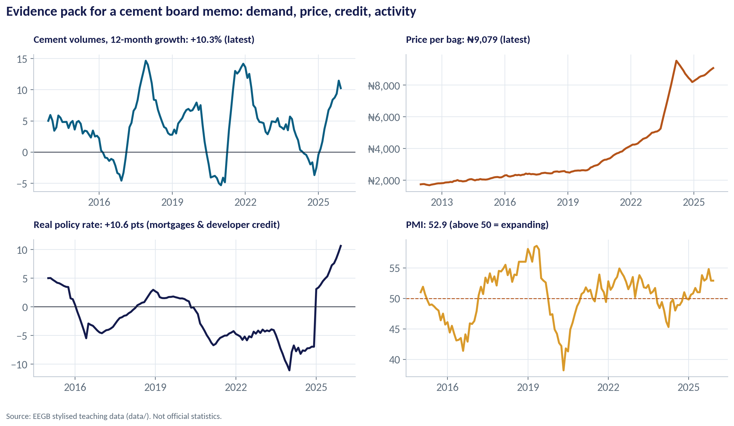
AN EVIDENCE PACK
Worked Example: The Cement Industry
WHAT TO SEE
Volumes: +10.3% over the last 12 months.
Price per bag: about ₦9,079.
Real policy rate: +10.6 points — expensive mortgages and developer credit.
PMI 52.9: activity expanding. Evidence for a cautious 'grow, but protect margin' memo.
Fig S16-F04 · replicate: s16_figures.R / .py
SESSION 16 · CAPSTONE & REVIEW
9

Slide 10
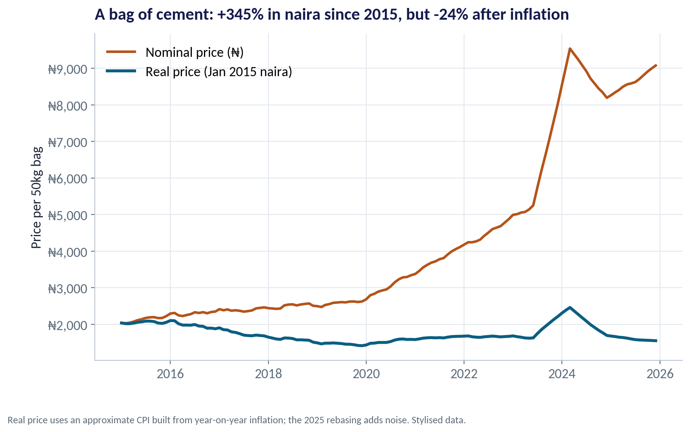
NOMINAL VS REAL
Don't Be Fooled by Naira Prices
WHAT TO SEE
The price of a bag of cement rose +345% in naira since 2015.
Adjusted for inflation, it fell about 24%.
A memo that celebrates naira price growth without deflating it misleads the board.
Session 1's first lesson is still the most important one.
Fig S16-F05 · replicate: s16_figures.R / .py
SESSION 16 · CAPSTONE & REVIEW
10

Slide 11
WORKED EXAMPLE
A Cement Memo in Six Lines
Item | Evidence
Volumes | +10.3% y/y
Price/bag | ₦9,079
Real rate | +10.6 pts
PMI | 52.9
Naira | ₦1,454/$
STEP BY STEP
1
Recommend: approve the second kiln line in two stages; stage one now, stage two on a trigger.
2
Changed: demand recovering, PMI above 50, naira stable for a year — but credit is costly.
3
For us: margins depend on energy costs in dollars and on price discipline in a concentrated market.
4
Scenarios: upside 30%, base 50%, downside 20% (naira above ₦2,000).
5
Signposts: PMI, 12-month FX change, reserves, permits; stage two if PMI > 52 for two quarters.
Actions: hedge 50% of next year's imported energy; finance stage one in naira at fixed rates; publish TCFD-style emissions data before the EU CBAM bites.
SESSION 16 · CAPSTONE & REVIEW
11
Notes:
This is an example of structure, not the 'right answer'. Teams will reach different recommendations — what matters is that the logic is explicit.

Slide 12


WHERE MANAGERS GO WRONG
What Makes a Weak Memo
THE TRAP
THE BETTER HABIT
Ten paragraphs of economic history before the recommendation.
Lead with the decision; history only where it changes the decision.
Naira growth numbers with no adjustment for inflation.
Report real and dollar values alongside naira.
One forecast presented as fact.
Three scenarios with probabilities and a downside you can survive.
Actions without owners or dates.
Who, what, by when — and the trigger that brings stage two forward.
Ignoring the global picture.
Show how the Fed, oil and trade reach your industry.
SESSION 16 · CAPSTONE & REVIEW
12

Slide 13
PART
02
The Course on One Page
Micro to macro, domestic to global, policy to profits.

Slide 14
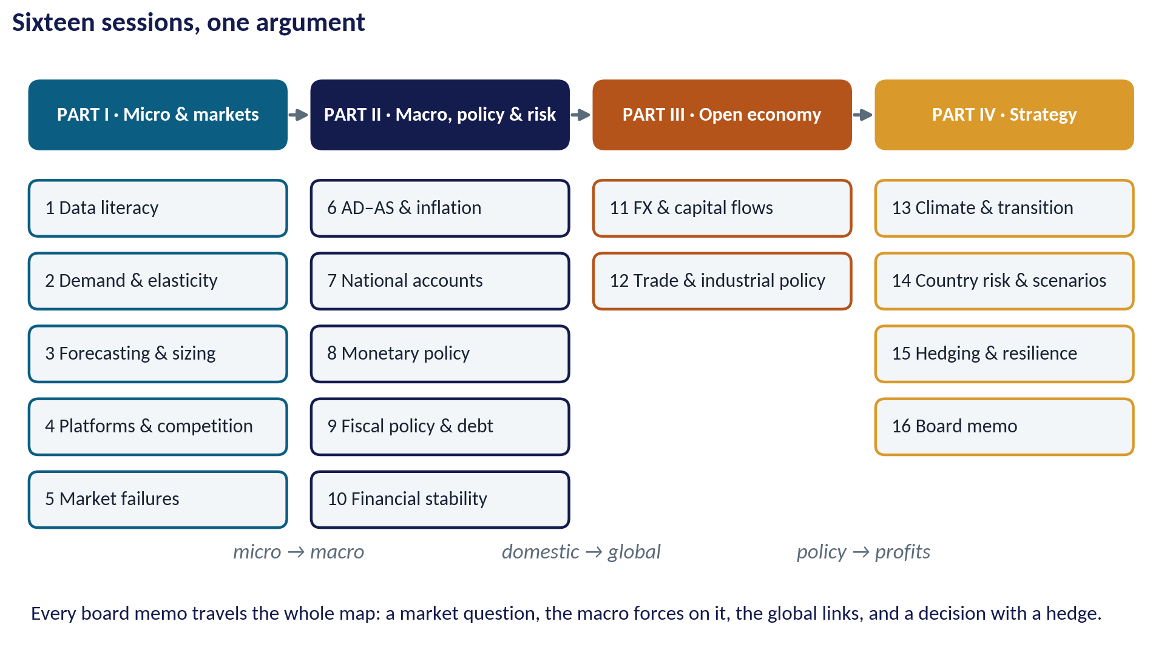
INTEGRATIVE MAP
Sixteen Sessions, One Logic
WHAT TO SEE
Part I: how markets set prices and quantities, and where they fail.
Part II: how the whole economy moves — inflation, output, money, budgets, banks.
Part III: how Nigeria connects to the world — currency, capital and trade.
Part IV: how a firm turns all of it into strategy — climate, country risk, hedging, the board memo.
Fig S16-F02 · replicate: s16_figures.R / .py
SESSION 16 · CAPSTONE & REVIEW
14

Slide 15
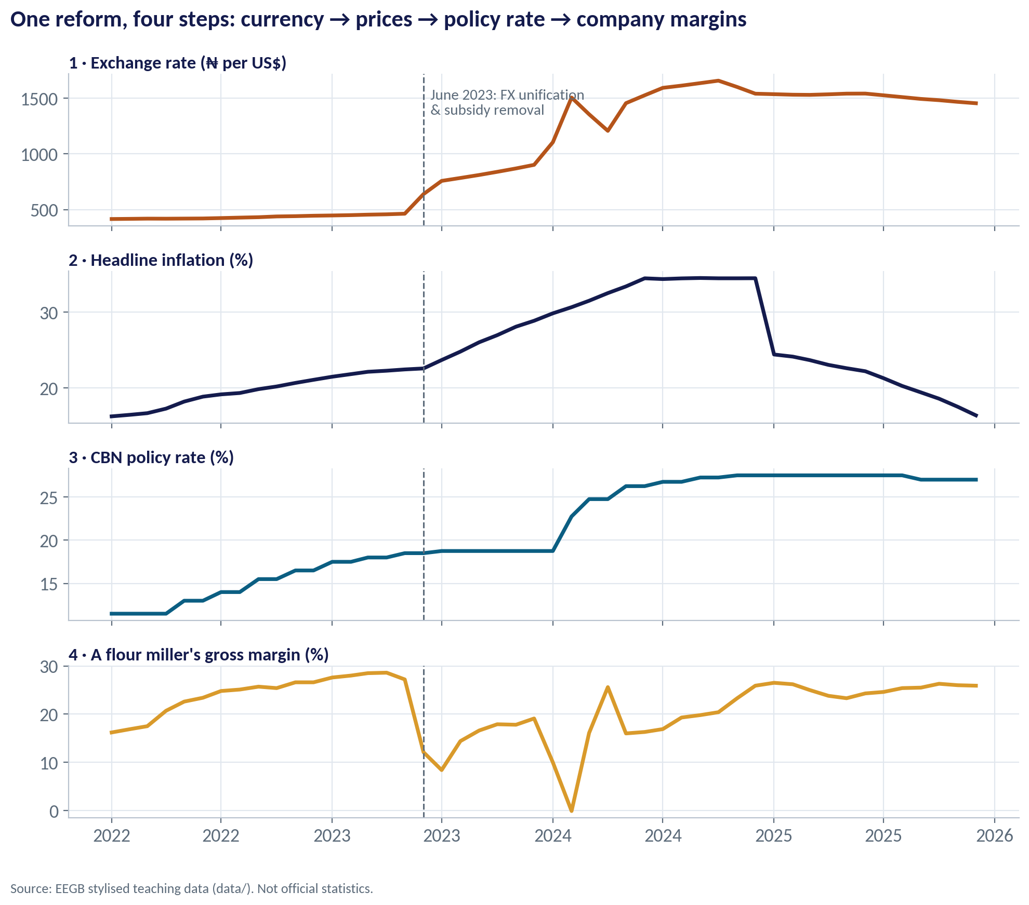
POLICY TO PROFITS
One Shock, Four Panels
WHAT TO SEE
June 2023: FX unification and petrol subsidy removal.
The naira moved from about ₦463 to a peak near ₦1,657 per dollar.
Inflation peaked near 34.5%; the CBN raised its rate from 11.5% (early 2022) to 27.5%.
A flour miller's gross margin fell to about zero at the worst point — policy reaches the P&L within months.
Fig S16-F01 · replicate: s16_figures.R / .py
SESSION 16 · CAPSTONE & REVIEW
15

Slide 16
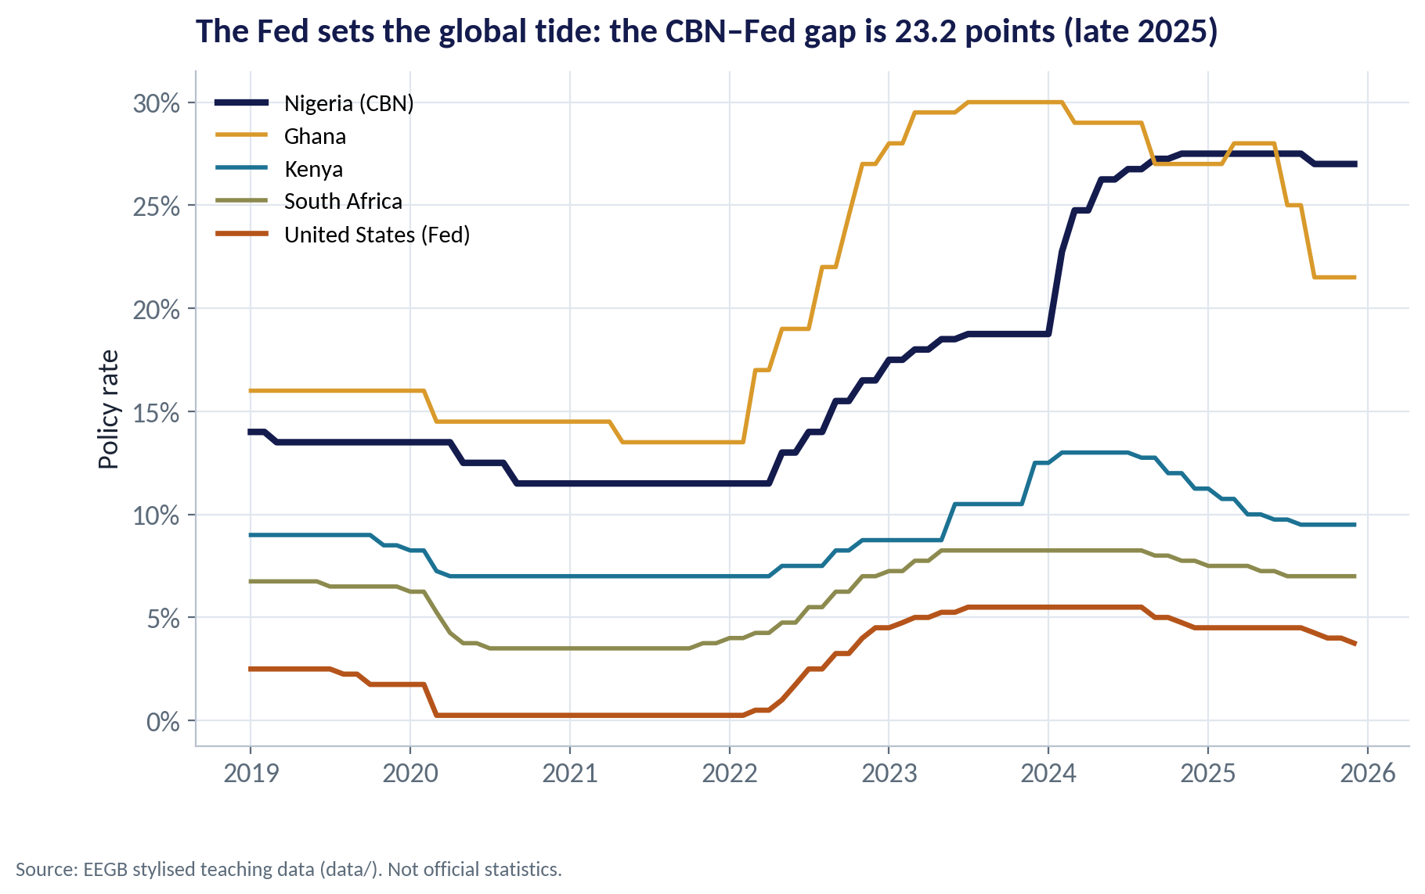
DOMESTIC MEETS GLOBAL
The Global Tide and Nigeria's Rate
WHAT TO SEE
The US Fed's rate moves capital worldwide; emerging markets must pay a premium to keep it.
In late 2025 the CBN's rate was about 23 points above the Fed's.
Part of that gap is Nigerian inflation; part is the risk premium investors demand.
When the Fed cuts, pressure on the naira usually eases — one signpost for your memo.
Fig S16-F06 · replicate: s16_figures.R / .py
SESSION 16 · CAPSTONE & REVIEW
16

Slide 17
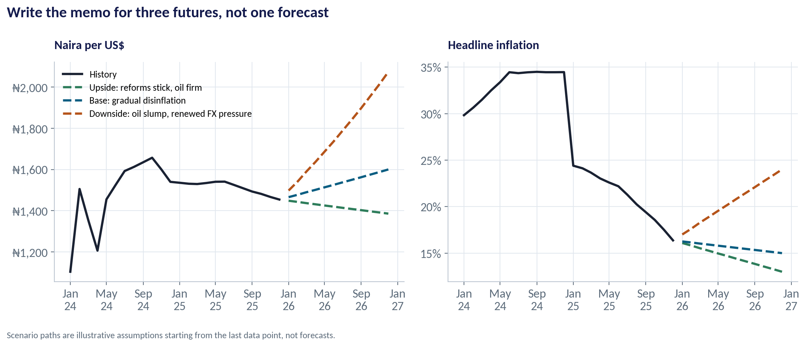
LOOKING AHEAD
Three Scenarios for 2026
WHAT TO SEE
Upside (reforms stick, oil firm): naira about ₦1,386, inflation about 13% by end-2026.
Base (gradual disinflation): about ₦1,600 and 15%.
Downside (oil slump, renewed FX pressure): about ₦2,073 and 24%.
These are teaching scenarios, not forecasts — build your own for the memo.
Fig S16-F03 · replicate: s16_figures.R / .py
SESSION 16 · CAPSTONE & REVIEW
17

Slide 18
THE TRANSMISSION CHAINS
Five Chains to Know for the Exam
Start | Chain | Reaches the firm as…
Oil price falls | Fewer dollars → reserves fall → naira weakens → imported inflation | Higher input costs, weaker demand
CBN raises rates | Higher yields → dearer credit → slower demand; bond prices fall | Costlier loans, lower valuations
Fiscal deficit financed by CBN | More money → inflation → weaker naira | Rising costs, policy uncertainty
Fed raises rates | Capital leaves EMs → FX pressure → CBN tightens | FX and rate risk at once
Carbon price / CBAM | Emitters pay → prices rise or margins fall → capital moves to clean firms | Transition risk and opportunity
SESSION 16 · CAPSTONE & REVIEW
18

Slide 19
PART
03
Preparing for the Final Exam
Closed-book, in class: reasoning over memorising.

Slide 20

THE FORMAT
What to Expect
Closed-book, in class
Reasoning, not recall
On-site, no notes or devices. It counts for 40% of your grade.
Expect short cases: a shock, a firm, a question. Explain the chain and recommend.
Simple numbers
Clear writing
Real vs nominal, elasticity and revenue, the debt equation, duration, the cost of a dollar loan.
Short paragraphs, the answer first, the reasoning after. Draw a diagram when it helps.
SESSION 16 · CAPSTONE & REVIEW
20

Slide 21
PRACTICE QUESTIONS
Try These Before the Exam
# | Question | What a good answer covers
1 | A firm's naira revenue rose 25% while inflation was 30%. Did it grow? | Real ≈ −5%; volume fell; check prices vs competitors
2 | Demand elasticity is −1.5. Should we raise prices 10% to pass on costs? | Volume −15%, revenue falls; margin vs volume trade-off
3 | Why can't the CBN fix the naira, allow free capital flows and cut rates? | Impossible trinity; reserves drain; parallel market
4 | r = 18%, g = 12%, primary deficit 1% of GDP, debt 50%. What happens to debt/GDP? | Rises: (r−g)/(1+g)×d ≈ 2.7 pts + 1 pt deficit
5 | A bank's duration gap is 2 years. What does a +3 point rate rise do? | Equity falls ≈ gap × assets × 3% ÷ (1+y)
6 | When is a petrol subsidy regressive? | Benefits rise with consumption; richer deciles gain most
SESSION 16 · CAPSTONE & REVIEW
21

Slide 22
CONCEPT CHECK
Quick Check: What Would You Say?
Practice: the Fed cuts rates by 1 point while Nigerian inflation is stable. Which chain is most likely for a Lagos importer?
A
Higher naira borrowing costs immediately
B
Capital flows toward emerging markets, easing pressure on the naira and the cost of imported inputs
C
No effect, because the Fed only affects the US
D
Higher Nigerian inflation
Discuss with your neighbour for 60 seconds — answer and reasoning in the speaker notes.
SESSION 16 · CAPSTONE & REVIEW
22
Notes:
ANSWER: B. B. Lower US rates make naira assets relatively more attractive (carry), supporting the naira. The importer's dollar costs in naira fall or stabilise. The effect is not guaranteed — oil and domestic policy matter too.

Slide 23
CONCEPT CHECK
Quick Check: What Would You Say?
Practice: a board member says 'our dollar loan at 7% is cheaper than a naira loan at 22%'. What do you check first?
A
Nothing — 7% is lower
B
The expected depreciation of the naira and whether our revenues are in naira (currency mismatch)
C
The Fed's balance sheet
D
The CPI rebasing
Discuss with your neighbour for 60 seconds — answer and reasoning in the speaker notes.
SESSION 16 · CAPSTONE & REVIEW
23
Notes:
ANSWER: B. B. The true cost of the dollar loan is roughly 7% plus expected naira depreciation. With naira revenues, a large devaluation can make it far dearer (Session 11).

Slide 24



HANDS-ON LAB
Capstone Starter: Your Evidence Pack
1
Set INDUSTRY and choose the four macro drivers that matter most to it.
YOU WILL NEED
Data
2
Run the script: it prints an evidence table (latest, a year ago, change).
data/ng_macro_monthly.csv
+ one industry file
3
It saves a four-panel chart for your memo.
R script
sessions/s16/R/s16_capstone_starter.R
4
Add one industry dataset or official series.
Python script
Fill in the six-paragraph memo template it prints — then rewrite in your own words.
sessions/s16/python/s16_capstone_starter.py
5
Deliverable: a one-page memo and an 8-minute presentation to the board.
⏱ Before your presentation
SESSION 16 · CAPSTONE & REVIEW
24

Slide 25
WORDS TO OWN
The Words That Carry the Course
Real vs nominal
Adjusted vs not adjusted for inflation (S1).
r − g
Interest rate minus growth: drives the debt ratio (S9).
Elasticity
% change in quantity for a 1% change in price or income (S2).
Duration gap
How a rate rise hits a balance sheet (S10).
Externality
A cost or benefit falling on others (S5, S13).
Impossible trinity
Fixed rate, free capital, own policy: pick two (S11).
Supply shock
A cost shock that raises prices and cuts output (S6).
Scenario & signpost
Plausible futures and the indicators that reveal them (S14).
Transmission
How policy reaches firms and households (S8).
Natural hedge
Matching costs and revenues in the same currency (S15).
SESSION 16 · CAPSTONE & REVIEW
25

Slide 26
KEY TAKEAWAYS
EEGB in Five Ideas
01
Think in incentives, margins and opportunity cost — and always separate real from nominal.
02
Prices, inflation, rates and the naira are linked: one shock travels through all of them.
03
Nigeria is an open economy: oil, the Fed and capital flows shape what the CBN can do.
04
Plan with scenarios, signposts and hedges, not a single forecast.
05
Tell the board what to do, why, and what would change your mind.
NEXT › Final exam
Next: Submit your one-page memo before your presentation slot. Revise the practice questions and the five transmission chains for the closed-book final exam.

