Slide 1


LAGOS BUSINESS SCHOOL · TURNING DATA INTO BUSINESS GROWTH · DAY 2
SESSION 2.1
The Analytics Mindset
The Analytics Mindset, Data Literacy & Your Toolkit
Source: Chapters 6–7 — Setting Up Your Environment · Data Literacy
AI-Powered Business Analytics: A Practical Textbook for Data-Driven Decision Making · Prof. Bongo Adi

Slide 2






TODAY'S PLAN
Session 2.1 at a Glance — 75 Minutes
Five blocks, one arc: from expectations, to concepts, to hands-on practice.
10'
20'
15'
25'
5'
Welcome & Policies
Lecture
Diagnostic Quiz
Guided Lab
Wrap-Up
Roadmap, expectations, assessment, AI-use policy
Data literacy & the analytics value chain
Ungraded — gauge your quantitative comfort
RStudio tour; load and inspect a real dataset
Recap + pre-work for Session 2.2
SESSION 2.1 · THE ANALYTICS MINDSET
2

Slide 3
WHERE WE ARE
Programme Roadmap — Days 2 to 5
Three modules across four days, a self-study practice paper for each, and the capstone defence on Friday.
YOU ARE HERE
Module 1
Module 2
Module 3
Finale
Sessions 2.1–3.1
Sessions 3.2–4.2
Sessions 4.3–5.3
Session 5.4
Practice paper — self-study
Practice paper — self-study
Practice paper — self-study
Capstone
Foundations & Inference: data literacy, statistics, EDA, visualisation, hypothesis & A/B testing
Predictive & Unsupervised: regression, classification, ensembles, explainability, clustering & PCA
Advanced & Applied: time series, text, recommendation, neural nets & GenAI, customer, risk, operations & people
Team capstone defence before an external panel
SESSION 2.1 · THE ANALYTICS MINDSET
3

Slide 4



GRADING
How You'll Be Assessed
Assessment blends tests, a real project and practice — mirroring how analytics judgement is built.
Three Module Tests
Capstone Project
Final Examination
Labs & Participation
30% (10% each)
30%
25%
15%
Practice Papers 1, 2 and 3 — concepts, reading output, and one applied task each.
Teams of 4–5 take a real business problem from question to recommendation; presented in Session 5.4.
Comprehensive and integrative — method choice, interpretation, business judgement.
Weekly labs are reviewed and lightly graded to build the habit, not to punish mistakes.
SESSION 2.1 · THE ANALYTICS MINDSET
4

Slide 5




GROUND RULES
AI-Use Policy & Academic Integrity
This is an AI-powered analytics course — using AI well is part of the skill we are building.
Permitted & Encouraged
Understand & Explain
Disclose Every Time
Integrity Is Non-Negotiable
AI assistants for learning, coding help and drafting are allowed — and encouraged — throughout the course.
You must understand, be able to explain, and take full responsibility for everything you submit.
All assessed work must disclose AI use. Short oral checks may be used to confirm understanding.
Submitting AI output you cannot explain, as if it were your own, is an integrity violation.
SESSION 2.1 · THE ANALYTICS MINDSET
5

Slide 6



BY THE END OF TODAY
Session 2.1 Learning Objectives
You will be able to:
01
02
03
Explain the Value Chain
Read Your Data
Run Your First Script
Describe how data becomes information, insight, decision and value — and where AI fits.
Tell data types, measurement scales, sources and quality problems apart before drawing any conclusion.
Open RStudio, load a real dataset in R and in Python, and inspect it end to end.
SESSION 2.1 · THE ANALYTICS MINDSET
6

Slide 7




THE HOOK
Why Analytics Matters for Managers
“Data without insight is just noise. Insight without decision is just interesting conversation.”
This course will not turn you into a research engineer. It will turn you into a manager who can:
Frame
Choose
Translate
Turn a business problem into an analytics question worth answering.
Pick the right method for the decision — not the fanciest one.
Turn model output into a recommendation an executive can act on.

Slide 8
PART
01
The Analytics Mindset
From raw records to decisions that create value.

Slide 9



THE CORE FRAMEWORK
The Analytics Value Chain
Five stages carry a manager from raw records to real business improvement.
›
›
›
›
Data
Information
Insight
Decision
Value
Raw, unprocessed observations — receipts, clicks, loan records
Data organised and summarised, with context
A pattern that explains why something is happening
A choice of action based on the insight
Measurable business improvement: revenue, cost, risk
Your job — as analyst and as manager — is to move people up this chain: from raw data to a decision they can act on.
SESSION 2.1 · THE ANALYTICS MINDSET
9

Slide 10
WORKED EXAMPLE
The Value Chain in Action: A Nigerian Bank Loan Book
Data
10,000 raw loan records sitting in the core banking system.
Information
Default rate is 8% overall — but under-30 borrowers default 2.4× more often.
Insight
Economic pressure is hitting the under-30 cohort hardest; personal loans are riskier than auto loans.
Decision
Tighten approval standards for under-30 personal loans; price risk into interest rates.
Value
Lower defaults, better-priced interest income, lower collection costs.
SESSION 2.1 · THE ANALYTICS MINDSET
10

Slide 11


THE ANALYTICS SPECTRUM
Four Questions Every Business Asks
Each question needs a different kind of analytics — and this course covers all four.
Descriptive
Diagnostic
Predictive
Prescriptive
“What happened?”
“Why did it happen?”
“What will happen?”
“What should we do?”
KPIs, dashboards and reports summarising past performance.
Drilling down, comparing groups, testing explanations.
Forecasts and risk scores that anticipate what comes next.
Recommendations and optimisation that turn foresight into action.
e.g. revenue by category, NPS
e.g. why did December spike?
e.g. churn risk, next-month demand
e.g. which customers to target
SESSION 2.1 · THE ANALYTICS MINDSET
11

Slide 12
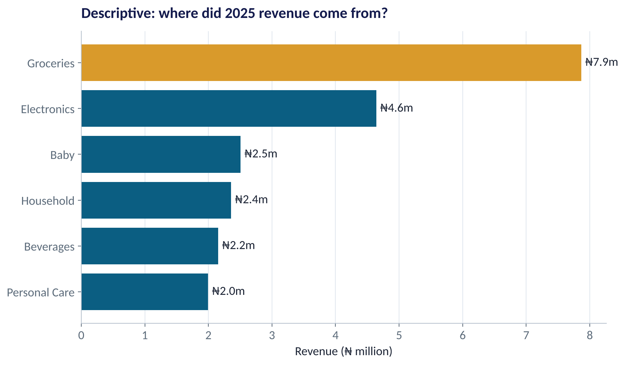
DESCRIPTIVE ANALYTICS
Descriptive: Where Did Our Revenue Come From?
WHAT TO SEE
Groceries carry the business — about ₦7.9m of ₦21.5m.
Electronics is second despite few receipts: few, big tickets.
A descriptive chart answers what — it never explains why.
Next question a manager should ask: is this mix changing month to month?
Fig S2.1-F02 · replicate: tdbg_2_1_figures.R / .py
SESSION 2.1 · THE ANALYTICS MINDSET
12

Slide 13
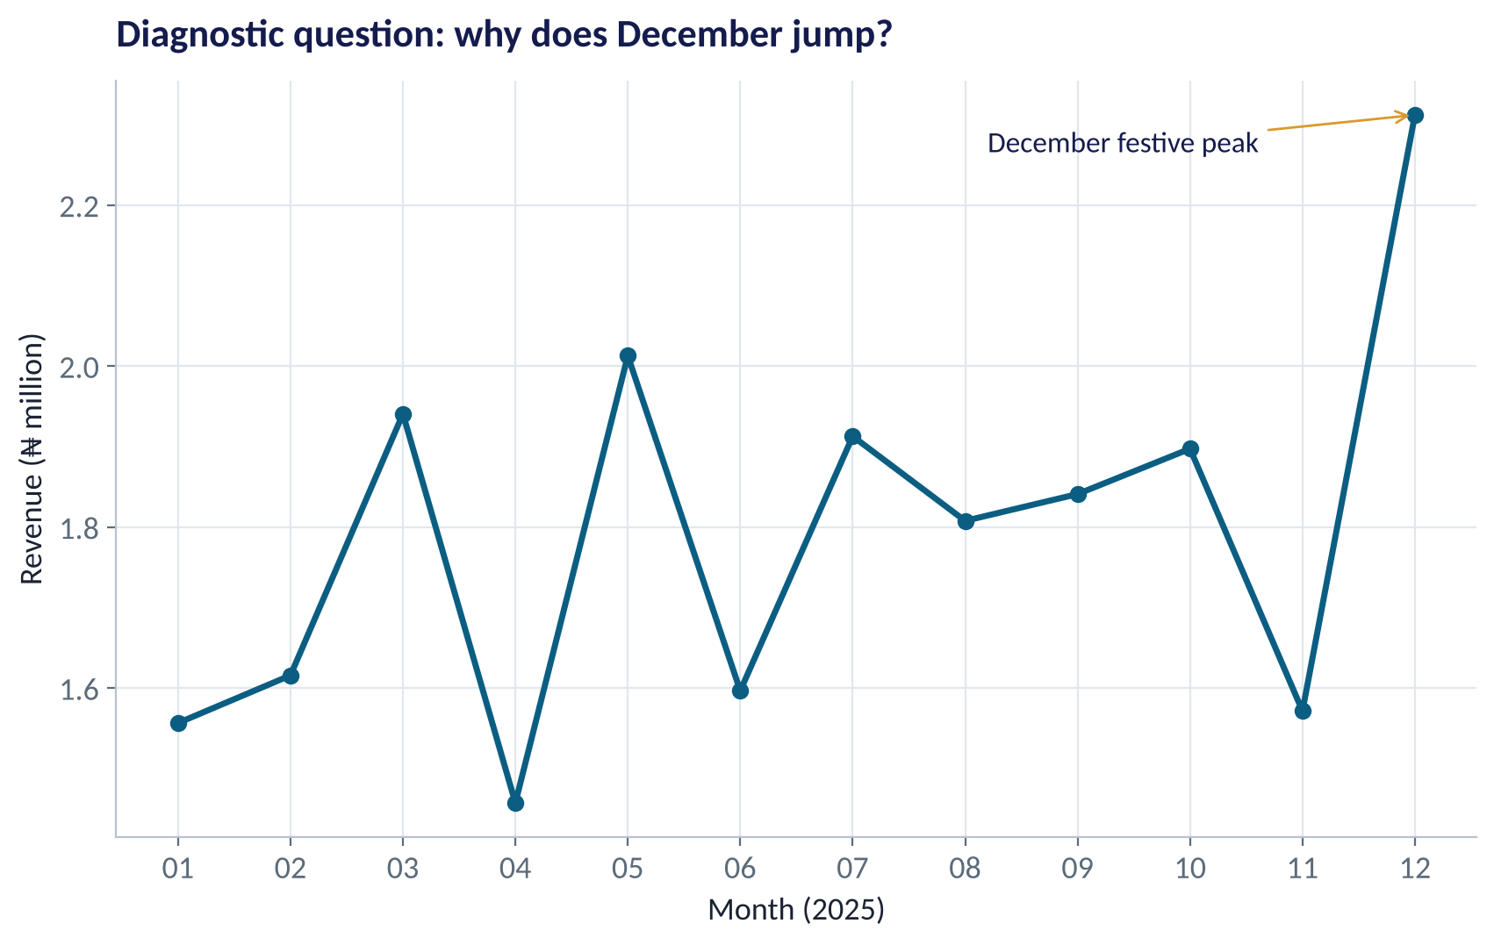
DIAGNOSTIC ANALYTICS
Diagnostic: Why Does December Jump?
WHAT TO SEE
Revenue in December is roughly 25% above a typical month.
Candidate explanations: festive shopping, bonuses, more shoppers or bigger baskets.
Diagnostics compares: more receipts, or bigger receipts? Which stores?
We will learn to test such explanations in Session 2.5.
Fig S2.1-F03 · replicate: tdbg_2_1_figures.R / .py
SESSION 2.1 · THE ANALYTICS MINDSET
13

Slide 14




THE QUESTION EVERYONE ASKS
Where Does AI Fit in the Value Chain?
AI is exceptional at the middle of the chain — but the ends still belong to you.
AI accelerates
AI assists
You decide
You safeguard
Finding patterns across huge, messy or fast data — turning information into candidate insights in minutes.
Writing and explaining code, cleaning data, drafting summaries — a tireless junior analyst.
Framing the question, judging whether the insight is real, and owning the decision and its consequences.
Bias checks, explainability and fairness — especially in lending, hiring and pricing.
SESSION 2.1 · THE ANALYTICS MINDSET
14

Slide 15
PART
02
Data Literacy
What data is, where it comes from, and how to tell good data from bad.

Slide 16




FIRST PRINCIPLES
What Is Data — and Where Does It Come From?
“Data is recorded information about the world.” Every dataset started as a choice about what to record.
Internal / Operational
External / Market
Human-Generated
Machine-Generated
Transaction systems, CRM, ERP — e.g. a retailer's point-of-sale receipts.
Government and industry data — e.g. the NBS Consumer Price Index, CBN exchange rates.
Surveys, reviews, social posts — e.g. customer feedback forms, app-store reviews.
Sensors, logs, event streams — e.g. mobile-money transaction pings, GPS traces.
SESSION 2.1 · THE ANALYTICS MINDSET
16

Slide 17

THE SHAPE OF A DATASET
Rows, Columns and the Unit of Analysis
IN PLAIN ENGLISH
WHY A MANAGER CARES
Almost every business dataset is a table. Each row is one observation — one receipt, one customer, one loan. Each column is a variable — one fact recorded about every row. The first question to ask of any table is: what does one row represent?
Mixing up the unit of analysis is the root of many bad reports. 'Average basket' (per receipt) and 'average customer spend' (per customer, across many receipts) are different numbers that answer different questions. Decide the unit before you calculate anything.
EXAMPLE
In our retailer file, one row = one receipt. Columns include date, hour, store, category, items, basket_naira, payment_method and loyalty_member. 2,000 rows × 10 columns.
SESSION 2.1 · THE ANALYTICS MINDSET
17

Slide 18
MEET TODAY'S DATA
One Row = One Receipt: The Lagos Retailer File
First five rows of retail_transactions.csv (2,000 rows, 10 columns).
txn_id | date | hour | store | category | items | basket_naira | payment | loyalty
T01489 | 2025-01-01 | 11 | Lekki Phase 1 | Beverages | 6 | 6,250 | Card | No
T00132 | 2025-01-01 | 14 | Yaba | Personal Care | 6 | 6,100 | Card | Yes
T00140 | 2025-01-01 | 14 | Yaba | Groceries | 8 | 10,570 | POS | No
T00756 | 2025-01-01 | 14 | Lekki Phase 1 | Beverages | 2 | 3,680 | Transfer | No
T01997 | 2025-01-01 | 15 | Ikeja City Mall | Groceries | 13 | 12,220 | Cash | Yes
Ask: which columns are categories, which are quantities — and which could you average meaningfully?
SESSION 2.1 · THE ANALYTICS MINDSET
18

Slide 19

DATA TYPES (1 OF 2)
Three Structures of Data
Know whether your data lives in rows and columns — or nowhere near them.
Structured
Semi-Structured
Unstructured
Organised into predefined tables, rows and columns.
Some organisation — tags or keys — but no rigid table.
No predefined format — the majority of data created today.
Bank accounts · stock prices · receipts
JSON from APIs · email headers · web logs
WhatsApp messages · emails · claim photos
SESSION 2.1 · THE ANALYTICS MINDSET
19

Slide 20
DATA TYPES (2 OF 2)
Not All Numbers Are Equal: Four Measurement Scales
Scale | What it means | Valid summaries | Business example
Nominal | Categories with no order | Counts, %, mode | Payment method; store; account type
Ordinal | Ordered categories, gaps not equal | Median, ranks, % | Satisfaction 1–5; credit rating A/B/C
Interval | Equal gaps, no true zero | Mean, standard deviation | Temperature in °C; calendar year
Ratio | Equal gaps and a true zero | All of the above + ratios | Revenue; items; age; loan amount
Rule of thumb: the scale decides the summary. Averages only make sense for interval and ratio data.
SESSION 2.1 · THE ANALYTICS MINDSET
20

Slide 21


WHERE MANAGERS GO WRONG
The Cost of Getting the Scale Wrong
Real errors seen in Nigerian boardroom reports.
THE TRAP
THE BETTER HABIT
Account type coded 1–4 is averaged: “the average account type is 2.4”.
Report counts and shares for nominal data: 46% savings, 31% current…
Satisfaction scores 1–5 averaged to 3.7 and compared to 3.6 as a 'real improvement'.
Report the median and the % of 4s and 5s (top-two-box).
Customer IDs or phone numbers summarised with mean and standard deviation.
Treat identifiers as labels: count them, check for duplicates, never average.
SESSION 2.1 · THE ANALYTICS MINDSET
21

Slide 22
CONCEPT CHECK
Quick Check: What Would You Say?
A bank codes branch region as 1 = Lagos, 2 = Abuja, 3 = Port Harcourt, 4 = Kano. Which summary is meaningful?
A
The mean region code across all customers
B
The share of customers in each region
C
The standard deviation of the region code
D
The median region code
Discuss with your neighbour for 60 seconds — answer and reasoning in the speaker notes.
SESSION 2.1 · THE ANALYTICS MINDSET
22

Slide 23




SCALING UP
The Five Vs of Big Data
Five properties that make modern business data harder — and more valuable — to work with.
Volume
Velocity
Variety
Sheer quantity — NIBSS processes billions of interbank transfers a year.
Speed — mobile-money pings and stock prices update in real time.
Tables, text, images and APIs — all at once.
Veracity
Value
Trust — real data is messy: duplicates, gaps, inconsistent formats.
The point of it all — insight that drives a decision.
SESSION 2.1 · THE ANALYTICS MINDSET
23

Slide 24





TRUST, BUT VERIFY
Six Dimensions of Data Quality
The checks every dataset should pass before it drives a decision.
Accuracy
Completeness
Consistency
Values correctly reflect reality — the ₦12,220 receipt really was ₦12,220.
No critical gaps — income is recorded for every loan applicant.
Same fact, same value — 'Ikeja' is not also 'ikeja ' and 'IKJ'.
Timeliness
Validity
Uniqueness
Current enough to act on — last week's stock levels, not last year's.
Fits the expected format and range — no borrower aged 140.
No duplicate records inflating counts — each receipt appears once.
SESSION 2.1 · THE ANALYTICS MINDSET
24

Slide 25

TWO KINDS OF METRIC
KPIs vs. Predictive Indicators
One tells you how you did. The other tells you what to do next.
KPIs — Lagging
Predictive — Leading
The scoreboard: confirm what already happened
The early-warning system: time to intervene
Monthly revenue
Customer NPS
Employee turnover rate
Loan default rate
Hold teams accountable for results
Sales pipeline value
Website and app traffic trend
Employee engagement score
Days-past-due in month one
Give managers time to act before results land
Excellent managers watch both: KPIs for accountability, leading indicators for early intervention.
SESSION 2.1 · THE ANALYTICS MINDSET
25

Slide 26


DATA HAS ETHICAL WEIGHT
Responsible Data Use in Nigeria
The Nigeria Data Protection Act (2023) shapes what responsible analytics looks like here.
Privacy & Consent
Bias & Fairness
Data Sovereignty
Transparency
Collect only what you need, with a lawful basis; people can ask to see or delete their data.
Historic bias in data can be copied by models — audit outcomes across groups.
Know where your data is stored and processed, and who can access it.
People affected by algorithmic decisions deserve an explanation they can understand.
SESSION 2.1 · THE ANALYTICS MINDSET
26

Slide 27



WHO IS MISSING?
The African Data Gap
Good analytics starts by asking who is missing from the data before trusting what it says.
Rural vs. Urban
Language Bias
Representation Gaps
Digital and transaction data over-represents Lagos and big cities; rural livelihoods are under-counted.
Text models trained mostly on English underserve Pidgin, Yoruba, Hausa and Igbo speakers.
The unbanked and informal sector leave few digital traces — models can miss whole segments.
SESSION 2.1 · THE ANALYTICS MINDSET
27

Slide 28
PART
03
Your Toolkit
R and Python, side by side, inside RStudio.

Slide 29


15 MINUTES · UNGRADED
Quick Diagnostic: Where Are You Starting From?
No grades — just a starting point. Answer honestly; there is no wrong baseline.
Statement 1
Statement 2
Statement 3
I can explain the difference between a mean and a median.
I have written at least one line of R or Python code before.
I can read a bar chart and state what decision it supports.
Agree · Unsure · Disagree
Agree · Unsure · Disagree
Agree · Unsure · Disagree
Results shape how we pace labs and clinics for the rest of the course — not your grade.
SESSION 2.1 · THE ANALYTICS MINDSET
29

Slide 30


MEET THE TOOLKIT
Your Toolkit: R and Python, Not R vs. Python
This course is dual-language on purpose — real analytics teams use both.
R
Python
Built by statisticians for data analysis
A general-purpose language that took over data science
tidyverse: dplyr for data, ggplot2 for charts
Excellent for statistics and reporting
Quarto / R Markdown for reproducible reports
Every course chart has an R script
pandas for data, matplotlib for charts
scikit-learn for machine learning
Dominant in AI, deep learning and production systems
Every course chart has a Python script
RStudio runs both. The reticulate package lets R and Python share the same session — you choose the language per task.
SESSION 2.1 · THE ANALYTICS MINDSET
30

Slide 31



WHERE YOU WILL WORK
Inside RStudio: Four Panes
Everything in this course happens in one window.
Source (top-left)
Environment (top-right)
Where scripts live. Write code here, save it, and run lines with Ctrl/Cmd + Enter.
Every object you have created — your data frames, numbers and models.
Console (bottom-left)
Files / Plots / Help (bottom-right)
Where code actually runs and results print. Try typing 2 + 2.
Browse the project folder, see charts, and read documentation.
SESSION 2.1 · THE ANALYTICS MINDSET
31

Slide 32




THE COURSE PROJECT
How the Course Folder Is Organised
Download it once from GitHub; every script expects this layout.
tdbg-labs.Rproj
Double-click to open the project in RStudio. All file paths start from here.
data/
Every course dataset as a CSV — the same files for R and Python, so both give identical answers.
sessions/2-1 … s22
Per session: slides/ (this deck), R/ and python/ scripts, and figures/ they produce.
R/ and python/
Shared chart style so every figure matches the slides: theme_tdbg.R and tdbg_style.py.
Course website
the TDBG course website — sessions, downloads, code in R and Python tabs.
SESSION 2.1 · THE ANALYTICS MINDSET
32

Slide 33
YOUR FIRST SCRIPT
Load and Inspect a Dataset — in Both Languages
Same four moves, two spellings.
R
Python
library(readr); library(dplyr)
# 1. load
tx <- read_csv("data/retail_transactions.csv")
# 2. look
dim(tx) # rows, columns
glimpse(tx) # column types
# 3. check quality
colSums(is.na(tx))
sum(duplicated(tx$txn_id))
# 4. summarise
summary(tx$basket_naira)
import pandas as pd
# 1. load
tx = pd.read_csv("data/retail_transactions.csv")
# 2. look
tx.shape # (rows, columns)
tx.info() # column types
# 3. check quality
tx.isna().sum()
tx["txn_id"].duplicated().sum()
# 4. summarise
tx["basket_naira"].describe()
Full, commented versions: sessions/2-1/R/tdbg_2_1_lab.R and sessions/2-1/python/tdbg_2_1_lab.py
SESSION 2.1 · THE ANALYTICS MINDSET
33

Slide 34
HOW TO READ THIS OUTPUT
Reading Your First Summary
R OUTPUT
1
Median ₦7,840
> summary(tx$basket_naira)
Min. 1st Qu. Median Mean 3rd Qu. Max.
730 5088 7840 10760 12410 132060
> colSums(is.na(tx))
txn_id date hour store region category
0 0 0 0 0 0
items basket_naira payment_method loyalty_member
0 0 0 0
Half the receipts are below ₦7,840 — the 'typical' basket.
2
Mean ₦10,760 > median
A few big baskets pull the average up. Data is right-skewed (Session 2.2).
3
Max ₦132,060
Real stock-up shop or data error? Always investigate extreme values (Session 2.3).
4
No missing values
Completeness check passed for this file — rare in real life!
SESSION 2.1 · THE ANALYTICS MINDSET
34

Slide 35
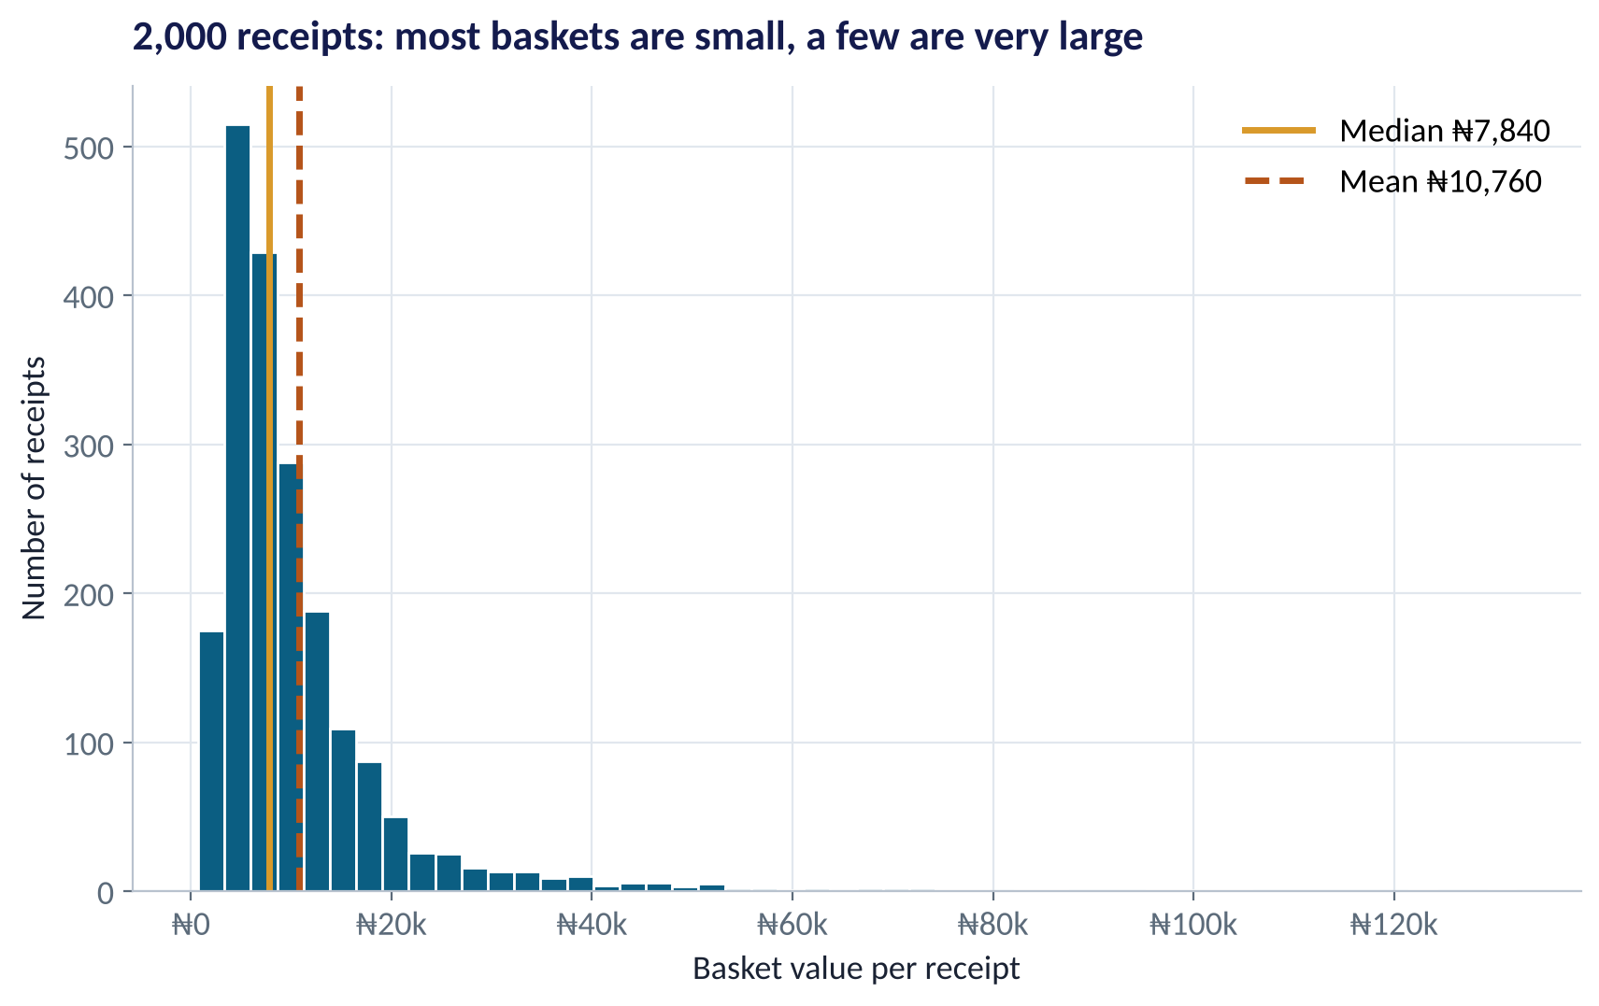
A FIRST CHART
What the Summary Looks Like as a Picture
WHAT TO SEE
Most receipts sit between ₦3k and ₦15k.
A long tail to the right: a few very large baskets.
The mean (dashed) sits right of the median — the tail drags it.
For a 'typical customer' figure, report the median.
Fig S2.1-F01 · replicate: tdbg_2_1_figures.R / .py
SESSION 2.1 · THE ANALYTICS MINDSET
35

Slide 36


NIGERIAN BUSINESS CASE
Tour of a Lagos Retailer's Transaction Data
The situation
The decision question
A six-store Lagos supermarket group has one year of point-of-sale receipts (2,000 sampled) and a new CEO who wants to 'use data better'.
What business questions could this dataset answer — and which kind of analytics (descriptive, diagnostic, predictive, prescriptive) does each need?
The data we have
What a good answer looks like
retail_transactions.csv: date, hour, store, region, category, items, basket value, payment method, loyalty membership.
A short list of 3 questions, one per analytics type, each tied to a decision the CEO could actually make (staffing, promotions, loyalty scheme, stock).
SESSION 2.1 · THE ANALYTICS MINDSET
36

Slide 37
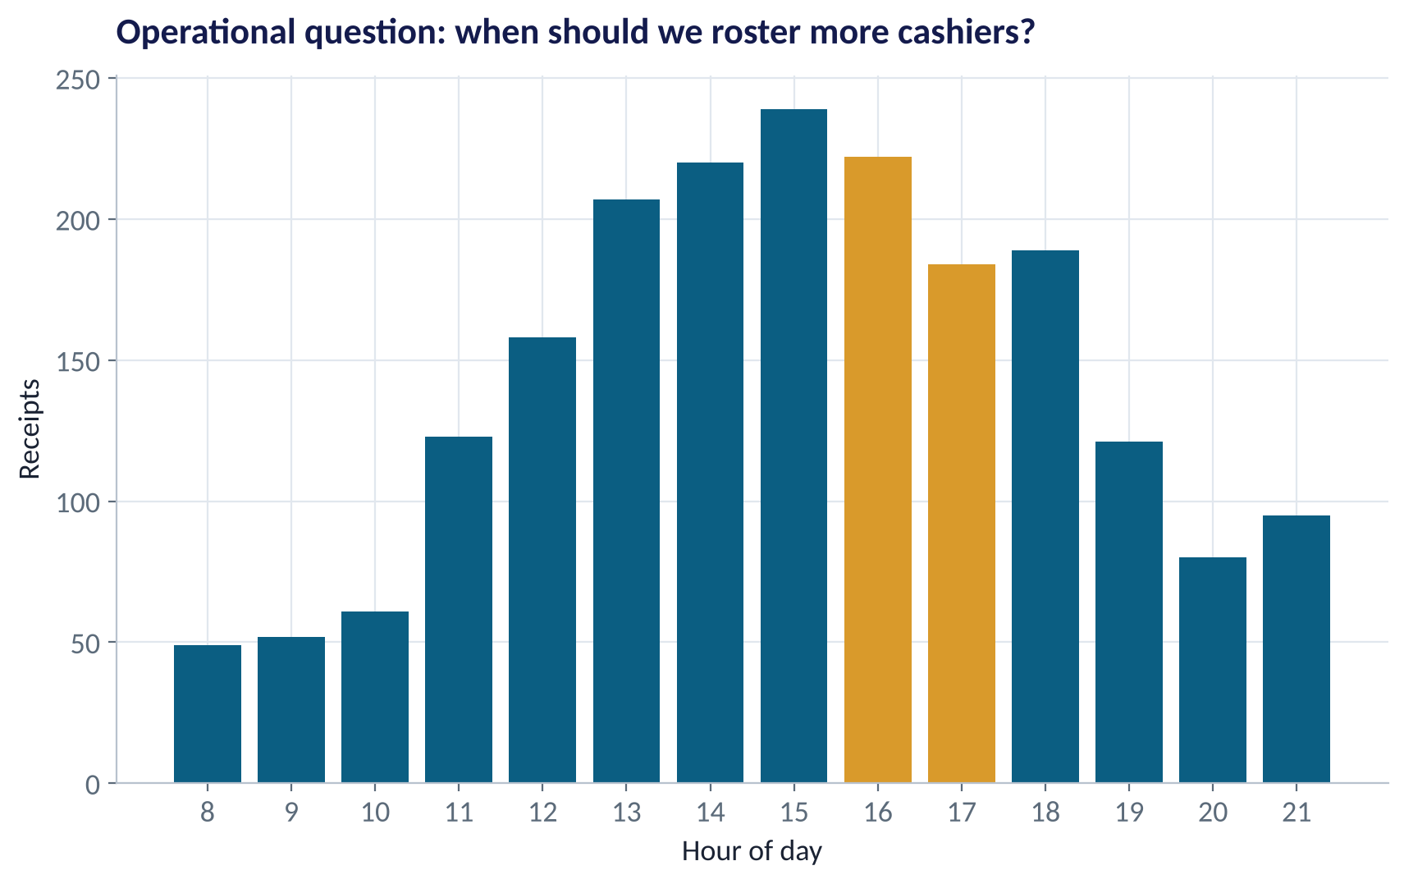
CASE · OPERATIONS
A Question With a Decision Attached: Cashier Rostering
WHAT TO SEE
Receipts peak at 4–5 pm.
Decision: shift cashier hours toward late afternoon.
Caveat: this is receipts, not queue length — what data would confirm the need?
Good analytics question = data + decision + caveat.
Fig S2.1-F04 · replicate: tdbg_2_1_figures.R / .py
SESSION 2.1 · THE ANALYTICS MINDSET
37

Slide 38
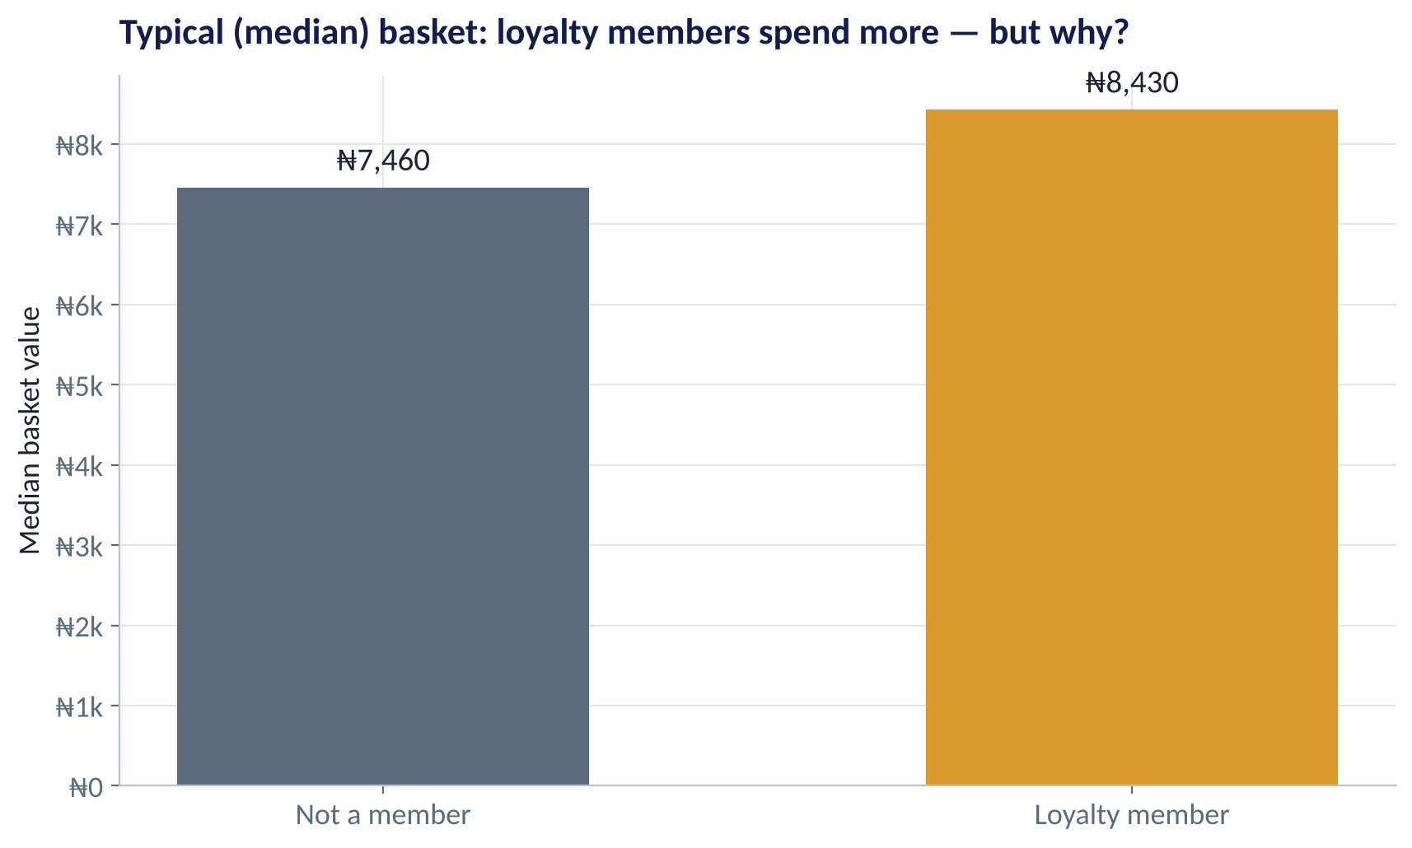
CASE · MARKETING
Loyalty Members Spend More — Does Loyalty Cause It?
WHAT TO SEE
Median basket: ₦8,430 for members vs ₦7,460 for others.
Tempting conclusion: the loyalty scheme makes people spend more.
Alternative: big spenders are more likely to join in the first place.
Separating these needs an experiment — Session 3.1.
Fig S2.1-F05 · replicate: tdbg_2_1_figures.R / .py
SESSION 2.1 · THE ANALYTICS MINDSET
38

Slide 39



HANDS-ON LAB
Guided Lab: Load, Inspect, Question
1
Open tdbg-labs.Rproj in RStudio. Open the lab script in your language.
YOU WILL NEED
Data
2
Run section 1–2: load the file and inspect it. What does one row represent?
data/retail_transactions.csv
3
Run section 3: check missing values, duplicate IDs and the range of basket values.
R script
sessions/2-1/R/tdbg_2_1_lab.R
4
Run section 4–5: summarise revenue by category and draw the histogram.
Python script
Section 6 — your turn: top store by revenue, share of loyalty receipts, one predictive question.
sessions/2-1/python/tdbg_2_1_lab.py
5
Deliverable: post your predictive question and the top store's revenue in the class channel.
⏱ 25 minutes
SESSION 2.1 · THE ANALYTICS MINDSET
39

Slide 40
WORDS TO OWN
Today's Vocabulary in Plain English
Dataset
A table of observations (rows) and variables (columns).
Interval / Ratio
Numbers with equal gaps; ratio also has a true zero.
Observation
One row — one receipt, customer or loan.
KPI
A lagging metric that scores past performance.
Variable
One column — a fact recorded for every row.
Leading indicator
A metric that signals future performance early.
Unit of analysis
What one row represents; decide it before calculating.
Data quality
Accuracy, completeness, consistency, timeliness, validity, uniqueness.
Nominal / Ordinal
Categories without / with a natural order.
Script
A saved file of code you can rerun — the basis of reproducible work.
SESSION 2.1 · THE ANALYTICS MINDSET
40

Slide 41
KEY TAKEAWAYS
Session 2.1 in 5 Ideas
01
Analytics creates value only when data travels the whole chain to a decision.
02
Ask four questions: what happened, why, what will happen, what should we do?
03
First ask of any table: what does one row represent? Then check its scale.
04
Trust data only after checking quality — and asking who is missing from it.
05
R and Python are two spellings of the same logic; RStudio runs both.
NEXT › Session 2.2: The Statistics a Manager Actually Needs
Before next session: Install R, RStudio and Python (see the Setup page on the course website). Read Chapter 8, sections 8.1–8.4, and rerun today's lab in the language you did NOT use.

