Slide 1


LAGOS BUSINESS SCHOOL · TURNING DATA INTO BUSINESS GROWTH · DAY 2
SESSION 2.2
The Statistics a
Manager Actually Needs
Statistical Foundations for Decision-Making
Source: Chapter 8 — A Statistical Primer
AI-Powered Business Analytics: A Practical Textbook for Data-Driven Decision Making · Prof. Bongo Adi

Slide 2




RECAP
Session 2.1 in Three Ideas
Value chain
Data only creates value when it travels all the way to a decision.
Read the table
First ask: what does one row represent? Then: what scale is each column on?
Trust, but verify
Check quality — missing values, duplicates, impossible values — before believing a number.
SESSION 2.2 · THE STATISTICS A MANAGER ACTUALLY NEEDS
2

Slide 3





TODAY'S PLAN
Session 2.2 at a Glance — 75 Minutes
From uncertainty, to the numbers managers use, to an honest margin of error.
10'
15'
20'
20'
10'
Recap & Hook
Probability
Describing Data
Sampling & CIs
Lab & Wrap-Up
Why managers need statistics at all
The language of uncertainty
Shape, centre and spread
CLT, standard error, confidence intervals
Compute a margin of error in R / Python
SESSION 2.2 · THE STATISTICS A MANAGER ACTUALLY NEEDS
3

Slide 4
BY THE END OF TODAY
Session 2.2 Learning Objectives
You will be able to:
01
02
03
Describe Data Honestly
Reason With Probability
Quantify Uncertainty
Choose between mean and median, and report spread, using the shape of the data.
Use basic probability rules — including Bayes — to avoid classic business misjudgements.
Explain sampling variation and build and interpret a 95% confidence interval.
SESSION 2.2 · THE STATISTICS A MANAGER ACTUALLY NEEDS
4

Slide 5



THE HOOK
The Manager's Uncertainty Problem
“Our average basket is ₦8,450.” — Based on 400 receipts. Out of millions. How sure are you?
Every business number you see is computed from a sample, and every sample could have come out differently. Statistics tells you:
What is typical
How much things vary
How sure to be
Which single number best summarises a messy pile of data.
Whether ₦8,450 means 'almost everyone' or 'hardly anyone'.
A margin of error so you neither over- nor under-react.

Slide 6



NIGERIAN BUSINESS CASE
A Lagos Supermarket Chain Asks a Simple Question
The situation
The decision question
A five-region supermarket chain is planning a loyalty programme. Rewards will be set as a share of the average basket.
What is the average basket value across all our stores — and how precise is our estimate? Do some regions genuinely spend more?
The data we have
What a good answer looks like
retail_basket_sizes.csv — 400 receipts sampled from 12 stores across Lagos Mainland, Lagos Island, Ikeja, Lekki and Surulere.
An estimate with a margin of error (e.g. ₦8,450 ± ₦206), and a judgement on whether regional differences are real or noise.
SESSION 2.2 · THE STATISTICS A MANAGER ACTUALLY NEEDS
6

Slide 7
PART
01
Probability: The Language of Uncertainty
Before we can measure uncertainty, we need words for it.

Slide 8

FIRST PRINCIPLES
What Is a Probability?
IN PLAIN ENGLISH
THE FORMULA
P(event) = favourable ÷ total
A probability is a number between 0 (impossible) and 1 (certain) that measures how likely something is. 0.25 means 'about one time in four'. Probabilities of all possible outcomes add up to 1.
when all outcomes are equally likely — or estimate it from past frequencies
WHY A MANAGER CARES
Pricing, provisioning and planning all rest on probabilities: the chance a loan defaults, a customer churns, a shipment is late. Managers who think in probabilities — not 'will it or won't it' — make calmer, better-calibrated decisions.
EXAMPLE
If 52 out of 500 past microloans defaulted, a reasonable estimate of P(default) for a similar new loan is 52 ÷ 500 = 0.104 (10.4%).
SESSION 2.2 · THE STATISTICS A MANAGER ACTUALLY NEEDS
8

Slide 9
THREE WAYS TO GET A PROBABILITY
Where Do Probabilities Come From?
Method | How it works | Business example | Watch out for
Classical | Count equally likely outcomes | 1 of 6 regions picked at random for an audit → 1/6 | Outcomes are rarely equally likely in business
Relative frequency | Use the share it happened in the past | Jimi Tool Rental: 12 of 40 days rented 3 machines → 0.30 | The past may not repeat (new regulation, FX shocks)
Subjective | Informed judgement of an expert | “60% chance the CBN holds rates at the next MPC” | Overconfidence and wishful thinking
Whatever the method, two rules always hold: each probability is between 0 and 1, and all outcomes add up to 1.
SESSION 2.2 · THE STATISTICS A MANAGER ACTUALLY NEEDS
9

Slide 10

RULE 1
The Complement: The Chance It Does NOT Happen
IN PLAIN ENGLISH
THE FORMULA
P(not A) = 1 − P(A)
Something either happens or it does not. So the probability it does not happen is simply one minus the probability it does. Often the 'not' is much easier to count.
WHY A MANAGER CARES
Risk is usually the complement of the target. A '95% uptime' network is down 5% of the time — about 36 hours a month. Translate percentages into the complement and into counts before you accept them.
EXAMPLE
If 92% of deliveries arrive on time, then 1 − 0.92 = 8% are late. With 3,000 orders a month, plan for about 240 late-delivery complaints.
SESSION 2.2 · THE STATISTICS A MANAGER ACTUALLY NEEDS
10

Slide 11

RULE 2
The Addition Rule: A OR B
IN PLAIN ENGLISH
THE FORMULA
P(A or B) = P(A) + P(B) − P(A and B)
To find the chance of A or B, add their probabilities — but subtract the overlap so you don't count customers who are in both twice.
WHY A MANAGER CARES
Marketing reach, product overlap and risk exposure are all 'or' questions. Forgetting the overlap is the most common way campaign reach gets inflated in board decks.
EXAMPLE
30% of a bank's customers use the app, 20% use USSD, and 8% use both. Share using at least one digital channel = 0.30 + 0.20 − 0.08 = 42%.
SESSION 2.2 · THE STATISTICS A MANAGER ACTUALLY NEEDS
11

Slide 12

RULE 3
Conditional Probability: Given That…
IN PLAIN ENGLISH
THE FORMULA
P(A | B) = P(A and B) ÷ P(B)
A conditional probability answers: if we already know B happened, how likely is A? We shrink the world to only the cases where B is true, then ask what share of those are also A.
read the bar “|” as “given”
WHY A MANAGER CARES
Almost every useful business number is conditional: default rate given sector, churn given a complaint, conversion given a mobile visit. Segmenting is just conditioning — and it is where insight lives.
EXAMPLE
Of 500 loans, 200 are to traders, and 34 traders defaulted. P(default | trader) = 34 ÷ 200 = 17%, compared with 10.4% for all loans.
SESSION 2.2 · THE STATISTICS A MANAGER ACTUALLY NEEDS
12

Slide 13

RULE 4
Independence: Does Knowing B Change A?
IN PLAIN ENGLISH
THE FORMULA
If independent: P(A and B) = P(A) × P(B)
Two events are independent if knowing one happened tells you nothing about the other. Then — and only then — the chance of both is just the product.
WHY A MANAGER CARES
Diversification only works if risks are (close to) independent. In 2020, 'independent' supply routes all failed together. Before multiplying probabilities, ask: could one common cause hit both?
EXAMPLE
Two unrelated suppliers each deliver late 10% of the time. Chance both are late on the same day = 0.1 × 0.1 = 1%. But if both use the same trucking firm, they are not independent — the true risk is far higher.
SESSION 2.2 · THE STATISTICS A MANAGER ACTUALLY NEEDS
13

Slide 14
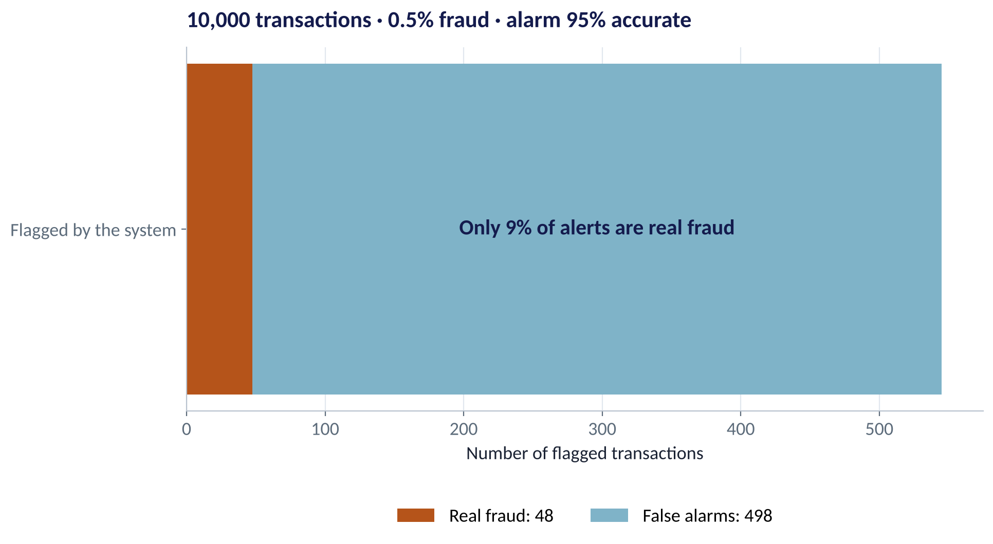
BAYES' THEOREM, MADE INTUITIVE
A Fraud Alert Is Not a Verdict
WHAT TO SEE
0.5% of 10,000 transactions are fraud: 50.
The alarm catches 95% of them: 48 true alerts.
But it also wrongly flags 5% of 9,950 honest ones: 498 false alarms.
So only 48 ÷ 546 ≈ 9% of alerts are real fraud.
Rare events + imperfect test = mostly false alarms. This is the base-rate trap.
Fig S2.2-F10 · replicate: tdbg_2_2_figures.R / .py
SESSION 2.2 · THE STATISTICS A MANAGER ACTUALLY NEEDS
14

Slide 15

CONCEPT CHECK
Quick Check: What Would You Say?
A CV-screening tool is '90% accurate'. Only 2% of applicants are truly strong hires. The tool flags an applicant as strong. What is the best reading?
A
There is a 90% chance this applicant is a strong hire
B
There is a 2% chance — the flag adds nothing
C
The chance is well below 90%, because strong hires are rare; we need the false-positive rate to say how far below
D
We cannot use probability for hiring decisions
Discuss with your neighbour for 60 seconds — answer and reasoning in the speaker notes.
SESSION 2.2 · THE STATISTICS A MANAGER ACTUALLY NEEDS
15

Slide 16

FROM EVENTS TO NUMBERS
Random Variables and Expected Value
IN PLAIN ENGLISH
THE FORMULA
E(X) = Σ x · P(x)
A random variable turns an uncertain outcome into a number — machines rented today, defaults this month, naira spent. Its expected value is the long-run average: each possible value weighted by its probability.
WHY A MANAGER CARES
Expected value is how lenders price risk, insurers set premiums and investors compare projects. It is an average over many repetitions — a single loan never earns ₦46,000 — so pair it with a measure of risk (spread).
EXAMPLE
A ₦500,000 microloan earns ₦90,000 interest if repaid (prob 0.9) and loses ₦350,000 net if it defaults (prob 0.1). E = 0.9×90,000 + 0.1×(−350,000) = +₦46,000 per loan.
SESSION 2.2 · THE STATISTICS A MANAGER ACTUALLY NEEDS
16

Slide 17
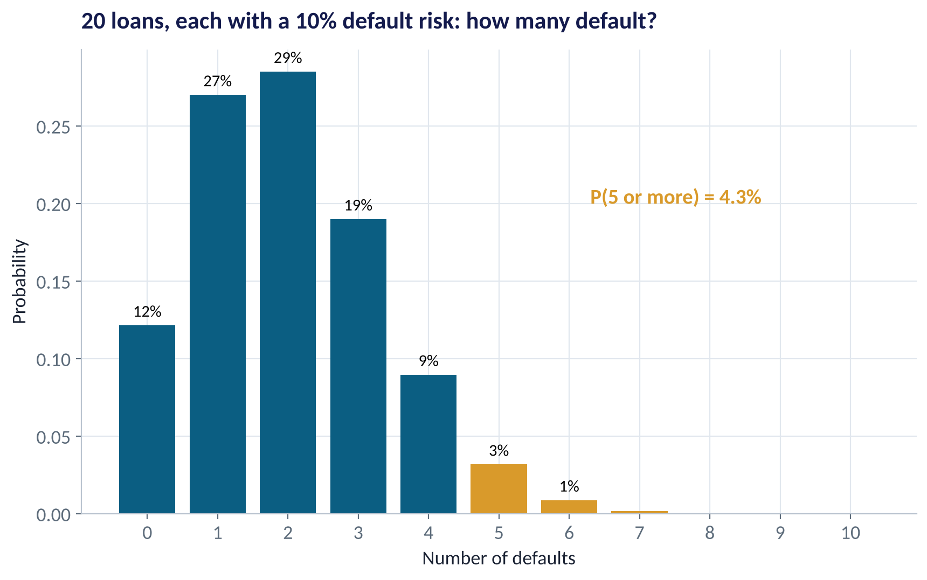
A DISTRIBUTION YOU WILL MEET OFTEN
The Binomial: Counting Yes/No Outcomes
WHAT TO SEE
Use it when there are n independent trials, each a yes/no with the same probability p.
20 new loans, 10% default risk each → expect 2 defaults.
But 5 or more defaults still happens 4.3% of the time — about one month in 23.
Provision for the range, not just the average.
Fig S2.2-F09 · replicate: tdbg_2_2_figures.R / .py
SESSION 2.2 · THE STATISTICS A MANAGER ACTUALLY NEEDS
17

Slide 18
PART
02
Describing Data: Shape, Centre, Spread
Three questions to ask of any column of numbers.

Slide 19
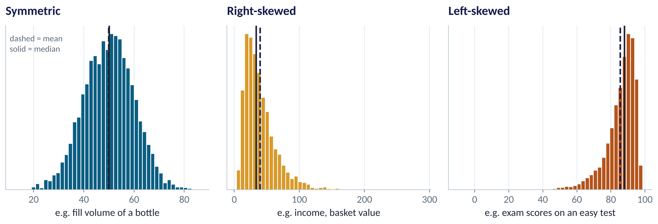
WHAT IS A DISTRIBUTION?
Three Shapes You Will See Every Week
WHAT TO SEE
A distribution shows how often each value occurs.
Symmetric: mean ≈ median.
Right-skewed (long tail to the right): mean > median. Income, sales, basket value.
Left-skewed: mean < median. Scores on an easy test, product lifetimes.
Shape decides which average to trust.
Fig S2.2-F01 · replicate: tdbg_2_2_figures.R / .py
SESSION 2.2 · THE STATISTICS A MANAGER ACTUALLY NEEDS
19

Slide 20

CENTRE
Mean, Median and Mode in Plain English
IN PLAIN ENGLISH
THE FORMULA
x̄ = (x₁ + x₂ + … + xₙ) ÷ n
Mean: add everything up and divide by how many — the 'fair share'. Median: line values up and take the middle one — half are below, half above. Mode: the most common value — useful for categories.
WHY A MANAGER CARES
The mean is sensitive to extremes; the median is robust. For skewed money data (income, house prices, claim sizes) the median describes the typical customer better. Use the mean when you need totals — revenue = mean × number of customers.
EXAMPLE
Five baskets: ₦4k, ₦5k, ₦6k, ₦7k, ₦48k. Mean = ₦70k ÷ 5 = ₦14k. Median = ₦6k. One stock-up shopper doubles the mean; the median does not move.
SESSION 2.2 · THE STATISTICS A MANAGER ACTUALLY NEEDS
20

Slide 21
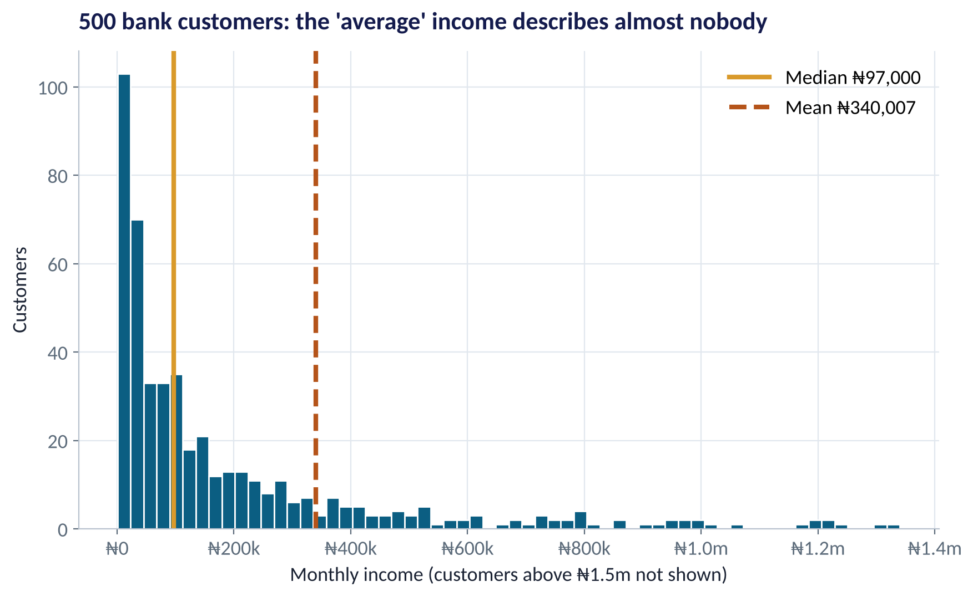
WHEN THE MEAN MISLEADS
A Nigerian Example: The 'Average' Bank Customer
WHAT TO SEE
Median monthly income: ₦97,000.
Mean: ₦340,007 — 3.5× higher.
A handful of very high earners drag the mean up.
A product priced for the 'average' customer would be unaffordable for most.
Skewness here = 7.4 (0 would be symmetric).
Fig S2.2-F02 · replicate: tdbg_2_2_figures.R / .py
SESSION 2.2 · THE STATISTICS A MANAGER ACTUALLY NEEDS
21

Slide 22
BY HAND, ONCE
Worked Example: Mean, Median and Spread of Six Deliveries
Delivery times (hours) for six Ikeja orders.
Order | Hours x | x − x̄ | (x − x̄)²
1 | 2 | −2 | 4
2 | 3 | −1 | 1
3 | 3 | −1 | 1
4 | 4 | 0 | 0
5 | 5 | 1 | 1
6 | 7 | 3 | 9
Sum | 24 | 0 | 16
STEP BY STEP
1
Mean x̄ = 24 ÷ 6 = 4 hours.
2
Median: sort (2, 3, 3, 4, 5, 7); middle two are 3 and 4 → 3.5 hours.
3
Deviations from the mean always sum to zero — so we square them.
4
Variance s² = 16 ÷ (6 − 1) = 3.2. We divide by n − 1 for a sample.
5
Standard deviation s = √3.2 ≈ 1.79 hours — the typical distance from the mean, back in hours.
Typical delivery ≈ 4 hours, give or take about 1.8 hours.
SESSION 2.2 · THE STATISTICS A MANAGER ACTUALLY NEEDS
22

Slide 23
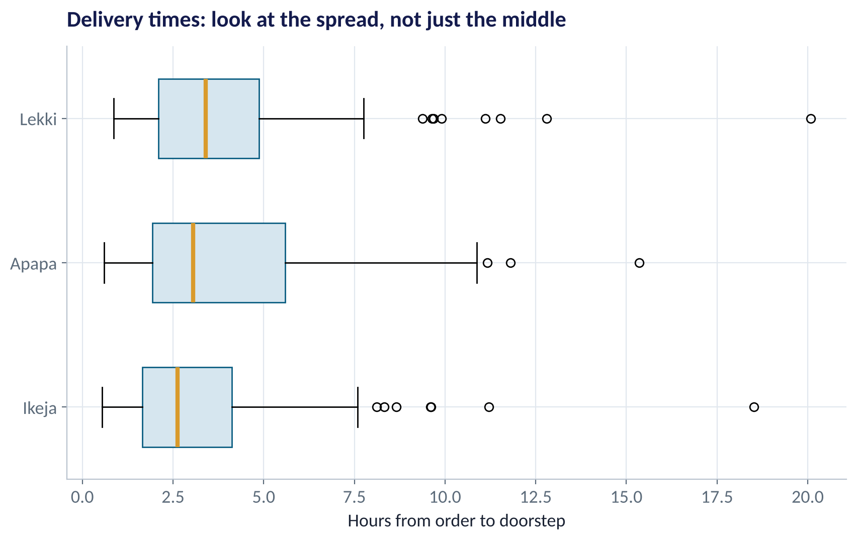
SPREAD
Same Average, Different Experience
WHAT TO SEE
Ikeja's median delivery is fastest — and its box is tightest.
Apapa's box is widest: customers can't predict when orders arrive.
Dots beyond the whiskers are unusual deliveries worth investigating.
Customers feel the spread, not the average.
Fig S2.2-F03 · replicate: tdbg_2_2_figures.R / .py
SESSION 2.2 · THE STATISTICS A MANAGER ACTUALLY NEEDS
23

Slide 24
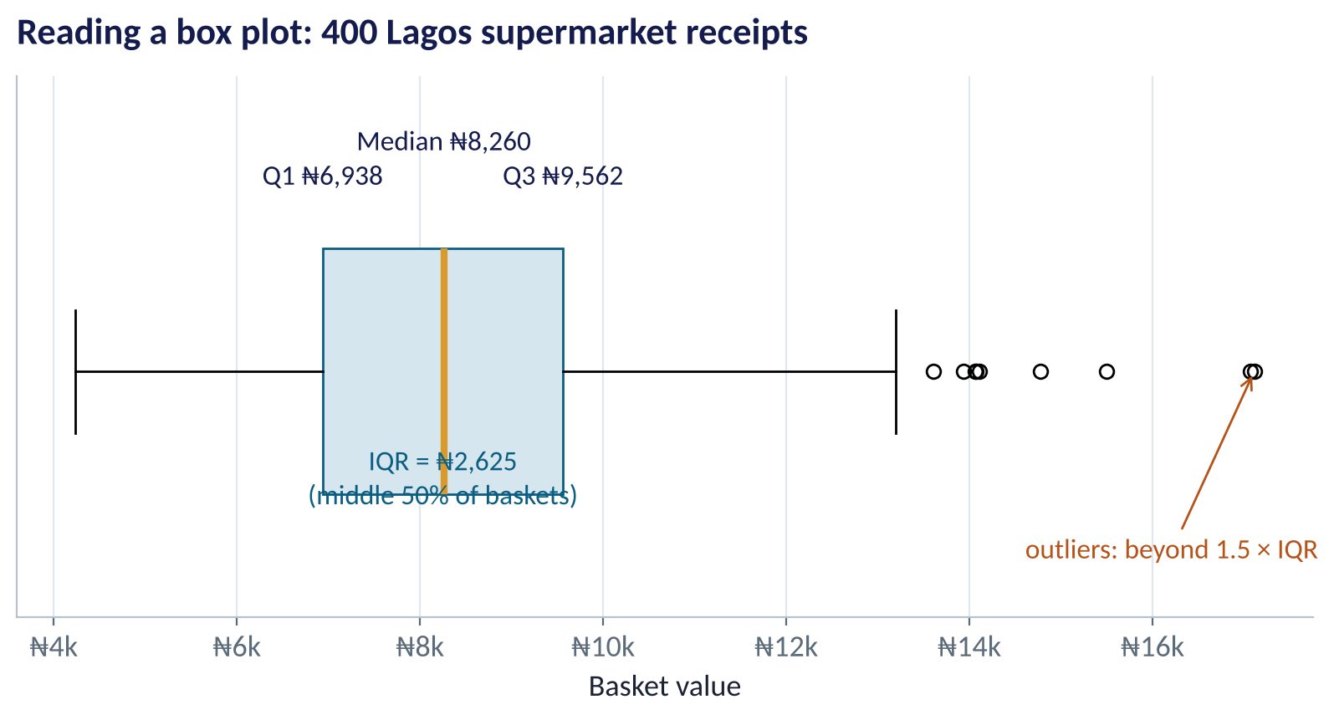
THE MOST USEFUL CHART YOU'LL LEARN
How to Read a Box Plot
WHAT TO SEE
The box holds the middle 50% (Q1 to Q3).
The line inside is the median.
IQR = Q3 − Q1 = ₦2,625: a robust measure of spread.
Whiskers reach the furthest points within 1.5 × IQR.
Dots beyond are flagged as outliers.
Fig S2.2-F04 · replicate: tdbg_2_2_figures.R / .py
SESSION 2.2 · THE STATISTICS A MANAGER ACTUALLY NEEDS
24

Slide 25
CHOOSING YOUR SUMMARY
Which Numbers Should You Report?
If the data is… | Report the centre as | Report the spread as | Example
Roughly symmetric | Mean | Standard deviation | Bottle fill volume; exam scores
Skewed or has outliers | Median | IQR (Q1–Q3) | Income; basket value; claim size
Categories (nominal) | Mode / % in each | Number of categories used | Payment method; region
Comparing very different scales | Mean | Coefficient of variation = SD ÷ mean | Volatility of ₦ sales vs unit sales
Always show the distribution (histogram or box plot) alongside the numbers — a picture reveals what summaries hide.
SESSION 2.2 · THE STATISTICS A MANAGER ACTUALLY NEEDS
25

Slide 26
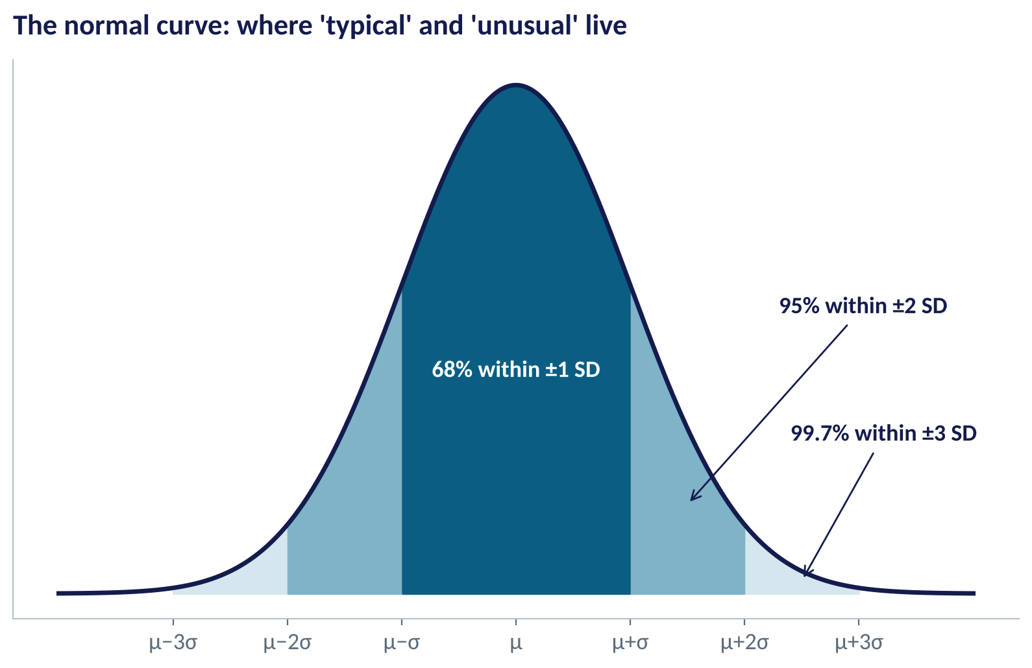
THE NORMAL DISTRIBUTION
The Bell Curve and the 68–95–99.7 Rule
WHAT TO SEE
Many averages and measurement errors follow a normal (bell) shape.
About 68% of values lie within 1 SD of the mean, 95% within 2 SD, 99.7% within 3 SD.
A z-score = (value − mean) ÷ SD: how many SDs from typical.
|z| > 2 is unusual; |z| > 3 is rare — worth a second look.
Fig S2.2-F05 · replicate: tdbg_2_2_figures.R / .py
SESSION 2.2 · THE STATISTICS A MANAGER ACTUALLY NEEDS
26

Slide 27
CONCEPT CHECK
Quick Check: What Would You Say?
Monthly sales across 40 branches have mean ₦52m and median ₦31m. Which statement is most defensible?
A
Most branches sell about ₦52m a month
B
Sales are right-skewed: a few large branches pull the mean up; the typical branch sells about ₦31m
C
The data must contain errors because mean and median differ
D
The distribution is symmetric
Discuss with your neighbour for 60 seconds — answer and reasoning in the speaker notes.
SESSION 2.2 · THE STATISTICS A MANAGER ACTUALLY NEEDS
27

Slide 28
PART
03
From Sample to Population
How 400 receipts can tell us about millions — and how sure to be.

Slide 29


THE CORE IDEA
Population vs. Sample
Population
Sample
Everyone or everything you care about
The part you actually measure
All receipts ever rung up across the chain
Usually too big, costly or slow to measure
Its true average is called a parameter (μ)
Fixed — but unknown
400 receipts drawn from 12 stores
Fast and affordable
Its average is a statistic (x̄)
Varies from sample to sample — that variation is what we must measure
Statistics is the art of using a sample statistic to say something honest about a population parameter.
SESSION 2.2 · THE STATISTICS A MANAGER ACTUALLY NEEDS
29

Slide 30



SAMPLING BIAS
Three Traps That No Formula Can Fix
A big sample does not save you from a biased one.
Selection bias
Non-response bias
Survivorship bias
Surveying only app users about 'customer satisfaction' misses everyone who left or never went digital.
Only angry or delighted customers answer surveys — the quiet middle is missing.
Studying only SMEs still trading hides the habits that killed the ones that closed.
SESSION 2.2 · THE STATISTICS A MANAGER ACTUALLY NEEDS
30

Slide 31
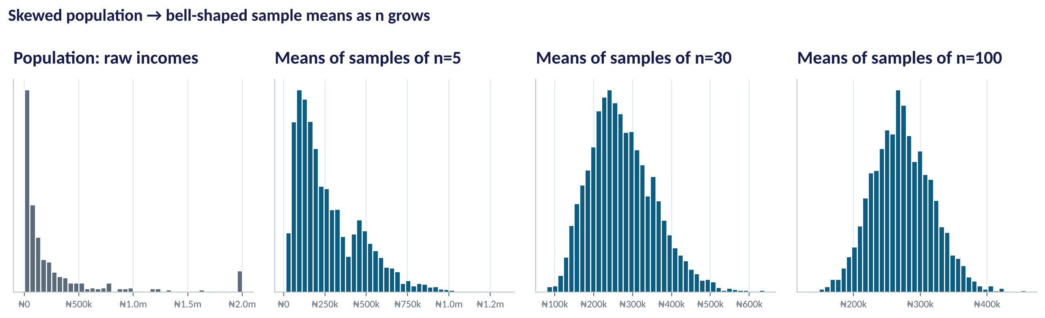
THE MOST IMPORTANT IDEA TODAY
The Central Limit Theorem in Action
WHAT TO SEE
Incomes are wildly skewed (left panel).
Take many samples and plot each sample's mean.
With n = 30 or more, the means form a bell curve — whatever the original shape.
That is why we can attach a normal-based margin of error to almost any average.
Fig S2.2-F06 · replicate: tdbg_2_2_figures.R / .py
SESSION 2.2 · THE STATISTICS A MANAGER ACTUALLY NEEDS
31

Slide 32
PRECISION
Standard Error: How Much Would the Average Wobble?
IN PLAIN ENGLISH
THE FORMULA
SE = s ÷ √n
If you repeated your sample many times, the average would change a little each time. The standard error (SE) measures that wobble. Bigger samples wobble less — but only with the square root of n.
WHY A MANAGER CARES
SE tells you if a change is real. If next month's average is ₦8,520, that is less than one SE away — probably noise. To halve the SE you need four times the sample: precision gets expensive fast.
EXAMPLE
Baskets: s = ₦2,100 and n = 400. SE = 2,100 ÷ √400 = 2,100 ÷ 20 = ₦105. Our average of ₦8,450 is precise to roughly ± ₦105.
SESSION 2.2 · THE STATISTICS A MANAGER ACTUALLY NEEDS
32

Slide 33
THE MANAGER'S TOOL
Confidence Intervals: An Honest Range
IN PLAIN ENGLISH
THE FORMULA
x̄ ± 1.96 × SE
A 95% confidence interval is a range built so that, if we repeated the sampling many times, 95% of the ranges would contain the true average. It is the estimate plus or minus a margin of error.
1.96 comes from the normal curve (95% within ±1.96 SD); software uses the t value, almost identical for large n
WHY A MANAGER CARES
Replace 'the average basket is ₦8,450' with 'between ₦8,244 and ₦8,656'. It stops over-reaction to small changes, and tells you when you need more data before deciding.
EXAMPLE
₦8,450 ± 1.96 × ₦105 = ₦8,450 ± ₦206 → ₦8,244 to ₦8,656.
SESSION 2.2 · THE STATISTICS A MANAGER ACTUALLY NEEDS
33

Slide 34
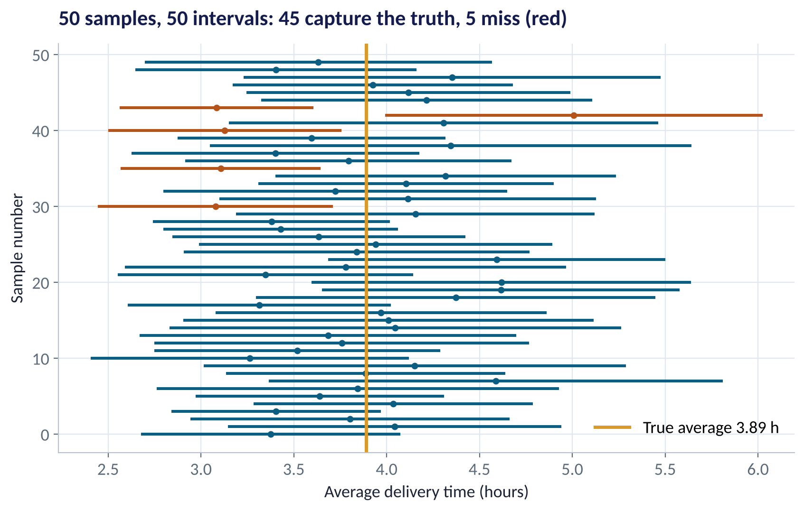
WHAT 95% REALLY MEANS
Fifty Samples, Fifty Intervals
WHAT TO SEE
Each line is one sample's 95% interval.
Most capture the true average (gold line).
About 1 in 20 miss — by design.
You never know whether your interval is one of the misses. That is the honest price of sampling.
Fig S2.2-F07 · replicate: tdbg_2_2_figures.R / .py
SESSION 2.2 · THE STATISTICS A MANAGER ACTUALLY NEEDS
34

Slide 35


WHAT CONTROLS THE WIDTH?
Three Levers on Your Margin of Error
Margin of error = critical value × s ÷ √n
Sample size (n) ↑
Variability (s) ↑
Confidence level ↑
Width shrinks with √n. Four times the data → half the margin of error.
More diverse customers → wider interval. Segmenting into similar groups can help.
99% instead of 95% → wider (2.58 vs 1.96). More certainty costs precision.
SESSION 2.2 · THE STATISTICS A MANAGER ACTUALLY NEEDS
35

Slide 36
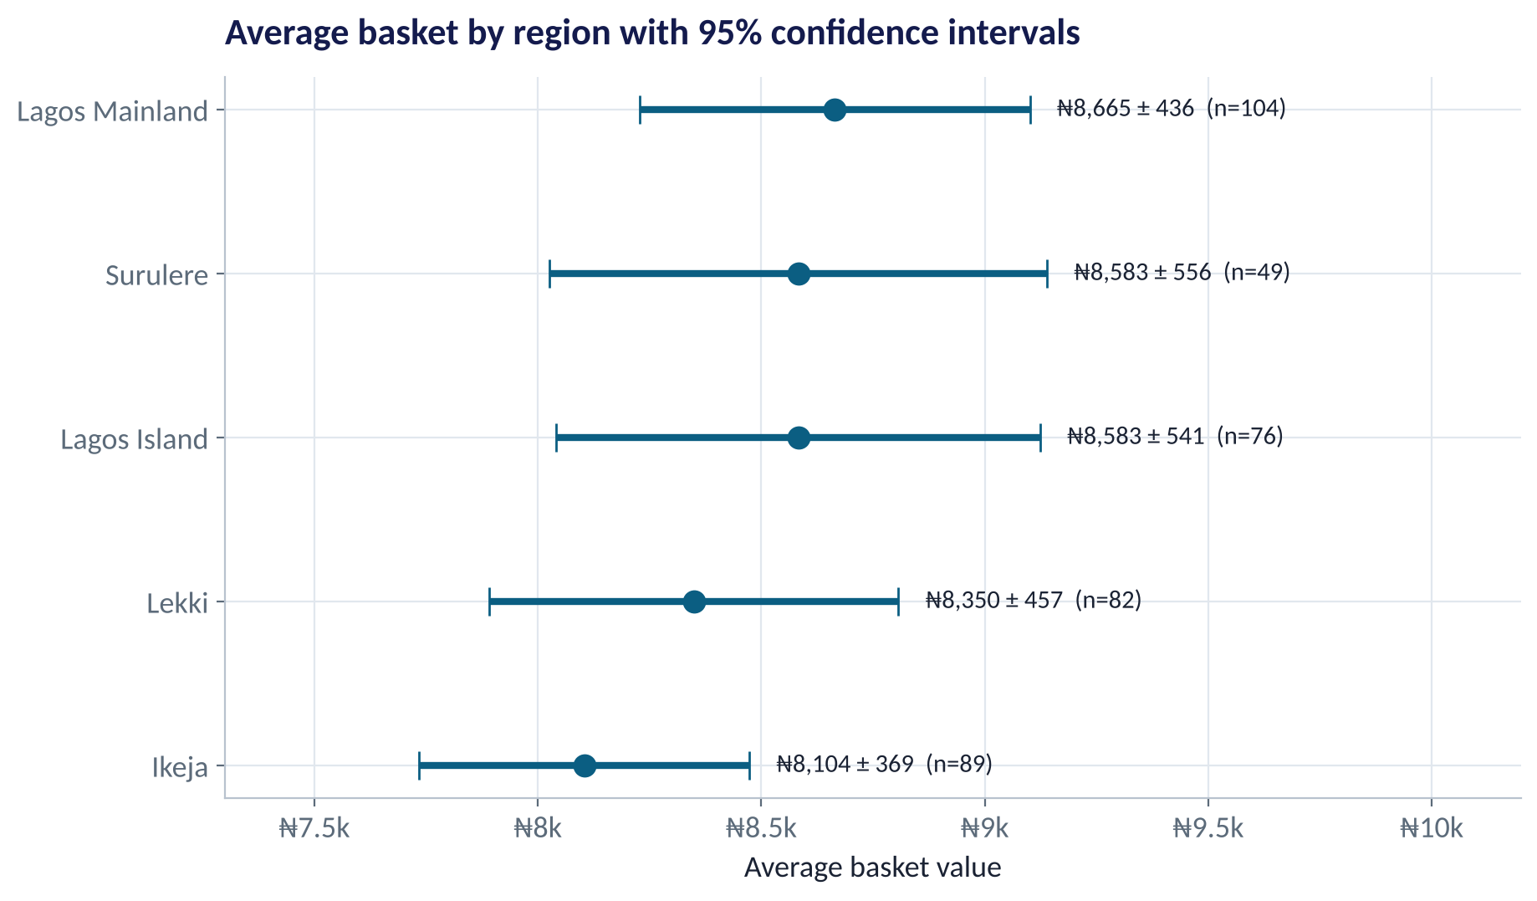
BACK TO THE CASE
Do Some Regions Really Spend More?
WHAT TO SEE
Ikeja looks lowest (₦8,104) and Lagos Mainland highest (₦8,665).
Their intervals barely overlap — a hint the gap may be real.
Surulere's interval is widest: only 49 receipts.
Session 2.5 gives a formal test. For now: don't redesign rewards by region on this evidence alone.
Fig S2.2-F08 · replicate: tdbg_2_2_figures.R / .py
SESSION 2.2 · THE STATISTICS A MANAGER ACTUALLY NEEDS
36

Slide 37
FROM RAW NUMBERS TO A CONFIDENCE INTERVAL
The Same Four Moves in R and Python
R
Python
basket <- read.csv("data/retail_basket_sizes.csv")
x <- basket$basket_size_naira
mean(x); median(x) # centre
sd(x); IQR(x) # spread
se <- sd(x) / sqrt(length(x))
mean(x) + c(-1.96, 1.96) * se # 95% CI
t.test(x)$conf.int # software version
import pandas as pd, numpy as np
from scipy import stats
x = pd.read_csv("data/retail_basket_sizes.csv")["basket_size_naira"]
x.mean(); x.median() # centre
x.std(); x.quantile(.75) - x.quantile(.25)
se = x.std() / np.sqrt(len(x))
x.mean() - 1.96*se, x.mean() + 1.96*se
stats.t.interval(.95, len(x)-1, x.mean(), se)
Full labs: tdbg_2_2_lab1_summarise, tdbg_2_2_lab2_clt and tdbg_2_2_lab3_confidence_interval — each in R/ and python/.
SESSION 2.2 · THE STATISTICS A MANAGER ACTUALLY NEEDS
37

Slide 38
HOW TO READ THIS OUTPUT
Reading R's t.test() Output
R OUTPUT
1
mean of x = 8449.775
> t.test(x)
One Sample t-test
data: x
t = 80.47, df = 399, p-value < 2.2e-16
alternative hypothesis: true mean is
not equal to 0
95 percent confidence interval:
8243.34 8656.21
sample estimates:
mean of x
8449.775
Our point estimate: the sample average basket.
2
95% CI: 8243 to 8656
The honest range for the true average — this is the number to report.
3
df = 399
Degrees of freedom = n − 1. Used to pick the t critical value (1.966).
4
t and p-value
Tests whether the mean is zero — meaningless here. We learn proper tests in Session 2.5.
SESSION 2.2 · THE STATISTICS A MANAGER ACTUALLY NEEDS
38

Slide 39



HANDS-ON LAB
Lab: Summarise, Simulate, Estimate
1
Lab 1 — summarise basket sizes: mean, median, mode, SD, IQR; draw the histogram and box plot.
YOU WILL NEED
Data
data/retail_basket_sizes.csv
data/bank_customer_income.csv
2
Lab 2 — simulate the CLT with bank incomes. Change the sample size to 5, 30 and 100 and watch the shape.
R script
3
Lab 3 — build the 95% CI for the average basket, by hand and with software; repeat by region.
sessions/2-2/R/tdbg_2_2_lab1…3_*.R
Python script
4
Write two sentences a CEO could act on, using an interval, not a single number.
sessions/2-2/python/tdbg_2_2_lab1…3_*.py
Deliverable: your two-sentence recommendation on rewards by region.
⏱ Labs 1–3 · 20 minutes in class
SESSION 2.2 · THE STATISTICS A MANAGER ACTUALLY NEEDS
39

Slide 40


WHERE MANAGERS GO WRONG
Five Statistical Habits That Mislead Boards
THE TRAP
THE BETTER HABIT
Reporting only the mean for skewed money data.
Report the median too, and explain the gap.
Treating a 2% month-on-month change as a trend.
Compare the change to the standard error first.
Single-number forecasts and estimates.
Always give a range (confidence interval).
Trusting a huge but self-selected sample.
Ask how the sample was drawn before how big it is.
Believing a '95% accurate' alert means 95% of alerts are real.
Check the base rate — use natural frequencies.
SESSION 2.2 · THE STATISTICS A MANAGER ACTUALLY NEEDS
40

Slide 41
WORDS TO OWN
Today's Vocabulary in Plain English
Probability
A number from 0 to 1 measuring how likely an event is.
Standard deviation
Typical distance of values from the mean.
Conditional prob.
P(A | B): chance of A once we know B happened.
IQR
Q3 − Q1: spread of the middle 50%.
Expected value
Long-run average outcome, weighting values by probability.
z-score
How many SDs a value is from the mean.
Distribution
How often each value occurs; its shape matters.
Standard error
How much a sample average would vary between samples.
Median
Middle value; robust to extremes.
Confidence interval
Estimate ± margin of error; an honest range.
SESSION 2.2 · THE STATISTICS A MANAGER ACTUALLY NEEDS
41

Slide 42
KEY TAKEAWAYS
Session 2.2 in 5 Ideas
01
Probabilities are conditional, and rare events breed false alarms — always check the base rate.
02
Shape decides the summary: median + IQR for skewed data, mean + SD for symmetric.
03
Spread is a business fact: customers feel variability, not averages.
04
The CLT makes sample averages bell-shaped, so we can measure their precision.
05
Report ranges: estimate ± 1.96 × SE.
NEXT › Session 2.3: What Is Odd Here?
Before next session: Read Chapter 9 (Exploratory Data Analysis). Rerun Lab 3 and post your regional CI chart. Optional: play with the CLT using different sample sizes in Lab 2.

