Slide 1


LAGOS BUSINESS SCHOOL · TURNING DATA INTO BUSINESS GROWTH · DAY 2
SESSION 2.3
What Is Odd Here?
Exploratory Data Analysis
Source: Chapter 9 — Exploratory Data Analysis
AI-Powered Business Analytics: A Practical Textbook for Data-Driven Decision Making · Prof. Bongo Adi

Slide 2




RECAP
Session 2.2 in Three Ideas
Shape first
Shape decides the summary: median + IQR for skewed data, mean + SD for symmetric.
Base rates
Rare events plus imperfect tests produce mostly false alarms — think in natural frequencies.
Report ranges
Estimate ± 1.96 × standard error: an honest confidence interval, not a single number.
SESSION 2.3 · WHAT IS ODD HERE?
2

Slide 3




TODAY'S PLAN
Session 2.3 at a Glance — 75 Minutes
The disciplined first look that comes before any model.
10'
25'
35'
5'
Recap & Hook
The EDA Workflow
Lab: Loan Book EDA
Wrap-Up
Why most model failures start with bad data
Profile, check quality, clean, explore
Find and fix the problems in a messy microfinance file
Hypotheses to carry into modelling
SESSION 2.3 · WHAT IS ODD HERE?
3

Slide 4



BY THE END OF TODAY
Session 2.3 Learning Objectives
You will be able to:
01
02
03
Profile a Dataset
Diagnose & Treat Problems
Form Hypotheses
Run a systematic first look: size, types, missing values, duplicates and ranges.
Tell outliers from errors, and decide — and document — how to treat each issue.
Use distributions and relationships to generate testable business hypotheses.
SESSION 2.3 · WHAT IS ODD HERE?
4

Slide 5


THE HOOK
Garbage In, Confident Garbage Out
“The model said our riskiest borrowers were 140 years old.” — every analytics team, at some point.
Models do not question their inputs. EDA is where a human does:
Find the errors
Judge the gaps
Spot the story
Duplicates, impossible values, typos and inconsistent labels — before they become 'insights'.
Missing data is rarely random. Who is missing changes what the data can say.
Distributions and relationships suggest the hypotheses worth testing.

Slide 6




NIGERIAN BUSINESS CASE
A Microfinance Loan Book Before Modelling
The situation
The decision question
A Nigerian microfinance bank with six branches (Ikeja, Oshodi, Ajah, Ibadan, Abeokuta, Onitsha) wants a default-risk model for small business loans.
Is the loan file fit to model? What problems does it have — and what early patterns hint at who defaults?
The data we have
What a good answer looks like
microfinance_loans_raw.csv — 1,515 rows, 13 columns: branch, sector, age, gender, income, loan amount, term, rate, prior loans, lending model, date, defaulted.
A cleaning log (every fix and why), a cleaned file, and three hypotheses for the modelling sessions (10–11).
SESSION 2.3 · WHAT IS ODD HERE?
6

Slide 7
PART
01
The EDA Workflow
Four stages, always in this order.

Slide 8




THE ROADMAP
A Repeatable EDA Workflow
Do not skip ahead to charts: profile and quality-check first.
›
›
›
›
1. Profile
2. Quality
3. Clean
4. Univariate
5. Relationships
Rows, columns, types, a first look at values
Missing, duplicate, inconsistent and impossible values
Fix, flag or drop — and log every decision
Shape, centre and spread of each variable
How variables move together and with the outcome
EDA ends with hypotheses, not conclusions: “younger borrowers default more” is a lead to test, not a finding to act on.
SESSION 2.3 · WHAT IS ODD HERE?
8

Slide 9
STEP 1 · PROFILE
Your First Five Minutes With Any File
R
Python
raw <- readr::read_csv("data/microfinance_loans_raw.csv")
dim(raw) # 1515 rows, 13 columns
dplyr::glimpse(raw) # types: <chr>, <dbl>
summary(raw) # min / quartiles / max / NAs
colSums(is.na(raw)) # missing per column
sum(duplicated(raw)) # exact duplicate rows
dplyr::count(raw, branch) # category labels
import pandas as pd
raw = pd.read_csv("data/microfinance_loans_raw.csv")
raw.shape # (1515, 13)
raw.info() # types: object, float64
raw.describe(include="all")
raw.isna().sum() # missing per column
raw.duplicated().sum() # exact duplicate rows
raw["branch"].value_counts() # category labels
Six commands answer: how big, what types, what is missing, what repeats, what labels exist.
SESSION 2.3 · WHAT IS ODD HERE?
9

Slide 10
WHAT THE PROFILE FOUND
Five Problems in 1,515 Rows
Each would quietly distort a model if left alone.
96
15
60
3
6
Missing incomes
Duplicate rows
Messy labels
Impossible ages
Extra-zero loans
6.3% of rows have no income — a key risk driver.
The same loan entered twice inflates counts.
'ikeja ' vs 'Ikeja' splits branches in two.
Borrowers aged 140.
Loans worth 12–30× monthly income.
SESSION 2.3 · WHAT IS ODD HERE?
10

Slide 11
PART
02
Data Quality: Find, Judge, Fix
Completeness, uniqueness, consistency and validity.

Slide 12
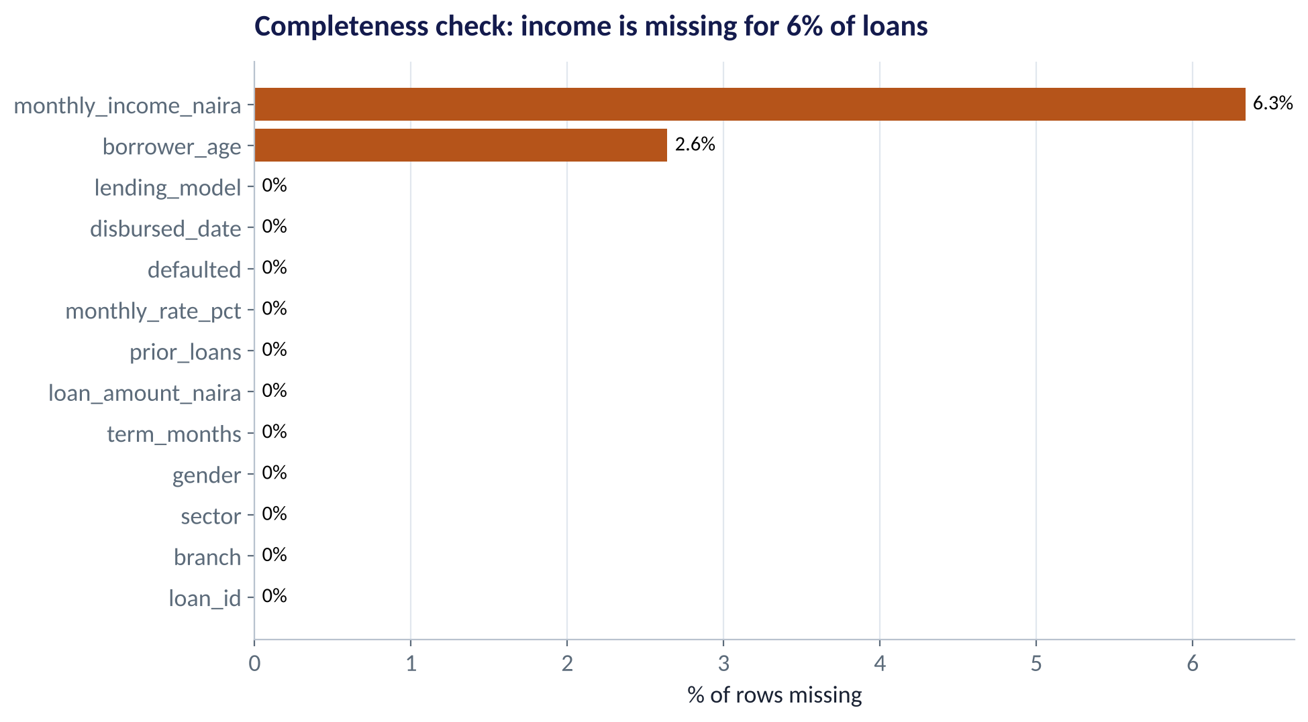
COMPLETENESS
What Is Missing — and Why?
WHAT TO SEE
Income is missing for 6.3% of loans; age for 2.6%.
Ask why: a branch that skipped the field? Applicants who refused?
If missingness is linked to risk, dropping rows biases the model.
Options: drop, fill (median), or flag as 'unknown' and keep.
Fig S2.3-F01 · replicate: tdbg_2_3_figures.R / .py
SESSION 2.3 · WHAT IS ODD HERE?
12

Slide 13
TREATING MISSING VALUES
Drop, Fill or Flag? A Decision Guide
Option | When it is reasonable | Risk | Loan-book example
Drop the rows | Very few missing and no pattern | Lose data; bias if missingness is linked to the outcome | 40 missing ages (2.6%) — probably fine
Fill (impute) | Value can be estimated from similar rows | Understates uncertainty; hides the gap | Fill income with the median for the same sector and branch
Flag & keep | The fact it is missing may itself be informative | Slightly more complex model | Add income_missing = 1 and let the model learn from it
Whatever you choose, write it in the cleaning log — and test whether results change if you choose differently.
SESSION 2.3 · WHAT IS ODD HERE?
13

Slide 14
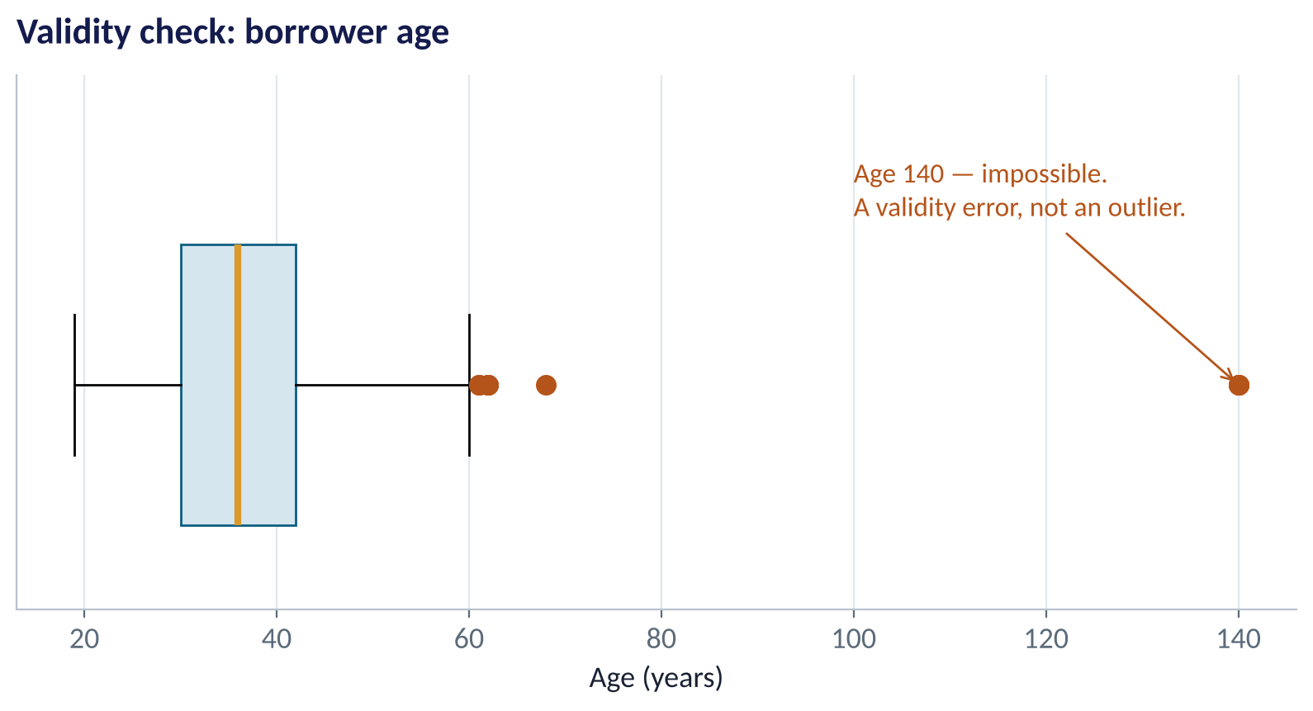
VALIDITY
Outlier or Error? Not the Same Thing
WHAT TO SEE
A 68-year-old borrower is an outlier: unusual but possible. Keep.
A 140-year-old borrower is an error: impossible. Set to missing.
Test: could this value exist in the real world?
If yes, investigate — don't delete because it is inconvenient.
Fig S2.3-F03 · replicate: tdbg_2_3_figures.R / .py
SESSION 2.3 · WHAT IS ODD HERE?
14

Slide 15
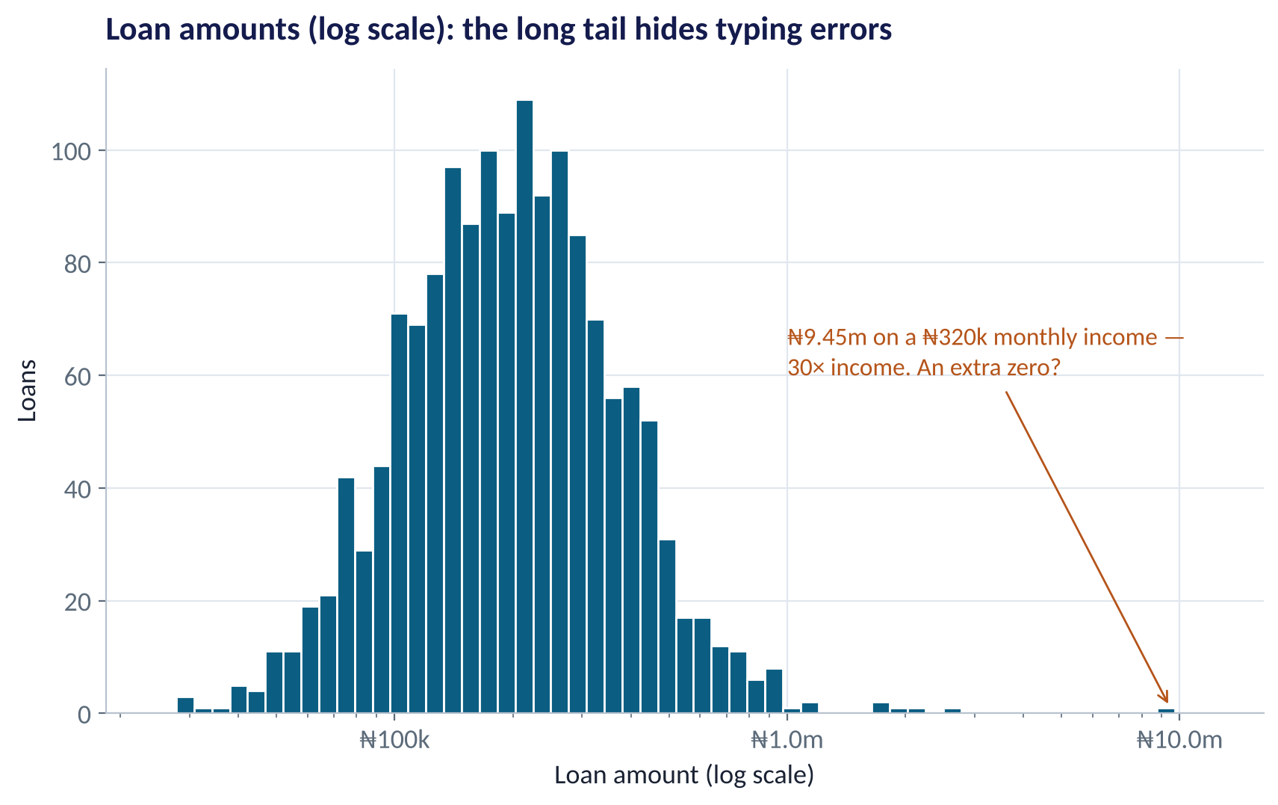
VALIDITY IN CONTEXT
Catching the Extra Zero
WHAT TO SEE
On a log scale the bulk of loans sits between ₦100k and ₦500k.
One loan of ₦9.45m to someone earning ₦320k a month: 30× income.
Typical loans are about 2× monthly income.
Rule used: loan > 10× income → likely entry error. Six loans flagged.
Fig S2.3-F02 · replicate: tdbg_2_3_figures.R / .py
SESSION 2.3 · WHAT IS ODD HERE?
15

Slide 16
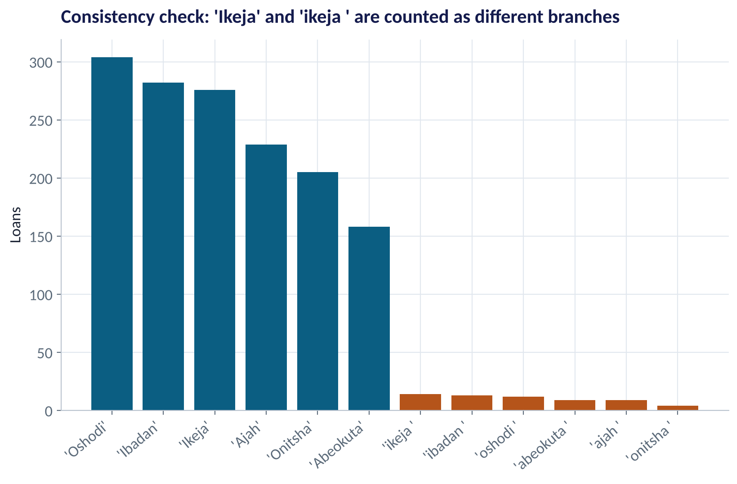
CONSISTENCY
One Branch, Two Spellings
WHAT TO SEE
'Ikeja' and 'ikeja ' (trailing space) are treated as different branches.
Every group-by, count and chart is quietly wrong.
Fix: trim spaces and standardise capitals.
Prevent: drop-down lists at data entry, not free text.
Fig S2.3-F04 · replicate: tdbg_2_3_figures.R / .py
SESSION 2.3 · WHAT IS ODD HERE?
16

Slide 17


WHERE MANAGERS GO WRONG
Cleaning Habits That Backfire
Each makes data look tidier — and less true.
THE TRAP
THE BETTER HABIT
Deleting every value beyond 1.5 × IQR because a textbook calls them outliers.
Delete only impossible values; investigate unusual ones.
Filling missing incomes with the overall mean and moving on.
Check who is missing; consider a flag; fill within similar groups.
Cleaning by hand in Excel, with no record of what changed.
Clean in a script: every step is visible, repeatable and reviewable.
Fixing the analysis file but not the source system.
Report root causes upstream so the error stops at data entry.
SESSION 2.3 · WHAT IS ODD HERE?
17

Slide 18
THE CLEANING LOG
Every Decision, Written Down
What the lab does to microfinance_loans_raw.csv.
Step | Issue | Action | Rows
1 | Exact duplicates | Remove | 1,515 → 1,500
2 | Branch labels | Trim + title case | 12 → 6 branches
3 | Ages over 100 | Set to missing | 3 values
4 | Loan > 10× income | Remove as entry error | 1,500 → 1,494
5 | Missing income | Keep; flag in Session 3.4 | 96 values
STEP BY STEP
1
Profile first: the problems above were all found with six commands.
2
Each fix is a line of code — rerunnable on next month's file.
3
Keep the raw file untouched; write a new cleaned file.
4
Share the log with the business owner of the data.
Result: 1,494 clean loans, 10.4% default rate — ready to explore.
SESSION 2.3 · WHAT IS ODD HERE?
18

Slide 19
PART
03
Exploring Patterns
From one variable at a time, to relationships with the outcome.

Slide 20
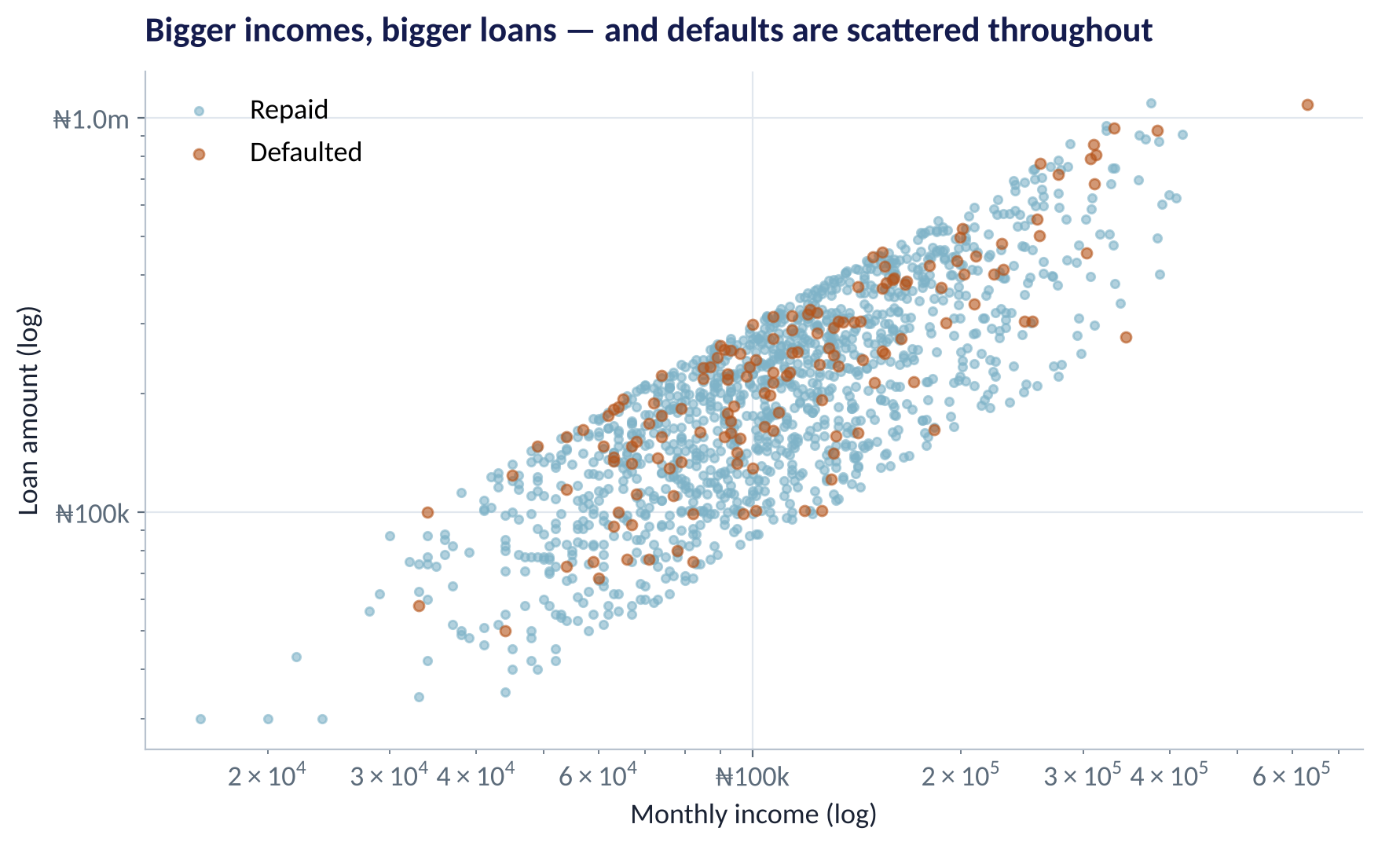
RELATIONSHIPS · TWO NUMBERS
Scatter Plots: How Two Variables Move Together
WHAT TO SEE
Each dot is one loan. Bigger incomes get bigger loans — a strong positive relationship.
Log scales spread out skewed money values so the pattern is visible.
Defaults (orange) appear across all incomes: income alone won't predict default.
Next question: what about loan size relative to income?
Fig S2.3-F05 · replicate: tdbg_2_3_figures.R / .py
SESSION 2.3 · WHAT IS ODD HERE?
20

Slide 21
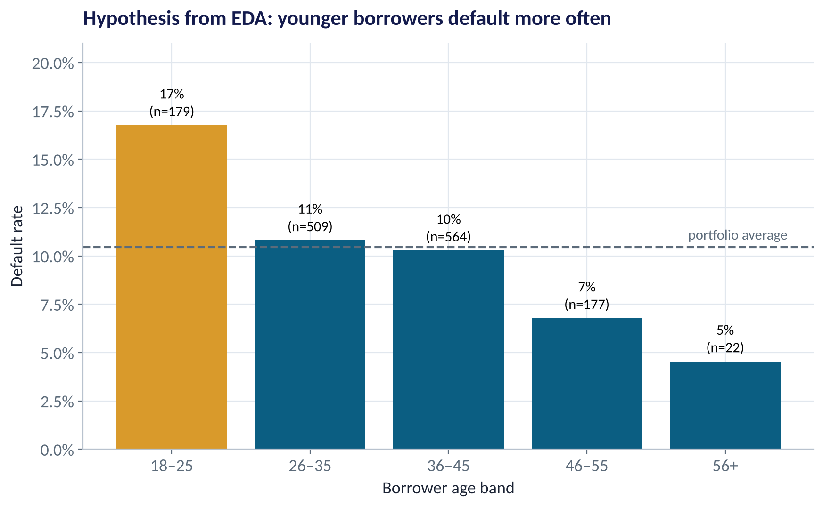
RELATIONSHIPS · GROUP COMPARISON
Default Rate by Age Band
WHAT TO SEE
18–25s default at 17% — about 1.6× the portfolio average.
The rate falls steadily with age to 5% for 56+.
But the 56+ group has only 22 loans — too few to trust.
Hypothesis: age (or what it stands for — experience, savings) predicts default.
Fig S2.3-F06 · replicate: tdbg_2_3_figures.R / .py
SESSION 2.3 · WHAT IS ODD HERE?
21

Slide 22
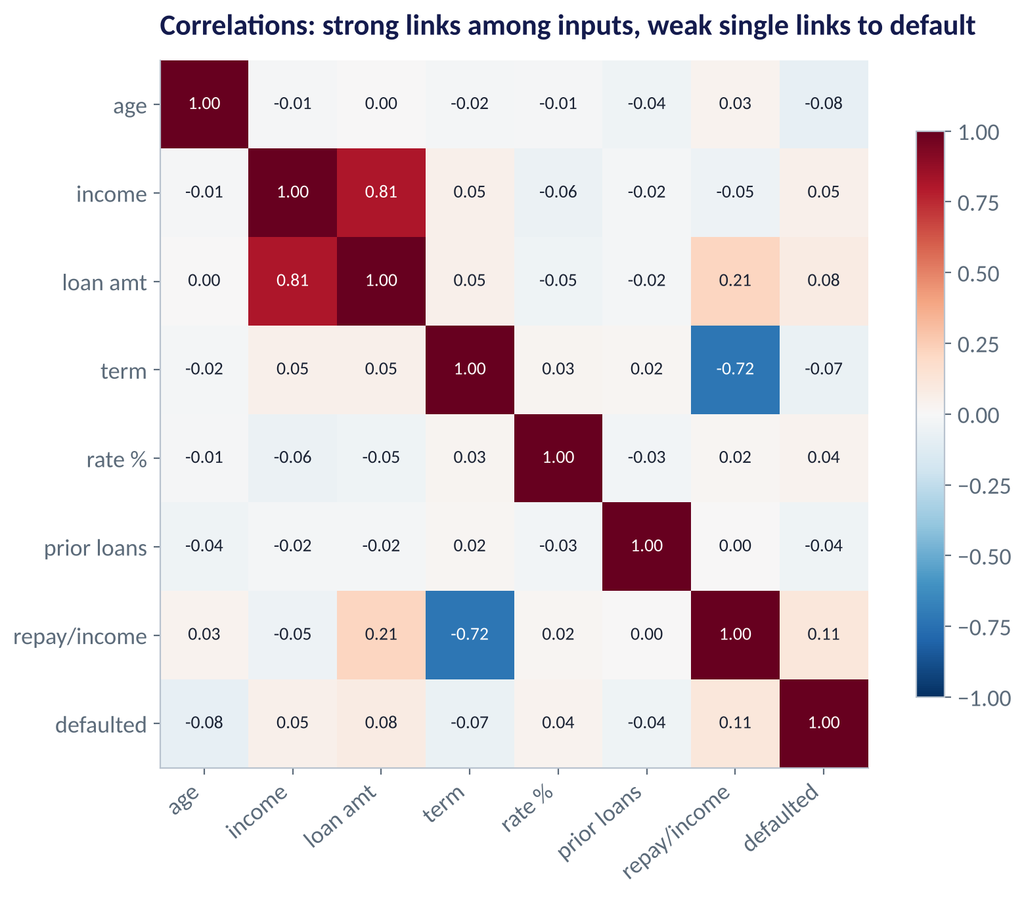
RELATIONSHIPS · MANY AT ONCE
The Correlation Heat Map
WHAT TO SEE
Correlation runs from −1 to +1 (Session 3.2 explains it fully).
Income and loan amount move together strongly (0.81).
Repayment-to-income links to default (0.11) more than income does.
No single column predicts default well — which is why we need models that combine them.
Fig S2.3-F07 · replicate: tdbg_2_3_figures.R / .py
SESSION 2.3 · WHAT IS ODD HERE?
22

Slide 23
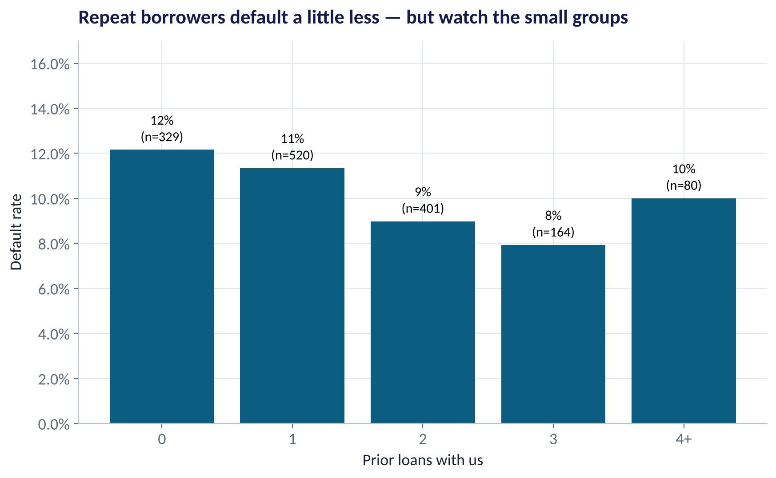
RELATIONSHIPS · SMALL GROUPS
Prior Loans and Default
WHAT TO SEE
First-time borrowers: 12% default. Third-time: 8%.
Plausible story: repeat borrowers have proven themselves.
The 4+ group bounces back up — but only 80 loans.
Lesson: small groups produce noisy rates. Don't chase every wiggle.
Fig S2.3-F08 · replicate: tdbg_2_3_figures.R / .py
SESSION 2.3 · WHAT IS ODD HERE?
23

Slide 24

CONCEPT CHECK
Quick Check: What Would You Say?
During EDA you find that 18–25-year-olds default at 17% versus 10% overall. What should you do next?
A
Stop lending to under-26s immediately
B
Record it as a hypothesis and test it in a model that controls for income, loan size and sector
C
Ignore it — age is not a business variable
D
Delete the young borrowers so the portfolio looks healthier
Discuss with your neighbour for 60 seconds — answer and reasoning in the speaker notes.
SESSION 2.3 · WHAT IS ODD HERE?
24

Slide 25



TOOLS THAT SPEED UP EDA
Automated Profiling — Useful, Not Sufficient
Let software do the counting; keep the judging for yourself.
R
Python
AI assistants
skimr::skim() for a one-page summary; DataExplorer::create_report() for a full HTML profile.
df.describe() and ydata-profiling for a full HTML report in one line.
Ask for an EDA plan or code — then read every number yourself. AI cannot know your business rules.
SESSION 2.3 · WHAT IS ODD HERE?
25

Slide 26



HANDS-ON LAB
Lab: Clean and Explore the Loan Book
1
Profile the file: dimensions, types, summary statistics.
YOU WILL NEED
Data
2
Quality checks: missing values (and where), duplicates, branch labels, ranges of age and loan size.
data/microfinance_loans_raw.csv
3
Clean with code, following the cleaning log — keep the raw file untouched.
R script
sessions/2-3/R/tdbg_2_3_lab.R
4
Explore: default rate by sector, age band and prior loans; correlations among numeric columns.
Python script
Your turn: worst branch after cleaning; your missing-income policy; three hypotheses for Session 3.4.
sessions/2-3/python/tdbg_2_3_lab.py
5
Deliverable: a one-slide cleaning log and three testable hypotheses.
⏱ 35 minutes
SESSION 2.3 · WHAT IS ODD HERE?
26

Slide 27
WORDS TO OWN
Today's Vocabulary in Plain English
EDA
Exploratory Data Analysis: the systematic first look before modelling.
Outlier
An unusual but possible value — investigate it.
Profiling
Summarising size, types, ranges and missingness of a file.
Error
An impossible value — correct it or set to missing.
Missing value
An empty cell (NA / NaN). Ask why it is missing.
Log scale
An axis where each step multiplies by 10; tames skew.
Imputation
Filling a missing value with an estimate.
Correlation
Strength of a straight-line relationship, −1 to +1.
Duplicate
The same record entered more than once.
Cleaning log
A written record of every change made to the data.
SESSION 2.3 · WHAT IS ODD HERE?
27

Slide 28
KEY TAKEAWAYS
Session 2.3 in 5 Ideas
01
EDA comes before every model: profile → quality → clean → explore.
02
Missing data is rarely random — ask who is missing before dropping or filling.
03
Outliers are unusual but real; errors are impossible. Treat them differently.
04
Clean in code and keep a log, so every decision is visible and repeatable.
05
EDA ends with hypotheses to test, not conclusions to act on.
NEXT › Session 2.4: Charts That Survive a Board Room
Before next session: Finish the lab and post your cleaning log. Read Chapter 10 (Data Visualisation for Business) and bring one chart from your own company's reports that you think could be better.

