Slide 1


LAGOS BUSINESS SCHOOL · TURNING DATA INTO BUSINESS GROWTH · DAY 2
SESSION 2.4
Charts That Survive
a Board Room
Data Visualisation & Storytelling for Business
Source: Chapter 10 — Data Visualisation for Business
AI-Powered Business Analytics: A Practical Textbook for Data-Driven Decision Making · Prof. Bongo Adi

Slide 2




RECAP
Session 2.3 in Three Ideas
Workflow
Profile → quality → clean → explore — always in that order.
Outlier ≠ error
Unusual but possible: investigate. Impossible: correct or set to missing.
Hypotheses
EDA ends with leads to test, not decisions to act on.
SESSION 2.4 · CHARTS THAT SURVIVE A BOARD ROOM
2

Slide 3




TODAY'S PLAN
Session 2.4 at a Glance — 75 Minutes
From choosing a chart, to designing it, to telling the story it supports.
10'
25'
30'
10'
Recap & Hook
Choose & Design
Lab: Telco Story
Peer Critique
Why most business charts fail
Chart choice, perception, declutter, honesty
Turn a KPI file into an executive story
One-slide data stories, reviewed in pairs
SESSION 2.4 · CHARTS THAT SURVIVE A BOARD ROOM
3

Slide 4


BY THE END OF TODAY
Session 2.4 Learning Objectives
You will be able to:
01
02
03
Choose the Right Chart
Design for the Eye
Tell a Data Story
Match the chart type to the question: compare, trend, relationship, distribution or composition.
Declutter, use colour and position deliberately, and keep axes honest and accessible.
Build a one-slide story with a message headline, one chart and a clear ask.
SESSION 2.4 · CHARTS THAT SURVIVE A BOARD ROOM
4

Slide 5


THE HOOK
A Chart Is an Argument, Not Decoration
“Above all else, show the data.” — Edward Tufte. And then: say what it means.
Executives give each chart a few seconds. In that time a good chart must:
Answer one question
Guide the eye
Lead to a decision
One chart, one message — stated in the title.
Colour and position point to what matters; everything else steps back.
The audience should know what you want them to do.

Slide 6



NIGERIAN BUSINESS CASE
A Telco's Monthly Performance Review
The situation
The decision question
A Nigerian mobile operator reviews five regions every month. The current pack is 40 slides of default charts; directors skim it and decide little.
Which region needs the executive committee's attention this month — and what should they do about it?
The data we have
What a good answer looks like
telecom_monthly_kpis.csv — 24 months × 5 regions: subscribers, ARPU, revenue, churn, data share, network uptime, NPS.
A one-page dashboard and a one-slide story: headline, one chart, three facts, one ask.
SESSION 2.4 · CHARTS THAT SURVIVE A BOARD ROOM
6

Slide 7
PART
01
Choosing the Right Chart
Start from the question, not from the chart menu.

Slide 8
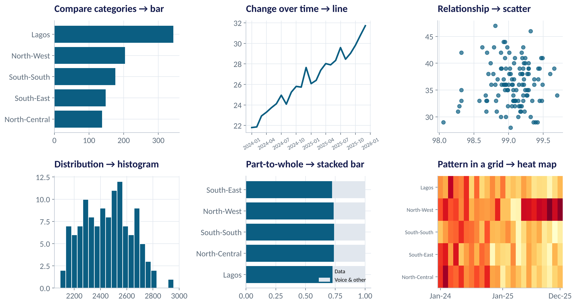
THE CHART CHOOSER
Six Questions, Six Charts
WHAT TO SEE
Compare categories → bar (sorted).
Change over time → line.
Relationship → scatter.
Distribution → histogram or box plot.
Part-to-whole → stacked bar (pies only for 2–3 parts).
Pattern across two dimensions → heat map.
Fig S2.4-F01 · replicate: tdbg_2_4_figures.R / .py
SESSION 2.4 · CHARTS THAT SURVIVE A BOARD ROOM
8

Slide 9
A QUICK REFERENCE
Match the Question to the Chart
Your question | Use | Avoid | Telco example
Which is biggest / smallest? | Sorted bar chart | Pie with many slices; 3-D bars | Revenue by region
How is it changing? | Line chart | Bars for long time series | Monthly churn rate
Do two things move together? | Scatter plot | Two lines on two axes | Uptime vs NPS
How is it spread out? | Histogram / box plot | Average alone | ARPU across months
What makes up the total? | Stacked bar / 100% bar | Pies with > 3 parts | Data vs voice revenue
SESSION 2.4 · CHARTS THAT SURVIVE A BOARD ROOM
9

Slide 10


HOW PEOPLE SEE
Why Some Charts Are Easier to Read
We judge some visual cues far more accurately than others.
Position on a common scale
Length and angle
Colour and area
Most accurate
Good / weaker
Least accurate
Bars and dots against the same axis. Use for the most important comparison.
Bar length is easy; pie angles are hard to compare precisely.
Use colour to highlight, not to encode exact amounts.
SESSION 2.4 · CHARTS THAT SURVIVE A BOARD ROOM
10

Slide 11
PART
02
Designing for the Eye
Declutter, focus, and stay honest.

Slide 12
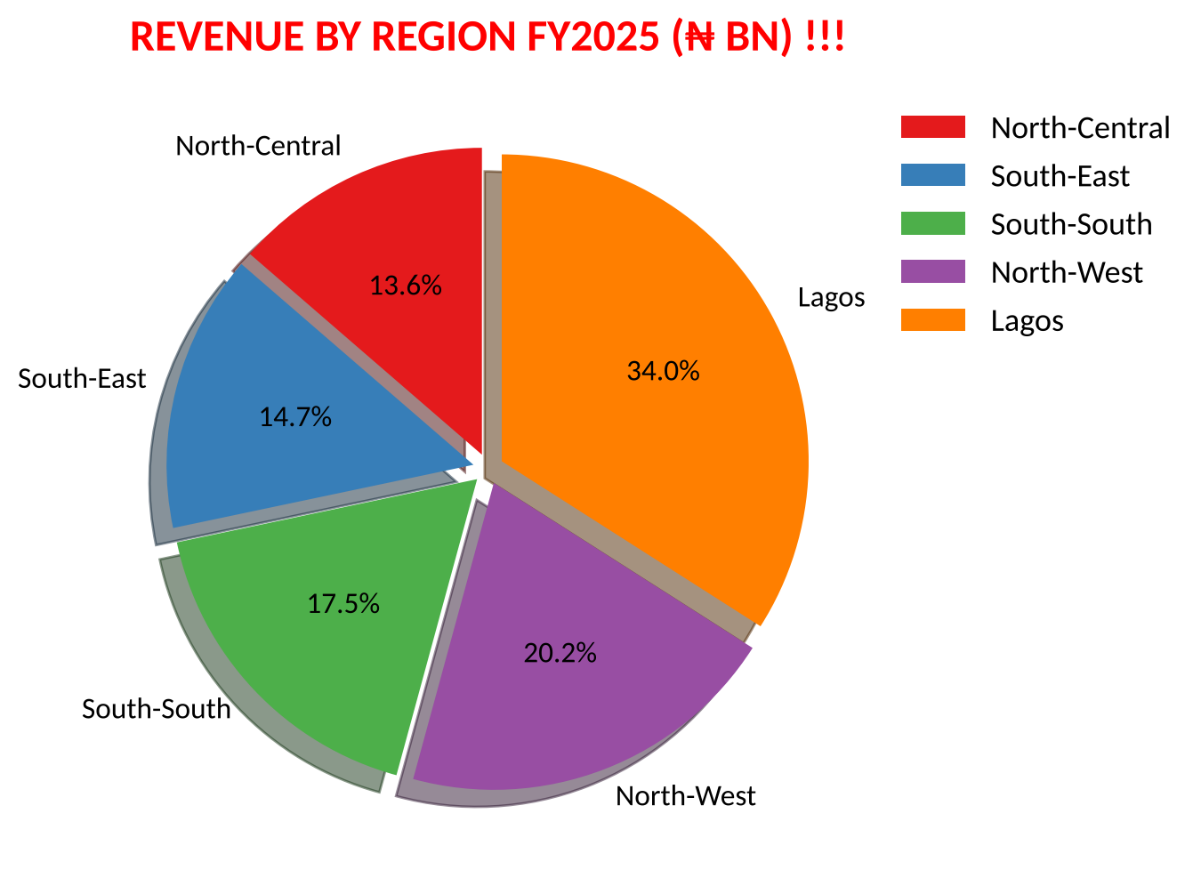
BEFORE
What's Wrong With This Chart?
SPOT THE PROBLEMS
Five colours that mean nothing.
Shadows and exploded slices add noise.
You must look back and forth to the legend.
Angles are hard to compare: is North-West bigger than South-South?
The title shouts but says nothing.
Fig S2.4-F02 · replicate: tdbg_2_4_figures.R / .py
SESSION 2.4 · CHARTS THAT SURVIVE A BOARD ROOM
12

Slide 13
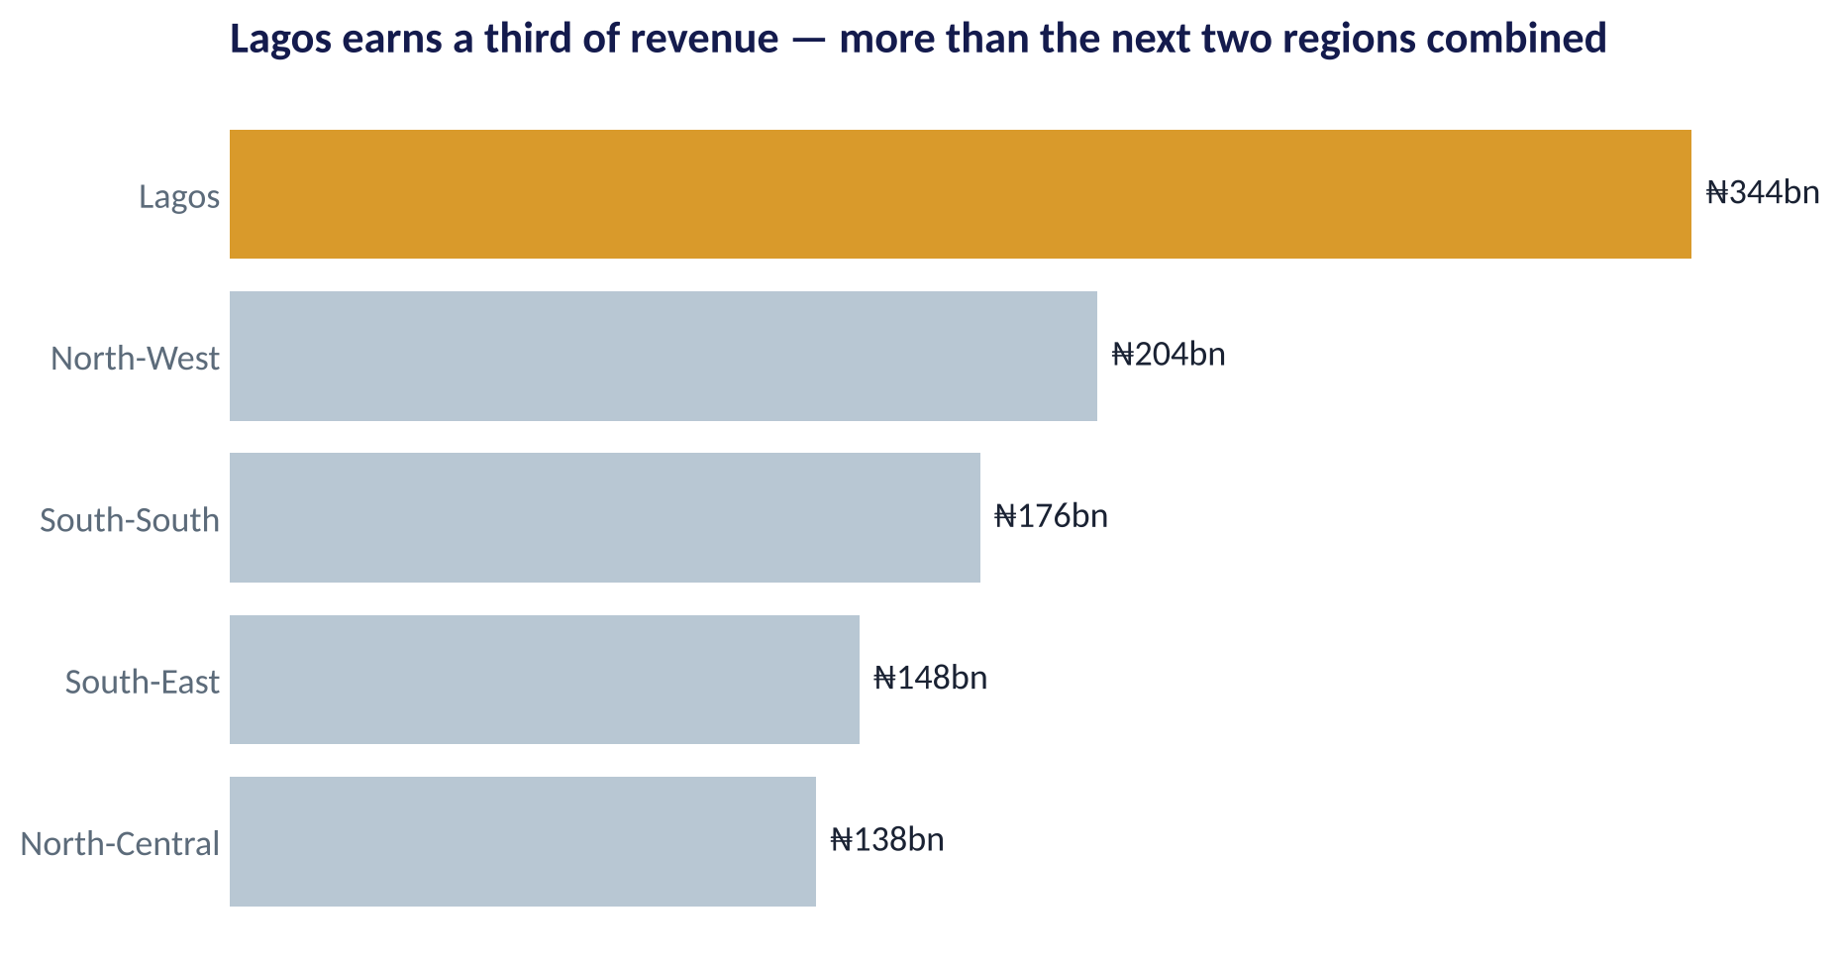
AFTER
The Same Data, Decluttered
WHAT TO SEE
Sorted bars: the ranking is instant.
Direct labels replace the axis and legend.
One highlight colour points to the message.
The title states the finding, not the topic.
Fig S2.4-F03 · replicate: tdbg_2_4_figures.R / .py
SESSION 2.4 · CHARTS THAT SURVIVE A BOARD ROOM
13

Slide 14





THE DECLUTTER CHECKLIST
Five Moves That Fix Most Business Charts
Message title
Replace 'Churn by region' with 'North-West churn broke away in May'.
Remove clutter
Delete borders, heavy gridlines, 3-D effects, shadows and redundant legends.
Label directly
Put labels on the bars or line ends instead of in a legend.
Grey + one colour
Push context to grey; give the story one strong colour.
Sort with purpose
Order bars by value (or by a natural order such as time), never alphabetically by default.
SESSION 2.4 · CHARTS THAT SURVIVE A BOARD ROOM
14

Slide 15
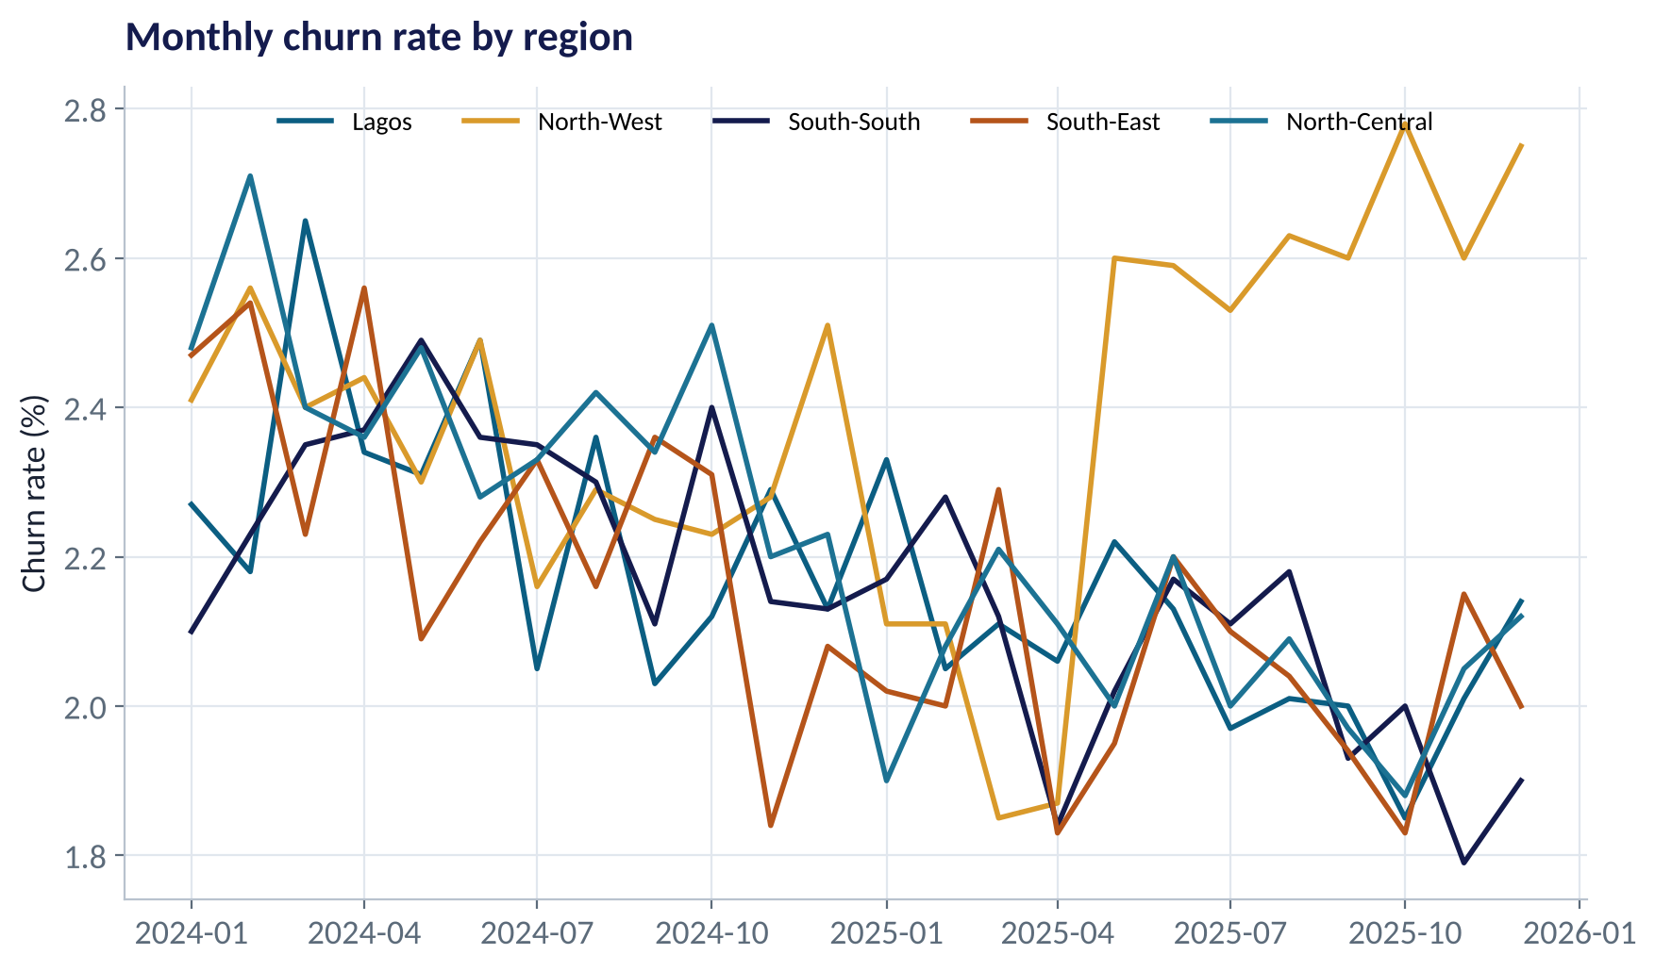
THE SPAGHETTI PROBLEM
Five Lines, No Story
WHAT TO SEE
Every region gets the same visual weight.
The eye has nowhere to land.
The important change is there — but hidden.
Can you spot which region broke away?
Fig S2.4-F04 · replicate: tdbg_2_4_figures.R / .py
SESSION 2.4 · CHARTS THAT SURVIVE A BOARD ROOM
15

Slide 16
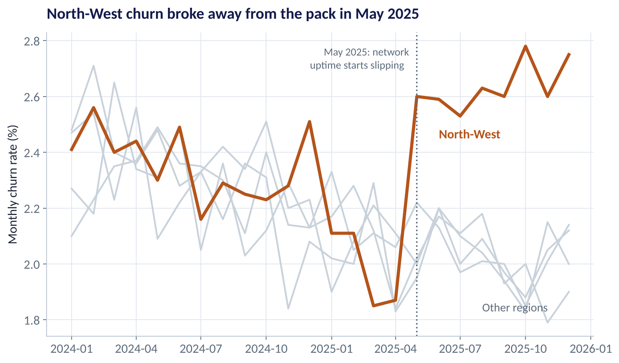
FOCUS
Grey the Context, Colour the Story
WHAT TO SEE
North-West churn jumps from about 1.9% to 2.6–2.8% from May 2025.
Other regions keep falling slowly.
The annotation offers a reason to investigate: uptime started slipping.
Same data as the last slide — now the message is unmissable.
Fig S2.4-F05 · replicate: tdbg_2_4_figures.R / .py
SESSION 2.4 · CHARTS THAT SURVIVE A BOARD ROOM
16

Slide 17
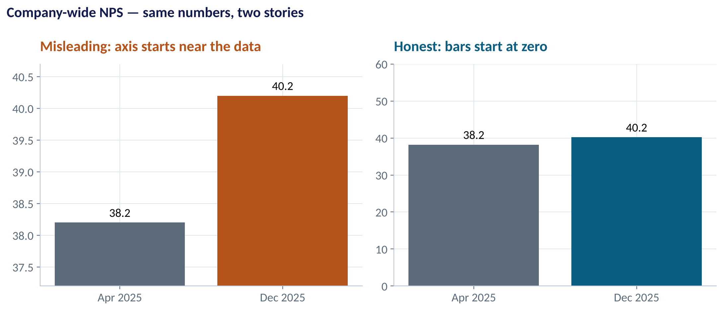
HONEST AXES
Truncated Axes Exaggerate
WHAT TO SEE
Left: NPS seems to have jumped.
Right: it rose 2 points on a 100-point scale.
Bars must start at zero — their length is the message.
Line charts may zoom in — but say so, and never to manufacture drama.
Fig S2.4-F06 · replicate: tdbg_2_4_figures.R / .py
SESSION 2.4 · CHARTS THAT SURVIVE A BOARD ROOM
17

Slide 18
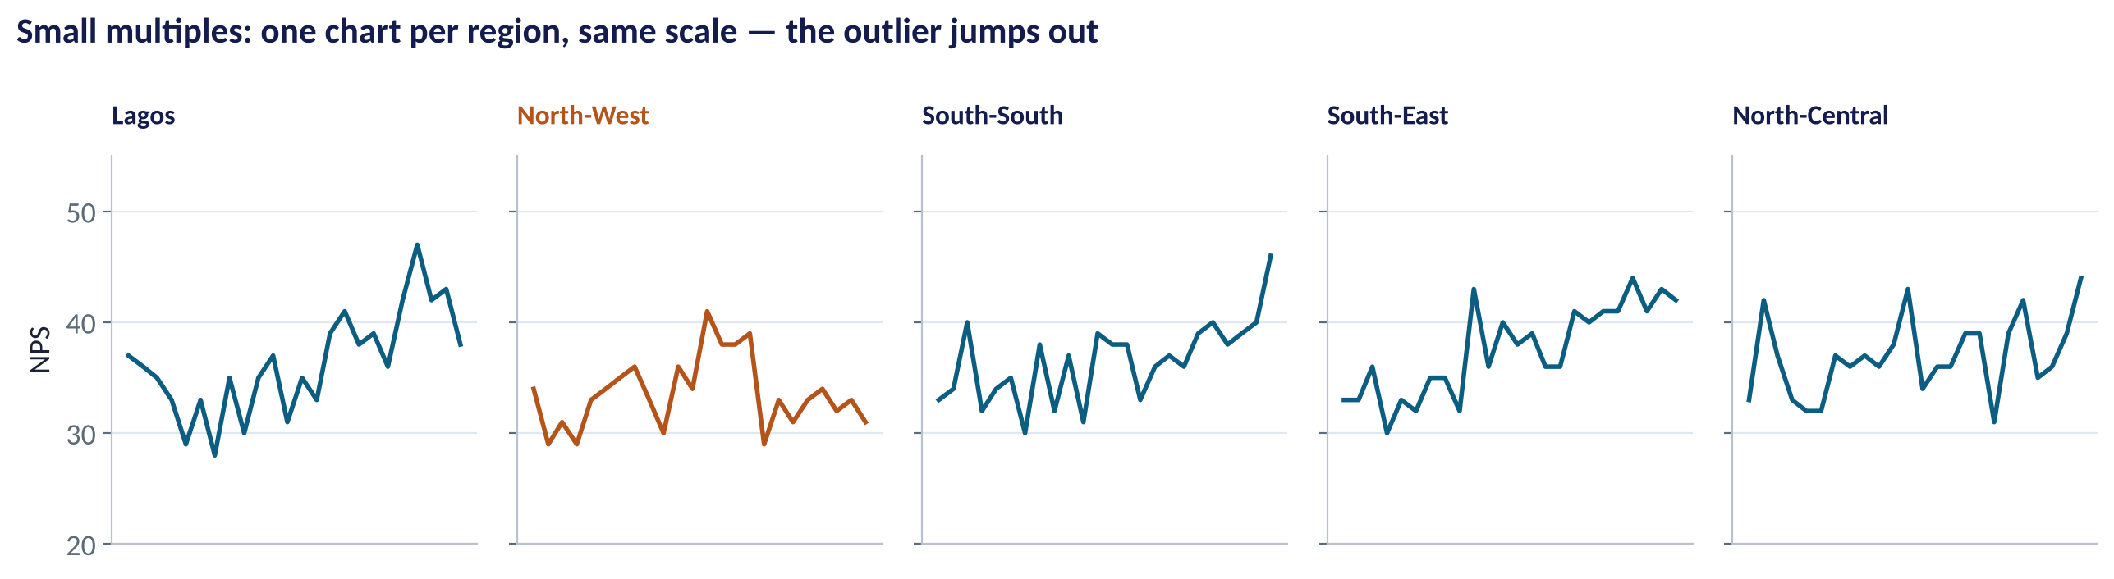
SMALL MULTIPLES
One Chart Per Group, Same Scale
WHAT TO SEE
Instead of one crowded chart, repeat a small chart per region.
A shared y-axis makes comparison fair.
North-West's NPS is the only one not improving.
R: facet_wrap(); Python: plt.subplots(sharey=True).
Fig S2.4-F07 · replicate: tdbg_2_4_figures.R / .py
SESSION 2.4 · CHARTS THAT SURVIVE A BOARD ROOM
18

Slide 19



COLOUR WITH CARE
Colour Rules for Business Charts
About 1 in 12 men has some form of colour-vision deficiency.
Meaningful, not decorative
Avoid red vs green alone
Sequential vs diverging
Consistent across the pack
Each colour should mean something; most of the chart can be grey.
Pair colour with labels, icons or position. Use colour-blind-safe palettes.
Light→dark for amounts; two-sided palettes only when there is a meaningful middle (e.g. zero).
Lagos is the same colour on every slide; 'bad' is always the same colour.
SESSION 2.4 · CHARTS THAT SURVIVE A BOARD ROOM
19

Slide 20

CONCEPT CHECK
Quick Check: What Would You Say?
You need to show how each of 12 product lines' share of revenue changed between 2024 and 2025. Which chart is best?
A
Two pie charts side by side
B
A slope chart or paired bar chart, sorted by 2025 share
C
A 3-D stacked column chart
D
A table with conditional colours in every cell
Discuss with your neighbour for 60 seconds — answer and reasoning in the speaker notes.
SESSION 2.4 · CHARTS THAT SURVIVE A BOARD ROOM
20

Slide 21
PART
03
From Chart to Story
Dashboards monitor. Stories persuade.

Slide 22
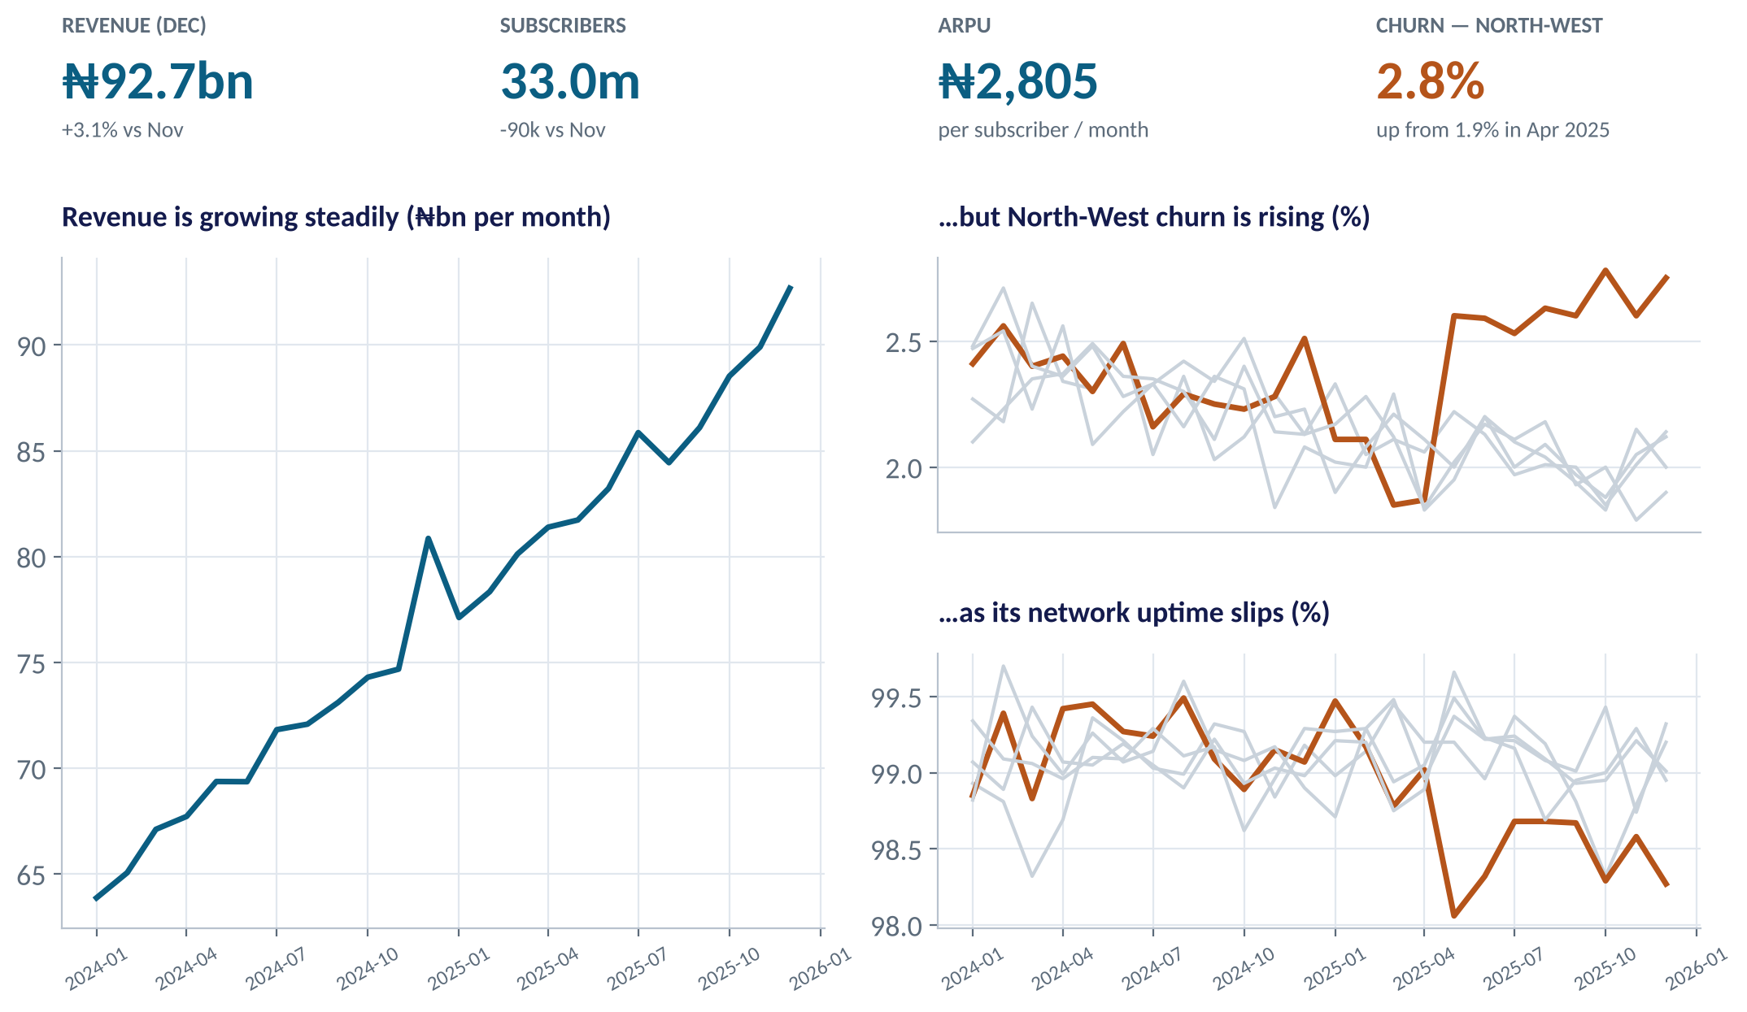
THE ONE-PAGE DASHBOARD
An Executive Dashboard That Reads in 10 Seconds
WHAT TO SEE
Top row: four KPI tiles — the numbers that matter, with change.
Left: the big picture — revenue is growing.
Right: the exception — North-West churn rising as uptime slips.
Read like a sentence: 'Good overall… but… because…'.
Fig S2.4-F08 · replicate: tdbg_2_4_figures.R / .py
SESSION 2.4 · CHARTS THAT SURVIVE A BOARD ROOM
22

Slide 23

TWO DIFFERENT JOBS
Dashboards vs. Data Stories
Dashboard
Data story
Monitor — 'how are we doing?'
Persuade — 'here is what we should do'
Updated regularly, often automatically
Many readers, many questions
Shows KPIs and flags exceptions
Reader explores; designer stays neutral
Built for one decision and one audience
Has a beginning, a tension and a resolution
Designer selects and emphasises
Ends with a clear recommendation or ask
A dashboard tells you where to look. A story tells people what to do about it.
SESSION 2.4 · CHARTS THAT SURVIVE A BOARD ROOM
23

Slide 24




STORY STRUCTURE
The Three-Act Data Story
Borrowed from film and journalism — works in any boardroom.
›
›
›
›
Context
Tension
Evidence
Resolution
The ask
Revenue grew 19% in 2025; churn fell in four of five regions.
But North-West churn jumped 40% from May — as network uptime slipped.
Focus chart + uptime chart; NPS falling in the same region.
Prioritise tower maintenance in North-West; track churn weekly.
Approve the maintenance budget at today's meeting.
Big idea test: can you state your message in one sentence with a verb? If not, you are not ready to build the slide.
SESSION 2.4 · CHARTS THAT SURVIVE A BOARD ROOM
24

Slide 25

THE ONE-SLIDE STORY
Anatomy of a Decision Slide
Use this template in the lab and in your capstone.
Headline = the message
One chart
A full sentence: 'North-West churn has risen 40% since May as network uptime slipped.'
The focus chart, with the story in colour and the context in grey.
Three supporting facts
One clear ask
Numbers with comparisons: from–to, vs. other regions, cost per month.
Who should do what, by when — and what it costs or saves.
SESSION 2.4 · CHARTS THAT SURVIVE A BOARD ROOM
25

Slide 26


WHERE MANAGERS GO WRONG
Habits That Kill Business Charts
THE TRAP
THE BETTER HABIT
Titles that name the topic: 'Revenue by Region, FY2025'.
Titles that state the finding: 'Lagos earns a third of revenue'.
Bar charts with axes that do not start at zero.
Bars start at zero; zoom only on line charts — and say so.
Every series in a different bright colour.
Grey for context; one colour for the story.
Showing everything you analysed.
Show what supports the decision; keep the rest in the appendix.
Dual-axis charts that suggest relationships.
Two aligned charts or a scatter plot.
SESSION 2.4 · CHARTS THAT SURVIVE A BOARD ROOM
26

Slide 27



HANDS-ON LAB
Lab: Turn a KPI File Into an Executive Story
1
Write the question: which region needs attention, and why?
YOU WILL NEED
Data
2
Draw the default spaghetti chart; then declutter and focus on the story.
data/telecom_monthly_kpis.csv
3
Check a possible explanation: plot North-West churn against network uptime.
R script
sessions/2-4/R/tdbg_2_4_lab.R
4
Build a sorted, labelled revenue bar chart and a small-multiples NPS chart.
Python script
Assemble a one-slide story: message headline, one chart, three facts, one ask. Swap with a partner and critique.
sessions/2-4/python/tdbg_2_4_lab.py
5
Deliverable: your one-slide story, critiqued by one classmate.
⏱ 30 minutes + 10 peer critique
SESSION 2.4 · CHARTS THAT SURVIVE A BOARD ROOM
27

Slide 28
WORDS TO OWN
Today's Vocabulary in Plain English
Chart chooser
Picking a chart type from the question you are answering.
Small multiples
A grid of small charts with a shared scale.
Data-ink ratio
Share of a chart's ink that shows data; raise it.
Truncated axis
An axis not starting at zero; misleading for bars.
Declutter
Removing marks that carry no information.
Dashboard
A regularly updated monitoring view of KPIs.
Message title
A headline that states the chart's finding.
Data story
A structured argument from data to a decision.
Direct labelling
Labels on the data instead of in a legend.
Big idea
Your message in one sentence, with a verb.
SESSION 2.4 · CHARTS THAT SURVIVE A BOARD ROOM
28

Slide 29
KEY TAKEAWAYS
Session 2.4 in 5 Ideas
01
Start from the question: compare, trend, relationship, distribution or composition.
02
Position beats angle and colour: sorted bars and lines beat pies and 3-D.
03
Declutter, label directly, and use grey + one colour to focus the eye.
04
Keep axes honest: bars start at zero.
05
Dashboards monitor; stories persuade — end with a clear ask.
NEXT › Session 2.5: Is the Difference Real?
Before next session: Read Chapter 11 (Hypothesis Testing). Redesign the chart you brought from your own company using today's checklist, and bring before/after versions.

