Slide 1


LAGOS BUSINESS SCHOOL · TURNING DATA INTO BUSINESS GROWTH · DAY 2
SESSION 2.5
Is the Difference Real?
Hypothesis Testing for Business Decisions
Source: Chapter 11 — Hypothesis Testing Fundamentals
AI-Powered Business Analytics: A Practical Textbook for Data-Driven Decision Making · Prof. Bongo Adi

Slide 2




RECAP
Session 2.4 in Three Ideas
Question first
Choose the chart from the question: compare, trend, relationship, distribution, composition.
Grey + one colour
Declutter and focus the eye on the story; keep bar axes at zero.
Story
Message headline, one chart, three facts, one ask.
SESSION 2.5 · IS THE DIFFERENCE REAL?
2

Slide 3




TODAY'S PLAN
Session 2.5 at a Glance — 75 Minutes
From a hunch, to a test, to a decision you can defend.
10'
30'
25'
10'
Recap & Hook
The Logic of Testing
Lab: Store Layout
Discussion
Is this difference real or just noise?
Hypotheses, p-values, errors, effect size
t-test, proportion test, chi-square
How p-values get misused in business
SESSION 2.5 · IS THE DIFFERENCE REAL?
3

Slide 4


BY THE END OF TODAY
Session 2.5 Learning Objectives
You will be able to:
01
02
03
Frame Hypotheses
Choose & Run a Test
Judge Significance
Turn a business question into a null and an alternative hypothesis — before seeing results.
Pick a t-test, proportion test or chi-square test, run it in R or Python, and read the output.
Separate statistical significance from practical importance — and both from the right unit of analysis.
SESSION 2.5 · IS THE DIFFERENCE REAL?
4

Slide 5




THE HOOK
Real Difference, or Just Noise?
“The new layout stores converted 22.1% of visitors; the old ones 21.4%. Roll it out to all 80 stores.”
Before spending ₦320m on refits, a good manager asks three questions:
Could chance do this?
How big is the effect?
What is the unit?
Stores differ every day. Would a 0.7-point gap appear even with no real effect?
Even if real, is it large enough to pay for the refit?
The layout was given to stores, not to shoppers. Analyse what was assigned.

Slide 6




NIGERIAN BUSINESS CASE
Did the New Store Layout Work?
The situation
The decision question
A Lagos supermarket chain trialled a new layout (wider aisles, fresh produce at the front) in 12 of 24 stores for four weeks. The other 12 kept the old layout.
Did the new layout raise conversion (share of visitors who buy) or basket value — enough to justify refitting all stores?
The data we have
What a good answer looks like
store_layout_test.csv — 24 stores × 28 days: visitors, buyers, conversion rate, average basket. About 349,000 visits in total.
A recommendation with effect sizes and confidence intervals, honest about what the data can and cannot show.
SESSION 2.5 · IS THE DIFFERENCE REAL?
6

Slide 7
PART
01
The Logic of Testing
A courtroom for data.

Slide 8


THE COURTROOM ANALOGY
Innocent Until Proven Guilty
In court
In a hypothesis test
The defendant is presumed innocent
H₀: 'no effect' is presumed true
Prosecution brings evidence
Verdict 'guilty' only if evidence is beyond reasonable doubt
'Not guilty' ≠ proven innocent
Two mistakes: jail the innocent, free the guilty
The data are the evidence
Reject H₀ only if the data would be very surprising under it
'Fail to reject' ≠ proven no effect
Two mistakes: false alarm (Type I), missed effect (Type II)
We never prove H₀. We ask whether the evidence is strong enough to abandon it.
SESSION 2.5 · IS THE DIFFERENCE REAL?
8

Slide 9



FIVE STEPS
Every Hypothesis Test, Step by Step
The same recipe for every test in this course.
›
›
›
›
1. Hypotheses
2. Threshold
3. Test
4. Compute
5. Decide
H₀: no difference. H₁: a difference. Written before looking.
Choose α — usually 5% — the false-alarm rate you accept
Pick the test that fits the data and the unit
Test statistic, p-value and a confidence interval
Statistical verdict + business judgement on size and cost
Step 5 has two halves: is it real (p-value, CI) — and does it matter (effect size, cost)?
SESSION 2.5 · IS THE DIFFERENCE REAL?
9

Slide 10


THE MOST MISUNDERSTOOD NUMBER IN BUSINESS
What a p-Value Actually Is
IN PLAIN ENGLISH
THE FORMULA
p = P(data this extreme | H₀ true)
The p-value answers one narrow question: if there were truly no effect, how often would we see a difference at least this big just by chance? A small p-value means 'this would be surprising if nothing were going on'.
WHY A MANAGER CARES
The p-value is not the probability that H₀ is true, not the probability the result is a fluke, and says nothing about size. Treat p < 0.05 as 'worth taking seriously', not as 'proven'.
EXAMPLE
Store conversion: p = 0.51. Even if the layout did nothing, a gap this size would appear about half the time. No evidence of an effect.
SESSION 2.5 · IS THE DIFFERENCE REAL?
10

Slide 11
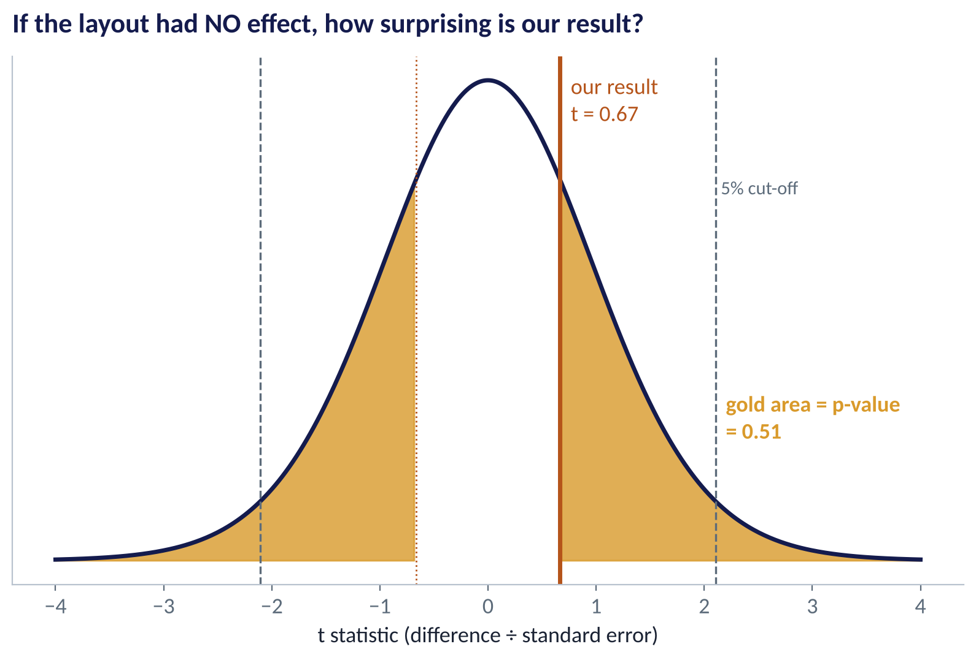
SEEING THE P-VALUE
How Surprising Is Our Result?
WHAT TO SEE
The curve shows the differences we would expect if the layout did nothing.
Our result, t = 0.67, sits comfortably in the middle.
The gold area — results at least this extreme — is the p-value: 0.51.
To reject H₀ at 5%, t would need to pass the dashed cut-offs (about ±2.1).
Fig S2.5-F01 · replicate: tdbg_2_5_figures.R / .py
SESSION 2.5 · IS THE DIFFERENCE REAL?
11

Slide 12

THE TEST STATISTIC
Signal Divided by Noise
IN PLAIN ENGLISH
THE FORMULA
t = (x̄₁ − x̄₂) ÷ SE
Most tests compute one number: how big is the difference compared with how much it would naturally bounce around? Large values mean the signal stands out from the noise.
WHY A MANAGER CARES
You can make the signal stand out in two ways: a bigger real effect, or less noise (more stores, longer trials, more similar stores). This is the logic behind sample-size planning in Session 3.1.
EXAMPLE
Conversion: difference = 0.64 points; standard error ≈ 0.97 points → t ≈ 0.67. The signal is smaller than the noise.
SESSION 2.5 · IS THE DIFFERENCE REAL?
12

Slide 13
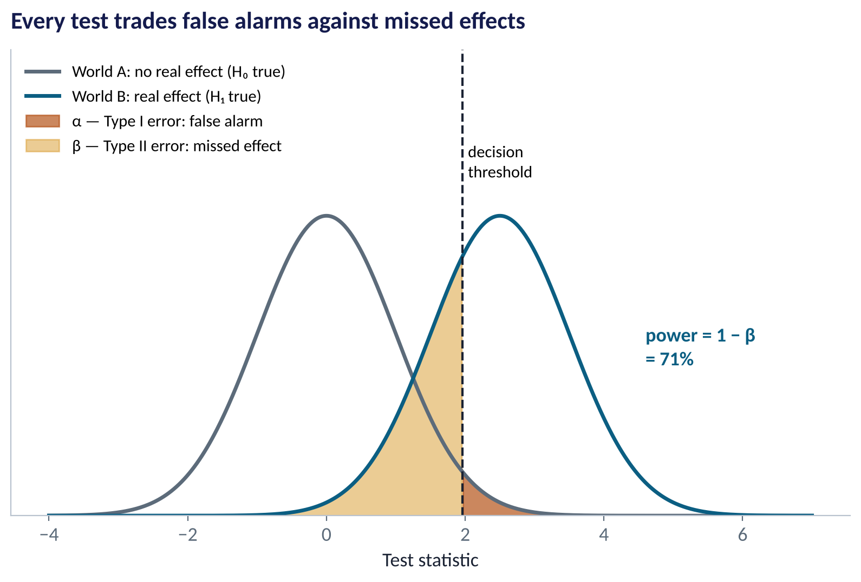
THE TWO MISTAKES
Type I and Type II Errors
WHAT TO SEE
Type I (α): concluding there is an effect when there isn't — a false alarm. Usually set at 5%.
Type II (β): missing a real effect.
Power = 1 − β: the chance of detecting an effect that is really there.
Lowering α to avoid false alarms makes you miss more real effects — unless you collect more data.
Fig S2.5-F05 · replicate: tdbg_2_5_figures.R / .py
SESSION 2.5 · IS THE DIFFERENCE REAL?
13

Slide 14
WHICH MISTAKE COSTS MORE?
Errors Have Business Prices
Decision | Type I error (false alarm) | Type II error (missed effect) | Which to guard against?
Refit 80 stores | Spend ₦320m on a layout that does nothing | Keep a layout that loses sales | Type I — the spend is large
Fraud alert | Block an honest customer's transfer | Let a fraudster through | Type II — losses are severe
New drug / food safety | Approve something that does not work | Reject something that does | Type I — safety first
Cheap website tweak | Ship a change that does nothing | Miss a small win | Either — low cost, test often
The 5% convention is a default, not a law. Set α by weighing what each error costs.
SESSION 2.5 · IS THE DIFFERENCE REAL?
14

Slide 15
CONCEPT CHECK
Quick Check: What Would You Say?
A test of a new loan-approval process gives p = 0.03. Which statement is correct?
A
There is a 3% chance the new process has no effect
B
There is a 97% chance the new process works
C
If the process truly had no effect, a result this extreme would occur about 3% of the time
D
The new process improves approvals by 3%
Discuss with your neighbour for 60 seconds — answer and reasoning in the speaker notes.
SESSION 2.5 · IS THE DIFFERENCE REAL?
15

Slide 16
PART
02
Choosing and Running the Test
Three tests cover most business questions.

Slide 17
THE TEST CHOOSER
Which Test Fits Your Question?
Question | Data | Test | R / Python
Do two groups have different averages? | Numeric outcome, 2 groups | Two-sample (Welch) t-test | t.test() / scipy.stats.ttest_ind()
Do two groups have different rates? | Yes/no outcome, 2 groups | Two-proportion z-test | prop.test() / proportions_ztest()
Are two categories related? | Two categorical variables | Chi-square test | chisq.test() / chi2_contingency()
Same as t-test but data very skewed | Numeric, outliers | Mann–Whitney (rank) test | wilcox.test() / mannwhitneyu()
More than two group averages? | Numeric, 3+ groups | ANOVA | aov() / scipy.stats.f_oneway()
SESSION 2.5 · IS THE DIFFERENCE REAL?
17

Slide 18
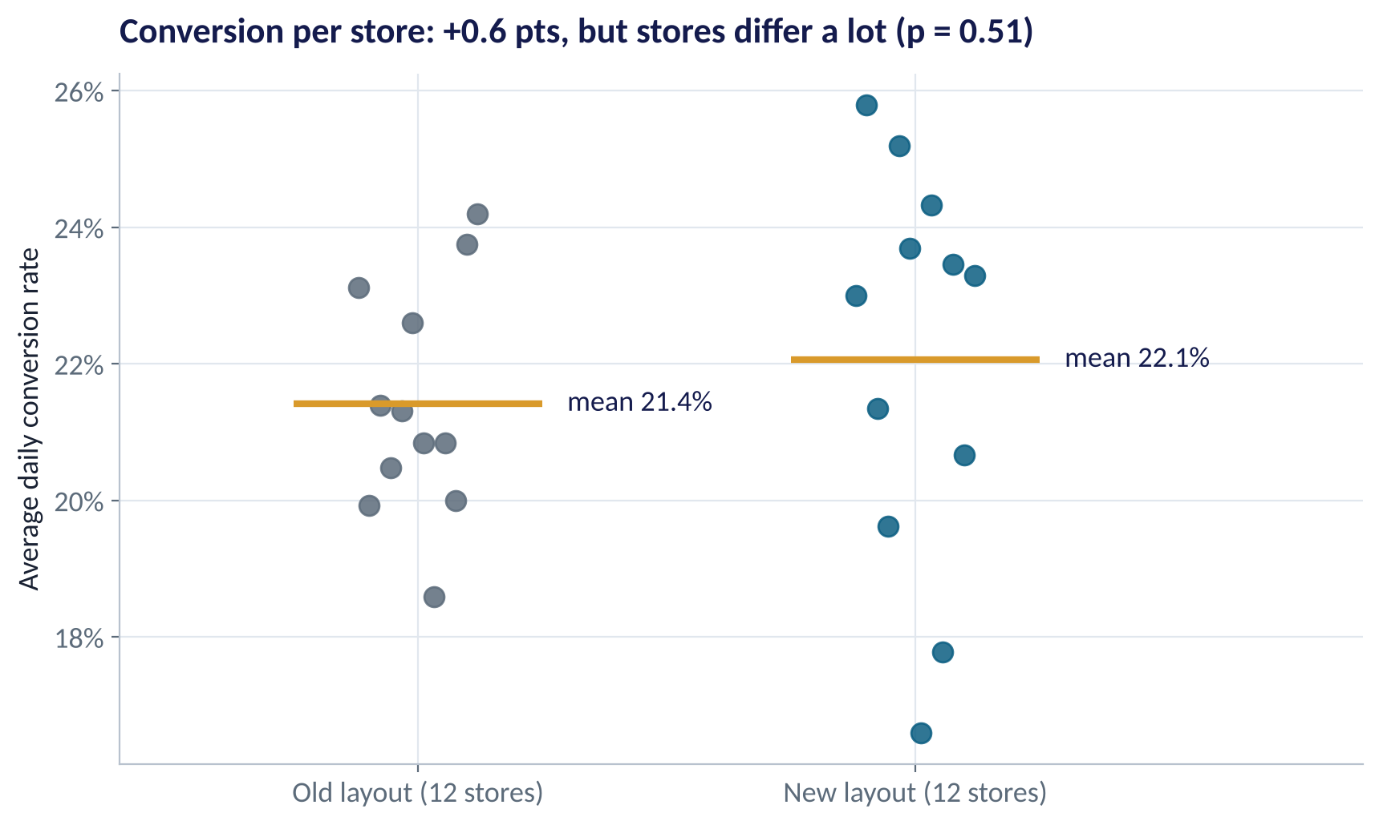
THE CASE · CONVERSION
Store by Store: Is the Gap Bigger Than the Spread?
WHAT TO SEE
New-layout stores average 22.1%, old 21.4%: +0.6 points.
But individual stores range from 17% to 26%.
The gap between groups is small next to the spread within groups.
Welch t-test: t = 0.67, p = 0.51. 95% CI for the difference: −1.4 to +2.7 points.
Fig S2.5-F02 · replicate: tdbg_2_5_figures.R / .py
SESSION 2.5 · IS THE DIFFERENCE REAL?
18

Slide 19
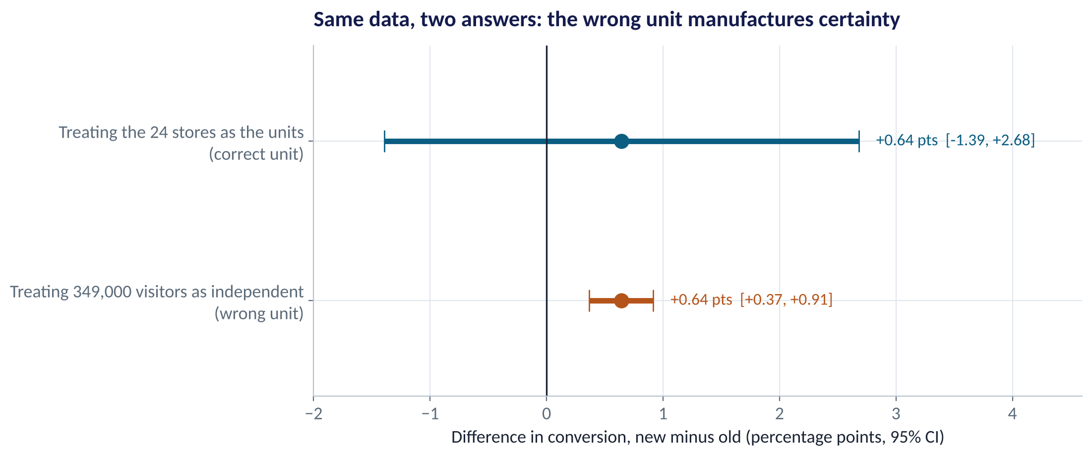
THE TRAP
Pseudo-Replication: Analysing the Wrong Unit
WHAT TO SEE
Treat all 349,000 visits as independent and the CI shrinks to +0.4 to +0.9 points — 'highly significant'.
But the layout was assigned to 24 stores, not to visitors.
Visitors in the same store share the same staff, location and catchment — they are not independent.
Rule: analyse the unit that was assigned.
Fig S2.5-F03 · replicate: tdbg_2_5_figures.R / .py
SESSION 2.5 · IS THE DIFFERENCE REAL?
19

Slide 20
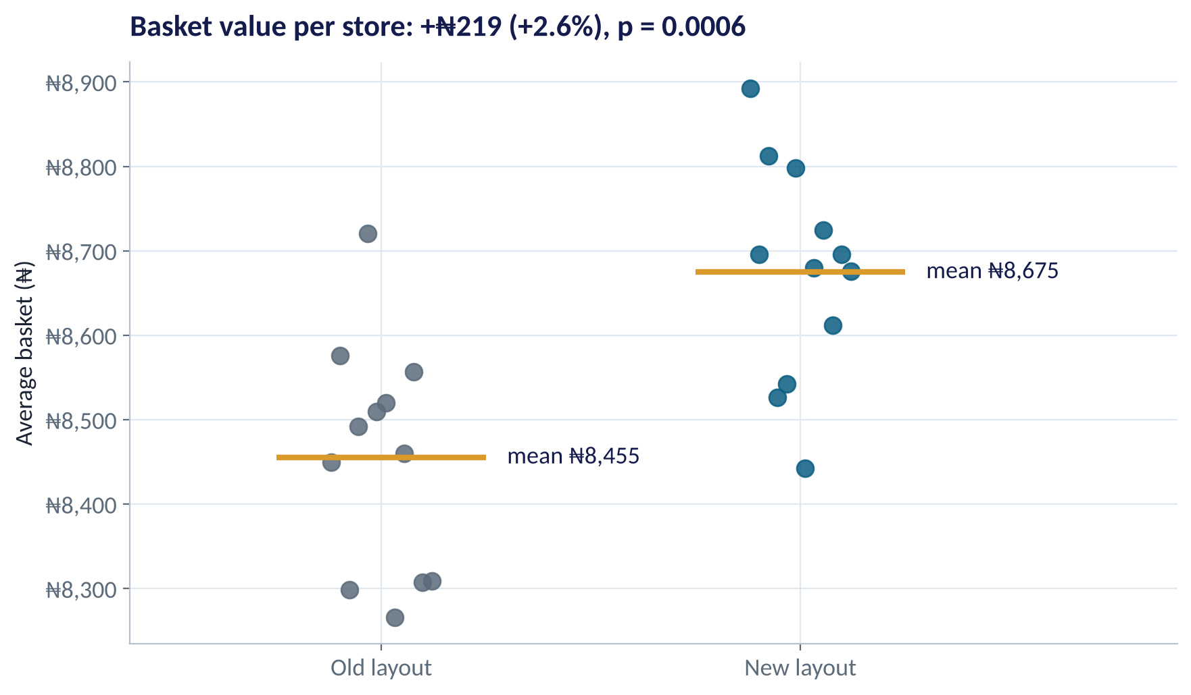
THE CASE · BASKET VALUE
A Real Effect — but Is It Big Enough?
WHAT TO SEE
Basket per receipt: ₦8,675 vs ₦8,455: +₦219 (+2.6%).
Welch t-test across 24 stores: p = 0.0006 — clearly not chance.
Rough value: ₦219 × ~110 buyers/day × 365 ≈ ₦8.7m extra revenue per store per year.
Against a ₦4m refit, it may pay back — if margins are healthy. That is a business judgement.
Fig S2.5-F04 · replicate: tdbg_2_5_figures.R / .py
SESSION 2.5 · IS THE DIFFERENCE REAL?
20

Slide 21
HOW TO READ THIS OUTPUT
Reading a Welch t-Test in R
R OUTPUT
1
Group means
> t.test(basket ~ layout, data = st)
Welch Two Sample t-test
data: basket by layout
t = 4.0397, df = 21.907,
p-value = 0.0005512
alternative hypothesis: true difference
in means between group New and group Old
is not equal to 0
95 percent confidence interval:
106.7417 332.0678
sample estimates:
mean in group New mean in group Old
8674.851 8455.446
₦8,675 vs ₦8,455 — the raw effect: +₦219.
2
95% CI: ₦107 to ₦332
The plausible size of the true uplift. Excludes zero → significant at 5%.
3
p = 0.00055
A gap this big would almost never appear by chance if the layout did nothing.
4
df = 21.9
Based on 24 stores, not 349,000 visits — the honest unit.
SESSION 2.5 · IS THE DIFFERENCE REAL?
21

Slide 22
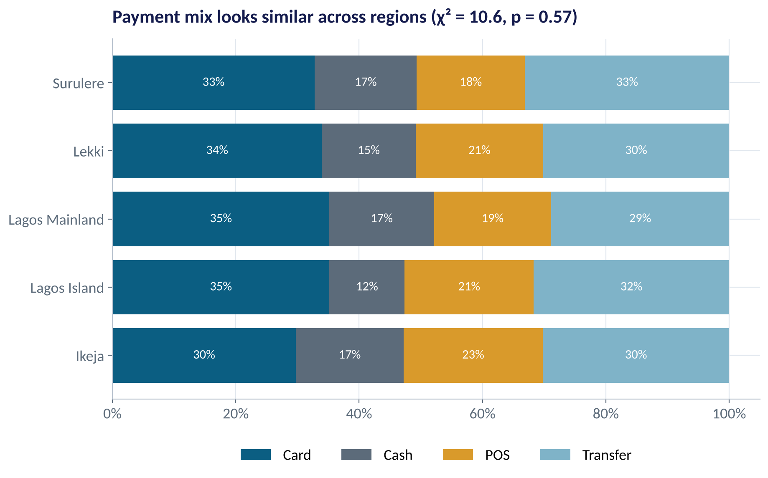
CATEGORIES VS CATEGORIES
Chi-Square: Are Two Categories Related?
WHAT TO SEE
Question: does payment method depend on region?
Chi-square compares the observed counts with the counts we'd expect if there were no relationship.
χ² = 10.6 on 12 degrees of freedom, p = 0.57.
No evidence that payment mix differs by region — one POS strategy can serve all regions.
Fig S2.5-F06 · replicate: tdbg_2_5_figures.R / .py
SESSION 2.5 · IS THE DIFFERENCE REAL?
22

Slide 23
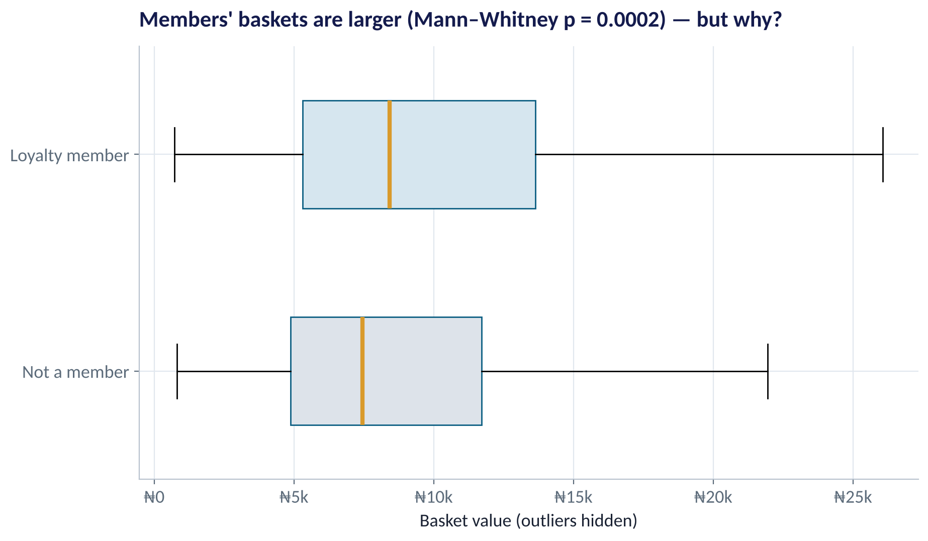
SKEWED DATA
When Data Are Skewed: Rank-Based Tests
WHAT TO SEE
Basket values are right-skewed with big outliers.
The Mann–Whitney test compares ranks, so outliers can't dominate.
Loyalty members' baskets are larger: p = 0.0002.
But the test cannot say why — members may simply be bigger spenders who joined (Session 2.1's question).
Fig S2.5-F08 · replicate: tdbg_2_5_figures.R / .py
SESSION 2.5 · IS THE DIFFERENCE REAL?
23

Slide 24
PART
03
Significance vs. Importance
A small p-value is not a business case.

Slide 25
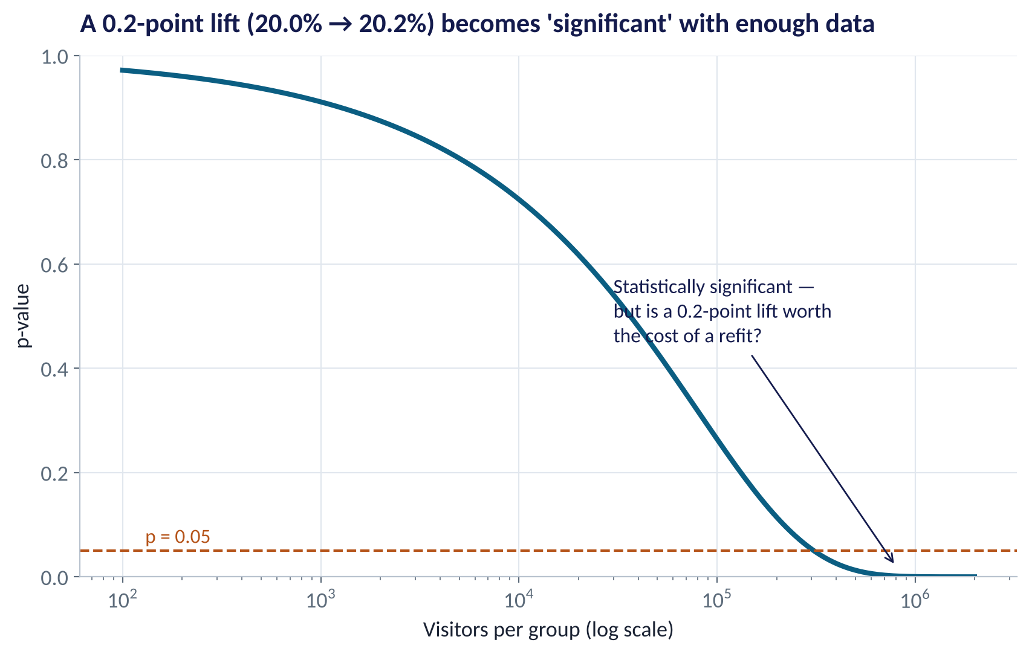
BIG DATA CHANGES THE GAME
Everything Is 'Significant' With Enough Data
WHAT TO SEE
Fix a tiny true lift: 20.0% → 20.2%.
With 1,000 visitors per group: p ≈ 0.9. With 1,000,000: p < 0.001.
With digital-scale data, almost any difference is 'significant'.
So always ask: how big is the effect, and what is it worth?
Fig S2.5-F07 · replicate: tdbg_2_5_figures.R / .py
SESSION 2.5 · IS THE DIFFERENCE REAL?
25

Slide 26


WHAT TO REPORT
Report the Effect, Not Just the p-Value
Three numbers turn a test into a decision.
Effect size
Confidence interval
Business value
The difference in business units: +₦219 per basket, +0.6 points of conversion.
The plausible range: ₦107 to ₦332. Shows both precision and direction.
What the effect is worth against its cost: ~₦8.7m revenue a year vs a ₦4m refit.
SESSION 2.5 · IS THE DIFFERENCE REAL?
26

Slide 27


WHERE MANAGERS GO WRONG
How p-Values Get Misused in Business
THE TRAP
THE BETTER HABIT
“p = 0.06, so the campaign had no effect.”
Absence of evidence is not evidence of absence. Report the CI — it may include useful effects.
Testing 20 segments and reporting the one with p < 0.05.
With 20 tests, one 'hit' is expected by chance. Pre-register the main question; adjust for many tests.
Peeking at results daily and stopping when p dips below 0.05.
Fix the sample size before the test (Session 3.1).
Pooling visitors when stores or branches were assigned.
Analyse the unit that was assigned.
“Highly significant” presented as “highly important”.
Lead with the effect size and its value.
SESSION 2.5 · IS THE DIFFERENCE REAL?
27

Slide 28
CONCEPT CHECK
Quick Check: What Would You Say?
The layout test shows conversion +0.6 points (p = 0.51, CI −1.4 to +2.7) and basket +₦219 (p = 0.0006, CI ₦107 to ₦332). What should you recommend?
A
Roll out to all stores — the basket result is highly significant
B
Abandon the layout — conversion did not change
C
Consider a phased rollout justified by the basket uplift if margins support it, and run a longer, larger trial to pin down conversion
D
Re-run the analysis treating each visitor as a unit to get significance on conversion
Discuss with your neighbour for 60 seconds — answer and reasoning in the speaker notes.
SESSION 2.5 · IS THE DIFFERENCE REAL?
28

Slide 29



HANDS-ON LAB
Lab: Did the Layout Work?
1
Write H₀ and H₁ for conversion and for basket value before running anything.
YOU WILL NEED
Data
2
Aggregate to one row per store; run Welch t-tests for conversion and basket.
data/store_layout_test.csv
data/retail_transactions.csv
3
Run the pooled proportion test and see how the wrong unit changes the answer.
R script
sessions/2-5/R/tdbg_2_5_lab.R
4
Run a chi-square test (payment × region) and a Mann–Whitney test (loyalty baskets).
Python script
Estimate the annual value of the basket uplift per store and compare it with a ₦4m refit.
sessions/2-5/python/tdbg_2_5_lab.py
5
Deliverable: a 3-sentence recommendation to the COO using effect sizes and CIs.
⏱ 25 minutes
SESSION 2.5 · IS THE DIFFERENCE REAL?
29

Slide 30
WORDS TO OWN
Today's Vocabulary in Plain English
Null hypothesis (H₀)
The 'no effect' default we try to find evidence against.
Type I error
False alarm: rejecting a true H₀.
Alternative (H₁)
What we would conclude if H₀ is rejected.
Type II error
Missed effect: failing to reject a false H₀.
Significance level α
The false-alarm rate we accept, often 5%.
Power
Chance of detecting a real effect (1 − β).
p-value
Chance of a result this extreme if H₀ were true.
Effect size
How big the difference is, in business units.
Test statistic
Signal divided by noise, e.g. a t value.
Pseudo-replication
Treating non-independent units as independent.
SESSION 2.5 · IS THE DIFFERENCE REAL?
30

Slide 31
KEY TAKEAWAYS
Session 2.5 in 5 Ideas
01
Write H₀ and H₁ before you look at the data.
02
The p-value is the chance of data this extreme if nothing were going on — nothing more.
03
Analyse the unit that was assigned; pooling creates false certainty.
04
Choose the test from the data: t-test, proportion test, chi-square, or a rank test for skew.
05
Decide on effect size, CI and value — significance is not importance.
NEXT › Session 3.1: Experiments That Settle Arguments
Before next session: Read Chapter 12 (A/B Testing and Business Experimentation). Think of one change in your organisation that could be tested with an experiment; bring the metric and the unit you would randomise.

