Slide 1


LAGOS BUSINESS SCHOOL · TURNING DATA INTO BUSINESS GROWTH · DAY 3
SESSION 3.1
Experiments That
Settle Arguments
A/B Testing & Business Experimentation
Source: Chapter 12 — A/B Testing and Business Experimentation
AI-Powered Business Analytics: A Practical Textbook for Data-Driven Decision Making · Prof. Bongo Adi

Slide 2




RECAP
Session 2.5 in Three Ideas
Test logic
Presume no effect (H₀); reject only if the data would be surprising under it.
Right unit
Analyse the unit that was assigned — stores, not shoppers.
Importance
Decide on effect size, confidence interval and business value — not p alone.
SESSION 3.1 · EXPERIMENTS THAT SETTLE ARGUMENTS
2

Slide 3




TODAY'S PLAN
Session 3.1 at a Glance — 75 Minutes
From 'we think it works' to 'we tested it, and here is how sure we are'.
10'
30'
25'
10'
Recap & Hook
Designing Experiments
Lab: Fintech A/B Test
Module 1 Review
Why correlation fooled us — and how experiments fix it
Randomisation, metrics, sample size, pitfalls
Analyse and decide on a real onboarding test
Practice-paper briefing: Practice Paper 1
SESSION 3.1 · EXPERIMENTS THAT SETTLE ARGUMENTS
3

Slide 4


BY THE END OF TODAY
Session 3.1 Learning Objectives
You will be able to:
01
02
03
Design a Sound Test
Spot Threats to Validity
Read and Decide
Choose the unit, primary and guardrail metrics, and compute the sample size before launch.
Recognise peeking, sample-ratio mismatch, novelty effects, interference and cherry-picked segments.
Interpret an experiment's results and turn them into a ship / don't ship / extend decision.
SESSION 3.1 · EXPERIMENTS THAT SETTLE ARGUMENTS
4

Slide 5



THE HOOK
Why Experiments Beat Everything Else
“Loyalty members spend more” (Session 2.1). But does the scheme cause it — or do big spenders just join?
Observational data can't separate cause from selection. A randomised experiment can, because:
Chance decides
Fair comparison
Causal answer
A coin-flip assigns who gets the change, so the groups are alike in every way — seen and unseen.
The only systematic difference between groups is the change itself.
So a difference in outcomes can be attributed to the change.

Slide 6




NIGERIAN BUSINESS CASE
A Fintech App's Onboarding Experiment
The situation
The decision question
A Lagos-based fintech loses many new users during sign-up: only about 18% complete onboarding (BVN, ID, selfie, first deposit). Product proposes a simplified flow that defers some KYC steps.
Does the simplified flow (B) raise onboarding completion versus the current flow (A) — without harming support load or the quality of new customers?
The data we have
What a good answer looks like
fintech_onboarding_ab.csv — 12,000 new users randomised 50/50 over three weeks: variant, device, state, completed onboarding, first deposit, support tickets.
Ship, don't ship, or extend — with the effect size, its uncertainty, guardrail checks and the value per month.
SESSION 3.1 · EXPERIMENTS THAT SETTLE ARGUMENTS
6

Slide 7
PART
01
Designing an Experiment
Most experiments fail at design, not at analysis.

Slide 8



THE ANATOMY OF AN A/B TEST
Six Design Decisions Before Launch
›
›
›
›
›
Hypothesis
Unit
Primary metric
Guardrails
Sample size
Duration
'A shorter flow will raise completion because drop-off is at KYC.'
What gets randomised: user, store, branch, region?
One success measure, decided in advance
Metrics that must not get worse
Users needed to detect the smallest lift worth shipping
Full weeks; long enough to cover cycles
Write these six decisions down — a pre-registration — before the first user sees variant B.
SESSION 3.1 · EXPERIMENTS THAT SETTLE ARGUMENTS
8

Slide 9

RANDOMISATION
Why the Coin Flip Matters
IN PLAIN ENGLISH
WHY A MANAGER CARES
Randomisation means chance — not people — decides who sees which version. With enough users, the two groups end up alike in age, device, location, motivation and everything else, including things you never measured.
Randomisation is what turns 'B users completed more' into 'B caused more completions'. Always check it worked: group sizes near 50/50 and similar mixes of device and region.
EXAMPLE
If product managers chose who got the new flow, they might pick keen early adopters — and the 'lift' would really be the users, not the flow.
SESSION 3.1 · EXPERIMENTS THAT SETTLE ARGUMENTS
9

Slide 10
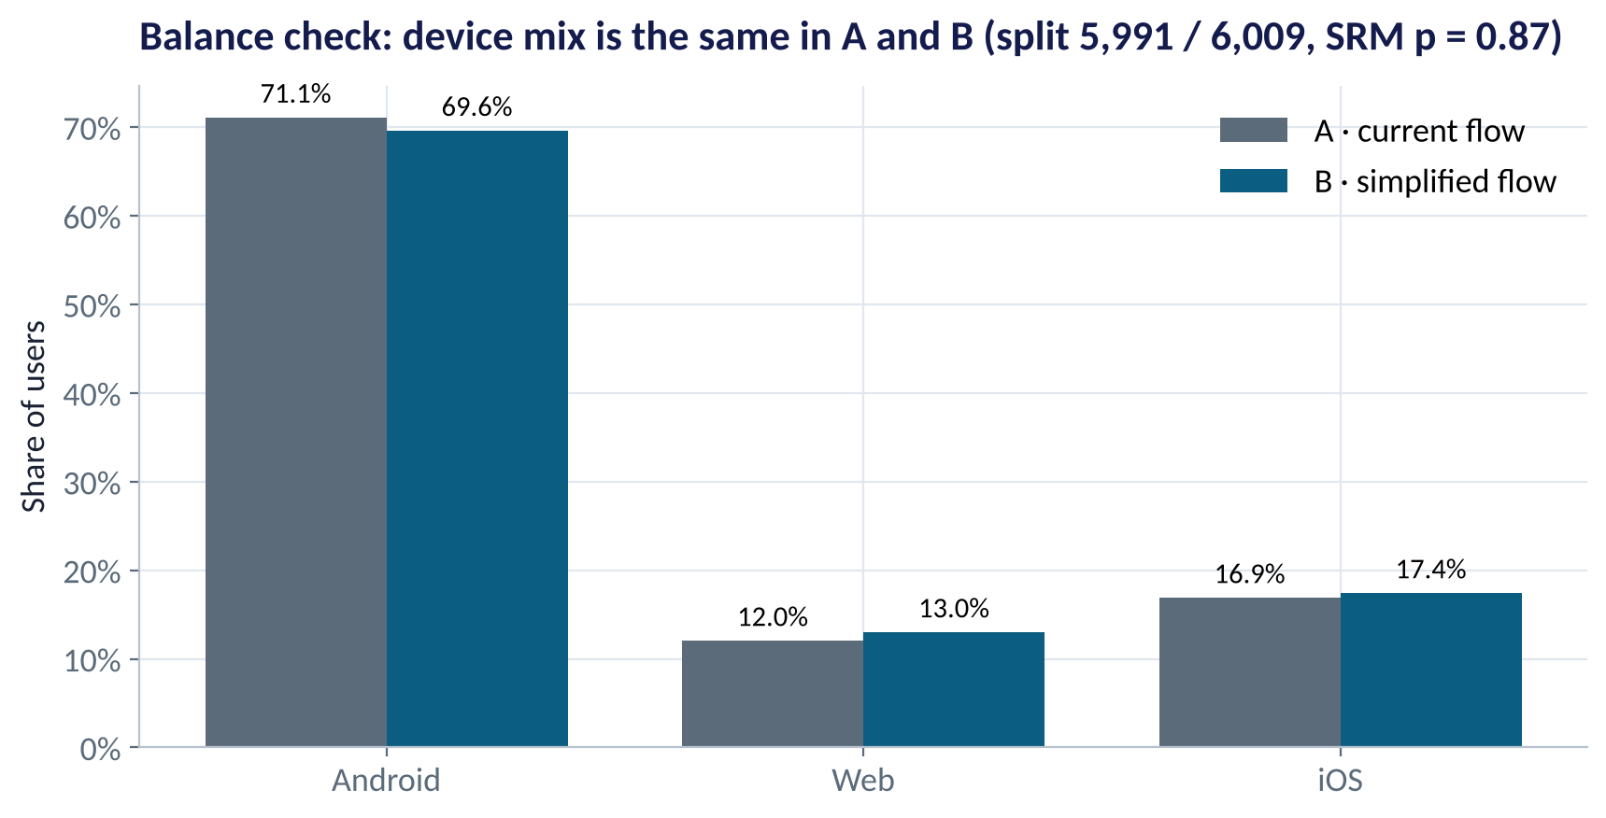
CHECK BEFORE YOU ANALYSE
Did Randomisation Work?
WHAT TO SEE
Group sizes: 5,991 vs 6,009 — very close to 50/50.
Sample-ratio mismatch (SRM) test: p = 0.87 — no sign of a broken split.
Device mix is almost identical in A and B.
If SRM fails (e.g. 52/48 with 12,000 users), stop: something in the plumbing is biased.
Fig S3.1-F04 · replicate: tdbg_3_1_figures.R / .py
SESSION 3.1 · EXPERIMENTS THAT SETTLE ARGUMENTS
10

Slide 11

CHOOSING METRICS
Primary, Guardrail and Diagnostic Metrics
Decide all three before launch.
Primary metric
Guardrail metrics
Diagnostic metrics
One number decides
Must not get worse
Explain the why
Onboarding completion rate. Must be sensitive to the change and tied to value.
Support tickets per user; first-deposit size; fraud rate; app crashes.
Drop-off at each screen; time to complete; device-level results.
SESSION 3.1 · EXPERIMENTS THAT SETTLE ARGUMENTS
11

Slide 12
SAMPLE SIZE & POWER
How Many Users Do We Need?
IN PLAIN ENGLISH
THE FORMULA
n ≈ 16 · p(1 − p) ÷ MDE²
Decide the smallest lift worth shipping (the minimum detectable effect, MDE). Then calculate how many users give a good chance — usually 80% power — of detecting it at a 5% false-alarm rate. Smaller effects need many more users.
rule of thumb per group, for 80% power and α = 5%
WHY A MANAGER CARES
Under-powered tests waste time and often 'find nothing' even when the idea works. Over-long tests delay good launches. Calculate n before launch — R: power.prop.test(); Python: statsmodels NormalIndPower.
EXAMPLE
Baseline p = 18%, MDE = 2 points: n ≈ 16 × 0.18 × 0.82 ÷ 0.02² ≈ 5,900 per group. Software gives about 6,000. Our test had 6,000 per group.
SESSION 3.1 · EXPERIMENTS THAT SETTLE ARGUMENTS
12

Slide 13
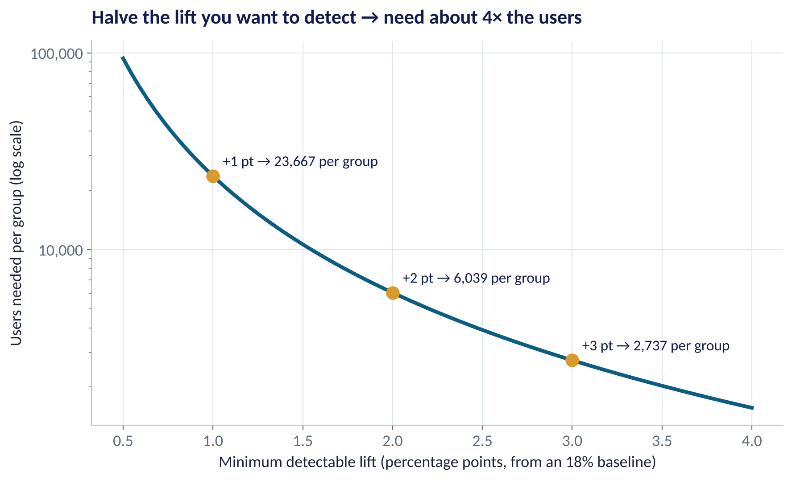
THE PRICE OF PRECISION
Smaller Effects Need Many More Users
WHAT TO SEE
Detecting +3 points needs about 2,700 users per group.
+2 points: about 6,000.
+1 point: about 23,700 — four times as many.
Ask the business: what is the smallest lift worth the effort? That sets the sample size.
Fig S3.1-F02 · replicate: tdbg_3_1_figures.R / .py
SESSION 3.1 · EXPERIMENTS THAT SETTLE ARGUMENTS
13

Slide 14

CONCEPT CHECK
Quick Check: What Would You Say?
A bank's app gets 1,500 new sign-ups a week. It wants to detect a 1-point lift from an 18% baseline (about 23,700 users per group). What is the best advice?
A
Run the test for one week and decide anyway
B
Run for about 32 weeks, or test a bolder change aiming at a bigger lift, or use a more sensitive metric
C
Peek every day and stop as soon as p < 0.05
D
Skip testing — launch and compare this month with last month
Discuss with your neighbour for 60 seconds — answer and reasoning in the speaker notes.
SESSION 3.1 · EXPERIMENTS THAT SETTLE ARGUMENTS
14

Slide 15
PART
02
Reading the Results
Primary metric, guardrails, segments — in that order.

Slide 16
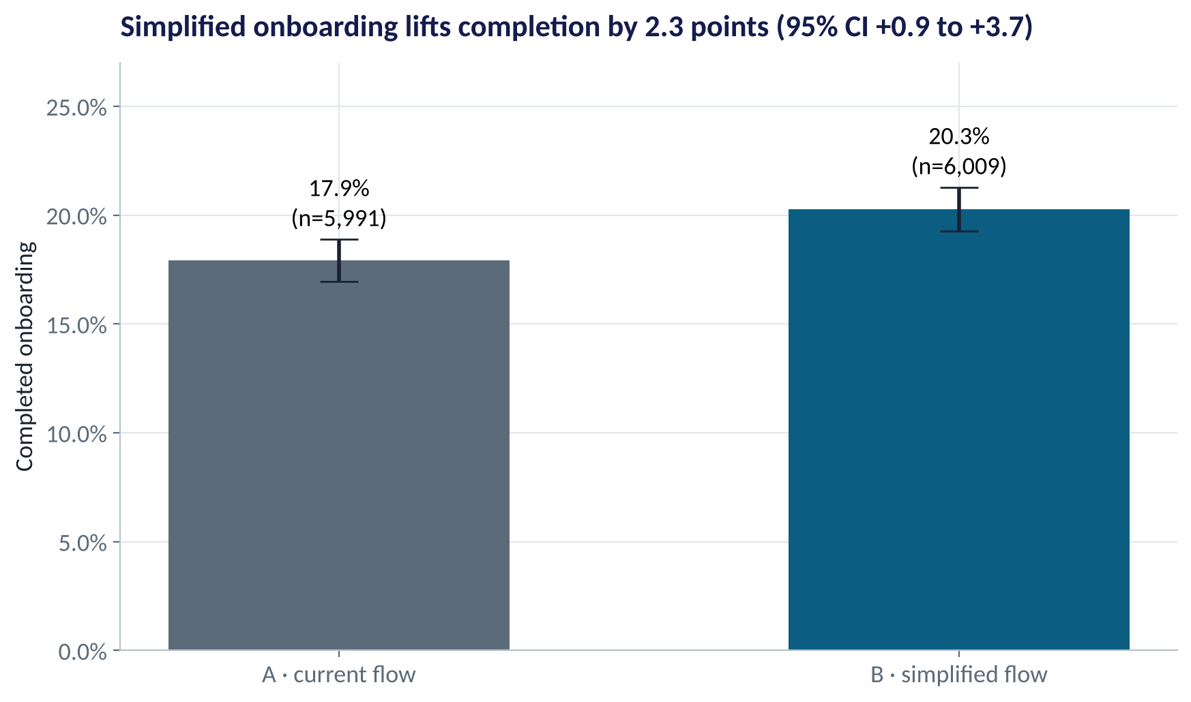
THE PRIMARY METRIC
Did the Simplified Flow Work?
WHAT TO SEE
Completion: 17.9% (A) vs 20.3% (B).
Lift: +2.3 points (a 13% relative increase).
95% CI for the lift: +0.9 to +3.7 points; p = 0.001.
The whole interval is above zero — and its centre is above the 2-point MDE we planned for.
Fig S3.1-F01 · replicate: tdbg_3_1_figures.R / .py
SESSION 3.1 · EXPERIMENTS THAT SETTLE ARGUMENTS
16

Slide 17
HOW TO READ THIS OUTPUT
Reading prop.test() in R
R OUTPUT
1
prop 1 vs prop 2
> prop.test(c(1218, 1074), c(6009, 5991))
2-sample test for equality of
proportions with continuity correction
X-squared = 10.504, df = 1,
p-value = 0.001191
alternative hypothesis: two.sided
95 percent confidence interval:
0.009201 0.037653
sample estimates:
prop 1 prop 2
0.2026959 0.1792689
B's completion (20.3%) and A's (17.9%).
2
95% CI: 0.009 to 0.038
The lift is between +0.9 and +3.8 points. Report this.
3
p = 0.0012
Very unlikely if the flows performed the same.
4
Continuity correction
A small adjustment; Python's z-test gives p = 0.0011 — same conclusion.
SESSION 3.1 · EXPERIMENTS THAT SETTLE ARGUMENTS
17

Slide 18
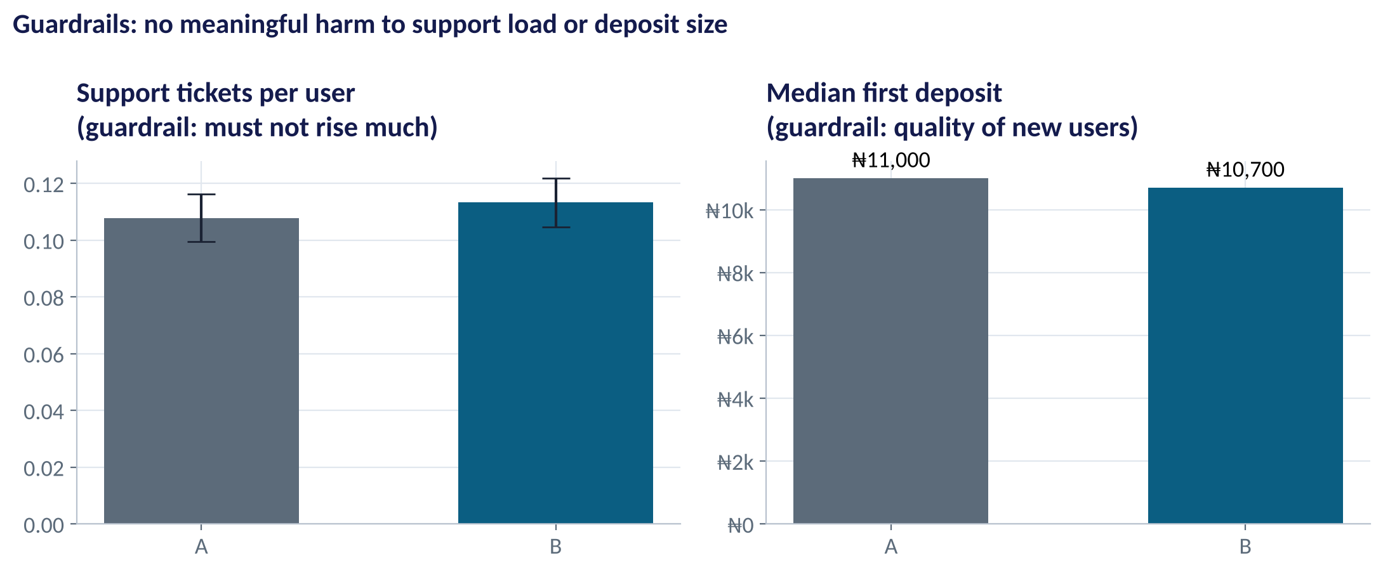
GUARDRAILS
Did We Break Anything?
WHAT TO SEE
Support tickets: 0.108 vs 0.113 per user — difference not significant (p = 0.37).
Median first deposit: ₦11,000 vs ₦10,700 — no meaningful change (p = 0.55).
So the extra completions are not low-quality sign-ups who never fund their accounts.
Guardrails passed → no reason to block the launch.
Fig S3.1-F05 · replicate: tdbg_3_1_figures.R / .py
SESSION 3.1 · EXPERIMENTS THAT SETTLE ARGUMENTS
18

Slide 19
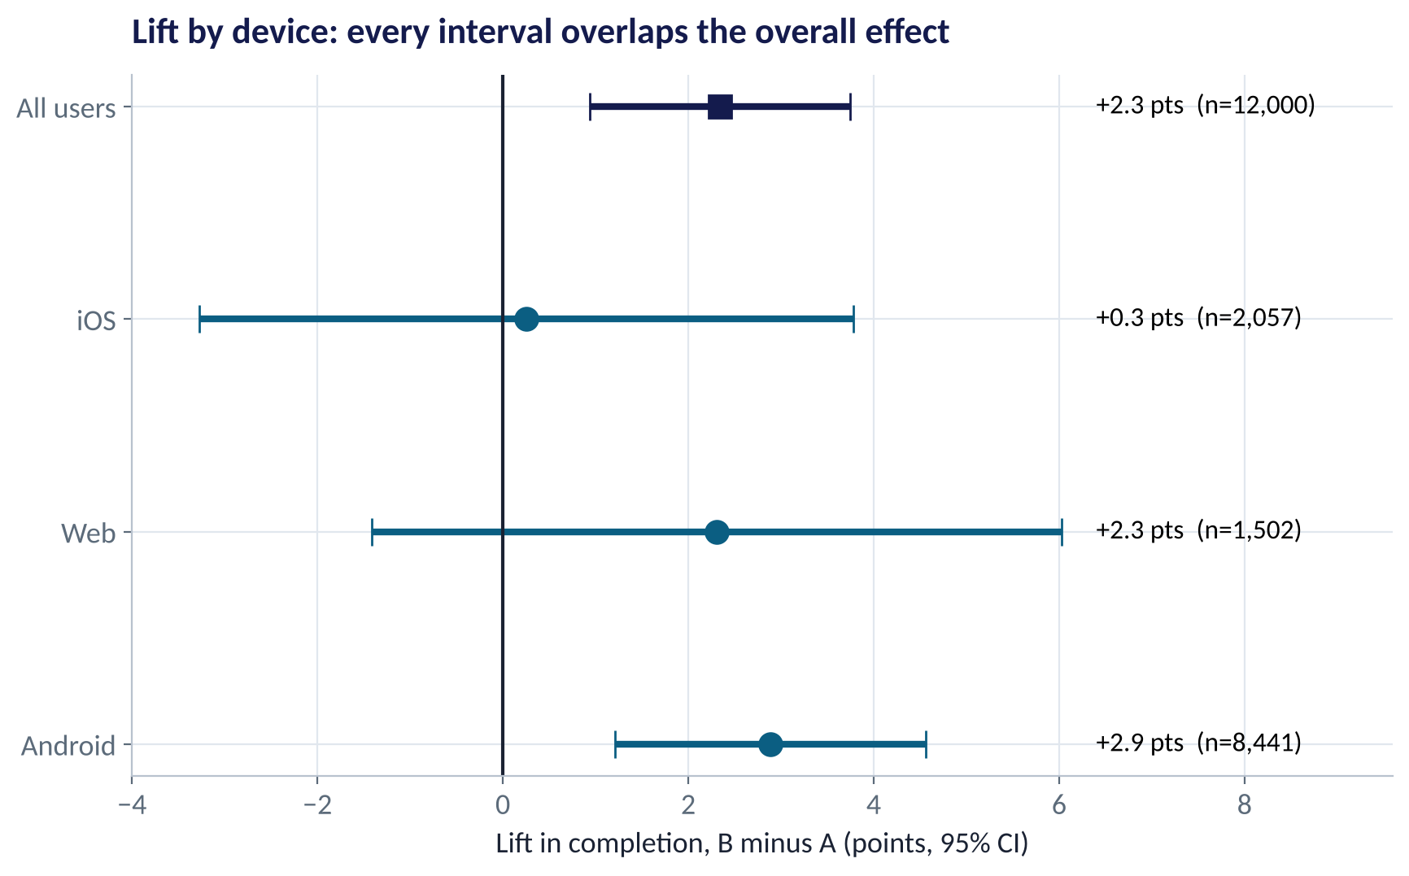
SEGMENTS — HANDLE WITH CARE
Does It Work for Everyone?
WHAT TO SEE
Android: +2.9 points; Web: +2.3; iOS: +0.3.
Tempting: 'don't ship to iOS'. But iOS's interval (−3.2 to +3.8) is wide and overlaps the overall effect.
Slice the data enough ways and some segment will look different by chance.
Treat segment results as hypotheses for the next test, not as decisions.
Fig S3.1-F06 · replicate: tdbg_3_1_figures.R / .py
SESSION 3.1 · EXPERIMENTS THAT SETTLE ARGUMENTS
19

Slide 20
FROM LIFT TO NAIRA
What Is the Lift Worth?
Turning +2.3 points into a monthly value.
Input | Value
New sign-ups per month | 40,000
Lift in completion | +2.34 points
Extra completed users / month | ≈ 937
First-year margin per user | ₦2,500
Low end of CI (+0.9 pts) | ≈ ₦0.9m / month
High end of CI (+3.8 pts) | ≈ ₦3.8m / month
Central estimate | ≈ ₦2.3m / month
STEP BY STEP
1
Extra users = 40,000 × 0.0234 ≈ 937 per month.
2
Value = 937 × ₦2,500 ≈ ₦2.3m per month (≈ ₦28m a year).
3
Use the CI to show the range: ₦0.9m to ₦3.8m per month.
4
Compare with cost: engineering time, and any compliance cost of deferred KYC.
Recommendation: ship B, monitor guardrails weekly, and follow up on iOS with a dedicated test.
SESSION 3.1 · EXPERIMENTS THAT SETTLE ARGUMENTS
20

Slide 21
PART
03
Pitfalls That Ruin Experiments
Most 'surprising wins' are one of these.

Slide 22
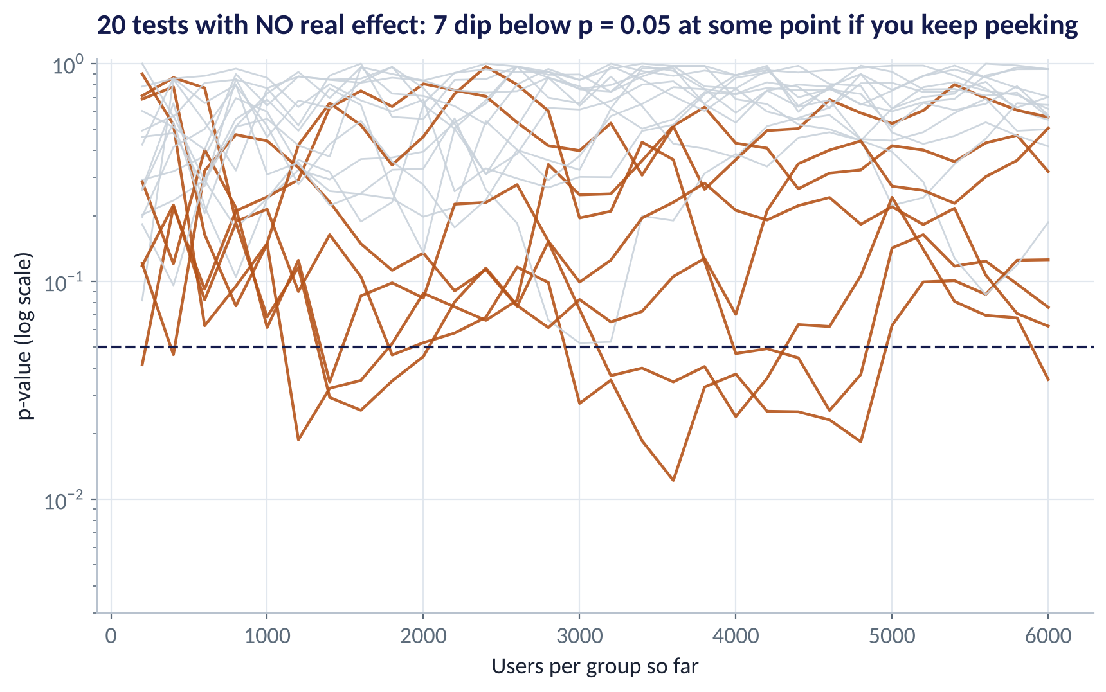
PITFALL 1
Peeking: Stopping When It Looks Good
WHAT TO SEE
Twenty simulated tests where A and B are identical.
Checked after every 200 users, several dip below p = 0.05 at some point.
Stop at the first dip and you 'prove' an effect that does not exist.
Fix: set the sample size in advance and analyse once — or use sequential methods built for peeking.
Fig S3.1-F03 · replicate: tdbg_3_1_figures.R / .py
SESSION 3.1 · EXPERIMENTS THAT SETTLE ARGUMENTS
22

Slide 23






MORE PITFALLS
Six More Ways Experiments Go Wrong
Sample-ratio mismatch
Novelty effect
Interference
Groups not split as planned → a bug, biased data. Check SRM first.
Users click the new thing because it is new; the lift fades. Run full weeks; check trends.
Treated users affect control users (referrals, shared pricing, drivers). Randomise by group or region.
Cherry-picking
Seasonality
Wrong unit
Reporting the one metric or segment that 'won'. Pre-register the primary metric.
Testing only around salary week or Christmas. Cover full business cycles.
Randomising stores but analysing shoppers (Session 2.5). Analyse what you randomised.
SESSION 3.1 · EXPERIMENTS THAT SETTLE ARGUMENTS
23

Slide 24
WHEN YOU CAN'T RANDOMISE USERS
Experiments Beyond the App
Situation | Design | Nigerian example
Change applies to a whole location | Cluster randomisation (stores, branches) | New layout in 12 of 24 randomly chosen stores
Market-level change (price, TV ad) | Geo experiment (matched regions) | Radio campaign in Ibadan and Abeokuta, not in Ilorin and Osogbo
Change rolled out in waves | Stepped-wedge rollout | New credit policy introduced branch by branch over six months
Randomisation impossible | Quasi-experiment (difference-in-differences) | Compare states before and after a regulation, against unaffected states
The logic is always the same: build a fair comparison group so the only systematic difference is the change.
SESSION 3.1 · EXPERIMENTS THAT SETTLE ARGUMENTS
24

Slide 25



HANDS-ON LAB
Lab: Ship, Don't Ship, or Extend?
1
Plan: compute the sample size for an 18% baseline and a 2-point MDE.
YOU WILL NEED
Data
2
Sanity checks: sample-ratio mismatch and device balance.
data/fintech_onboarding_ab.csv
3
Primary metric: completion by variant, CI for the lift, p-value.
R script
sessions/3-1/R/tdbg_3_1_lab.R
4
Guardrails: support tickets and first-deposit size. Segments: device (exploratory only).
Python script
Value: extra completions × ₦2,500 per month, with the CI range.
sessions/3-1/python/tdbg_3_1_lab.py
5
Deliverable: a 5-sentence decision memo: decision, effect, uncertainty, guardrails, value.
⏱ 25 minutes
SESSION 3.1 · EXPERIMENTS THAT SETTLE ARGUMENTS
25

Slide 26



MODULE 1 REVIEW
Practice Paper 1 — What to Expect
75 minutes. Covers Sessions 2.1–3.1. Sections B and C are open-resource.
Section A · 30%
Section B · 40%
Section C · 30%
15 short conceptual questions: data types, summaries, probability, p-values, experiment design.
Interpret provided output: summaries, box plots, CIs, t-test, chi-square and A/B results.
Applied task: design a test (unit, metrics, sample size) or read an experiment and recommend.
Revise the recap slides and rerun the six labs. The Practice Paper 1 review deck has a full practice paper.
SESSION 3.1 · EXPERIMENTS THAT SETTLE ARGUMENTS
26

Slide 27
WORDS TO OWN
Today's Vocabulary in Plain English
A/B test
A randomised experiment comparing two versions.
Power
Chance the test detects a real effect of the MDE size.
Randomisation
Letting chance decide who gets each version.
SRM
Sample-ratio mismatch: groups not split as planned.
Primary metric
The one pre-chosen measure that decides success.
Peeking
Checking repeatedly and stopping early; inflates false alarms.
Guardrail metric
A measure that must not get worse.
Novelty effect
A temporary lift because something is new.
MDE
Minimum detectable effect: smallest lift worth detecting.
Pre-registration
Writing the design down before the test starts.
SESSION 3.1 · EXPERIMENTS THAT SETTLE ARGUMENTS
27

Slide 28
KEY TAKEAWAYS
Session 3.1 in 5 Ideas
01
Randomisation makes the groups alike, so differences can be called causal.
02
Design first: unit, primary metric, guardrails, sample size, duration — written down.
03
Check SRM and balance before reading any result.
04
Decide on the lift, its CI, guardrails and value — segments are hypotheses.
05
Avoid peeking, novelty traps, interference and cherry-picking.
NEXT › Session 3.2: From Association to Prediction
Before next session: Prepare for the Module 1 Practice Paper (Practice Paper 1): rerun all six labs, revise each session's recap, and attempt the practice paper in the Practice Paper 1 deck.

