Slide 1
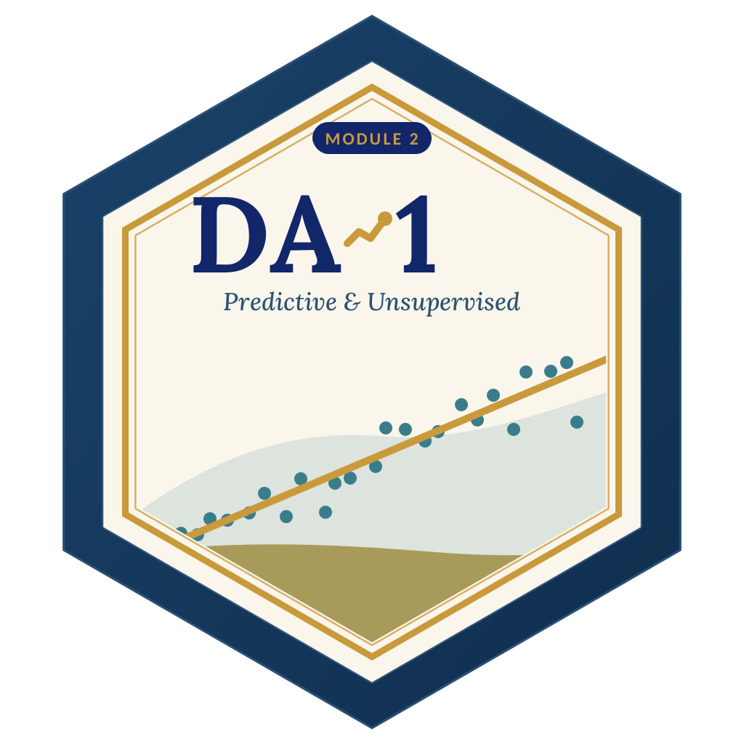

LAGOS BUSINESS SCHOOL · TURNING DATA INTO BUSINESS GROWTH · DAY 3
SESSION 3.2
From Association
to Prediction
Correlation & Linear Regression
Source: Chapters 13–14 — Correlation and Association · Simple & Multiple Linear Regression
AI-Powered Business Analytics: A Practical Textbook for Data-Driven Decision Making · Prof. Bongo Adi

Slide 2

WHERE WE ARE
Programme Roadmap — Days 2 to 5
Three modules across four days, a self-study practice paper for each, and the capstone defence on Friday.
YOU ARE HERE
Module 1
Module 2
Module 3
Finale
Sessions 2.1–3.1
Sessions 3.2–4.2
Sessions 4.3–5.3
Session 5.4
Practice paper — self-study
Practice paper — self-study
Practice paper — self-study
Capstone
Foundations & Inference: data literacy, statistics, EDA, visualisation, hypothesis & A/B testing
Predictive & Unsupervised: regression, classification, ensembles, explainability, clustering & PCA
Advanced & Applied: time series, text, recommendation, neural nets & GenAI, customer, risk, operations & people
Team capstone defence before an external panel
SESSION 3.2 · FROM ASSOCIATION TO PREDICTION
2

Slide 3




TODAY'S PLAN
Session 3.2 at a Glance — 75 Minutes
From 'these move together' to 'here is how much each driver matters'.
10'
30'
30'
5'
Module 1 Debrief
Correlation & Regression
Lab: FMCG Revenue
Wrap-Up
Test feedback; the bridge to prediction
r, least squares, coefficients, R², diagnostics
Build and interpret a multiple regression
What regression can and can't claim
SESSION 3.2 · FROM ASSOCIATION TO PREDICTION
3

Slide 4


BY THE END OF TODAY
Session 3.2 Learning Objectives
You will be able to:
01
02
03
Read Correlation Wisely
Fit & Read a Regression
Check the Model
Interpret r, spot non-linear and outlier traps, and avoid causal over-claims.
Interpret slopes, intercepts, confidence intervals and R² in business units.
Use residual plots to judge whether the straight-line model is trustworthy.
SESSION 3.2 · FROM ASSOCIATION TO PREDICTION
4

Slide 5




THE HOOK
From 'What Happened' to 'What Drives It'
“If I give you ₦5m more for advertising, how much more revenue will we see?” — every CFO, to every marketing director.
Regression is the workhorse of business analytics because it answers three questions at once:
How much?
Holding what fixed?
How well?
The size of each driver's effect, in naira.
Each driver's effect with the others held constant.
How much of the variation the model explains — and how far off its predictions are.

Slide 6




NIGERIAN BUSINESS CASE
What Drives an FMCG Distributor's Revenue?
The situation
The decision question
A Nigerian FMCG company sells through regional distributors. Management debates where the next naira should go: advertising, more outlets, more sales reps, or price.
Which drivers are associated with higher monthly distributor revenue — and by how much each?
The data we have
What a good answer looks like
fmcg_distributor_revenue.csv — 240 distributor-months: revenue, ad spend, price index, active outlets, sales reps, rainfall, region (Lagos, South-West, North, East).
A ranked list of drivers with effect sizes and CIs, plus a what-if forecast — and a clear statement of what the model can't prove.
SESSION 3.2 · FROM ASSOCIATION TO PREDICTION
6

Slide 7
PART
01
Correlation
How strongly do two things move together?

Slide 8

CORRELATION
The Correlation Coefficient r
IN PLAIN ENGLISH
THE FORMULA
−1 ≤ r ≤ +1
r measures how closely two numeric variables follow a straight line. It runs from −1 (perfect downward line) through 0 (no straight-line link) to +1 (perfect upward line). It has no units.
WHY A MANAGER CARES
r is a quick screen for which variables move together. But it says nothing about how much revenue changes per naira (that's the slope), and nothing about cause.
EXAMPLE
Ad spend and revenue: r = 0.59 (moderate positive). Active outlets and revenue: r = 0.61. Rainfall and revenue: r = 0.06 (essentially none).
SESSION 3.2 · FROM ASSOCIATION TO PREDICTION
8

Slide 9
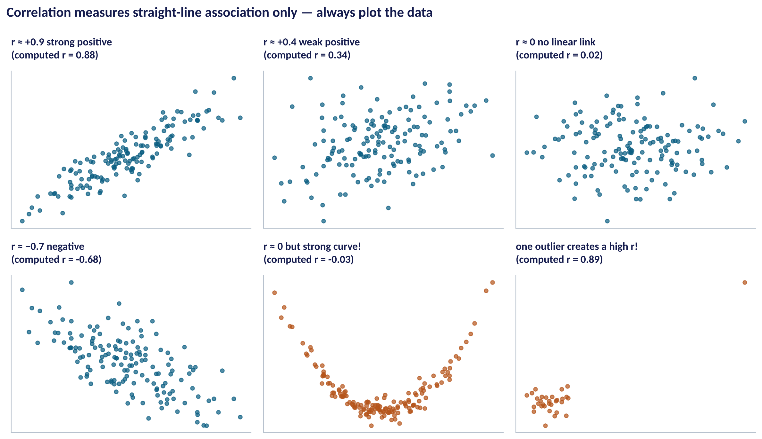
ALWAYS PLOT THE DATA
What r Captures — and What It Misses
WHAT TO SEE
Top row: r summarises straight-line patterns well.
Bottom middle: a perfect curve gives r ≈ 0. r misses non-linear links.
Bottom right: one outlier manufactures a high r from noise.
Rule: never report r without looking at the scatter plot.
Fig S3.2-F02 · replicate: tdbg_3_2_figures.R / .py
SESSION 3.2 · FROM ASSOCIATION TO PREDICTION
9

Slide 10



THE MOST IMPORTANT CAVEAT
Correlation Is Not Causation
Three reasons two things can move together without one causing the other.
A common cause
Reverse causation
Coincidence
Ice-cream sales and drownings both rise in hot weather. In business: ad spend and revenue both rise in December.
Do ads raise sales — or do strong-selling distributors get bigger ad budgets?
Search enough variables and some will correlate by chance (Session 2.5's multiple-testing trap).
SESSION 3.2 · FROM ASSOCIATION TO PREDICTION
10

Slide 11
PART
02
Simple Linear Regression
One driver, one straight line.

Slide 12
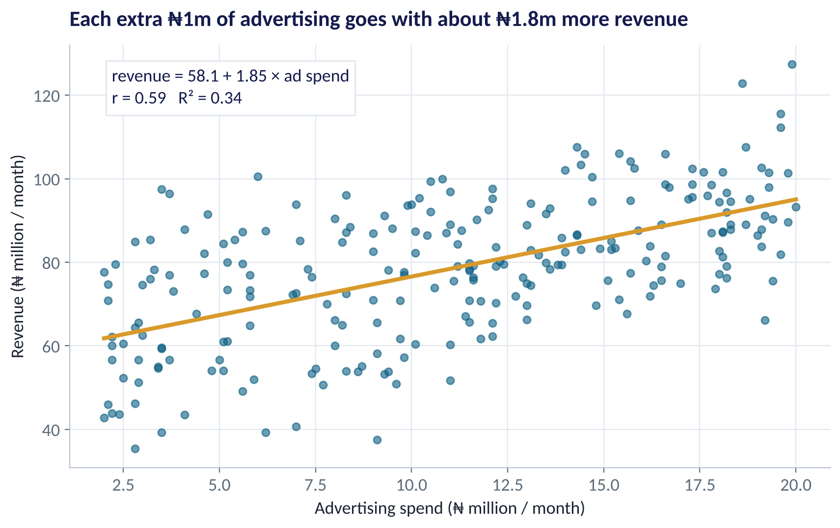
THE REGRESSION LINE
Revenue vs Advertising
WHAT TO SEE
Each dot is one distributor-month.
The line: revenue = 58.1 + 1.85 × ad spend.
Slope 1.85: each extra ₦1m of advertising goes with ₦1.85m more revenue, on average.
Intercept 58.1: predicted revenue at zero ad spend — a mathematical anchor, rarely meaningful on its own.
R² = 0.34: advertising alone explains a third of the variation.
Fig S3.2-F01 · replicate: tdbg_3_2_figures.R / .py
SESSION 3.2 · FROM ASSOCIATION TO PREDICTION
12

Slide 13
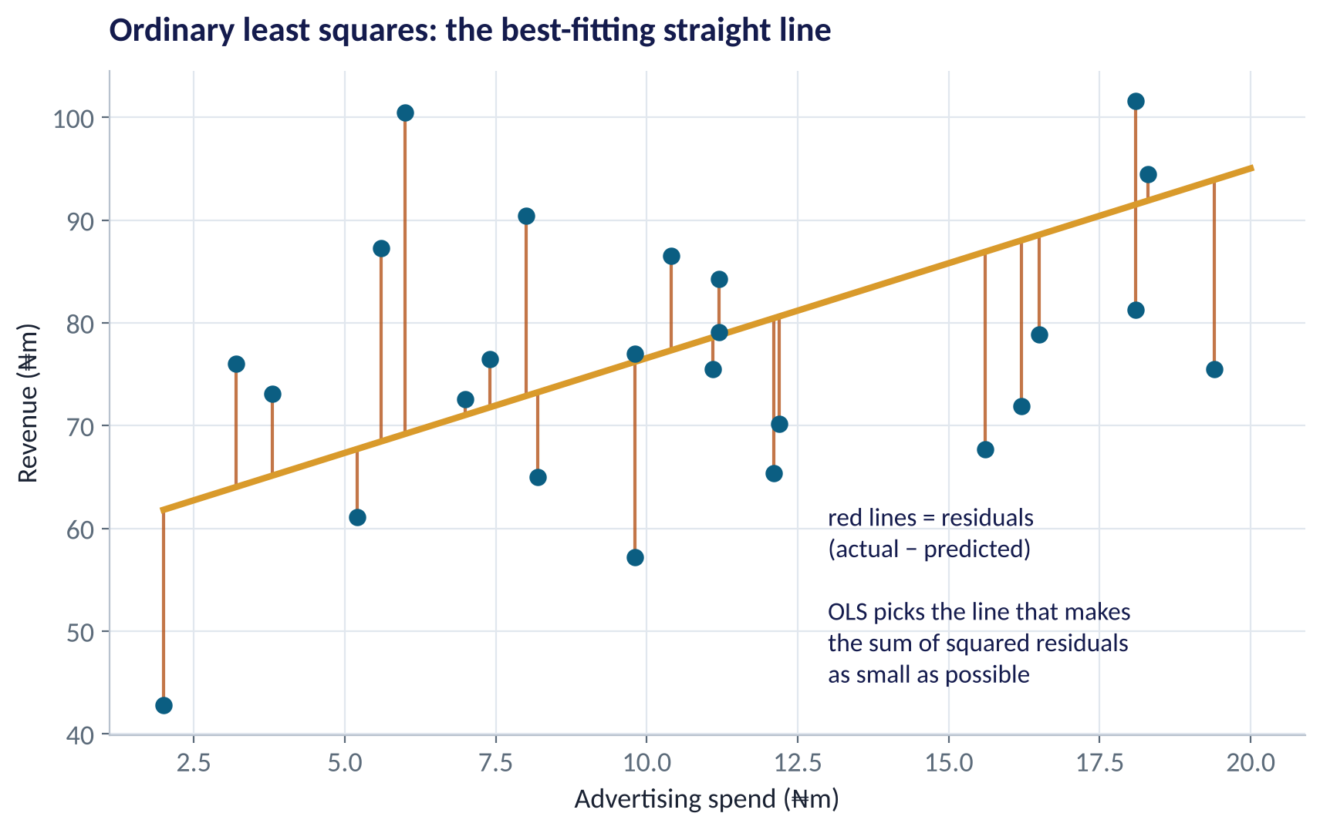
HOW THE LINE IS CHOSEN
Least Squares in One Picture
WHAT TO SEE
A residual is actual minus predicted: the model's miss for one month.
Ordinary least squares (OLS) chooses the line with the smallest sum of squared residuals.
Squaring stops positive and negative misses cancelling — and punishes big misses.
Software does this in milliseconds; your job is to interpret it.
Fig S3.2-F03 · replicate: tdbg_3_2_figures.R / .py
SESSION 3.2 · FROM ASSOCIATION TO PREDICTION
13

Slide 14

THE EQUATION
Reading a Regression Equation
IN PLAIN ENGLISH
THE FORMULA
ŷ = b₀ + b₁x
A regression predicts an outcome (y) from one or more drivers (x). The slope (b₁) is how much y changes, on average, when x rises by one unit. The intercept (b₀) is the predicted y when x is zero.
WHY A MANAGER CARES
Slopes are in business units — '₦1.85m per ₦1m' — which makes them easy to discuss with finance. Always give the CI too: R says ₦1.52m to ₦2.17m per ₦1m for the simple model.
EXAMPLE
ŷ = 58.1 + 1.85 × ad spend. At ₦10m of advertising: 58.1 + 18.5 = ₦76.6m predicted revenue.
SESSION 3.2 · FROM ASSOCIATION TO PREDICTION
14

Slide 15

GOODNESS OF FIT
R² — How Much Does the Model Explain?
IN PLAIN ENGLISH
THE FORMULA
R² = 1 − (unexplained ÷ total variation)
R² is the share of the variation in the outcome that the model accounts for. 0 means the model explains nothing; 1 means it predicts perfectly. With one driver, R² = r².
WHY A MANAGER CARES
High R² is good for prediction — but a model with low R² can still reveal an important, real effect. And R² always rises when you add variables, even useless ones. Use adjusted R² to compare models of different sizes.
EXAMPLE
Ad spend alone: R² = 0.34 (0.59² ≈ 0.34). All drivers: R² = 0.86.
SESSION 3.2 · FROM ASSOCIATION TO PREDICTION
15

Slide 16
PART
03
Multiple Regression
Several drivers at once — 'holding the others fixed'.

Slide 17
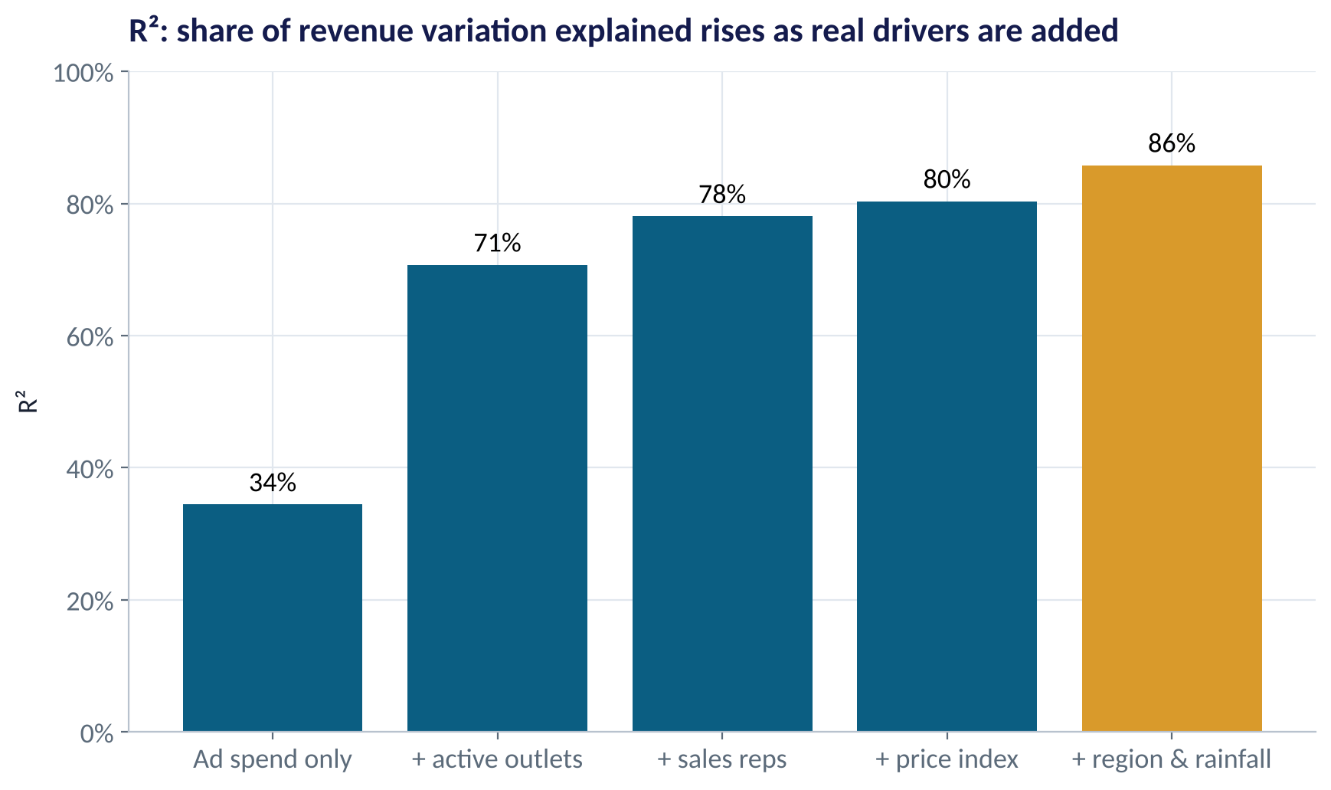
ADDING DRIVERS
More Real Drivers, More Explained
WHAT TO SEE
Ad spend alone: 34% of revenue variation explained.
Adding active outlets jumps to 71% — distribution reach matters enormously.
Sales reps and price add more; region and rainfall finish at 86%.
Each added driver must earn its place — Session 3.3 tackles that properly.
Fig S3.2-F04 · replicate: tdbg_3_2_figures.R / .py
SESSION 3.2 · FROM ASSOCIATION TO PREDICTION
17

Slide 18
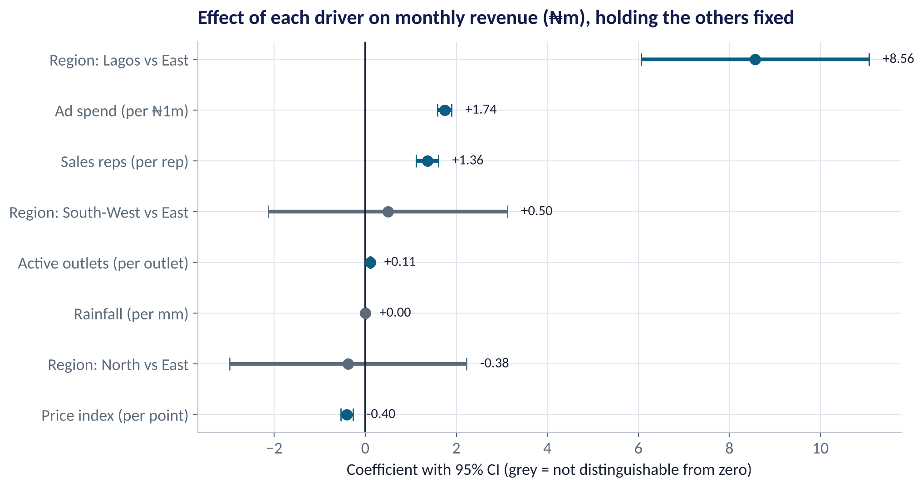
THE MULTIPLE REGRESSION
Each Driver's Effect, Holding the Others Fixed
WHAT TO SEE
Ad spend: +₦1.74m revenue per ₦1m (CI 1.58 to 1.90).
Each active outlet: +₦0.11m; each sales rep: +₦1.36m.
Price index: −₦0.40m per point.
Lagos: +₦8.6m vs East. North and South-West not different from East.
Rainfall: no detectable effect (CI spans zero).
Fig S3.2-F05 · replicate: tdbg_3_2_figures.R / .py
SESSION 3.2 · FROM ASSOCIATION TO PREDICTION
18

Slide 19
HOW TO READ THIS OUTPUT
Reading R's summary(lm())
R OUTPUT
1
Estimate
Coefficients:
Estimate Std. Error t value Pr(>|t|)
(Intercept) 59.3200 7.0325 8.435 3.6e-15
ad_spend_m_naira 1.7411 0.0794 21.924 < 2e-16
price_index -0.4038 0.0683 -5.914 1.2e-08
active_outlets 0.1080 0.0049 21.891 < 2e-16
sales_reps 1.3637 0.1234 11.055 < 2e-16
rainfall_mm 0.0005 0.0063 0.085 0.932
regionLagos 8.5646 1.2706 6.740 1.3e-10
regionNorth -0.3776 1.3208 -0.286 0.775
regionSouth-West 0.4960 1.3334 0.372 0.710
Residual standard error: 6.484 on 231 df
Multiple R-squared: 0.8577, Adjusted: 0.8527
F-statistic: 174 on 8 and 231 DF, p < 2.2e-16
The effect per one-unit change, others held fixed. Ad spend: +₦1.74m per ₦1m.
2
Std. Error & t
Precision. t = estimate ÷ SE; |t| > 2 ≈ significant at 5%.
3
Pr(>|t|)
p-value for 'this effect is zero'. Rainfall: 0.93 — no evidence of any effect.
4
Residual SE & R²
Typical miss ≈ ₦6.5m; 86% of variation explained.
SESSION 3.2 · FROM ASSOCIATION TO PREDICTION
19

Slide 20


CATEGORIES IN REGRESSION
How Regions Enter the Model
Categorical drivers become 0/1 'dummy' variables compared with a baseline.
Pick a baseline
One dummy per other level
Read as a gap
East is the reference region. Every region coefficient is a difference from East.
regionLagos = 1 for Lagos rows, 0 otherwise — and the same for North and South-West.
Lagos +8.6: a Lagos distributor-month earns ₦8.6m more than an otherwise-identical East one.
SESSION 3.2 · FROM ASSOCIATION TO PREDICTION
20

Slide 21
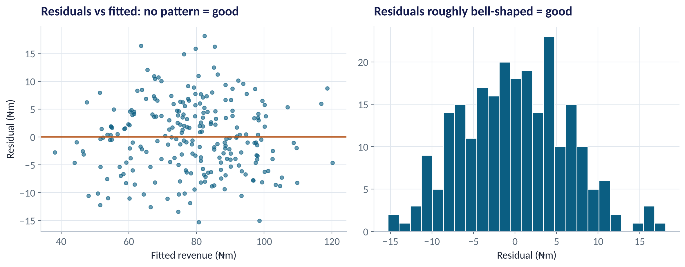
IS THE MODEL TRUSTWORTHY?
Residual Diagnostics
WHAT TO SEE
Left: residuals scatter randomly around zero with even spread — the straight-line model fits.
Warning signs: a curve (missing non-linearity), a funnel (spread grows with size), clusters.
Right: residuals roughly bell-shaped — confidence intervals are reliable.
R: plot(model); Python: plot fitted vs resid.
Fig S3.2-F06 · replicate: tdbg_3_2_figures.R / .py
SESSION 3.2 · FROM ASSOCIATION TO PREDICTION
21

Slide 22
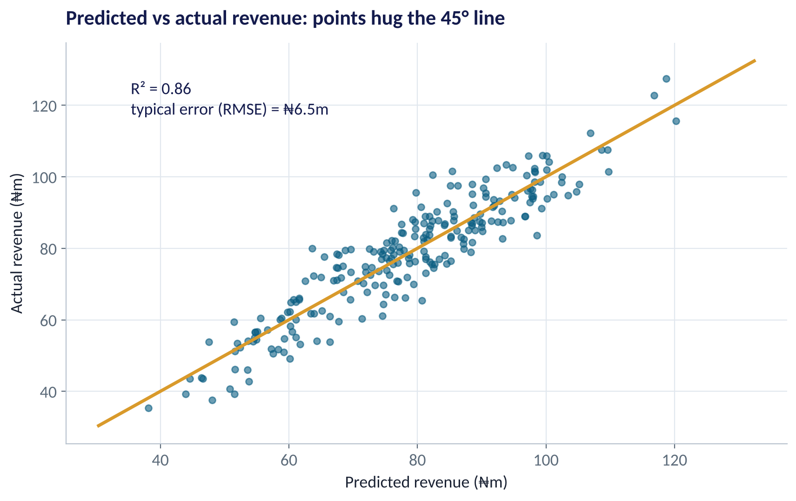
PREDICTION
How Good Are the Predictions?
WHAT TO SEE
Points close to the 45° line = accurate predictions.
Typical error (residual SE / RMSE): about ₦6.5m on revenue of ₦40m–₦130m.
A prediction interval for one month is roughly ±₦13m — much wider than the CI for an average.
Session 3.3: test predictions on data the model has not seen.
Fig S3.2-F07 · replicate: tdbg_3_2_figures.R / .py
SESSION 3.2 · FROM ASSOCIATION TO PREDICTION
22

Slide 23
FROM COEFFICIENT TO DECISION
Is Another ₦5m of Advertising Worth It?
Item | Value
Extra ad spend | ₦5.0m
Revenue per ₦1m ad (coefficient) | ₦1.74m
Extra revenue | ≈ ₦8.7m
Gross margin | 25%
Extra gross profit | ≈ ₦2.2m
Net of ad cost | ≈ −₦2.8m
STEP BY STEP
1
Extra revenue = 5 × 1.74 ≈ ₦8.7m (CI ₦7.9m to ₦9.5m).
2
At a 25% gross margin, that is ≈ ₦2.2m of gross profit.
3
Against ₦5m of extra spend: a loss of about ₦2.8m — on these numbers.
4
But the coefficient may not be causal, and brand effects can last beyond the month. Test it (Session 3.1) before cutting or raising budgets.
Revenue up ≠ profit up. Always convert coefficients into margin before deciding.
SESSION 3.2 · FROM ASSOCIATION TO PREDICTION
23

Slide 24


WHERE MANAGERS GO WRONG
Regression Mistakes Managers Make
THE TRAP
THE BETTER HABIT
“Advertising causes ₦1.74m of revenue per ₦1m.”
“Is associated with, holding other drivers fixed.” Test causation.
Comparing raw coefficients to rank drivers with different units.
Compare realistic changes (e.g. +10 outlets vs +₦1m ads) or standardise.
Predicting far outside the data (₦80m of ads when the data stop at ₦20m).
Stay within the range you observed.
Celebrating a high R² without checking residuals.
Look at residual plots first.
Dropping a driver because p = 0.08.
Keep drivers that make business sense; report CIs.
SESSION 3.2 · FROM ASSOCIATION TO PREDICTION
24

Slide 25

CONCEPT CHECK
Quick Check: What Would You Say?
In the full model, the active_outlets coefficient is 0.108 (CI 0.098 to 0.118). Which statement is best?
A
Each additional outlet causes ₦108,000 more revenue
B
Holding ad spend, price, reps, rainfall and region fixed, each additional active outlet is associated with about ₦108,000 (₦98k–₦118k) more monthly revenue
C
Outlets explain 10.8% of revenue
D
Outlets matter less than ads because 0.108 < 1.74
Discuss with your neighbour for 60 seconds — answer and reasoning in the speaker notes.
SESSION 3.2 · FROM ASSOCIATION TO PREDICTION
25

Slide 26



HANDS-ON LAB
Lab: Model the Distributor's Revenue
1
Explore: correlation matrix and scatter-plot matrix.
YOU WILL NEED
Data
2
Fit the simple regression of revenue on ad spend; read the slope, CI and R².
data/fmcg_distributor_revenue.csv
3
Fit the multiple regression with all drivers and East as the baseline region.
R script
sessions/3-2/R/tdbg_3_2_lab.R
4
Check residual plots; then predict revenue for two what-if scenarios with prediction intervals.
Python script
Your turn: interpret outlets for a sales director; test the ₦5m ad case at a 25% margin; name one causal threat.
sessions/3-2/python/tdbg_3_2_lab.py
5
Deliverable: a one-slide driver ranking with effect sizes, CIs and one caveat.
⏱ 30 minutes
SESSION 3.2 · FROM ASSOCIATION TO PREDICTION
26

Slide 27
WORDS TO OWN
Today's Vocabulary in Plain English
Correlation (r)
Strength of a straight-line link, from −1 to +1.
OLS
Ordinary least squares: minimises squared residuals.
Regression
A model predicting an outcome from one or more drivers.
R²
Share of outcome variation the model explains.
Slope / coefficient
Change in outcome per one-unit change in a driver.
Adjusted R²
R² penalised for the number of drivers.
Intercept
Predicted outcome when all drivers are zero.
Dummy variable
A 0/1 column representing a category.
Residual
Actual minus predicted: the model's miss.
Prediction interval
Range for a single new outcome; wider than a CI.
SESSION 3.2 · FROM ASSOCIATION TO PREDICTION
27

Slide 28
KEY TAKEAWAYS
Session 3.2 in 5 Ideas
01
r measures straight-line association only — always plot, and never read it as cause.
02
A regression slope is the change in the outcome per unit of the driver, in business units.
03
Multiple regression estimates each effect holding the others fixed.
04
R² measures fit; residual plots tell you whether to trust the model.
05
Convert coefficients to profit, and test causal claims before acting.
NEXT › Session 3.3: Forecasts That Survive New Data
Before next session: Read Chapters 15–16 (Regularised Regression; Predictive Sales Analytics). Think about why a model with 20 drivers might predict next month worse than one with 5.

