Slide 1
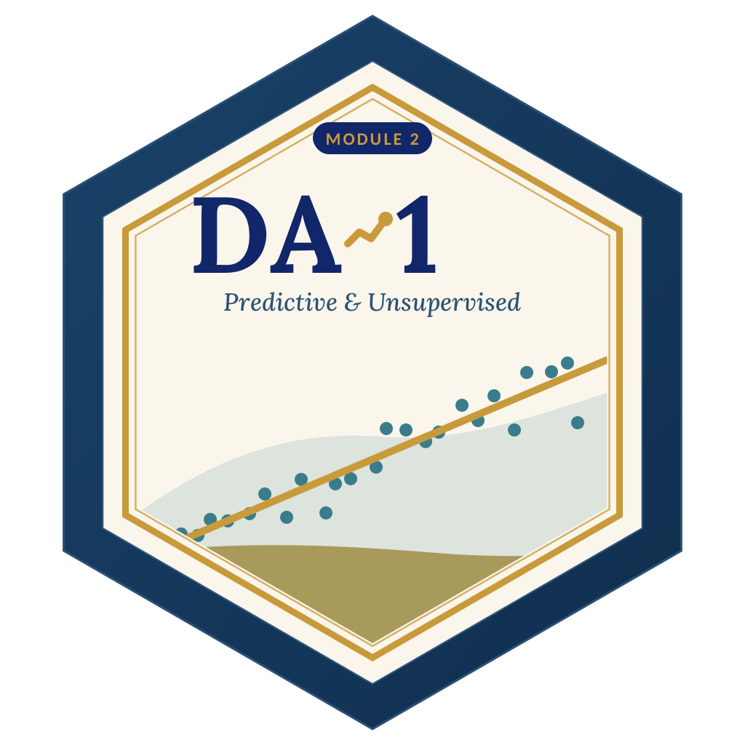
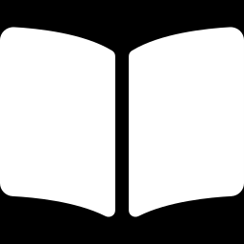
LAGOS BUSINESS SCHOOL · TURNING DATA INTO BUSINESS GROWTH · DAY 3
SESSION 3.3
Forecasts That Survive
New Data
Regularised Regression & Predictive Sales
Source: Chapters 15–16 — Regularised Regression & Feature Selection · Predictive Sales Analytics
AI-Powered Business Analytics: A Practical Textbook for Data-Driven Decision Making · Prof. Bongo Adi

Slide 2
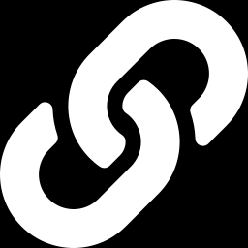
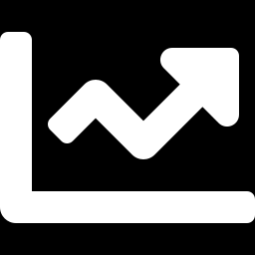
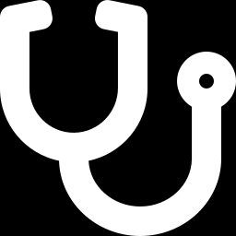

RECAP
Session 3.2 in Three Ideas
Correlation
r measures straight-line association only — always plot, never read it as cause.
Coefficients
Each slope is the change in outcome per unit of a driver, holding the others fixed.
Diagnostics
R² measures fit; residual plots tell you whether to trust the model.
SESSION 3.3 · FORECASTS THAT SURVIVE NEW DATA
2

Slide 3
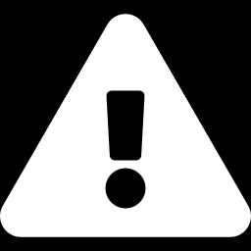
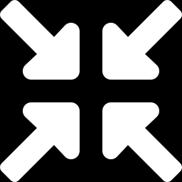
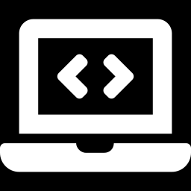
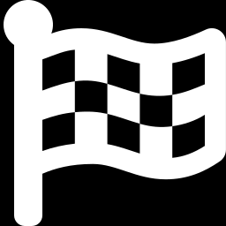
TODAY'S PLAN
Session 3.3 at a Glance — 75 Minutes
From explaining the past to predicting the future — honestly.
10'
30'
30'
5'
Recap & Hook
Overfitting & Regularisation
Lab: New SKU Forecast
Wrap-Up
Why the best-fitting model can forecast worst
Bias–variance, train/test, CV, ridge, lasso
Predict weekly cases from only 60 weeks
Rules for honest validation
SESSION 3.3 · FORECASTS THAT SURVIVE NEW DATA
3

Slide 4
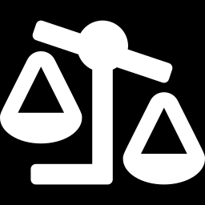
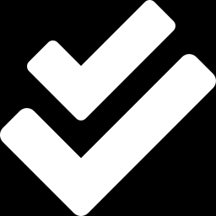
BY THE END OF TODAY
Session 3.3 Learning Objectives
You will be able to:
01
02
03
Explain Overfitting
Apply Ridge & Lasso
Validate Honestly
Describe the bias–variance trade-off and why training error flatters a model.
Use penalised regression to shrink coefficients and select drivers automatically.
Judge models with train/test splits and cross-validation — never on the data they learned from.
SESSION 3.3 · FORECASTS THAT SURVIVE NEW DATA
4

Slide 5
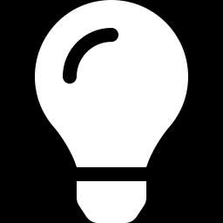
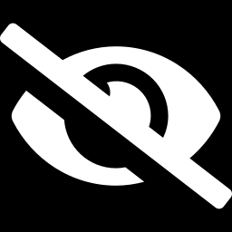
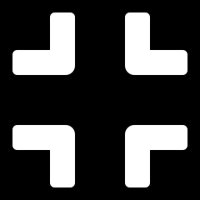
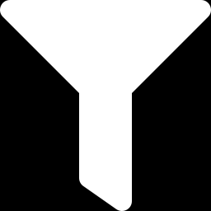
THE HOOK
The Model That Knew Too Much
“Our new forecast fits last year with 99% accuracy.” Three months later, it misses by 30%.
A model that memorises the past learns its noise as if it were signal. In prediction, you must:
Hide some data
Keep it simple
Let data choose
Judge the model on data it has never seen.
Penalise complexity so noise can't masquerade as signal.
Use cross-validation to pick which drivers and how much penalty.

Slide 6
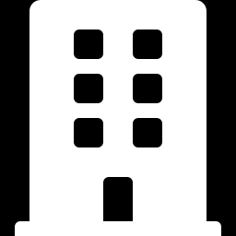
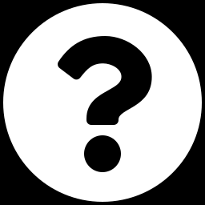
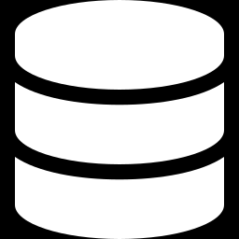
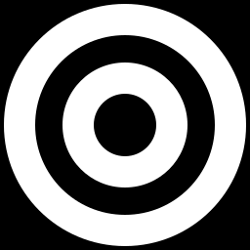
NIGERIAN BUSINESS CASE
Forecasting Sales for a New Beverage SKU
The situation
The decision question
A Nigerian beverage company launched a new SKU. Brand managers have a long list of 24 candidate drivers — price, promotions, shelf facings, distribution, weather, media, and more — but only 60 weeks of sales history.
Which drivers really matter, and how accurately can we forecast weekly cases for planning production and distribution?
The data we have
What a good answer looks like
beverage_sku_sales.csv — 400 SKU-weeks across 5 regions. We train on the first 60 weeks and test on the other 340. Ten of the 24 drivers are pure noise; one is a near-duplicate.
A forecast model with honest out-of-sample accuracy and a short list of drivers the brand team can act on.
SESSION 3.3 · FORECASTS THAT SURVIVE NEW DATA
6

Slide 7
PART
01
Overfitting
Fitting the past is easy. Predicting the future is the job.

Slide 8
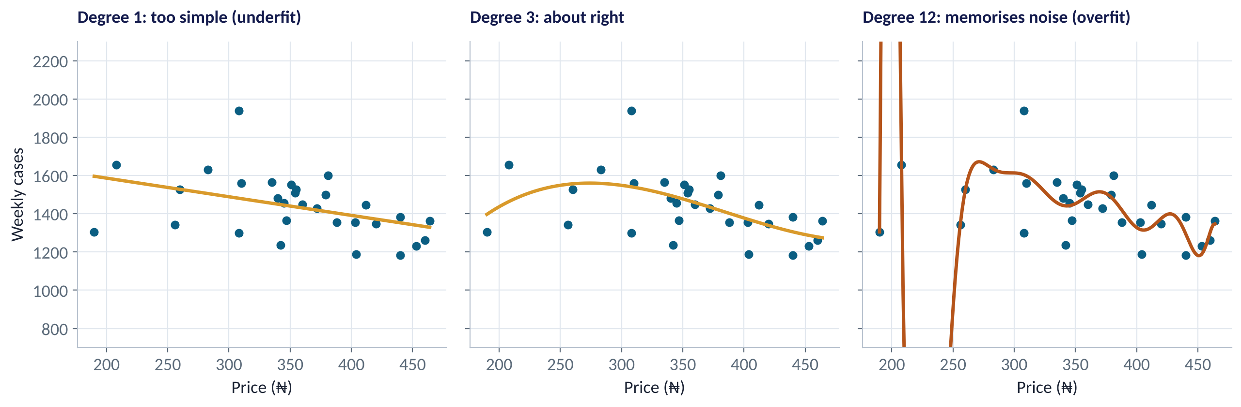
THE CORE PROBLEM
Underfit, About Right, Overfit
WHAT TO SEE
Left: a straight line misses the curve — high bias.
Middle: a gentle curve captures the pattern.
Right: a wiggly curve passes near every point — and makes absurd predictions in between. High variance.
Overfit models are confident and wrong on new data.
Fig S3.3-F01 · replicate: tdbg_3_3_figures.R / .py
SESSION 3.3 · FORECASTS THAT SURVIVE NEW DATA
8

Slide 9
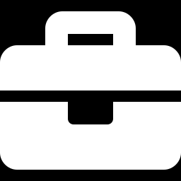
BIAS VS VARIANCE
The Bias–Variance Trade-Off
IN PLAIN ENGLISH
THE FORMULA
error ≈ bias² + variance + noise
Bias is error from a model that is too simple to capture the pattern. Variance is error from a model so flexible that it chases noise and changes wildly with each new sample. Total prediction error depends on both — so the best model is in between.
WHY A MANAGER CARES
More data lets you afford more complexity. With little data — new products, new markets, new branches — simpler is safer. Regularisation is a dial for choosing where you sit on this trade-off.
EXAMPLE
A forecast using only price is biased (misses promotions). A forecast using all 24 drivers on 60 weeks has high variance (learns the noise).
SESSION 3.3 · FORECASTS THAT SURVIVE NEW DATA
9

Slide 10
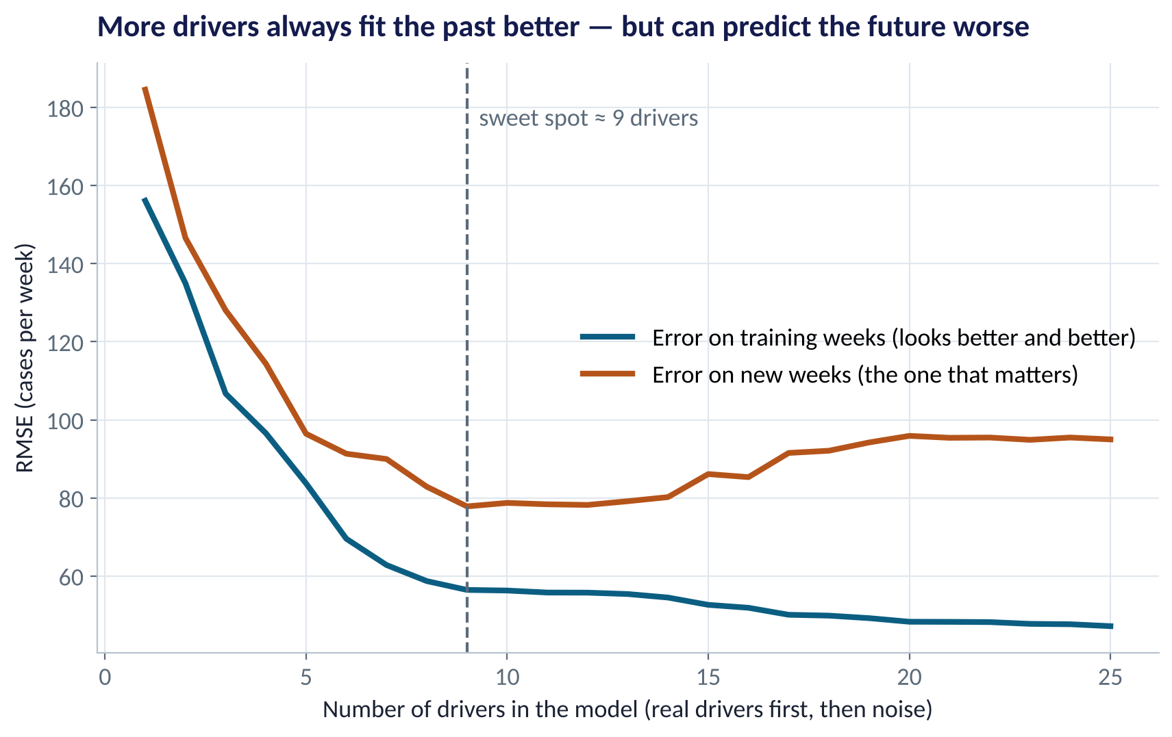
THE TELL-TALE SIGN
Training Error Lies; Test Error Tells the Truth
WHAT TO SEE
Adding drivers always lowers training error (blue).
Test error (red) falls, then rises once noise drivers enter.
Sweet spot here: about 9 drivers — the real ones.
Rule: never report training accuracy as model accuracy.
Fig S3.3-F02 · replicate: tdbg_3_3_figures.R / .py
SESSION 3.3 · FORECASTS THAT SURVIVE NEW DATA
10

Slide 11
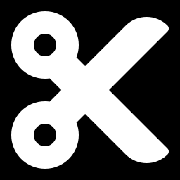
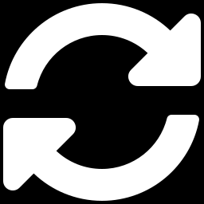
HONEST VALIDATION
Train / Test Split vs Cross-Validation
Train / test split
k-fold cross-validation
Hold back a test set; touch it once
Rotate which part is held out
Fit on training data only
Report error on the untouched test set
Simple and transparent
With little data, one split can be lucky or unlucky
Split training data into k folds (often 5 or 10)
Fit k times, each time validating on one fold
Average the k errors
Used to tune choices like the penalty λ
Use CV to choose the model; keep a separate test set for the final, honest score. For time series, never shuffle — always test on the future (Session 4.3).
SESSION 3.3 · FORECASTS THAT SURVIVE NEW DATA
11

Slide 12
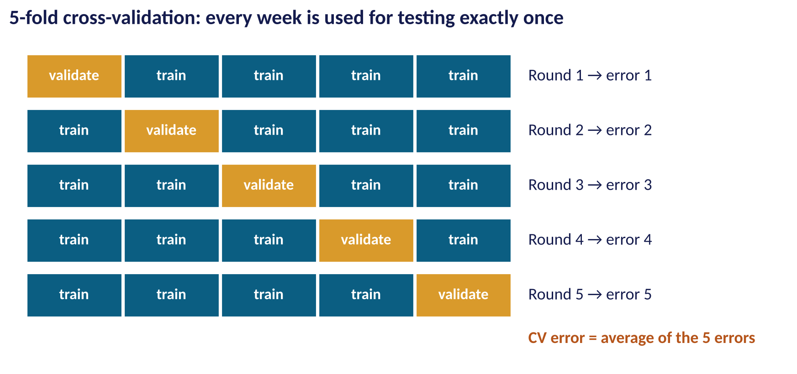
HOW CV WORKS
Five-Fold Cross-Validation
WHAT TO SEE
Split the training data into 5 equal folds.
Train on 4, validate on the 5th; repeat 5 times.
Every observation is validated exactly once.
The average error estimates out-of-sample performance.
Fig S3.3-F03 · replicate: tdbg_3_3_figures.R / .py
SESSION 3.3 · FORECASTS THAT SURVIVE NEW DATA
12

Slide 13
PART
02
Regularisation: Ridge and Lasso
Regression with a penalty for complexity.

Slide 14
THE IDEA
Penalised Regression in Plain English
IN PLAIN ENGLISH
THE FORMULA
minimise: errors² + λ × size of coefficients
Ordinary regression picks coefficients that fit the training data as closely as possible. Regularised regression adds a penalty for large coefficients. The model must now 'pay' for every driver it uses heavily — so only drivers that really help survive.
λ (lambda) sets how strong the penalty is — chosen by cross-validation
WHY A MANAGER CARES
Regularisation protects you from noisy drivers, near-duplicate drivers and small samples — exactly the conditions of new products, new markets and long wish-lists of KPIs.
EXAMPLE
λ = 0 → ordinary regression. Very large λ → all coefficients squeezed to zero (predict the average). The best λ is somewhere between.
SESSION 3.3 · FORECASTS THAT SURVIVE NEW DATA
14

Slide 15
TWO PENALTIES
Ridge vs Lasso
Ridge (L2)
Lasso (L1)
Penalty on squared coefficients
Penalty on absolute coefficients
Shrinks all coefficients towards zero
Keeps every driver in the model
Excellent when many drivers each matter a little
Handles near-duplicate drivers by sharing the weight
Shrinks — and sets some coefficients exactly to zero
Performs automatic driver selection
Gives a shorter, explainable model
With near-duplicates, tends to keep one and drop the other
Elastic net blends both. In R: glmnet(alpha = 0 ridge, 1 lasso, between = elastic net). In Python: Ridge, Lasso, ElasticNet.
SESSION 3.3 · FORECASTS THAT SURVIVE NEW DATA
15

Slide 16
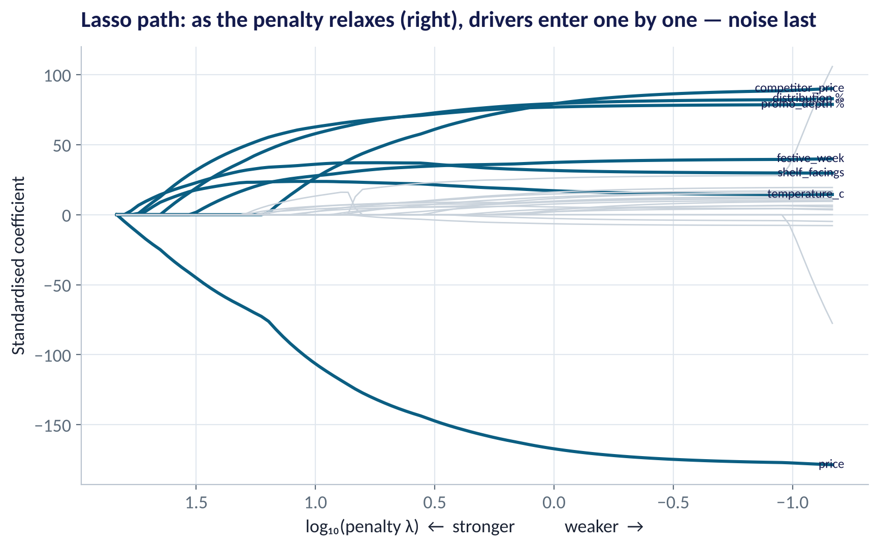
WATCHING LASSO WORK
The Lasso Path
WHAT TO SEE
Left: strong penalty — every coefficient is zero.
Moving right, drivers enter one by one: price, distribution, promotions, competitor price…
The noise drivers (grey) enter last and stay small.
The path shows which drivers carry the most signal.
Fig S3.3-F04 · replicate: tdbg_3_3_figures.R / .py
SESSION 3.3 · FORECASTS THAT SURVIVE NEW DATA
16

Slide 17
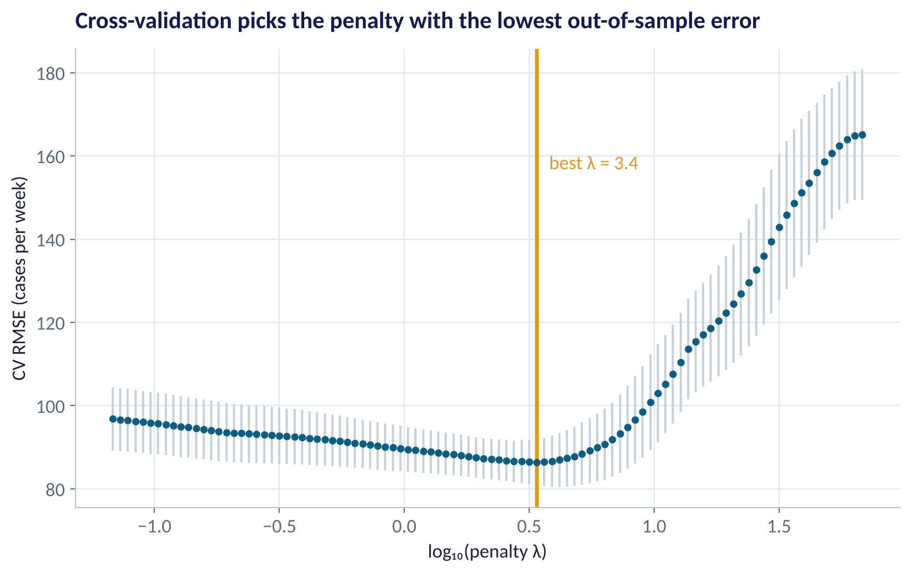
CHOOSING THE PENALTY
Cross-Validation Picks the Penalty
WHAT TO SEE
Each dot: CV error for one value of λ.
Too much penalty (right): underfit. Too little (left): overfit.
Best λ ≈ 3.4 on standardised drivers.
Many analysts prefer the one-standard-error rule: the simplest model within 1 SE of the best.
Fig S3.3-F05 · replicate: tdbg_3_3_figures.R / .py
SESSION 3.3 · FORECASTS THAT SURVIVE NEW DATA
17

Slide 18
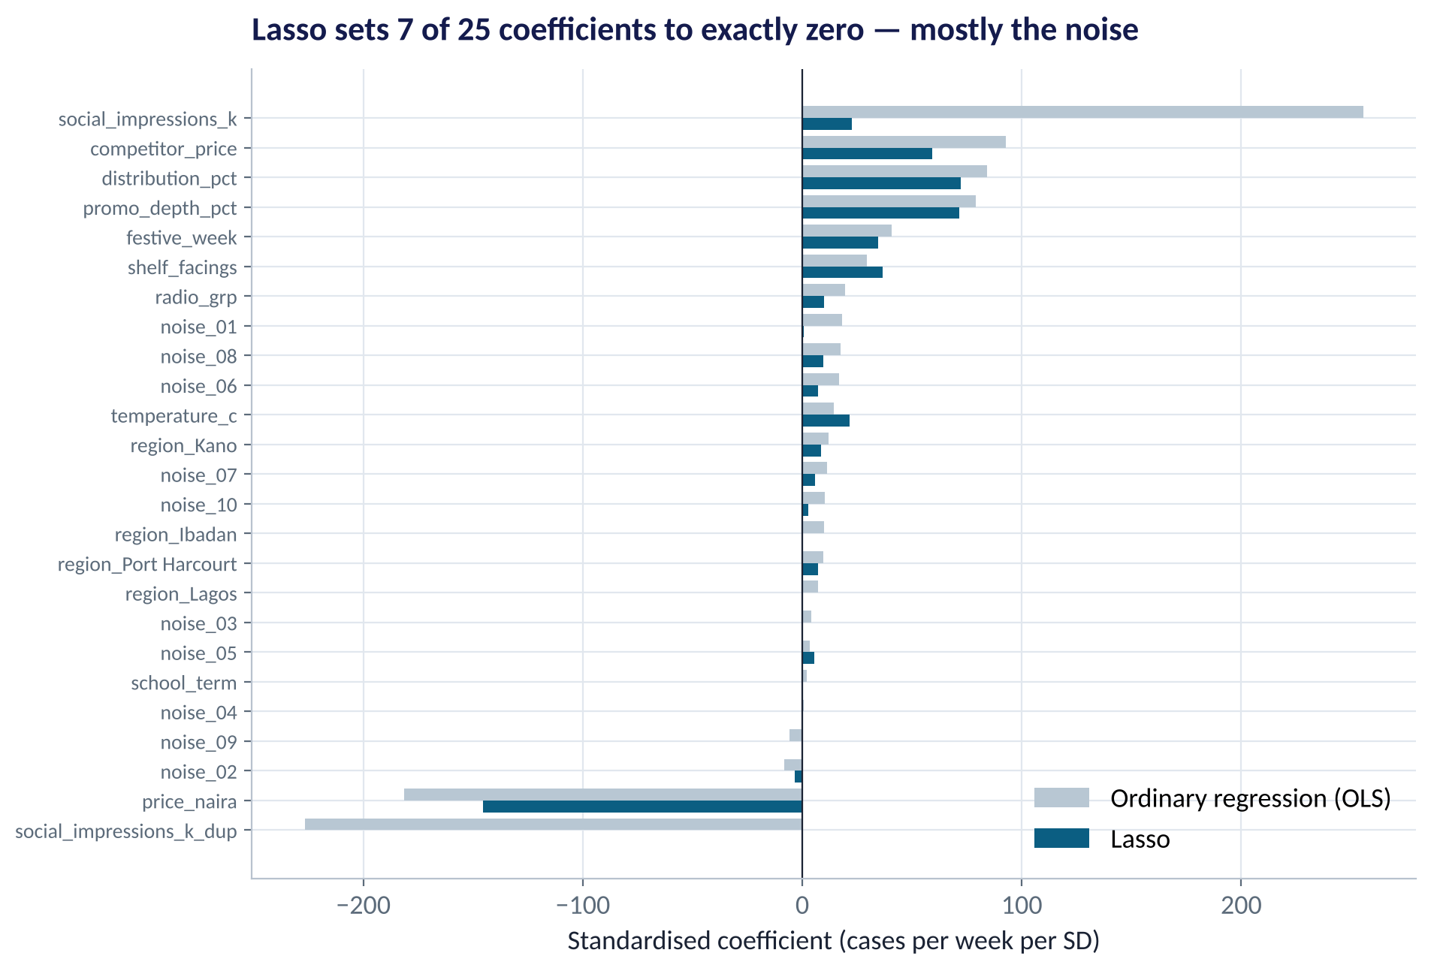
WHAT LASSO KEPT
Ordinary Regression vs Lasso, Driver by Driver
WHAT TO SEE
OLS gives social impressions +250 and its near-duplicate −230 — nonsense caused by collinearity.
Lasso keeps one modest coefficient instead.
Lasso sets 7 of 25 coefficients exactly to zero — mostly noise.
Real drivers keep sensible signs: price −, distribution +, promotion +.
Fig S3.3-F06 · replicate: tdbg_3_3_figures.R / .py
SESSION 3.3 · FORECASTS THAT SURVIVE NEW DATA
18

Slide 19
PART
03
Predictive Sales in Practice
Did the extra discipline pay off?

Slide 20
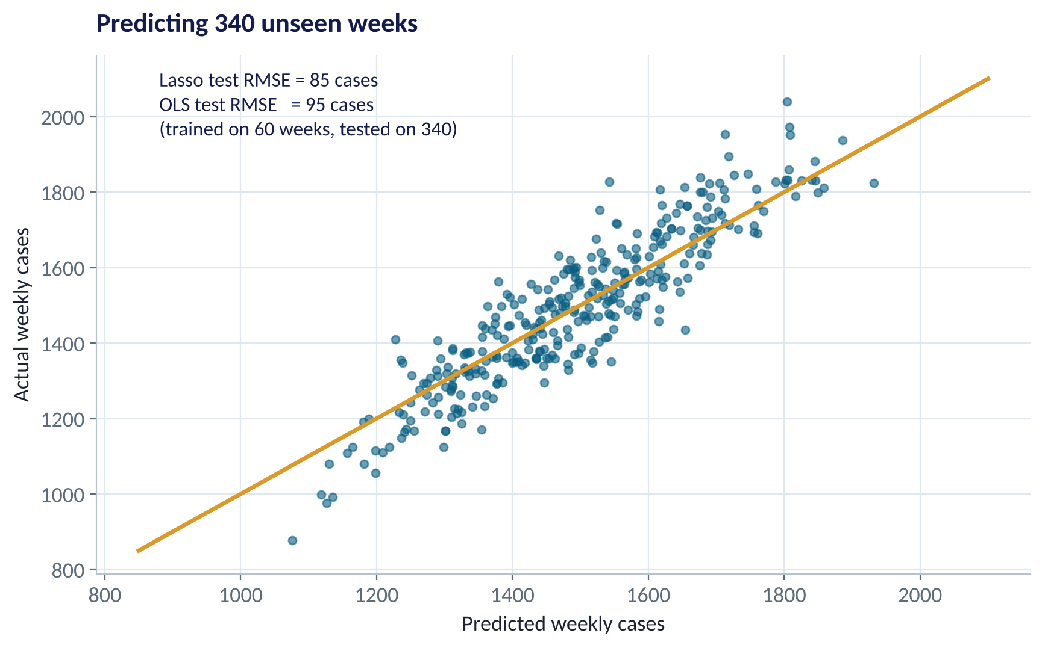
THE TEST
Predicting 340 Weeks the Model Never Saw
WHAT TO SEE
Trained on 60 weeks, tested on 340.
Lasso test RMSE ≈ 85 cases; OLS ≈ 95 cases — about 10% better.
Average sales are about 1,490 cases a week, so lasso's typical miss is ~6%.
For production planning, a 10-case error reduction compounds across SKUs and regions.
Fig S3.3-F08 · replicate: tdbg_3_3_figures.R / .py
SESSION 3.3 · FORECASTS THAT SURVIVE NEW DATA
20

Slide 21
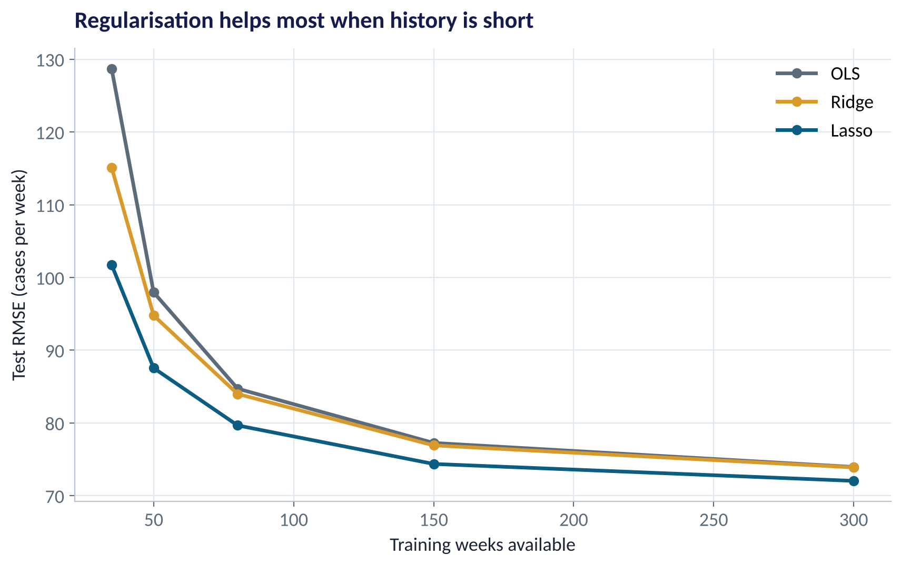
WHEN DOES IT MATTER?
Regularisation Pays Most With Little Data
WHAT TO SEE
With 35 weeks, lasso's error is ~20% lower than OLS.
With 300 weeks, all three methods converge.
So regularise new products, new markets, new branches — and any model with more drivers than you can trust.
Even with lots of data, lasso gives a simpler model.
Fig S3.3-F07 · replicate: tdbg_3_3_figures.R / .py
SESSION 3.3 · FORECASTS THAT SURVIVE NEW DATA
21

Slide 22
HOW TO READ THIS OUTPUT
Reading coef() From a Cross-Validated Lasso
R OUTPUT
1
Numbers = kept drivers
> coef(cv_lasso, s = "lambda.1se")
s1
(Intercept) 1243.30
regionKano 25.42
regionPort Harcourt 20.50
price_naira -2.30
promo_depth_pct 10.32
shelf_facings 12.45
temperature_c 7.42
distribution_pct 4.45
competitor_price 0.81
festive_week 115.20
school_term .
noise_03 .
noise_04 .
social_impressions_k_dup .
... (other rows omitted)
Coefficients in original units: each extra ₦1 of price costs about 2.3 cases a week; a festive week adds ~115.
2
Dots (.) = dropped
Exactly zero: lasso decided these drivers add nothing.
3
lambda.1se
The simplest model within 1 SE of the best CV error — easier to explain.
4
Shrunk values
Penalised coefficients are biased towards zero — use them to predict and rank, not as exact causal effects.
SESSION 3.3 · FORECASTS THAT SURVIVE NEW DATA
22

Slide 23


WHERE MANAGERS GO WRONG
How Predictive Models Mislead
THE TRAP
THE BETTER HABIT
Reporting training accuracy (R² 0.95!) to the board.
Report test or cross-validated error only.
Tuning the model repeatedly against the test set.
Tune with CV; touch the test set once.
Shuffling time-ordered data before splitting.
Train on the past, test on the future.
Adding every KPI 'just in case'.
Regularise and let CV decide what earns its place.
Reading lasso coefficients as precise causal effects.
Use them to predict and prioritise; test causes with experiments.
SESSION 3.3 · FORECASTS THAT SURVIVE NEW DATA
23

Slide 24
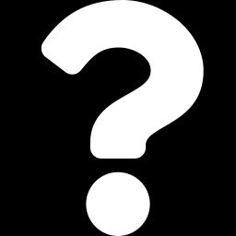
CONCEPT CHECK
Quick Check: What Would You Say?
A churn model with 150 candidate drivers, trained on 2,000 customers, shows training accuracy 97% and cross-validated accuracy 71%. What is the most likely diagnosis and first fix?
A
Underfitting — add more drivers
B
Overfitting — regularise (e.g. lasso) and/or reduce drivers, then re-check CV accuracy
C
The CV is wrong — trust the 97%
D
Collect a smaller sample
Discuss with your neighbour for 60 seconds — answer and reasoning in the speaker notes.
SESSION 3.3 · FORECASTS THAT SURVIVE NEW DATA
24

Slide 25



HANDS-ON LAB
Lab: Forecast a New SKU From 60 Weeks
1
Fit OLS with all 24 drivers on weeks 1–60. Compare training and test RMSE.
YOU WILL NEED
Data
2
Fit a lasso with 5-fold CV; list the drivers it keeps and its test RMSE.
data/beverage_sku_sales.csv
3
Fit a ridge model for comparison; try lasso's 1-SE rule for a simpler model.
R script
sessions/3-3/R/tdbg_3_3_lab.R
4
Explain the strange OLS coefficients on social impressions and its duplicate.
Python script
Refit everything on 300 weeks: does lasso still win? Why?
sessions/3-3/python/tdbg_3_3_lab.py
5
Deliverable: a model-comparison table (drivers used, train RMSE, test RMSE) and your deployment choice.
⏱ 30 minutes
SESSION 3.3 · FORECASTS THAT SURVIVE NEW DATA
25

Slide 26
WORDS TO OWN
Today's Vocabulary in Plain English
Overfitting
Learning noise in the training data; poor on new data.
Cross-validation
Rotating train/validate folds to estimate error.
Underfitting
Too simple to capture the real pattern.
Regularisation
Penalising large coefficients to reduce overfitting.
Bias
Error from an over-simple model.
Ridge
L2 penalty: shrinks all coefficients.
Variance
Error from an over-flexible, unstable model.
Lasso
L1 penalty: shrinks and zeroes out coefficients.
Train / test split
Fit on one part, score on an untouched part.
Collinearity
Drivers so correlated their effects can't be separated.
SESSION 3.3 · FORECASTS THAT SURVIVE NEW DATA
26

Slide 27
KEY TAKEAWAYS
Session 3.3 in 5 Ideas
01
Training error always flatters; judge models on data they have not seen.
02
Error = bias + variance: the best model balances simplicity and flexibility.
03
Cross-validation chooses model settings; a test set gives the final score.
04
Ridge shrinks; lasso shrinks and selects — both tame noise and collinearity.
05
Regularise hardest when data are scarce and drivers are many.
NEXT › Session 3.4: Yes-or-No Decisions
Before next session: Read Chapters 17–18 (Introduction to Classification; Logistic Regression). Bring an example of a yes/no decision in your business that a model could support.

