Slide 1
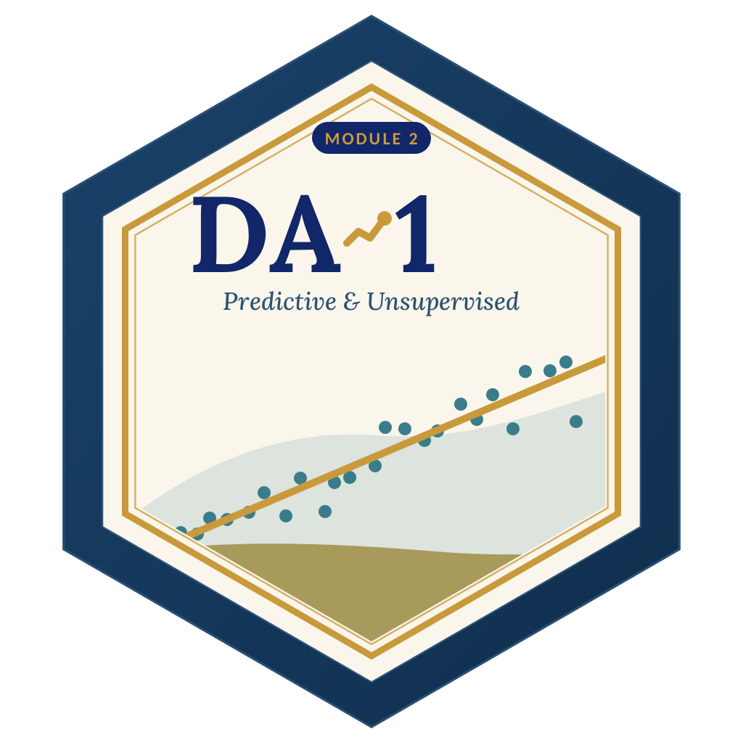

LAGOS BUSINESS SCHOOL · TURNING DATA INTO BUSINESS GROWTH · DAY 3
SESSION 3.4
Yes-or-No Decisions
Classification & Logistic Regression
Source: Chapters 17–18 — Introduction to Classification · Logistic Regression
AI-Powered Business Analytics: A Practical Textbook for Data-Driven Decision Making · Prof. Bongo Adi

Slide 2




RECAP
Session 3.3 in Three Ideas
Honest validation
Judge every model on data it has not seen: test sets and cross-validation.
Bias vs variance
Too simple misses the pattern; too flexible learns the noise.
Regularisation
Ridge shrinks, lasso shrinks and selects — vital when data are scarce.
SESSION 3.4 · YES-OR-NO DECISIONS
2

Slide 3




TODAY'S PLAN
Session 3.4 at a Glance — 75 Minutes
From 'how much?' to 'yes or no?' — and how sure.
10'
30'
30'
5'
Recap & Hook
Logistic Regression
Lab: Loan Default
Wrap-Up
Most business decisions are yes/no
Probabilities, odds ratios, thresholds, metrics
Build, evaluate and price a credit model
Accuracy is not the goal — value is
SESSION 3.4 · YES-OR-NO DECISIONS
3

Slide 4

BY THE END OF TODAY
Session 3.4 Learning Objectives
You will be able to:
01
02
03
Frame Classification
Fit & Read Logistic Regression
Evaluate & Choose a Threshold
Turn a business decision into a yes/no prediction problem with a clear cost of each mistake.
Interpret predicted probabilities and odds ratios in plain English.
Use the confusion matrix, precision, recall and ROC-AUC — and pick the threshold by profit.
SESSION 3.4 · YES-OR-NO DECISIONS
4

Slide 5



THE HOOK
Most Business Decisions Are Yes or No
Approve or decline? Will this customer churn? Is this transaction fraud? Will this lead buy?
Classification models don't just say yes or no. Good ones give a **probability** — which lets managers:
Rank
Set a threshold
Price the risk
Work from the riskiest (or most promising) cases down.
Decide where to draw the line based on what each mistake costs.
Turn probabilities into expected losses, interest rates and limits.

Slide 6




NIGERIAN BUSINESS CASE
A Digital Microlender's Credit Decisions
The situation
The decision question
A Lagos fintech offers 14–90-day app loans. About 18% of loans default — eating the margin on the rest. It wants an automated credit score.
Can we predict which applicants will default — and where should we set the cut-off to maximise profit?
The data we have
What a good answer looks like
digital_loans.csv — 6,000 loans: age, income, salary status, loan size, tenure, repayment-to-income, prior repayments and late payments, account age, phone OS, airtime spend, BVN, acquisition channel, state.
A model with honest test-set performance, interpretable risk drivers, and a profit-maximising threshold. Assumptions: a repaid loan earns ₦8,000; a default loses ₦45,000.
SESSION 3.4 · YES-OR-NO DECISIONS
6

Slide 7
PART
01
Logistic Regression
Regression for yes/no outcomes.

Slide 8
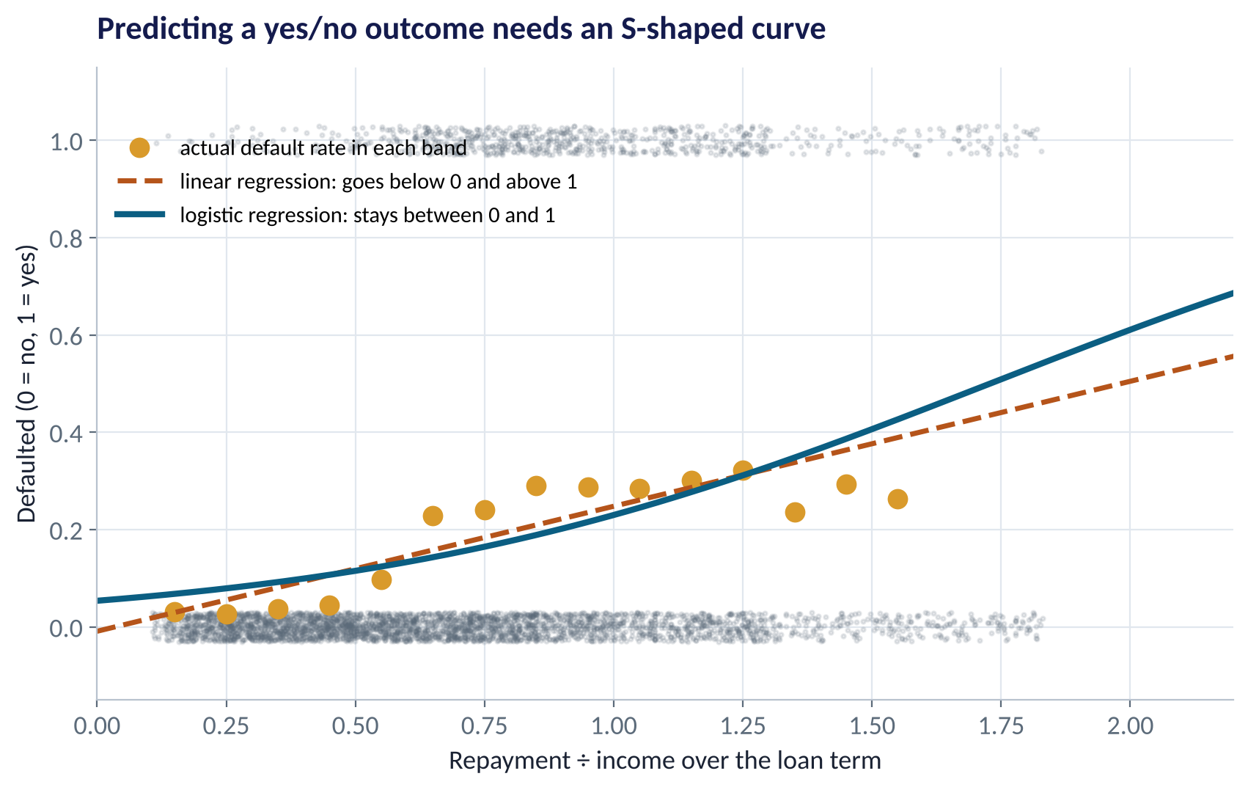
WHY A NEW MODEL?
Why Not Ordinary Regression?
WHAT TO SEE
The outcome is 0 (repaid) or 1 (defaulted).
A straight line can predict below 0% or above 100% — nonsense for a probability.
Default risk rises steeply then levels off — an S-shape.
Logistic regression fits exactly that shape.
Fig S3.4-F01 · replicate: tdbg_3_4_figures.R / .py
SESSION 3.4 · YES-OR-NO DECISIONS
8

Slide 9
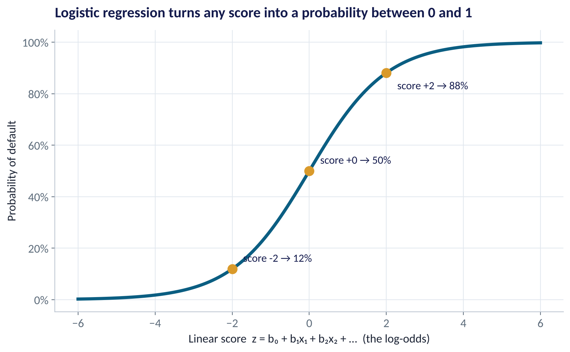
THE KEY IDEA
From Score to Probability
WHAT TO SEE
The model builds a score from the drivers, just like regression.
The logistic curve squeezes any score into 0–100%.
Score 0 → 50%; score +2 → 88%; score −2 → 12%.
The score is the log-odds: log(p ÷ (1 − p)).
Fig S3.4-F02 · replicate: tdbg_3_4_figures.R / .py
SESSION 3.4 · YES-OR-NO DECISIONS
9

Slide 10

SPEAKING THE LANGUAGE
Probability, Odds and Odds Ratios
IN PLAIN ENGLISH
THE FORMULA
odds ratio = e^coefficient
Probability = chance out of 1 (20% default). Odds = chance it happens ÷ chance it doesn't (20% → 0.2/0.8 = 0.25, '1 to 4'). An odds ratio says how many times the odds are multiplied when a driver changes by one unit.
WHY A MANAGER CARES
Odds ratios turn a logistic model into statements credit committees understand: 'Paid-social customers have 2.4× the odds of default of organic ones.' Above 1 raises risk; below 1 lowers it.
EXAMPLE
Each prior late payment has an odds ratio of 2.12: it roughly doubles the odds of default, holding everything else fixed. BVN verification: 0.57 — cuts the odds by 43%.
SESSION 3.4 · YES-OR-NO DECISIONS
10

Slide 11
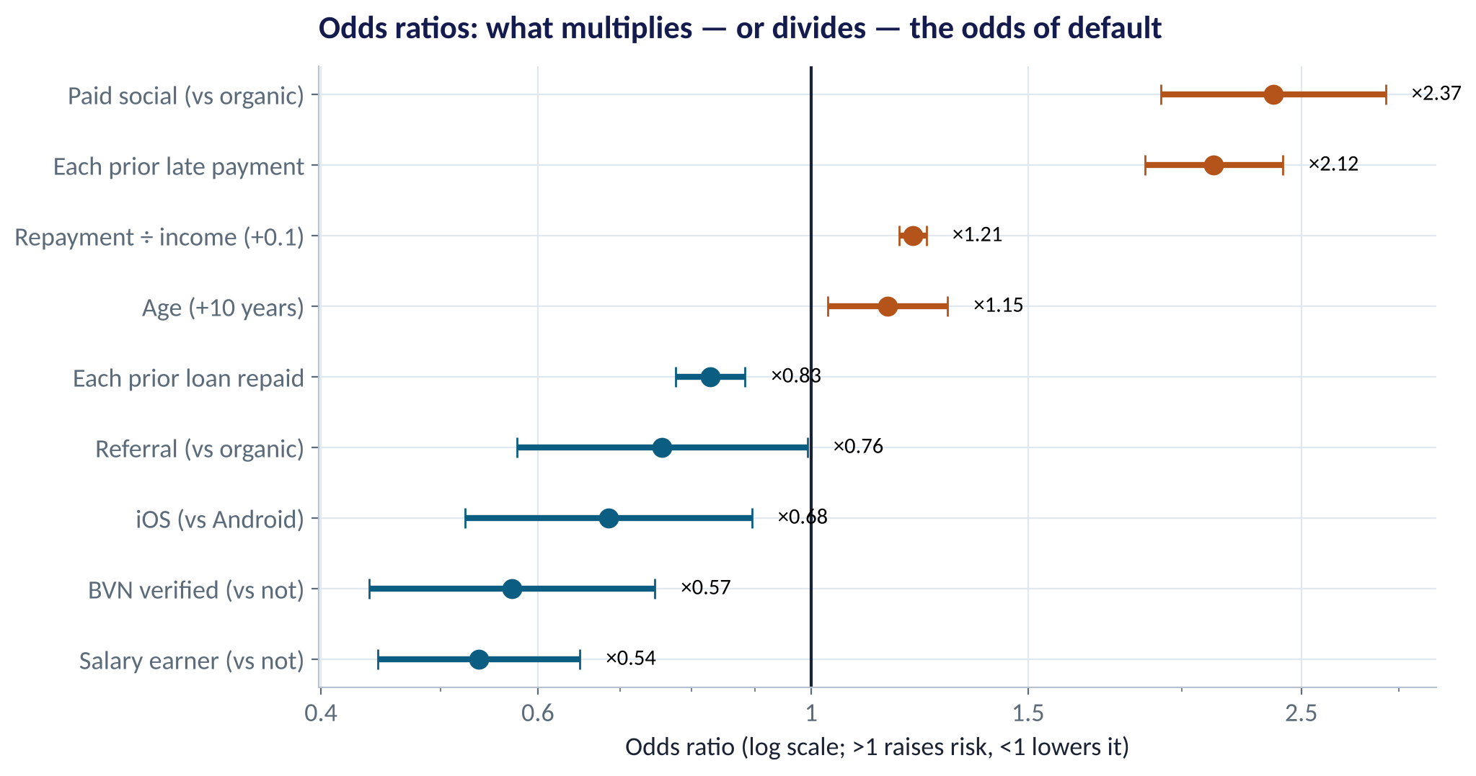
THE RISK DRIVERS
What Moves the Odds of Default?
WHAT TO SEE
Raise risk: paid-social acquisition (×2.4), each prior late payment (×2.1), higher repayment-to-income (×1.2 per 0.1).
Lower risk: salary earners (×0.54), BVN verified (×0.57), iOS users (×0.68), each prior loan repaid (×0.83).
Bars that cross 1 are not clearly different from 'no effect'.
Each odds ratio holds all other drivers fixed.
Fig S3.4-F03 · replicate: tdbg_3_4_figures.R / .py
SESSION 3.4 · YES-OR-NO DECISIONS
11

Slide 12
HOW TO READ THIS OUTPUT
Reading glm() Output for a Logistic Model
R OUTPUT
1
Estimate = log-odds
glm(formula = defaulted ~ ..., family = binomial)
Coefficients (selected):
Estimate Std.Err z value Pr(>|z|)
(Intercept) -0.958 1.106 -0.87 0.386
repayment_to_income 1.902 0.129 14.76 < 2e-16
prior_late_payments 0.753 0.066 11.47 < 2e-16
prior_loans_repaid -0.188 0.033 -5.68 1.4e-08
salary_earner -0.621 0.096 -6.44 1.2e-10
bvn_verified -0.559 0.136 -4.11 4.0e-05
acquisition_channelPaid social
0.864 0.107 8.08 6.6e-16
> exp(0.753)
[1] 2.12
Positive raises risk, negative lowers it. Not directly a % change.
2
exp(estimate) = odds ratio
0.753 → ×2.12 odds per prior late payment.
3
z and Pr(>|z|)
Same logic as t and p in regression: is the effect distinguishable from zero?
4
No R²
Judge classifiers with AUC, confusion matrices and profit on test data.
SESSION 3.4 · YES-OR-NO DECISIONS
12

Slide 13
PART
02
Evaluating a Classifier
Accuracy is the wrong question.

Slide 14
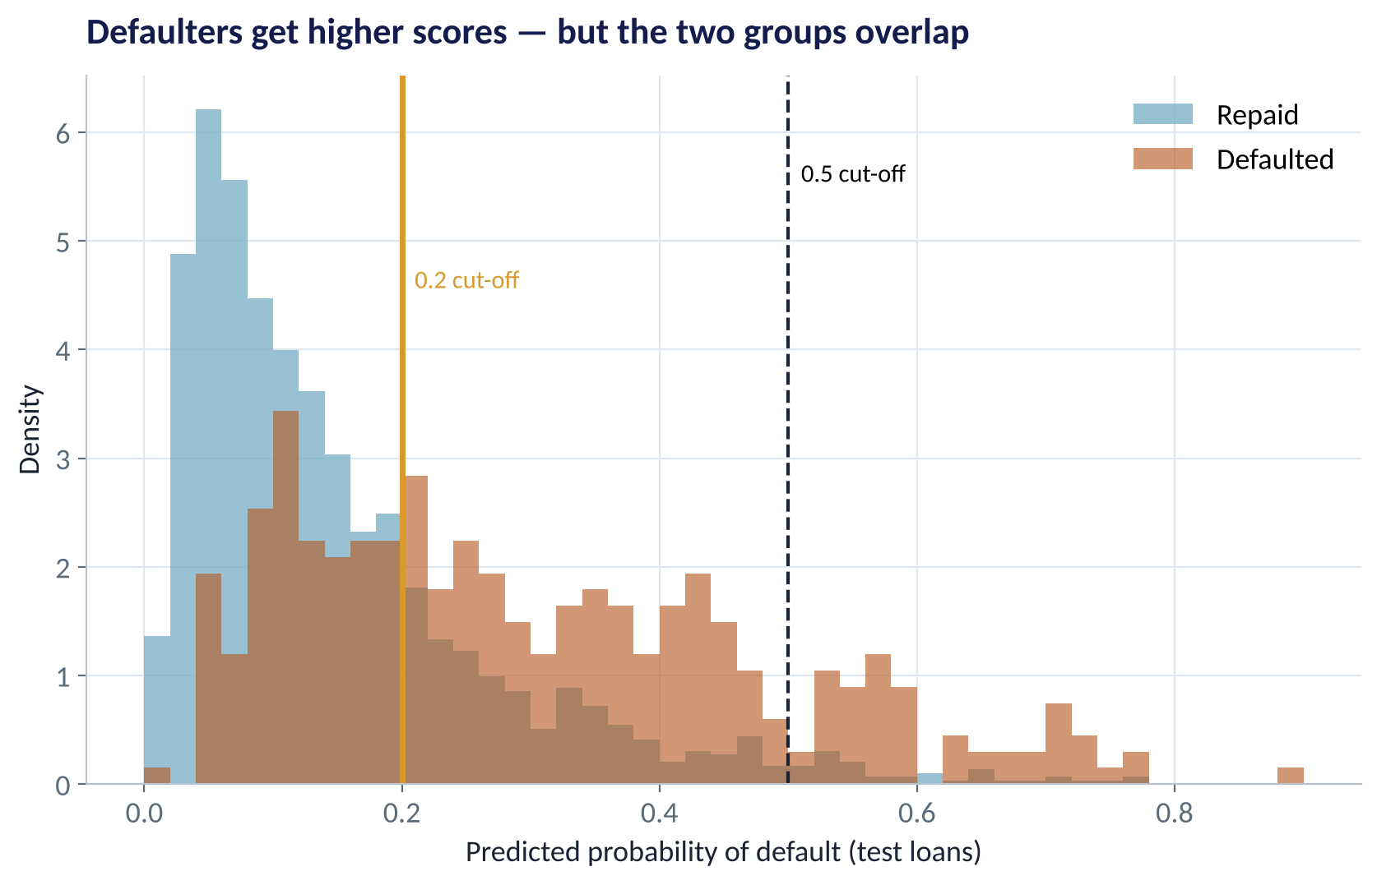
WHAT THE MODEL OUTPUTS
Two Overlapping Groups of Scores
WHAT TO SEE
Defaulters (red) generally get higher predicted probabilities.
But the groups overlap: no threshold separates them perfectly.
At 0.5, very few loans are flagged — most defaulters slip through.
At 0.2, many more defaulters are caught — at the cost of rejecting some good customers.
Fig S3.4-F04 · replicate: tdbg_3_4_figures.R / .py
SESSION 3.4 · YES-OR-NO DECISIONS
14

Slide 15
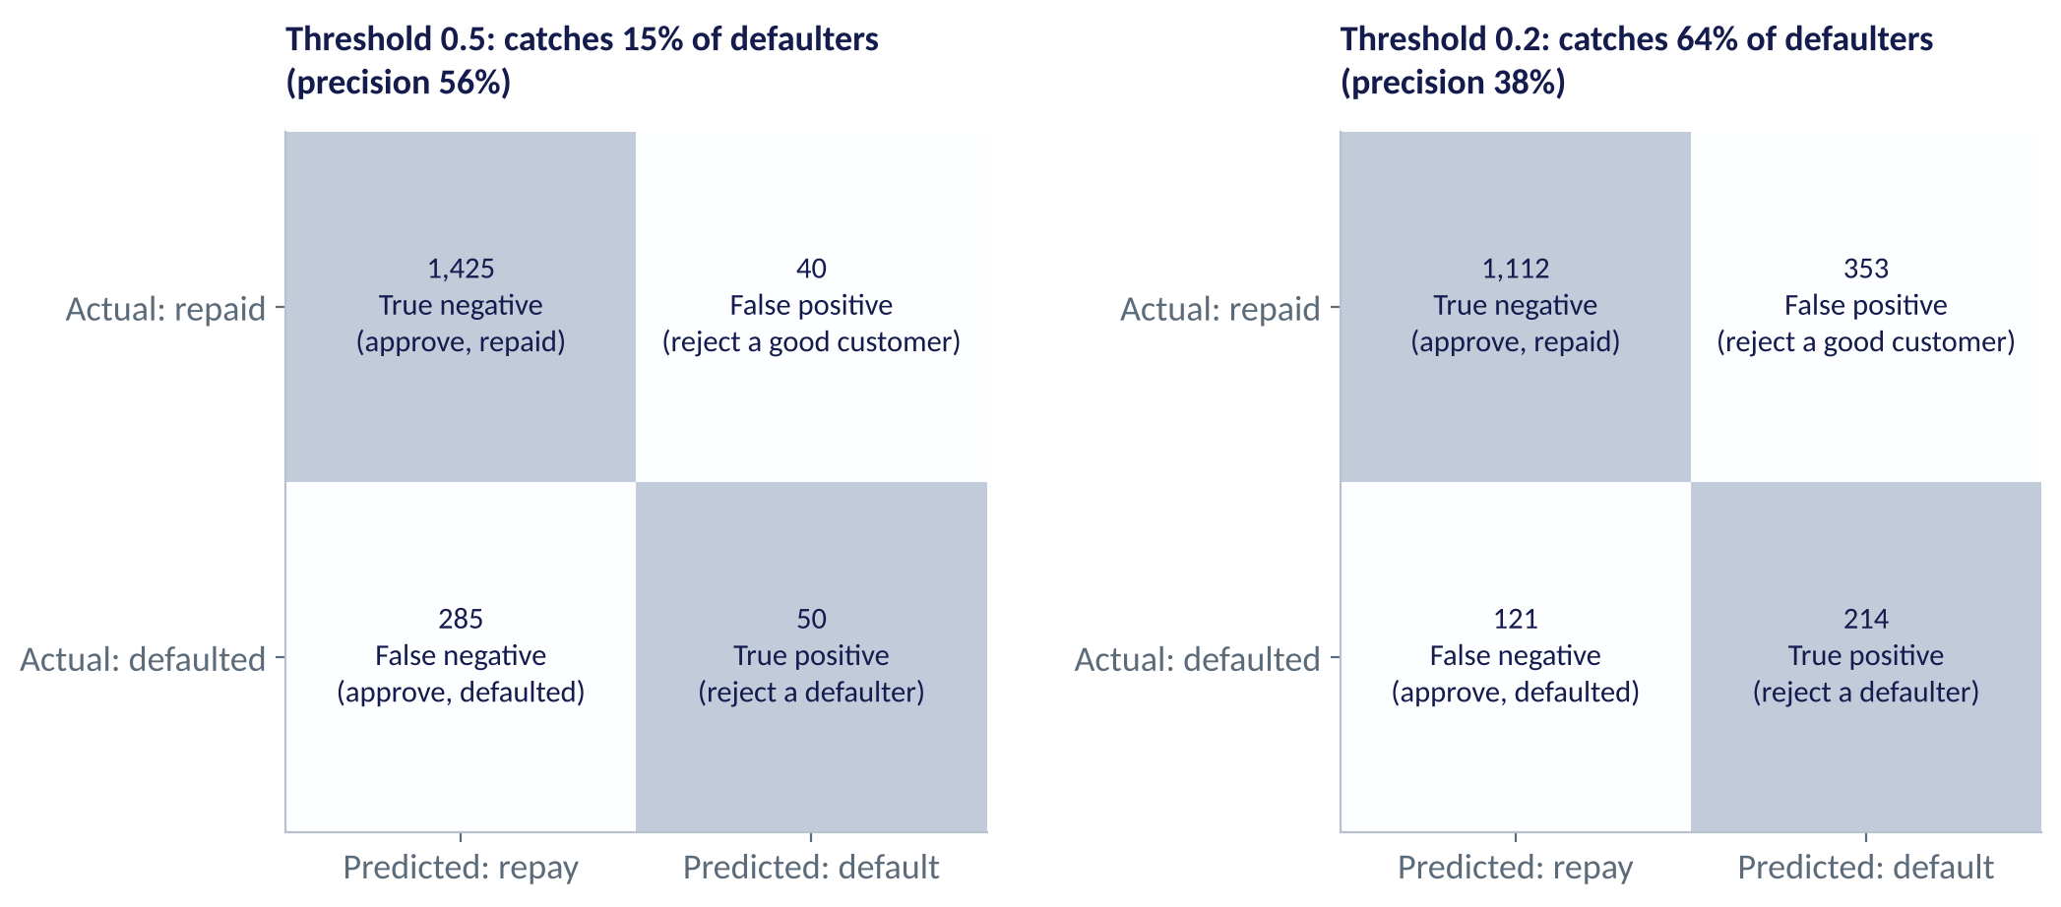
THE CONFUSION MATRIX
Four Outcomes, Two Kinds of Mistake
WHAT TO SEE
False negative: we approved a defaulter (costly loss).
False positive: we rejected a good customer (lost margin).
At 0.5 we catch only 15% of defaulters.
At 0.2 we catch 64%, but 353 good customers are turned away.
Fig S3.4-F05 · replicate: tdbg_3_4_figures.R / .py
SESSION 3.4 · YES-OR-NO DECISIONS
15

Slide 16
THE METRICS VOCABULARY
Precision, Recall and Friends
Metric | Question it answers | Formula | Loan example (threshold 0.2)
Recall (sensitivity) | Of all defaulters, what share did we catch? | TP ÷ (TP + FN) | 214 ÷ 335 = 64%
Precision | Of all we flagged, what share were defaulters? | TP ÷ (TP + FP) | 214 ÷ 567 = 38%
Specificity | Of all good customers, what share did we approve? | TN ÷ (TN + FP) | 1,112 ÷ 1,465 = 76%
Accuracy | What share of all predictions were right? | (TP + TN) ÷ all | 1,326 ÷ 1,800 = 74%
AUC | How well does the score rank defaulters above repayers? | Area under ROC | 0.77 (0.5 = random, 1 = perfect)
Pick metrics by the decision: fraud teams prize recall; marketing campaigns with costly contacts prize precision.
SESSION 3.4 · YES-OR-NO DECISIONS
16

Slide 17
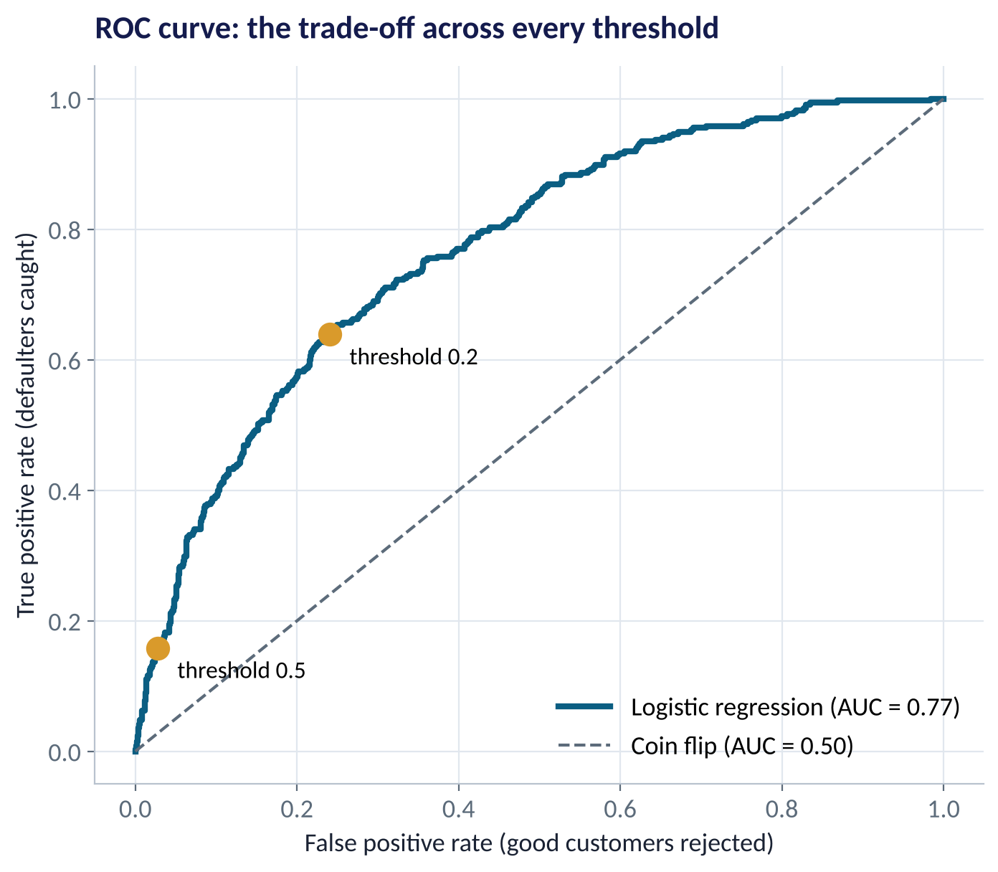
THRESHOLD-FREE QUALITY
The ROC Curve and AUC
WHAT TO SEE
Each point is one threshold: defaulters caught vs good customers rejected.
The diagonal is a coin flip.
AUC = 0.77: pick a random defaulter and a random repayer — 77% of the time the model scores the defaulter higher.
AUC compares models; the threshold is chosen separately.
Fig S3.4-F06 · replicate: tdbg_3_4_figures.R / .py
SESSION 3.4 · YES-OR-NO DECISIONS
17

Slide 18
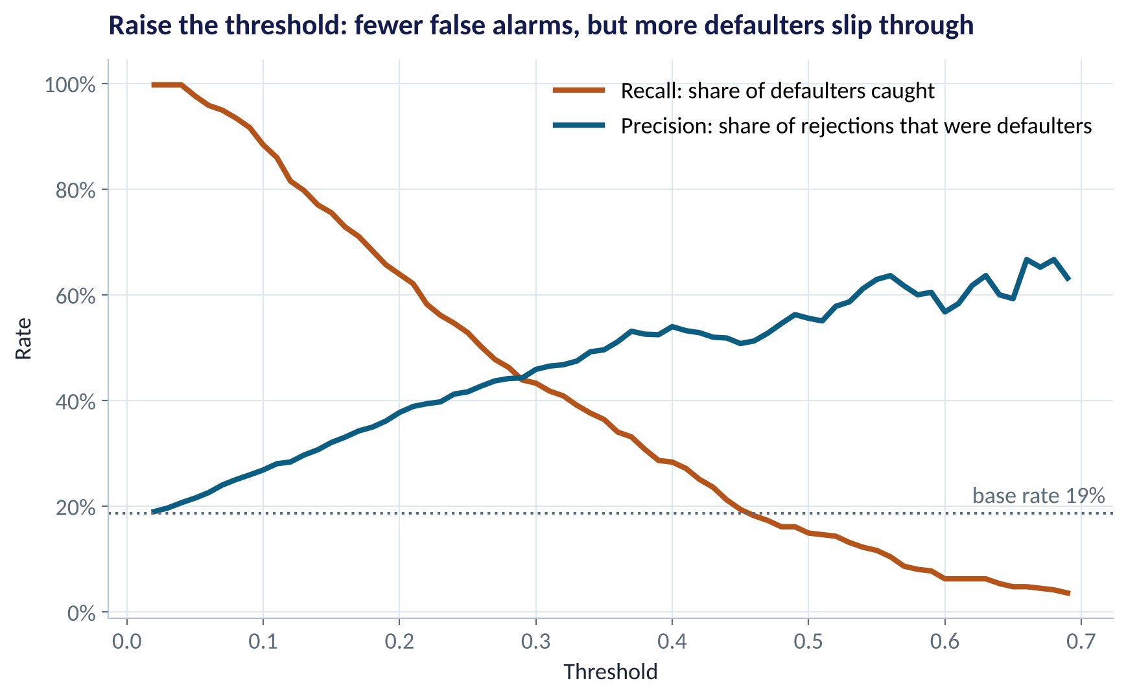
THE TRADE-OFF
Precision vs Recall as the Threshold Moves
WHAT TO SEE
Low threshold: catch almost every defaulter, but most flags are false alarms.
High threshold: flags are usually right, but most defaulters get through.
No single threshold is 'correct' — it depends on the costs.
So let money decide.
Fig S3.4-F08 · replicate: tdbg_3_4_figures.R / .py
SESSION 3.4 · YES-OR-NO DECISIONS
18

Slide 19
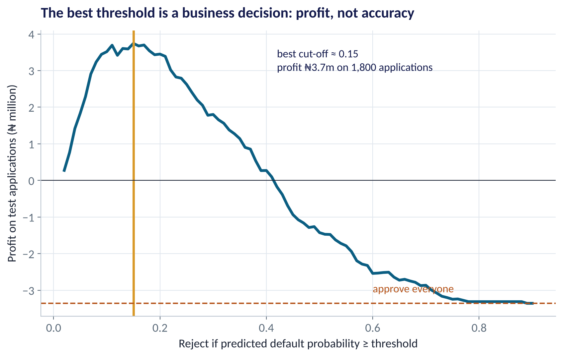
THE DECISION
Choosing the Threshold by Profit
WHAT TO SEE
Approving everyone loses ₦3.4m on 1,800 applications.
Best cut-off ≈ 0.15: reject if predicted default ≥ 15%.
Profit ≈ ₦3.7m — a ₦7m swing.
We approve 56% of applicants; their default rate falls from 19% to 8%.
If loss per default rises, the best threshold falls.
Fig S3.4-F07 · replicate: tdbg_3_4_figures.R / .py
SESSION 3.4 · YES-OR-NO DECISIONS
19

Slide 20

A USEFUL SHORTCUT
The Break-Even Probability
IN PLAIN ENGLISH
THE FORMULA
p* = gain ÷ (gain + loss)
Approve a loan only if the expected profit is positive. That happens when the predicted default probability is below a break-even point set by the gain on good loans and the loss on bad ones.
WHY A MANAGER CARES
This links the model to the P&L in one line. When pricing changes — higher interest (bigger gain) or worse recoveries (bigger loss) — the threshold should move with it, without rebuilding the model.
EXAMPLE
Gain ₦8,000, loss ₦45,000: p* = 8,000 ÷ 53,000 ≈ 0.15. Exactly where the profit curve peaked.
SESSION 3.4 · YES-OR-NO DECISIONS
20

Slide 21


WHERE MANAGERS GO WRONG
Classification Mistakes in Practice
THE TRAP
THE BETTER HABIT
Celebrating 82% accuracy when 81% repay anyway.
Compare against the base rate; use AUC, precision and recall.
Using the default 0.5 threshold.
Set the threshold from costs and benefits.
Reading coefficients as % changes in probability.
Convert to odds ratios, or show predicted probabilities for example customers.
Evaluating on the training data.
Always score a held-out test set.
Ignoring who gets rejected.
Audit approval and error rates across groups — fairness (Session 5.3).
SESSION 3.4 · YES-OR-NO DECISIONS
21

Slide 22

CONCEPT CHECK
Quick Check: What Would You Say?
A fraud model has AUC 0.92. At the chosen threshold, recall is 80% and precision is 10%. What does precision of 10% mean?
A
The model is useless
B
Only 10% of fraud cases are caught
C
Of every 10 transactions flagged, about 1 is actually fraud — the rest are false alarms
D
The model is 10% accurate
Discuss with your neighbour for 60 seconds — answer and reasoning in the speaker notes.
SESSION 3.4 · YES-OR-NO DECISIONS
22

Slide 23



HANDS-ON LAB
Lab: Build and Price a Credit Score
1
Check the base rate; fit the logistic regression on the first 4,200 loans.
YOU WILL NEED
Data
2
Convert coefficients to odds ratios with 95% CIs; interpret three for the credit committee.
data/digital_loans.csv
3
Predict test-set probabilities; build confusion matrices at 0.5 and 0.2.
R script
sessions/3-4/R/tdbg_3_4_lab.R
4
Compute AUC and plot the ROC curve.
Python script
Find the profit-maximising threshold; recompute if the loss per default rises to ₦60,000.
sessions/3-4/python/tdbg_3_4_lab.py
5
Deliverable: a one-slide credit policy: threshold, approval rate, expected default rate, profit — and one fairness caveat.
⏱ 30 minutes
SESSION 3.4 · YES-OR-NO DECISIONS
23

Slide 24
WORDS TO OWN
Today's Vocabulary in Plain English
Classification
Predicting a category, often yes/no.
Confusion matrix
Table of correct and incorrect predictions.
Logistic regression
Models the probability of a yes/no outcome.
Precision
Share of flagged cases that are truly positive.
Odds
p ÷ (1 − p): chance for vs chance against.
Recall
Share of true positives that we caught.
Odds ratio
How many times the odds multiply per unit change.
ROC / AUC
Ranking quality across all thresholds.
Threshold
Probability above which we predict 'yes'.
Break-even probability
gain ÷ (gain + loss): the profit-optimal cut-off.
SESSION 3.4 · YES-OR-NO DECISIONS
24

Slide 25
KEY TAKEAWAYS
Session 3.4 in 5 Ideas
01
Logistic regression turns drivers into a probability between 0 and 1.
02
Interpret effects as odds ratios: above 1 raises risk, below 1 lowers it.
03
Accuracy misleads when outcomes are imbalanced — use recall, precision and AUC.
04
Choose the threshold from costs and benefits: p* = gain ÷ (gain + loss).
05
Evaluate on test data, and check who your errors fall on.
NEXT › Session 3.5: Many Trees, Better Decisions
Before next session: Read Chapters 19–20 (Decision Trees; Random Forests, Gradient Boosting and Ensembles). Sketch the questions a loan officer asks, in order, before approving a loan — that is a decision tree.

