Slide 1


LAGOS BUSINESS SCHOOL · TURNING DATA INTO BUSINESS GROWTH · DAY 3
SESSION 3.5
Many Trees,
Better Decisions
Trees, Random Forests & Gradient Boosting
Source: Chapters 19–20 — Decision Trees · Random Forests, Gradient Boosting & Ensembles
AI-Powered Business Analytics: A Practical Textbook for Data-Driven Decision Making · Prof. Bongo Adi

Slide 2




RECAP
Session 3.4 in Three Ideas
Probabilities
Logistic regression turns drivers into a probability; effects read as odds ratios.
Evaluation
Accuracy misleads on imbalanced data; use AUC, precision and recall on a test set.
Thresholds
Set the cut-off by money: break-even p = gain ÷ (gain + loss). Our logistic score earned ₦3.7m.
SESSION 3.5 · MANY TREES, BETTER DECISIONS
2

Slide 3




TODAY'S PLAN
Session 3.5 at a Glance — 75 Minutes
Can a crowd of simple trees beat our logistic credit score?
10'
30'
30'
5'
Recap & Hook
Trees & Ensembles
Lab: Model Showdown
Wrap-Up
How loan officers already think in trees
Splits, overfitting, bagging, forests, boosting
Tree vs forest vs boosting on the loan book
Accuracy vs explainability
SESSION 3.5 · MANY TREES, BETTER DECISIONS
3

Slide 4

BY THE END OF TODAY
Session 3.5 Learning Objectives
You will be able to:
01
02
03
Read a Decision Tree
Explain Ensembles
Tune & Interpret
Explain how a tree splits data into rules, and why a single deep tree overfits.
Describe how random forests and gradient boosting combine many trees — and why that works.
Compare models on test data, adjust key settings, and read feature importance and partial dependence.
SESSION 3.5 · MANY TREES, BETTER DECISIONS
4

Slide 5




THE HOOK
Loan Officers Already Think in Trees
“Is the repayment more than half their income? Have they paid late before? Did they come in through a paid ad?”
A decision tree turns that instinct into data-driven rules. Ensembles turn many trees into a stronger judge:
Interactions
Thresholds
Crowd wisdom
Trees find combinations — late payers acquired by paid social — without being told.
They capture cliffs, like risk jumping once repayments exceed ~55% of income.
Averaging hundreds of trees cancels their individual mistakes.

Slide 6




NIGERIAN BUSINESS CASE
Improving the Digital Lender's Credit Score
The situation
The decision question
Session 3.4's logistic credit score has a test AUC of 0.77 and earns about ₦3.7m on 1,800 applications at its best threshold.
Can tree-based models rank risk better — and is the extra profit worth the loss of simplicity?
The data we have
What a good answer looks like
Same digital_loans.csv, same train (4,200) / test (1,800) split, same profit assumptions (₦8,000 gain, ₦45,000 loss).
A model recommendation that weighs AUC, profit, explainability and governance — not AUC alone.
SESSION 3.5 · MANY TREES, BETTER DECISIONS
6

Slide 7
PART
01
Decision Trees
Twenty questions, learned from data.

Slide 8
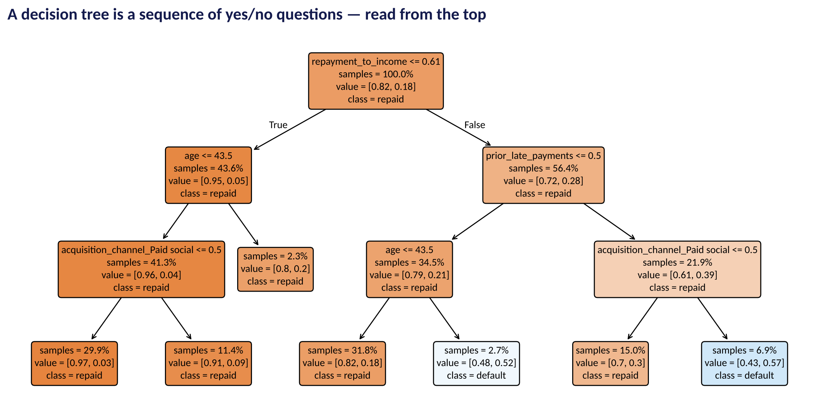
HOW A TREE READS
A Decision Tree for Loan Default
Fig S3.5-F01 · replicate: tdbg_3_5_figures.R / .py
SESSION 3.5 · MANY TREES, BETTER DECISIONS
8

Slide 9




READING THE TREE
What the Tree Is Saying
Each path from top to bottom is a rule; each leaf shows the default rate for loans that end there.
First split
Repayment ÷ income ≤ 0.61? The single most informative question — affordability.
Affordable
Mostly safe: default rates around 3–9%, with older borrowers riskier in this branch.
Stretched + late before
Risk climbs to 39%; add paid-social acquisition and it reaches about 57%.
Rules a human can audit
Each leaf can be written as policy: 'decline if repayment > 61% of income and prior late payment and paid-social'.
SESSION 3.5 · MANY TREES, BETTER DECISIONS
9

Slide 10
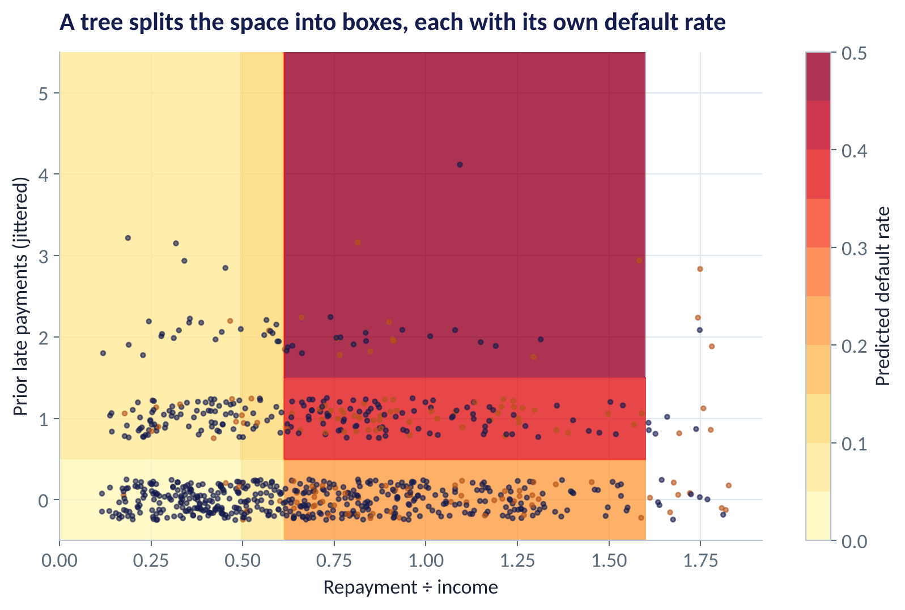
HOW TREES SPLIT
A Tree Carves the Data Into Boxes
WHAT TO SEE
With two drivers you can see it: the tree draws straight cuts.
Each box gets the default rate of the training loans inside it.
The big jump at ~0.6 repayment ÷ income is a threshold a straight-line model can't capture.
Each split is chosen to make the boxes as pure as possible.
Fig S3.5-F02 · replicate: tdbg_3_5_figures.R / .py
SESSION 3.5 · MANY TREES, BETTER DECISIONS
10

Slide 11
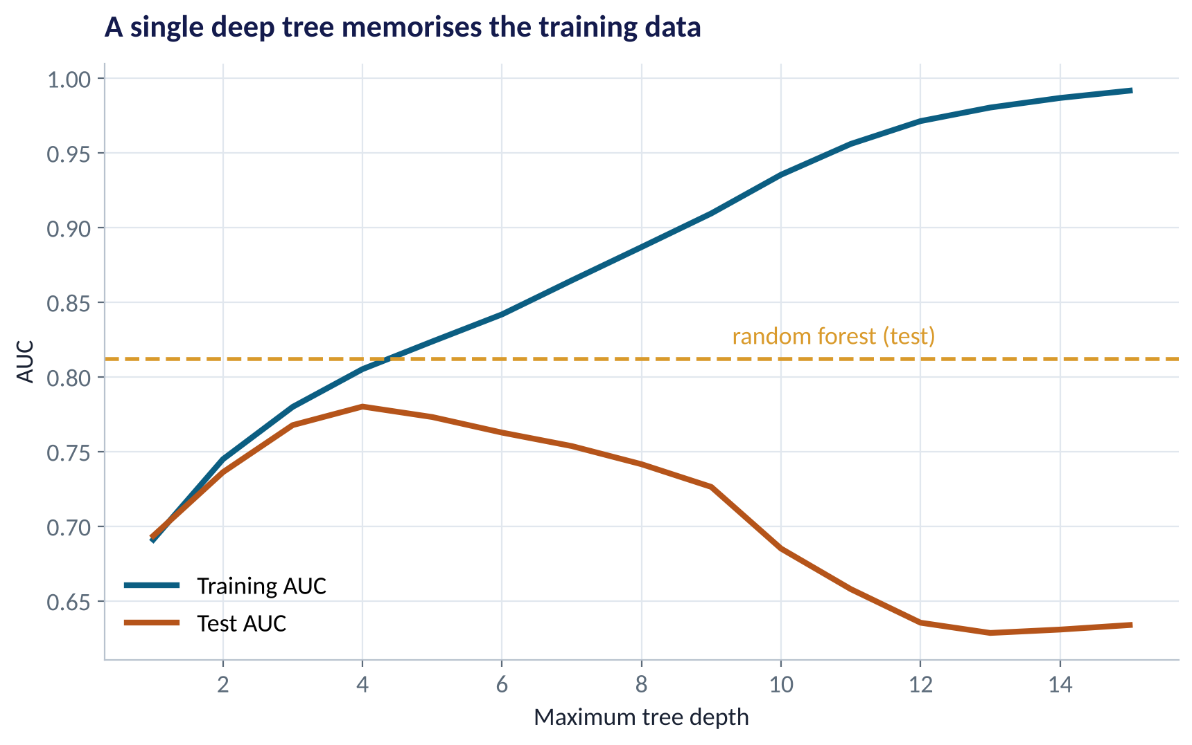
THE CATCH
Deep Trees Memorise
WHAT TO SEE
Deeper trees fit the training data almost perfectly (blue).
Test AUC peaks around depth 4 — then falls as the tree learns noise.
A single tree is also unstable: small data changes can redraw it completely.
Ensembles fix both problems (gold line).
Fig S3.5-F03 · replicate: tdbg_3_5_figures.R / .py
SESSION 3.5 · MANY TREES, BETTER DECISIONS
11

Slide 12
PART
02
Ensembles
Many weak judges, one strong verdict.

Slide 13

TWO WAYS TO COMBINE TREES
Random Forests vs Gradient Boosting
Random forest (bagging)
Gradient boosting
Many independent trees, averaged
Small trees built in sequence
Each tree sees a random bootstrap sample of loans
Each split considers a random subset of drivers
Trees are deep and different; averaging cancels their errors
Robust, hard to overfit, few settings to tune
Each new tree focuses on the mistakes of the trees so far
Learning rate controls how big each correction is
Often the most accurate tabular model (XGBoost, LightGBM)
Needs more careful tuning; can overfit if left unchecked
Both are ensembles of trees. Forests reduce variance by averaging; boosting reduces bias by correcting step by step.
SESSION 3.5 · MANY TREES, BETTER DECISIONS
13

Slide 14
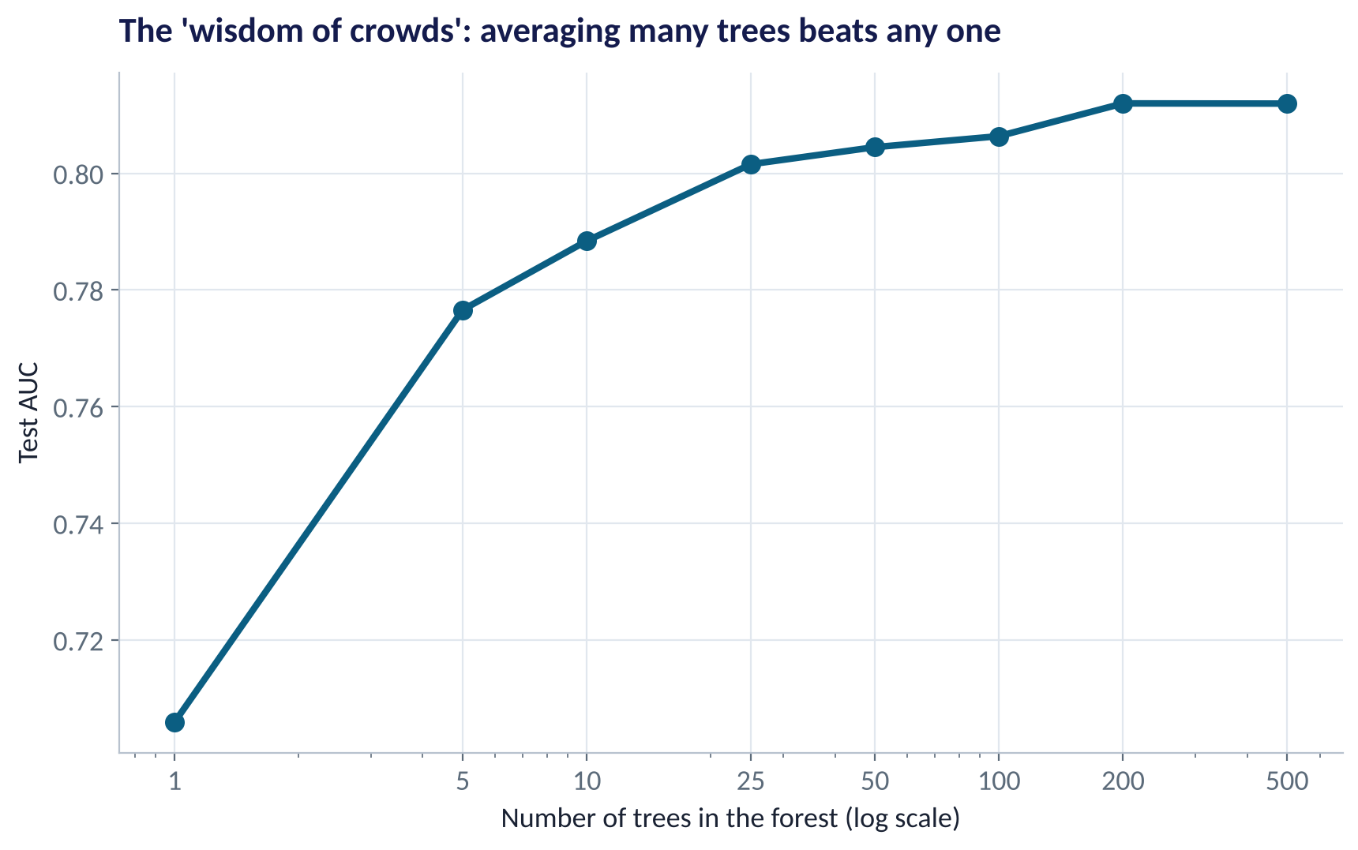
THE WISDOM OF CROWDS
Why Averaging Trees Works
WHAT TO SEE
One random tree: test AUC ≈ 0.71.
25 trees: ≈ 0.80. 500 trees: ≈ 0.81.
Each tree is noisy, but their errors point in different directions — averaging cancels them.
More trees never hurt accuracy; they only cost computing time.
Fig S3.5-F04 · replicate: tdbg_3_5_figures.R / .py
SESSION 3.5 · MANY TREES, BETTER DECISIONS
14

Slide 15
THE KNOBS THAT MATTER
Key Settings, in Plain English
Model | Setting | What it controls | Rule of thumb
Decision tree | max depth / min leaf size | How many questions; how small a group can get its own rule | Depth 3–6; leaves of 20–100 cases
Random forest | number of trees | How many trees are averaged | 300–1,000 (more is safe)
Random forest | min node size; features per split | How detailed each tree is; how different trees are | Defaults work well; tune with CV
Gradient boosting | learning rate × number of trees | Size of each correction × how many | Small rate (0.01–0.1) with more trees
Gradient boosting | tree depth / leaves | Complexity of interactions each tree can capture | Shallow trees: depth 3–6
Tune with cross-validation on training data (Session 3.3) — never by peeking at the test set.
SESSION 3.5 · MANY TREES, BETTER DECISIONS
15

Slide 16
PART
03
The Showdown
Same data, same test set, same profit rules.

Slide 17
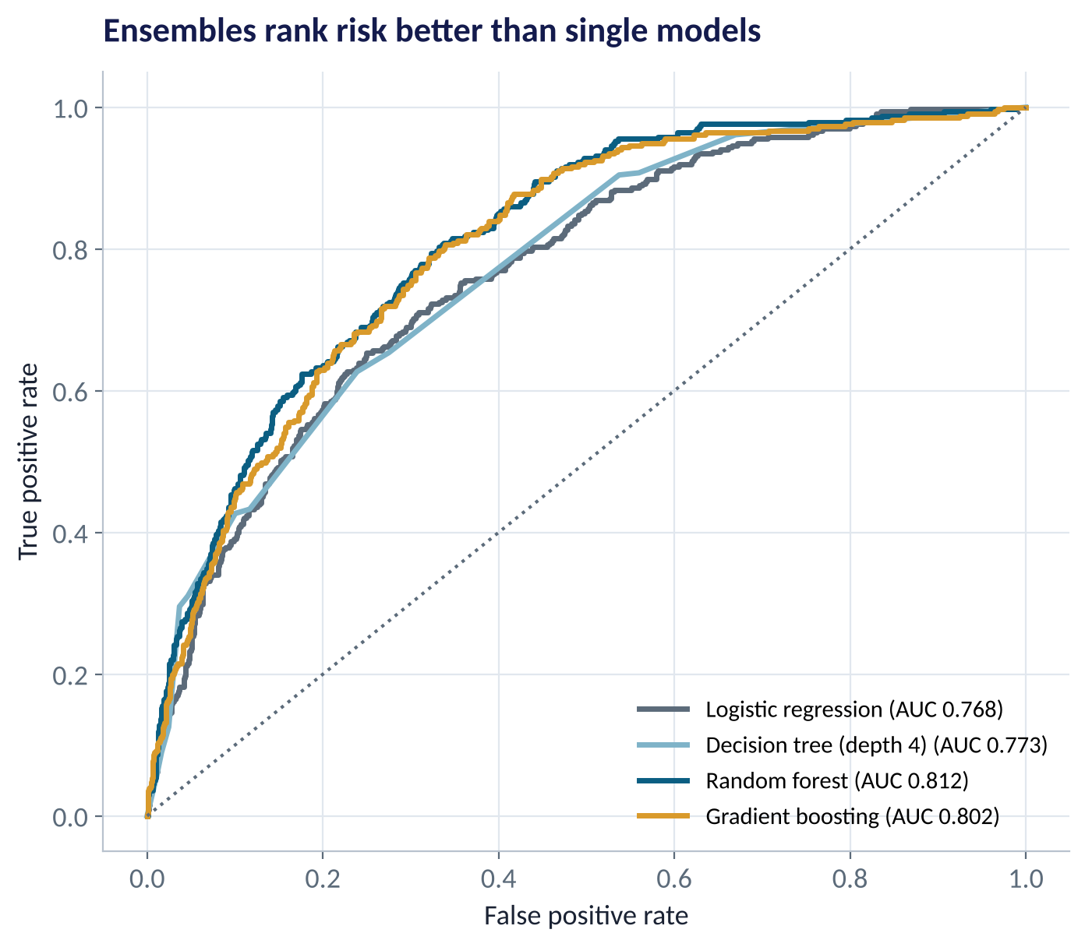
RANKING QUALITY
Which Model Ranks Risk Best?
WHAT TO SEE
Logistic regression: AUC 0.77. Single tree: 0.77.
Random forest: 0.81. Gradient boosting: 0.80.
Ensembles capture the affordability cliff and the late-payer × paid-social interaction.
In R, gbm edges out ranger — small differences depend on settings and random seeds.
Fig S3.5-F05 · replicate: tdbg_3_5_figures.R / .py
SESSION 3.5 · MANY TREES, BETTER DECISIONS
17

Slide 18
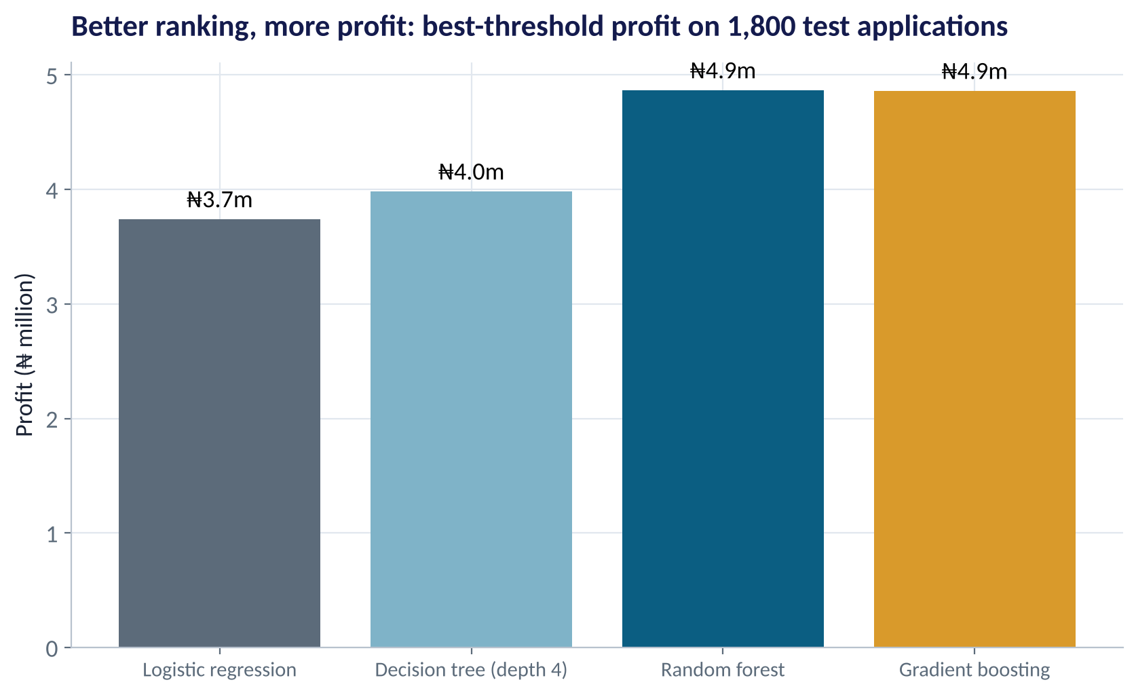
THE BOTTOM LINE
Better Ranking, More Profit
WHAT TO SEE
At each model's best threshold on 1,800 test applications:
Logistic ₦3.7m, tree ₦4.0m, forest ₦4.9m, boosting ₦4.9m.
≈ ₦1.1m extra per 1,800 applications — about 30% more profit.
At 50,000 applications a month, that gap is worth roughly ₦30m a month.
Fig S3.5-F08 · replicate: tdbg_3_5_figures.R / .py
SESSION 3.5 · MANY TREES, BETTER DECISIONS
18

Slide 19
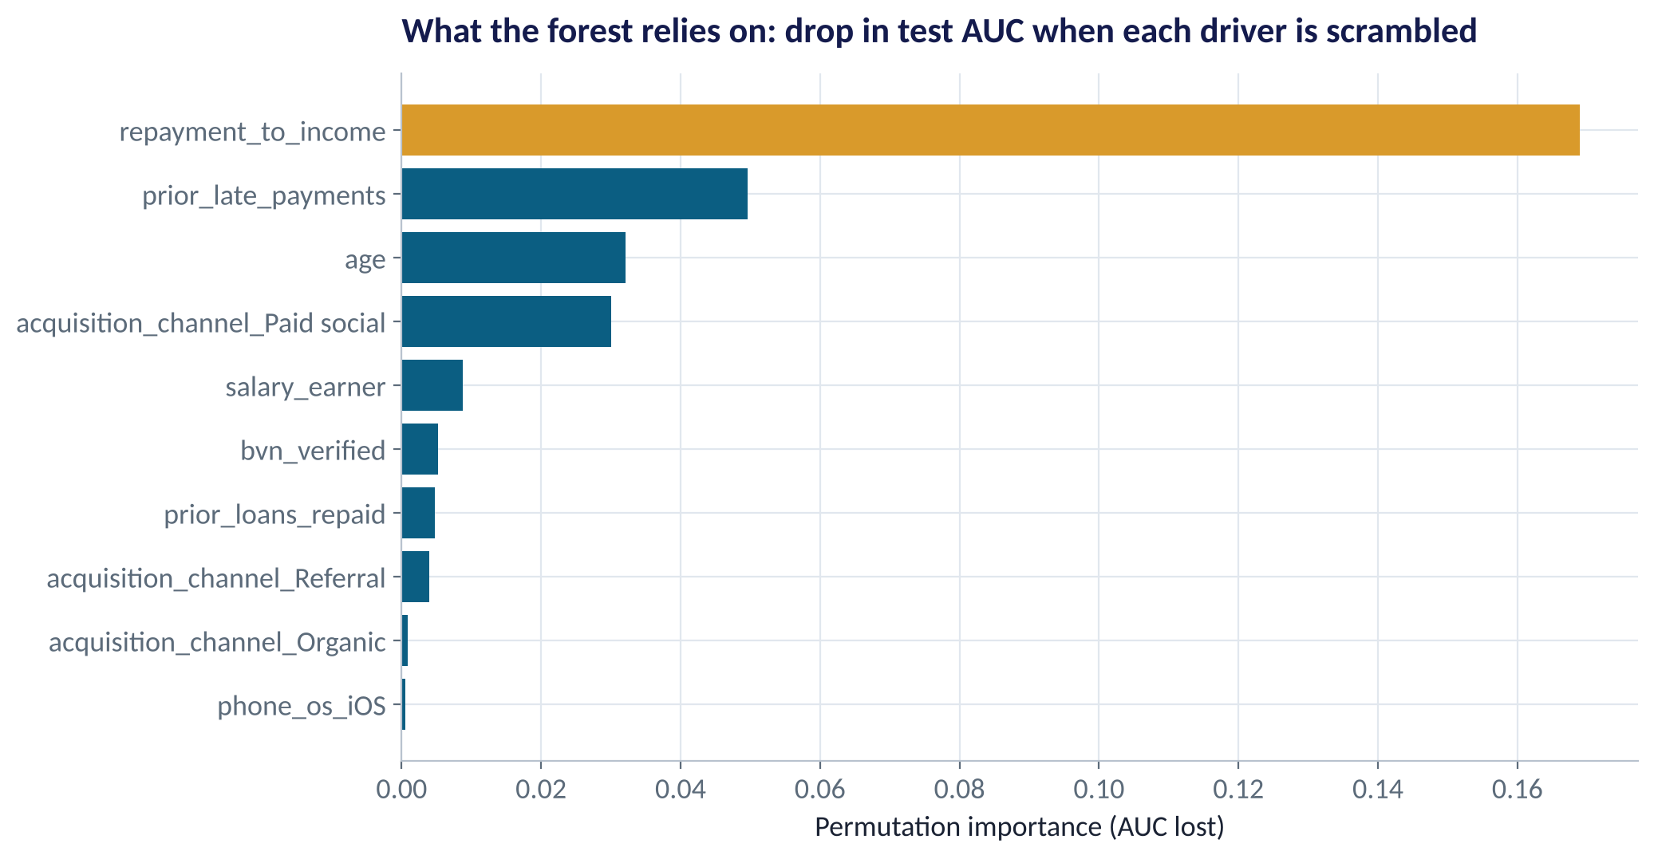
OPENING THE FOREST
Which Drivers Does the Forest Use?
WHAT TO SEE
Permutation importance: scramble one driver and measure how much test AUC drops.
Affordability (repayment ÷ income) dominates.
Then prior late payments, age and paid-social acquisition.
Importance says how much a driver matters — not in which direction.
Fig S3.5-F06 · replicate: tdbg_3_5_figures.R / .py
SESSION 3.5 · MANY TREES, BETTER DECISIONS
19

Slide 20
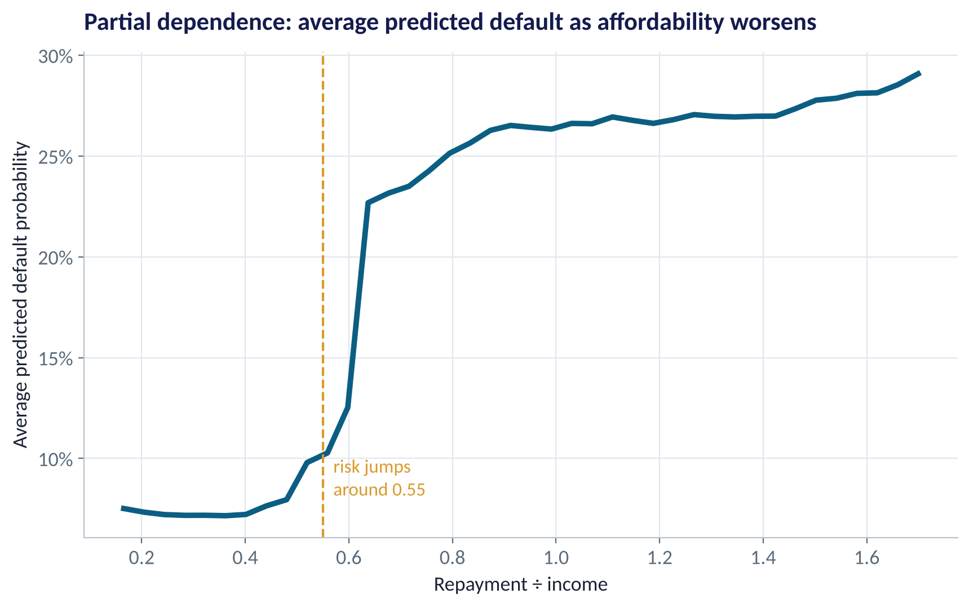
DIRECTION AND SHAPE
Partial Dependence: The Affordability Cliff
WHAT TO SEE
Average predicted default as one driver changes, others held as they are.
Below ~0.5 of income, risk is flat at about 7%.
Between 0.55 and 0.65 it jumps to about 23%.
A clear policy insight: cap repayments at ~50% of income.
Fig S3.5-F07 · replicate: tdbg_3_5_figures.R / .py
SESSION 3.5 · MANY TREES, BETTER DECISIONS
20

Slide 21


THE REAL TRADE-OFF
Accuracy vs Explainability
Logistic regression / small tree
Forest / boosting
Glass box
More accurate, harder to explain
Each decision explainable in a sentence
Easy to validate, document and defend to regulators
Stable when data shift slightly
Leaves profit on the table
Higher AUC and profit
Hundreds of trees: no single rule to show
Needs explanation tools (Session 4.1: SHAP, LIME)
Needs monitoring for drift and fairness
A common compromise: deploy the ensemble for ranking, explain individual decisions with SHAP, and keep simple policy rules (like a 50% affordability cap) as guardrails.
SESSION 3.5 · MANY TREES, BETTER DECISIONS
21

Slide 22

CONCEPT CHECK
Quick Check: What Would You Say?
A random forest has training AUC 0.99 and test AUC 0.81. A single depth-12 tree has training AUC 0.97 and test AUC 0.63. What's the best reading?
A
Both models are badly overfitted and useless
B
The forest's high training AUC is expected (deep trees); its test AUC is what counts — and averaging protects it from the overfitting that wrecks the single deep tree
C
The single tree is better because its training and test AUC are closer
D
Use the training AUC to choose between models
Discuss with your neighbour for 60 seconds — answer and reasoning in the speaker notes.
SESSION 3.5 · MANY TREES, BETTER DECISIONS
22

Slide 23



HANDS-ON LAB
Lab: Tree vs Forest vs Boosting
1
Fit a depth-4 decision tree; write its top three rules as plain-English policy.
YOU WILL NEED
Data
2
Fit a random forest (500 trees) and list the top permutation importances.
data/digital_loans.csv
3
Fit gradient boosting; compare all models' test AUC with Session 3.4's logistic score.
R script
sessions/3-5/R/tdbg_3_5_lab.R
4
Compute each model's best-threshold profit on the 1,800 test loans.
Python script
Tune one setting (trees, leaf size, learning rate) and judge the change on CV, not test.
sessions/3-5/python/tdbg_3_5_lab.py
5
Deliverable: a model recommendation for the credit committee — accuracy, profit, explainability, risks.
⏱ 30 minutes
SESSION 3.5 · MANY TREES, BETTER DECISIONS
23

Slide 24
WORDS TO OWN
Today's Vocabulary in Plain English
Decision tree
A flowchart of yes/no splits ending in predictions.
Random forest
Bagged trees with random driver subsets at each split.
Split
A question that divides cases into purer groups.
Boosting
Adding trees in sequence, each fixing earlier errors.
Leaf
An end node with a predicted rate or class.
Learning rate
How big each boosting correction is.
Bootstrap sample
A random sample drawn with replacement.
Permutation importance
Accuracy lost when a driver is scrambled.
Bagging
Averaging models trained on bootstrap samples.
Partial dependence
Average prediction as one driver varies.
SESSION 3.5 · MANY TREES, BETTER DECISIONS
24

Slide 25
KEY TAKEAWAYS
Session 3.5 in 5 Ideas
01
Trees turn data into if–then rules and capture thresholds and interactions automatically.
02
A single deep tree overfits and is unstable; depth must be limited.
03
Forests average many diverse trees; boosting corrects errors in sequence.
04
Here ensembles lifted AUC from 0.77 to 0.81 and profit by about 30%.
05
Use importance and partial dependence to see inside — and weigh accuracy against explainability.
NEXT › Session 4.1: Opening the Black Box
Before next session: Read Chapters 21–22 (Model Explainability — SHAP and LIME; Lead Scoring). Think of a model decision in your organisation that a customer or regulator might ask you to explain.

