Slide 1
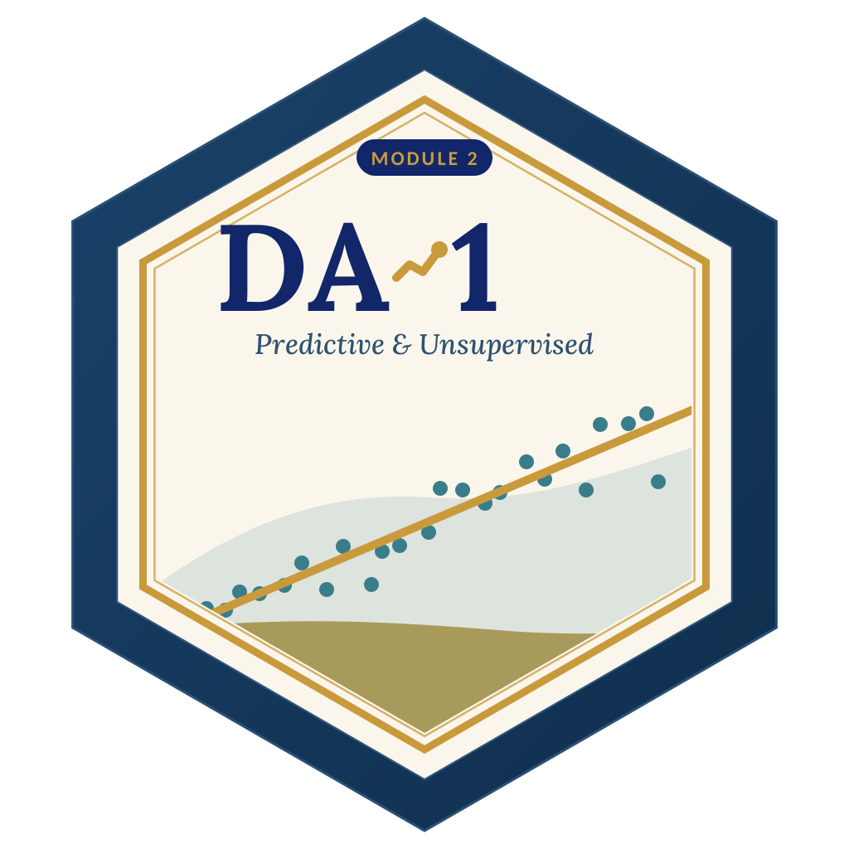

LAGOS BUSINESS SCHOOL · TURNING DATA INTO BUSINESS GROWTH · DAY 4
SESSION 4.1
Opening the
Black Box
Model Explainability & Lead Scoring
Source: Chapters 21–22 — Model Explainability (SHAP & LIME) · Lead Scoring
AI-Powered Business Analytics: A Practical Textbook for Data-Driven Decision Making · Prof. Bongo Adi

Slide 2




RECAP
Session 3.5 in Three Ideas
Trees
If–then rules that capture thresholds and interactions — but a single deep tree overfits.
Ensembles
Forests average many trees; boosting corrects errors in sequence. AUC 0.77 → 0.81.
The cost
More accuracy, less transparency. Today: how to open the black box.
SESSION 4.1 · OPENING THE BLACK BOX
2

Slide 3




TODAY'S PLAN
Session 4.1 at a Glance — 75 Minutes
From 'the model says so' to 'here is why'.
10'
30'
30'
5'
Recap & Hook
Explainability
Lab: Lead Scoring
Module 2 Review
Why 'trust me' is not enough
Global vs local; SHAP; LIME; limits
Score, grade and explain B2B leads
Practice-paper briefing: Practice Paper 2
SESSION 4.1 · OPENING THE BLACK BOX
3

Slide 4



BY THE END OF TODAY
Session 4.1 Learning Objectives
You will be able to:
01
02
03
Explain Globally
Explain Locally
Build a Lead Score
Show which drivers matter most across all predictions, and in which direction.
Use SHAP (and know LIME) to explain a single prediction to a non-technical stakeholder.
Turn a model into lead grades and a calling plan a sales director can trust and act on.
SESSION 4.1 · OPENING THE BLACK BOX
4

Slide 5




THE HOOK
“Why Did the Model Say That?”
A sales director asks why a ₦40m prospect is graded 'D'. A customer asks why her loan was declined. A regulator asks you to prove the model is fair.
If you can't answer, the model won't be used — or shouldn't be. Explainability gives you:
Trust
Debugging
Accountability
People act on scores they understand.
Spot when a model relies on a leak, a proxy or nonsense.
Meet NDPA and fair-lending expectations to explain automated decisions.

Slide 6



NIGERIAN BUSINESS CASE
A B2B Lead-Scoring Model for a Sales Director
The situation
The decision question
A Lagos-based enterprise software firm generates 2,500 leads a year from referrals, events, its website, LinkedIn and cold outreach. Only 16% convert. The 12-person sales team can't call everyone well.
Which leads should sales call first — and can we explain each score so account managers trust it?
The data we have
What a good answer looks like
b2b_leads.csv — industry, company size, lead source, web visits, demo request, emails opened, days since first touch, converted. Train on 1,750 leads; test on 750.
Lead grades (A–D) with expected conversion rates, a calling plan, and a plain-English explanation for any individual lead.
SESSION 4.1 · OPENING THE BLACK BOX
6

Slide 7
PART
01
Opening the Black Box
Global explanations, local explanations.

Slide 8
TWO QUESTIONS
Global vs Local Explanations
Global
Local
How does the model behave overall?
Why did this one lead get this score?
Which drivers matter most across all leads?
In which direction does each push?
Tools: permutation importance, mean |SHAP|, partial dependence
Audience: management, model validators, regulators
Which drivers pushed this score up or down, and by how much?
What would need to change for a different outcome?
Tools: SHAP waterfall, LIME
Audience: account managers, customers, complaints teams
SESSION 4.1 · OPENING THE BLACK BOX
8

Slide 9


SHAP
SHAP Values in Plain English
IN PLAIN ENGLISH
THE FORMULA
score = average + Σ driver pushes
Think of a prediction as a team result. SHAP (from game theory's Shapley values) fairly shares out the credit: starting from the average score, each driver gets a push up or down, and the pushes add up exactly to this lead's score.
WHY A MANAGER CARES
SHAP gives consistent, additive explanations for any model, global and local, from the same numbers. Exact and fast for tree models (TreeSHAP); slower but possible for any model (KernelSHAP).
EXAMPLE
Average lead: log-odds −1.65 (16%). This lead: requested a demo (+0.99), recent touch (+0.49), enterprise (+0.47), referral (+0.31)… → 77%.
SESSION 4.1 · OPENING THE BLACK BOX
9

Slide 10
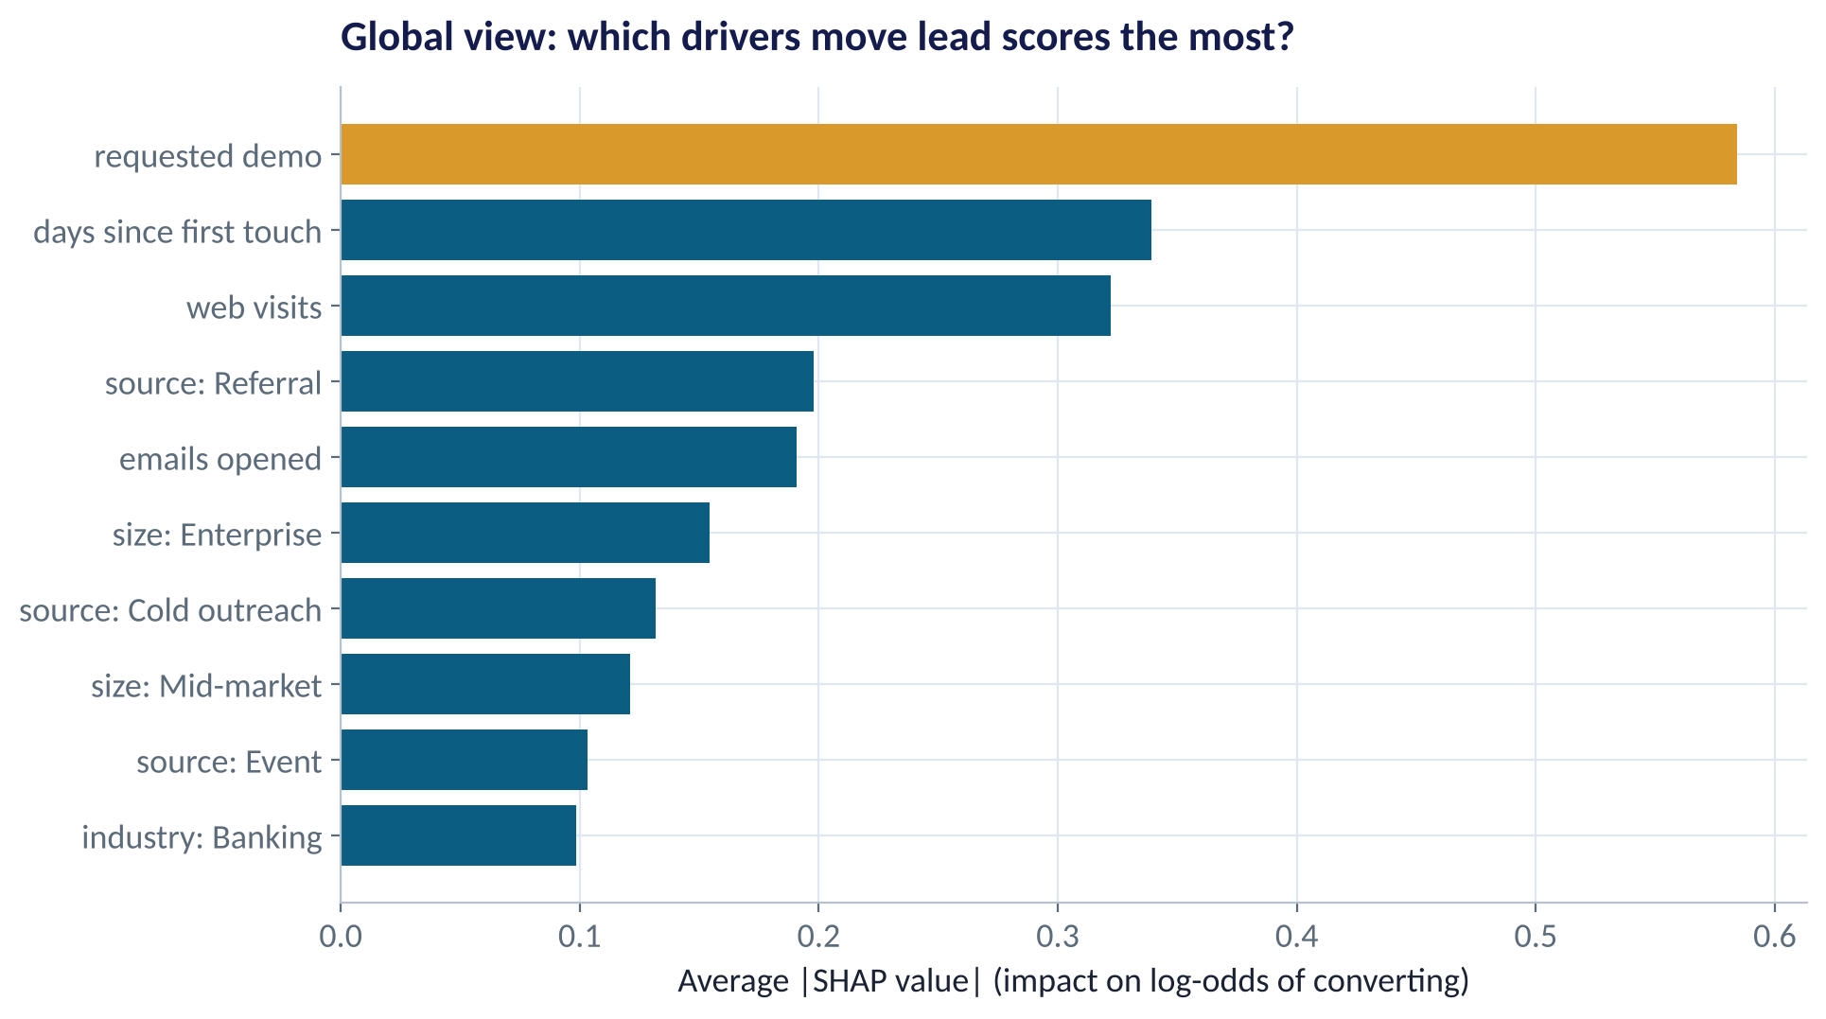
GLOBAL · IMPORTANCE
Which Drivers Move Lead Scores Most?
WHAT TO SEE
Demo requested is by far the strongest signal.
Then recency (days since first touch) and web visits.
Lead source matters: referral up, cold outreach down.
Company size and industry matter less than behaviour.
Fig S4.1-F01 · replicate: tdbg_4_1_figures.R / .py
SESSION 4.1 · OPENING THE BLACK BOX
10

Slide 11
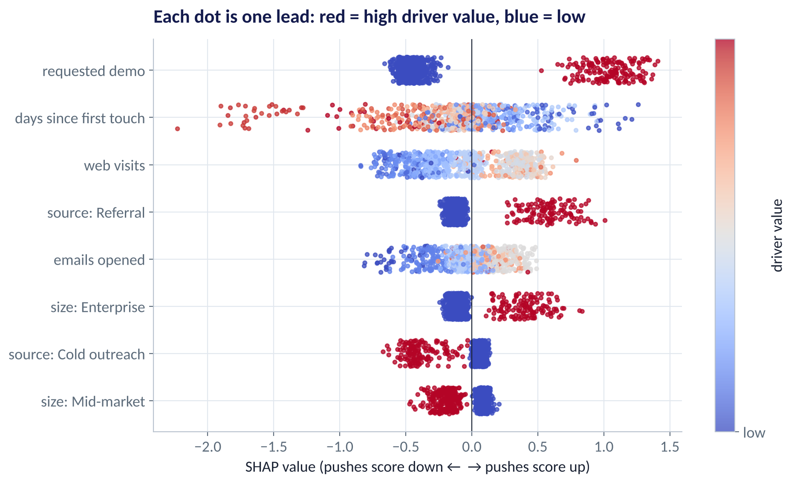
GLOBAL · DIRECTION
The SHAP Summary Plot
WHAT TO SEE
Each dot is one test lead; colour is the driver's value.
Demo requested (red) → strongly positive; not requested (blue) → negative.
Older leads (red on 'days since first touch') score lower: interest decays.
Cold-outreach leads (red) are pushed down.
Fig S4.1-F02 · replicate: tdbg_4_1_figures.R / .py
SESSION 4.1 · OPENING THE BLACK BOX
11

Slide 12
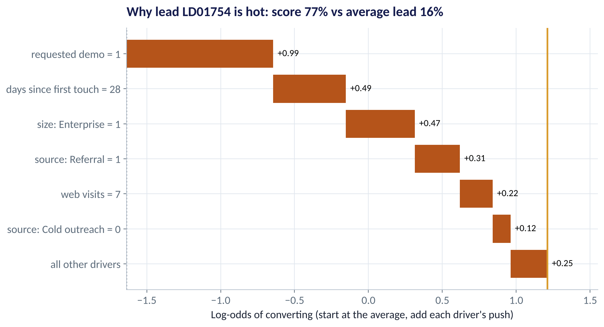
LOCAL · A HOT LEAD
Why Is This Lead Graded 'A'?
WHAT TO SEE
Starts from the average lead's log-odds.
Demo requested, 28 days since first touch, enterprise, referral each push it up.
Final score ≈ 77%: call today.
An account manager can read this in ten seconds.
Fig S4.1-F03 · replicate: tdbg_4_1_figures.R / .py
SESSION 4.1 · OPENING THE BLACK BOX
12

Slide 13
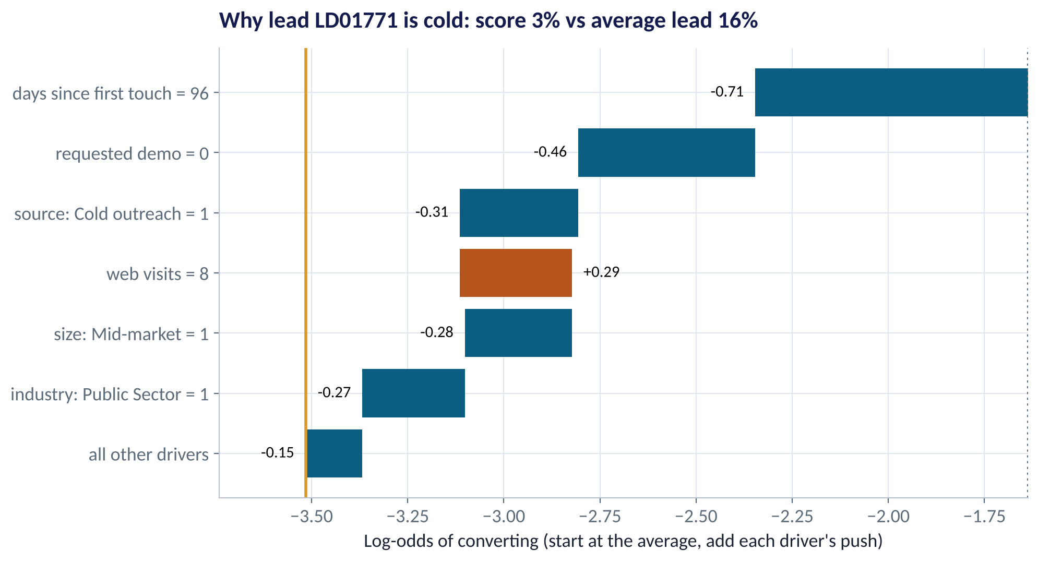
LOCAL · A COLD LEAD
Why Is This Lead Graded 'D'?
WHAT TO SEE
96 days since first touch: interest has cooled (−0.71).
No demo request; came from cold outreach; public sector.
Eight web visits help a little (+0.29) — not enough.
Score ≈ 3%. Action: nurture by email, don't spend a senior rep's time.
Fig S4.1-F04 · replicate: tdbg_4_1_figures.R / .py
SESSION 4.1 · OPENING THE BLACK BOX
13

Slide 14
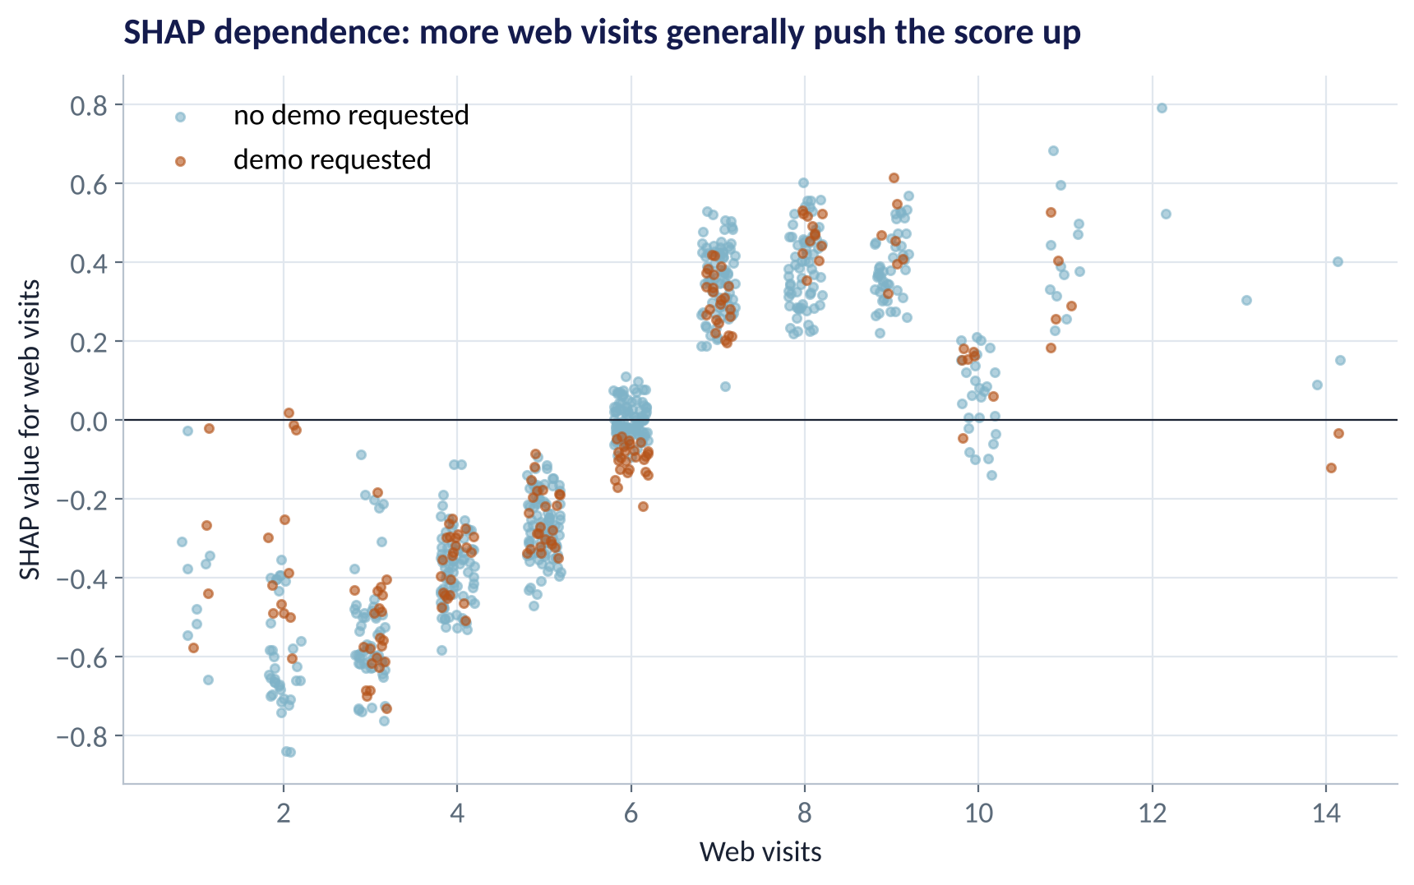
GLOBAL · SHAPE
SHAP Dependence: How One Driver Works
WHAT TO SEE
Each dot: one lead's web visits and that driver's push.
Below ~6 visits pushes the score down; 7+ pushes it up.
The pattern is noisy at high counts — few leads visit 10+ times.
Use it to sanity-check that the model learned something sensible.
Fig S4.1-F05 · replicate: tdbg_4_1_figures.R / .py
SESSION 4.1 · OPENING THE BLACK BOX
14

Slide 15
LIME
LIME: A Simple Model Around One Prediction
IN PLAIN ENGLISH
WHY A MANAGER CARES
LIME (Local Interpretable Model-agnostic Explanations) creates many slightly altered copies of one case, asks the black box to score them, then fits a small, simple model (like a short regression) that mimics the black box just around that case.
LIME works with any model, including text and image models. But explanations can change from run to run and depend on choices like neighbourhood size. SHAP is usually more stable for tabular business data; LIME is a useful second opinion.
EXAMPLE
For a declined loan: 'Near this applicant, the score is driven mainly by repayment-to-income and two late payments.'
SESSION 4.1 · OPENING THE BLACK BOX
15

Slide 16


THE LIMITS OF EXPLANATION
What Explanations Can't Tell You
THE TRAP
THE BETTER HABIT
“SHAP says demos cause conversions — make everyone book a demo.”
SHAP explains the model, not the world. Demo requests may signal intent rather than create it.
Explaining a model built on leaked data ('call outcome' recorded after conversion).
Use explanations to find leaks — a too-good driver is a red flag.
Treating a clean explanation as proof of fairness.
Check outcomes across groups; proxies can hide in innocent-looking drivers.
Using a black box when a glass box is as accurate.
Prefer the simplest model that performs — here logistic matches XGBoost.
SESSION 4.1 · OPENING THE BLACK BOX
16

Slide 17
PART
02
Lead Scoring in Practice
From probabilities to a Monday-morning calling plan.

Slide 18
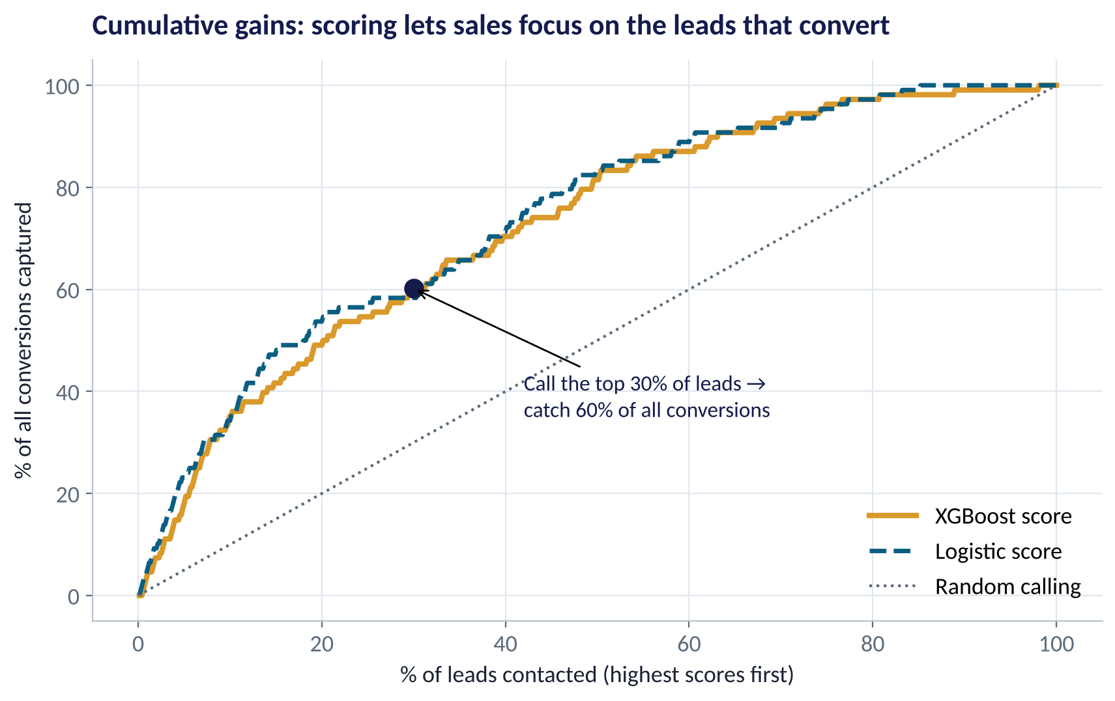
THE VALUE OF RANKING
Cumulative Gains: Who to Call First
WHAT TO SEE
Sort leads by score and call from the top.
Calling the top 30% captures about 60% of all conversions.
Random calling would capture only 30%.
Logistic and XGBoost scores perform almost identically here.
Fig S4.1-F06 · replicate: tdbg_4_1_figures.R / .py
SESSION 4.1 · OPENING THE BLACK BOX
18

Slide 19
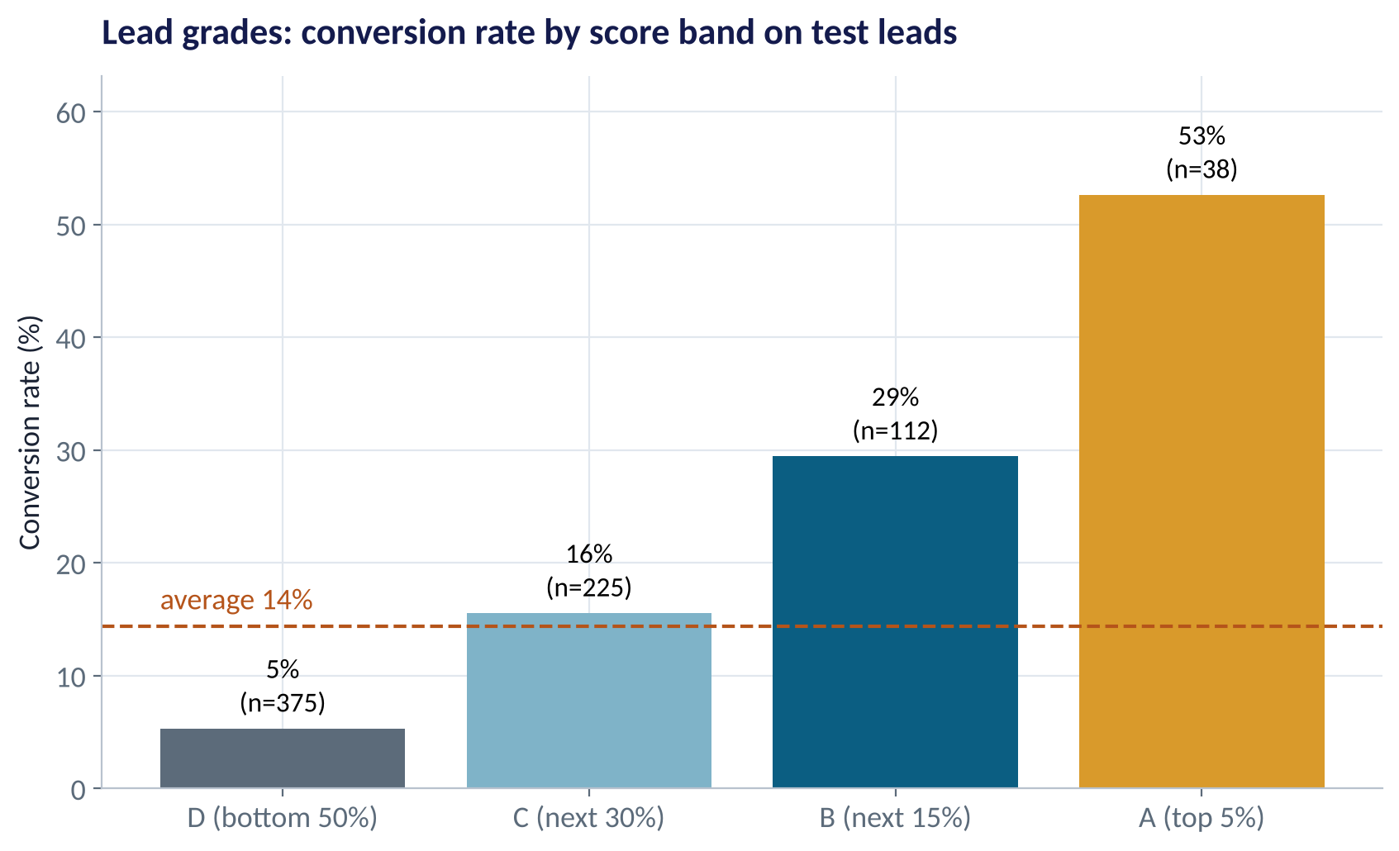
MAKING IT USABLE
From Scores to Lead Grades
WHAT TO SEE
A (top 5%): 53% convert — senior rep, same day.
B (next 15%): 29% — call within 48 hours.
C (next 30%): 16% — inside sales / email + call.
D (bottom 50%): 5% — automated nurture.
Grades are easier to act on than raw probabilities.
Fig S4.1-F07 · replicate: tdbg_4_1_figures.R / .py
SESSION 4.1 · OPENING THE BLACK BOX
19

Slide 20
THE CALLING PLAN
What Does Scoring Buy the Sales Team?
Sales can make 200 quality calls a week; about 48 new leads arrive weekly.
Grade | Share of leads | Conversion | Leads / week | Expected wins
A | 5% | 53% | 2.4 | 1.3
B | 15% | 29% | 7.2 | 2.1
C | 30% | 16% | 14.4 | 2.2
D | 50% | 5% | 24.0 | 1.3
All | 100% | 14% | 48 | 6.9
STEP BY STEP
1
Weekly leads ≈ 2,500 ÷ 52 ≈ 48.
2
Focus senior reps on A and B: ~10 leads → 3.4 expected wins a week.
3
D leads (half the volume) yield only ~1.3 wins — move them to automated nurture.
4
Freed capacity goes to faster follow-up, which itself raises conversion.
Same team, sharper focus: the top half of leads (A–C) produce about 80% of the wins.
SESSION 4.1 · OPENING THE BLACK BOX
20

Slide 21





DEPLOYING A LEAD SCORE
Five Rules for a Score Sales Will Actually Use
Explain every score
Co-design with sales
Prove it
Show the top 3 reasons next to each lead in the CRM.
Agree grades and actions with the sales director before launch.
Champion–challenger test: half the team uses scores, half doesn't (Session 3.1).
Refresh
Watch for bias
Retrain quarterly; markets and campaigns change what signals intent.
Check grades across industries and regions — avoid starving whole segments.
SESSION 4.1 · OPENING THE BLACK BOX
21

Slide 22

CONCEPT CHECK
Quick Check: What Would You Say?
A SHAP waterfall shows 'industry = Public Sector' pushes a lead's score down by −0.27. The sales director asks: 'Should we stop selling to the public sector?' Best answer?
A
Yes — the model proves public-sector leads are worse
B
No — SHAP shows how the model uses industry for this lead; it reflects past conversion patterns, not whether public-sector deals are worth pursuing (they may be large or strategic)
C
SHAP values are random and should be ignored
D
Remove industry from the model so the problem disappears
Discuss with your neighbour for 60 seconds — answer and reasoning in the speaker notes.
SESSION 4.1 · OPENING THE BLACK BOX
22

Slide 23



HANDS-ON LAB
Lab: Score, Grade and Explain the Leads
1
Fit a logistic model and an XGBoost model on 1,750 leads; compare test AUC.
YOU WILL NEED
Data
2
Compute SHAP values; produce the global importance and summary views.
data/b2b_leads.csv
3
Explain the hottest lead with a waterfall; write three plain-English lines for the account manager.
R script
sessions/4-1/R/tdbg_4_1_lab.R
4
Create A–D grades; compute conversion by grade and the top-30% gains.
Python script
Build a weekly calling plan for 200 calls and estimate expected wins.
sessions/4-1/python/tdbg_4_1_lab.py
5
Deliverable: a one-page brief for the sales director: grades, calling plan, and one explained example lead.
⏱ 30 minutes
SESSION 4.1 · OPENING THE BLACK BOX
23

Slide 24



MODULE 2 REVIEW
Practice Paper 2 — What to Expect
75 minutes. Covers Sessions 3.2–4.2. Sections B and C are open-resource.
Section A · 25%
Section B · 40%
Section C · 35%
Concepts: bias–variance, regularisation, metrics, odds ratios, ensembles, explainability, clustering.
Interpret output: regression tables, confusion matrices, ROC, importance/SHAP, cluster profiles.
Applied build-and-interpret task on a provided dataset — R or Python.
SESSION 4.1 · OPENING THE BLACK BOX
24

Slide 25
WORDS TO OWN
Today's Vocabulary in Plain English
Explainability
Making a model's reasoning understandable to people.
LIME
A simple local model that mimics a black box near one case.
Global explanation
How the model behaves across all cases.
Lead scoring
Ranking prospects by likelihood to convert.
Local explanation
Why one case got its prediction.
Cumulative gains
Share of positives captured as you work down the ranked list.
SHAP value
A driver's fair share of one prediction's deviation from average.
Lead grade
A band (A–D) grouping leads by score.
Waterfall plot
Shows SHAP pushes adding up to one prediction.
Data leakage
Using information that wouldn't exist at prediction time.
SESSION 4.1 · OPENING THE BLACK BOX
25

Slide 26
KEY TAKEAWAYS
Session 4.1 in 5 Ideas
01
Explanations come in two kinds: global (the model) and local (one case).
02
SHAP splits a prediction into additive pushes from the average — consistent and model-agnostic.
03
Explanations describe the model, not cause and effect in the world.
04
Prefer the simplest model that performs; explain the rest.
05
A lead score becomes useful as grades + reasons + a calling plan, proven with a test.
NEXT › Session 4.2: Segmentation You Can Act On
Before next session: Read Chapters 24–27 (Unsupervised Learning: K-Means, Hierarchical & Density-Based Clustering, PCA). List three ways your organisation currently segments customers — and how those segments were chosen.

