Slide 1
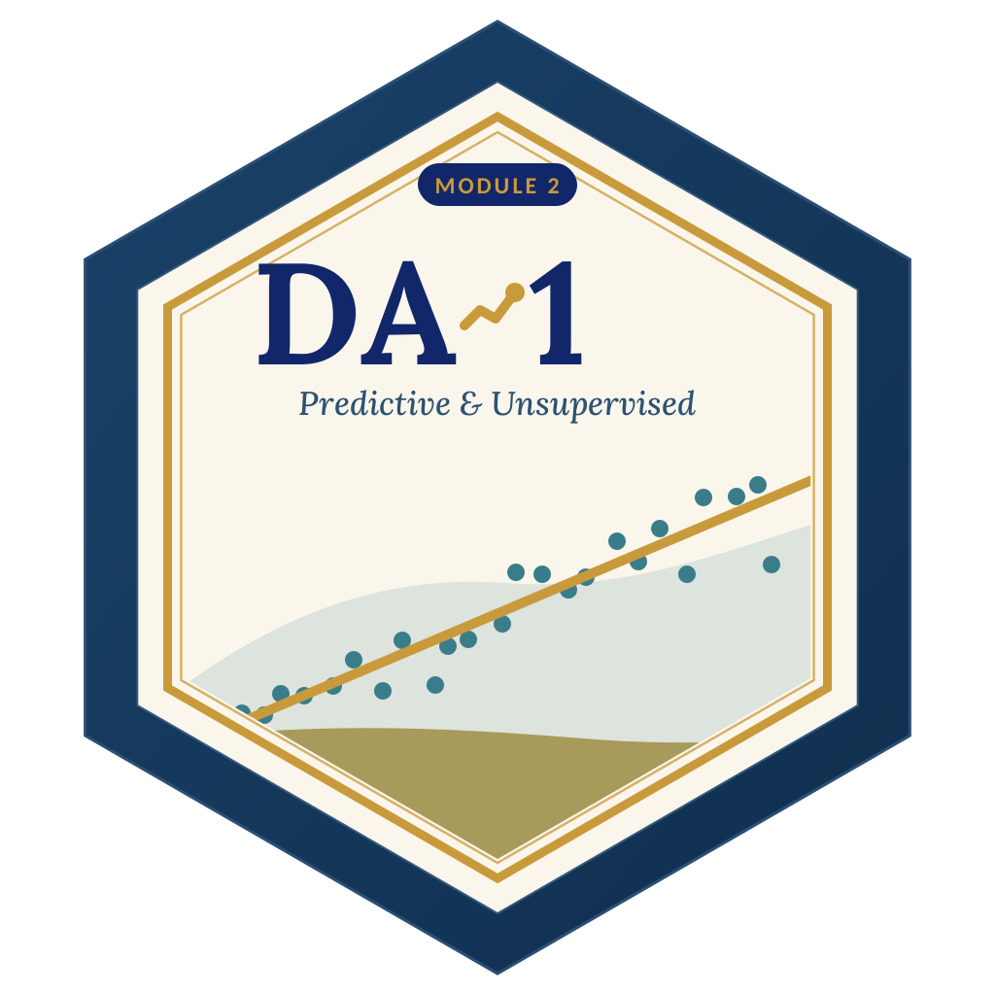

LAGOS BUSINESS SCHOOL · TURNING DATA INTO BUSINESS GROWTH · DAY 4
SESSION 4.2
Segmentation
You Can Act On
Unsupervised Learning: Clustering & Dimensionality Reduction
Source: Chapters 24–27 — Unsupervised Learning · K-Means · Hierarchical & Density-Based · PCA
AI-Powered Business Analytics: A Practical Textbook for Data-Driven Decision Making · Prof. Bongo Adi

Slide 2




RECAP
Session 4.1 in Three Ideas
Global & local
Explain the model overall, and explain each individual prediction.
SHAP
Splits a prediction into additive pushes from the average — the same numbers serve both views.
Lead grades
Scores become useful as grades + reasons + a calling plan, proven with a test.
SESSION 4.2 · SEGMENTATION YOU CAN ACT ON
2

Slide 3




TODAY'S PLAN
Session 4.2 at a Glance — 75 Minutes
No outcome to predict — just structure to discover.
10'
30'
30'
5'
Module 1–2 Bridge
Clustering & PCA
Lab: Bank Segments
Wrap-Up
From supervised to unsupervised learning
Scaling, k-means, choosing k, hierarchical, PCA
Segment 3,400 retail customers
From clusters to customer strategy
SESSION 4.2 · SEGMENTATION YOU CAN ACT ON
3

Slide 4


BY THE END OF TODAY
Session 4.2 Learning Objectives
You will be able to:
01
02
03
Explain Clustering
Run & Choose k
Use PCA
Describe how k-means, hierarchical and density-based methods find groups without labels.
Prepare data, run k-means, and choose the number of clusters with the elbow and silhouette.
Summarise many drivers in a few components — and turn clusters into named, actionable segments.
SESSION 4.2 · SEGMENTATION YOU CAN ACT ON
4

Slide 5


A NEW KIND OF PROBLEM
Supervised vs Unsupervised Learning
Supervised (Sessions 3.2–4.1)
Unsupervised (today)
There is an answer column
No answer column
Revenue, default, conversion — known for past cases
The model learns to predict it
Judged by accuracy on test data
Regression, logistic, trees, ensembles
Only descriptions of customers, products or stores
The algorithm finds structure: groups, patterns, dimensions
Judged by usefulness and stability, not 'accuracy'
Clustering, PCA, association rules (Session 4.5)
SESSION 4.2 · SEGMENTATION YOU CAN ACT ON
5

Slide 6



NIGERIAN BUSINESS CASE
Segmenting a Bank's Retail Customers
The situation
The decision question
A Nigerian retail bank treats its 3,400-customer sample as one market. Marketing sends the same offers to students, salary earners, traders and the wealthy.
Are there natural customer groups — and what should the bank offer each one?
The data we have
What a good answer looks like
bank_customers_segmentation.csv — average balance, monthly transactions, digital share of transactions, age, products held, tenure.
A small set of named, profiled segments with size, value and one strategic action each.
SESSION 4.2 · SEGMENTATION YOU CAN ACT ON
6

Slide 7
PART
01
Clustering
Grouping similar customers.

Slide 8
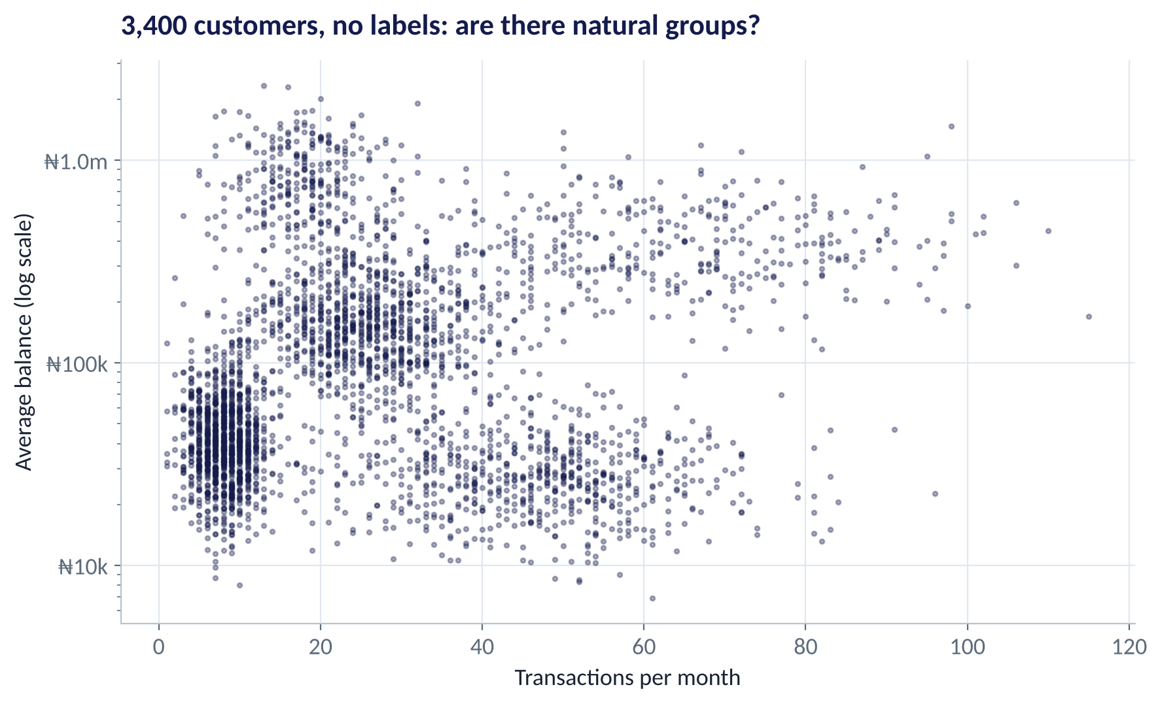
THE STARTING POINT
Can You See the Groups?
WHAT TO SEE
Each dot is a customer; no labels.
Some clumps are visible — high-balance customers, heavy transactors, a dense low-activity mass.
But we have six drivers, not two: groups may only appear across all of them.
Clustering finds them systematically.
Fig S4.2-F01 · replicate: tdbg_4_2_figures.R / .py
SESSION 4.2 · SEGMENTATION YOU CAN ACT ON
8

Slide 9

THE ALGORITHM
How k-Means Works
IN PLAIN ENGLISH
THE FORMULA
minimise: Σ distance² to own centre
Choose k, the number of groups. Drop k centre points at random. Then repeat two steps until nothing changes: (1) assign every customer to the nearest centre; (2) move each centre to the average of its customers.
WHY A MANAGER CARES
k-means is fast, simple and scales to millions of customers. But you choose k, it prefers round, similar-sized groups, and results depend on the starting centres — so run it several times (nstart / n_init) and check stability.
EXAMPLE
With k = 5, the centres settle on: older wealthy customers, heavy business transactors, young digital users, salaried customers, and low-activity savers.
SESSION 4.2 · SEGMENTATION YOU CAN ACT ON
9

Slide 10



PREPARING THE DATA
Three Steps Before Any Clustering
Clustering is all about distance — so the units matter.
Standardise
Tame skew
Choose drivers wisely
Balance in naira (up to ₦2.3m) would swamp age (18–80). Rescale each driver to mean 0, SD 1.
Log-transform money values so a few millionaires don't become a cluster of their own.
Use drivers that matter for the decision — behaviour, value, needs — not every column you have.
SESSION 4.2 · SEGMENTATION YOU CAN ACT ON
10

Slide 11
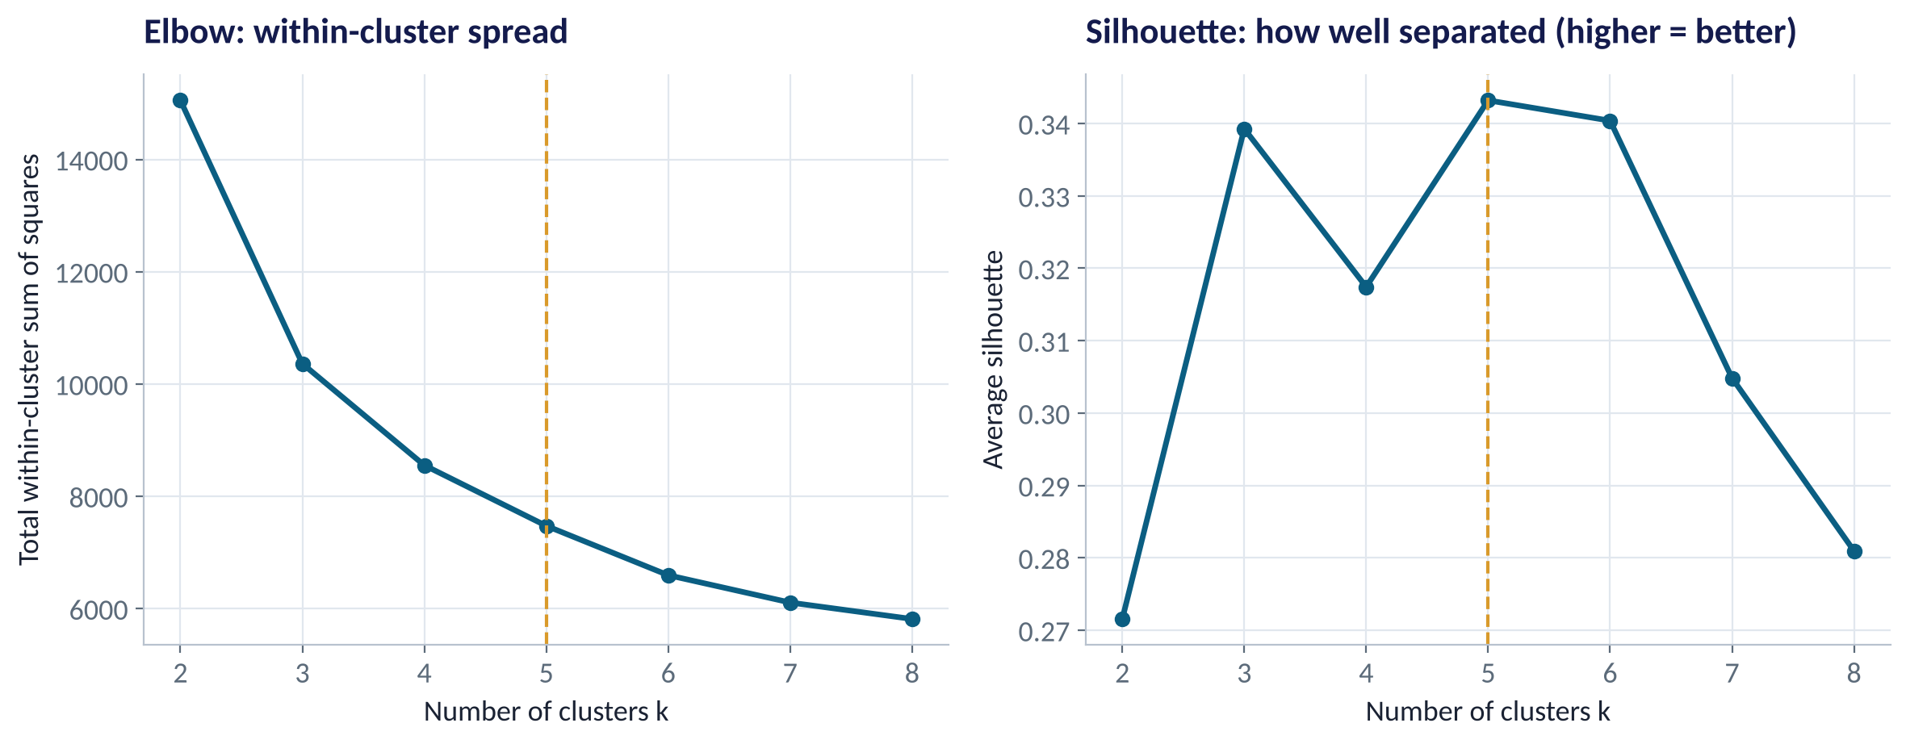
HOW MANY CLUSTERS?
The Elbow and the Silhouette
WHAT TO SEE
Elbow (left): within-cluster spread always falls as k rises; look for where gains flatten.
Silhouette (right): how much closer customers are to their own cluster than to the next one. Higher is better.
Both point to k = 5 here.
Final choice also depends on business use: can marketing run 5 strategies? 12?
Fig S4.2-F02 · replicate: tdbg_4_2_figures.R / .py
SESSION 4.2 · SEGMENTATION YOU CAN ACT ON
11

Slide 12
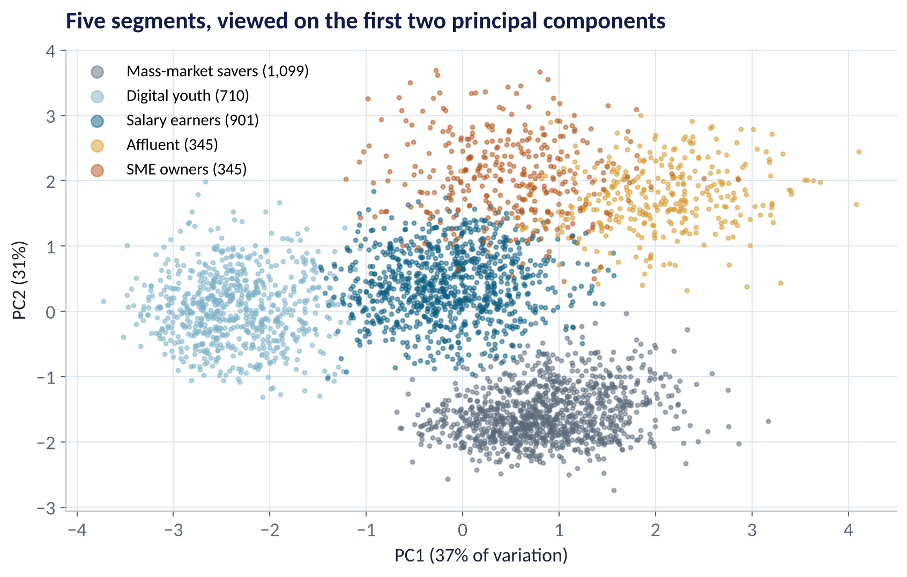
THE RESULT
Five Segments Emerge
WHAT TO SEE
Seen on two summary axes (PCA — explained shortly).
Five well-separated groups, sizes from 345 to 1,099 customers.
Names come after profiling — the algorithm only gives numbers.
Cluster numbers can differ between runs and between R and Python.
Fig S4.2-F03 · replicate: tdbg_4_2_figures.R / .py
SESSION 4.2 · SEGMENTATION YOU CAN ACT ON
12

Slide 13
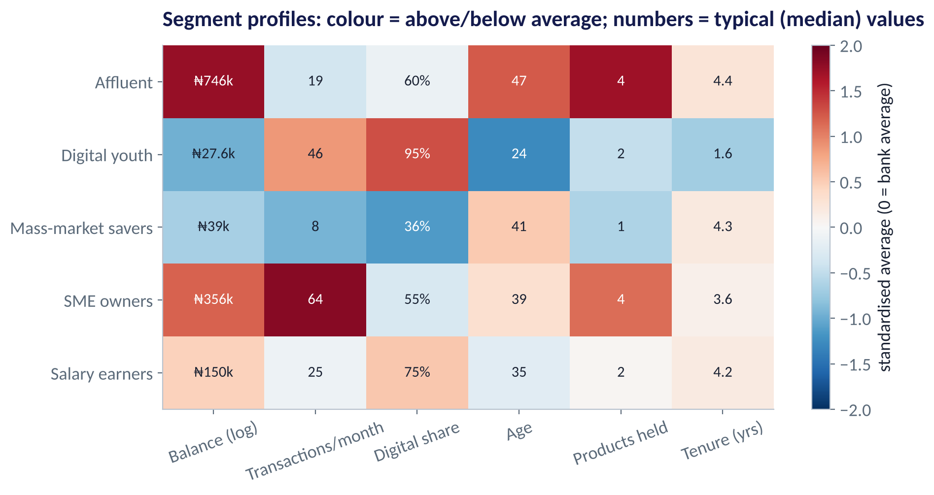
MAKING SENSE OF CLUSTERS
Profiling the Segments
WHAT TO SEE
Affluent: ₦746k balances, 47 years, 4 products.
SME owners: 64 transactions a month, ₦356k balances.
Digital youth: 95% digital, 24 years, low balances.
Salary earners: middle on most things, 75% digital.
Mass-market savers: low activity, low digital, 1 product.
Fig S4.2-F04 · replicate: tdbg_4_2_figures.R / .py
SESSION 4.2 · SEGMENTATION YOU CAN ACT ON
13

Slide 14
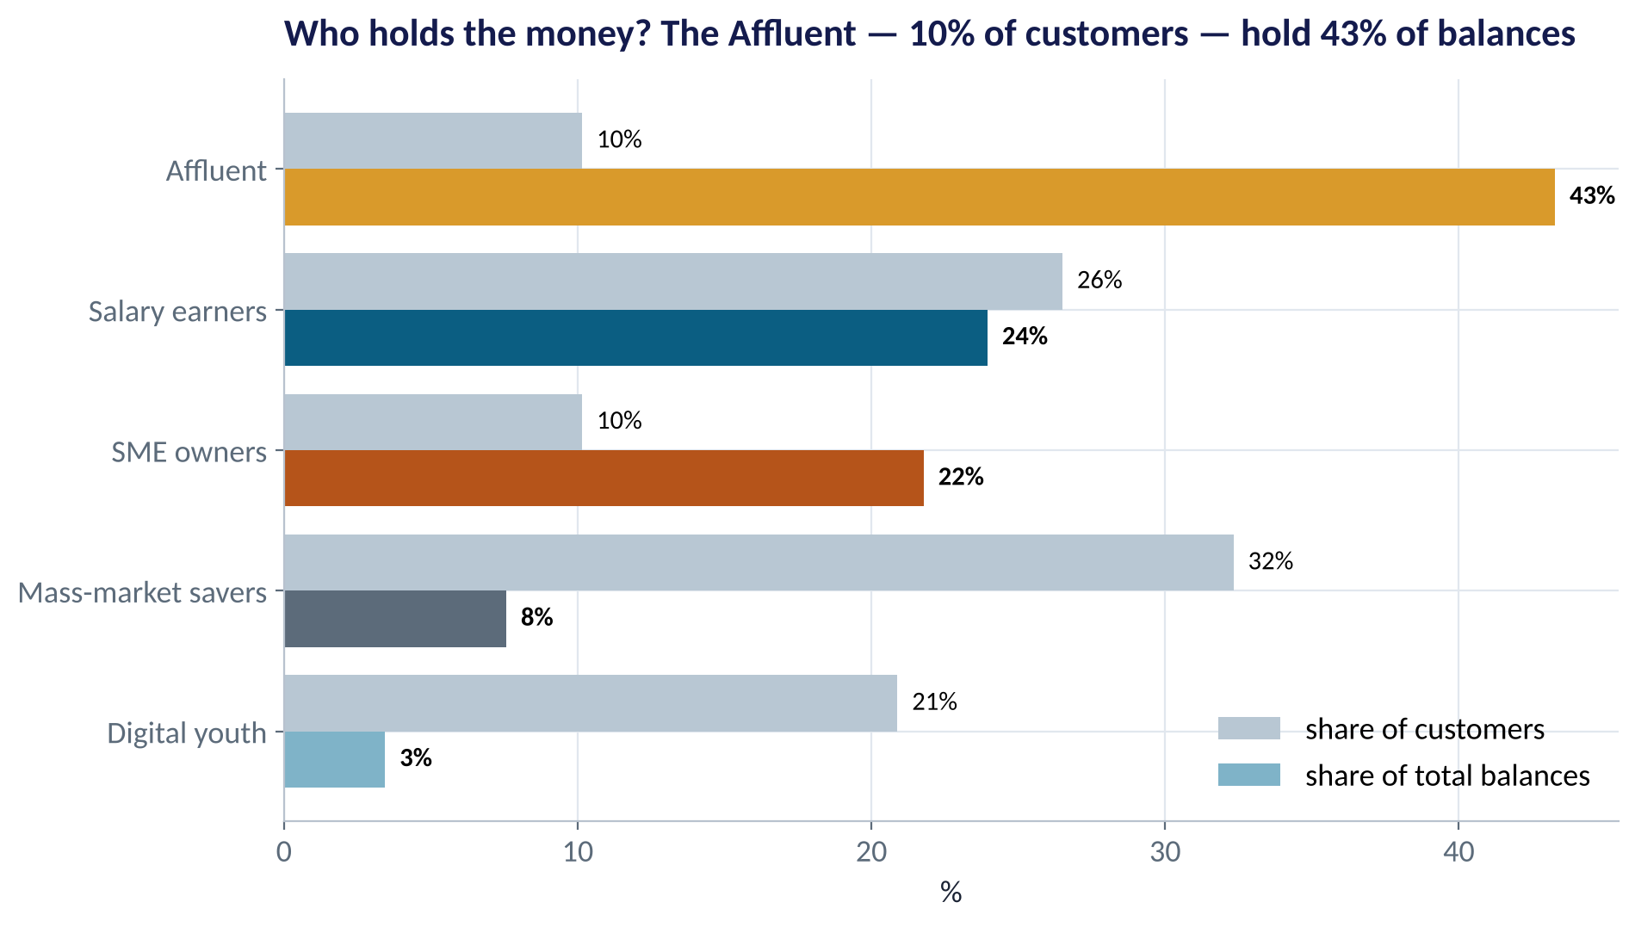
SIZE VS VALUE
Segments Differ Hugely in Value
WHAT TO SEE
Affluent: 10% of customers, 43% of balances.
Mass-market savers: 32% of customers, 8% of balances.
Digital youth: small balances today — future salary earners tomorrow.
Strategy should weigh current value and future potential.
Fig S4.2-F05 · replicate: tdbg_4_2_figures.R / .py
SESSION 4.2 · SEGMENTATION YOU CAN ACT ON
14

Slide 15
FROM SEGMENTS TO STRATEGY
One Action per Segment
Segment | Who they are | Opportunity | Example action
Affluent (10%) | Older, wealthy, multi-product, long tenure | Retain and deepen | Relationship manager; investment and FX products
SME owners (10%) | Very high transactions, healthy balances | Business banking | POS, payroll and working-capital lines
Salary earners (26%) | Mid-income, mostly digital | Cross-sell | Salary-linked credit card or savings plan
Digital youth (21%) | Young, 95% digital, low balances | Grow with them | App-only savings goals; first-job salary account
Mass-market savers (32%) | Low activity, branch-reliant | Activate cheaply | USSD onboarding; agent banking; nudges
SESSION 4.2 · SEGMENTATION YOU CAN ACT ON
15

Slide 16

CONCEPT CHECK
Quick Check: What Would You Say?
You cluster customers on balance (₦) and age without standardising. Most likely result?
A
Clusters are driven almost entirely by balance, because its numbers are millions of times larger than age
B
Clusters are driven mainly by age
C
Both drivers contribute equally
D
k-means automatically rescales the drivers
Discuss with your neighbour for 60 seconds — answer and reasoning in the speaker notes.
SESSION 4.2 · SEGMENTATION YOU CAN ACT ON
16

Slide 17

OTHER CLUSTERING FAMILIES
Hierarchical and Density-Based Clustering
Hierarchical
Density-based (DBSCAN)
Merge the closest customers, step by step
Groups are dense regions
Builds a tree (dendrogram) of merges
Cut the tree at any height to get k groups
No need to fix k in advance
Slow beyond a few thousand rows
Finds clusters of any shape
Labels isolated points as noise — useful for anomalies and fraud
No need to choose k; choose a neighbourhood size instead
Struggles when densities vary a lot
SESSION 4.2 · SEGMENTATION YOU CAN ACT ON
17

Slide 18
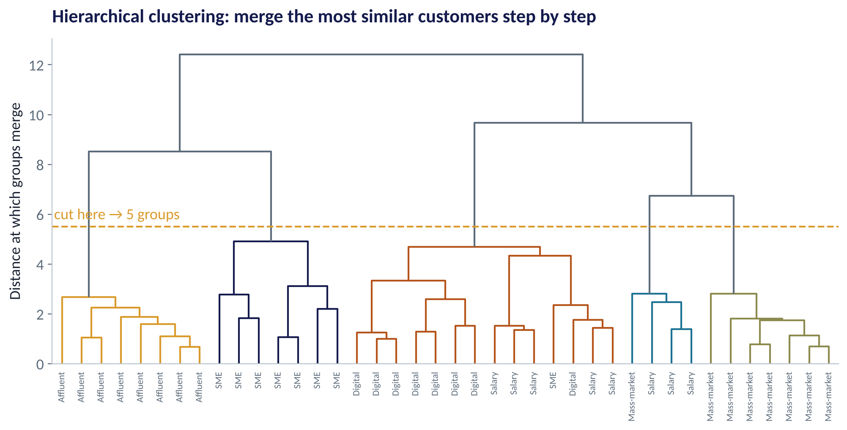
HIERARCHICAL CLUSTERING
Reading a Dendrogram
WHAT TO SEE
40 customers (8 per segment), merged from the bottom up.
Height = how different the groups being merged are.
Cutting at the dashed line gives 5 groups — closely matching the k-means segments.
Good for small samples and for seeing structure at every level.
Fig S4.2-F08 · replicate: tdbg_4_2_figures.R / .py
SESSION 4.2 · SEGMENTATION YOU CAN ACT ON
18

Slide 19
PART
02
Dimensionality Reduction
Many drivers, few dimensions.

Slide 20
PCA
Principal Component Analysis in Plain English
IN PLAIN ENGLISH
WHY A MANAGER CARES
Many business drivers move together. PCA finds new summary axes — principal components — that capture as much of the variation as possible. The first component is the single best summary; the second is the best summary of what is left; and so on.
Use PCA to visualise high-dimensional data, to compress many correlated drivers (e.g. 40 survey questions → 5 themes), and to remove collinearity before modelling. The price: components are mixtures, so they need careful naming.
EXAMPLE
Six customer drivers → two components keep about two-thirds of the information. We can then plot every customer on one chart.
SESSION 4.2 · SEGMENTATION YOU CAN ACT ON
20

Slide 21
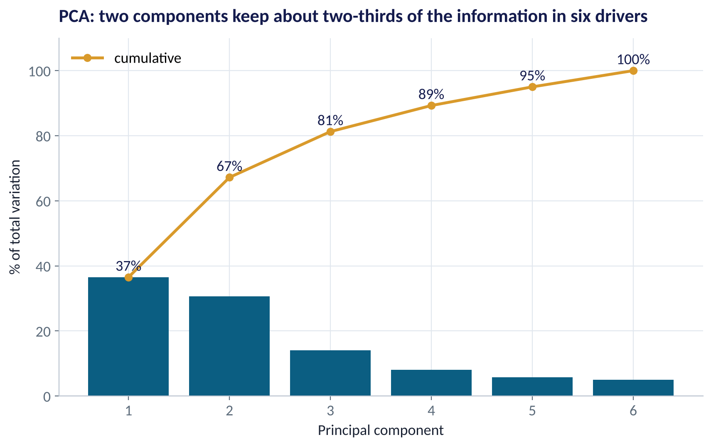
HOW MANY COMPONENTS?
Variance Explained
WHAT TO SEE
PC1 captures 37% of variation; PC2 31%.
Together: 67% — enough for a reliable 2-D picture.
Four components capture 89%.
Rule of thumb: keep components until the extra gain is small (scree 'elbow').
Fig S4.2-F06 · replicate: tdbg_4_2_figures.R / .py
SESSION 4.2 · SEGMENTATION YOU CAN ACT ON
21

Slide 22
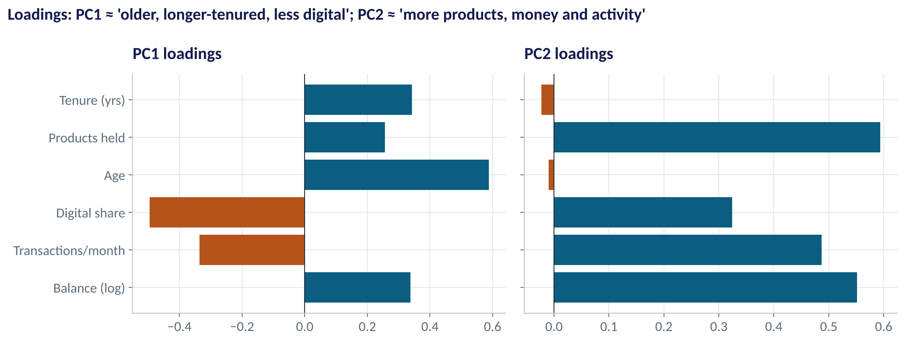
NAMING COMPONENTS
What Do the Components Mean?
WHAT TO SEE
Loadings show how much each driver contributes to a component.
PC1: older, longer-tenured customers vs young, digital, transaction-heavy ones.
PC2: more products, higher balances and more activity — overall relationship depth.
Signs can flip between software; read which drivers move together.
Fig S4.2-F07 · replicate: tdbg_4_2_figures.R / .py
SESSION 4.2 · SEGMENTATION YOU CAN ACT ON
22

Slide 23


WHERE MANAGERS GO WRONG
Segmentation Mistakes
THE TRAP
THE BETTER HABIT
Treating cluster numbers as meaningful ("cluster 3 is best").
Profile and name clusters; numbers are arbitrary.
Choosing k purely from the elbow plot.
Combine statistics with business usability and stability.
Clustering on every column available.
Pick drivers tied to the decision (needs, behaviour, value).
Building segments once and using them for years.
Refresh — customers move between segments.
Forgetting to scale.
Standardise, and log skewed money values.
SESSION 4.2 · SEGMENTATION YOU CAN ACT ON
23

Slide 24



HANDS-ON LAB
Lab: Segment the Bank's Customers
1
Log-transform balance and standardise all six drivers.
YOU WILL NEED
Data
2
Plot the elbow and silhouette for k = 2–8; choose k.
data/bank_customers_segmentation.csv
3
Fit k-means; profile each cluster with medians and sizes; give each a name.
R script
sessions/4-2/R/tdbg_4_2_lab.R
4
Run PCA; plot customers on PC1–PC2 coloured by segment; read the loadings.
Python script
Compare with hierarchical clustering; then check the hidden true labels.
sessions/4-2/python/tdbg_4_2_lab.py
5
Deliverable: a segment table: name, size, share of balances, profile, one action.
⏱ 30 minutes
SESSION 4.2 · SEGMENTATION YOU CAN ACT ON
24

Slide 25
WORDS TO OWN
Today's Vocabulary in Plain English
Unsupervised learning
Finding structure in data with no outcome column.
Elbow plot
Within-cluster spread vs k; look for the bend.
Clustering
Grouping similar cases together.
Silhouette
How well each case fits its cluster vs the next.
k-means
Clusters by assigning to the nearest of k centres.
Dendrogram
Tree showing how hierarchical clusters merge.
Centroid
The average point of a cluster.
PCA
Finds summary axes capturing the most variation.
Standardise
Rescale a driver to mean 0, standard deviation 1.
Loading
A driver's weight in a principal component.
SESSION 4.2 · SEGMENTATION YOU CAN ACT ON
25

Slide 26
KEY TAKEAWAYS
Session 4.2 in 5 Ideas
01
Unsupervised learning finds structure — there is no answer to predict.
02
Scale the data; k-means then assigns, moves and repeats.
03
Choose k with elbow, silhouette and business sense.
04
Clusters become segments only after profiling and naming.
05
PCA compresses many drivers into a few interpretable axes.
NEXT › Session 4.3: Forecasting with Intervals
Before next session: Prepare for the Module 2 Practice Paper (Practice Paper 2): rerun the labs from Sessions 3.2–4.2 and attempt the practice paper in the Practice Paper 2 deck.

