Slide 1


LAGOS BUSINESS SCHOOL · TURNING DATA INTO BUSINESS GROWTH · DAY 4
SESSION 4.3
Forecasting
with Intervals
Time Series & Business Forecasting
Source: Chapters 28–31 — Time Series · ARIMA & Exponential Smoothing · Modern Forecasting · Cash Flow
AI-Powered Business Analytics: A Practical Textbook for Data-Driven Decision Making · Prof. Bongo Adi

Slide 2

WHERE WE ARE
Programme Roadmap — Days 2 to 5
Three modules across four days, a self-study practice paper for each, and the capstone defence on Friday.
YOU ARE HERE
Module 1
Module 2
Module 3
Finale
Sessions 2.1–3.1
Sessions 3.2–4.2
Sessions 4.3–5.3
Session 5.4
Practice paper — self-study
Practice paper — self-study
Practice paper — self-study
Capstone
Foundations & Inference: data literacy, statistics, EDA, visualisation, hypothesis & A/B testing
Predictive & Unsupervised: regression, classification, ensembles, explainability, clustering & PCA
Advanced & Applied: time series, text, recommendation, neural nets & GenAI, customer, risk, operations & people
Team capstone defence before an external panel
SESSION 4.3 · FORECASTING WITH INTERVALS
2

Slide 3




TODAY'S PLAN
Session 4.3 at a Glance — 75 Minutes
From 'what will sales be?' to 'how sure are we, and can we afford it?'
10'
30'
30'
5'
Module 2 Debrief
Forecasting
Lab: SME Forecast
Wrap-Up
Test feedback; why time is different
Components, benchmarks, ETS, ARIMA, backtesting
Sales forecast and cash-flow scenarios
Forecasts as ranges, not numbers
SESSION 4.3 · FORECASTING WITH INTERVALS
3

Slide 4


BY THE END OF TODAY
Session 4.3 Learning Objectives
You will be able to:
01
02
03
Diagnose a Time Series
Build & Backtest Forecasts
Forecast With Uncertainty
Identify trend, seasonality, shocks and autocorrelation in business data.
Compare naive benchmarks, exponential smoothing and ARIMA honestly on held-out months.
Produce prediction intervals and cash-flow scenarios that support real decisions.
SESSION 4.3 · FORECASTING WITH INTERVALS
4

Slide 5




THE HOOK
Every Budget Is a Forecast
“Sales will be ₦1.37bn next year.” — but the CFO really needs to know: could it be ₦1.2bn? Could we run out of cash in March?
Forecasting is the most common analytics task in business — and the most commonly done badly. Good forecasts:
Respect time
Beat a benchmark
Show a range
Use the past to predict the future — never the other way round.
A fancy model must beat 'same as last year'.
Intervals and scenarios, not a single number.

Slide 6




NIGERIAN BUSINESS CASE
Forecasting Sales and Cash for a Nigerian SME
The situation
The decision question
A Lagos-based distributor of household goods has seven years of monthly sales. Sales grow steadily, peak sharply every December, and fell during the 2020 lockdown.
What will 2026 sales be, month by month — and can the business pay for a ₦55m warehouse expansion in March without running out of cash?
The data we have
What a good answer looks like
sme_monthly_sales.csv — 84 months (2019–2025): sales, cash inflows, cash outflows (₦ million). Opening cash for 2026: ₦30m.
A 2026 sales forecast with intervals, evidence it beats simple benchmarks, and a recommendation on when to fund the expansion.
SESSION 4.3 · FORECASTING WITH INTERVALS
6

Slide 7
PART
01
Understanding Time Series
What makes time different.

Slide 8
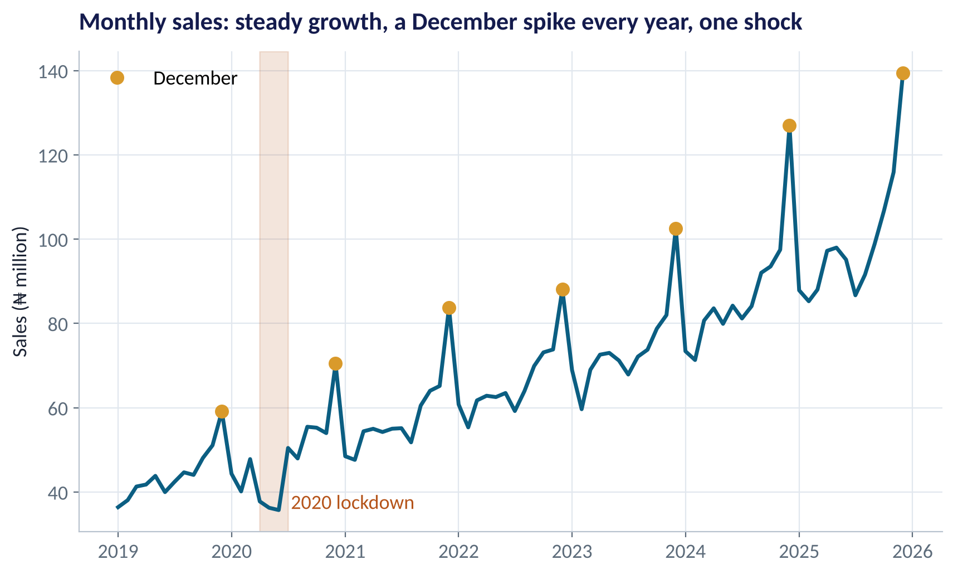
LOOK FIRST
Seven Years of Monthly Sales
WHAT TO SEE
Trend: sales roughly tripled from ₦36m to ₦139m a month.
Seasonality: a December spike every year (gold).
Shock: the 2020 lockdown.
Order matters: you cannot shuffle months like customers.
Fig S4.3-F01 · replicate: tdbg_4_3_figures.R / .py
SESSION 4.3 · FORECASTING WITH INTERVALS
8

Slide 9
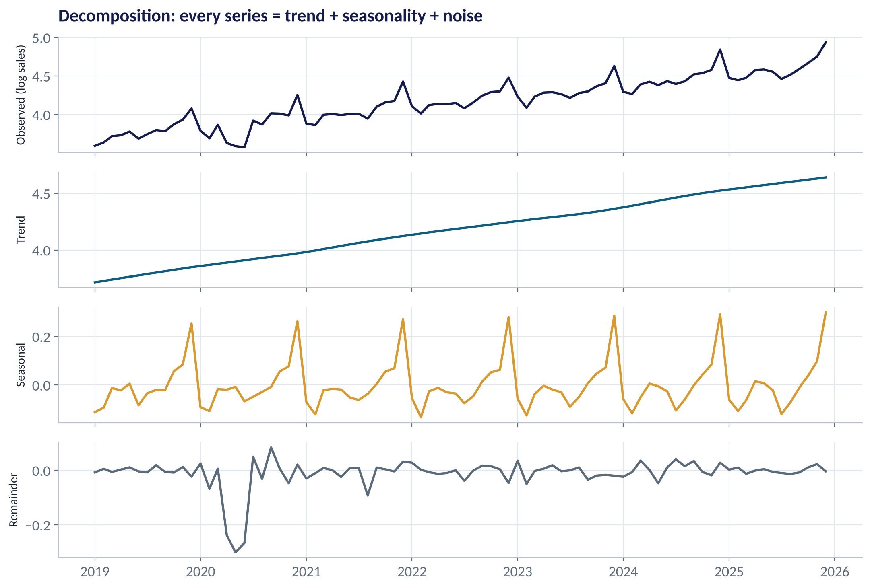
DECOMPOSITION
Trend + Seasonality + Noise
WHAT TO SEE
Trend: the long-run direction — about 1% growth a month.
Seasonal: a repeating yearly pattern; December ≈ 30% above normal.
Remainder: what's left — mostly small, except the 2020 shock.
Logs turn growth into straight lines and seasonal swings into constant percentages.
Fig S4.3-F02 · replicate: tdbg_4_3_figures.R / .py
SESSION 4.3 · FORECASTING WITH INTERVALS
9

Slide 10
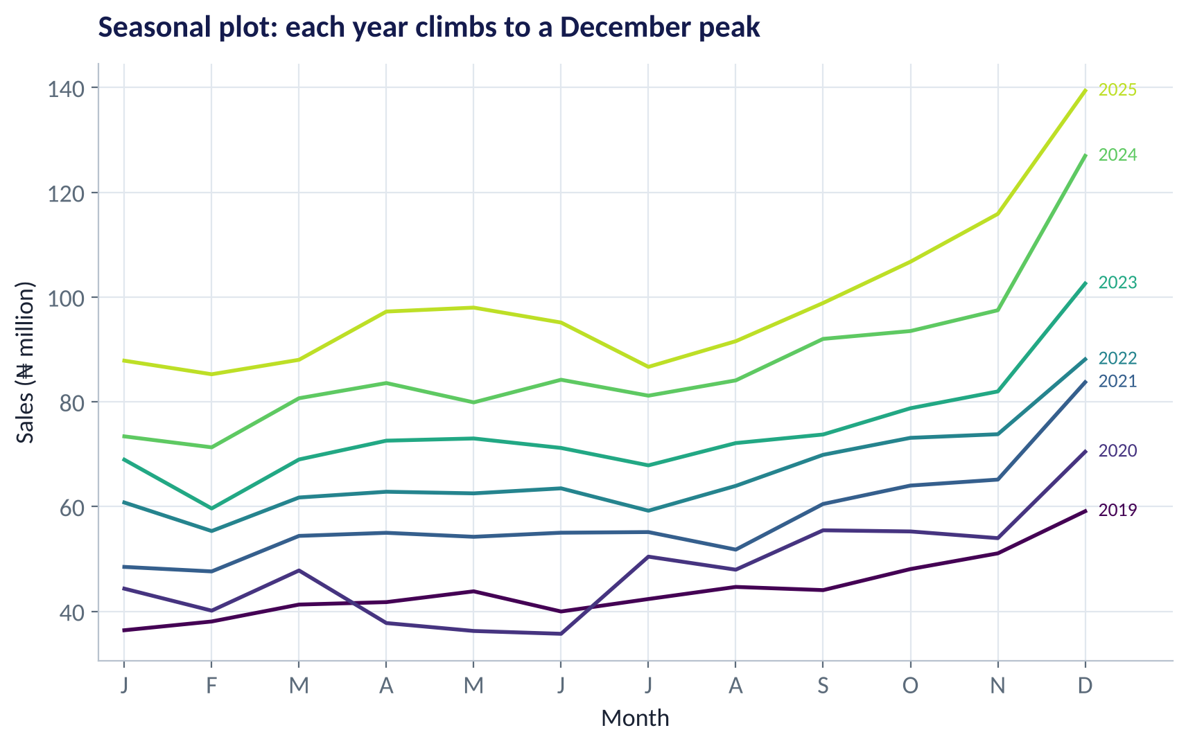
SEASONALITY
The Seasonal Plot
WHAT TO SEE
One line per year, January to December.
Every year climbs from mid-year to a December peak.
Each line sits above the last: growth.
2020's spring dip stands out — the lockdown.
Fig S4.3-F03 · replicate: tdbg_4_3_figures.R / .py
SESSION 4.3 · FORECASTING WITH INTERVALS
10

Slide 11

AUTOCORRELATION
This Month Remembers Last Month
IN PLAIN ENGLISH
WHY A MANAGER CARES
Autocorrelation is the correlation of a series with itself a number of periods earlier. Sales this December are strongly related to sales last December (lag 12). That 'memory' is what forecasting models exploit.
Autocorrelation breaks the 'independent rows' assumption of ordinary regression and of random train/test splits. It's why we backtest in time order and use models built for time.
EXAMPLE
The correlation of monthly growth with growth 12 months earlier is about 0.67 — a clear yearly rhythm.
SESSION 4.3 · FORECASTING WITH INTERVALS
11

Slide 12
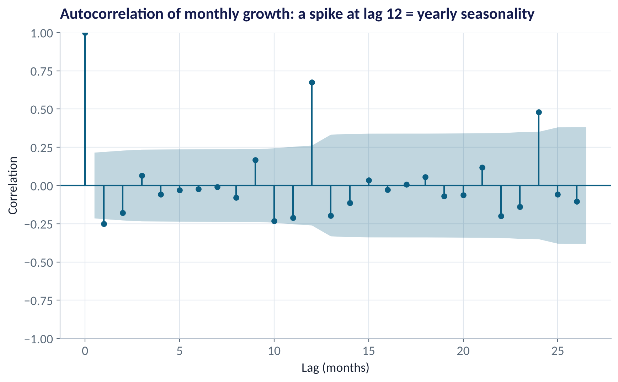
THE ACF PLOT
Reading an Autocorrelation Plot
WHAT TO SEE
Each bar: correlation with the series k months earlier.
Bars outside the shaded band are stronger than chance.
The spike at lag 12 (and 24) = yearly seasonality.
Seasonal models are needed.
Fig S4.3-F04 · replicate: tdbg_4_3_figures.R / .py
SESSION 4.3 · FORECASTING WITH INTERVALS
12

Slide 13
PART
02
Forecasting Methods
From simple benchmarks to ARIMA.

Slide 14
THE TOOLKIT
Four Forecasting Methods
Method | Idea in plain English | Strength | Weakness
Naive | Next month = this month | Simple benchmark | Ignores trend and season
Seasonal naive | Next December = last December | Captures season; hard to beat for stable series | Ignores growth
Exponential smoothing (ETS / Holt-Winters) | Weighted average of the past — recent months count more — with trend and seasonal parts | Fast, robust, interpretable | Struggles with sudden breaks
ARIMA / seasonal ARIMA | Models the series' own memory (autocorrelation) after removing trend and season | Flexible; good intervals | Harder to explain and tune
Modern options — Prophet, gradient boosting with lag features, ensembles of models — are covered in Chapter 30. Always benchmark them against seasonal naive.
SESSION 4.3 · FORECASTING WITH INTERVALS
14

Slide 15

EXPONENTIAL SMOOTHING
Holt-Winters in Plain English
IN PLAIN ENGLISH
THE FORMULA
forecast = (level + h × trend) × season
Keep three running estimates — the current level, the trend (growth per month) and a seasonal factor for each month. Each new month nudges all three, giving recent months more weight. The forecast = level + trend, times the seasonal factor.
WHY A MANAGER CARES
Holt-Winters is the workhorse of demand planning: it adapts automatically as patterns shift, needs little data science skill to maintain, and its pieces map onto how managers already think (base, growth, season).
EXAMPLE
Level ₦98m, trend +₦1m/month, December factor 1.30 → December forecast ≈ (98 + 12) × 1.30 ≈ ₦143m.
SESSION 4.3 · FORECASTING WITH INTERVALS
15

Slide 16
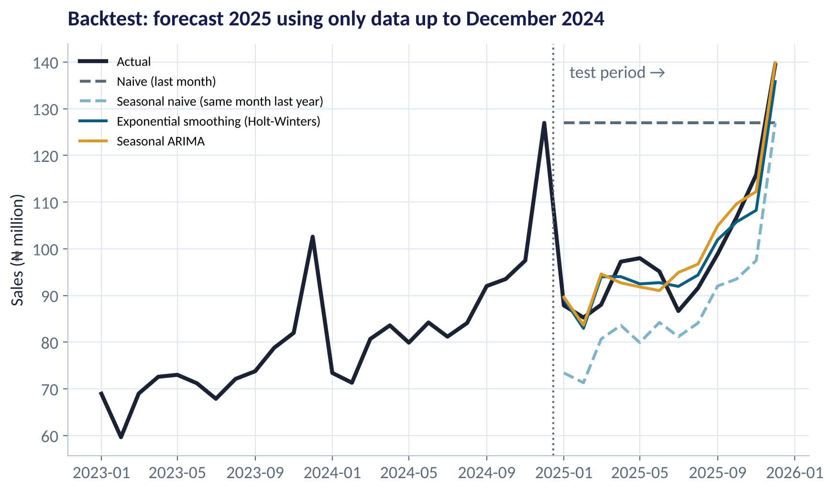
BACKTESTING
Pretend It's December 2024 — Forecast 2025
WHAT TO SEE
Train on 2019–2024 only; forecast the 12 months of 2025; compare with what happened.
Naive (flat line) misses badly.
Seasonal naive gets the shape but misses growth.
Holt-Winters and seasonal ARIMA track 2025 closely.
Fig S4.3-F05 · replicate: tdbg_4_3_figures.R / .py
SESSION 4.3 · FORECASTING WITH INTERVALS
16

Slide 17
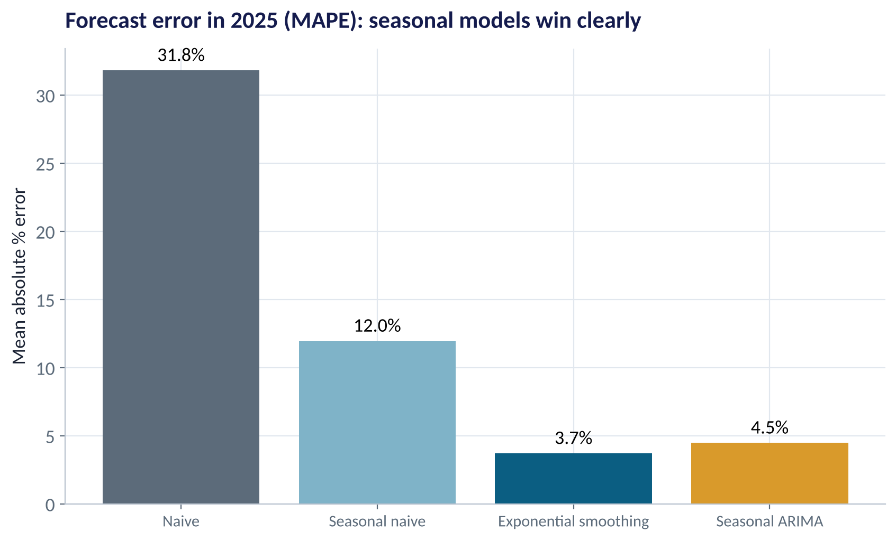
THE SCOREBOARD
Which Model Forecast 2025 Best?
WHAT TO SEE
MAPE: mean absolute % error — easy to explain to a CFO.
Naive: 32%. Seasonal naive: 12%.
Holt-Winters: 3.7%; seasonal ARIMA: 4.5%.
Rule: a model earns its place only by beating the seasonal-naive benchmark.
Fig S4.3-F06 · replicate: tdbg_4_3_figures.R / .py
SESSION 4.3 · FORECASTING WITH INTERVALS
17

Slide 18
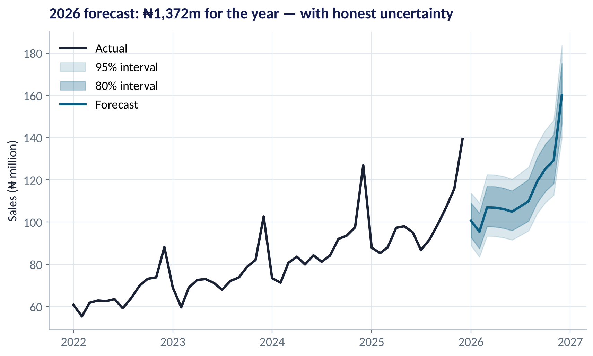
THE 2026 FORECAST
A Forecast Is a Range
WHAT TO SEE
Central forecast: ₦1.37bn for 2026.
80% interval (dark): where sales should land 4 times in 5.
95% interval (light) widens with each month ahead — uncertainty compounds.
Budget on the centre; plan inventory and cash for the edges.
Fig S4.3-F07 · replicate: tdbg_4_3_figures.R / .py
SESSION 4.3 · FORECASTING WITH INTERVALS
18

Slide 19

CONCEPT CHECK
Quick Check: What Would You Say?
A new machine-learning forecast has a backtest MAPE of 9%. The seasonal-naive benchmark scores 8%. What do you conclude?
A
Deploy the ML model — it is more sophisticated
B
Keep seasonal naive (or improve the ML model): the complex model doesn't beat a free benchmark
C
MAPE is meaningless for sales
D
Average the two forecasts without checking
Discuss with your neighbour for 60 seconds — answer and reasoning in the speaker notes.
SESSION 4.3 · FORECASTING WITH INTERVALS
19

Slide 20
PART
03
Cash-Flow Forecasting
From a sales forecast to a funding decision.

Slide 21

SCENARIOS
Simulating Thousands of Possible Years
IN PLAIN ENGLISH
WHY A MANAGER CARES
Instead of one forecast, ask the model to simulate 2,000 plausible versions of 2026 — each with its own ups and downs. Turn each sales path into cash in and cash out, add the expansion payment, and track the bank balance month by month.
The question isn't 'what's the expected balance?' but 'how likely are we to go overdrawn?'. Simulation answers that directly — it's the bridge to Monte Carlo methods in Data Analytics II.
EXAMPLE
In each scenario: cash in ≈ 86–95% of sales (collection rates vary); cash out ≈ 78% of sales + ₦4m fixed costs; opening cash ₦30m; ₦55m paid for the warehouse.
SESSION 4.3 · FORECASTING WITH INTERVALS
21

Slide 22
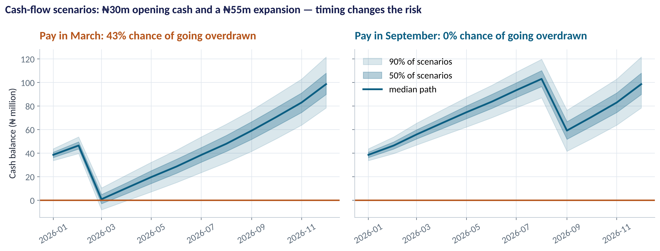
THE DECISION
When Should the SME Pay for the Expansion?
WHAT TO SEE
Pay in March: the balance dips close to zero — about 40% chance of going overdrawn.
Pay in September: cash has built up — almost no risk.
Same project, same cost; timing changes the risk.
Options: delay, phase the payment, or arrange an overdraft for March.
Fig S4.3-F08 · replicate: tdbg_4_3_figures.R / .py
SESSION 4.3 · FORECASTING WITH INTERVALS
22

Slide 23


WHERE MANAGERS GO WRONG
Forecasting Mistakes in Business
THE TRAP
THE BETTER HABIT
Single-number forecasts in the budget.
Show ranges and plan for the edges.
Shuffled train/test splits for time data.
Backtest in time order: train on the past, test on the future.
No benchmark — 'the model looks good'.
Always beat seasonal naive first.
Treating 2020-type shocks as normal.
Flag one-off events; consider scenarios for the next one.
Forecasting profit directly.
Forecast drivers (sales, collection, costs), then build cash and profit.
SESSION 4.3 · FORECASTING WITH INTERVALS
23

Slide 24



HANDS-ON LAB
Lab: Forecast Sales and Plan the Expansion
1
Plot the series, decompose it, and read the ACF.
YOU WILL NEED
Data
2
Backtest seasonal naive, exponential smoothing and ARIMA on 2025; compare MAPE.
data/sme_monthly_sales.csv
3
Forecast 2026 with 80% and 95% intervals; report the annual total.
R script
sessions/4-3/R/tdbg_4_3_lab.R
4
Simulate 2,000 cash scenarios; compute the chance of going overdrawn if the ₦55m is paid in March.
Python script
Repeat for June and September; recommend a month.
sessions/4-3/python/tdbg_4_3_lab.py
5
Deliverable: a one-slide CFO memo: 2026 forecast with range, best model and its error, and the expansion timing.
⏱ 30 minutes
SESSION 4.3 · FORECASTING WITH INTERVALS
24

Slide 25
WORDS TO OWN
Today's Vocabulary in Plain English
Time series
Data recorded at regular time intervals.
Exponential smoothing
Forecast from weighted past values; recent count more.
Trend
The long-run direction of a series.
ARIMA
Model of a series' own memory after differencing.
Seasonality
A pattern that repeats every year (or week, day).
Backtest
Testing a forecast on past periods it didn't see.
Autocorrelation
Correlation of a series with its own past.
MAPE
Mean absolute percentage error.
Naive forecast
Next value = last value (or last season's value).
Prediction interval
Range likely to contain the future value.
SESSION 4.3 · FORECASTING WITH INTERVALS
25

Slide 26
KEY TAKEAWAYS
Session 4.3 in 5 Ideas
01
Every series = trend + seasonality + noise (+ shocks).
02
Backtest in time order, and always beat the seasonal-naive benchmark.
03
Exponential smoothing and ARIMA cut 2025 error from 12% to about 4%.
04
Report intervals: uncertainty grows with every month ahead.
05
Simulate cash scenarios to turn forecasts into funding decisions.
NEXT › Session 4.4: Text as Data
Before next session: Read Chapters 32–34 (Text Analytics, Sentiment Analysis, Topic Modelling). Collect 20 real customer reviews or social posts about a Nigerian brand you know.

