Slide 1


LAGOS BUSINESS SCHOOL · TURNING DATA INTO BUSINESS GROWTH · DAY 4
SESSION 4.4
Text as Data
Text, Language & Sentiment Analytics
Source: Chapters 32–34 — Text Analytics · Sentiment Analysis · Topic Modelling & Brand Analytics
AI-Powered Business Analytics: A Practical Textbook for Data-Driven Decision Making · Prof. Bongo Adi

Slide 2




RECAP
Session 4.3 in Three Ideas
Components
Every series = trend + seasonality + noise (+ shocks).
Backtest
Train on the past, test on the future — and beat the seasonal-naive benchmark.
Ranges
Forecasts are intervals; simulation turns them into risk-aware decisions.
SESSION 4.4 · TEXT AS DATA
2

Slide 3




TODAY'S PLAN
Session 4.4 at a Glance — 75 Minutes
Turning what customers write into numbers managers can act on.
10'
30'
30'
5'
Recap & Hook
The Text Pipeline
Lab: App Reviews
Wrap-Up
Most customer data is words
Clean, tokenise, count, score, classify
Sentiment and themes in 1,200 reviews
Where LLMs fit (Session 5.1)
SESSION 4.4 · TEXT AS DATA
3

Slide 4


BY THE END OF TODAY
Session 4.4 Learning Objectives
You will be able to:
01
02
03
Prepare Text for Analysis
Measure Sentiment & Themes
Act on Voice of Customer
Clean, tokenise and turn reviews into a table of word counts.
Score sentiment with a lexicon, find distinctive words with TF-IDF, and tag themes.
Classify reviews automatically and translate patterns into brand and CX decisions.
SESSION 4.4 · TEXT AS DATA
4

Slide 5




THE HOOK
Your Customers Are Already Telling You
“Customer care no dey pick call.” “I was debited twice, no refund yet.” “Rider was polite and on time.”
Reviews, WhatsApp chats, call notes and social posts hold the 'why' behind every KPI. Text analytics lets you:
Measure mood
Find themes
Automate triage
Track sentiment weekly, by product, region or channel.
See which issues — refunds, delivery, fakes — drive complaints.
Route angry or urgent messages to the right team in seconds.

Slide 6




NIGERIAN BUSINESS CASE
Voice of the Customer for a Nigerian E-Commerce App
The situation
The decision question
A Lagos-based marketplace app receives thousands of reviews a month across phones, fashion, groceries, home and beauty. Its app-store rating is sliding and the COO wants to know why.
What are customers unhappy about — delivery, product quality, payments or service — and where should the COO act first?
The data we have
What a good answer looks like
ecommerce_reviews.csv — 1,200 reviews with star rating and category, written in English and Nigerian Pidgin. sentiment_lexicon.csv — a small business lexicon including Pidgin phrases.
A ranked list of themes by negative sentiment, an automatic classifier for 1–2 star reviews, and one operational priority.
SESSION 4.4 · TEXT AS DATA
6

Slide 7
PART
01
From Words to Numbers
The text-analytics pipeline.

Slide 8





THE PIPELINE
Five Steps From Raw Text to Insight
›
›
›
›
Clean
Tokenise
Remove stop words
Count
Analyse
Lower-case; remove punctuation, numbers, emojis (or keep them on purpose)
Split text into words (tokens) or phrases (n-grams)
Drop 'the', 'and', 'is' — but keep 'no' and 'not'!
Build a document-term matrix: one row per review, one column per word
Sentiment, TF-IDF, themes, topics, classifiers
After step 4, text is just a (very wide) table — and every tool from Modules 1–2 applies.
SESSION 4.4 · TEXT AS DATA
8

Slide 9
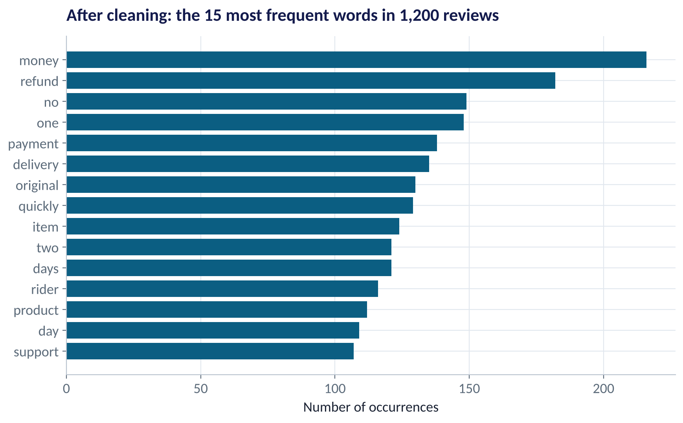
FIRST LOOK
What Do Customers Talk About Most?
WHAT TO SEE
'Money', 'refund' and 'payment' dominate the vocabulary.
Delivery words follow: 'rider', 'days', 'delivery'.
Raw counts show what people talk about — not how they feel about it.
Always read a sample of raw reviews alongside any count.
Fig S4.4-F01 · replicate: tdbg_4_4_figures.R / .py
SESSION 4.4 · TEXT AS DATA
9

Slide 10
THE DOCUMENT–TERM MATRIX
Text as a Table
Three reviews become three rows; every distinct word becomes a column.
Review | refund | debited | twice | fast | polite | fake | … 300 more
“I was debited twice, no refund yet.” | 1 | 1 | 1 | 0 | 0 | 0 | …
“Delivery was fast. Rider was polite.” | 0 | 0 | 0 | 1 | 1 | 0 | …
“Product is fake, not original.” | 0 | 0 | 0 | 0 | 0 | 1 | …
Most cells are zero ('sparse'). Software stores this efficiently — R: cast_sparse(); Python: CountVectorizer().
SESSION 4.4 · TEXT AS DATA
10

Slide 11
PART
02
Sentiment and Themes
How do customers feel — and about what?

Slide 12

LEXICON SENTIMENT
Sentiment by Dictionary
IN PLAIN ENGLISH
THE FORMULA
sentiment = Σ scores of matched words
A sentiment lexicon is a list of words and phrases with scores: 'excellent' +2, 'fast' +1, 'late' −1, 'fake' −2. Add up the scores of the words in a review to get its sentiment. Simple, transparent and fast.
WHY A MANAGER CARES
Off-the-shelf lexicons (AFINN, Bing, VADER) are built on American English and miss local language. Adding Nigerian phrases like 'no dey pick', 'na wa', 'sweet me' matters — Session 2.1's 'language bias' in practice.
EXAMPLE
“Payment failed but money left my account. Na wa o.” → 'failed' −2, 'na wa' −1 → −3.
SESSION 4.4 · TEXT AS DATA
12

Slide 13
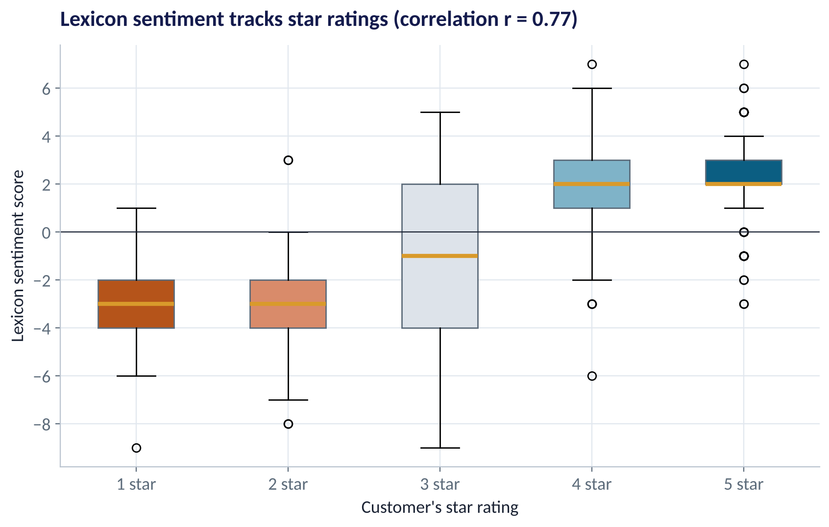
DOES IT WORK?
Lexicon Sentiment vs Star Ratings
WHAT TO SEE
1–2 star reviews score clearly negative; 4–5 star clearly positive.
Correlation with stars: r = 0.77 — a good validity check.
3-star reviews are mixed, as you'd expect.
Outliers are worth reading: e.g. 5 stars with negative words.
Fig S4.4-F02 · replicate: tdbg_4_4_figures.R / .py
SESSION 4.4 · TEXT AS DATA
13

Slide 14
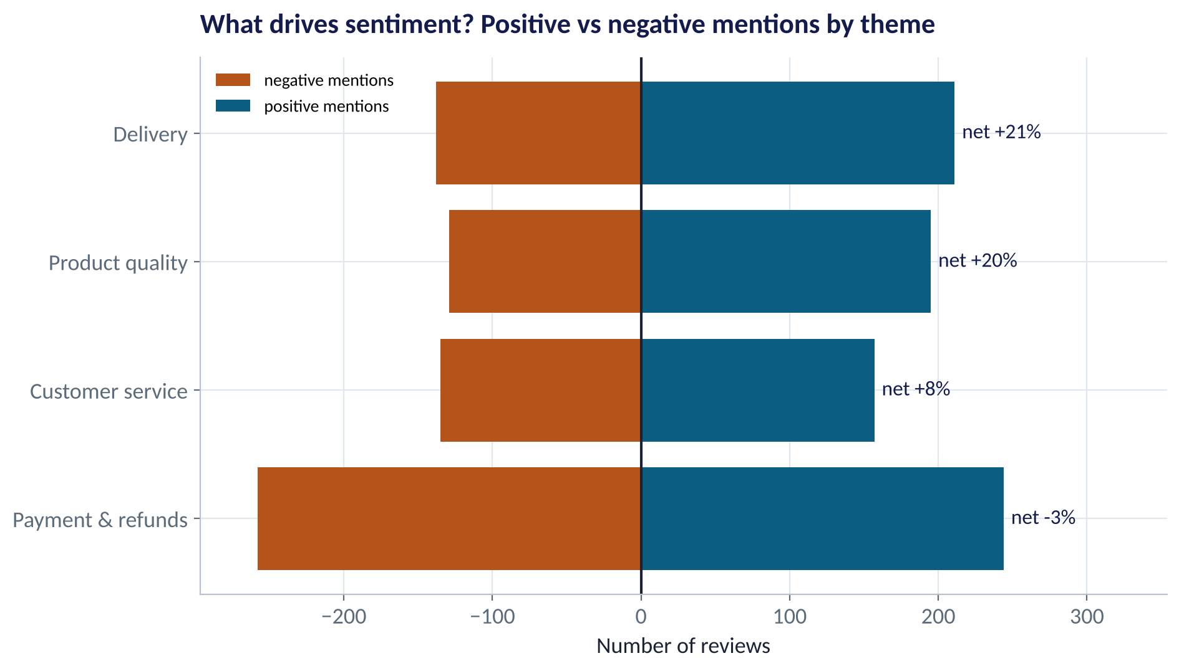
THEMES
Which Issues Drive Negative Sentiment?
WHAT TO SEE
Reviews tagged by simple keyword rules into four themes.
Payment & refunds: the most mentions, and net negative.
Delivery and product quality: more positive than negative.
Priority for the COO: fix refunds and double debits.
Fig S4.4-F03 · replicate: tdbg_4_4_figures.R / .py
SESSION 4.4 · TEXT AS DATA
14

Slide 15

TF-IDF
Finding the Words That Matter
IN PLAIN ENGLISH
WHY A MANAGER CARES
TF-IDF (term frequency × inverse document frequency) scores a word highly if it's common in this group of text but rare elsewhere. It filters out words everyone uses and surfaces the distinctive ones.
TF-IDF tells you what is different about unhappy customers, a region, a competitor's reviews, or this month vs last — the words to investigate first.
EXAMPLE
'Refund', 'never', 'fake' and 'na wa' are distinctive of 1–2 star reviews; 'thank', 'recommend' and 'quickly' of 4–5 star reviews.
SESSION 4.4 · TEXT AS DATA
15

Slide 16
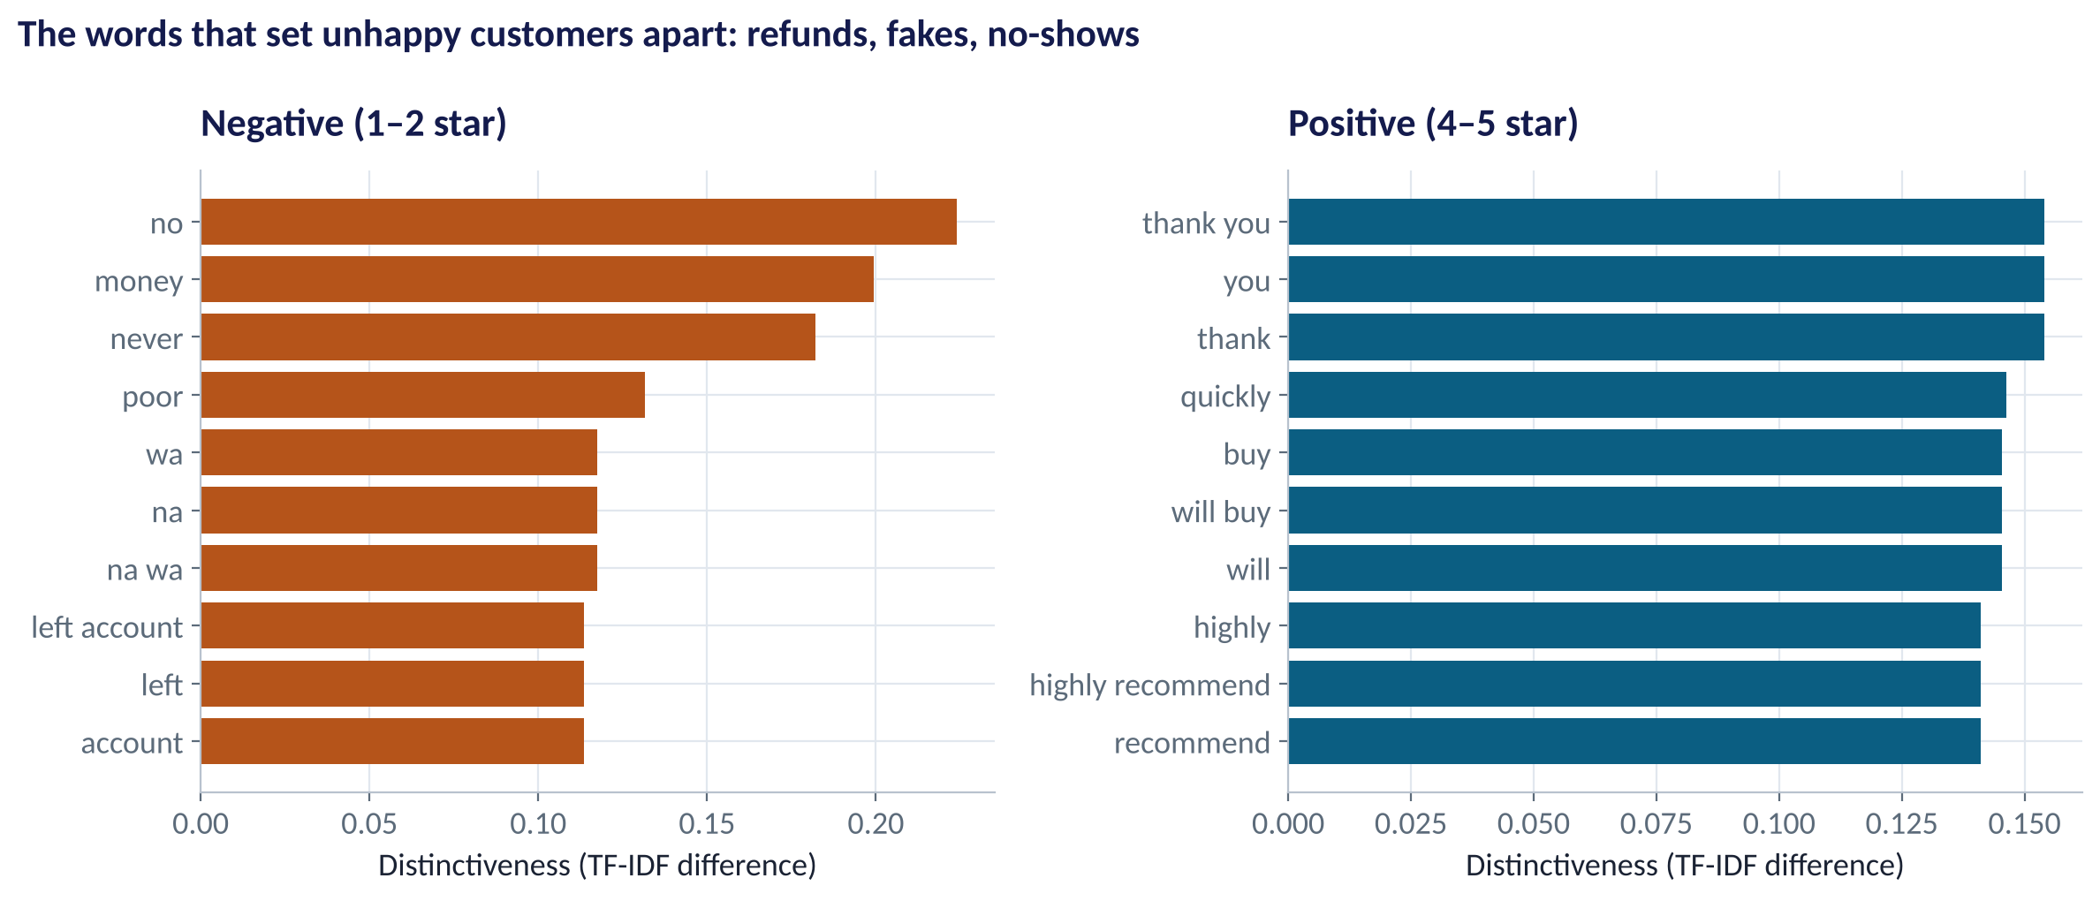
DISTINCTIVE WORDS
What Sets Unhappy Customers Apart
WHAT TO SEE
Negative reviews: 'no', 'money', 'never', 'poor', 'na wa', 'left account'.
Positive reviews: 'thank you', 'quickly', 'will buy', 'highly recommend'.
Unhappiness is about money and broken promises; happiness is about speed and courtesy.
Fig S4.4-F04 · replicate: tdbg_4_4_figures.R / .py
SESSION 4.4 · TEXT AS DATA
16

Slide 17
PART
03
Classifying Text
Session 3.4's logistic regression — with words as drivers.

Slide 18
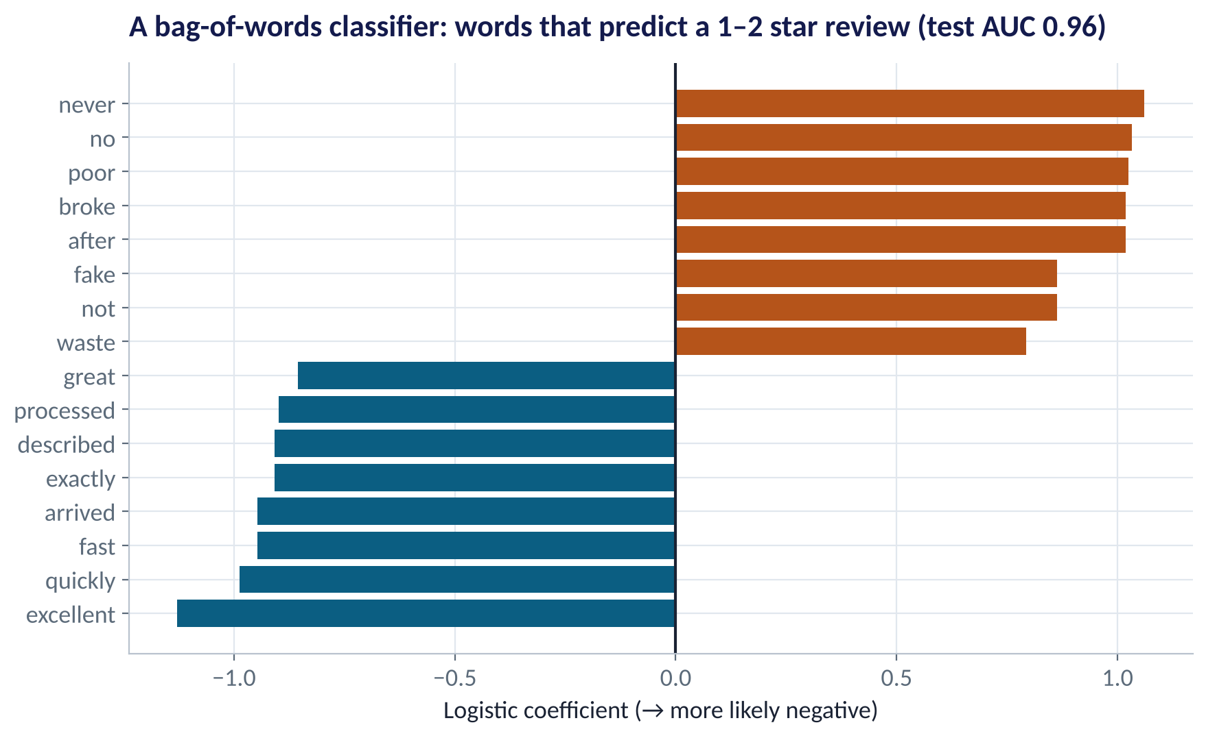
TEXT CLASSIFICATION
Predicting a 1–2 Star Review From Its Words
WHAT TO SEE
Each word becomes a driver in a logistic regression (bag of words).
Test AUC 0.96 on 360 held-out reviews.
Words like 'never', 'fake', 'broke', 'waste' push towards negative.
Use it to triage: route likely-negative reviews to the care team within minutes.
Fig S4.4-F05 · replicate: tdbg_4_4_figures.R / .py
SESSION 4.4 · TEXT AS DATA
18

Slide 19
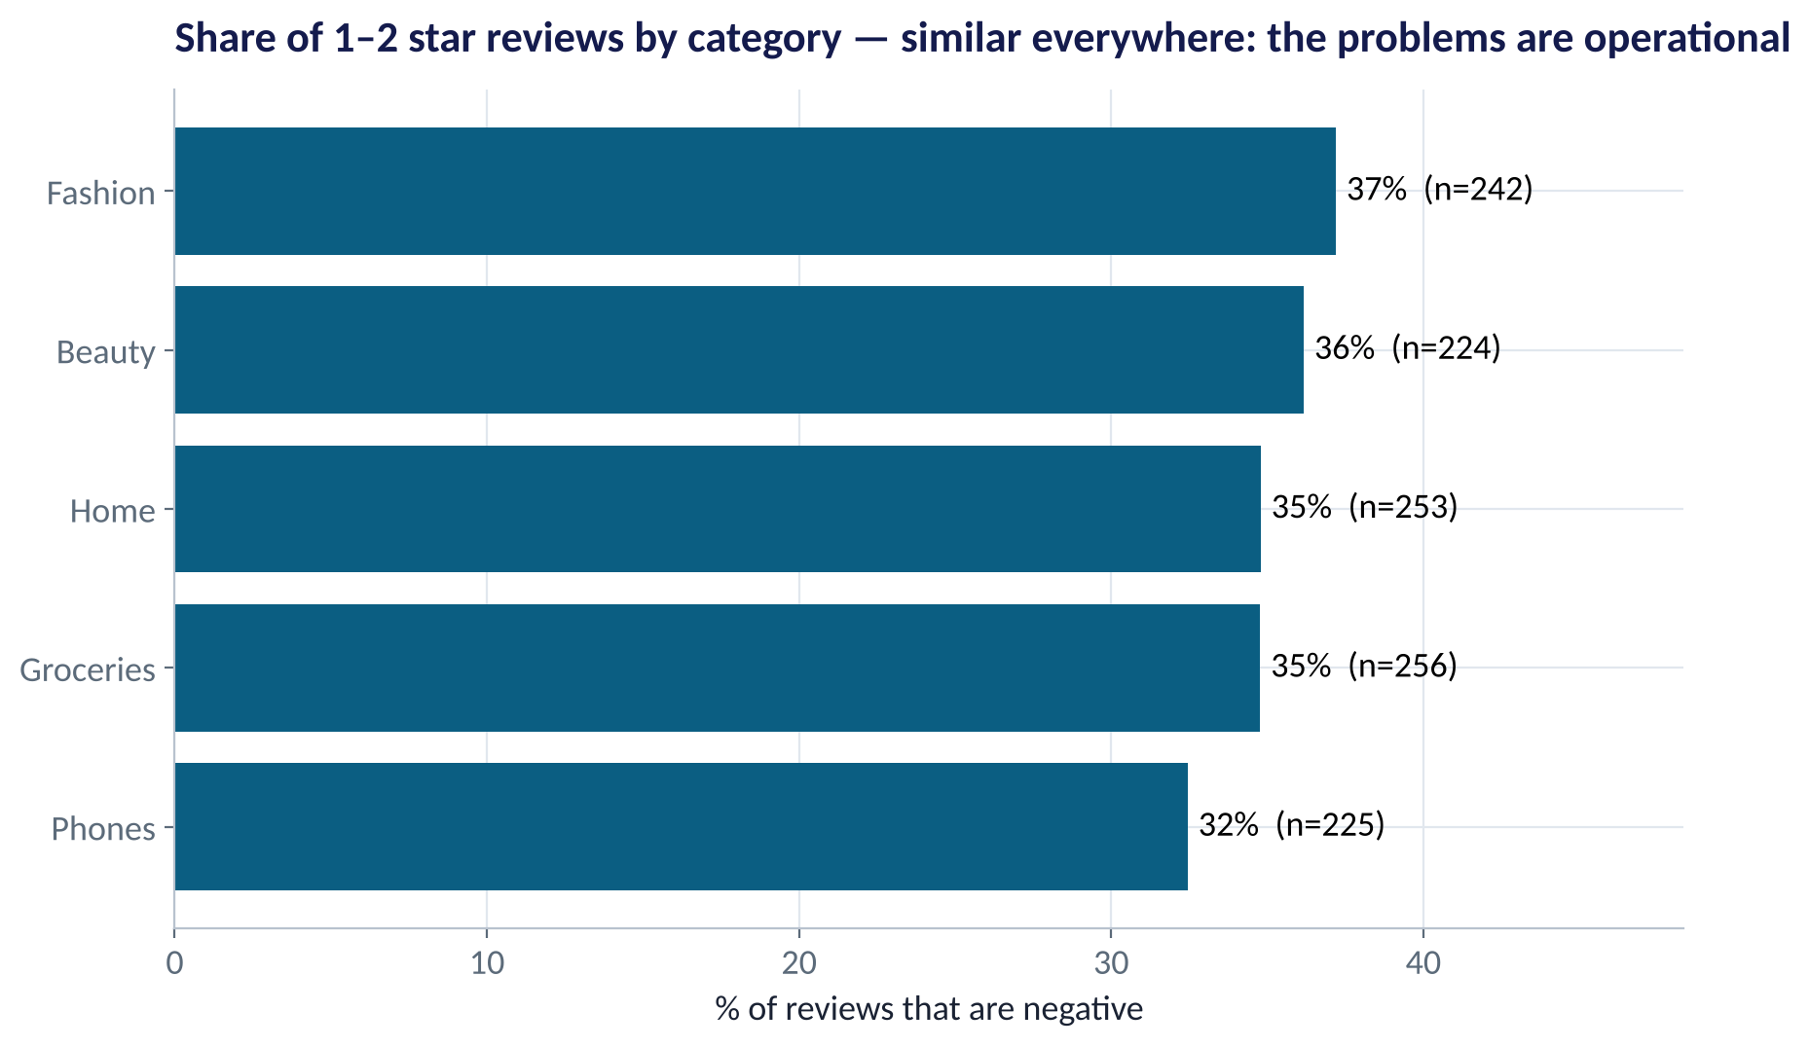
BY CATEGORY
Is One Product Category the Problem?
WHAT TO SEE
Share of 1–2 star reviews: 32–37% in every category.
So the problem isn't phones vs fashion.
It's operational: payments, refunds and service — cutting across all categories.
Fixes belong to finance and customer-care operations, not category managers.
Fig S4.4-F06 · replicate: tdbg_4_4_figures.R / .py
SESSION 4.4 · TEXT AS DATA
19

Slide 20
THE TOOLKIT
Choosing a Text Method
Method | Best for | Strength | Limitation
Word counts & TF-IDF | Exploring what's being said | Fast, transparent | No meaning or context
Lexicon sentiment | Tracking mood over time | Explainable; no labels needed | Misses sarcasm, negation, slang
Bag-of-words classifier | Triage, routing, tagging | Accurate with labelled data | Needs labels; ignores order
Topic models (LDA) | Discovering themes | Unsupervised | Topics can be hard to name
LLMs (GPT, Claude, etc.) | Summaries, nuanced classification, multilingual | Understands context and Pidgin | Cost, privacy, consistency checks needed
SESSION 4.4 · TEXT AS DATA
20

Slide 21


WHERE MANAGERS GO WRONG
Text-Analytics Mistakes
THE TRAP
THE BETTER HABIT
Analysing counts without reading any raw text.
Read 50 reviews before and after every analysis.
Removing 'not' and 'no' as stop words.
Keep negations — they flip meaning.
Using an American lexicon on Nigerian text unchanged.
Add local phrases; validate against star ratings.
Assuming reviewers represent all customers.
Reviewers skew angry or delighted — selection bias (Session 2.2).
Uploading customer messages to public AI tools.
Mask personal data; follow NDPA rules (Session 5.3).
SESSION 4.4 · TEXT AS DATA
21

Slide 22

CONCEPT CHECK
Quick Check: What Would You Say?
A review says: “Not bad at all — delivery was not late this time.” A simple lexicon scores it −2 ('bad', 'late'). What's the best fix?
A
Drop the review
B
Handle negation (e.g. flip the score of words after 'not'), or use a context-aware model
C
Ignore sentiment and use only star ratings
D
Remove 'not' as a stop word
Discuss with your neighbour for 60 seconds — answer and reasoning in the speaker notes.
SESSION 4.4 · TEXT AS DATA
22

Slide 23



HANDS-ON LAB
Lab: What Are Customers Saying?
1
Read 10 raw reviews. Then clean, tokenise and count words.
YOU WILL NEED
Data
2
Score each review with the lexicon; check the correlation with star ratings.
data/ecommerce_reviews.csv
data/sentiment_lexicon.csv
3
Tag reviews by theme; compare sentiment and the share of 1–2 star reviews by theme.
R script
sessions/4-4/R/tdbg_4_4_lab.R
4
Find distinctive words of negative vs positive reviews with TF-IDF.
Python script
Train a bag-of-words classifier for 1–2 star reviews; report test AUC.
sessions/4-4/python/tdbg_4_4_lab.py
5
Deliverable: a one-slide voice-of-customer brief: top issue, evidence, one action, one metric to track.
⏱ 30 minutes
SESSION 4.4 · TEXT AS DATA
23

Slide 24
WORDS TO OWN
Today's Vocabulary in Plain English
Token
A unit of text, usually a word.
Lexicon
Dictionary of words with sentiment scores.
Tokenise
Split text into tokens.
Sentiment
Positive, negative or neutral tone of a text.
Stop words
Very common words removed before counting.
TF-IDF
Weights words common in one text but rare overall.
n-gram
A sequence of n words, e.g. 'no refund'.
Bag of words
Representing text by word counts, ignoring order.
Document-term matrix
Table: one row per text, one column per word.
Topic model
Unsupervised method that discovers themes.
SESSION 4.4 · TEXT AS DATA
24

Slide 25
KEY TAKEAWAYS
Session 4.4 in 5 Ideas
01
Text becomes a table of word counts — then every Module 1–2 tool applies.
02
Lexicon sentiment is transparent; validate it against ratings and add local language.
03
TF-IDF surfaces what is distinctive about a group of texts.
04
Word-based classifiers triage reviews automatically (AUC 0.96 here).
05
Here the problem is payments and refunds, across all categories.
NEXT › Session 4.5: What Sells with What
Before next session: Read Chapters 23 and 37 (Association Rules & Market Basket Analysis; Recommendation Engines). Look at your last three supermarket receipts — which items do you always buy together?

