Slide 1


LAGOS BUSINESS SCHOOL · TURNING DATA INTO BUSINESS GROWTH · DAY 4
SESSION 4.5
What Sells
with What
Market Basket Analysis & Recommendation Engines
Source: Chapters 23 & 37 — Association Rules & Market Basket Analysis · Recommendation Engines
AI-Powered Business Analytics: A Practical Textbook for Data-Driven Decision Making · Prof. Bongo Adi

Slide 2




RECAP
Session 4.4 in Three Ideas
Text → table
Clean, tokenise and count: text becomes a document–term matrix.
Sentiment
Lexicon scores are transparent; validate them against star ratings and add local language.
Classify
Word-based classifiers triage reviews automatically; the issue was payments and refunds.
SESSION 4.5 · WHAT SELLS WITH WHAT
2

Slide 3




TODAY'S PLAN
Session 4.5 at a Glance — 75 Minutes
What sells with what, and what each customer should see next.
10'
30'
30'
5'
Recap & Hook
Market Basket & Recommenders
Lab: Supermarket & Grocer
Wrap-Up
Every receipt is a clue
Support, confidence, lift; collaborative filtering
Find rules; recommend for one customer
Onward to neural nets (Session 5.1)
SESSION 4.5 · WHAT SELLS WITH WHAT
3

Slide 4


BY THE END OF TODAY
Session 4.5 Learning Objectives
You will be able to:
01
02
03
Find Products Bought Together
Build a Simple Recommender
Turn Patterns Into Actions
Calculate support, confidence and lift, and read a list of association rules.
Use item-based collaborative filtering to predict what a customer will like.
Design shelf layouts, bundles and personalised offers, and test them properly.
SESSION 4.5 · WHAT SELLS WITH WHAT
4

Slide 5




THE HOOK
Every Receipt Is a Clue
“Customers who bought this also bought…” — the line behind about a third of Amazon's sales, by widely quoted estimates.
A supermarket in Surulere processes thousands of baskets a day. Each one shows which products customers combine. With those combinations you can:
Lay out the store
Design bundles
Personalise
Put items bought together near each other, or deliberately apart.
Tea + sugar, rice + tomato paste: promotions that people actually want.
Show each app user the products they are most likely to buy next.

Slide 6




NIGERIAN BUSINESS CASE
Cross-Selling at a Lagos Supermarket and an Online Grocer
The situation
The decision question
A mid-sized Lagos supermarket chain wants to raise basket size. Its online grocery app wants a 'recommended for you' row on the home screen.
Which products should be shelved together or bundled, and which three products should each app customer see first?
The data we have
What a good answer looks like
supermarket_baskets.csv — 3,000 baskets, 20 everyday products. product_ratings.csv — 1,400 ratings (1–5) from 200 app customers on 20 products.
Three bundle or layout ideas backed by lift, plus a recommender that beats 'show the bestsellers' on a hidden-rating test.
SESSION 4.5 · WHAT SELLS WITH WHAT
6

Slide 7
PART
01
Market Basket Analysis
Which products travel together?

Slide 8


THE LANGUAGE OF RULES
An Association Rule: If A, Then B
IN PLAIN ENGLISH
WHY A MANAGER CARES
An association rule says: baskets that contain item A (the 'if') often also contain item B (the 'then'). Written A → B. Three numbers tell you whether the rule is worth acting on: support, confidence and lift.
Rules describe what customers do, not what they say. They come straight from till data you already own, with no survey needed.
EXAMPLE
Bread → Eggs: of the baskets with bread, how many also have eggs, and is that more than we'd expect by chance?
SESSION 4.5 · WHAT SELLS WITH WHAT
8

Slide 9



THREE NUMBERS
Support, Confidence and Lift in Plain English
Support
Confidence
Lift
How common is the combination? Share of all baskets that contain both A and B.
support = P(A and B)
How reliable is the rule? Of baskets with A, the share that also contain B.
confidence = P(B | A)
How much more likely is B when A is in the basket, compared with normal?
lift = confidence ÷ P(B)
Lift = 1: no relationship. Lift > 1: bought together more than chance. Lift < 1: bought together less than chance (substitutes).
SESSION 4.5 · WHAT SELLS WITH WHAT
9

Slide 10
BY HAND, ONCE
Worked Example: Bread → Eggs
Counts from 3,000 supermarket baskets.
Count | Baskets
All baskets | 3,000
Contain bread | 369
Contain eggs | 574
Contain bread AND eggs | 224
STEP BY STEP
1
Support = 224 ÷ 3,000 = 7.5% of all baskets.
2
Confidence = 224 ÷ 369 = 61%: most bread buyers also buy eggs.
3
Normal egg rate P(Eggs) = 574 ÷ 3,000 = 19%.
4
Lift = 61% ÷ 19% = 3.2: bread buyers are three times as likely to buy eggs.
Bread → Eggs is common, reliable and strong: a candidate for a breakfast bundle.
SESSION 4.5 · WHAT SELLS WITH WHAT
10

Slide 11
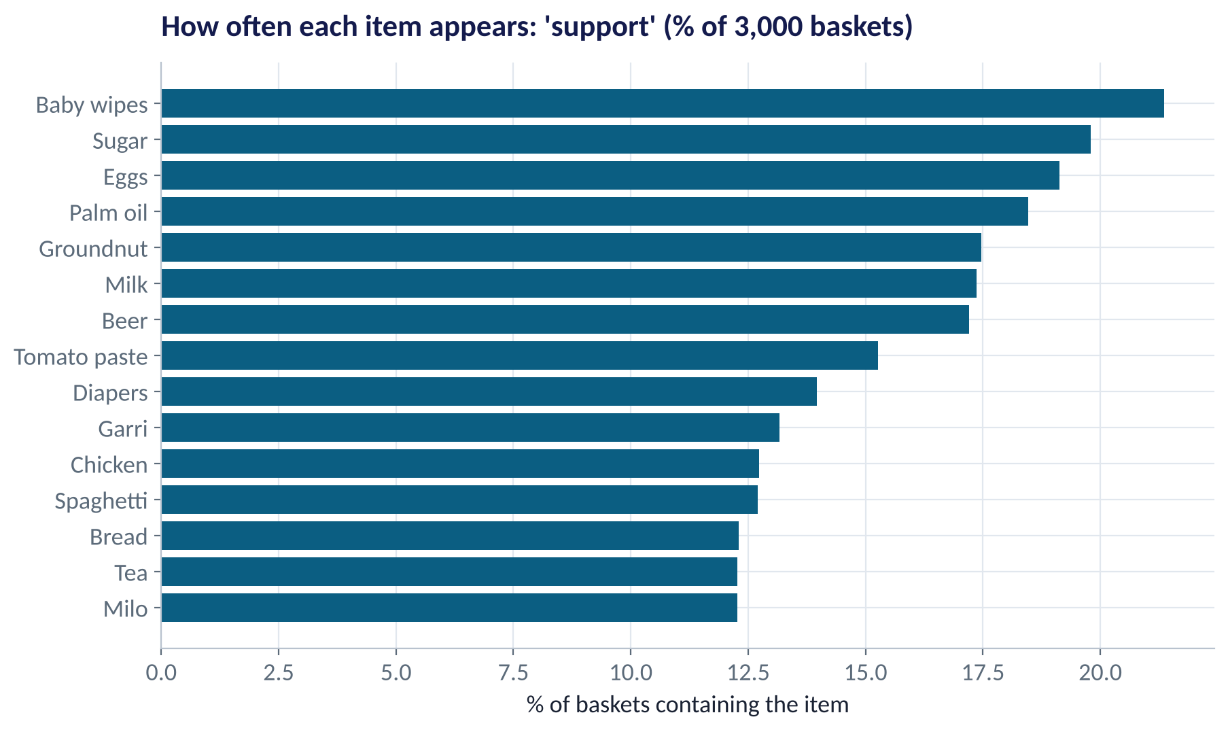
STEP 1 · SUPPORT
How Popular Is Each Product?
WHAT TO SEE
Baby wipes, sugar and eggs are in about 1 basket in 5.
Popular items appear in many rules just because they are popular.
That's why we need lift, not only confidence.
Set a minimum support (here 1%) to ignore rare, noisy combinations.
Fig S4.5-F01 · replicate: tdbg_4_5_figures.R / .py
SESSION 4.5 · WHAT SELLS WITH WHAT
11

Slide 12
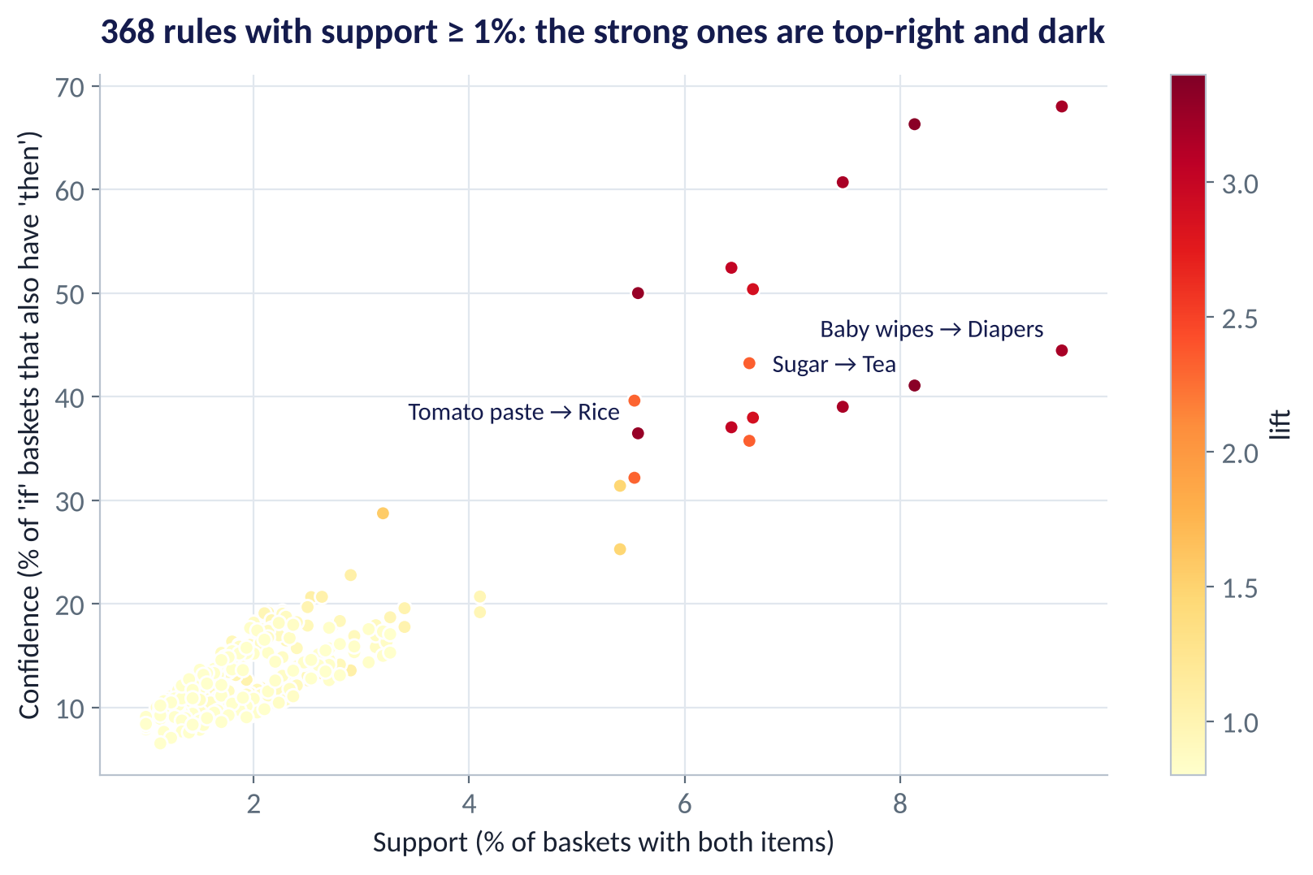
STEP 2 · ALL RULES
368 Rules: Most Are Weak
WHAT TO SEE
Each dot is one rule A → B with support ≥ 1%.
The pale cloud bottom-left: rules no stronger than chance.
A small group stands out: high confidence, high support, dark (high lift).
Algorithms such as Apriori find these quickly even with thousands of products.
Fig S4.5-F02 · replicate: tdbg_4_5_figures.R / .py
SESSION 4.5 · WHAT SELLS WITH WHAT
12

Slide 13
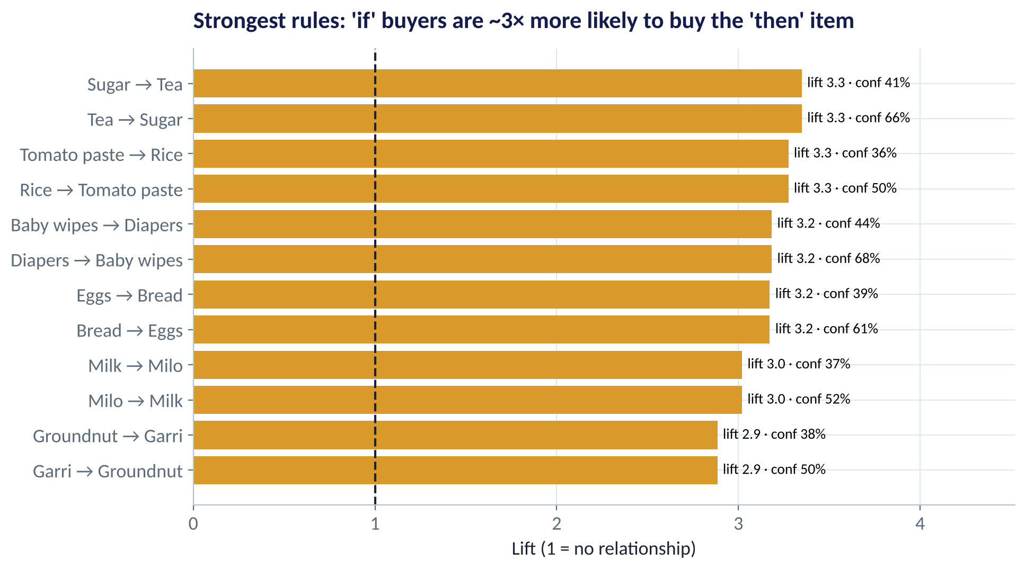
STEP 3 · THE STRONG RULES
The Shopping Missions Behind the Rules
WHAT TO SEE
Tea ↔ Sugar (lift 3.3): the morning cup.
Tomato paste ↔ Rice (3.3): the jollof mission.
Diapers ↔ Baby wipes (3.2): the baby run.
Bread ↔ Eggs, Milo ↔ Milk, Garri ↔ Groundnut: each is a recognisable occasion.
Fig S4.5-F03 · replicate: tdbg_4_5_figures.R / .py
SESSION 4.5 · WHAT SELLS WITH WHAT
13

Slide 14
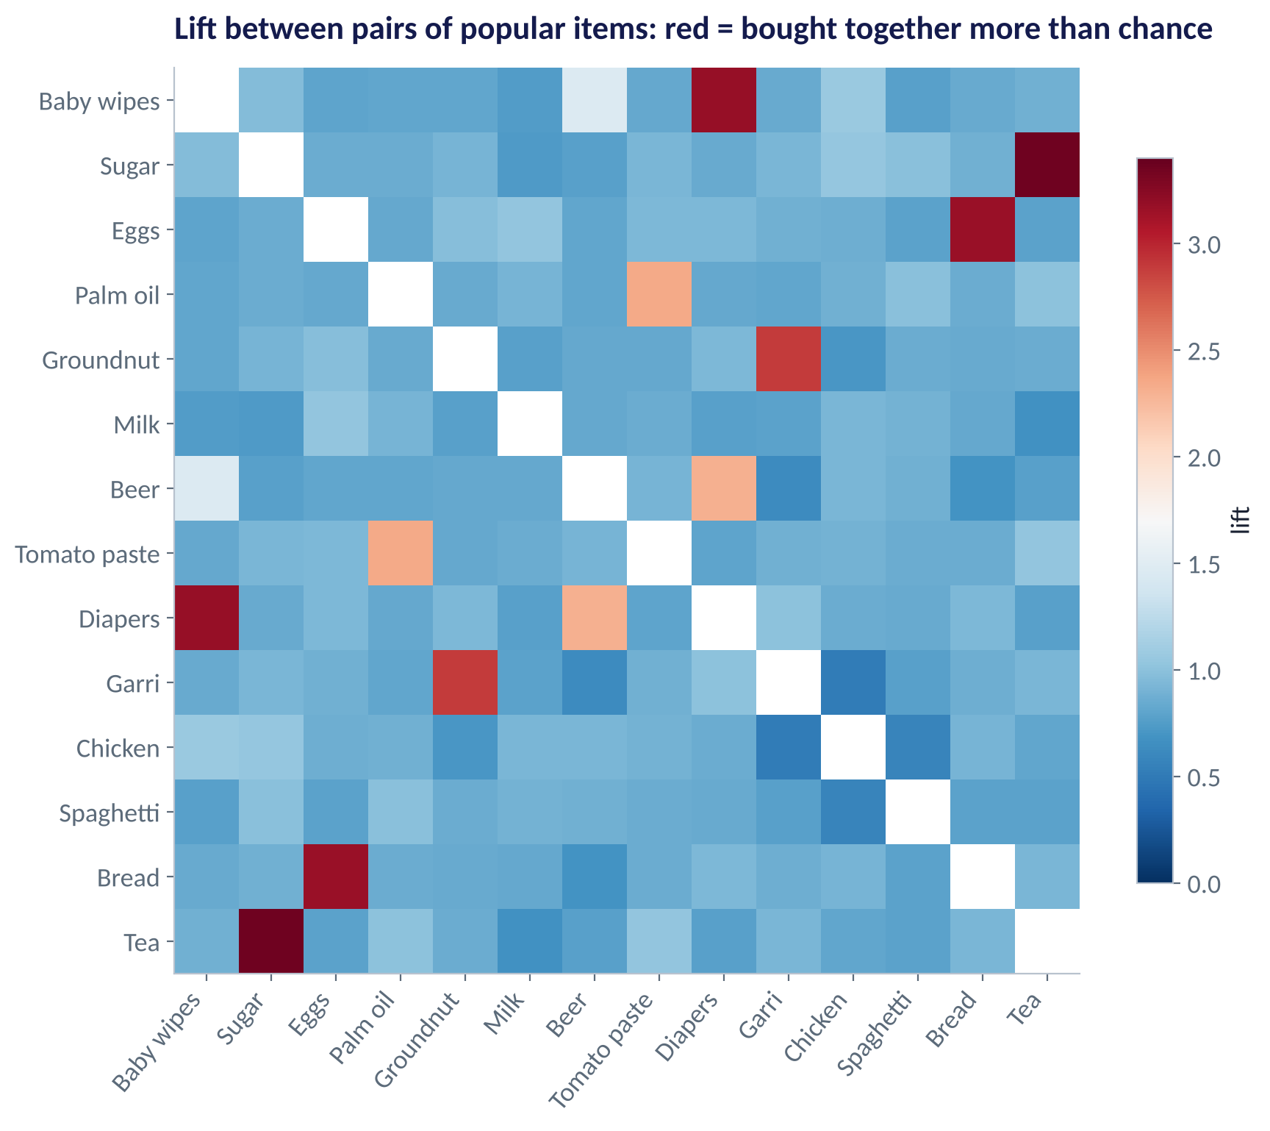
THE WHOLE PICTURE
A Lift Map of Popular Products
WHAT TO SEE
Dark red cells: pairs bought together far more than chance.
Blue cells: lift below 1, bought together less than chance.
Low lift can signal substitutes (e.g. two brands of the same thing).
A lift map on one page is a good conversation-starter with category managers.
Fig S4.5-F04 · replicate: tdbg_4_5_figures.R / .py
SESSION 4.5 · WHAT SELLS WITH WHAT
14

Slide 15

A FAMOUS STORY
Diapers and Beer
IN PLAIN ENGLISH
WHY A MANAGER CARES
A retail legend says a US chain found young fathers buying diapers and beer together on Friday evenings. In our data, Diapers → Beer has support 5.5%, confidence 40% and lift 2.3: a real pattern, but weaker than the obvious ones.
Ask of every rule: Is it new to us? Can we act on it? Will acting change behaviour, or would customers buy both anyway?
EXAMPLE
The strongest rules are usually the obvious ones (tea and sugar). The valuable ones are surprising and actionable.
SESSION 4.5 · WHAT SELLS WITH WHAT
15

Slide 16
FROM RULE TO ACTION
What to Do With a Strong Rule
Action | Example | Watch out for
Shelf placement | Tomato paste next to rice | Or place apart, so shoppers walk past more aisles
Bundle / promotion | Tea + sugar breakfast pack | Discounting items people already buy together loses margin
Cross-sell at checkout | 'Add baby wipes?' when diapers are scanned | Don't nag; one suggestion only
Stock planning | Order eggs when a bread promotion runs | Joint stock-outs hurt twice
Test it | A/B test the layout in 10 stores vs 10 control stores (Session 3.1) | Rules are correlations; only a test shows the effect
SESSION 4.5 · WHAT SELLS WITH WHAT
16

Slide 17
PART
02
Recommendation Engines
What should this customer see next?

Slide 18

TWO FAMILIES
How Recommenders Decide
Content-based
Collaborative filtering
Recommend things similar to what you liked
Recommend what similar customers liked
Uses product attributes: category, brand, price, ingredients
Works for new products with no ratings yet
Can be narrow: only more of the same
Example: 'more breakfast cereals'
Uses only behaviour: ratings, purchases, clicks
Finds surprising connections no attribute would show
Needs plenty of data; struggles with new items and users
Example: 'customers like you also liked…'
Most real systems (Netflix, Jumia, Spotify) are hybrids: collaborative filtering plus content, popularity and business rules.
SESSION 4.5 · WHAT SELLS WITH WHAT
18

Slide 19

ITEM-BASED COLLABORATIVE FILTERING
Products That the Same People Rate Alike
IN PLAIN ENGLISH
THE FORMULA
predicted rating = your average + Σ (similarity × your centred rating) ÷ Σ |similarity|
Build a table: one row per customer, one column per product, ratings in the cells (mostly empty). Two products are similar if customers who rate one highly also rate the other highly. To predict your rating of a product you haven't tried, take a weighted average of your ratings of similar products.
WHY A MANAGER CARES
It needs no product descriptions, just behaviour, and its reasons are explainable: 'because you liked Sardine'.
EXAMPLE
You rated Sardine 5 and Soap 4. Spaghetti is highly similar to both, so your predicted Spaghetti rating is high.
SESSION 4.5 · WHAT SELLS WITH WHAT
19

Slide 20
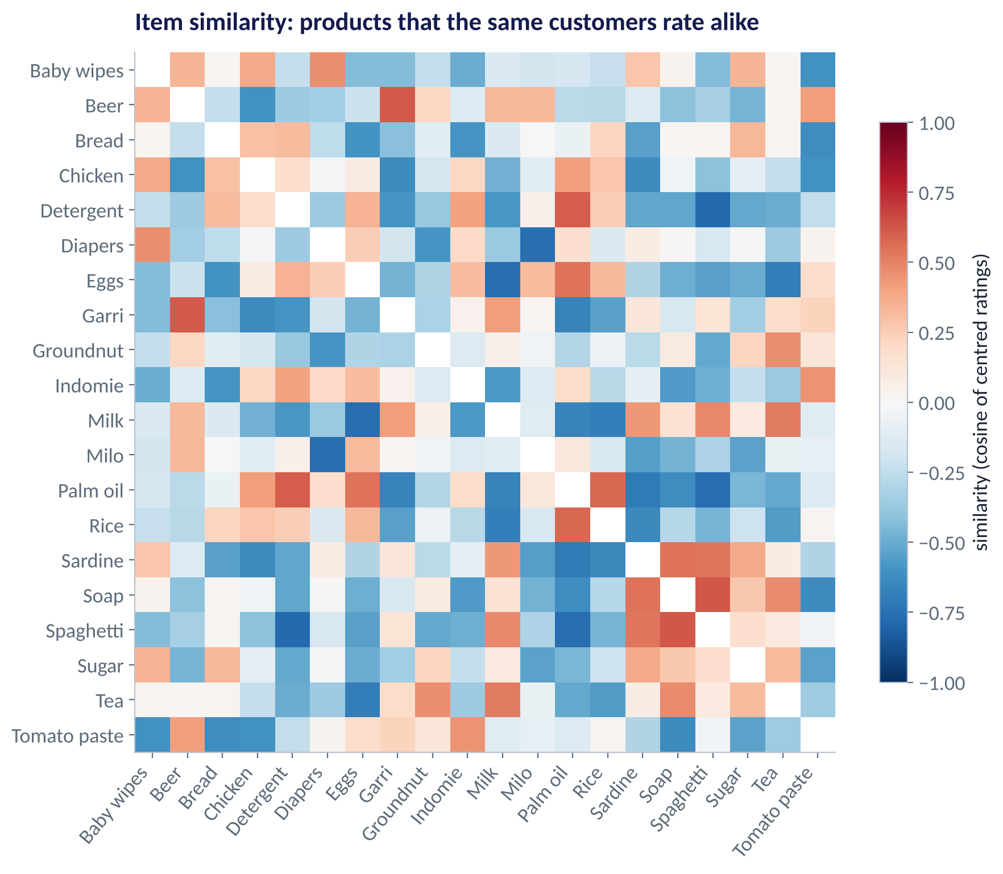
THE SIMILARITY TABLE
Which Products Are 'Liked Together'?
WHAT TO SEE
Red: customers rate the pair alike. Blue: opposite tastes.
Similarity from ratings differs from lift from baskets: different questions.
This table is the engine of the recommender.
Recompute it weekly as new ratings arrive.
Fig S4.5-F05 · replicate: tdbg_4_5_figures.R / .py
SESSION 4.5 · WHAT SELLS WITH WHAT
20

Slide 21
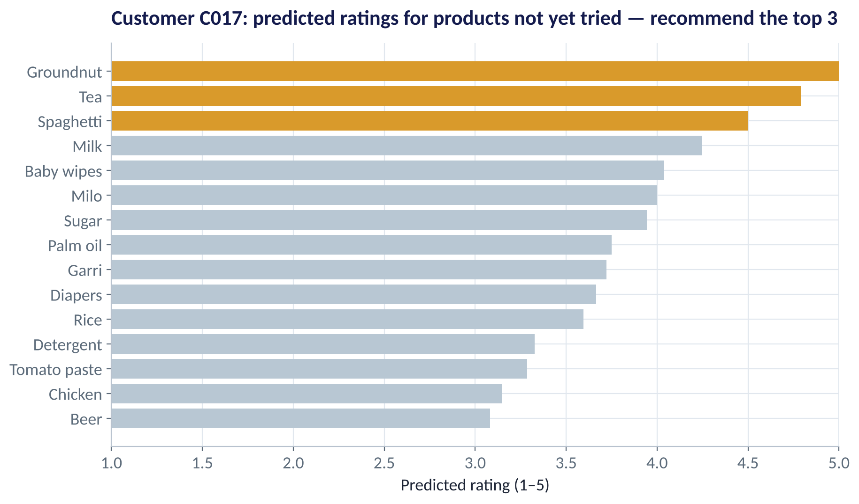
ONE CUSTOMER
Recommendations for Customer C017
WHAT TO SEE
Predicted ratings for the 13 products C017 hasn't rated yet.
Top 3: Groundnut, Tea, Spaghetti: these go in the 'For you' row.
Low predictions (Beer, Chicken) are left out.
Each recommendation can be explained by the similar products C017 rated.
Fig S4.5-F06 · replicate: tdbg_4_5_figures.R / .py
SESSION 4.5 · WHAT SELLS WITH WHAT
21

Slide 22
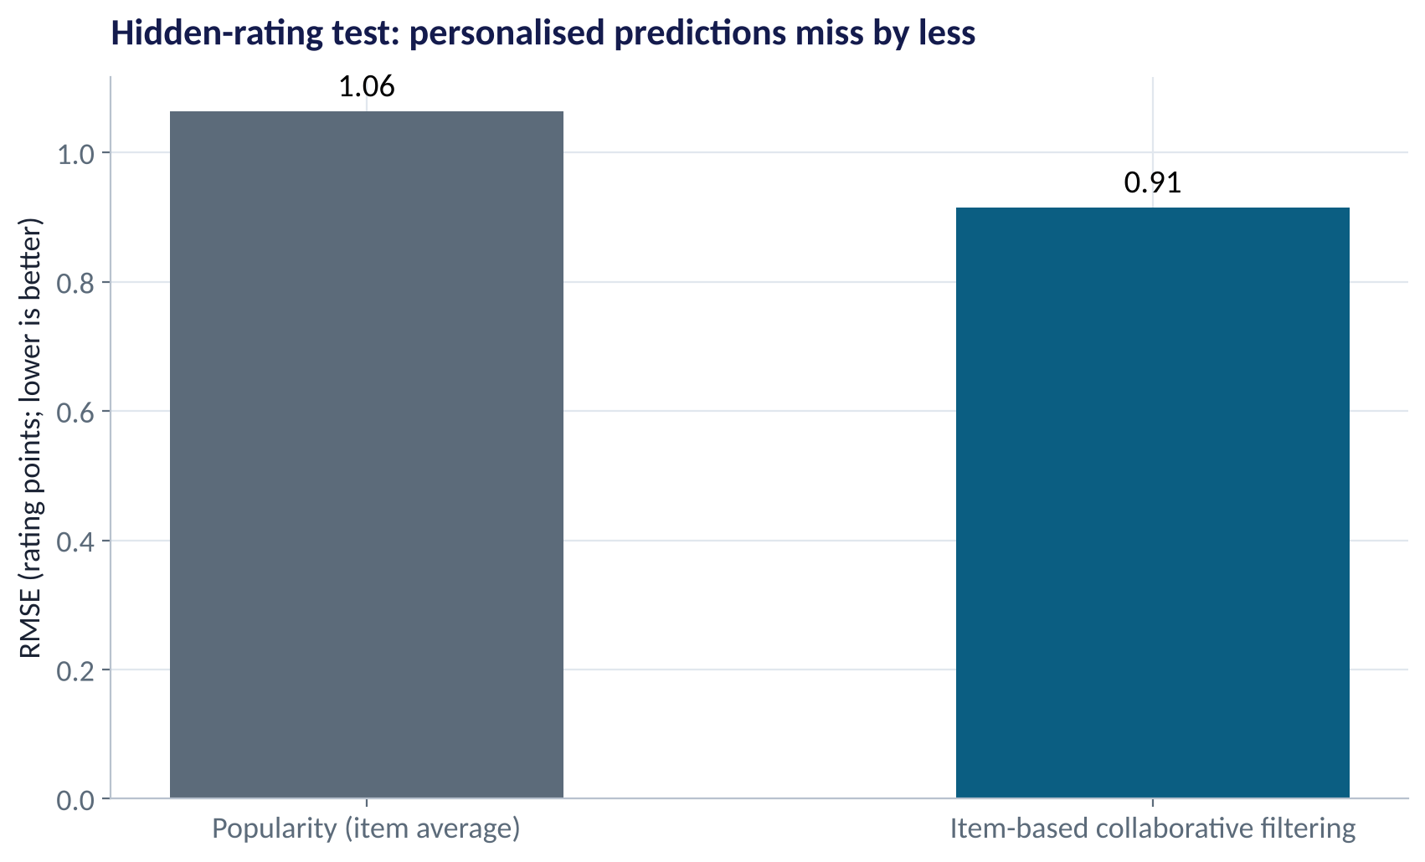
DOES IT BEAT THE BESTSELLER LIST?
Testing the Recommender on Hidden Ratings
WHAT TO SEE
Hide each known rating in turn, predict it, compare: leave-one-out testing.
Popularity (item average) misses by 1.06 points on average (RMSE).
Collaborative filtering misses by 0.91: about 14% better.
Offline accuracy is a first check; the real test is an A/B test on clicks and sales.
Fig S4.5-F07 · replicate: tdbg_4_5_figures.R / .py
SESSION 4.5 · WHAT SELLS WITH WHAT
22

Slide 23




REAL-WORLD PROBLEMS
What Can Go Wrong With Recommenders
Cold start
Filter bubble
New customers and new products have no ratings. Fix: start with popularity or content, ask for 3 favourites at sign-up.
Recommending only 'more of the same' narrows choice. Fix: mix in some new or diverse items.
Popularity bias
Privacy
Bestsellers get recommended, so they sell more, so they get recommended more. Fix: cap or discount popular items.
Purchase histories reveal health, religion and family. Fix: consent, minimise data, follow the NDPA (Session 5.3).
SESSION 4.5 · WHAT SELLS WITH WHAT
23

Slide 24


WHERE MANAGERS GO WRONG
Market Basket & Recommender Mistakes
THE TRAP
THE BETTER HABIT
Ranking rules by confidence alone.
Use lift: confidence flatters popular 'then' items.
Treating a rule as cause and effect.
Rules are correlations; A/B test any layout or bundle.
Discounting items that already sell together.
Bundle to lift basket size, not to subsidise habits.
Judging a recommender only on offline RMSE.
Measure clicks, conversion and margin in a live test.
Ignoring new customers and products.
Plan for cold start with popularity and content rules.
SESSION 4.5 · WHAT SELLS WITH WHAT
24

Slide 25

CONCEPT CHECK
Quick Check: What Would You Say?
Rule: Sugar → Rice has confidence 40%. 50% of all baskets contain rice. What does this tell you?
A
Strong rule: 40% is high
B
Lift = 0.8: sugar buyers buy rice LESS often than average
C
Support is 40%
D
Rice causes sugar purchases
Discuss with your neighbour for 60 seconds — answer and reasoning in the speaker notes.
SESSION 4.5 · WHAT SELLS WITH WHAT
25

Slide 26



HANDS-ON LAB
Lab: What Sells With What?
1
Turn the transactions into a basket × item table; find the 10 most popular items.
YOU WILL NEED
Data
2
Compute support, confidence and lift for every pair; list the top rules by lift.
data/supermarket_baskets.csv
data/product_ratings.csv
3
Check Diapers → Beer by hand against the software.
R script
sessions/4-5/R/tdbg_4_5_lab.R
4
Build the item-similarity table from the ratings; find the 5 products most like Milo.
Python script
Recommend 3 products for a customer of your choice; compare with popularity on hidden ratings.
sessions/4-5/python/tdbg_4_5_lab.py
5
Deliverable: a one-slide merchandising brief: 2 rules to act on, 1 bundle, 1 test design, and the recommender result.
⏱ 30 minutes
SESSION 4.5 · WHAT SELLS WITH WHAT
26

Slide 27
WORDS TO OWN
Today's Vocabulary in Plain English
Basket / transaction
The set of items bought in one visit.
Apriori
Algorithm that finds frequent itemsets and rules efficiently.
Association rule
If A is in a basket, B tends to be too: A → B.
Collaborative filtering
Recommending from the behaviour of similar customers or items.
Support
Share of baskets containing both A and B.
Content-based
Recommending items with similar attributes.
Confidence
Share of A-baskets that also contain B.
Cold start
No history for a new user or item.
Lift
Confidence ÷ baseline rate of B; 1 = no relationship.
RMSE
Typical size of prediction error, in rating points.
SESSION 4.5 · WHAT SELLS WITH WHAT
27

Slide 28
KEY TAKEAWAYS
Session 4.5 in 5 Ideas
01
Support = how common; confidence = how reliable; lift = how much more than chance.
02
Strong rules reveal shopping missions: tea + sugar, rice + tomato paste, the baby run.
03
Rules are correlations: A/B test layouts and bundles before rolling out.
04
Item-based collaborative filtering predicts ratings from products liked alike.
05
It beat the bestseller list on hidden ratings (RMSE 0.91 vs 1.06); plan for cold start.
NEXT › Session 5.1: Neural Networks and Generative AI
Before next session: Read Chapters 38, 39 and 62 (Neural Networks; Deep Learning; Generative AI for Business). Try one task at work with an AI assistant and note one thing it did well and one mistake.

