Slide 1


LAGOS BUSINESS SCHOOL · TURNING DATA INTO BUSINESS GROWTH · DAY 5
SESSION 5.1
Neural Networks and
Generative AI
Neural Networks, Deep Learning & Generative AI
Source: Chapters 38, 39 & 62 — Neural Networks · Image Analytics · Generative AI & LLMs
AI-Powered Business Analytics: A Practical Textbook for Data-Driven Decision Making · Prof. Bongo Adi

Slide 2




RECAP
Session 4.5 in Three Ideas
Rules
Support = how common, confidence = how reliable, lift = how much more than chance.
Missions
Strong rules reveal shopping missions; A/B test any layout or bundle before rollout.
Recommenders
Collaborative filtering beat the bestseller list on hidden ratings; plan for cold start.
SESSION 5.1 · NEURAL NETWORKS AND GENERATIVE AI
2

Slide 3




TODAY'S PLAN
Session 5.1 at a Glance — 75 Minutes
What neural networks really do, when they're worth it, and where generative AI fits.
10'
35'
25'
5'
Recap & Hook
Neural Nets, Deep Learning & GenAI
Lab: Telco Churn
Wrap-Up
The AI everyone is talking about
Neurons, layers, overfitting, images, LLMs
Neural net vs logistic regression
Money analytics next (Session 5.2)
SESSION 5.1 · NEURAL NETWORKS AND GENERATIVE AI
3

Slide 4



BY THE END OF TODAY
Session 5.1 Learning Objectives
You will be able to:
01
02
03
Explain a Neural Network
Judge When Deep Learning Pays
Use Generative AI Wisely
Describe neurons, weights, layers and activation functions in plain English.
Compare a neural net with simpler models fairly, and spot overfitting.
Map GenAI and LLM use cases by value and risk, and keep humans accountable.
SESSION 5.1 · NEURAL NETWORKS AND GENERATIVE AI
4

Slide 5




THE HOOK
The Board Wants 'AI'
“Our competitors are using AI. Why aren't we?” — a question every Nigerian CEO has heard since ChatGPT arrived.
Neural networks power face unlock, voice assistants, fraud screens and ChatGPT. But on a typical customer table, are they better than what you already know? Today you'll find out, and learn to:
See inside
Test fairly
Choose the right tool
A neural network is many small logistic regressions stacked together.
Same data, same test set, same metric: does the complex model actually win?
Deep learning for images, sound, text; simpler models for most tables.

Slide 6




NIGERIAN BUSINESS CASE
Predicting Churn at a Nigerian Telco
The situation
The decision question
A mobile operator loses about 1 in 5 subscribers a year to competitors, mostly multi-SIM users who simply stop recharging. The new Head of Data wants to replace the retention team's logistic model with a 'deep learning' model.
Does a neural network predict churn better than logistic regression? And where can generative AI help the retention team?
The data we have
What a good answer looks like
telecom_churn.csv — 5,000 subscribers: plan, tenure, data and voice use, dropped calls, complaints, average recharge (₦), multi-SIM flag, churned (22%).
A model recommendation backed by test AUC, plus a short list of GenAI uses ranked by value and risk.
SESSION 5.1 · NEURAL NETWORKS AND GENERATIVE AI
6

Slide 7
PART
01
Inside a Neural Network
No magic: weights, sums and a bend.

Slide 8


ONE NEURON
A Neuron Is a Tiny Logistic Regression
IN PLAIN ENGLISH
THE FORMULA
output = activation( w₁x₁ + w₂x₂ + … + b )
A neuron takes inputs (tenure, complaints, …), multiplies each by a weight, adds them up with a bias, and passes the total through an activation function. With a sigmoid activation, one neuron is exactly the logistic regression from Session 3.4.
WHY A MANAGER CARES
If you understood logistic regression, you already understand the building block of every deep learning model, including ChatGPT.
EXAMPLE
complaints × 0.9 + tenure × (−1.2) + … → sum = 0.4 → sigmoid → 0.60 chance of churn.
SESSION 5.1 · NEURAL NETWORKS AND GENERATIVE AI
8

Slide 9
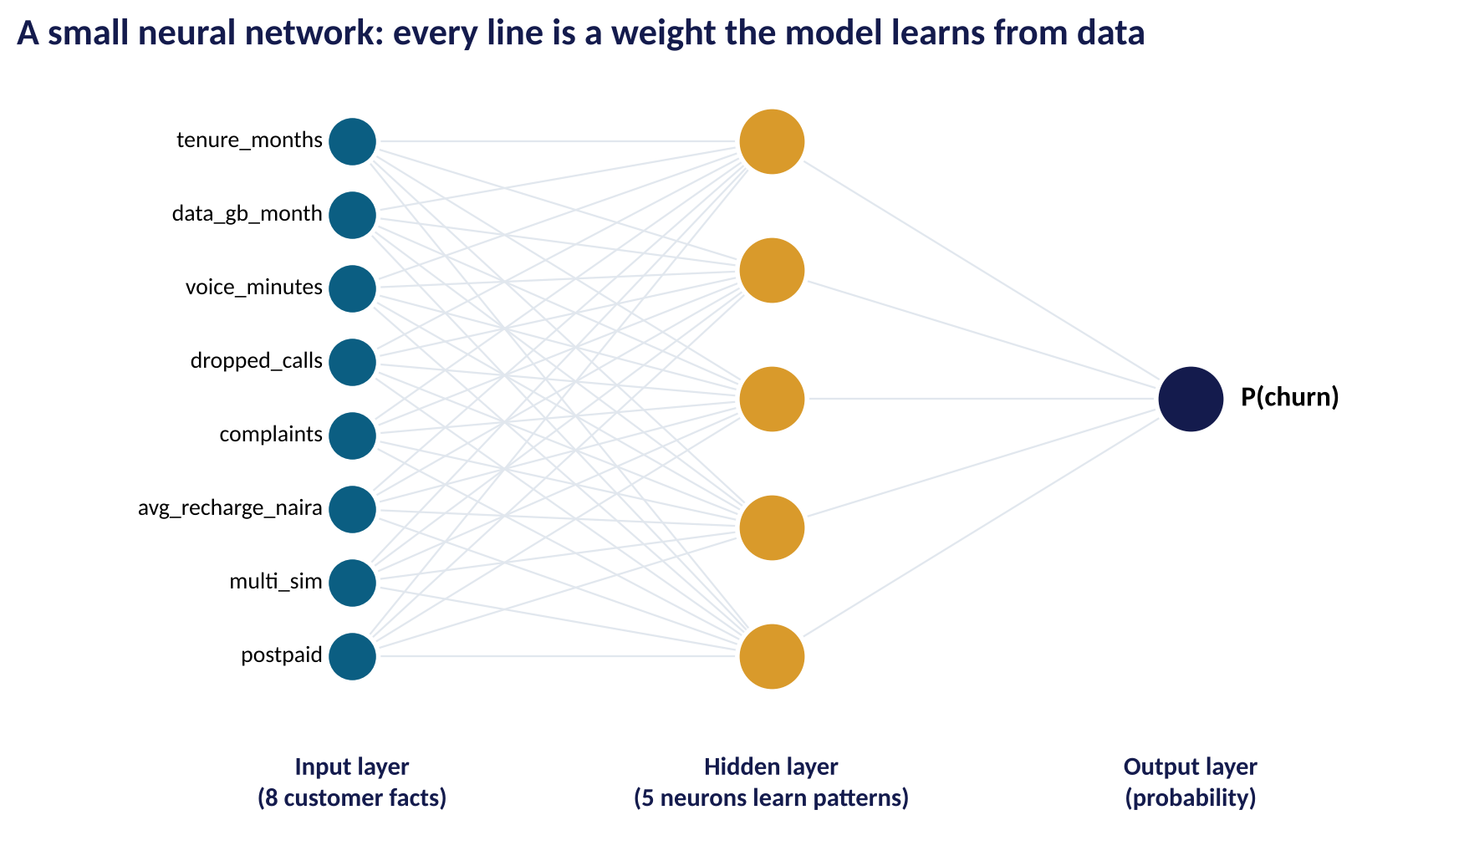
MANY NEURONS
Layers: Inputs, Hidden Patterns, Output
WHAT TO SEE
Input layer: the 8 customer facts.
Hidden layer: each neuron learns its own combination, e.g. 'new, complaining multi-SIM user'.
Output: the probability of churn.
This small net has 51 weights; 'deep' nets have many hidden layers and millions or billions of weights.
Fig S5.1-F01 · replicate: tdbg_5_1_figures.R / .py
SESSION 5.1 · NEURAL NETWORKS AND GENERATIVE AI
9

Slide 10
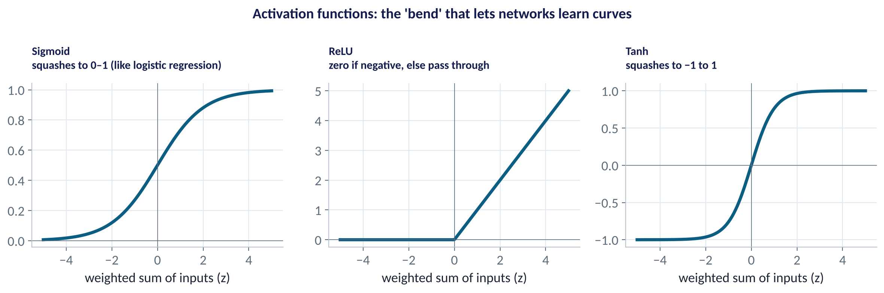
THE BEND
Activation Functions
WHAT TO SEE
Without a bend, stacked layers collapse into one straight-line model.
ReLU (zero if negative) is the default in modern networks.
Sigmoid at the output turns a score into a probability.
The bend is what lets networks learn curves and interactions.
Fig S5.1-F02 · replicate: tdbg_5_1_figures.R / .py
SESSION 5.1 · NEURAL NETWORKS AND GENERATIVE AI
10

Slide 11
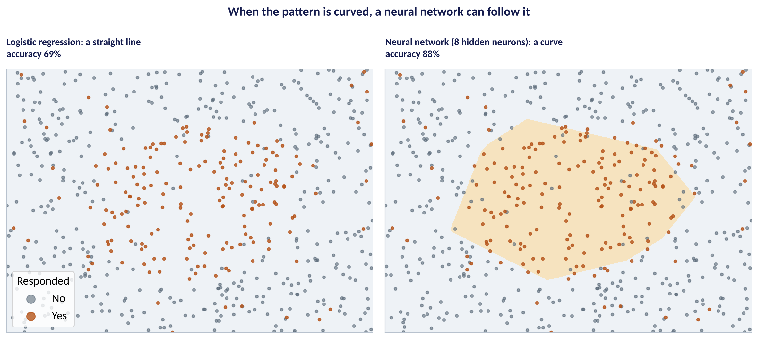
WHY BOTHER?
Neural Networks Can Follow Curved Patterns
WHAT TO SEE
Illustration: customers inside a 'ring' respond; those outside don't.
Logistic regression can only draw a straight line: 69% accuracy.
A network with 8 hidden neurons bends around the pattern: 88%.
Real business patterns are rarely this curved, as we'll see.
Fig S5.1-F03 · replicate: tdbg_5_1_figures.R / .py
SESSION 5.1 · NEURAL NETWORKS AND GENERATIVE AI
11

Slide 12




HOW IT LEARNS
Training a Network in Four Steps
›
›
›
Start random
Predict
Measure error
Adjust weights
All weights begin as small random numbers
Push training customers through; get churn probabilities
Compare with what really happened (log loss)
Nudge every weight to reduce the error (backpropagation + gradient descent)
One pass through all the training data is an epoch. Repeat for many epochs until the error on unseen data stops improving.
SESSION 5.1 · NEURAL NETWORKS AND GENERATIVE AI
12

Slide 13
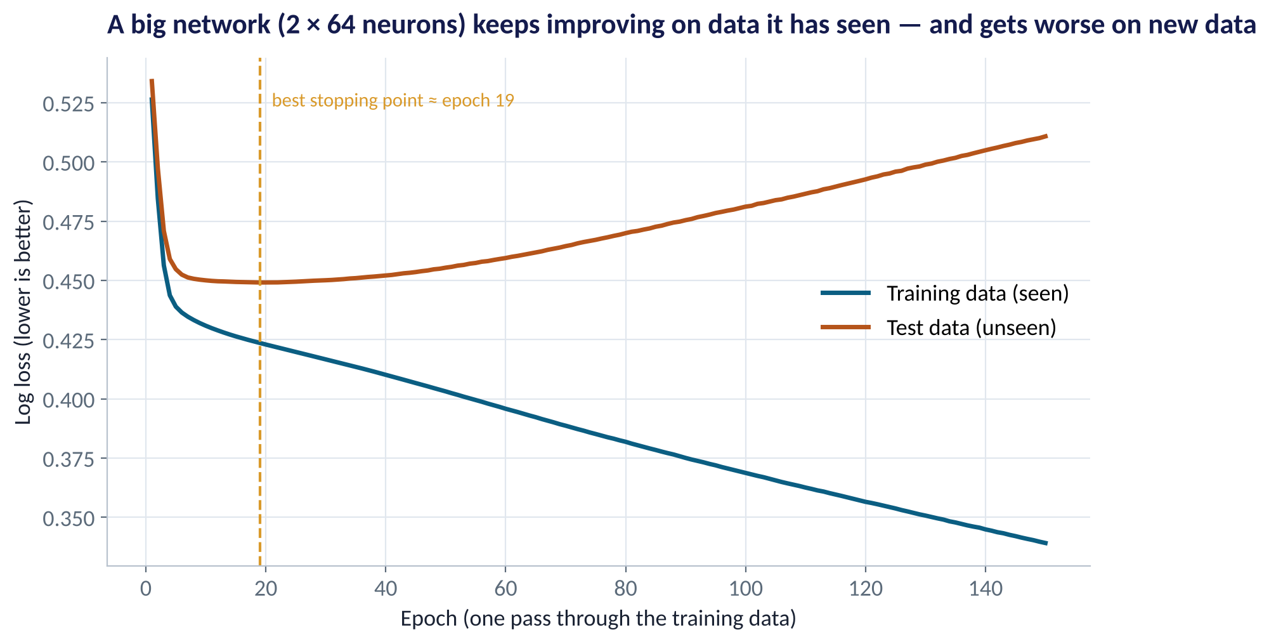
THE DANGER
Big Networks Memorise
WHAT TO SEE
Training error (blue) keeps falling: the network memorises customers it has seen.
Test error (orange) bottoms out early, then rises.
Same overfitting story as Session 3.3, with many more weights to overfit with.
Fixes: early stopping, regularisation (weight decay), dropout, more data.
Fig S5.1-F04 · replicate: tdbg_5_1_figures.R / .py
SESSION 5.1 · NEURAL NETWORKS AND GENERATIVE AI
13

Slide 14
PART
02
Does Deep Learning Win?
A fair contest on a customer table.

Slide 15
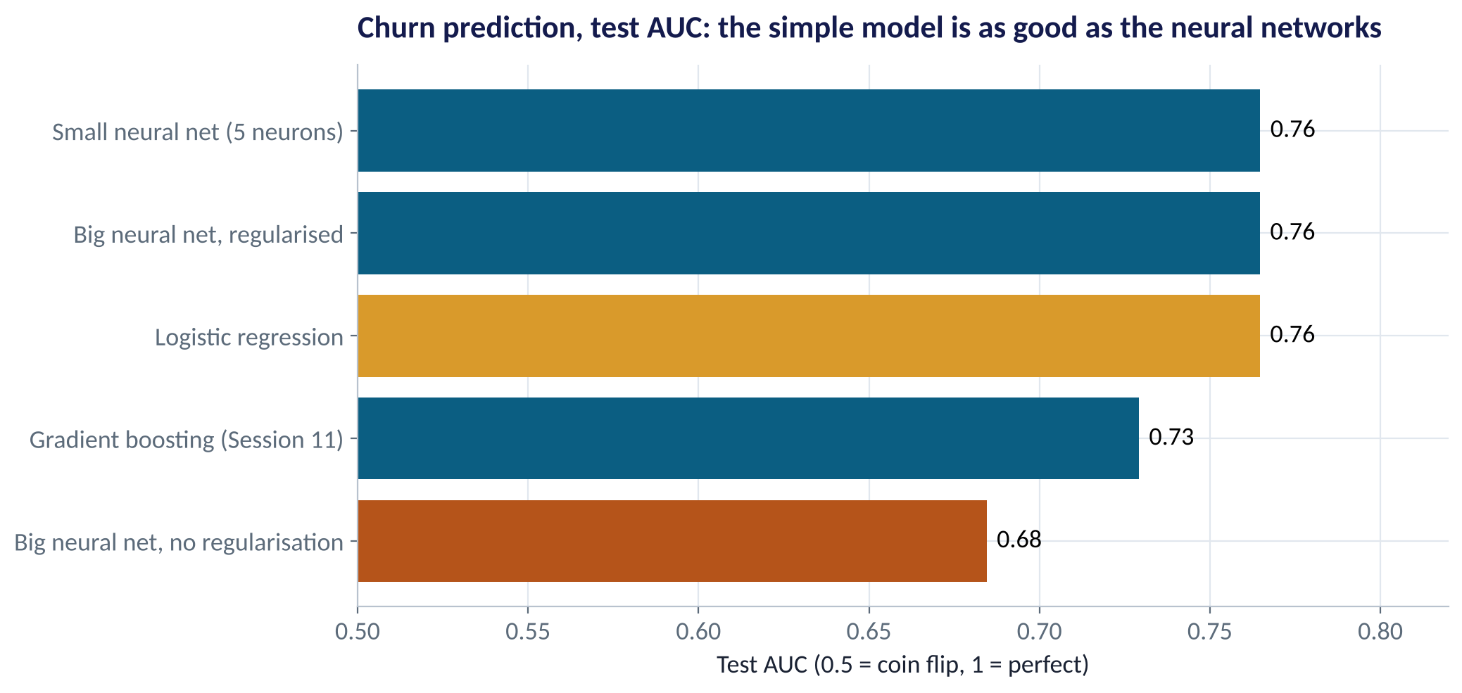
THE FAIR CONTEST
Neural Nets vs Logistic Regression on Churn
WHAT TO SEE
Same 70/30 split, same test set, same metric.
Logistic regression: 0.76. Small or regularised neural net: 0.76. No gain.
Big unregularised net: 0.68, worse than the simple model.
On tabular business data, simple models and tree ensembles usually match or beat neural nets.
Fig S5.1-F05 · replicate: tdbg_5_1_figures.R / .py
SESSION 5.1 · NEURAL NETWORKS AND GENERATIVE AI
15

Slide 16
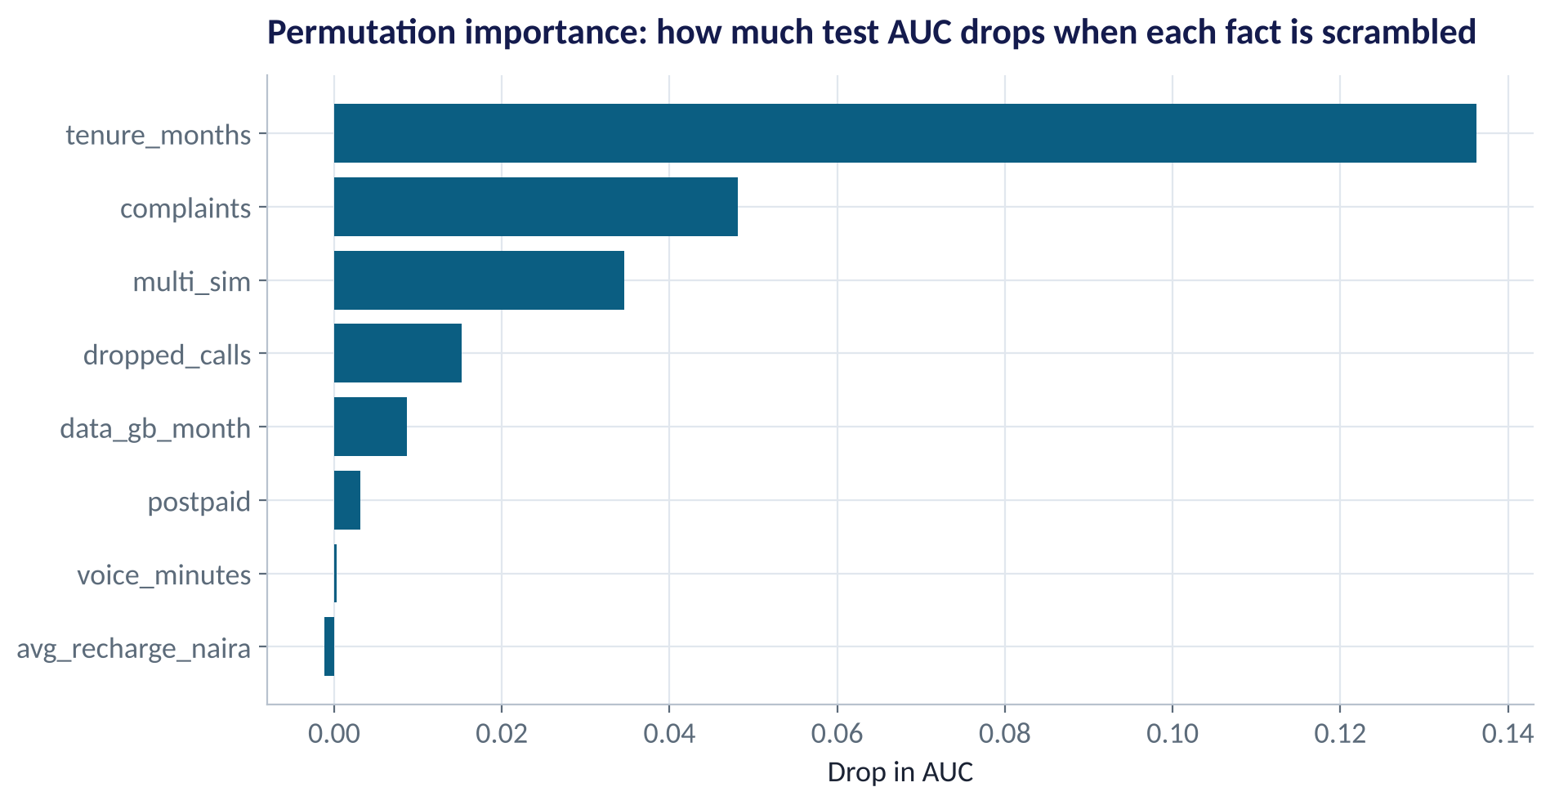
OPENING THE BOX
What Drives the Network's Predictions?
WHAT TO SEE
Permutation importance: scramble one fact, see how much AUC drops.
Tenure matters most: new subscribers leave.
Then complaints and multi-SIM.
The same drivers the logistic model finds, so the network adds complexity, not insight.
Fig S5.1-F06 · replicate: tdbg_5_1_figures.R / .py
SESSION 5.1 · NEURAL NETWORKS AND GENERATIVE AI
16

Slide 17
THE DECISION
When Is Deep Learning Worth It?
Data type | Example | Best first choice | Deep learning?
Customer / finance tables | Churn, credit, sales | Logistic regression, boosting | Rarely better
Images | Shelf photos, ID checks, crop disease | Convolutional neural net | Yes, by far
Text | Reviews, chats, contracts | Bag-of-words → LLM | Yes for nuance
Sound | Call-centre audio, voice | Pre-trained speech model | Yes
Sequences at scale | Card transactions, clickstreams | Boosting → recurrent / transformer nets | Sometimes
Rule of thumb: the less structured the data, the more deep learning helps.
SESSION 5.1 · NEURAL NETWORKS AND GENERATIVE AI
17

Slide 18
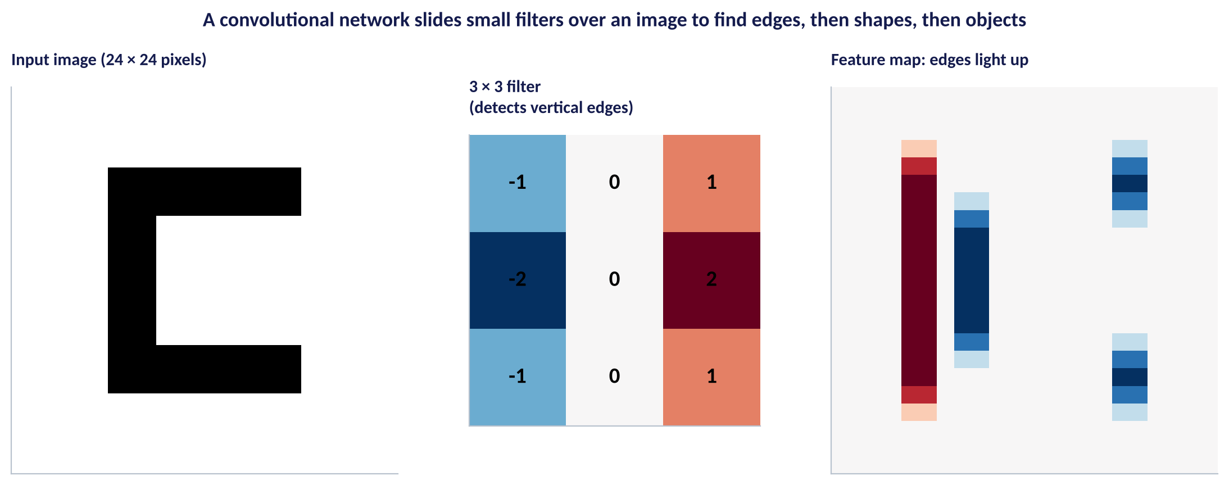
IMAGES IN BRIEF
How a Convolutional Network Sees
WHAT TO SEE
A filter is a small grid of weights that slides across the image.
Early layers find edges; later layers combine them into shapes and objects.
The network learns its own filters from thousands of labelled images.
Uses: shelf-compliance photos, KYC selfie checks, crop and livestock disease detection.
Fig S5.1-F07 · replicate: tdbg_5_1_figures.R / .py
SESSION 5.1 · NEURAL NETWORKS AND GENERATIVE AI
18

Slide 19
PART
03
Generative AI & LLMs
Models that create, not just predict.

Slide 20
LARGE LANGUAGE MODELS
What an LLM Actually Does
IN PLAIN ENGLISH
WHY A MANAGER CARES
A large language model is a very deep neural network (a transformer) trained on vast amounts of text to predict the next word. Doing that well at huge scale gives it the ability to summarise, draft, translate, classify and write code.
LLMs turn unstructured text (Session 4.4) into analysis in seconds. But they predict plausible words, not verified facts, so they can be confidently wrong ('hallucinate').
EXAMPLE
Prompt: “Summarise these 200 complaint notes into 5 themes with counts.” The model writes the summary one predicted word at a time.
SESSION 5.1 · NEURAL NETWORKS AND GENERATIVE AI
20

Slide 21
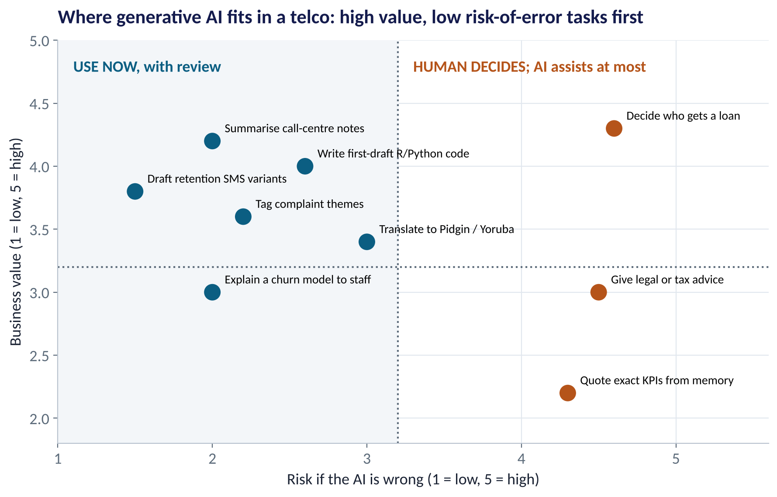
WHERE IT FITS
A Value–Risk Map for Generative AI
WHAT TO SEE
Start top-left: summarising notes, drafting SMS, first-draft code, tagging themes.
Middle: translation into Pidgin or Yoruba: useful, but have a native speaker check.
Right side: credit decisions, legal advice, quoting KPIs: a human decides.
The scores are a judgement: rebuild the map with your own team.
Fig S5.1-F08 · replicate: tdbg_5_1_figures.R / .py
SESSION 5.1 · NEURAL NETWORKS AND GENERATIVE AI
21

Slide 22





USING GENAI SAFELY
Five Rules for Analysts and Managers
Verify every number
Protect data
Run the code
Check figures against the data. LLMs invent plausible statistics.
Never paste customer PII into public tools; follow the NDPA and company policy.
AI-written R or Python must run, and its output must make sense.
Own the decision
Log your prompts
AI drafts; a named person signs off. Accountability can't be delegated.
Keep prompts and outputs for important work, so others can reproduce and audit it.
SESSION 5.1 · NEURAL NETWORKS AND GENERATIVE AI
22

Slide 23


WHERE MANAGERS GO WRONG
Neural Net & GenAI Mistakes
THE TRAP
THE BETTER HABIT
Assuming 'deep learning' must beat simpler models.
Run a fair contest on the same test set.
Forgetting to standardise inputs for a neural net.
Scale with training means and SDs only.
Judging a network on training accuracy.
Watch test error; use early stopping and regularisation.
Trusting an LLM's numbers and citations.
Verify against source data every time.
Pasting customer data into a public chatbot.
Mask PII; use approved, governed tools.
SESSION 5.1 · NEURAL NETWORKS AND GENERATIVE AI
23

Slide 24

CONCEPT CHECK
Quick Check: What Would You Say?
A neural network has training AUC 0.98 and test AUC 0.68. Logistic regression has 0.77 and 0.76. What should you do?
A
Deploy the neural network: 0.98 is excellent
B
Keep logistic regression; the network is overfitting
C
Average the two AUCs
D
Add more hidden layers
Discuss with your neighbour for 60 seconds — answer and reasoning in the speaker notes.
SESSION 5.1 · NEURAL NETWORKS AND GENERATIVE AI
24

Slide 25



HANDS-ON LAB
Lab: Neural Net vs Logistic Regression
1
Split 70/30 and standardise the inputs using training means and SDs.
YOU WILL NEED
Data
2
Fit logistic regression: the benchmark AUC to beat.
data/telecom_churn.csv
3
Fit a small, regularised neural network; compare test AUC.
R script
sessions/5-1/R/tdbg_5_1_lab.R
4
Fit a big network with no penalty; compare training and test AUC.
Python script
Find the drivers with permutation importance; ask an AI assistant to explain your results, then check its numbers.
sessions/5-1/python/tdbg_5_1_lab.py
5
Deliverable: a recommendation to the Head of Data: which model to deploy and why, in three sentences.
⏱ 25 minutes
SESSION 5.1 · NEURAL NETWORKS AND GENERATIVE AI
25

Slide 26
WORDS TO OWN
Today's Vocabulary in Plain English
Neuron
Weighted sum of inputs passed through an activation.
Backpropagation
Method for working out how to adjust every weight.
Weight
A number the network learns; one per connection.
Early stopping
Stop training when test error stops improving.
Hidden layer
Neurons between inputs and output that learn patterns.
CNN
Convolutional network for images; learns filters.
Activation function
The bend (ReLU, sigmoid) that allows curves.
LLM
Large language model trained to predict the next word.
Epoch
One pass through all the training data.
Hallucination
Fluent but false output from a generative model.
SESSION 5.1 · NEURAL NETWORKS AND GENERATIVE AI
26

Slide 27
KEY TAKEAWAYS
Session 5.1 in 5 Ideas
01
A neural network is stacked logistic regressions with a bend.
02
Big networks memorise: watch test error, regularise, stop early.
03
On the churn table, the neural net tied logistic regression (0.76): complexity without gain.
04
Deep learning shines on images, sound and text: CNNs, transformers, LLMs.
05
Use GenAI where value is high and the cost of error is low; verify and own the decision.
NEXT › Session 5.2: Where the Money Is
Before next session: Read Chapters 40–42, 45 and 46 (Credit Risk; Fraud Detection; Customer Lifetime Value; Segmentation; Churn). Think of one customer of your business: roughly how much are they worth to you over five years?

