Slide 1


LAGOS BUSINESS SCHOOL · TURNING DATA INTO BUSINESS GROWTH · DAY 5
SESSION 5.2
Where the Money Is
Customer & Financial Analytics: CLV, Churn, Credit & Fraud
Source: Chapters 40–46 — Credit Risk · Fraud · CLV · Segmentation · Churn
AI-Powered Business Analytics: A Practical Textbook for Data-Driven Decision Making · Prof. Bongo Adi

Slide 2




RECAP
Session 5.1 in Three Ideas
Neural nets
Stacked logistic regressions with a bend; big ones memorise unless regularised.
Fair contest
On the churn table, the neural net only tied logistic regression (AUC 0.76).
GenAI
Use it where value is high and the cost of error is low; verify and own the decision.
SESSION 5.2 · WHERE THE MONEY IS
2

Slide 3




TODAY'S PLAN
Session 5.2 at a Glance — 75 Minutes
Putting the whole toolkit to work on money: customers, credit and fraud.
10'
35'
25'
5'
Recap & Hook
Customer & Financial Analytics
Lab: Retailer & Mobile Money
Wrap-Up
Not all customers are equal
RFM, CLV, churn economics, credit loss, fraud
Segment customers; tune a fraud alert
Operations & people next (Session 5.3)
SESSION 5.2 · WHERE THE MONEY IS
3

Slide 4



BY THE END OF TODAY
Session 5.2 Learning Objectives
You will be able to:
01
02
03
Value Your Customers
Price Risk
Detect Rare Events
Segment customers with RFM and estimate customer lifetime value (CLV).
Calculate the expected loss on a loan and the payback of a churn campaign.
Judge fraud models with precision and recall, and set alert thresholds by cost.
SESSION 5.2 · WHERE THE MONEY IS
4

Slide 5




THE HOOK
Not All Customers Are Equal
“The customer is king” — but some kings bring 50 times more revenue than others, and a few are not customers at all, but fraudsters.
Every financial decision about customers comes down to three questions:
Who is valuable?
Who will leave or default?
Who is lying?
Which customers to reward, keep and grow: RFM and CLV.
Churn and credit models from Sessions 3.4–4.1 and 5.1, priced in naira.
Fraud detection: finding 1 bad transfer in 100 without blocking honest customers.

Slide 6




NIGERIAN BUSINESS CASE
An Online Retailer and a Mobile-Money Operator
The situation
The decision question
A Lagos online retailer wants to know which customers to invest in. A mobile-money operator is losing money to account-takeover fraud and its call centre is drowning in false alerts.
Which customer segments drive revenue, what is a customer worth, and how many transfers should the fraud team review each day?
The data we have
What a good answer looks like
customer_orders.csv — 12,121 orders from 1,200 customers (2024–2025). mobile_money_txns.csv — 20,000 transfers with device, payee, time, velocity and distance flags; 1.2% fraud.
A segment-by-segment action plan with a CLV figure, and a fraud alert threshold chosen to minimise total cost.
SESSION 5.2 · WHERE THE MONEY IS
6

Slide 7
PART
01
Customer Value
RFM, Pareto and lifetime value.

Slide 8



RFM
Three Questions About Every Customer
Recency
Frequency
Monetary
How many days since their last purchase? Recent customers are most likely to buy again.
How many orders have they placed? Frequent buyers have formed a habit.
How much have they spent in total? High spenders matter most to revenue.
Score each from 1 to 5 by quintile (5 = best), then combine the scores into named segments. No model needed; it works in Excel.
SESSION 5.2 · WHERE THE MONEY IS
8

Slide 9
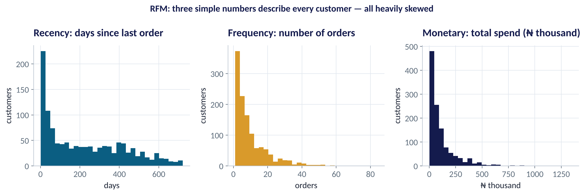
THE INGREDIENTS
Recency, Frequency and Money
WHAT TO SEE
All three are skewed: most customers order rarely and spend little.
A few customers order 50+ times.
That's why we score by quintile (rank), not by raw value.
Recency has a bump near zero: a core of active customers.
Fig S5.2-F01 · replicate: tdbg_5_2_figures.R / .py
SESSION 5.2 · WHERE THE MONEY IS
9

Slide 10
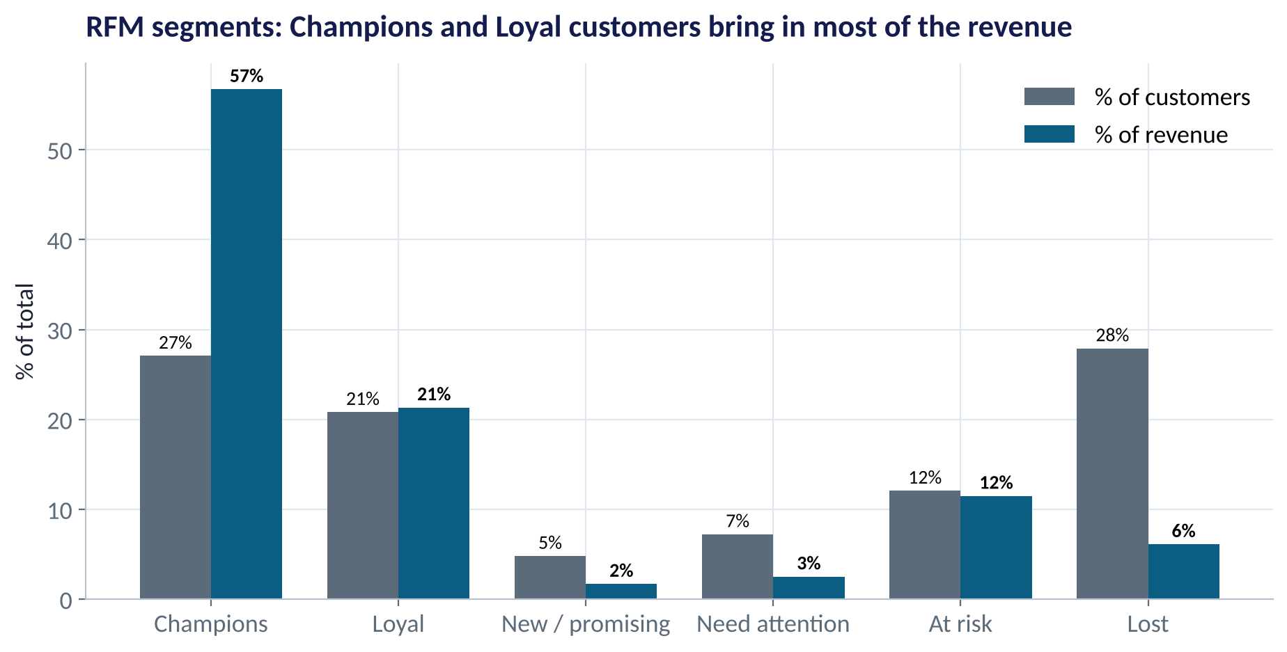
SEGMENTS
Who Brings In the Revenue?
WHAT TO SEE
Champions: 27% of customers, 57% of revenue. Protect them.
At risk: 12% of customers, 12% of revenue. They used to buy often and have gone quiet. Win them back now.
Lost: 28% of customers, only 6% of revenue. Low-cost reactivation at most.
Each segment gets a different action and budget.
Fig S5.2-F02 · replicate: tdbg_5_2_figures.R / .py
SESSION 5.2 · WHERE THE MONEY IS
10

Slide 11
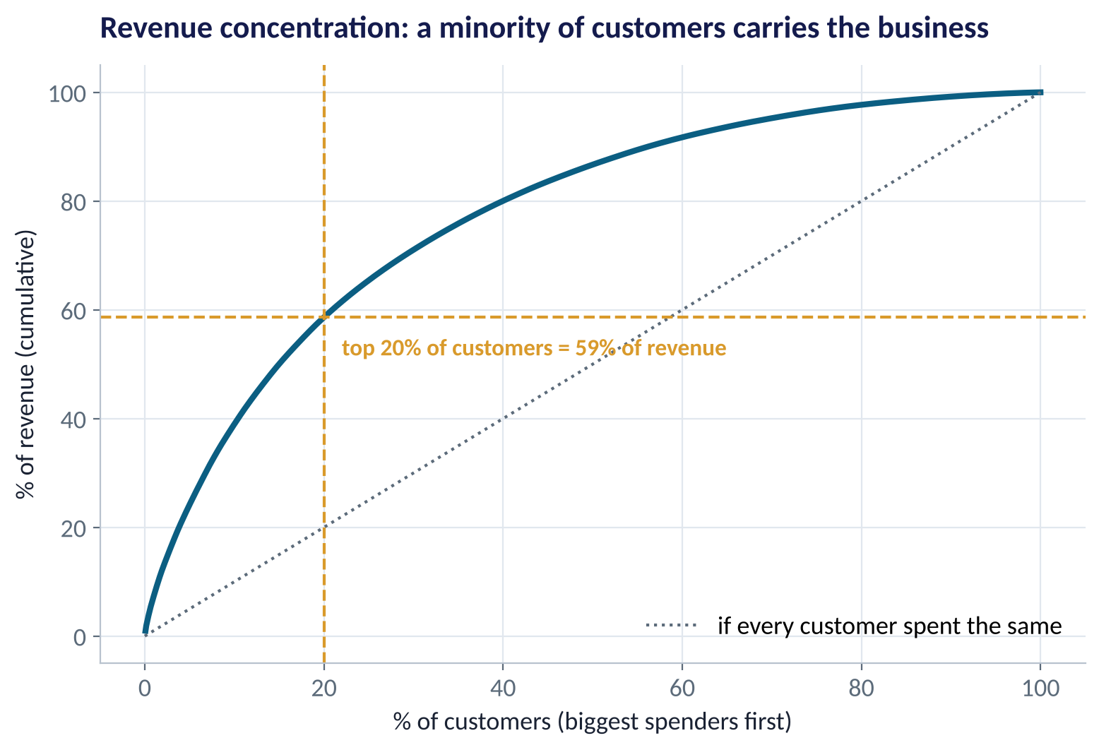
CONCENTRATION
The 80/20 Rule, Measured
WHAT TO SEE
The top 20% of customers produce 59% of revenue.
Losing one top customer costs as much as losing dozens of small ones.
Key-account management, loyalty perks and service levels should follow this curve.
Fig S5.2-F03 · replicate: tdbg_5_2_figures.R / .py
SESSION 5.2 · WHERE THE MONEY IS
11

Slide 12

CUSTOMER LIFETIME VALUE
What Is a Customer Worth?
IN PLAIN ENGLISH
THE FORMULA
CLV = annual margin × (1 + d) ÷ (1 + d − r)
CLV is the total profit you expect from a customer over the whole relationship, in today's money. It needs three numbers: the annual margin a customer brings, the retention rate (the chance they stay another year), and a discount rate (money later is worth less than money now).
WHY A MANAGER CARES
CLV tells you the most you should spend to acquire or keep a customer. If acquiring one costs ₦60,000, you are destroying value.
EXAMPLE
Average customer spends ₦98,330 a year; 25% margin = ₦24,582. Retention r = 62%, discount d = 20%. CLV = 24,582 × 1.20 ÷ 0.58 ≈ ₦50,800.
SESSION 5.2 · WHERE THE MONEY IS
12

Slide 13
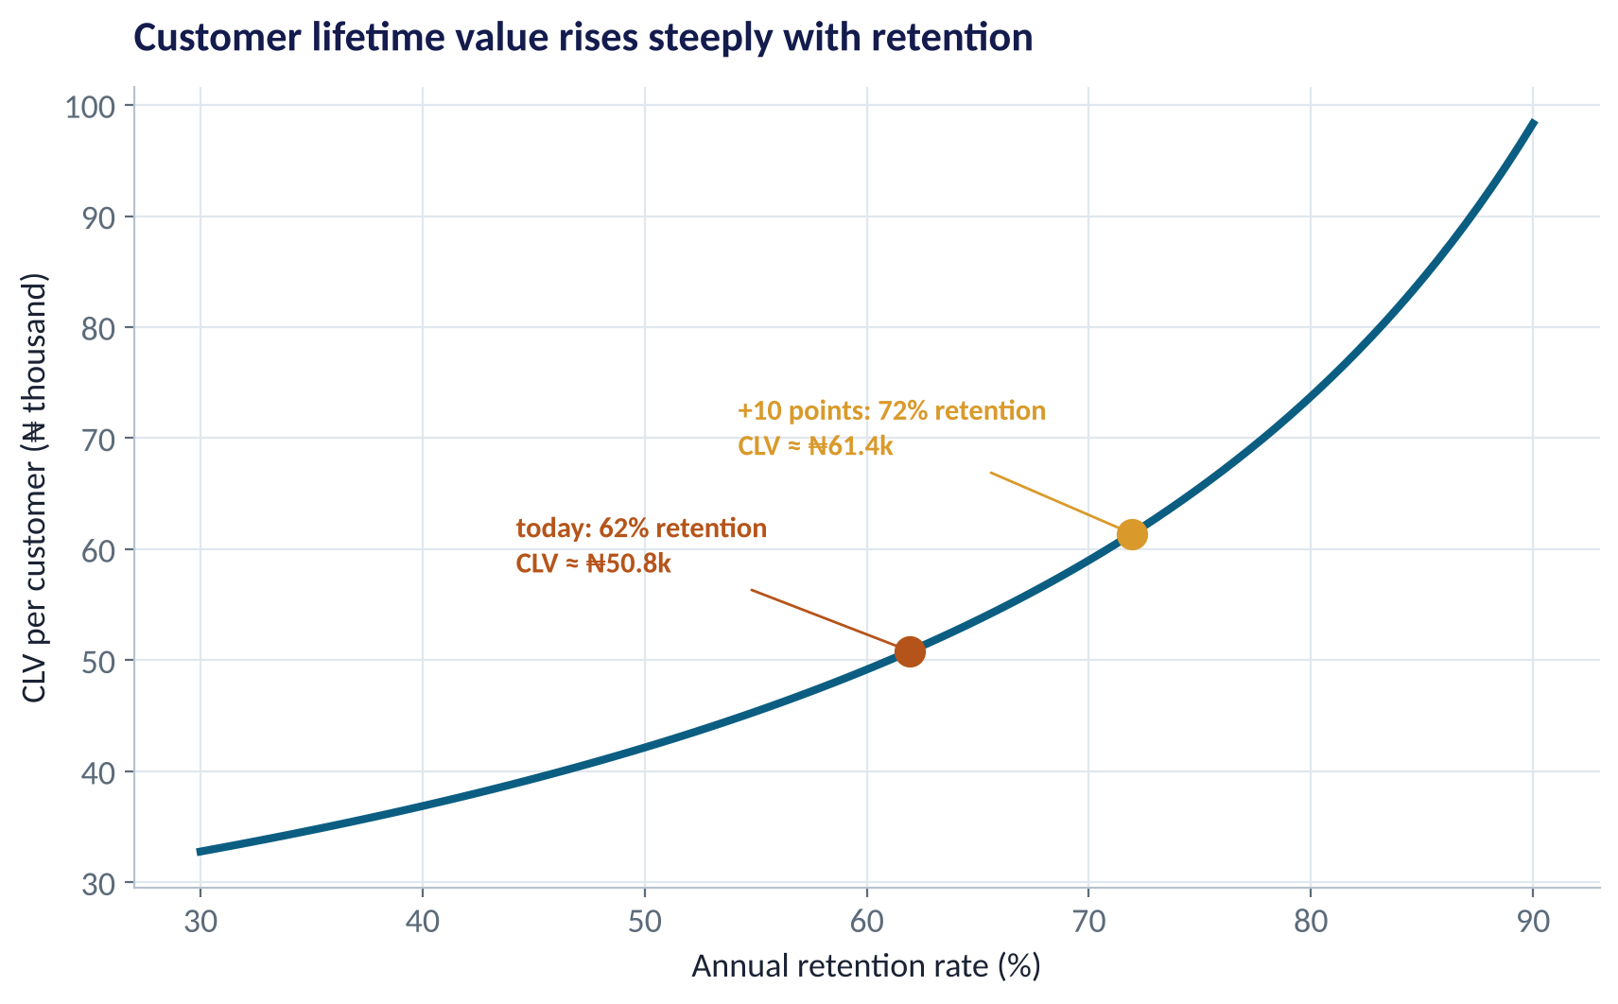
RETENTION IS THE LEVER
Small Retention Gains, Big Value Gains
WHAT TO SEE
Raising retention from 62% to 72% lifts CLV from ₦50.8k to ₦61.4k (+21%).
The curve gets steeper: each extra point is worth more than the last.
This is why retention projects often beat acquisition campaigns.
Fig S5.2-F04 · replicate: tdbg_5_2_figures.R / .py
SESSION 5.2 · WHERE THE MONEY IS
13

Slide 14
CHURN ECONOMICS
Does the Retention Campaign Pay?
Using a churn model (Session 5.1) to target 1,000 high-risk customers.
Input | Value
Customers targeted | 1,000
Would churn without action | 40% → 400
Campaign saves | 25% of those → 100
Value of a saved customer (CLV) | ₦50,800
Cost per customer contacted (voucher + SMS) | ₦2,000
Net value | ≈ ₦3.1m
STEP BY STEP
1
Value created = 100 saved × ₦50,800 = ₦5.08m.
2
Cost = 1,000 contacted × ₦2,000 = ₦2.0m.
3
Net = ₦5.08m − ₦2.0m ≈ ₦3.1m: the campaign pays.
4
Untargeted (random) customers churn at only 15%: the same campaign would save 37 customers and lose money.
The churn model's value is in targeting: it decides who is worth the voucher.
SESSION 5.2 · WHERE THE MONEY IS
14

Slide 15
CREDIT RISK
Expected Loss on a Loan Book
The language every bank and fintech uses (Chapter 40).
Component | Meaning | Example
PD | Probability of default (from a model, Sessions 3.4–3.5) | 8%
LGD | Loss given default: share not recovered | 70%
EAD | Exposure at default: amount owed | ₦200,000
Expected loss | PD × LGD × EAD | ₦11,200
STEP BY STEP
1
Expected loss = 0.08 × 0.70 × ₦200,000 = ₦11,200 per loan.
2
Price for it: interest and fees must cover expected loss plus funding and operating costs.
3
A better PD model lets you approve more good borrowers at the right price.
4
Regulators (CBN, IFRS 9) require banks to provision for expected losses.
PD comes from the classification models you built in Module 2; LGD and EAD come from collections and product data.
SESSION 5.2 · WHERE THE MONEY IS
15

Slide 16
PART
02
Fraud Detection
Finding the needle without burning the haystack.

Slide 17
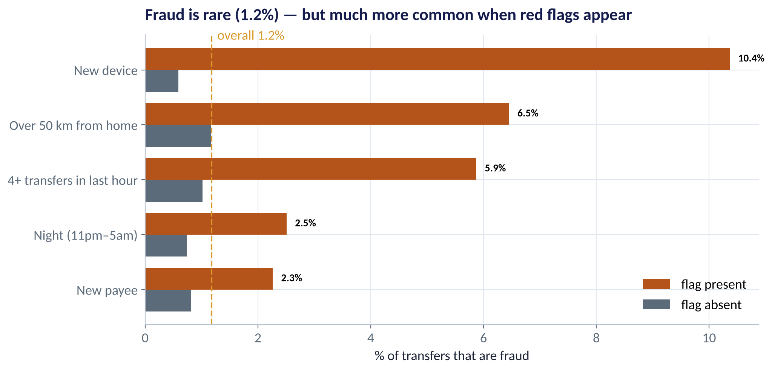
RED FLAGS
Fraud Is Rare, but Not Random
WHAT TO SEE
Overall fraud rate: 1.2% of transfers.
New device: 10.4% fraud, about 17 times the rate on a known device.
Far from home and bursts of transfers are also strong flags.
Rules like these are where fraud teams start; models combine them.
Fig S5.2-F05 · replicate: tdbg_5_2_figures.R / .py
SESSION 5.2 · WHERE THE MONEY IS
17

Slide 18

THE ACCURACY TRAP
Why Accuracy Is Useless Here
IN PLAIN ENGLISH
THE FORMULA
recall = fraud caught ÷ all fraud
precision = fraud caught ÷ all alerts
A 'model' that says never fraud is 98.8% accurate, and catches nothing. With rare events, measure instead: recall (what share of fraud we catch) and precision (what share of our alerts are really fraud).
WHY A MANAGER CARES
Every alert costs analyst time and annoys an honest customer; every miss costs the transfer. You must trade them off in naira.
EXAMPLE
At our chosen threshold: 109 alerts, 29 real frauds. Precision = 29 ÷ 109 = 27%; recall = 29 ÷ 71 = 41%.
SESSION 5.2 · WHERE THE MONEY IS
18

Slide 19
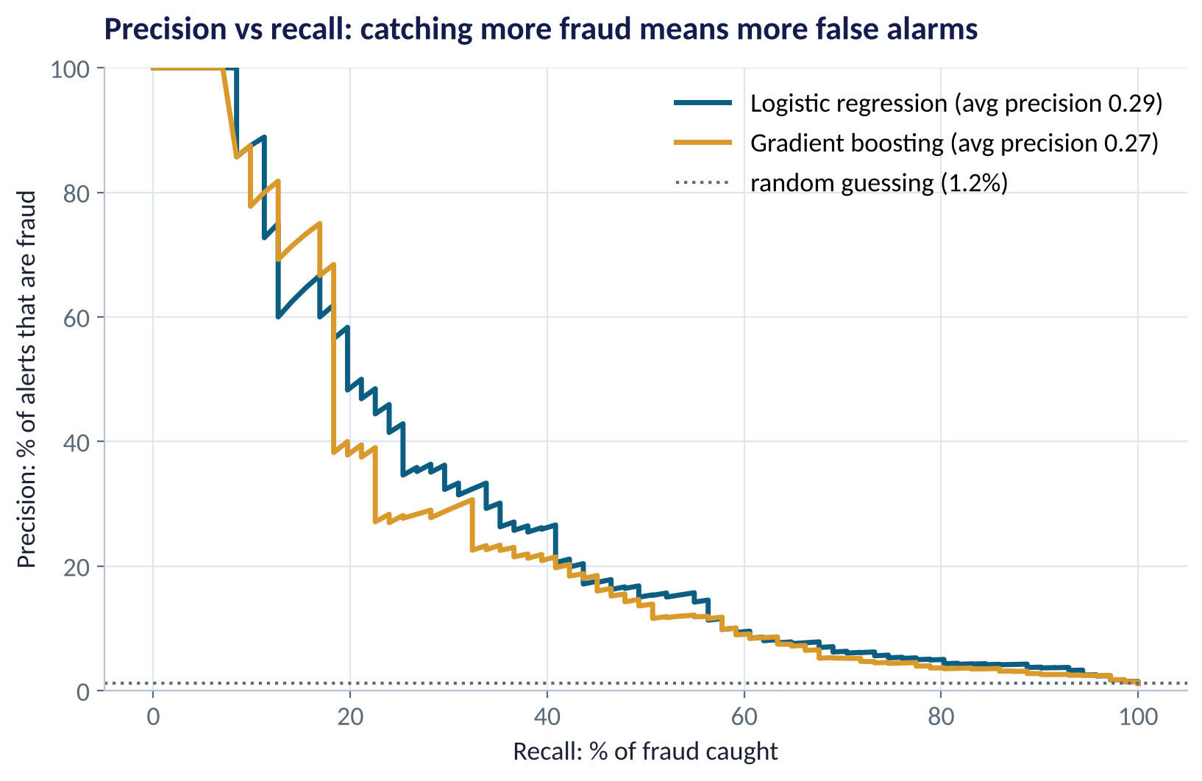
THE TRADE-OFF
Precision vs Recall
WHAT TO SEE
Catch the riskiest 10% of fraud and most alerts are real.
Catch 60% and only about 1 alert in 10 is real.
Logistic regression slightly beats boosting here (AUC 0.90 vs 0.88).
Pick the point on this curve using costs, not gut feel.
Fig S5.2-F06 · replicate: tdbg_5_2_figures.R / .py
SESSION 5.2 · WHERE THE MONEY IS
19

Slide 20
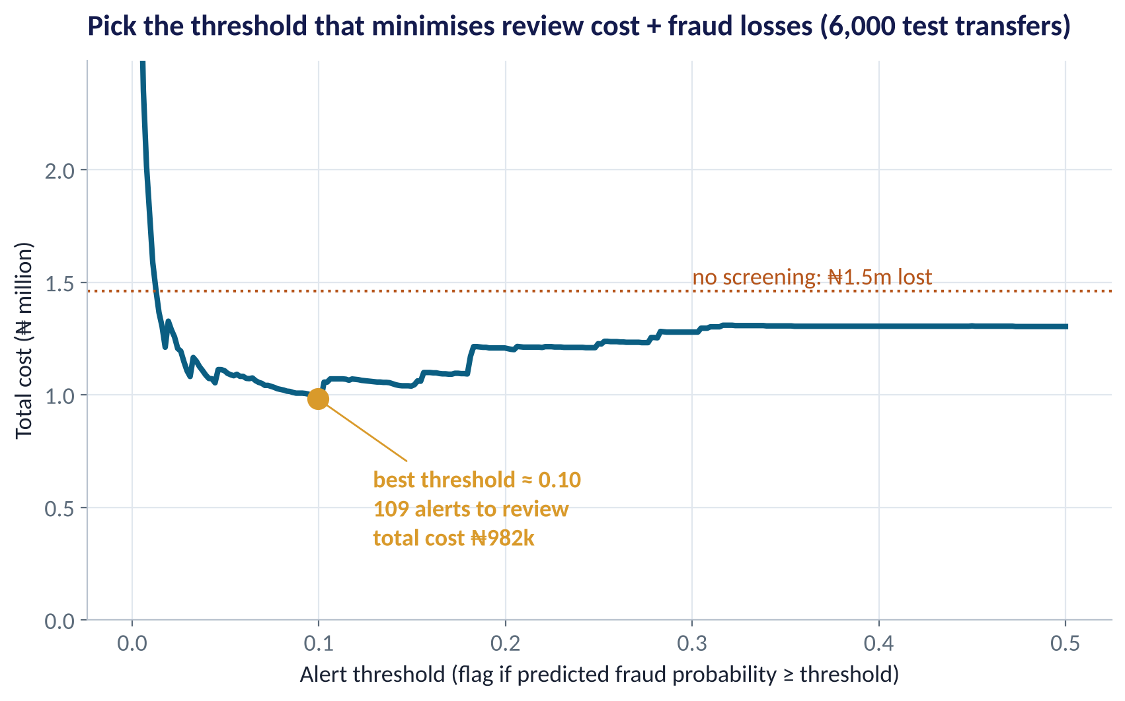
THE DECISION
Set the Threshold by Cost
WHAT TO SEE
Cost = ₦1,500 per alert reviewed + every naira of fraud missed.
Threshold too low: thousands of alerts. Too high: fraud walks through.
Best: flag if P(fraud) ≥ 0.10: 109 alerts per 6,000 transfers.
Total cost ₦982k vs ₦1.46m with no screening: about a third saved.
Fig S5.2-F07 · replicate: tdbg_5_2_figures.R / .py
SESSION 5.2 · WHERE THE MONEY IS
20

Slide 21
FRAUD IN PRACTICE
Beyond the Model
Practice | Why it matters
Rules + model together | Hard rules block known patterns instantly; the model scores everything else
Real-time scoring | Decide in milliseconds, before the money leaves
Step-up checks, not just blocks | Ask for an OTP or call-back on medium risk; block only high risk
Feedback loop | Analyst decisions become new labels; retrain monthly
Watch for drift | Fraudsters adapt; monitor precision and recall every week
Fairness | Check that flags don't fall unfairly on one region or group (Session 5.3)
SESSION 5.2 · WHERE THE MONEY IS
21

Slide 22


WHERE MANAGERS GO WRONG
Customer & Financial Analytics Mistakes
THE TRAP
THE BETTER HABIT
Treating all customers the same.
Segment with RFM; budget by segment value.
Spending more to acquire a customer than their CLV.
Cap acquisition cost at a fraction of CLV.
Sending retention offers to everyone.
Target high-risk, high-value customers; keep a holdout.
Judging a fraud model on accuracy.
Use precision, recall and cost.
Setting thresholds by gut feel.
Choose the threshold that minimises total cost.
SESSION 5.2 · WHERE THE MONEY IS
22

Slide 23

CONCEPT CHECK
Quick Check: What Would You Say?
A fraud model flags 200 transfers a day; 30 are fraud. There are 50 frauds a day in total. What are precision and recall?
A
Precision 60%, recall 15%
B
Precision 15%, recall 60%
C
Precision 30%, recall 50%
D
Accuracy 99%
Discuss with your neighbour for 60 seconds — answer and reasoning in the speaker notes.
SESSION 5.2 · WHERE THE MONEY IS
23

Slide 24



HANDS-ON LAB
Lab: Customer Value and Fraud Alerts
1
Compute recency, frequency and monetary value per customer; score 1–5 and name segments.
YOU WILL NEED
Data
2
Find each segment's share of customers and revenue, and the top-20% revenue share.
data/customer_orders.csv
data/mobile_money_txns.csv
3
Estimate retention and CLV; see what +10 points of retention is worth.
R script
sessions/5-2/R/tdbg_5_2_lab.R
4
Fit a fraud model; compare accuracy of 'never fraud' with the model's AUC.
Python script
Choose the alert threshold that minimises review cost + fraud losses.
sessions/5-2/python/tdbg_5_2_lab.py
5
Deliverable: two recommendations: one customer action (with CLV) and one fraud threshold (with alerts per day and naira saved).
⏱ 25 minutes
SESSION 5.2 · WHERE THE MONEY IS
24

Slide 25
WORDS TO OWN
Today's Vocabulary in Plain English
RFM
Recency, frequency, monetary: three customer scores.
PD / LGD / EAD
Default probability, loss share, amount owed.
Pareto (80/20)
A small share of customers drives most revenue.
Expected loss
PD × LGD × EAD.
CLV
Expected profit over the relationship, in today's money.
Precision
Share of alerts that are truly fraud.
Retention rate
Share of customers who stay another period.
Recall
Share of all fraud that is caught.
Discount rate
How much less future money is worth today.
Threshold
Score above which a case is flagged.
SESSION 5.2 · WHERE THE MONEY IS
25

Slide 26
KEY TAKEAWAYS
Session 5.2 in 5 Ideas
01
RFM segments customers without a model; Champions bring 57% of revenue here.
02
CLV sets how much a customer is worth; retention is the biggest lever.
03
Churn and credit models create value through targeting and pricing: put them in naira.
04
For rare events like fraud, use precision and recall, never accuracy.
05
Set alert thresholds to minimise total cost: here about a third saved.
NEXT › Session 5.3: Running the Business Responsibly
Before next session: Read Chapters 53, 54, 56, 58 and 63 (Supply Chain; Inventory; Quality & SPC; Employee Attrition; AI Ethics). Think of one decision in your organisation that an algorithm could make about people. What could go wrong?

