Slide 1


LAGOS BUSINESS SCHOOL · TURNING DATA INTO BUSINESS GROWTH · DAY 5
SESSION 5.3
Running the Business
Responsibly
Operations & People Analytics, and Responsible AI
Source: Chapters 53–59 & 63 — Supply Chain · Inventory · SPC · Attrition · Performance · AI Ethics
AI-Powered Business Analytics: A Practical Textbook for Data-Driven Decision Making · Prof. Bongo Adi

Slide 2




RECAP
Session 5.2 in Three Ideas
RFM & CLV
Champions brought 57% of revenue; +10 points of retention lifted CLV by 21%.
Risk in naira
Expected loss = PD × LGD × EAD; churn models pay through targeting.
Rare events
Use precision and recall, and set fraud thresholds to minimise total cost.
SESSION 5.3 · RUNNING THE BUSINESS RESPONSIBLY
2

Slide 3




TODAY'S PLAN
Session 5.3 at a Glance — 75 Minutes
Analytics on the factory floor and in HR, and the checks every model needs before it touches people.
10'
35'
25'
5'
Recap & Hook
Operations, People & Responsible AI
Lab: Bottling Line & HR Audit
Wrap-Up
When the line drifts and the model discriminates
SPC, inventory, attrition, fairness
Control chart; fairness audit
Module 3 practice paper next (Practice Paper 3)
SESSION 5.3 · RUNNING THE BUSINESS RESPONSIBLY
3

Slide 4



BY THE END OF TODAY
Session 5.3 Learning Objectives
You will be able to:
01
02
03
Control Quality and Stock
Model Employee Attrition
Audit a Model for Fairness
Read a control chart, judge process capability, and set a reorder point with safety stock.
Find the drivers of attrition and estimate what it costs by department.
Compare selection and error rates across groups, and apply responsible-AI principles.
SESSION 5.3 · RUNNING THE BUSINESS RESPONSIBLY
4

Slide 5



THE HOOK
Two Problems, One Discipline
A bottling plant in Ikeja quietly overfills every bottle by 1.7 ml. A bank's HR model quietly flags women as 'flight risks' more often than men. Neither problem shows up until someone measures.
Operations and people analytics use the same tools you already know — averages, variation, regression — to answer:
Is the process stable?
How much stock?
Is the model fair?
Separate real change from everyday noise before you act.
Enough to serve customers, not so much that cash sits on shelves.
Check who gets flagged, and who gets it wrong, before decisions about people.

Slide 6




NIGERIAN BUSINESS CASE
A Lagos Bottling Line and a Bank's HR Team
The situation
The decision question
A beverage company's Line 2 fills 50cl bottles; NAFDAC requires the labelled volume, and overfilling gives product away. Separately, a bank's HR team wants a model to identify employees at risk of leaving so managers can intervene.
Has Line 2 changed, and what should the plant do? Which employees are likely to leave, at what cost, and is the HR model fair?
The data we have
What a good answer looks like
bottling_fill_volumes.csv — 40 batches × 5 bottles, target 500 ml, specification 494–506 ml. hr_employees.csv — 1,800 employees, 25% left; department, gender, pay, engagement, overtime, manager rating.
A quality alarm with a root-cause action, a reorder rule, and an HR model with a fairness audit attached.
SESSION 5.3 · RUNNING THE BUSINESS RESPONSIBLY
6

Slide 7
PART
01
Operations Analytics
Quality control and inventory.

Slide 8

STATISTICAL PROCESS CONTROL
Common Cause vs Special Cause
IN PLAIN ENGLISH
WHY A MANAGER CARES
Every process varies. Common-cause variation is the normal noise of a stable process: small, random, always there. Special-cause variation is a signal that something has changed: a worn nozzle, a new operator, a different supplier. Control charts tell them apart.
Reacting to noise (tampering) makes a process worse. Ignoring a real signal costs money and compliance. The control chart tells you when to act.
EXAMPLE
Fill volumes bounce between about 497 and 503 ml every day (common cause). Then a filler valve is mis-set and the average jumps 1.7 ml (special cause).
SESSION 5.3 · RUNNING THE BUSINESS RESPONSIBLY
8

Slide 9
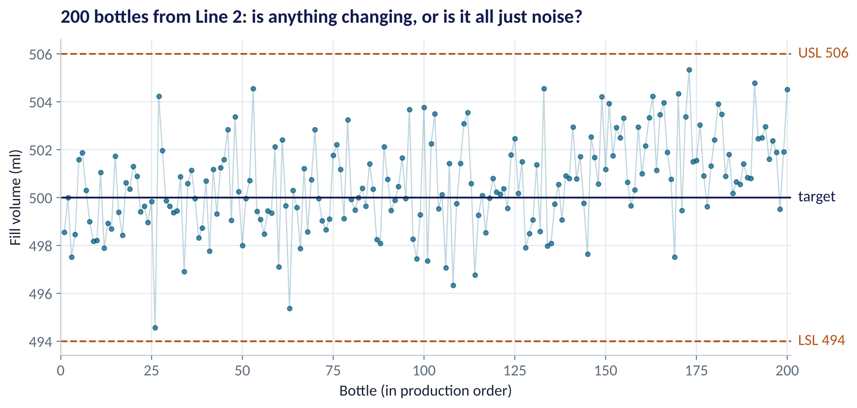
LOOK FIRST
A Run Chart of Every Bottle
WHAT TO SEE
200 bottles in production order: all within the 494–506 ml specification.
It looks noisy throughout. Has anything changed?
Individual readings are too noisy to judge by eye.
Average them in batches, and add limits based on stable performance.
Fig S5.3-F01 · replicate: tdbg_5_3_figures.R / .py
SESSION 5.3 · RUNNING THE BUSINESS RESPONSIBLY
9

Slide 10
BUILD THE CHART
X-bar Control Limits by Hand
Batches of 5 bottles; limits from the stable first 20 batches.
Quantity | Value
Average of batch averages (x̿) | 499.99 ml
Average batch range (R̄) | 4.31 ml
Constant A₂ for n = 5 | 0.577
Upper control limit = x̿ + A₂R̄ | 502.48 ml
Lower control limit = x̿ − A₂R̄ | 497.50 ml
STEP BY STEP
1
Take 5 bottles per batch; record the average and the range (max − min).
2
Use a stable period (batches 1–20) to set the centre line and limits.
3
A₂ comes from SPC tables; it turns the average range into ±3 standard errors.
4
Plot every new batch; a point outside the limits is a signal: stop and investigate.
Control limits describe what the process does; specification limits describe what the customer wants. They are different things.
SESSION 5.3 · RUNNING THE BUSINESS RESPONSIBLY
10

Slide 11
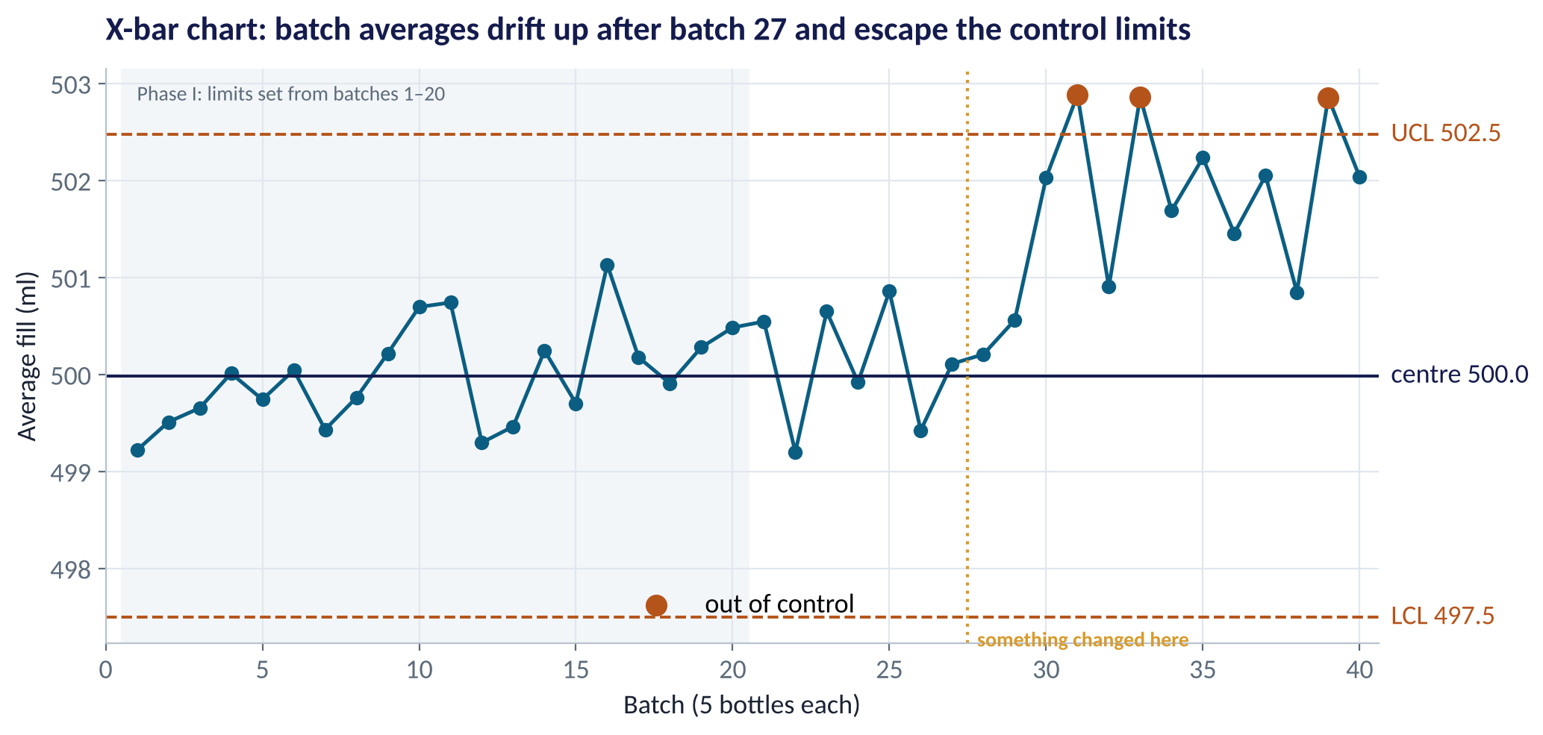
THE SIGNAL
Line 2 Has Shifted
WHAT TO SEE
Batches 1–27 move randomly around 500 ml: common cause.
From batch 28 the average sits higher; batches 31, 33 and 39 break the upper limit.
A special cause: check the filler valve settings, maintenance log, shift change.
The chart caught it while every single bottle was still within specification.
Fig S5.3-F02 · replicate: tdbg_5_3_figures.R / .py
SESSION 5.3 · RUNNING THE BUSINESS RESPONSIBLY
11

Slide 12
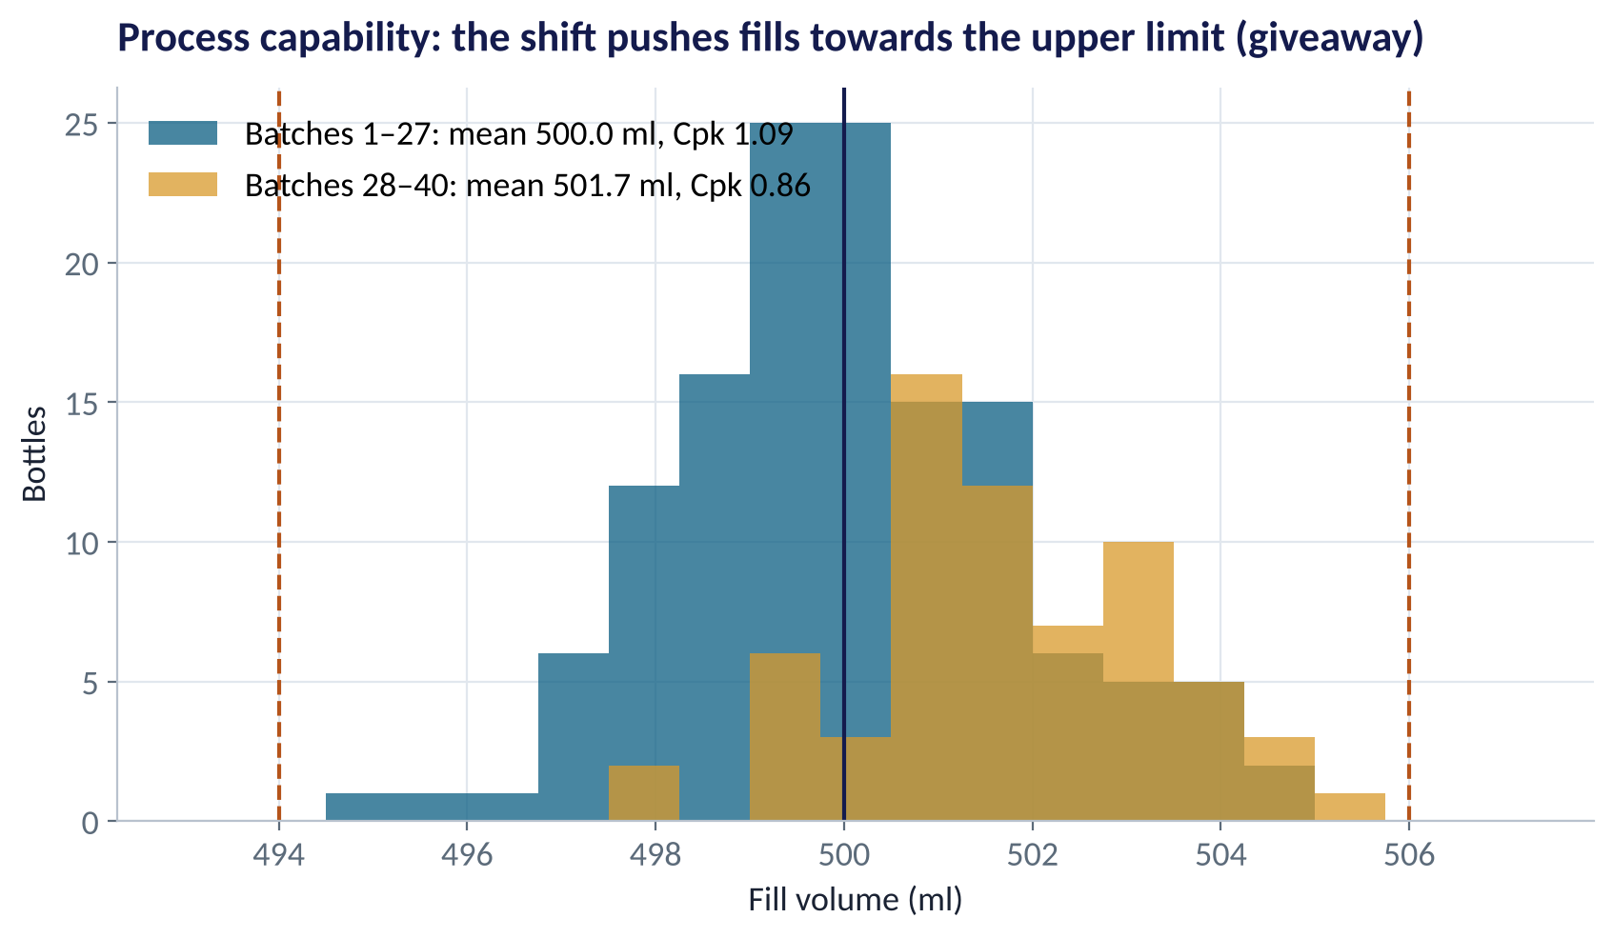
CAPABILITY
Can the Process Meet the Specification?
WHAT TO SEE
Cpk measures how many '3-sigma' widths fit between the mean and the nearest spec limit.
Before the shift: Cpk 1.09. After: 0.86, closer to the upper limit.
Targets: Cpk ≥ 1.33 is the usual standard; ≥ 1.0 is the bare minimum.
1.7 ml × 200,000 bottles a day ≈ 340 litres given away daily.
Fig S5.3-F03 · replicate: tdbg_5_3_figures.R / .py
SESSION 5.3 · RUNNING THE BUSINESS RESPONSIBLY
12

Slide 13
INVENTORY
When to Reorder, and How Much Safety Stock
IN PLAIN ENGLISH
THE FORMULA
reorder point = demand × lead time
+ z × σ × √lead time
Reorder when stock falls to the reorder point: the demand you expect during the supplier's lead time, plus safety stock to cover bad luck. Safety stock grows with demand variability, lead time and the service level you want.
WHY A MANAGER CARES
Too little stock loses sales and customers; too much ties up cash, which is expensive at Nigerian interest rates. Safety stock is the price of uncertainty.
EXAMPLE
Demand 120 cases/day (σ = 40), lead time 6 days, 95% service (z = 1.65): 720 + 1.65 × 40 × √6 ≈ 720 + 161 = 881 cases.
SESSION 5.3 · RUNNING THE BUSINESS RESPONSIBLY
13

Slide 14
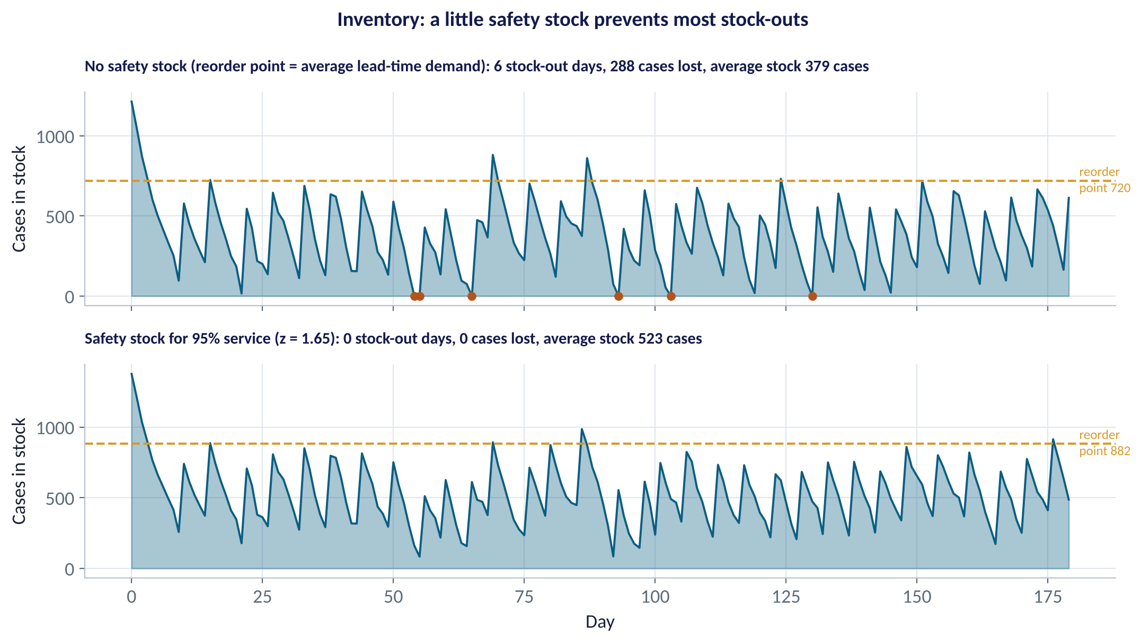
SIMULATE IT
Safety Stock in Action
WHAT TO SEE
Same 180 days of random demand, two reorder policies.
No safety stock: 6 stock-out days, 288 cases of lost sales.
Safety stock (z = 1.65): no stock-outs, at the cost of about 140 more cases on the shelf on average.
The manager's choice: the cost of lost sales vs the cost of holding stock.
Fig S5.3-F04 · replicate: tdbg_5_3_figures.R / .py
SESSION 5.3 · RUNNING THE BUSINESS RESPONSIBLY
14

Slide 15
PART
02
People Analytics
Why employees leave, and what it costs.

Slide 16
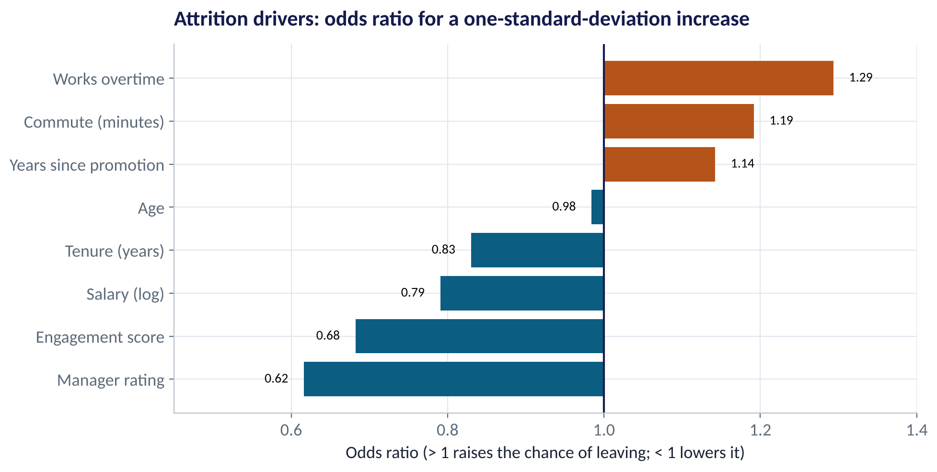
DRIVERS
Why Do Employees Leave?
WHAT TO SEE
Manager rating and engagement: the strongest protectors.
Overtime, long commutes and years without promotion raise attrition.
Higher pay lowers it, but less than people expect.
Test AUC 0.69: people are harder to predict than machines, so use the model for priorities, not verdicts.
Fig S5.3-F05 · replicate: tdbg_5_3_figures.R / .py
SESSION 5.3 · RUNNING THE BUSINESS RESPONSIBLY
16

Slide 17
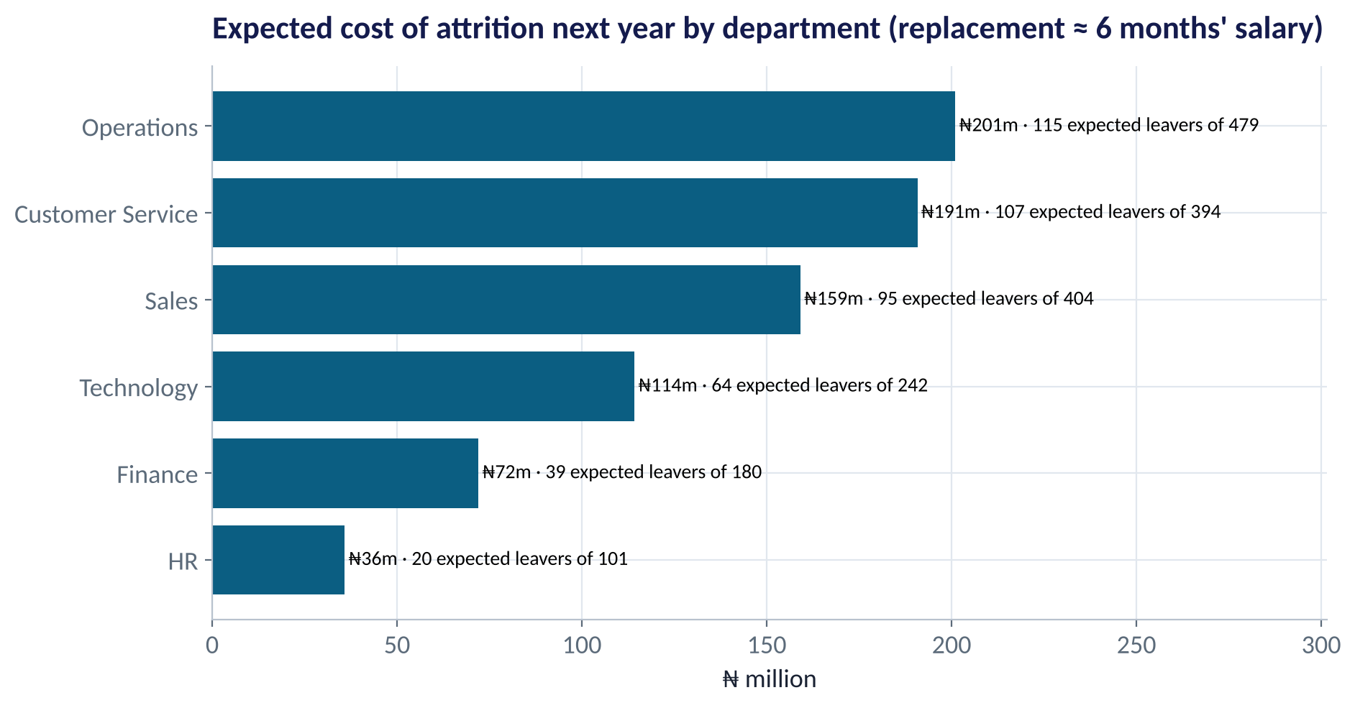
THE BUSINESS CASE
What Attrition Costs, by Department
WHAT TO SEE
Replacing an employee costs about 6 months' salary (hiring, training, lost output).
Operations and Customer Service: about ₦200m each in expected cost next year.
Expected leavers come from the model's probabilities.
Spend retention budget where expected cost is highest, and drivers are fixable.
Fig S5.3-F07 · replicate: tdbg_5_3_figures.R / .py
SESSION 5.3 · RUNNING THE BUSINESS RESPONSIBLY
17

Slide 18
PART
03
Responsible AI
Fair, transparent, accountable.

Slide 19
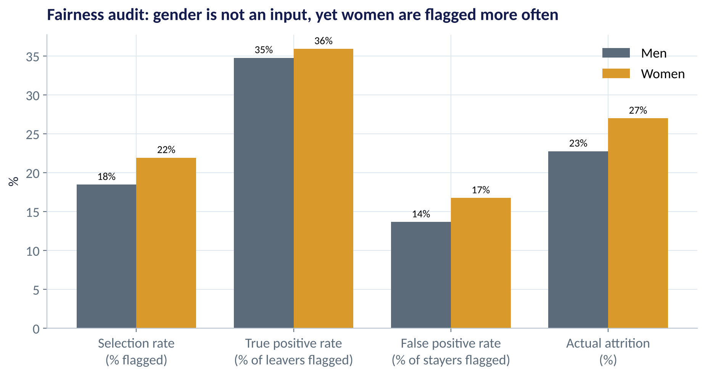
FAIRNESS AUDIT
Is the Attrition Model Fair to Women?
WHAT TO SEE
Gender is not a model input. Yet 22% of women are flagged vs 18% of men.
Selection-rate ratio 18 ÷ 22 = 0.84: passes the 'four-fifths' rule, but only just.
True-positive rates are similar (35–36%); false positives are higher for women (17% vs 14%).
Why? Women here are paid about 10% less, and pay drives attrition. Salary is a proxy.
Fig S5.3-F06 · replicate: tdbg_5_3_figures.R / .py
SESSION 5.3 · RUNNING THE BUSINESS RESPONSIBLY
19

Slide 20
THREE WAYS TO DEFINE FAIR
Fairness Metrics Disagree
Metric | Question it asks | Our model (women vs men)
Demographic parity | Are both groups flagged at the same rate? | 22% vs 18%: not equal
Equal opportunity | Among real leavers, is each group caught equally? | 36% vs 35%: about equal
Equal false-positive rate | Among stayers, is each group wrongly flagged equally? | 17% vs 14%: not equal
Four-fifths rule | Is the lower selection rate at least 80% of the higher? | 0.84: passes
When base rates differ between groups, you cannot satisfy all fairness metrics at once. Choosing one is a business and ethical decision, not a technical one.
SESSION 5.3 · RUNNING THE BUSINESS RESPONSIBLY
20

Slide 21




RESPONSIBLE AI
Six Principles Before a Model Touches People
Fairness
Transparency
Accountability
Audit outcomes and error rates by gender, age, region, ethnicity.
Explain what drives a score (Session 4.1); tell people a model is used.
A named owner signs off and answers for the model's decisions.
Privacy
Human oversight
Monitoring
Collect the minimum; get consent; comply with the Nigeria Data Protection Act 2023.
People can question, appeal and override automated decisions.
Re-check accuracy and fairness regularly; data and behaviour drift.
SESSION 5.3 · RUNNING THE BUSINESS RESPONSIBLY
21

Slide 22


WHERE MANAGERS GO WRONG
Operations, People & Responsible-AI Mistakes
THE TRAP
THE BETTER HABIT
Adjusting the machine after every odd reading.
Act only on special-cause signals from a control chart.
Confusing control limits with specification limits.
Control = what the process does; spec = what customers need.
Holding the same safety stock for every product.
Set it by demand variability, lead time and service level.
Assuming a model is fair because gender isn't an input.
Audit outcomes: proxies like pay carry bias.
Using attrition scores to punish employees.
Use them to support people: development, workload, manager coaching.
SESSION 5.3 · RUNNING THE BUSINESS RESPONSIBLY
22

Slide 23

CONCEPT CHECK
Quick Check: What Would You Say?
Your HR model doesn't use age. Employees over 45 are flagged 'low potential' at half the rate of those under 30 — but because 'years since promotion' is an input. What's the best response?
A
Nothing: age isn't in the model
B
Remove the model entirely
C
Investigate the proxy, measure group outcomes and error rates, and decide with HR and legal how the score may be used
D
Add age as an input to correct it
Discuss with your neighbour for 60 seconds — answer and reasoning in the speaker notes.
SESSION 5.3 · RUNNING THE BUSINESS RESPONSIBLY
23

Slide 24



HANDS-ON LAB
Lab: Bottling Line and HR Fairness Audit
1
Compute batch averages and ranges; set X-bar limits from batches 1–20; find out-of-control batches.
YOU WILL NEED
Data
2
Calculate Cpk before and after the shift.
data/bottling_fill_volumes.csv
data/hr_employees.csv
3
Compute safety stock and the reorder point for a 95% service level.
R script
sessions/5-3/R/tdbg_5_3_lab.R
4
Fit the attrition model (without gender); read the odds ratios and AUC.
Python script
Audit the model: selection, true- and false-positive rates by gender; check the four-fifths rule.
sessions/5-3/python/tdbg_5_3_lab.py
5
Deliverable: a memo to the COO (one paragraph on Line 2) and to the CHRO (one paragraph on the model's fairness and how it should be used).
⏱ 25 minutes
SESSION 5.3 · RUNNING THE BUSINESS RESPONSIBLY
24

Slide 25
WORDS TO OWN
Today's Vocabulary in Plain English
Common cause
Normal, random variation of a stable process.
Safety stock
Extra stock that covers demand and lead-time uncertainty.
Special cause
Variation from a specific, fixable change.
Attrition
Employees leaving the organisation.
Control chart
Plot with limits that separate signal from noise.
Proxy variable
An input that stands in for a protected attribute.
Cpk
Process capability vs specification limits; ≥ 1.33 is good.
Demographic parity
Equal selection rates across groups.
Reorder point
Stock level that triggers a new order.
Four-fifths rule
Lower group's selection rate ≥ 80% of the higher's.
SESSION 5.3 · RUNNING THE BUSINESS RESPONSIBLY
25

Slide 26
KEY TAKEAWAYS
Session 5.3 in 5 Ideas
01
Control charts separate signals from noise: Line 2 shifted at batch 28.
02
Capability (Cpk) asks if the process meets the spec: 1.09 → 0.86.
03
Safety stock is the price of uncertainty: set it by variability, lead time and service.
04
Attrition follows managers, engagement and workload; price it by department.
05
Leaving out gender isn't enough: audit outcomes, choose a fairness metric, govern how scores are used.
NEXT › Session 5.4: Capstone: From Question to Recommendation
Before next session: Revise Sessions 4.3–5.3 for the Module 3 practice paper. Re-run one lab in each session and write one sentence on the business decision each analysis supports.

