Slide 1
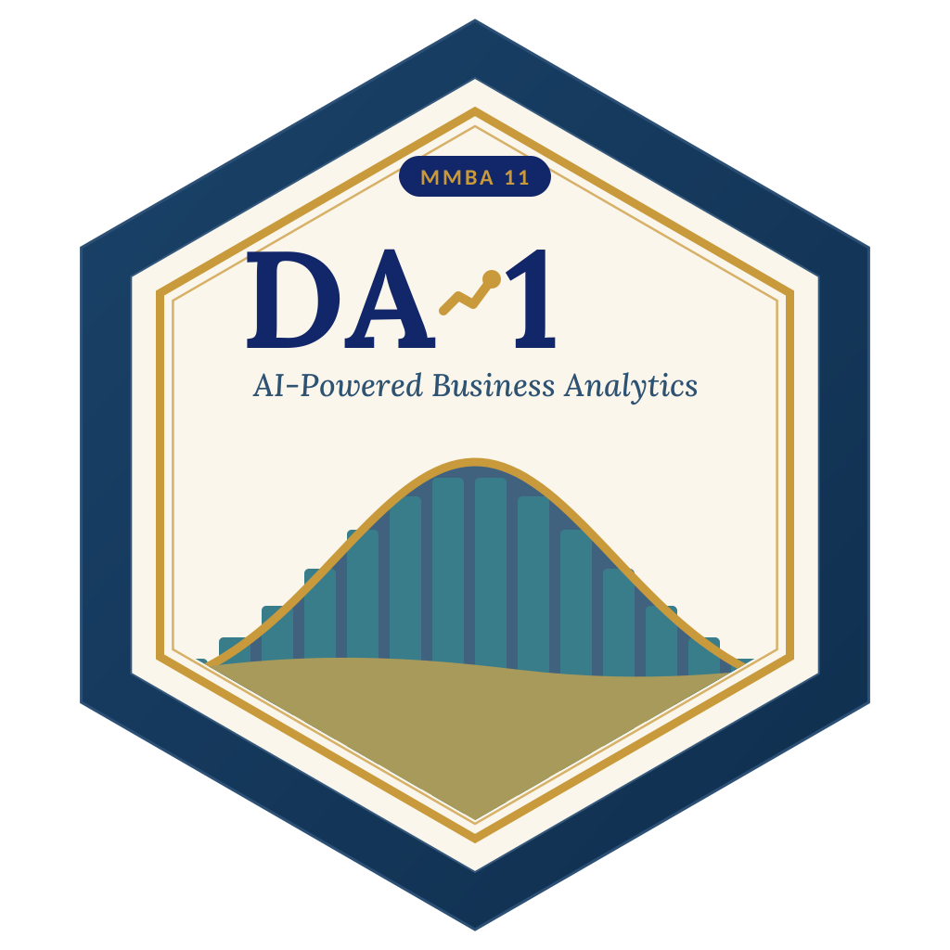

LAGOS BUSINESS SCHOOL · TURNING DATA INTO BUSINESS GROWTH · DAY 5
SESSION 5.4
Capstone: From Question
to Recommendation
Capstone Presentations & Building Your Analytics Practice
Source: All chapters — Chapter 64: Building Your Analytics Practice
AI-Powered Business Analytics: A Practical Textbook for Data-Driven Decision Making · Prof. Bongo Adi

Slide 2

WHERE WE ARE
Programme Roadmap — Days 2 to 5
Three modules across four days, a self-study practice paper for each, and the capstone defence on Friday.
YOU ARE HERE
Module 1
Module 2
Module 3
Finale
Sessions 2.1–3.1
Sessions 3.2–4.2
Sessions 4.3–5.3
Session 5.4
Practice paper — self-study
Practice paper — self-study
Practice paper — self-study
Capstone
Foundations & Inference: data literacy, statistics, EDA, visualisation, hypothesis & A/B testing
Predictive & Unsupervised: regression, classification, ensembles, explainability, clustering & PCA
Advanced & Applied: time series, text, recommendation, neural nets & GenAI, customer, risk, operations & people
Team capstone defence before an external panel
SESSION 5.4 · CAPSTONE: FROM QUESTION TO RECOMMENDATION
2

Slide 3




TODAY'S PLAN
Session 5.4 at a Glance — 75 Minutes
From question to recommendation: show what you can do.
10'
45'
15'
5'
Course Wrap-Up
Capstone Presentations
Final Exam Briefing
Close
The whole journey on one page
Teams present; peers and faculty question
Blueprint, sample question, tips
Building your analytics practice
SESSION 5.4 · CAPSTONE: FROM QUESTION TO RECOMMENDATION
3

Slide 4



BY THE END OF TODAY
Session 5.4 Learning Objectives
You will be able to:
01
02
03
Connect the Toolkit
Present a Recommendation
Prepare for the Final
See how every method in the course fits one question-to-decision process.
Defend a data-driven recommendation, its value in naira and its risks.
Know the exam blueprint and how integrative questions are marked.
SESSION 5.4 · CAPSTONE: FROM QUESTION TO RECOMMENDATION
4

Slide 5
PART
01
The Journey
Twenty-two sessions, one way of thinking.

Slide 6
THREE MODULES
What You Can Now Do
Module | Sessions | You can now…
1 · Foundations | 2.1–3.1 + Practice Paper 1 | Frame a business problem; summarise, clean and visualise data; test hypotheses; run and read an A/B test
2 · Predictive & unsupervised | 3.2–4.2 + Practice Paper 2 | Build and judge regression, classification, trees and ensembles; explain models with SHAP; segment with clustering and PCA
3 · Advanced & applied | 4.3–5.3 + Practice Paper 3 | Forecast; analyse text; find basket rules; judge neural nets and GenAI; value customers; detect fraud; control quality; audit fairness
Capstone & final | 5.4 | Take a real problem from question to recommendation, and defend it
SESSION 5.4 · CAPSTONE: FROM QUESTION TO RECOMMENDATION
6

Slide 7







ONE PROCESS
Every Analysis Follows the Same Seven Steps
›
›
›
›
›
›
Question
Data
Explore
Model
Value
Check
Communicate
What decision? What does success look like in naira?
Load, check, clean; write down every change
Summaries and charts before any model
Simple benchmark first; judge on held-out data
Turn predictions into a decision rule and naira
Fairness, sensitivity, what could go wrong
One chart, one recommendation, one risk
This is the structure of the capstone starter script, and the structure markers look for in your presentation.
SESSION 5.4 · CAPSTONE: FROM QUESTION TO RECOMMENDATION
7

Slide 8
PART
02
The Capstone
Question to recommendation, as a team.

Slide 9


THE BRIEF
Capstone Project: What's Required
Teams of 4–5.
A real decision
Real or realistic data
From a team member's organisation or a public Nigerian/African dataset: pricing, churn, credit, demand, staffing, marketing, operations.
At least 1,000 rows. Anonymise personal data; get permission for company data (NDPA).
Reproducible analysis
10-minute presentation
An R or Python script (or both) that runs from raw data to every chart in your deck.
Plus 5 minutes of questions. Submit the deck, script and a 2-page executive memo.
SESSION 5.4 · CAPSTONE: FROM QUESTION TO RECOMMENDATION
9

Slide 10
MARKING
Capstone Rubric
Criterion | Weight | What excellent looks like
Problem framing | 15% | A specific decision, a success metric in naira, a clear 'so what'
Data & preparation | 15% | Sources explained; cleaning logged; limitations stated honestly
Method choice & execution | 25% | A benchmark and a challenger; fair test on held-out data; right metrics
Business value | 20% | Predictions turned into a decision rule with naira value and sensitivity
Responsible use | 10% | Fairness, privacy and risks checked; human oversight described
Communication | 15% | One clear storyline; readable charts; confident, honest answers to questions
SESSION 5.4 · CAPSTONE: FROM QUESTION TO RECOMMENDATION
10

Slide 11



THE 10-MINUTE STORY
How to Structure Your Presentation
1 min · The decision
What decision, who makes it, and what it's worth to get it right.
1 min · The data
Where it came from, how much, what you had to fix, what's missing.
2 min · What we found
Two or three insights from exploration, each with one chart.
2 min · The model
Benchmark vs challenger on test data; why you chose the one you did.
2 min · The value
The decision rule and its naira value, with a sensitivity check.
2 min · Recommendation & risks
What to do on Monday, what could go wrong, how you'd monitor it.
SESSION 5.4 · CAPSTONE: FROM QUESTION TO RECOMMENDATION
11

Slide 12
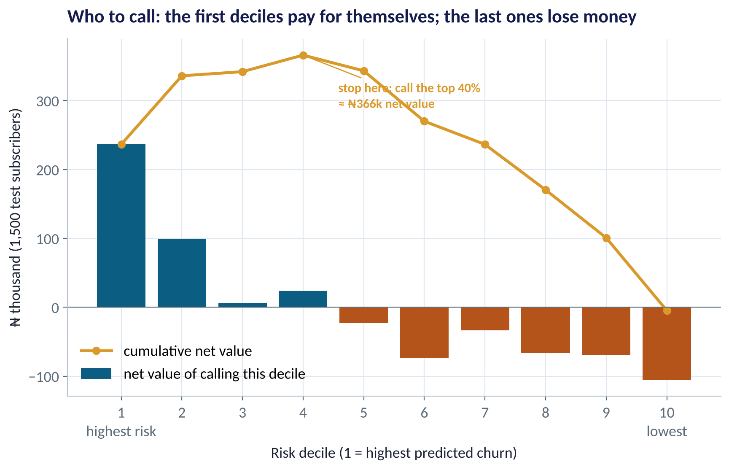
THE ONE CHART
The Chart That Sells the Recommendation
WHAT TO SEE
Worked example in the capstone starter: who should the retention team call?
Rank subscribers by predicted churn; value each decile in naira.
The first 4 deciles pay for themselves; the rest lose money.
Recommendation: call the top 40% ≈ ₦366k net per 1,500 subscribers, and test it against a holdout.
Fig S5.4-F01 · replicate: tdbg_5_4_capstone_starter.R / .py
SESSION 5.4 · CAPSTONE: FROM QUESTION TO RECOMMENDATION
12

Slide 13



HANDS-ON LAB
Your Starting Point: The Capstone Starter Script
1
State the decision, the action's cost and the value of success as named assumptions at the top.
YOU WILL NEED
Data
2
Load, check and clean the data; print the base rate.
data/telecom_churn.csv
(replace with your data)
3
Explore two or three drivers against the outcome.
R script
sessions/5-4/R/tdbg_5_4_capstone_starter.R
4
Fit a simple benchmark and one challenger; compare on held-out data.
Python script
Value the decision by decile; check fairness and sensitivity; save the one chart.
sessions/5-4/python/tdbg_5_4_capstone_starter.py
5
Deliverable: your own version of this script, running end to end on your data, submitted with your deck and memo.
⏱ Use from week 1
SESSION 5.4 · CAPSTONE: FROM QUESTION TO RECOMMENDATION
13

Slide 14


WHERE MANAGERS GO WRONG
Capstone Mistakes We See Every Year
THE TRAP
THE BETTER HABIT
Starting with a technique ('let's use a neural net').
Start with a decision; choose the simplest method that answers it.
Twenty charts and no recommendation.
One storyline: decision → insight → value → action.
Reporting accuracy on training data.
Benchmark vs challenger on held-out data.
No naira figure, or one with hidden assumptions.
State assumptions; show a sensitivity check.
Hiding the data's weaknesses.
Say what's missing and how it could change the answer.
SESSION 5.4 · CAPSTONE: FROM QUESTION TO RECOMMENDATION
14

Slide 15
PART
03
The Final Examination
Comprehensive and integrative.

Slide 16
BLUEPRINT
Final Exam: Structure and Coverage
Section | Weight | Format | Covers
A · Concepts | 20% | Short answers and multiple choice (closed book) | All sessions
B · Read the output | 35% | Interpret R/Python output and charts | Testing, regression, classification, forecasting, segmentation
C · Integrative case | 45% | A Nigerian business case: choose methods, interpret results, recommend, assess risks | Combines at least three modules' tools
25% of the final grade. 2 hours. Sections B and C are open-resource; no AI assistants. Marks reward judgement and business interpretation, not memorised formulas.
SESSION 5.4 · CAPSTONE: FROM QUESTION TO RECOMMENDATION
16

Slide 17


SAMPLE SECTION C QUESTION
A Lagos Supermarket Chain Wants to Cut Stock-Outs
The situation
The decision question
A 25-store supermarket chain loses sales to empty shelves, especially in December. It has 6 years of weekly sales by store and product, loyalty-card baskets, and store temperature and staffing logs.
(a) Which methods would you use to forecast demand and set stock levels? (b) How would you use basket data? (c) How would you know your plan worked? (d) Name two risks.
The data we have
What a good answer looks like
Weekly sales (store × product), loyalty baskets, staffing and temperature logs.
A forecasting-plus-inventory plan, a cross-sell idea, an evaluation design, and the risks, all in business language.
SESSION 5.4 · CAPSTONE: FROM QUESTION TO RECOMMENDATION
17

Slide 18
SAMPLE SECTION A
Sample Integrative Question
A fintech's new credit model has a higher AUC than the old one, but approves 30% fewer applicants from northern states. What should happen before deployment?
A
Deploy: higher AUC means a better model
B
Audit outcomes and error rates by region, investigate proxies, estimate the profit and fairness trade-off, and agree governance
C
Remove the region column and deploy
D
Keep the old model forever
Discuss with your neighbour for 60 seconds — answer and reasoning in the speaker notes.
SESSION 5.4 · CAPSTONE: FROM QUESTION TO RECOMMENDATION
18

Slide 19




EXAM TIPS
How to Earn the Marks
Answer the question asked
Show your working
Put it in naira
Underline the decision in the question; end every answer with what the manager should do.
Write the formula, the numbers and the result: partial credit is generous.
Translate statistics into money, customers or risk wherever you can.
Name a limitation
Watch the clock
Practise with the papers
Correlation vs causation, data quality, sample size, drift: one well-chosen caveat earns marks.
Marks ≈ minutes. Don't spend 20 minutes on a 5-mark question.
Re-run the Practice Papers 1, 2 and 3 practice papers; model answers are in the speaker notes.
SESSION 5.4 · CAPSTONE: FROM QUESTION TO RECOMMENDATION
19

Slide 20
PART
04
Building Your Analytics Practice
Chapter 64: what happens after the course.

Slide 21



THE NEXT 90 DAYS
Turn the Course Into Results at Work
Pick one decision
Run one experiment
Choose one recurring decision in your unit and measure how it's made today. Then improve it with data.
A/B test one change (price, message, layout, process) and let the data decide.
Build the team habit
Govern AI use
Ask for the benchmark, the test-set result and the naira value in every analysis presented to you.
Agree data, privacy and fairness rules (NDPA) before models touch customers or staff.
SESSION 5.4 · CAPSTONE: FROM QUESTION TO RECOMMENDATION
21

Slide 22
KEY TAKEAWAYS
Turning Data into Business Growth in Five Ideas
01
Start with the decision, not the data or the technique.
02
Understand variation: averages hide spread, samples carry uncertainty, noise isn't signal.
03
Judge every model on held-out data against a simple benchmark.
04
Translate results into naira, customers and risk and a clear action.
05
Use AI responsibly: verify, audit for fairness, keep a human accountable.
NEXT › Capstone defences at 16:15. Go and build!
Keep learning: The textbook, all decks, data and R/Python scripts stay available at markanalytics.online. Revisit any lab with your own organisation's data.

