Slide 1


LAGOS BUSINESS SCHOOL · TURNING DATA INTO BUSINESS GROWTH · SELF-STUDY
PRACTICE PAPER 1
Module 1 Review:
Foundations & Inference
Module 1 Review — Foundations & Inference
Source: Chapters 6–12 (Sessions 2.1–3.1)
AI-Powered Business Analytics: A Practical Textbook for Data-Driven Decision Making · Prof. Bongo Adi

Slide 2





TODAY'S PLAN
Practice Paper 1 — Module 1 Practice Paper (75 Minutes)
Use this deck in the revision session before the test, or for self-study.
5'
25'
30'
15'
Briefing
Section A
Section B
Section C
Format, rules, what's allowed
15 conceptual questions (30%)
Interpret statistical output (40%)
Applied design / decision task (30%)
PRACTICE PAPER 1 · MODULE 1 REVIEW: FOUNDATIONS & INFERENCE
2

Slide 3



THE RULES
How the Module 1 Practice Paper Works
Ungraded — a self-check. Covers Sessions 2.1–3.1 (Chapters 6–12).
Open resource for B and C
Laptop allowed
AI assistants
Show your reasoning
Notes, slides, the textbook and your own scripts are allowed for Sections B and C. Section A is closed-book.
Bring R or Python ready. You may rerun course scripts, but Section B output is provided.
Not permitted during the test. You must be able to explain every answer yourself.
Marks go to the reasoning and the business interpretation, not just the final number.
PRACTICE PAPER 1 · MODULE 1 REVIEW: FOUNDATIONS & INFERENCE
3

Slide 4
REVISION
01
Module 1 on a Page
Six sessions, the ideas that matter most.

Slide 5
THE BIG IDEAS
What Each Session Taught
Session | Core idea | Typical exam question
2.1 · Analytics mindset | Value chain; four analytics questions; data types & scales; data quality | Which summary is valid for this column? What type of analytics is this?
2.2 · Statistical foundations | Probability rules, Bayes; mean vs median; SD, IQR; CLT; SE; confidence intervals | Interpret a CI; spot the base-rate trap; choose mean or median
2.3 · EDA | Profile → quality → clean → explore; outliers vs errors; missing data | What is wrong with this file? How would you treat it?
2.4 · Visualisation | Chart chooser; declutter; honest axes; data stories | Critique this chart; pick the right chart for this question
2.5 · Hypothesis testing | H₀/H₁; p-value meaning; Type I/II; t, proportion, chi-square; unit of analysis | Read this test output and state the business conclusion
3.1 · A/B testing | Randomisation; primary & guardrail metrics; sample size; SRM; peeking | Design a test; read an experiment and recommend
PRACTICE PAPER 1 · MODULE 1 REVIEW: FOUNDATIONS & INFERENCE
5

Slide 6
FORMULA SHEET
The Few Formulas You Need
Quantity | Formula | In words
Mean | x̄ = Σx ÷ n | Add up, divide by how many
Standard deviation | s = √[Σ(x − x̄)² ÷ (n − 1)] | Typical distance from the mean
Standard error | SE = s ÷ √n | How much the average would wobble between samples
95% confidence interval | x̄ ± 1.96 × SE | An honest range for the true average
z-score | z = (x − mean) ÷ SD | How many SDs from typical
Conditional probability | P(A | B) = P(A and B) ÷ P(B) | Chance of A among cases where B happened
Expected value | E(X) = Σ x · P(x) | Long-run average outcome
Sample size (rule of thumb) | n ≈ 16 p(1 − p) ÷ MDE² | Users per group for 80% power, α = 5%
PRACTICE PAPER 1 · MODULE 1 REVIEW: FOUNDATIONS & INFERENCE
6

Slide 7


WHERE MARKS ARE LOST
Common Errors in Past Module 1 Practice Papers
THE TRAP
THE BETTER HABIT
“p = 0.04 means there is a 4% chance the null is true.”
It's the chance of data this extreme if H₀ were true.
Reporting the mean for income or basket data without comment.
Note the skew; report the median (and IQR) too.
“Not significant, so there is no difference.”
Fail to reject H₀; report the CI — it may include useful effects.
Concluding causation from an observational comparison.
Only randomised comparisons support causal claims.
Giving a number with no business meaning.
Always end with so what for the decision-maker.
PRACTICE PAPER 1 · MODULE 1 REVIEW: FOUNDATIONS & INFERENCE
7

Slide 8
PRACTICE PAPER
02
Section A — Concepts
Five sample questions. Answers in the speaker notes.

Slide 9

SECTION A · Q1
Section A · Question 1
A column records customer satisfaction as Very poor / Poor / Neutral / Good / Very good. Which summary is most appropriate?
A
The mean score
B
The median and the percentage in each category
C
The standard deviation
D
The coefficient of variation
Discuss with your neighbour for 60 seconds — answer and reasoning in the speaker notes.
PRACTICE PAPER 1 · MODULE 1 REVIEW: FOUNDATIONS & INFERENCE
9

Slide 10
SECTION A · Q2
Section A · Question 2
A fraud model flags 2% of transactions. Fraud occurs in 0.5% of transactions. The model catches 90% of fraud. Roughly what share of flagged transactions are fraud?
A
About 90%
B
About 50%
C
About 22%
D
About 2%
Discuss with your neighbour for 60 seconds — answer and reasoning in the speaker notes.
PRACTICE PAPER 1 · MODULE 1 REVIEW: FOUNDATIONS & INFERENCE
10

Slide 11
SECTION A · Q3
Section A · Question 3
Doubling the sample size (all else equal) changes the width of a 95% confidence interval for a mean by about…
A
Halving it
B
Reducing it by about 29% (÷ √2)
C
No change
D
Doubling it
Discuss with your neighbour for 60 seconds — answer and reasoning in the speaker notes.
PRACTICE PAPER 1 · MODULE 1 REVIEW: FOUNDATIONS & INFERENCE
11

Slide 12
SECTION A · Q4
Section A · Question 4
In an A/B test, the split was 6,300 vs 5,700 users although a 50/50 split was planned. What should you do first?
A
Analyse as normal — larger groups are fine
B
Weight the smaller group up to 6,300
C
Treat it as a sample-ratio mismatch and investigate the assignment before trusting any result
D
Drop 600 users from the larger group at random
Discuss with your neighbour for 60 seconds — answer and reasoning in the speaker notes.
PRACTICE PAPER 1 · MODULE 1 REVIEW: FOUNDATIONS & INFERENCE
12

Slide 13
SECTION A · Q5
Section A · Question 5
A bank pools 400,000 customers' transactions to test a new branch design that was installed in 6 of 12 branches. The p-value is 0.00001. The main concern is…
A
The sample is too small
B
Pseudo-replication: branches, not customers, were assigned — only 12 independent units
C
The p-value is too small to be believable
D
Customers should have been surveyed instead
Discuss with your neighbour for 60 seconds — answer and reasoning in the speaker notes.
PRACTICE PAPER 1 · MODULE 1 REVIEW: FOUNDATIONS & INFERENCE
13

Slide 14
PRACTICE PAPER
03
Section B — Interpret the Output
Data: hr_attrition_salary.csv — 300 employees of a Lagos services firm.

Slide 15
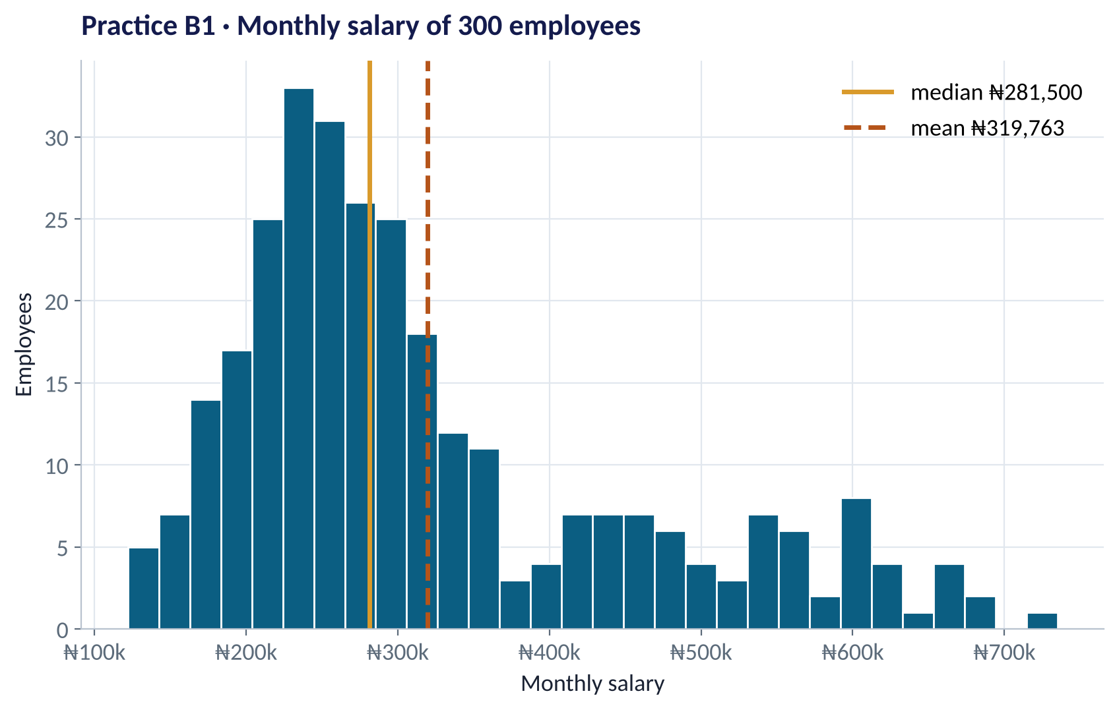
SECTION B · Q1 (8 MARKS)
Describe Monthly Salary
QUESTIONS
(a) Describe the shape of the distribution. [2]
(b) Mean ₦319,763; median ₦281,500. Which would you report as the 'typical' salary, and why? [3]
(c) The 95% CI for the mean is ₦304,729 to ₦334,798. Interpret it for the HR director. [3]
Fig PP1-F01 · replicate: tdbg_pp1_practice_paper.R / .py
PRACTICE PAPER 1 · MODULE 1 REVIEW: FOUNDATIONS & INFERENCE
15

Slide 16
SECTION B · Q2 (12 MARKS)
Do Leavers Have Lower Engagement?
R OUTPUT
1
(a) State H₀ and H₁ [2]
> t.test(engagement_score ~ attrited, data = h)
Welch Two Sample t-test
data: engagement_score by attrited
t = 8.7796, df = 65.626, p-value = 1.122e-12
alternative hypothesis: true difference in
means between group 0 and group 1 is not
equal to 0
95 percent confidence interval:
1.711766 2.719607
sample estimates:
mean in group 0 mean in group 1
6.615686 4.400000
In words, for this HR question.
2
(b) Effect size and CI [4]
How big is the difference, and how precisely is it known?
3
(c) Conclusion [3]
What do you conclude at α = 5%? Use the p-value correctly.
4
(d) Causation? [3]
Can HR claim low engagement causes attrition? Explain.
PRACTICE PAPER 1 · MODULE 1 REVIEW: FOUNDATIONS & INFERENCE
16

Slide 17
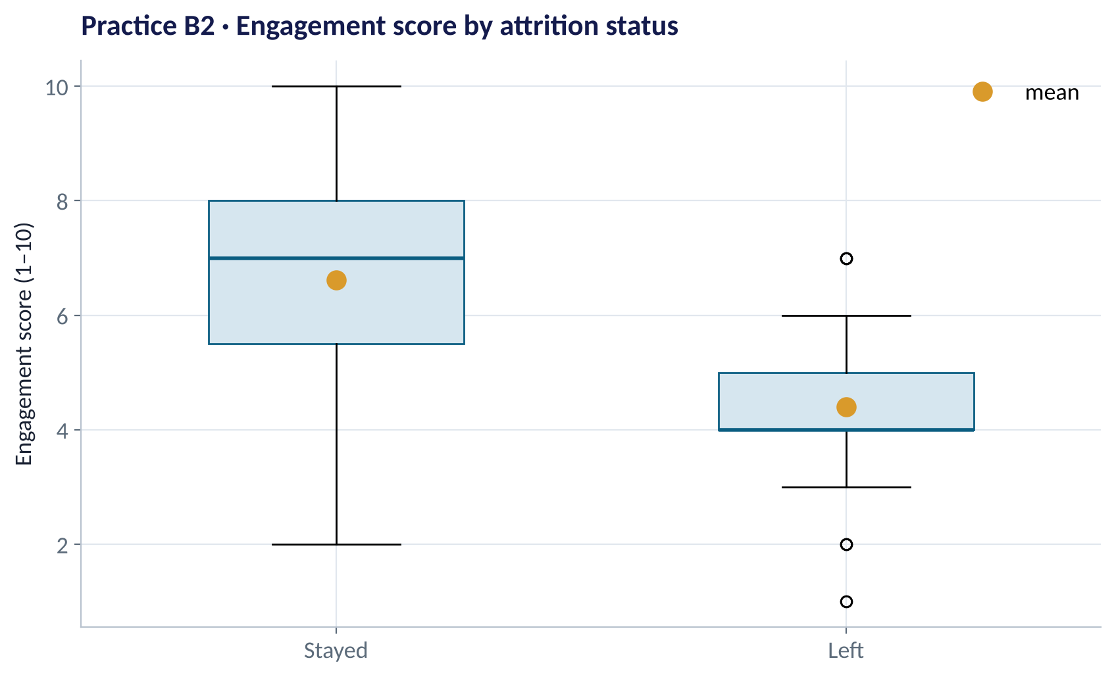
SECTION B · Q2 (CONTINUED)
The Same Comparison as a Picture
ALSO ASKED
(e) Which chart type is this, and what does the box show? [2]
(f) Suggest one improvement to make this chart clearer for the board. [2]
Fig PP1-F02 · replicate: tdbg_pp1_practice_paper.R / .py
PRACTICE PAPER 1 · MODULE 1 REVIEW: FOUNDATIONS & INFERENCE
17

Slide 18
SECTION B · Q3 (10 MARKS)
Is Attrition Related to Department?
R OUTPUT
1
(a) Rates [3]
> table(h$department, h$attrited)
0 1
Customer Support 66 11
Engineering 53 12
Finance 23 1
Operations 38 12
Sales 75 9
> chisq.test(tab)
Pearson's Chi-squared test
X-squared = 7.2374, df = 4,
p-value = 0.1239
Warning message:
Chi-squared approximation may
be incorrect
Compute the attrition rate in Operations and Finance.
2
(b) Conclusion [3]
Is there evidence attrition differs by department at α = 5%?
3
(c) The warning [2]
Why does R warn us? (Hint: expected counts.)
4
(d) Advice [2]
What would you tell the HR director about Operations?
PRACTICE PAPER 1 · MODULE 1 REVIEW: FOUNDATIONS & INFERENCE
18

Slide 19
PRACTICE PAPER
04
Section C — Applied Task
Design an experiment and make a recommendation.

Slide 20




SECTION C (30 MARKS)
A Nigerian Bank's SMS Reminder Experiment
The situation
The decision question
A retail bank's microloans have a 14% late-payment rate. The collections team proposes a friendly SMS reminder three days before each repayment date.
Design an A/B test to evaluate the SMS (unit, primary metric, guardrails, sample size for a 2-point reduction, duration) and state what result would justify a rollout.
The data we have
What a good answer looks like
About 9,000 repayments fall due each month. Each late payment costs the bank about ₦4,000 in collection effort. Each SMS costs ₦4.
A design table, a sample-size calculation with working, two threats to validity, and a decision rule tied to cost and benefit.
PRACTICE PAPER 1 · MODULE 1 REVIEW: FOUNDATIONS & INFERENCE
20

Slide 21



ON THE DAY
Five Test-Day Habits
Budget your time
Find the key line
Give the size
About 1.5 minutes per mark. Don't over-invest in Section A.
In output, locate the estimate, the CI and the p-value first.
Always state the effect in business units, with its interval.
Check the unit
End with 'so what'
Ask what was assigned and what one row represents.
One sentence a manager could act on, with any caveat.
PRACTICE PAPER 1 · MODULE 1 REVIEW: FOUNDATIONS & INFERENCE
21

Slide 22
KEY TAKEAWAYS
You Are Ready If You Can…
01
Choose the right summary and chart for any column or question.
02
Explain a CI and a p-value in plain English — correctly.
03
Spot bad data, base-rate traps and the wrong unit.
04
Read t-test, proportion and chi-square output and state the business conclusion.
05
Design an A/B test: unit, metrics, sample size, threats, decision rule.
NEXT › Practice Paper 2: Module 2 Review: Prediction & Segmentation
Before next session: After the test: read Chapters 13–14 (Correlation and Linear Regression) to start Module 2.

