Slide 1


LAGOS BUSINESS SCHOOL · TURNING DATA INTO BUSINESS GROWTH · SELF-STUDY
PRACTICE PAPER 2
Module 2 Review: Prediction
& Segmentation
Module 2 Review — Predictive & Unsupervised Modelling
Source: Chapters 13–27 (Sessions 3.2–4.2)
AI-Powered Business Analytics: A Practical Textbook for Data-Driven Decision Making · Prof. Bongo Adi

Slide 2





TODAY'S PLAN
Practice Paper 2 — Module 2 Practice Paper (75 Minutes)
Use this deck for the revision session before the test, or for self-study.
5'
20'
30'
20'
Briefing
Section A
Section B
Section C
Format, rules, what's allowed
Concepts (25%)
Interpret model output (40%)
Applied build-and-interpret task (35%)
PRACTICE PAPER 2 · MODULE 2 REVIEW: PREDICTION & SEGMENTATION
2

Slide 3



THE RULES
How the Module 2 Practice Paper Works
Ungraded — a self-check. Covers Sessions 3.2–4.2 (Chapters 13–27).
Open resource for B and C
Laptop with R or Python
AI assistants
Interpretation earns marks
Slides, textbook, your own scripts. Section A is closed-book.
Section C asks you to fit and interpret a model on a provided file.
Not permitted during the test. Explain every answer yourself.
A correct number with no business meaning earns little.
PRACTICE PAPER 2 · MODULE 2 REVIEW: PREDICTION & SEGMENTATION
3

Slide 4
REVISION
01
Module 2 on a Page
Six sessions, one toolkit for prediction and discovery.

Slide 5
THE BIG IDEAS
What Each Session Taught
Session | Core idea | Typical exam question
3.2 · Regression | r; OLS; coefficients holding others fixed; R²; residuals; dummies | Interpret a coefficient and its CI; read a residual plot
3.3 · Regularisation | Overfitting; bias–variance; train/test; CV; ridge vs lasso | Diagnose train vs test gaps; explain what lasso did
3.4 · Classification | Logistic; odds ratios; confusion matrix; precision/recall; ROC/AUC; profit threshold | Compute metrics from a matrix; choose a threshold
3.5 · Trees & ensembles | Splits; depth; bagging; forests; boosting; importance; partial dependence | Why does a forest beat a tree? Read an importance plot
4.1 · Explainability | Global vs local; SHAP; LIME; limits; lead grades; gains | Explain a SHAP waterfall to a manager
4.2 · Clustering & PCA | Scaling; k-means; elbow/silhouette; profiling; PCA loadings | Name segments from a profile table; why scale?
PRACTICE PAPER 2 · MODULE 2 REVIEW: PREDICTION & SEGMENTATION
5

Slide 6
FORMULA SHEET
The Formulas You Need
Quantity | Formula | In words
Regression prediction | ŷ = b₀ + b₁x₁ + b₂x₂ + … | Intercept plus each driver × its slope
R² | 1 − unexplained ÷ total variation | Share of variation the model explains
Odds ratio | e^coefficient | Times the odds multiply per one-unit change
Recall | TP ÷ (TP + FN) | Share of actual positives caught
Precision | TP ÷ (TP + FP) | Share of flagged cases that were positive
Break-even threshold | gain ÷ (gain + loss) | Approve/act only below (or above) this probability
Standardise | z = (x − mean) ÷ SD | Put drivers on one scale before clustering or penalising
PRACTICE PAPER 2 · MODULE 2 REVIEW: PREDICTION & SEGMENTATION
6

Slide 7


WHERE MARKS ARE LOST
Common Errors in Module 2 Answers
THE TRAP
THE BETTER HABIT
“The coefficient proves advertising causes sales.”
Association, holding others fixed — causation needs an experiment.
Judging a model on training accuracy.
Use test or cross-validated performance.
“Accuracy 85%, so the churn model is good.”
Compare with the base rate; report recall, precision, AUC.
Reading a logistic coefficient as a % change.
Exponentiate: an odds ratio.
Calling clusters by number.
Profile and name them; give each an action.
PRACTICE PAPER 2 · MODULE 2 REVIEW: PREDICTION & SEGMENTATION
7

Slide 8
PRACTICE PAPER
02
Section A — Concepts
Answers in the speaker notes.

Slide 9

SECTION A · Q1
Section A · Question 1
A model's training RMSE falls as you add 30 more drivers, but its cross-validated RMSE rises. This is a sign of…
A
Underfitting (high bias)
B
Overfitting (high variance)
C
Perfect fit
D
A data entry error
Discuss with your neighbour for 60 seconds — answer and reasoning in the speaker notes.
PRACTICE PAPER 2 · MODULE 2 REVIEW: PREDICTION & SEGMENTATION
9

Slide 10
SECTION A · Q2
Section A · Question 2
Which statement about lasso is TRUE?
A
It always uses every driver
B
It can set some coefficients exactly to zero, selecting drivers
C
It cannot be used with more than 10 drivers
D
Its penalty should be chosen on the test set
Discuss with your neighbour for 60 seconds — answer and reasoning in the speaker notes.
PRACTICE PAPER 2 · MODULE 2 REVIEW: PREDICTION & SEGMENTATION
10

Slide 11
SECTION A · Q3
Section A · Question 3
In a churn model, 'complaints' has an odds ratio of 2.10. Best interpretation?
A
Each complaint raises churn probability by 2.1 percentage points
B
Each complaint roughly doubles the odds of churning, holding other drivers fixed
C
Complaints explain 21% of churn
D
Customers with complaints always churn
Discuss with your neighbour for 60 seconds — answer and reasoning in the speaker notes.
PRACTICE PAPER 2 · MODULE 2 REVIEW: PREDICTION & SEGMENTATION
11

Slide 12
SECTION A · Q4
Section A · Question 4
Why does a random forest usually beat a single deep decision tree on test data?
A
Each of its trees is shallower
B
Averaging many de-correlated trees cancels their individual errors, reducing variance
C
It uses logistic regression inside
D
It is trained on the test data
Discuss with your neighbour for 60 seconds — answer and reasoning in the speaker notes.
PRACTICE PAPER 2 · MODULE 2 REVIEW: PREDICTION & SEGMENTATION
12

Slide 13
SECTION A · Q5
Section A · Question 5
Before running k-means on customers' age (years) and balance (₦), you should…
A
Do nothing — k-means handles units
B
Standardise the drivers (and consider logging balance)
C
Remove age
D
Sort the data by balance
Discuss with your neighbour for 60 seconds — answer and reasoning in the speaker notes.
PRACTICE PAPER 2 · MODULE 2 REVIEW: PREDICTION & SEGMENTATION
13

Slide 14
PRACTICE PAPER
03
Section B — Interpret the Output
Reproduce everything with tdbg_pp2_practice_paper.R / .py

Slide 15
SECTION B · Q1 (14 MARKS)
What Explains Monthly Salary?
R OUTPUT
1
(a) Baseline [3]
lm(salary_k ~ tenure_months + engagement_score
+ department, data = h) # salary in ₦'000
Estimate Std.Err t value Pr(>|t|)
(Intercept) 202.701 13.002 15.590 < 2e-16
tenure_months 0.024 0.101 0.234 0.815
engagement_score 0.794 1.973 0.403 0.687
departmentEngineering 322.765 9.746 33.118 < 2e-16
departmentFinance 160.978 13.599 11.838 < 2e-16
departmentOperations 52.154 10.536 4.950 1.3e-06
departmentSales 68.365 9.151 7.471 9.2e-13
Residual standard error: 57.83 on 293 df
Multiple R-squared: 0.8128, Adjusted: 0.809
Which department is the baseline, and what does the intercept mean?
2
(b) Engineering [4]
Interpret 322.765 in naira, in one sentence.
3
(c) Tenure [3]
Is there evidence salary rises with tenure? Use the output.
4
(d) Fit [4]
Interpret R² and the residual standard error for HR.
PRACTICE PAPER 2 · MODULE 2 REVIEW: PREDICTION & SEGMENTATION
15

Slide 16
SECTION B · Q2 (14 MARKS)
Evaluating a Churn Classifier
R OUTPUT
1
(a) Odds ratios [4]
> round(exp(coef(m2)), 2) # odds ratios
(Intercept) tenure_months dropped_calls
0.23 0.96 1.23
complaints multi_sim data_gb_month
2.10 2.52 0.95
planPrepaid
1.67
> table(predicted = p >= 0.3, actual = churned)
actual
predicted 0 1
0 952 153
1 195 200
> auc(te$churned, te$p)
Area under the curve: 0.7815
Interpret multi_sim and tenure_months for the retention director.
2
(b) Metrics [4]
Compute recall, precision and accuracy at threshold 0.3.
3
(c) AUC [2]
What does 0.78 mean in plain English?
4
(d) Threshold [4]
A retention offer costs ₦500; a saved churner is worth ₦4,000. What threshold does break-even suggest?
PRACTICE PAPER 2 · MODULE 2 REVIEW: PREDICTION & SEGMENTATION
16

Slide 17
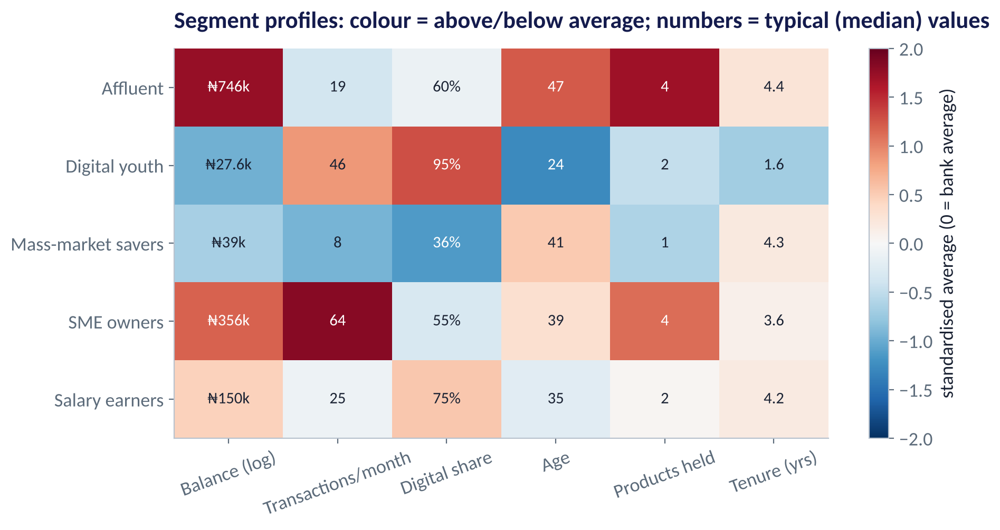
SECTION B · Q3 (12 MARKS)
Name and Act on These Segments
QUESTIONS
(a) Give each of the five segments a short name based on the profile. [5]
(b) Which segment would you target with a working-capital loan? Why? [3]
(c) Why were the drivers standardised before clustering? [2]
(d) Name one risk in using these segments for the next three years. [2]
Fig S4.2-F04 · replicate: tdbg_4_2_figures.R / .py
PRACTICE PAPER 2 · MODULE 2 REVIEW: PREDICTION & SEGMENTATION
17

Slide 18
PRACTICE PAPER
04
Section C — Applied Task
Build, evaluate and recommend.

Slide 19




SECTION C (35 MARKS)
Predict Subscriber Churn for a Telco
The situation
The decision question
A Nigerian mobile operator wants to target retention offers. You receive telecom_churn.csv (5,000 subscribers).
Using rows 1–3,500 to train and 3,501–5,000 to test: fit a logistic regression and one tree-based model, compare them, and recommend which to deploy and at what threshold.
The data we have
What a good answer looks like
tenure, data use, voice minutes, dropped calls, complaints, recharge, multi-SIM, plan type, churned.
A table of test AUCs, the top 3 drivers with interpretation, a profit-based threshold (offer ₦500; saved customer ₦4,000), and a 5-sentence recommendation.
PRACTICE PAPER 2 · MODULE 2 REVIEW: PREDICTION & SEGMENTATION
19

Slide 20
KEY TAKEAWAYS
You Are Ready If You Can…
01
Interpret a regression coefficient, its CI and R² in business units.
02
Explain overfitting and how CV, ridge and lasso guard against it.
03
Compute precision, recall and accuracy from a confusion matrix — and choose a profit threshold.
04
Explain why ensembles beat single trees, and read SHAP explanations.
05
Prepare data for clustering, choose k and turn clusters into named segments.
NEXT › Practice Paper 3: Module 3 Review: Applied Analytics
Before next session: After the test: read Chapters 28–31 (Time Series & Forecasting) to start Module 3.

