Slide 1


LAGOS BUSINESS SCHOOL · TURNING DATA INTO BUSINESS GROWTH · SELF-STUDY
PRACTICE PAPER 3
Module 3 Review:
Applied Analytics
Module 3 Review — Advanced & Applied Analytics
Source: Chapters 23, 28–46, 53–63 (Sessions 4.3–5.3)
AI-Powered Business Analytics: A Practical Textbook for Data-Driven Decision Making · Prof. Bongo Adi

Slide 2





TODAY'S PLAN
Practice Paper 3 — Module 3 Practice Paper (75 Minutes)
Use this deck for the revision session before the test, or for self-study.
5'
20'
30'
20'
Briefing
Section A
Section B
Section C
Format, rules, what's allowed
Concepts (25%)
Interpret outputs and charts (40%)
Applied analysis task (35%)
PRACTICE PAPER 3 · MODULE 3 REVIEW: APPLIED ANALYTICS
2

Slide 3



THE RULES
How the Module 3 Practice Paper Works
Ungraded — a self-check. Covers Sessions 4.3–5.3.
Open resource for B and C
Laptop with R or Python
AI assistants
Naira and decisions earn marks
Slides, textbook, your own scripts. Section A is closed-book.
Section C asks you to run an analysis on a provided file.
Not permitted during the test. Explain every answer yourself.
Every answer should end in a business decision, ideally with a naira figure.
PRACTICE PAPER 3 · MODULE 3 REVIEW: APPLIED ANALYTICS
3

Slide 4
REVISION
01
Module 3 on a Page
Six sessions of applied analytics.

Slide 5
THE BIG IDEAS
What Each Session Taught
Session | Core idea | Typical exam question
4.3 · Time series | Trend + seasonality + noise; backtest vs seasonal naive; MAPE; intervals; simulation | Which forecast to trust? Read an interval
4.4 · Text & sentiment | Tokenise; document–term matrix; lexicon sentiment; TF-IDF; text classifier | Why did the lexicon misread a review?
4.5 · Market basket | Support, confidence, lift; collaborative filtering; cold start | Compute lift; pick a bundle
5.1 · Neural nets & GenAI | Neurons, layers, overfitting; fair contest; CNNs; LLMs; value–risk map | Train vs test AUC gap; where GenAI fits
5.2 · Customer & financial | RFM; CLV; churn ROI; PD × LGD × EAD; precision/recall; cost threshold | Compute CLV or expected loss; set an alert threshold
5.3 · Ops, people & ethics | Control charts; Cpk; safety stock; attrition drivers; fairness metrics | Read a control chart; audit a model
PRACTICE PAPER 3 · MODULE 3 REVIEW: APPLIED ANALYTICS
5

Slide 6
FORMULA SHEET
The Formulas You Need
Quantity | Formula | In words
MAPE | average of |actual − forecast| ÷ actual | Typical % forecast error
Lift | confidence(A → B) ÷ support(B) | How much more likely B is when A is in the basket
CLV | margin × (1 + d) ÷ (1 + d − r) | Lifetime profit in today's money
Expected loss | PD × LGD × EAD | Average loss to provision and price for
Precision / recall | TP ÷ (TP + FP) / TP ÷ (TP + FN) | Alerts that are real / fraud that's caught
Control limits | x̿ ± A₂ × R̄ | Range of normal batch averages
Reorder point | demand × lead time + z × σ × √lead time | Stock level that triggers an order
Four-fifths rule | lower selection rate ÷ higher ≥ 0.8 | A simple test for adverse impact
PRACTICE PAPER 3 · MODULE 3 REVIEW: APPLIED ANALYTICS
6

Slide 7


WHERE MARKS ARE LOST
Common Errors in Module 3 Answers
THE TRAP
THE BETTER HABIT
Choosing a forecast by how good it looks on past data.
Backtest on a held-out period; beat the seasonal-naive benchmark.
Ranking basket rules by confidence alone.
Use lift; check the baseline.
“The neural net is better because it's deep learning.”
Compare on test data; weigh explainability.
Reporting accuracy for fraud.
Report precision, recall and the cost trade-off.
“Gender isn't an input, so the model is fair.”
Audit outcomes by group; watch for proxies.
PRACTICE PAPER 3 · MODULE 3 REVIEW: APPLIED ANALYTICS
7

Slide 8
PRACTICE PAPER
02
Section A — Concepts
Answers in the speaker notes.

Slide 9

SECTION A · Q1
Section A · Question 1
A new forecasting model has a MAPE of 9% on the 2025 test year. The seasonal-naive forecast (same month last year) has 7%. What should you conclude?
A
Use the new model: 9% is low
B
The new model adds no value over a simple benchmark; keep the seasonal naive or improve the model
C
MAPE can't compare models
D
Average the two MAPEs
Discuss with your neighbour for 60 seconds — answer and reasoning in the speaker notes.
PRACTICE PAPER 3 · MODULE 3 REVIEW: APPLIED ANALYTICS
9

Slide 10
SECTION A · Q2
Section A · Question 2
A sentiment lexicon gives “Not bad at all, delivery was not late” a score of −2. Why?
A
The review is negative
B
The lexicon ignores negation: 'not' flips 'bad' and 'late'
C
TF-IDF removed the positive words
D
The review is in Pidgin
Discuss with your neighbour for 60 seconds — answer and reasoning in the speaker notes.
PRACTICE PAPER 3 · MODULE 3 REVIEW: APPLIED ANALYTICS
10

Slide 11
SECTION A · Q3
Section A · Question 3
Rule: Bread → Milk has confidence 45%. 50% of all baskets contain milk. The lift is…
A
0.45: bread buyers buy milk less than average
B
0.9: bread buyers buy milk slightly LESS than average
C
1.11: slightly more than average
D
2.2: strongly more
Discuss with your neighbour for 60 seconds — answer and reasoning in the speaker notes.
PRACTICE PAPER 3 · MODULE 3 REVIEW: APPLIED ANALYTICS
11

Slide 12
SECTION A · Q4
Section A · Question 4
On a customer table, which situation most clearly signals that a neural network is overfitting?
A
Training AUC 0.80, test AUC 0.79
B
Training AUC 0.98, test AUC 0.68
C
Training AUC 0.70, test AUC 0.72
D
It uses ReLU activations
Discuss with your neighbour for 60 seconds — answer and reasoning in the speaker notes.
PRACTICE PAPER 3 · MODULE 3 REVIEW: APPLIED ANALYTICS
12

Slide 13
SECTION A · Q5
Section A · Question 5
A process has Cpk = 0.8 and all recent points are inside the control limits. What's the right description?
A
In control and capable
B
In control, but not capable of meeting the specification reliably
C
Out of control
D
Capable but not in control
Discuss with your neighbour for 60 seconds — answer and reasoning in the speaker notes.
PRACTICE PAPER 3 · MODULE 3 REVIEW: APPLIED ANALYTICS
13

Slide 14
PRACTICE PAPER
03
Section B — Interpret the Output
Reproduce everything with tdbg_pp3_practice_paper.R / .py

Slide 15
SECTION B · Q1 (12 MARKS)
Which Forecast Should the SME Trust?
Python OUTPUT
1
(a) Method [3]
MAPE, 2025 test year
Naive (last month) 31.8%
Seasonal naive 12.0%
Holt-Winters 3.7%
Holt-Winters forecast, next 3 months (₦m),
approx. 80% interval
Jan 2026 99.3 [ 95.3, 103.3]
Feb 2026 93.3 [ 89.3, 97.3]
Mar 2026 102.9 [ 98.9, 106.9]
Explain how these MAPEs were obtained and why the test year matters.
2
(b) Choice [3]
Which method would you use, and why is the naive forecast so poor?
3
(c) Interval [3]
Interpret the February interval for the owner.
4
(d) Decision [3]
The owner must commit to ₦95m of stock for February. Advise using the interval.
PRACTICE PAPER 3 · MODULE 3 REVIEW: APPLIED ANALYTICS
15

Slide 16
SECTION B · Q2 (10 MARKS)
Which Products Should Be Bundled?
Python OUTPUT
1
(a) Read [3]
3000 baskets
rule support confidence lift
Tea -> Sugar 0.081 0.663 3.35
Sugar -> Tea 0.081 0.411 3.35
Diapers -> Beer 0.055 0.396 2.30
Rice -> Detergent 0.012 0.105 0.95
Interpret support, confidence and lift for Tea → Sugar in plain English.
2
(b) Direction [2]
Why do Tea → Sugar and Sugar → Tea have different confidence but the same lift?
3
(c) Rice → Detergent [2]
What does a lift of 0.95 mean?
4
(d) Action [3]
Recommend one bundle and how you would test it before rollout.
PRACTICE PAPER 3 · MODULE 3 REVIEW: APPLIED ANALYTICS
16

Slide 17
SECTION B · Q3 (10 MARKS)
Is the Fraud Alert Working?
Python OUTPUT
1
(a) Metrics [4]
Test transfers: 6000
fraud 0 1
flagged
False 5849 42
True 80 29
Review cost: ₦1,500 per alert
Average fraudulent transfer: ₦20,600
Compute precision, recall and accuracy.
2
(b) Accuracy [2]
Why is accuracy misleading here?
3
(c) Cost [2]
What does reviewing the alerts cost per 6,000 transfers?
4
(d) Trade-off [2]
The CFO wants to halve alerts. What happens to recall, and what should you check?
PRACTICE PAPER 3 · MODULE 3 REVIEW: APPLIED ANALYTICS
17

Slide 18
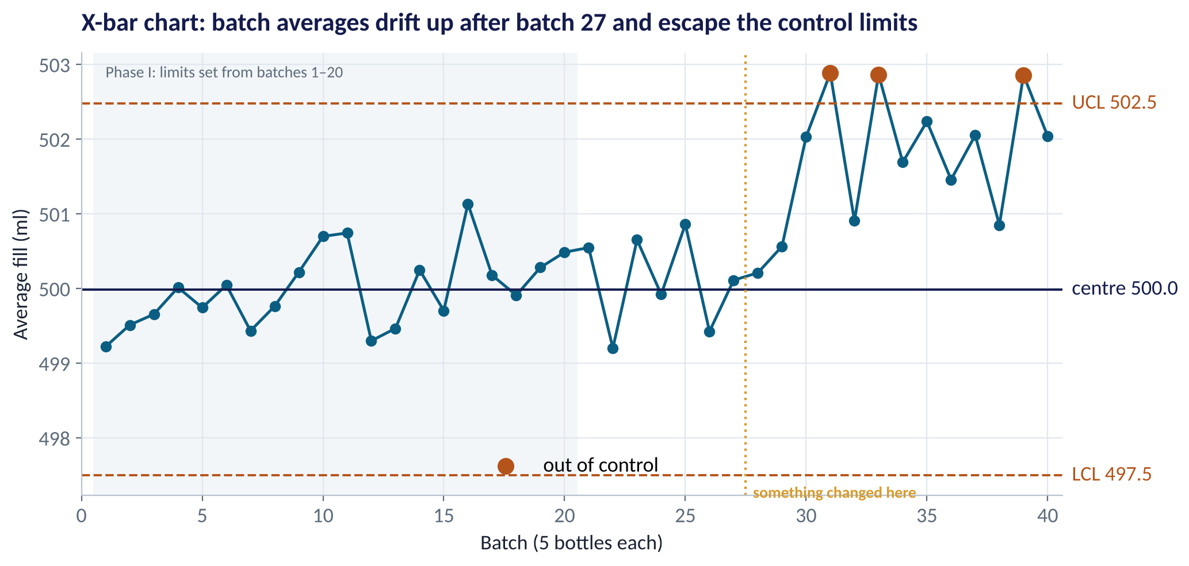
SECTION B · Q4 (8 MARKS)
Read This Control Chart
QUESTIONS
(a) What do the centre line and the dashed limits represent, and how were they set? [3]
(b) What happened after batch 27? Is it common- or special-cause variation? [3]
(c) Every bottle was still within the 494–506 ml spec. Why act anyway? [2]
Fig S5.3-F02 · replicate: tdbg_5_3_figures.R / .py
PRACTICE PAPER 3 · MODULE 3 REVIEW: APPLIED ANALYTICS
18

Slide 19
PRACTICE PAPER
04
Section C — Applied Task
Analyse, value and recommend.

Slide 20




SECTION C (35 MARKS)
Grow Customer Value at an Online Retailer
The situation
The decision question
The retailer's CEO has ₦10m to spend on customer marketing next year and asks you where to put it. You receive customer_orders.csv (12,121 orders, 1,200 customers, 2024–2025).
Build RFM segments, estimate CLV, and design one retention or reactivation campaign. Show whether it pays.
The data we have
What a good answer looks like
customer_id, order_date, order_value_naira. Assume a 25% gross margin and a 20% discount rate.
A segment table (customers, revenue share), a CLV estimate with a retention scenario, a campaign with costs, expected saves and net value, and a 5-sentence recommendation to the CEO.
PRACTICE PAPER 3 · MODULE 3 REVIEW: APPLIED ANALYTICS
20

Slide 21
KEY TAKEAWAYS
You Are Ready If You Can…
01
Backtest a forecast, read MAPE and an interval, and turn it into a stock or cash decision.
02
Explain sentiment and TF-IDF results, and why a lexicon can misread text.
03
Compute and interpret support, confidence and lift; explain collaborative filtering.
04
Judge a neural net fairly and place GenAI uses on a value–risk map.
05
Compute CLV, expected loss, precision/recall, read a control chart, and audit a model for fairness.
NEXT › Session 5.4: Capstone: From Question to Recommendation
Before next session: After the test: draft your capstone problem statement (one page): the business decision, the data you will use, and how you'll measure success. Bring it to Session 5.4.

