Slide 1

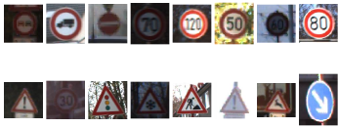
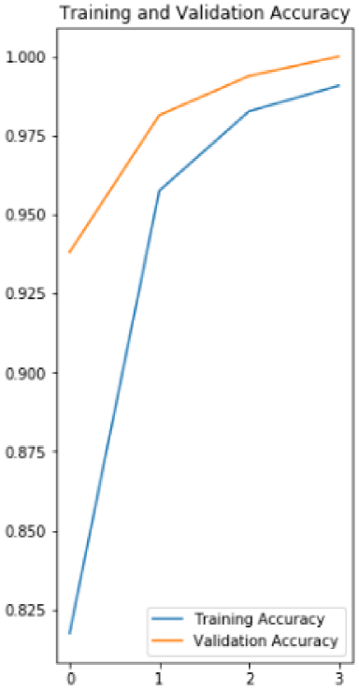
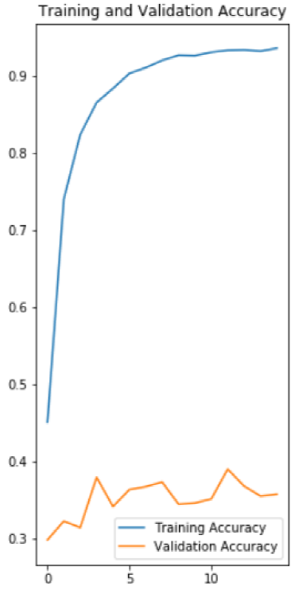
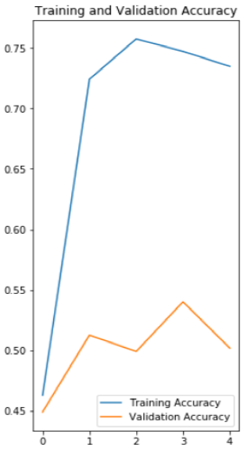
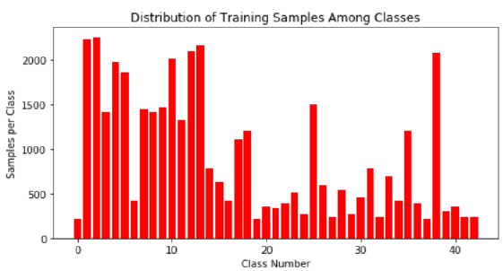
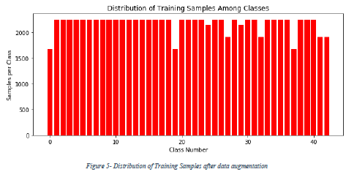
Road Signs Classification with Machine Learning
Adib Rachid, Mokhles Bouzaien
Project Definition
Goal: Assist drivers by identifying road signs & many other use cases
Solve the problem using Supervised Machine Learning
Classify images in 43 classes
Unbalanced labeled dataset of 40000 images
Data Augmentation up to 80000 images (Rotation & Shifting)
Data Preprocessing (RGB & contrast)
Fig 2. Test images
Neural Network model implementation
Neural Network from scratch
Lack of resources
Neural Network using TensorFlow
75% Training & 25% validation
ResNet50
Simple Model
3 convolution layers:
125000 parameters
Fig 3. Training & validation 4, 9, 43 classes respectively
Table 1. Testing results
Classes | % correctness
4 | 98 %
9 | 8%
43 | 10%
Test and Results
Improvements
Tests done using the simple model.
Modification of:
model parameters
classes complexity
adding/removing layers
Change model used
Add Variational Auto Encoders (VAE)
Get sign without background and other preprocessing techniques
Add more augmentation features
Use many classifications – split classes and classify again
Fig 2. Classes Distribution

