Slide 1
California Housing Price Prediction
A Supervised Learning Project
Presented by: Adib
Date: 04/27/2025

Slide 2
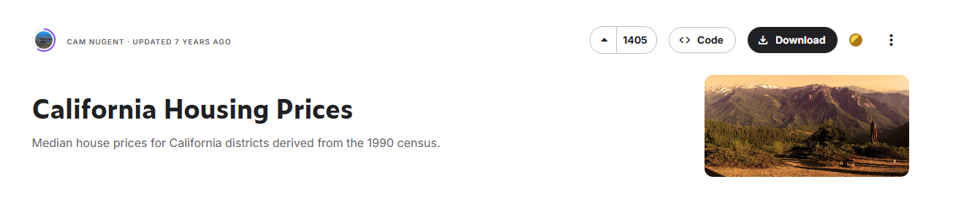
Introduction
Dataset: California Housing Prices (Kaggle)
Link: https://www.kaggle.com/datasets/camnugent/california-housing-prices/data
Goal: Predict median house value
Method: Full supervised learning pipeline

Slide 3
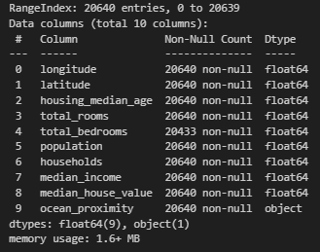
Data Overview
20,640 observations, 10 features
Key features: Median income, rooms, population, ocean proximity
Target: Median house value

Slide 4
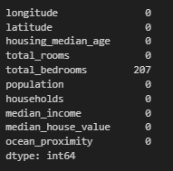
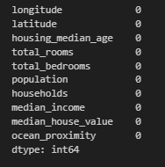
Data Cleaning & Preprocessing
Imputed missing values (median)
Created ratios: rooms/household, bedrooms/room, population/household
Log transforms to reduce skew
Stratified split on income

Slide 5
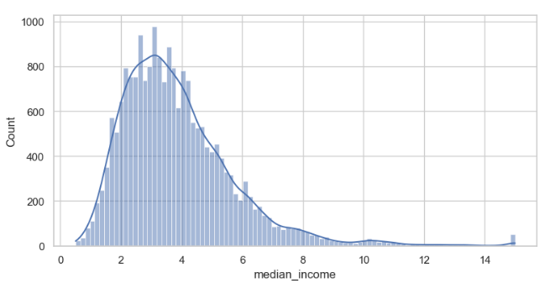
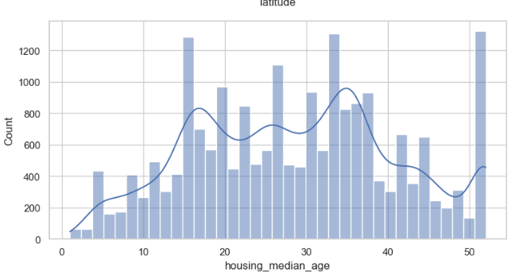
Exploratory Data Analysis
Strong correlation: income and house value
Coastal locations have higher prices
Log transformations normalized skewed features

Slide 6
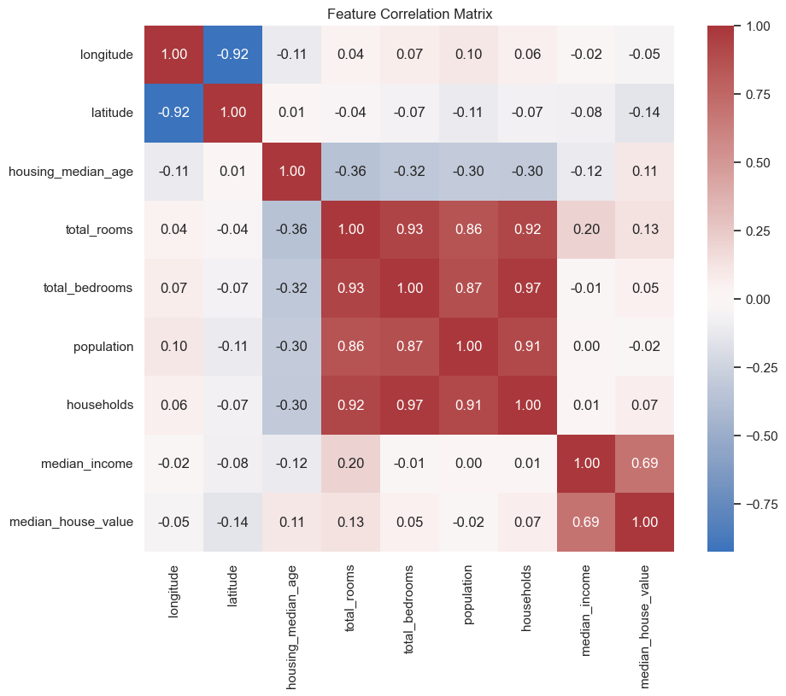
Correlation matrix

Slide 7
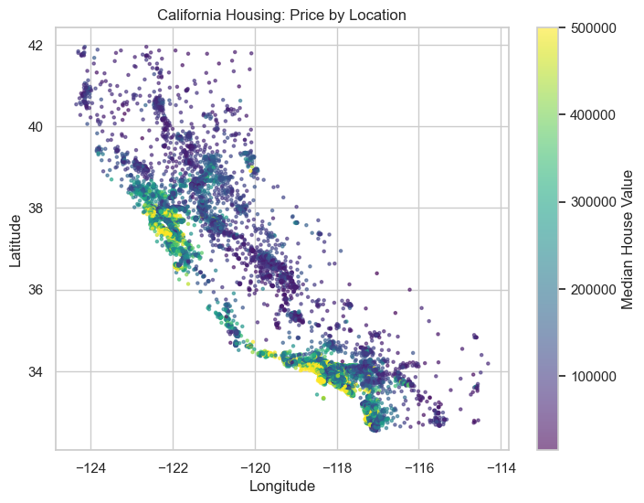
Price by Location

Slide 8
Feature Engineering & Data Preparation
New Features Created:
Rooms per Household
Bedrooms per Room
Population per Household
Why Ratios?
Normalize raw totals
Capture housing density & living conditions
Improve model interpretability
Transformations:
Applied log transformations to skewed features (e.g., median income, room ratios)
Result: More symmetrical distributions and better model fit
Stratified Sampling:
Binned median income into five categories
Ensured balanced 80/20 train-test split across income levels

Slide 9
Modeling Approach
Dummy Regressor: Predicts mean
Linear Regression: Straight-line fit
Random Forest: Ensemble trees for non-linear patterns
Gradient Boosting: Sequential error correction

Slide 10

Model Performance
Dummy: MAE $92,837, R² ≈ 0
Linear: MAE $50,413, R² 0.649
Random Forest: MAE $31,678, R² 0.826
Gradient Boosting: MAE $39,267, R² 0.766

Slide 11
Linear Regression Diagnostics
Actual vs Predicted: Underestimates mid-range
Residuals vs Predicted: Funnel shape
Residuals Distribution: Skewed errors
Linear assumptions violated

Slide 12
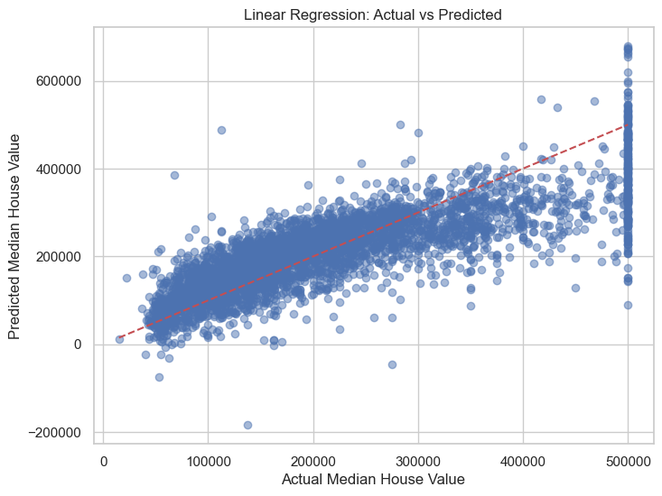

Slide 13
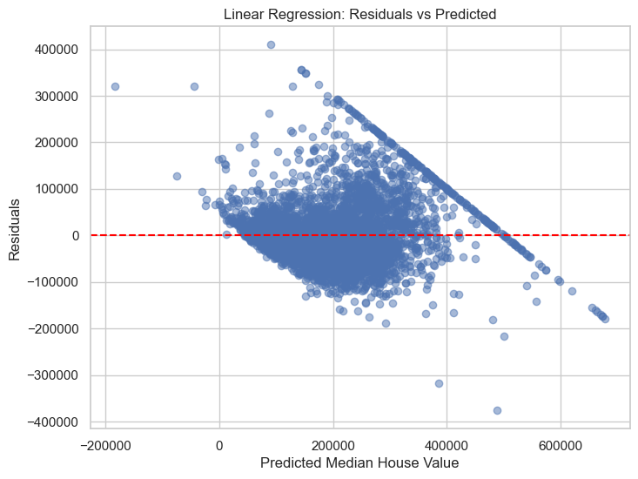

Slide 14
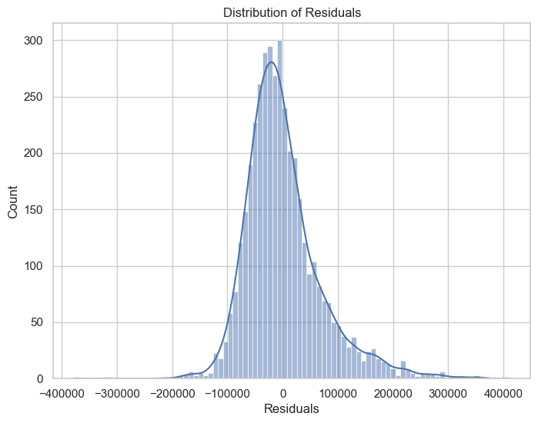

Slide 15
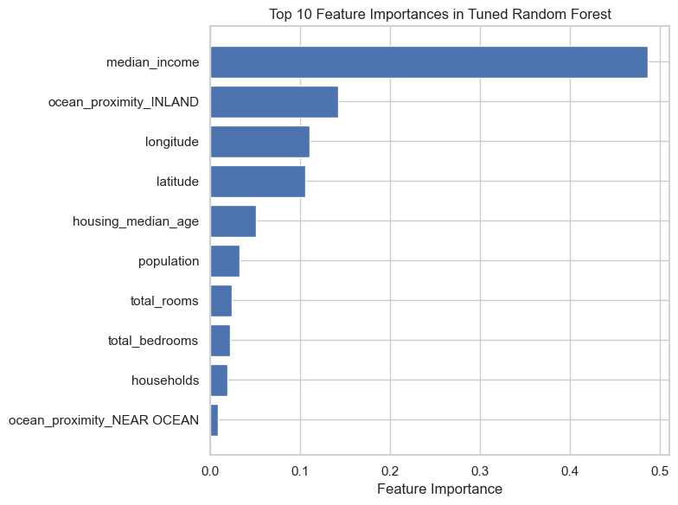
Final Model Tuning
Random Forest tuning improved to MAE $31,580, R² 0.827
Top predictors: median_income (log), rooms_per_household (log), longitude

Slide 16
Conclusion & Next Steps
Learned: Feature engineering, diagnostics crucial
Next: Try XGBoost/LightGBM, add external features, deploy as web app

