Slide 1
A Novel Index to Monitor Physiological Systems from the Arterial Blood Pressure Waveform during Hemorrhage
Mohammad Adibuzzaman^{1,2}, George Kramer³, Loriano Galeotti², Stephen J. Merrill^{1,2}, David G. Strauss² and Christopher G. Scully²
1. Department of Mathematics, Statistics, and Computer Science, Marquette University, Milwaukee, WI
2. Food and Drug Administration, CDRH/OSEL/ Division of Physics
3. The University of Texas Medical Branch, Department of Anesthesiology, Galveston, TX

Slide 2
Motivation
During hemorrhage, hemodynamic compensation mechanisms stabilize traditional vital signs.
Algorithms can be applied to recorded physiological signals (e.g. blood pressure, electrocardiogram) to monitor the hemodynamic stability.
This information could better inform caregivers of a patient’s physiology leading to earlier interventions and improved patient outcomes.
Notes:
until a significant amount of blood loss has occurred

Slide 3
Background
A Markov chain is defined as a system with different states where the transition probability from one state to the next depends only on the current state.
Eigenvalues of Markov chains capture information about changes in system dynamics.
The second largest eigenvalue or the mixing rate describes how fast the system is approaching towards the steady state.
Shock index is used in clinical settings to determine stability of a patient and is defined by the ratio of heart rate to systolic blood pressure.

Slide 4
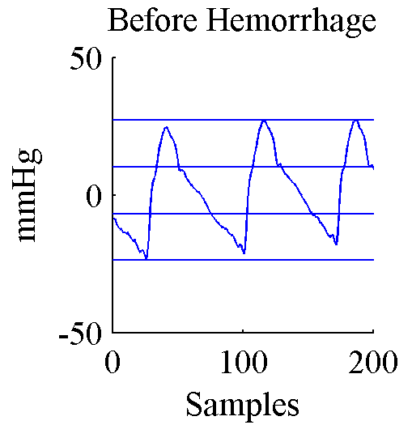
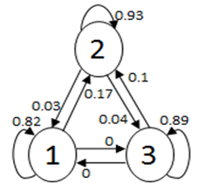
Methods
3
2
1
Arterial Blood Pressure
States
Markov Chain

Slide 5
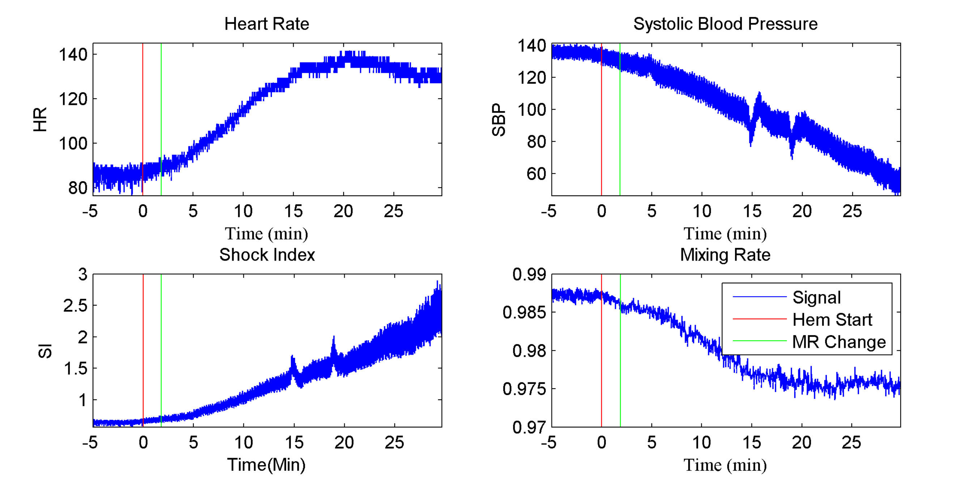
Results

Slide 6
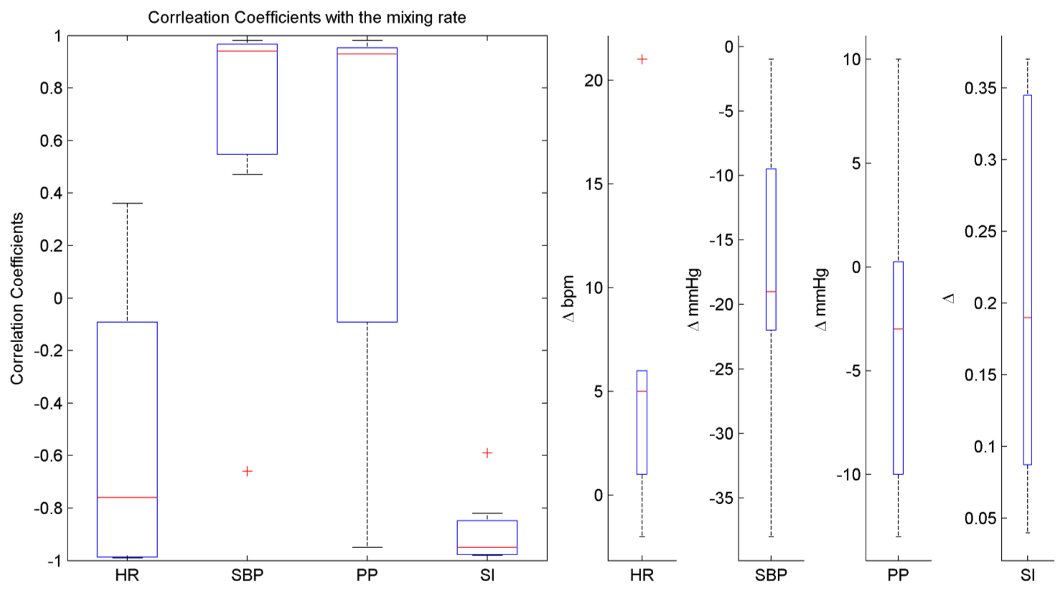
Results
HR = Heart Rate
SBP = Systolic Blood Pressure
PP = Pulse Pressure
SI = Shock Index

Slide 7
Summary
The mixing rate was inversely correlated with shock index which is defined as the ratio between heart rate and systolic blood pressure for all 7 animals (median correlation coefficient of -0.95).
A change in the mixing rate from baseline estimates was identified during hemorrhage for each animal (median time of 13 min, ~10% estimated blood volume, range of 2 to 33 min).
Future work should investigate the morphological change in arterial blood pressure waveform that causes the change in the mixing rate due to hemorrhage.

