Slide 1




Platform for Longitudinal Analysis of Time-Course Data from Patient Generated Health Data
Mohammad Adibuzzaman, Pavlos Vlachos, Aniket Kate

Slide 2


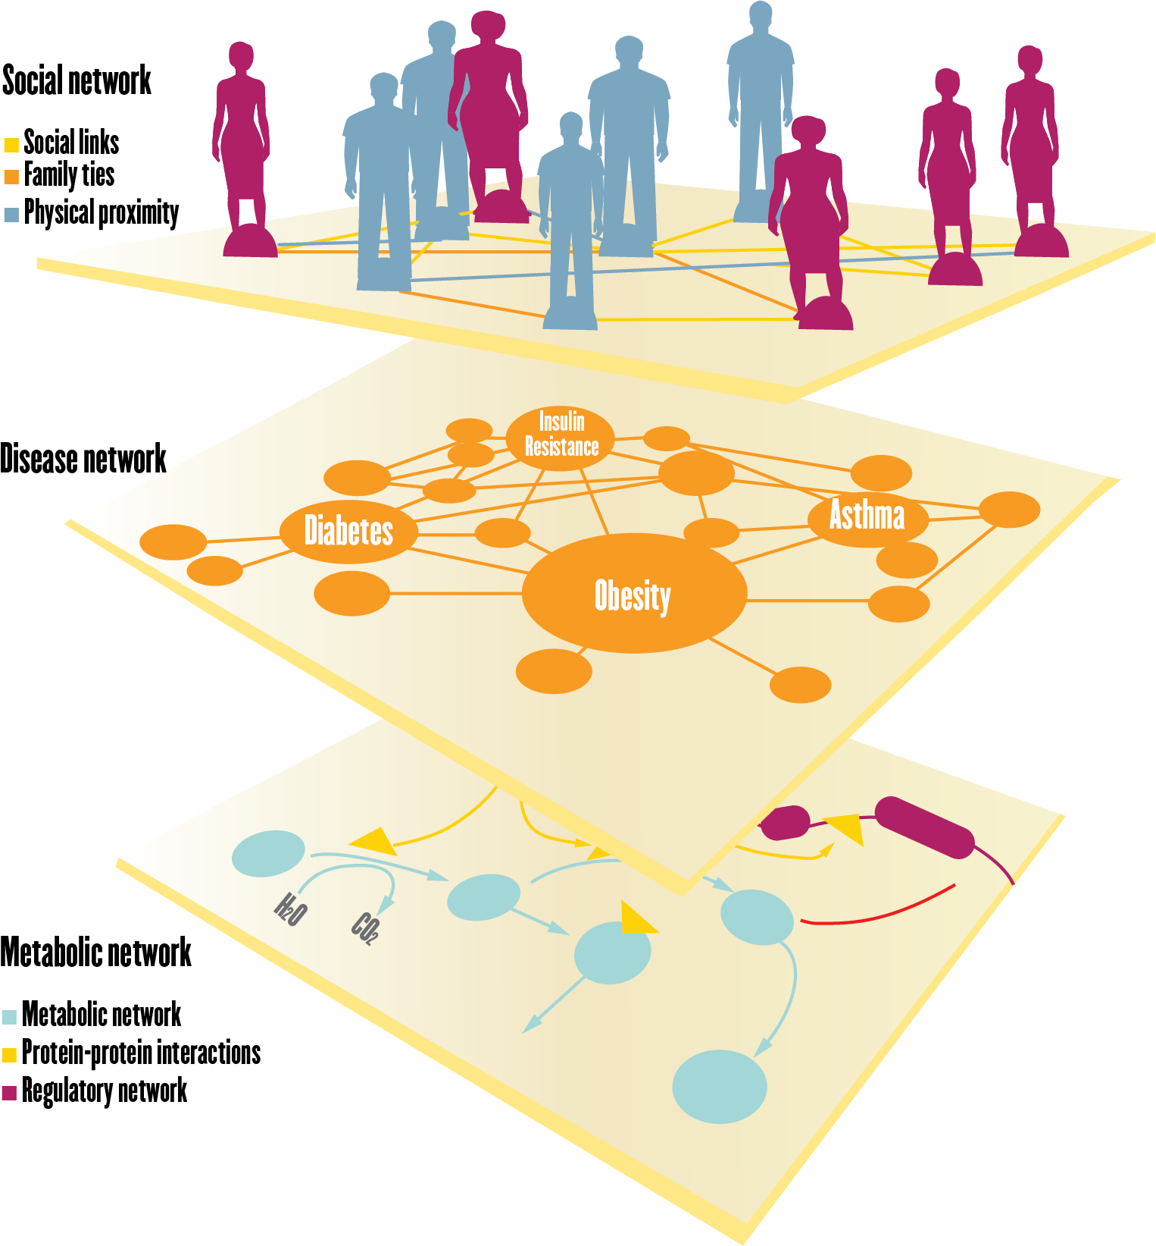
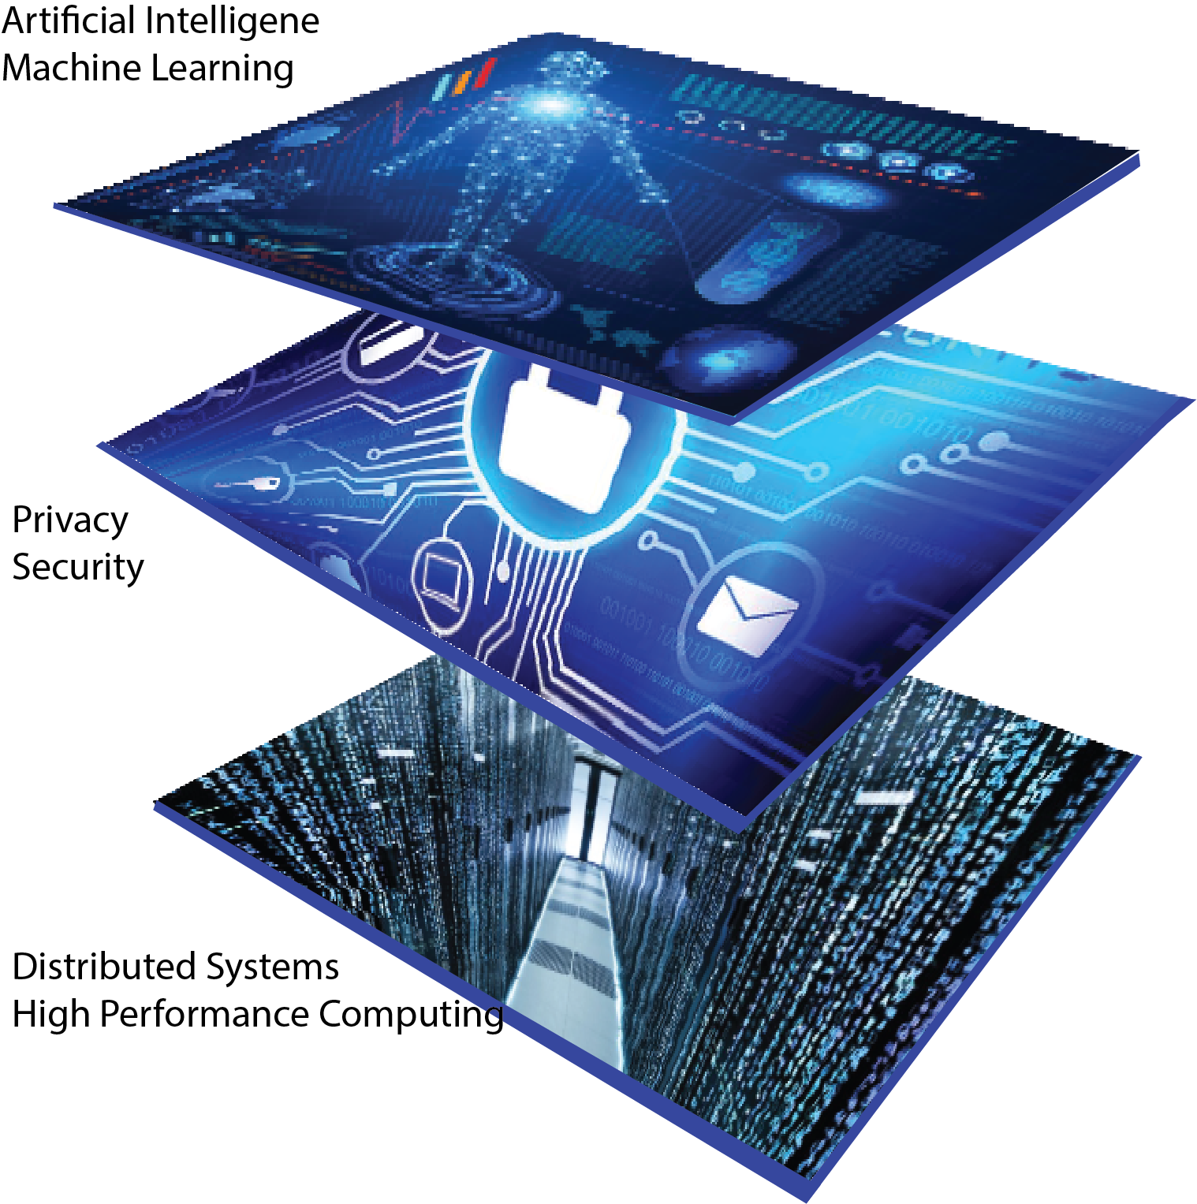

Life Sciences and Data Science
Dimensions of Life Sciences
Dimensions of Computer Science
Data
Dimensions
Time

Slide 3
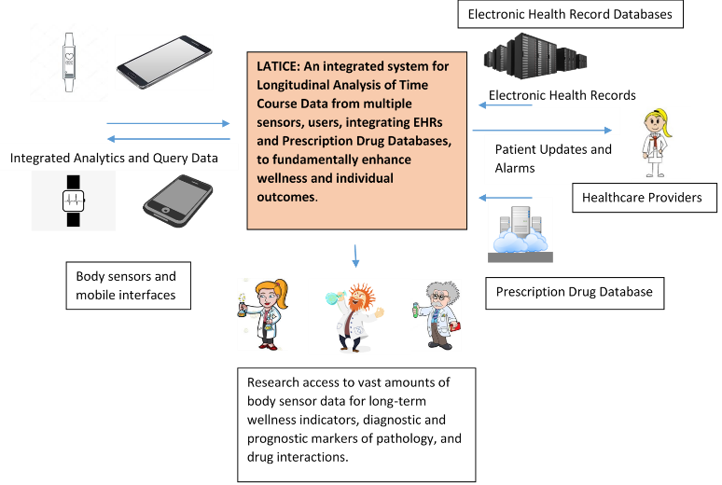

Slide 4
Challenges
Heterogeneity of sensor devices
Missing data handling
Disparate drug regimens and handling
Open and flexible cyberinfrastructure
Integrating complex real time and offline analysis
Optimizing loss of information and strong privacy and security constraints
Reproducibility and generalizability

Slide 5
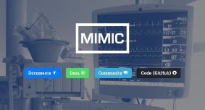


Prototype System
Open source technology
Scalable system
300TB data storage and computation
Currently supports SQL, images, time series
Demo
MULTIPLE DATA SOURCES
MIMIC III (Beth Israel Hospital EHR)
Cerner Health Facts (60M patients over 18 years)
Claims data
Indiana Medicaid (2012 to present)
Purdue Community (staff and families)

Slide 6
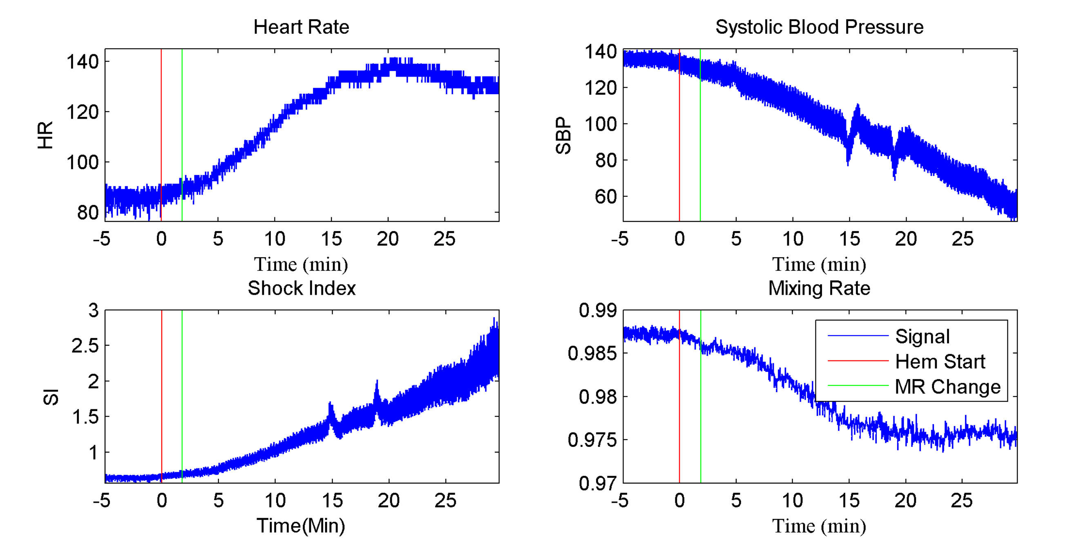
Use Case: Hemorrhage Detection

Slide 7
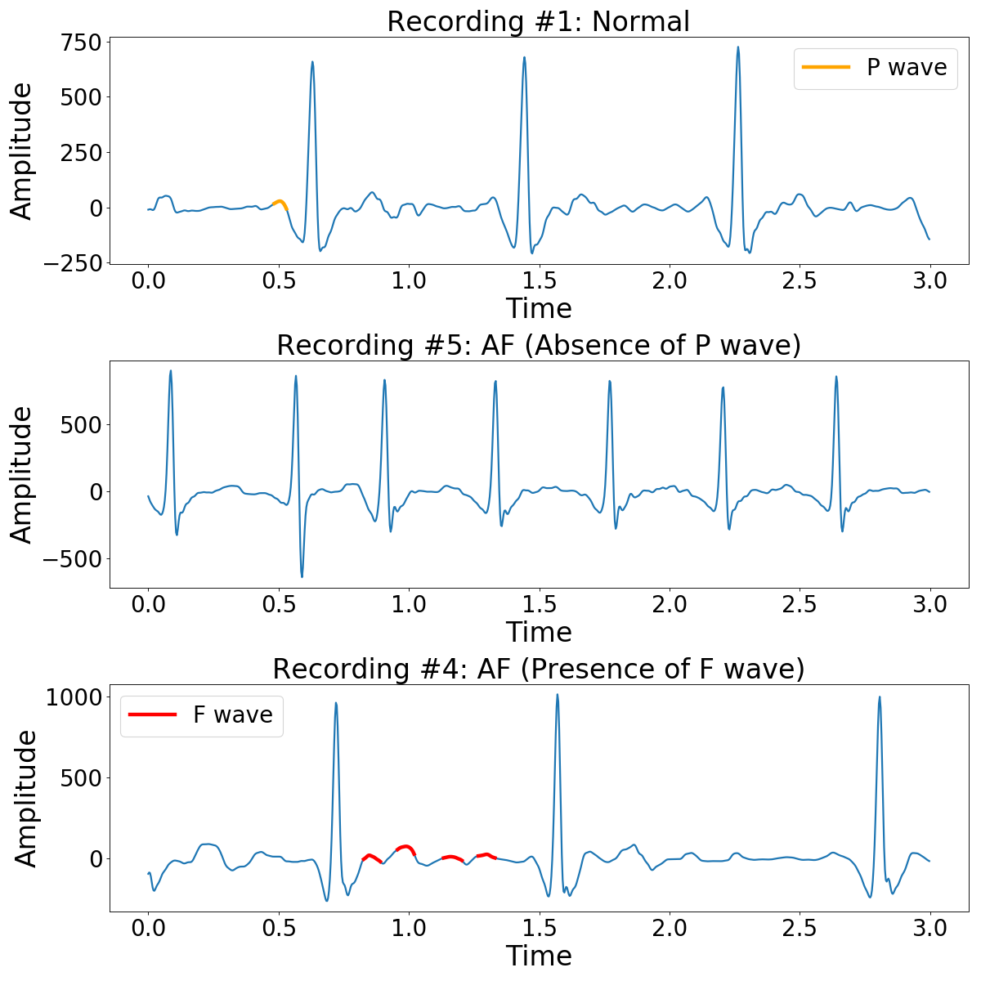
Use Case: Atrial Fibrillation Classification

