Slide 1
Evaluation of Machine Learning Algorithms for Multi-parameter Patient Monitoring
Mohammad Adibuzzaman
ORISE Fellow, FDA
PhD Candidate, Marquette University

Slide 2
Outline
Introduction
Study design and dataset
Approaches (decision tree and support vector machine, early warning score)
Results (sensitivity and specificity)
Summary

Slide 3
Introduction
Alarm fatigue
Poor interpretation of patient state
Timely Clinical Response (e.g. medical emergency team (MET) activation)
Automatic Warnings
Data Fusion Algorithms
Heart Rate
Blood Pressure
Oxygen Saturation

Slide 4
Introduction
Early warning systems include algorithms that use multiple vital signs to monitor patients and recognize early deterioration.
Performance evaluation of these algorithms are critical to provide warnings with high sensitivity and reduced numbers of false alarms to address alarm fatigue.
The aim of this research is to investigate how algorithm development techniques (selection of training, testing and validation dataset) can affect performance using a publicly available dataset.

Slide 5
Regulatory Impact
Multiple submissions have come in using these approaches
Visensia (FDA cleared data fusion device for monitoring of patient deterioration)
How to evaluate the machine learning algorithms?
What data set should be used for training, testing and validation?
Are the machine learning algorithms ‘better’ than existing reference early warning scoring systems?

Slide 6
Hypothesis
We hypothesize that the performance of machine learning algorithms to predict critical hospital events improves when the algorithm is trained on larger data sets.

Slide 7
Data: Multi-parameter Intelligent Monitoring in Intensive Care (MIMIC II)
Clinical Database
Waveform Database
~28,000 records
~24,000 records
CareVue Clinical Information System (Philips Healthcare)
Intellivue MP-70 (Philips Healthcare)
Nurse entered physiological data
Medications
Laboratory data
Nursing notes
Discharge notes
Waveforms
ECG
Blood pressure
Plethysmography
Vital Signs
Heart rate
Blood pressure
Oxygen saturation
Cardiac output
Matched Subset
~6,000 records
Saeed et al. Multiparameter Intelligent Monitoring in Intensive Care II: a public-access intensive care unit database. Crit Care Med. 39:5. 2011.

Slide 8
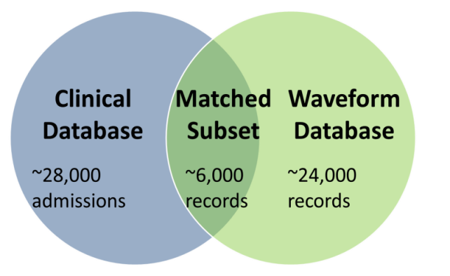
Data for Training, Testing and Validation
2400 records from the matched subset of Multi-parameter Intelligent Monitoring in Intensive Care (MIMIC2) with 5 hours of continuous trend data.
10 fold cross validation for each set
2400 records with 5 hours of trend data
500
500
500
Train
Test
Test
Train
Train
2000-1
1500-1
1000-1
500-1
Train and Test
500-2
Test
1000-2
500-3
Test
500-4
Validation
400
400
400
400
Select the best performance algorithm, and test that with the independent validation set
1 set of 2000 records
1 set of 1500 records
2 sets of 1000 records
4 sets of 500 records

Slide 9
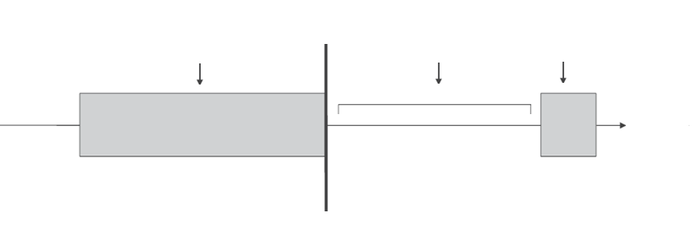
Designing an Algorithm to Predict Clinical Events
Observation Window
(60 Min)
Gap Window
(60 Min)
Target Window
(10 Min)
Critical hospital events e.g. Medical Emergency Team (MET) Activation Criteria

Slide 10
Medical emergency team activation (MET) criteria
Medical emergency team (MET) activation criteria is used in hospital settings as ‘clinically critical events’.
MET activation criteria was set as the event to predict.
MET activation criteria
Heart rate (<40 or >160 bpm)
Systolic blood pressure(<60 or >200 mmHg) or
Oxygen saturation (<85%)
The goal is to predict if MET activation will occur 60 minutes in advance (in the target window).

Slide 11
Algorithm
Two machine learning approaches (decision tree and support vector machine SVM) were applied to develop the MET prediction algorithm using three vital signs (heart rate, systolic blood pressure and oxygen saturation).
Heart Rate
Features (Mean, median, variance, kurtosis, skewness, cross correlation and early warning score)
Machine Learning Algorithms
Predict MET activation 60 minutes in advance
Systolic Blood Pressure
Oxygen Saturation
Observation window containing vital signs
MET activation prediction in the target window

Slide 12
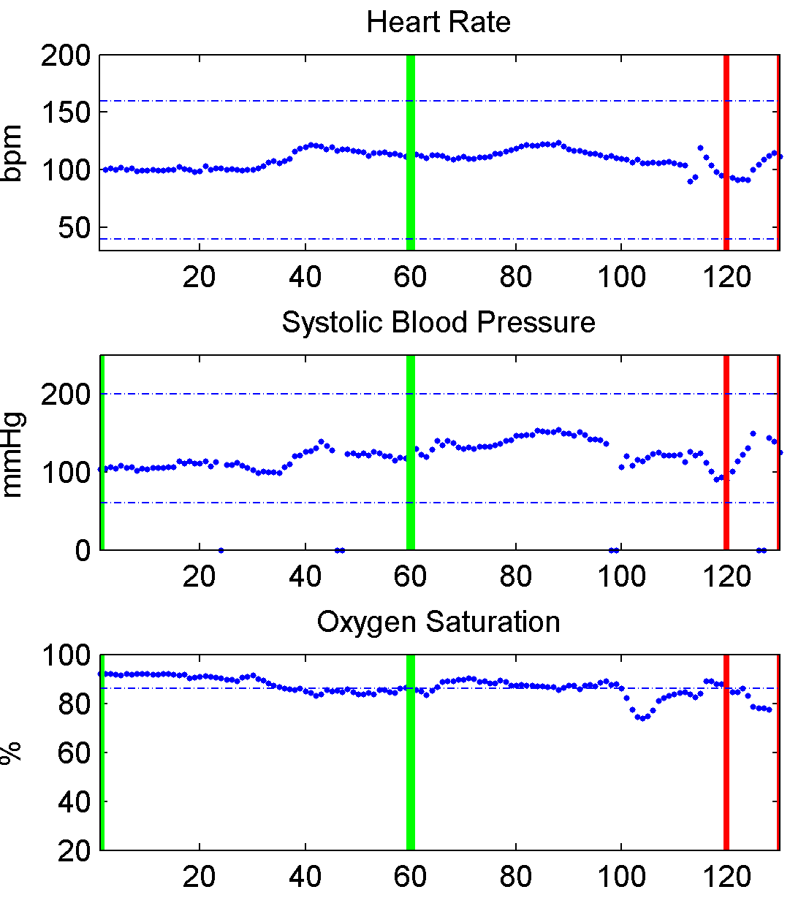
True Positive Event: Medical Emergency Team Activation (MET) Criteria Satisfied
Oxygen Saturation drops below 85%
(MET activation criteria)
Observation
window
Gap
window
Target window

Slide 13
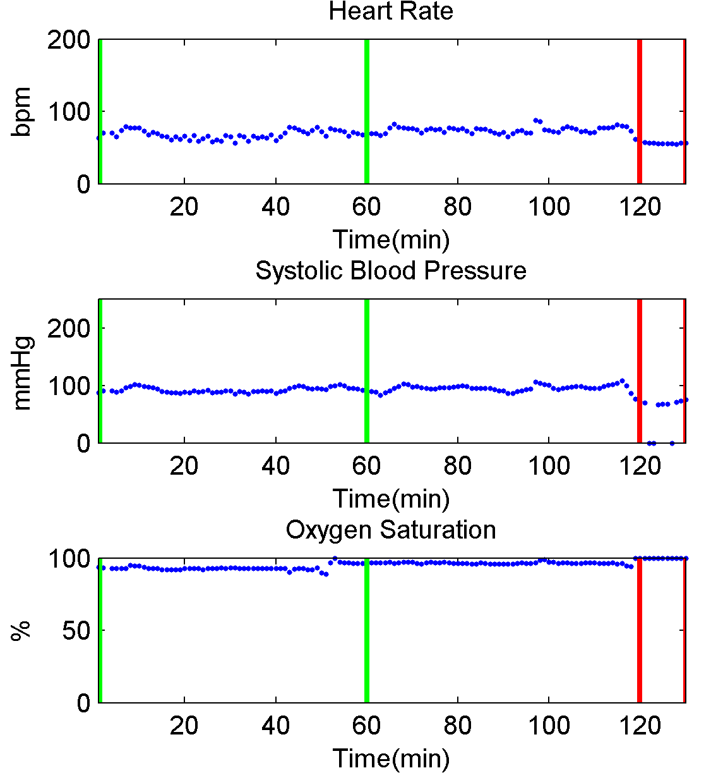
True Negative Event: Medical Emergency Team Activation (MET) Criteria not Satisfied
Target window does not satisfy MET activation criteria
Observation
window
Gap
window
Target window

Slide 14
Comparison Approaches
Decision tree (Machine learning algorithm)
Support vector machine (Machine learning algorithm)
National early warning score (NEWS) (Reference method)

Slide 15
Decision Tree
Mean(Heart rate) >80
Yes
No
Mean(Systolic blood pressure) >200
Mean(Oxygen saturation) <85
Yes
No
Yes
No
MET
activation
No
MET
activation
Variance
(Oxygen saturation)
<0.4
Variance
(Systolic blood pressure)
> 0.8
Yes
No
Yes
No
MET
activation
No
MET
activation
MET
activation
No
MET
activation

Slide 16
Support Vector Machine
+
+
+
+
+
Margin
+
+
+
+
Mean Blood Pressure (Feature 2)
Separating Hyperplane
+
_
_
_
_
_
_
_
_
Mean Heart Rate (Feature 1)

Slide 17
Early Warning Scores: Reference System
National Early Warning Score (NEWS) in the UK
PHYSIOLOGICAL PARAMETER | 3 | 2 | 1 | 0 | 1 | 2 | 3
Oxygen Saturation | ≤91 | 92-93 | 94-95 | ≥96
Systolic BP | ≤90 | 91-100 | 101-110 | 111-219 |  |  | ≥220
Heart Rate | ≤40 |  | 41-50 | 51-90 | 91-110 | 111-130 | ≥131
A positive event (prediction for MET activation) using NEWS
If any of the vital signs reaches the threshold of 3 for 10 minutes.
If the cumulative score reaches 5 for 10 minutes.

Slide 18
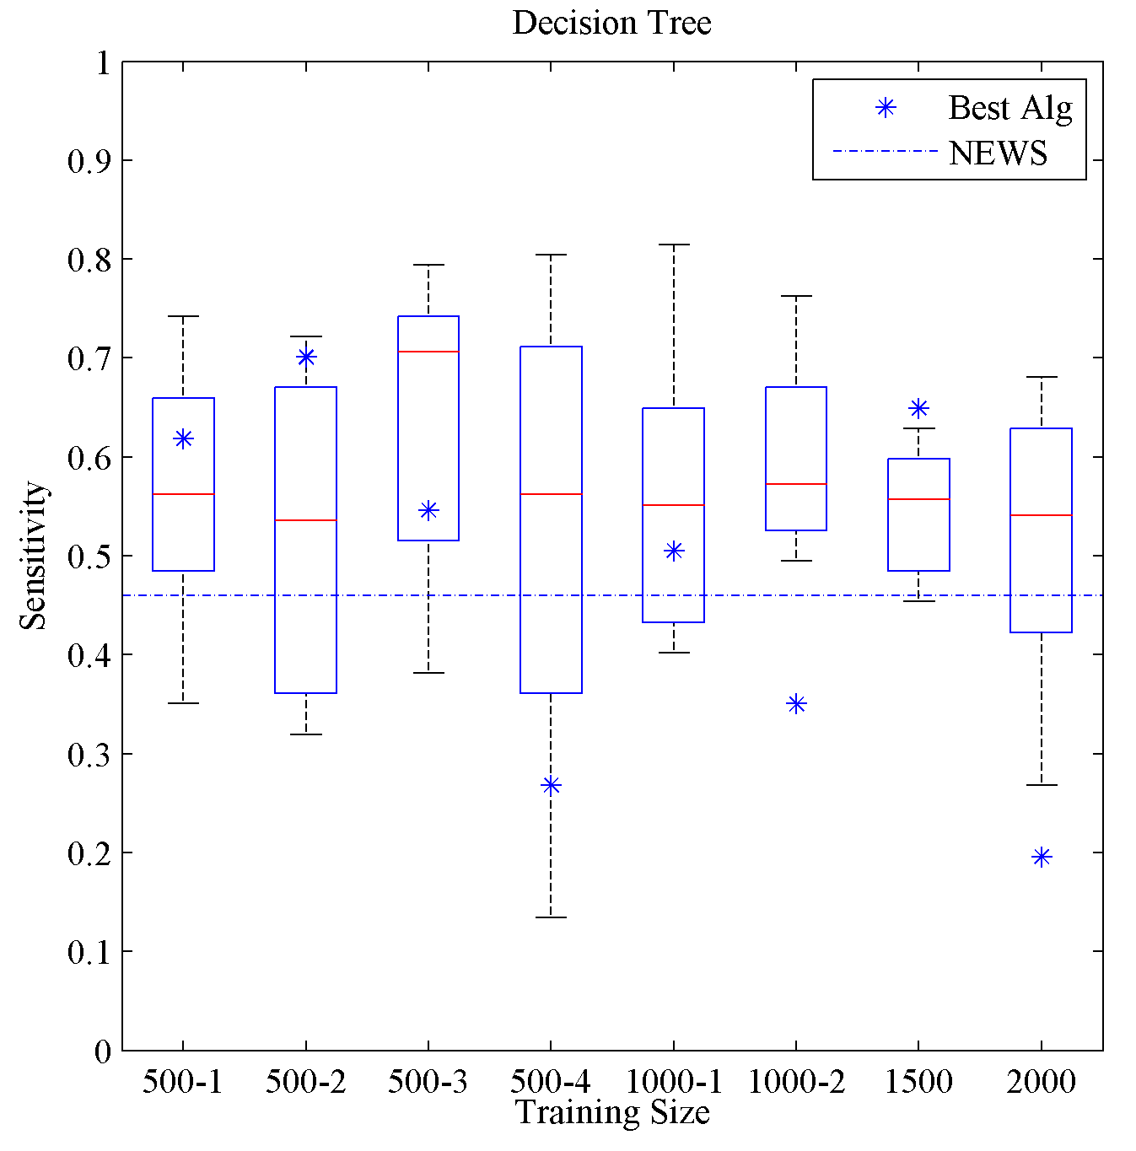
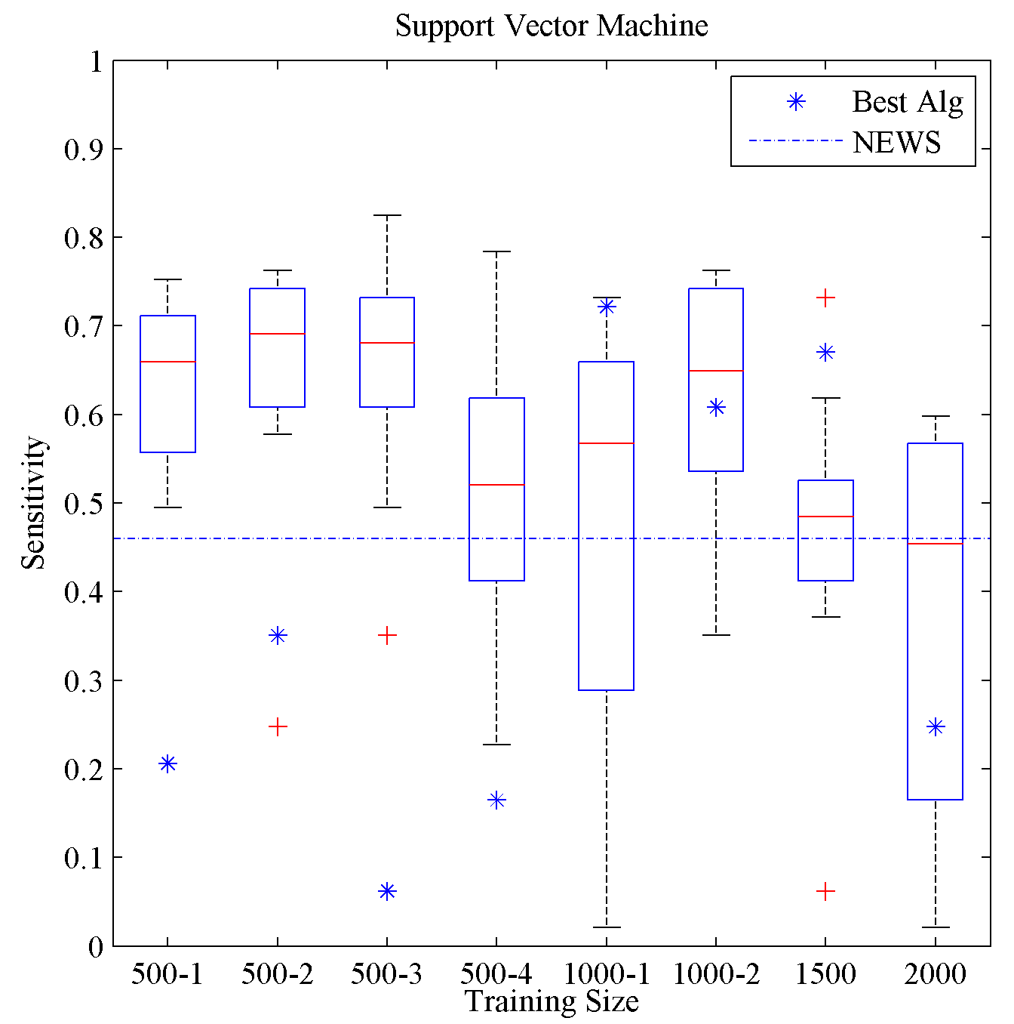
Results: Sensitivity to Detect MET Activation an Hour Before It Occurs
National Early Warning Score (NEWS)
Each box plot represent the results for the 10 fold cross validation for the independent validation set.

Slide 19
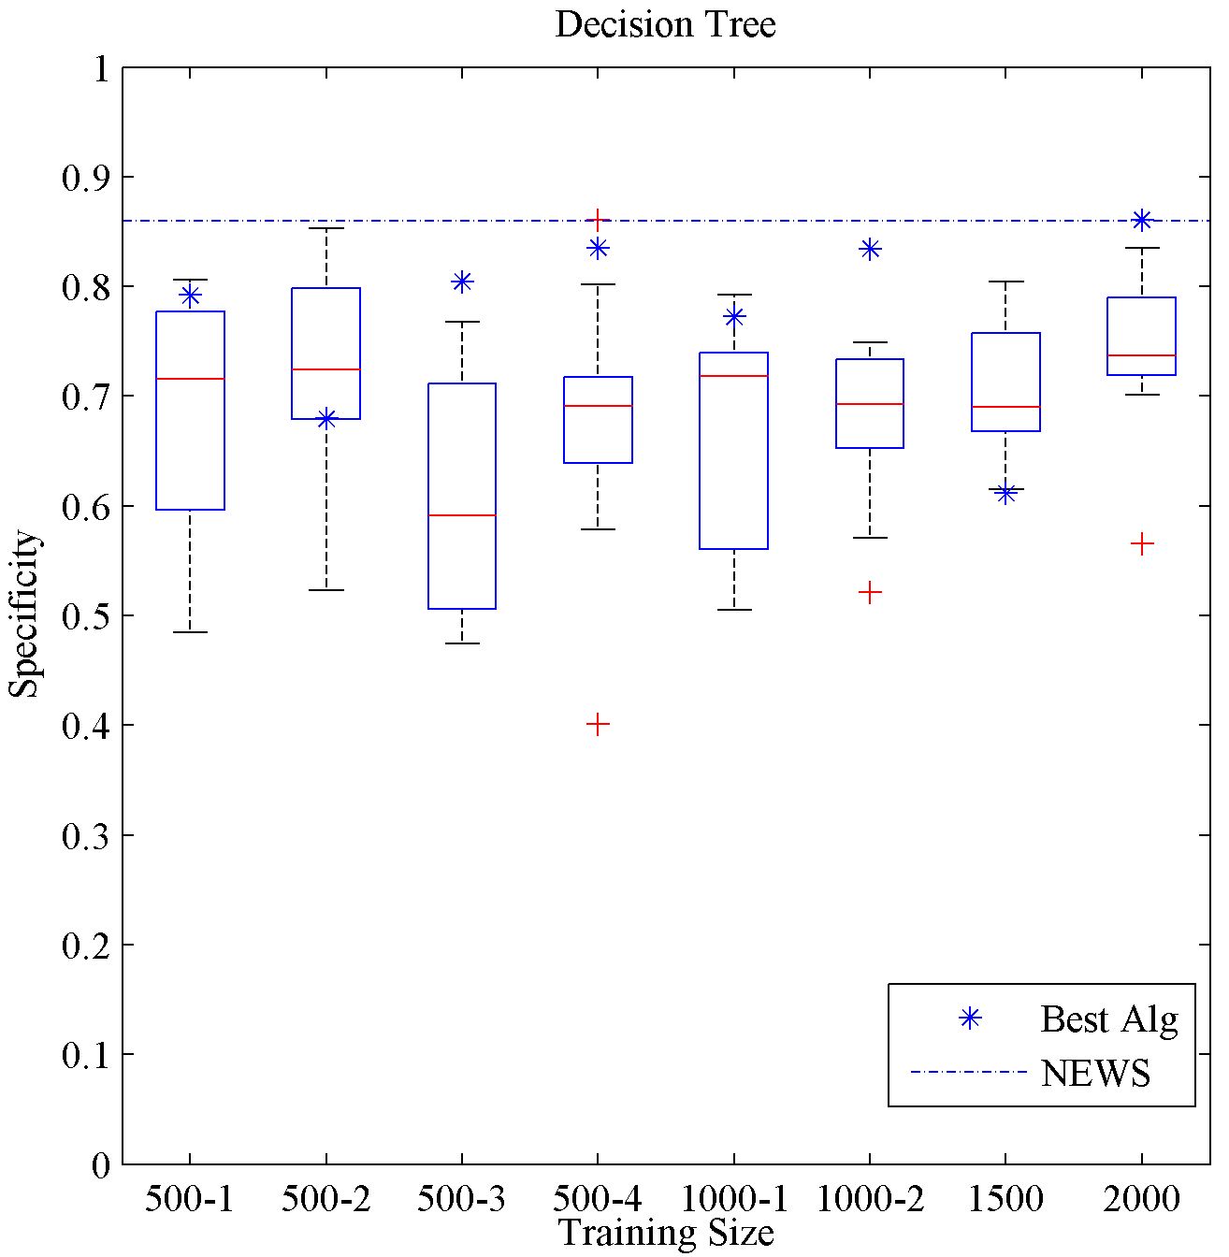
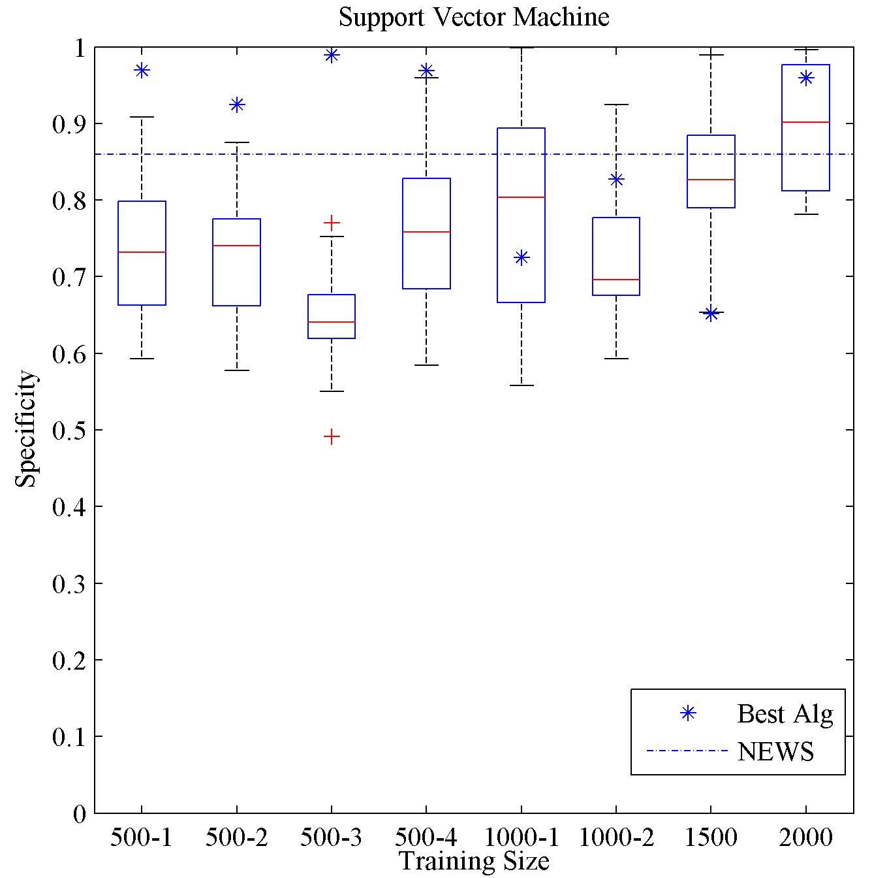
Results: Specificity to Detect MET Activation an Hour Before It Occurs

Slide 20
Summary
With a fixed training set, there is much variability in the performance of the algorithms depending on the random split for training and testing.
Increasing the number of records in the training set did not necessarily increase algorithm sensitivity.
The ‘best’ algorithm using the test sets is not necessarily the best algorithm for an ‘independent validation set’.
Future work to improve early warning patient monitoring algorithms should investigate:
- Key signal features to include in the algorithms.
Alternative techniques to combine information from multiple sources.

Slide 21
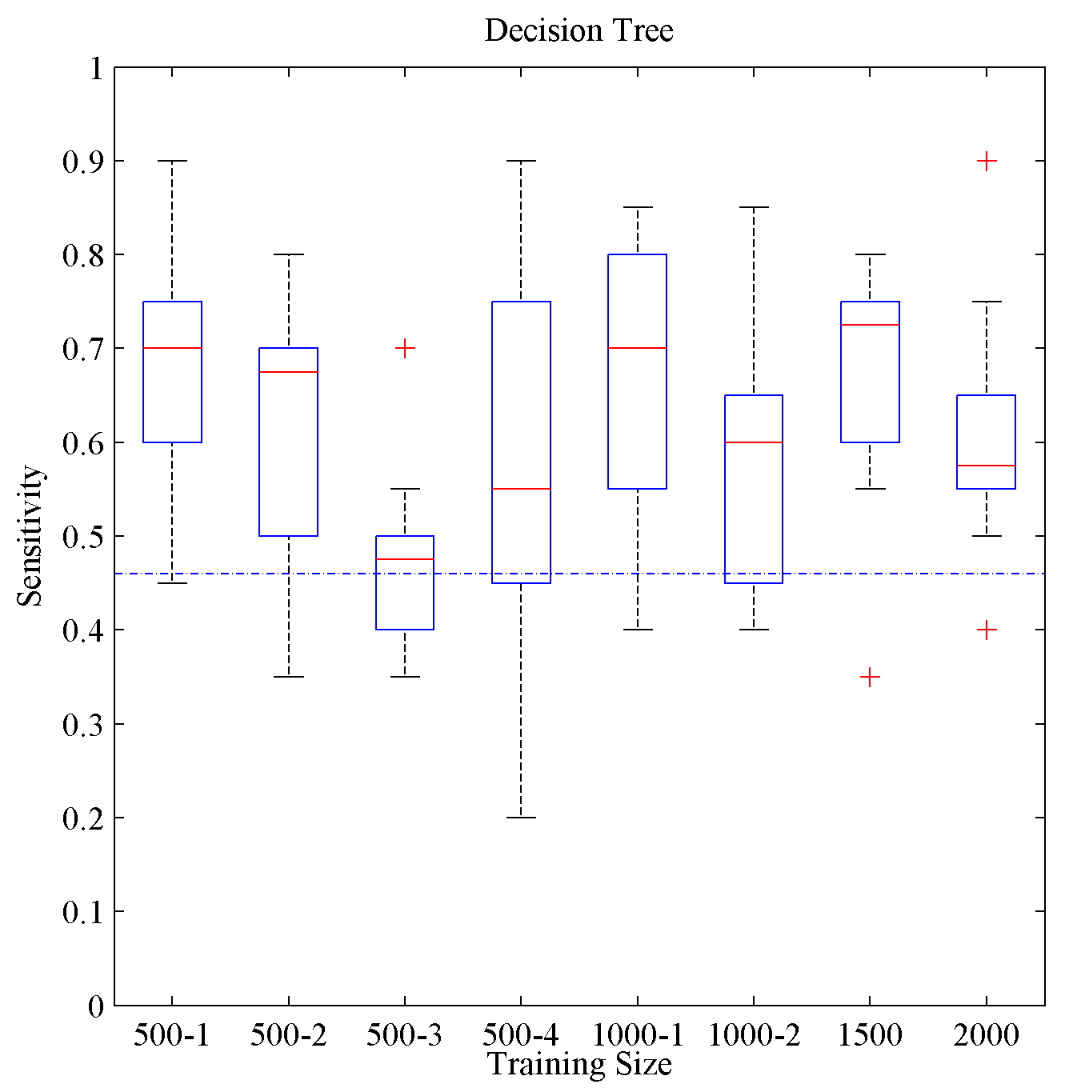
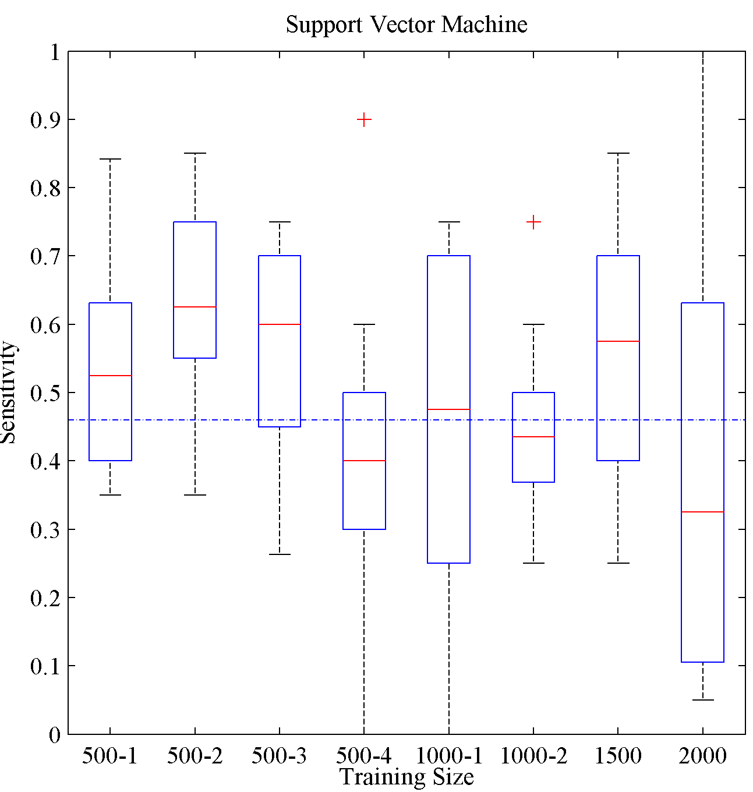
Extra Slide: Sensitivity Using the Test Set

Slide 22
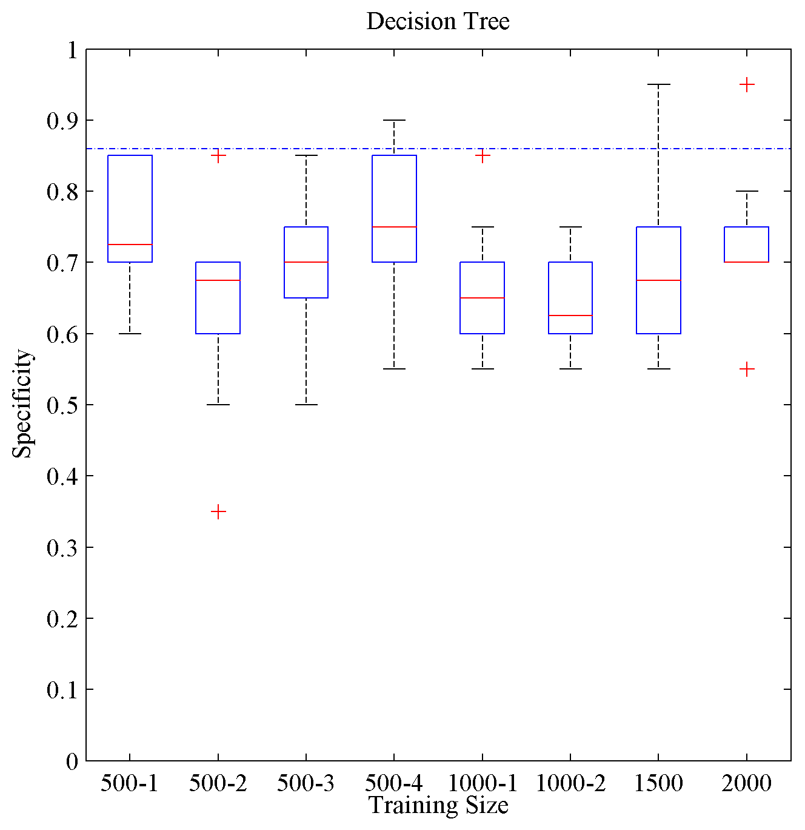
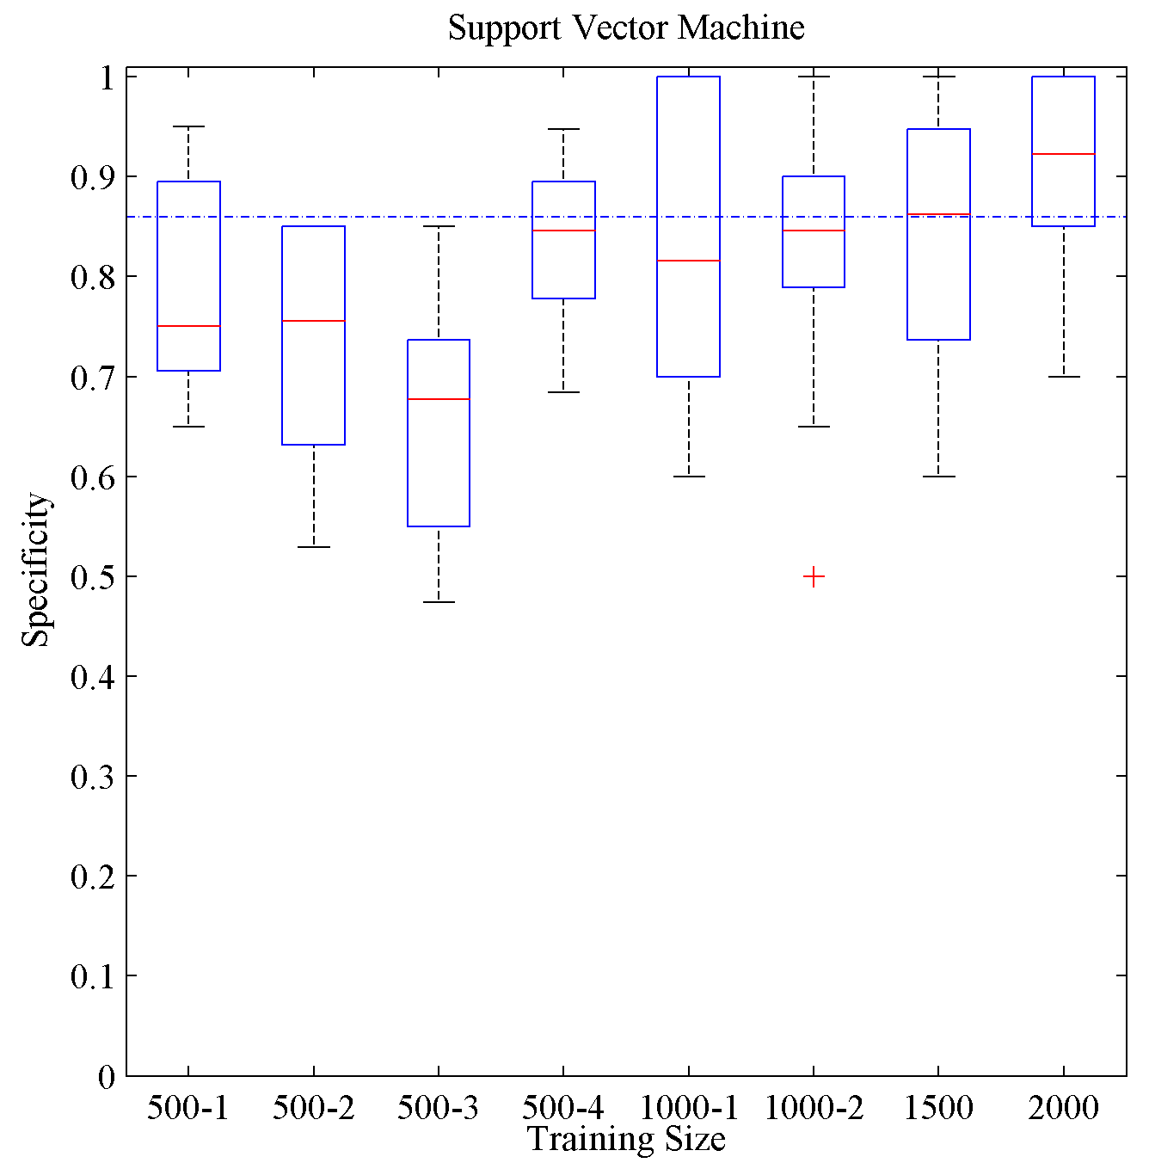
Extra Slide: Specificity Using the Test Set

