Slide 1
Closing the Data Loop: An Integrated Open Access Analysis Platform for the MIMIC Database
Mohammad Adibuzzaman¹, Ken Musselman¹, Alistair Johnson²,
Paul Brown³, Zachary Pitluk³, Ananth Grama⁴
¹Regenstrief Center for Healthcare Engineering, Purdue University, West Lafayette, USA
²Laboratory for Computational Physiology, Massachusetts Institute of Technology, Cambridge, USA
³Paradigm4, Waltham, USA
⁴Department of Computer Science, Purdue University, West Lafayette, USA
Mohammad Adibuzzaman, PhD
Assistant Research Scientist
madibuzz@purdue.edu

Slide 2
Research to translation: big data in healthcare
Big Data Preprocess
Reproduce/Evidence Based Medicine/FDA Approval
High Performance Computing
Publication
Analysis/Code

Slide 3
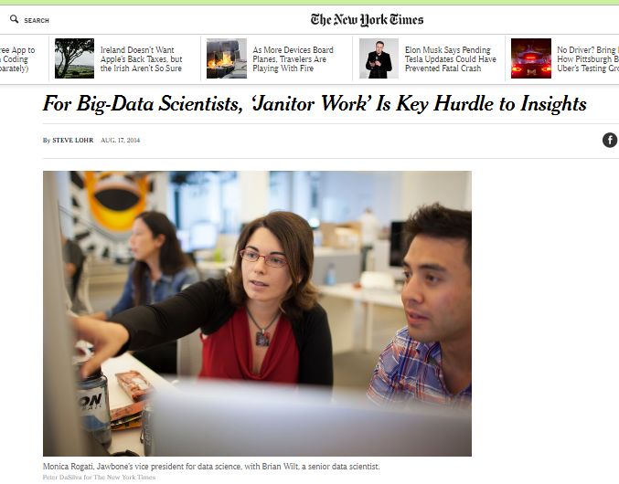
Janitor work?

Slide 4
Proposed architecture
Big Data
High Performance Computing
Analysis
Reproduce/Analysis
Publication
Publication
Evidence Based Medicine/FDA Approval

Slide 5
Multi-parameter Intelligent Monitoring in Intensive Care (MIMIC II)
MIMIC III
Clinical Database
Waveform Database
Matched Subset
58,000 Hospital Admission
2001-2012
Nurse entered physiology
Medications
Laboratory data
Nursing notes
Discharge notes
Format: CSV, SQL
~40GB
23,180 Records
2001-2012
Waveforms
ECG
Blood pressure
Plethysmography
Format: Text, Matlab
~3TB Compressed
4,897 Waveform and 5,266 Numeric records matched with 2,809 clinical records

Slide 6
Mimic iiI Access Platform
Clinical
PostgreSQL
CSV
Waveform
Physiobank ATM (one by one)
Rsync (batch) (install rsync in Ubuntu by the command)
sudo apt-get -y install rsync
Matlab WFDB (Waveform database) toolbox
rdsamp('mimic2wdb/31/3141595/3141595_0008')

Slide 7
Limitations of current platform
High level browsing and exploration of the database
How many patients with Acute Kidney Injury
Integration of heterogeneous data sources
SQL and Waveform or Text
Cohort selection according to research goal based on clinical criteria,
At least 8 hours of continuous minute by minute HR and BP trend within the first 24 hour of admission
Reproduce different machine learning and statistical algorithms.
Logistic Regression
Multivariate Regression
Artificial Neural Network
5. No parallelism

Slide 8
Research with mimic database
Most of the studies use only Clinical database

Slide 9
Proposed architecture
Platform
Clinical
PostgreSQL
Waveform
SciDB
Integration
R
Interface
R/Shiny
SciDB Capabilities
CROSS_JOIN: Combine two arrays, aligning cells with equal dimension values
MERGE: Union-like combination of two arrays
WINDOW: Apply aggregates over a moving window
window(input, NUM_PRECEDING_X, NUM_FOLLOWING_X, NUM_PRECEDING_Y...,aggregate(ATTNAME) [as ALIAS] [,aggregate2...])
SORT: Unpack and sort
UNIQ: Select unique elements from a sorted array
KENDALL, PEARSON, SPEARMAN: Correlation metrics
Distributed Computing

Slide 10
Proposed architecture
Waveform Database
Bash/ Python
SciDB (Distributed DB) ICU Time Series
‘R’/Shiny
Postgres (Single Server DB) Clinical Data

Slide 11

Waveform database design in scidb
MIMIC_Metadata
MIMIC_Numeric
Elapsed_Time
File_ID
File_ID
Start_Time: datetime, mimiciii_id: int32
II:float, V: float, resp: float,…

Slide 12
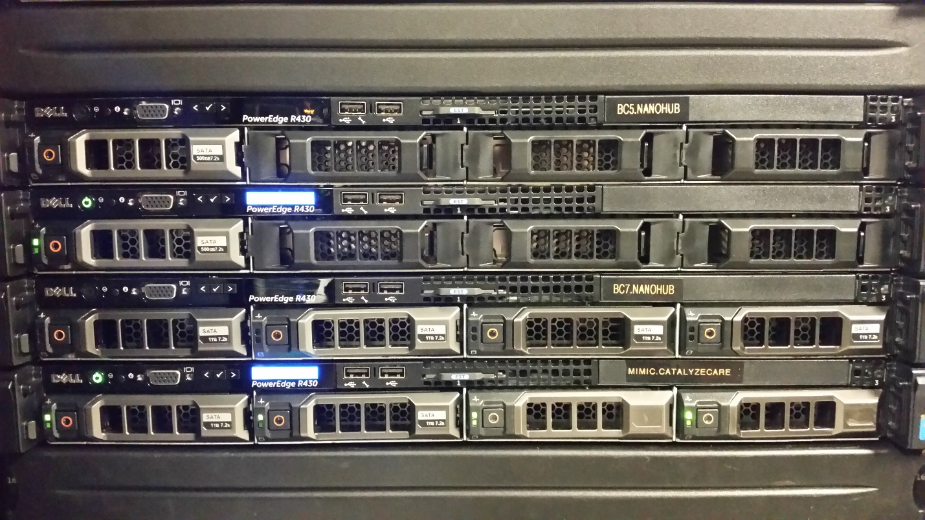
hardware
12 cores (24 hyperthreaded cores).
6TB disk
64G RAM
8 instances of SciDB

Slide 13
Use case One
http://www.fda.gov/Drugs/DrugSafety/ucm504617.htm

Slide 14
Use case one
http://mimic.catalyzecare.org:3838/sample-apps/usecaseone/

Slide 15
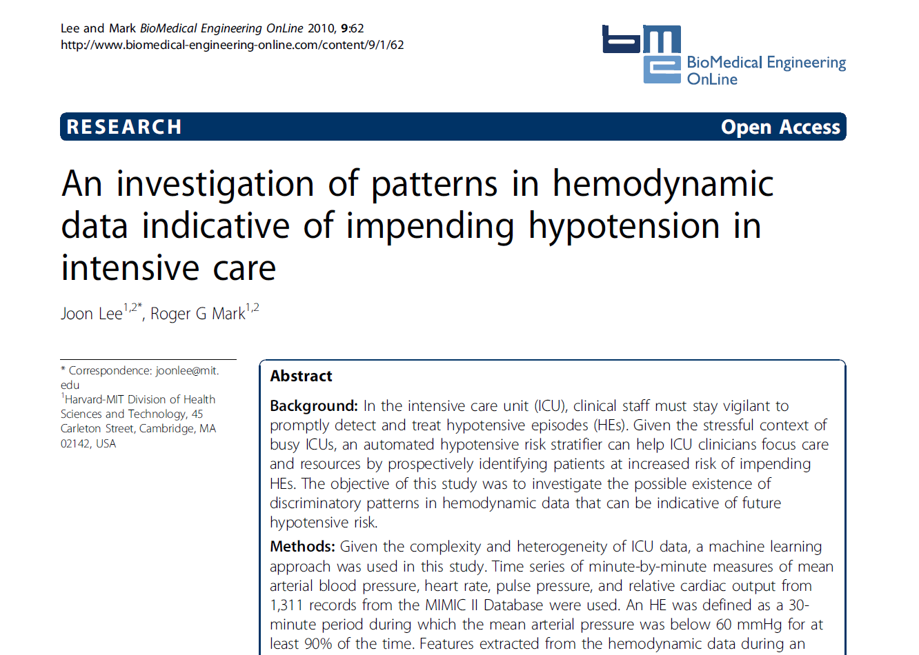
Use case two

Slide 16
Use case two
http://mimic.catalyzecare.org:3838/sample-apps/usecasetwo/

Slide 17
Revisit: Proposed architecture
Big Data
High Performance Computing
Analysis
Reproduce/Analysis
Publication
Publication
Evidence Based Medicine/FDA Approval

Slide 18
Issues to be addressed
Sustainability
Privacy/Security
Scalability

Slide 19
Questions

