Slide 1
Big data in the intensive care unit (ICU): An open-access high performance computing system for developing research applications (apps)
Mohammad Adibuzzaman¹
¹Regenstrief Center for Healthcare Engineering, Purdue University, West Lafayette, USA
Mohammad Adibuzzaman, PhD
Research Scientist
madibuzz@purdue.edu

Slide 2
Outline
Use cases
Hemorrhage detection
AF Risk stratification
Computational platform
What's next?

Slide 3
Hemorrhage Detection

Slide 4
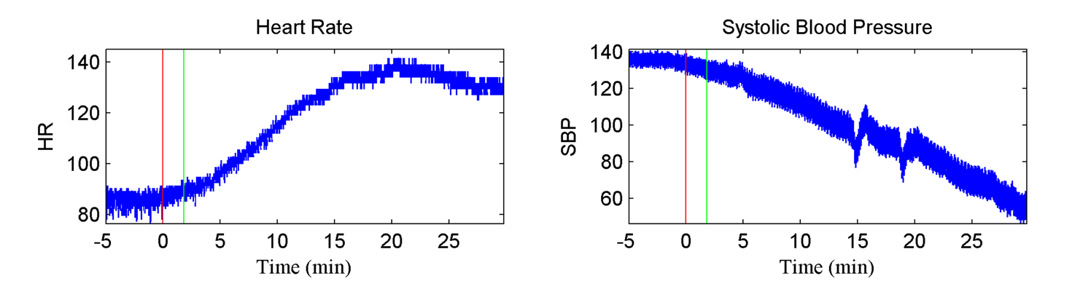
Hemorrhage, ahe and death
Hemorrhage leads to acute hypotensive episode (AHE) or shock, and shock leads to death.
Notes:
When regulatory mechanisms fail, shock happens:
Blood pressure remains unchanged for a long time
Heart rate increases (to compensate for low circulation and keep BP unchanged)
Eventually, blood pressure “craters”
However, many patients have reactions that do not follow this pattern, making shock diagnosis tricky

Slide 5
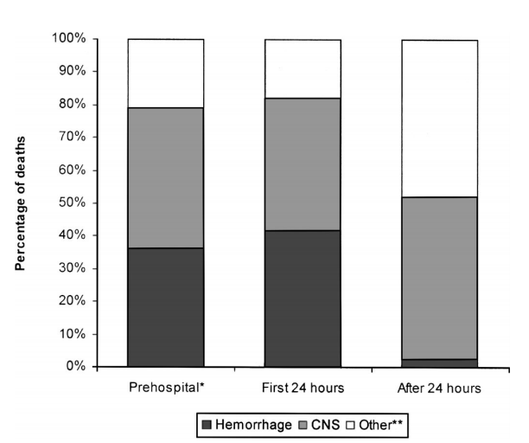
Problem Description
A METHOD IS NEEDED TO IDENTIFY PATIENTS THAT REQUIRE IMMEDIATE MEDICAL CARE
Hemorrhage results in over 80% of operating room deaths after major trauma [2]
Almost 50% of deaths in the first 24 hours of trauma care are due to hemorrhage [2]
Heart rate, mean arterial pressure, and shock index poorly predict the need for continued resuscitation and the effectiveness of treatment [1]
[2]
Notes:
Figure shows the causes of death at various phases of a patient’s stay in the hospital
- Prehospital ranges from before EMS arrive to before arriving at the hospital
- Other** deaths include combinations of hemorrhage/CNS injury
Problem Description
What is hemorrhage? Bleeding – blood escaping from the circulatory system
Causes: Different types of trauma (blunt, penetrating), medical procedures, coagulation disorders
Hemorrhage can lead to a host of complications, and eventually death
Why is it important to treat?
Hospital emergency departments
Triage situations
Battlefield treatment

Slide 6
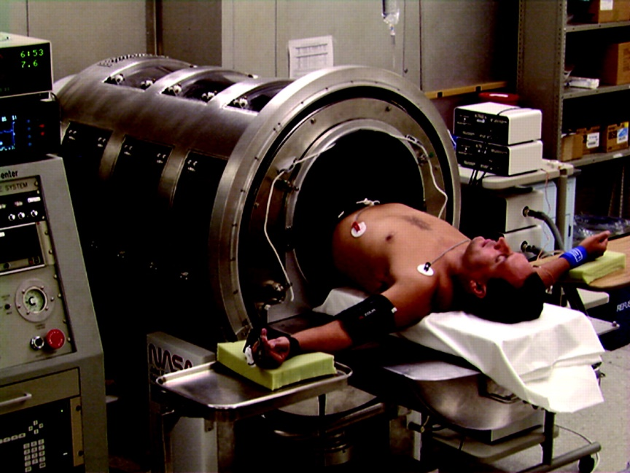
State of the art
Compensatory reserve index (cri)
Require ~30 heartbeats of baseline patient data
Estimates the remaining proportion of physiological reserve available to compensate for loss of blood volume [3]
Compares individual waveforms to a large library of reference waveforms (using lower body negative pressure (LBNP))
[3]
Notes:
Lower body negative pressure causes increased retention of blood in lower body, resulting in reduction of central blood volume
- Meant to imitate a hypotensive episode in the patient’s upper body
Goals:
Prospectively identify ongoing loss of blood volume [1]
Estimate the point at which individuals would experience hemodynamic decompensation well in advance compared to traditional vital signs

Slide 7
Animal study: data
Immature swine (N=7)
Underwent continuous hemorrhage of 10 ml/kg over 30 minutes as SBP was recorded [4]
Eigenvalues were calculated for each window of 2000 samples (20 seconds)
Correlation coefficients determined between mixing rate and each vital sign (HR, SBP, PP, shock index)

Slide 8
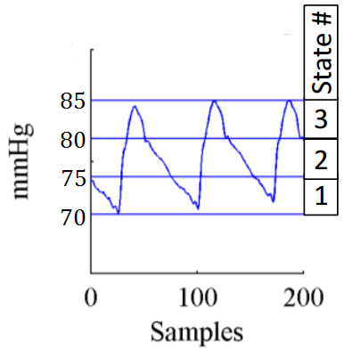
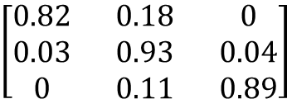
Algorithm
State 2 (75-80 mmHg)
$$\left[\begin{matrix}0.82 & 0.18 & 0 \\ 0.03 & 0.93 & 0.04 \\ 0 & 0.11 & 0.89\end{matrix}\right]$$
State 1 (70-75 mmHg)
State 3 (80-85 mmHg)
[4]
Arterial Blood Pressure
Markov Chain
Transition Probability Matrix
Notes:
From the waveform dataset, a Markov chain transition probability matrix is created
Create a matrix of m×m states, where the entry at the i^{th} row and j^{th} column represents the probability for which blood pressure changes from the i^{th} to the j^{th} state

Slide 9
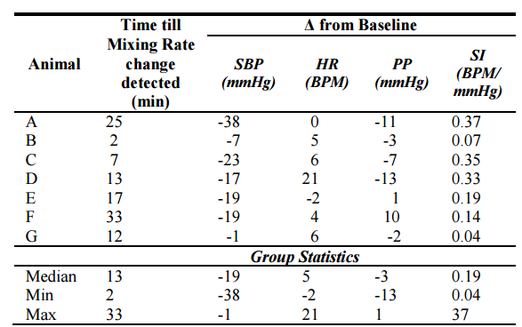
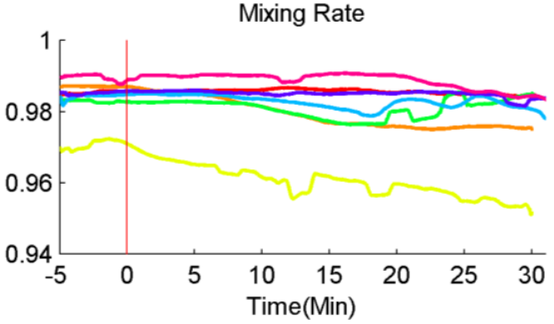
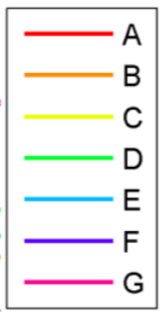
Animal study: Results
Mixing rates from each successive transition probability matrix are compiled into a single graph [4]
[4]
[4]
Notes:
SLEMs from successive windows (2000 samples) are plotted to make a single graph of mixing rate
Significant changes in mixing rate can be calculated from this graph
Table shows the median time that a significant change is detected using the mixing rate metric in swine compared to the change in shock index since baseline

Slide 10
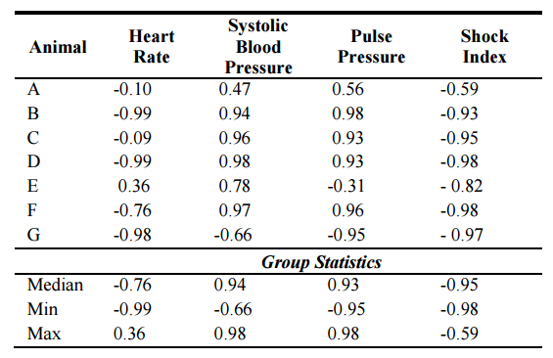
Animal study: Results
Correlation coefficients
[4]
Notes:
This table displays the correlation coefficients between mixing rate and HR, SBP, PP, and SI
- Shock index had an inverse correlation greater than 0.5 for all 7 swine samples

Slide 11
Translational study: Challenge Data
Computing in cardiology Challenge Data 2009
Minute by minute data
Acute hypotensive episode (AHE) is defined a period of 30 minutes or more during which at least 90% of the mean arterial pressure (MAP) measurements were at or below 60 mmHg
Notes:
In our research, we only considered patients in groups H1 and H2, as they were the only ones with identifiable hypotensive episodes

Slide 12
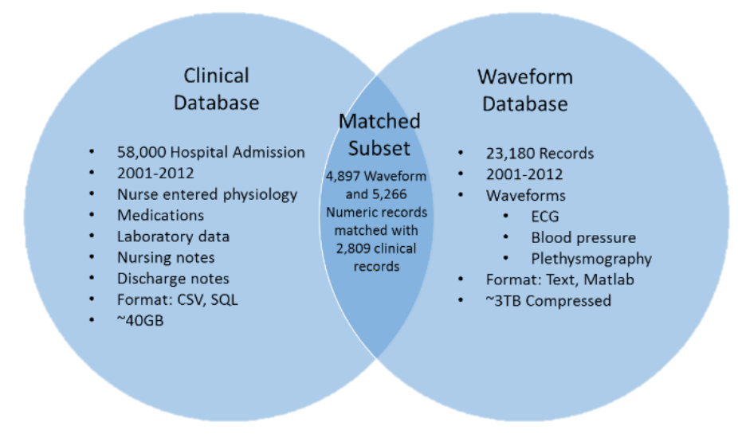
Translational study: mimic database
MIMIC Data
MIMIC II Waveform Database Matched Subset [6]
Challenge data in Matched Subset
Clinical records (SBP, DBP, MAP, HR) – 1 reading per minute [7]
Waveform records (ECGs, continuous blood pressure waveforms) – 125 samples per second [7]
[6]
Notes:
CINC Challenge Data came from the MIMIC II Waveform Database Matched Subset
Clinical records (1 per minute) → Used to calculate shock index
Waveform records (125 per second) → Used to calculate mixing rate
Use Matlab for waveform analysis

Slide 13
Translational study: Patient Data
MIMIC II Waveform database matched subset
Example Patient BP Waveform Data (125 Hz, ~72 hours total data, T₀ known):
T₀
(onset of forecast window)
Observation Window
(noncritical, 10 minutes)
AHE of Interest
(~30 minutes into Forecast Window)
Forecast Window
(60 minutes)
10 minutes prior to onset of forecast window to establish baseline
60 minutes of data in forecast window (AHE ~30 minutes into forecast window)
Notes:
What do we do with this database?
Find location of T₀ in dataset (given)
Collect 10 minutes of data prior to T₀ to establish baseline
Collect 60 minutes of data after T₀, find first instance of significant change to mixing rate
Approximately 30 minutes into forecast window

Slide 14
Patient MR waveforms
Notes:
Background: 11 patient MR waveforms that fit criteria and do not contain excessive noise around AHE
Blue line: Average of all 11 patient waveforms

Slide 15
Matching and linking data
Algorithms worked for some patients and did not work for some patients
What are the characteristics of the patients? Why did it work?
Clinical data is in SQL

Slide 16
Stroke risk stratification

Slide 17
Stroke, AF and mortality
Absolute/ relative risk/ risk stratification of ischemic stroke/TIA
For patients with persistent AF and Paroxysmal AF.
Atrial fibrillation (AF) has been shown to be an independent risk factor for an ischemic stroke [1].
Current approaches
Scoring method for risk assessment
CHADS2 [2, 3] and, CHA2DS2-VASc score [4].

Slide 18
Cohort selection

Slide 19
Features for different scores

Slide 20
Initial result

Slide 21
Heterogeneous data
Features in EHR (SQL)
ECG for AF in Waveform (SciDB)
Echocardiogram in ultrasound imaging

Slide 22
What Data Infrastructure is Needed?

Slide 23
Research to translation: big data in healthcare
Patient data
EHR
Device
Genomics
Integration
De-identification
Data broker
High Performance Computing
Analytics
Visualization

Slide 24
Research to translation: big data in healthcare
Big Data Preprocess
Reproduce/Evidence Based Medicine/FDA Approval
High Performance Computing
Publication
Analysis/Code

Slide 25
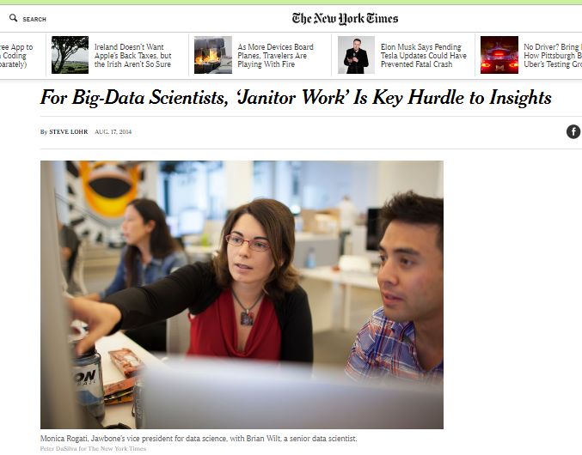
Janitor work?

Slide 26
Proposed architecture
Big Data
High Performance Computing
Analysis
Reproduce/Analysis
Publication
Publication
Evidence Based Medicine/FDA Approval

Slide 27
Multi-parameter Intelligent Monitoring in Intensive Care (MIMIC II)
MIMIC III
Clinical Database
Waveform Database
Matched Subset
58,000 Hospital Admission
2001-2012
Nurse entered physiology
Medications
Laboratory data
Nursing notes
Discharge notes
Format: CSV, SQL
~40GB
23,180 Records
2001-2012
Waveforms
ECG
Blood pressure
Plethysmography
Format: Text, Matlab
~3TB Compressed
4,897 Waveform and 5,266 Numeric records matched with 2,809 clinical records

Slide 28
Mimic iiI Access Platform
Clinical
PostgreSQL
CSV
Waveform
Physiobank ATM (one by one)
Rsync (batch) (install rsync in Ubuntu by the command)
sudo apt-get -y install rsync
Matlab WFDB (Waveform database) toolbox
rdsamp('mimic2wdb/31/3141595/3141595_0008')

Slide 29
Limitations of current platform
High level browsing and exploration of the database
How many patients with Acute Kidney Injury
Integration of heterogeneous data sources
SQL and Waveform or Text
Cohort selection according to research goal based on clinical criteria,
At least 8 hours of continuous minute by minute HR and BP trend within the first 24 hour of admission
Reproduce different machine learning and statistical algorithms.
Logistic Regression
Multivariate Regression
Artificial Neural Network
5. No parallelism

Slide 30
Research with mimic database
Most of the studies use only Clinical database

Slide 31
architecture
Platform
Clinical
PostgreSQL
Waveform
SciDB
Integration
R
Interface
R/Shiny
SciDB Capabilities
CROSS_JOIN: Combine two arrays, aligning cells with equal dimension values
MERGE: Union-like combination of two arrays
WINDOW: Apply aggregates over a moving window
window(input, NUM_PRECEDING_X, NUM_FOLLOWING_X, NUM_PRECEDING_Y...,aggregate(ATTNAME) [as ALIAS] [,aggregate2...])
SORT: Unpack and sort
UNIQ: Select unique elements from a sorted array
KENDALL, PEARSON, SPEARMAN: Correlation metrics
Distributed Computing

Slide 32
architecture
Waveform Database
Bash/ Python
SciDB (Distributed DB) ICU Time Series
‘R’/Shiny
Postgres (Single Server DB) Clinical Data

Slide 33

Waveform database design in scidb
MIMIC_Metadata
MIMIC_Numeric
Elapsed_Time
File_ID
File_ID
Start_Time: datetime, mimiciii_id: int32
II:float, V: float, resp: float,…

Slide 34
Use case
https://mimic.catalyzecare.org:3838/sample-apps/bcollar/measurementErrors/

Slide 35
Issues to be addressed
Sustainability
Privacy/Security
Scalability
Methodological
Causal inference
Transportability
Generalizability

Slide 36
acknowledgement
Roger Mark, Professor, MIT
Alistair Johnson, Post-doctoral Researcher, MIT
Paul Brown, Paradigm4
Elias Bareinboim, Assistant Professor, Purdue University
Yonghan Jung, PhD Candidate, Purdue University
Yiyan Zhou, Undergraduate Student, Purdue University
Brett Collar, Under graduate Student, Purdue University
Yao Chen, PhD Candidate, Purdue University
Ananth Grama, Professor, Purdue University

Slide 37
Questions

