Slide 1
Methods for Quantifying Efficacy-Effectiveness Gap of Randomized Controlled Trials: Examples in ARDS
Mohammad Adibuzzaman, PhD¹, Yonghan Jung, MSc^{1,2}, Elias Bareinboim, PhD², Paul Griffin, PhD^{1,3}, Shravan Kethireddy, MD⁴, Marvi Bikak, MD⁵, Robert Kaplan, MD, PhD⁶
¹Regenstrief Center for Healthcare Engineering, Purdue University, West Lafayette, Indiana, USA
²Department of Computer Science, Purdue University, West Lafayette, Indiana
³Purdue University School of Industrial Engineering, West Lafayette Indiana, USA
⁴NGHS Critical Care, Gainesville, Georgia
­⁵Indiana University School of Medicine, Indianapolis, Indiana
⁶Stanford University, Palo Alto, California

Slide 2
Randomized Controlled Trials
RCT: Randomized Controlled Trial
Ethical/safety issues
Limited samples
Cost
… or simply not possible
Causal inference using observational data
Objective: conduct virtual experimental study by using 1) clinical knowledge and 2) observational data

Slide 3
Approach
Efficacy-effectiveness gap
Difference between RCT and real world
Approach
Step 1: Reproduce the results of RCT from observational data using strict inclusion exclusion criteria and Structure Causal Model
Step 2: Transportability of Inference
Generate results for the broader population with relaxed inclusion-exclusion criteria.

Slide 4
To Adjust or not to Adjust
Graphical representation of causal models
Co-variate selection using backdoor criterion from graphical models

Slide 5
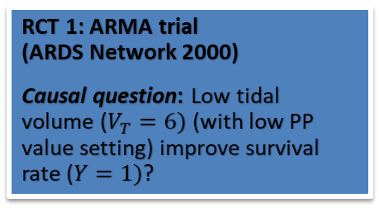
Causal Inference Framework using Observational Data
RCT 1: ARMA trial (ARDS Network 2000)
Causal question: Low tidal volume ($V_{T}=6)$(with low PP value setting) improve survival rate ($Y=1)$?
RCT2:ALVEOLI trial (ARDS network 2004)
Causal question: High Positive End Expiratory Pressure (PEEP) value improve survival rate?
RCT3: ACURASYS trial (Papazian 2010)
Causal question: NMBA (cisatracurium) treatment improve survival rate of ‘severe’ ARDS patients?

Slide 6
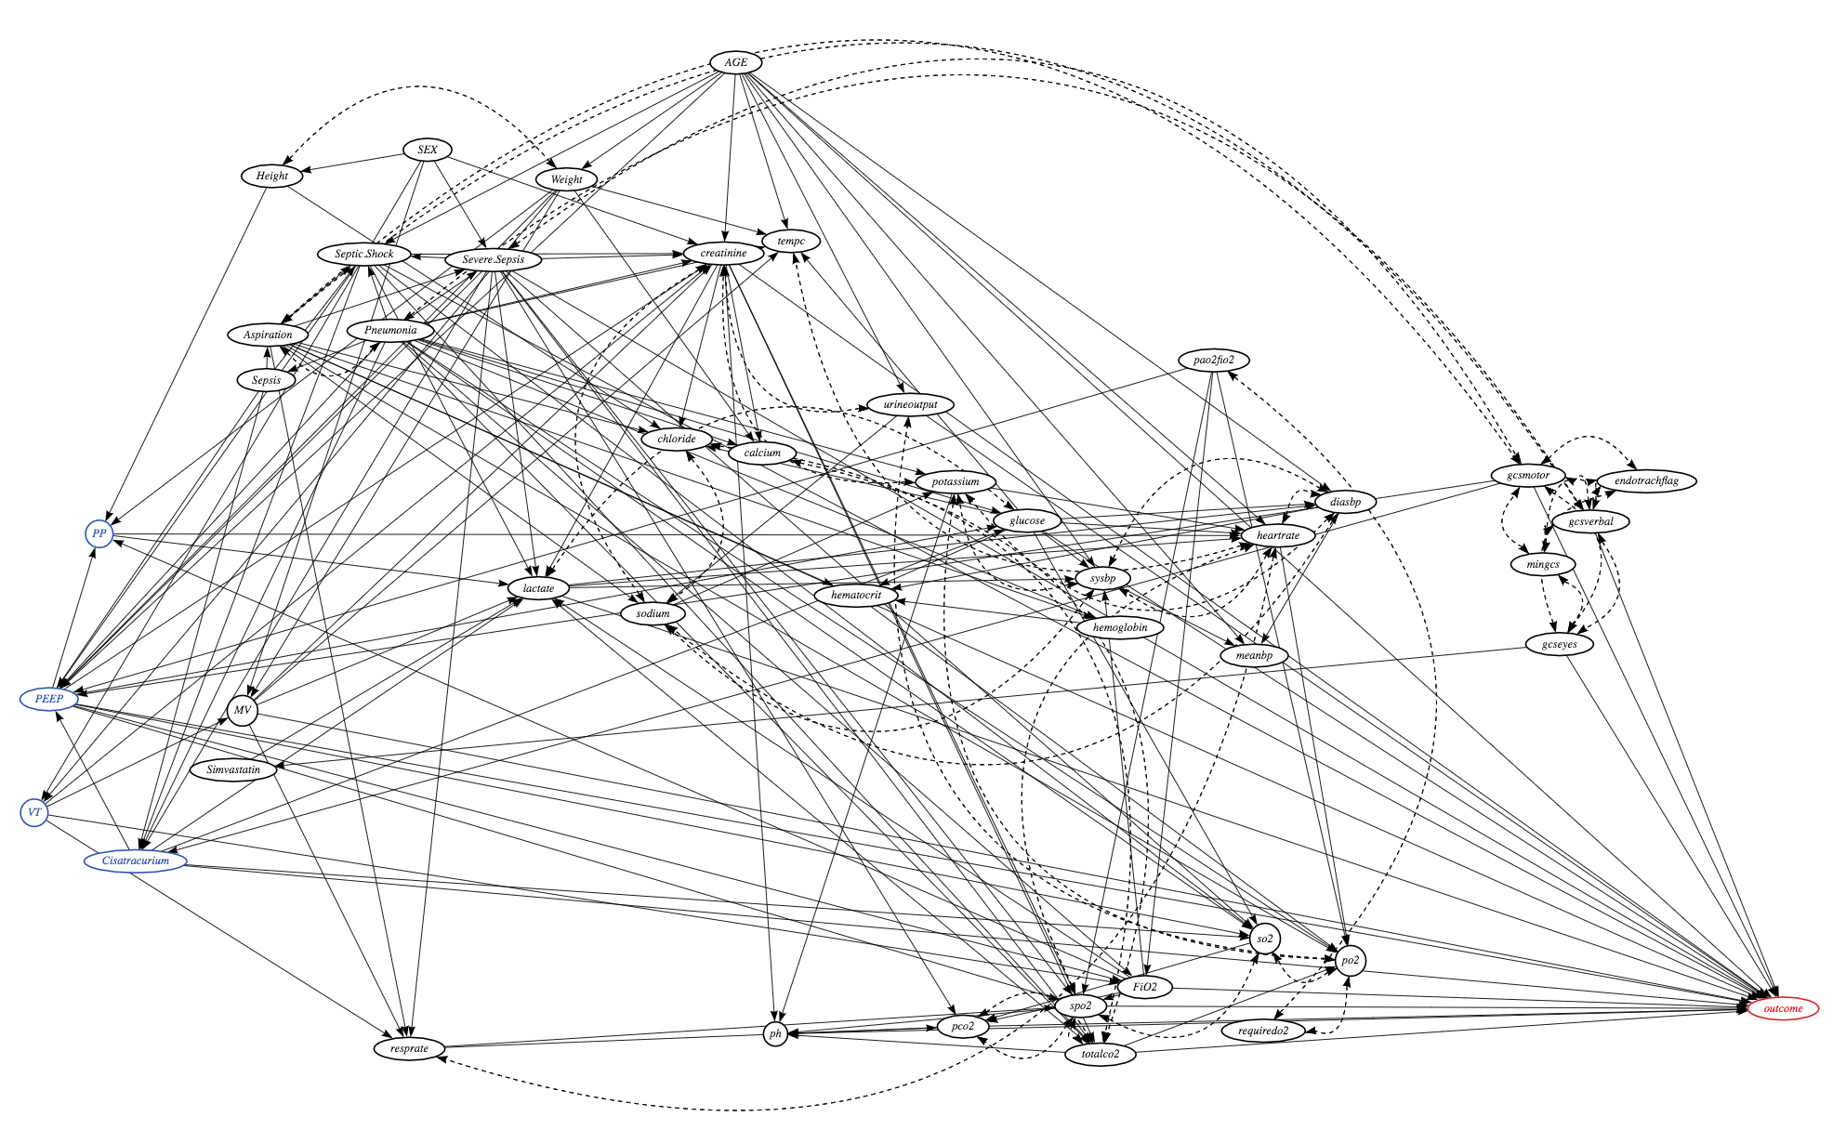

RCT 1: ARMA trial (ARDS Network 2000)
Causal question: Low tidal volume ($V_{T}=6)$(with low PP value setting) improve survival rate ($Y=1)$?
RCT2:ALVEOLI trial (ARDS network 2004)
Causal question: High Positive End Expiratory Pressure (PEEP) value improve survival rate?
RCT3: ACURASYS trial (Papazian 2010)
Causal question: NMBA (cisatracurium) treatment improve survival rate of ‘severe’ ARDS patients?

Slide 7
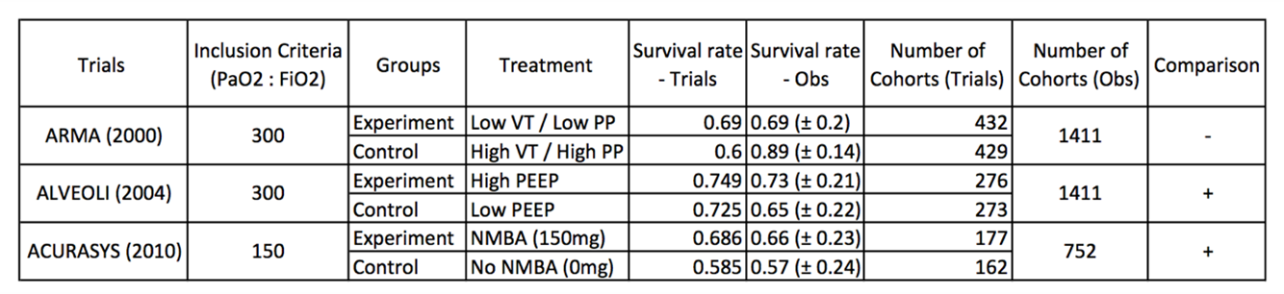
RCT 1: ARMA trial (ARDS Network 2000)
Causal question: Low tidal volume ($V_{T}=6)$(with low PP value setting) improve survival rate ($Y=1)$?
RCT2:ALVEOLI trial (ARDS network 2004)
Causal question: High Positive End Expiratory Pressure (PEEP) value improve survival rate?
RCT3: ACURASYS trial (Papazian 2010)
Causal question: NMBA (Cisatracurium) treatment improve survival rate of ‘severe’ ARDS patients?

Slide 8
Summary and Next Steps
We developed methods to reproduce results from RCT
The methods need to be improved with the time dependent protocol of RCT
Apply the method for relaxed inclusion-exclusion criteria to compute the efficacy-effectiveness gap.

