Slide 1
An open-access high performance computing system for developing research applications (apps)
Mohammad Adibuzzaman¹
¹Regenstrief Center for Healthcare Engineering, Purdue University, West Lafayette, USA
Mohammad Adibuzzaman, PhD
Assistant Research Scientist
madibuzz@purdue.edu

Slide 2
question
How do we use observational data for evidence based medicine?
Data Infrastructure
Translation

Slide 3
Data Infrastructure

Slide 4
Research to translation: big data in healthcare
Patient data
EHR
Device
Genomics
Integration
De-identification
Data broker
High Performance Computing
Analytics
Visualization

Slide 5
Research to translation: big data in healthcare
Big Data Preprocess
Reproduce/Evidence Based Medicine/FDA Approval
High Performance Computing
Publication
Analysis/Code

Slide 6

Janitor work?

Slide 7
Proposed architecture
Big Data
High Performance Computing
Analysis
Reproduce/Analysis
Publication
Publication
Evidence Based Medicine/FDA Approval

Slide 8
Multi-parameter Intelligent Monitoring in Intensive Care (MIMIC II)
MIMIC III
Clinical Database
Waveform Database
Matched Subset
58,000 Hospital Admission
2001-2012
Nurse entered physiology
Medications
Laboratory data
Nursing notes
Discharge notes
Format: CSV, SQL
~40GB
23,180 Records
2001-2012
Waveforms
ECG
Blood pressure
Plethysmography
Format: Text, Matlab
~3TB Compressed
4,897 Waveform and 5,266 Numeric records matched with 2,809 clinical records

Slide 9
Mimic iiI Access Platform
Clinical
PostgreSQL
CSV
Waveform
Physiobank ATM (one by one)
Rsync (batch) (install rsync in Ubuntu by the command)
sudo apt-get -y install rsync
Matlab WFDB (Waveform database) toolbox
rdsamp('mimic2wdb/31/3141595/3141595_0008')

Slide 10
Limitations of current platform
High level browsing and exploration of the database
How many patients with Acute Kidney Injury
Integration of heterogeneous data sources
SQL and Waveform or Text
Cohort selection according to research goal based on clinical criteria,
At least 8 hours of continuous minute by minute HR and BP trend within the first 24 hour of admission
Reproduce different machine learning and statistical algorithms.
Logistic Regression
Multivariate Regression
Artificial Neural Network
5. No parallelism

Slide 11
Research with mimic database
Most of the studies use only Clinical database

Slide 12
Proposed architecture
Platform
Clinical
PostgreSQL
Waveform
SciDB
Integration
R
Interface
R/Shiny
SciDB Capabilities
CROSS_JOIN: Combine two arrays, aligning cells with equal dimension values
MERGE: Union-like combination of two arrays
WINDOW: Apply aggregates over a moving window
window(input, NUM_PRECEDING_X, NUM_FOLLOWING_X, NUM_PRECEDING_Y...,aggregate(ATTNAME) [as ALIAS] [,aggregate2...])
SORT: Unpack and sort
UNIQ: Select unique elements from a sorted array
KENDALL, PEARSON, SPEARMAN: Correlation metrics
Distributed Computing

Slide 13
Proposed architecture
Waveform Database
Bash/ Python
SciDB (Distributed DB) ICU Time Series
‘R’/Shiny
Postgres (Single Server DB) Clinical Data

Slide 14

Waveform database design in scidb
MIMIC_Metadata
MIMIC_Numeric
Elapsed_Time
File_ID
File_ID
Start_Time: datetime, mimiciii_id: int32
II:float, V: float, resp: float,…

Slide 15
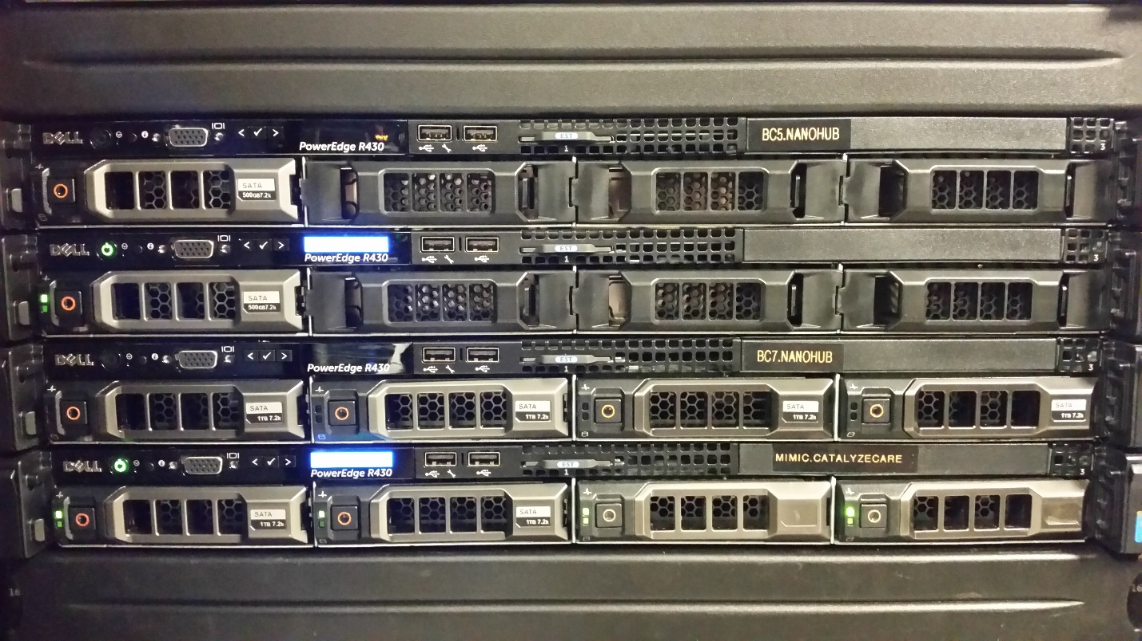
hardware
12 cores (24 hyperthreaded cores).
6TB disk
64G RAM
8 instances of SciDB

Slide 16
Use case One
http://www.fda.gov/Drugs/DrugSafety/ucm504617.htm

Slide 17
Use case one
https://mimic.catalyzecare.org:3838/sample-apps/madibuzz/usecaseone/

Slide 18
Use case two
https://mimic.catalyzecare.org:3838/sample-apps/madibuzz/usecasetwo/

Slide 19
Issues to be addressed
Sustainability
Privacy/Security
Scalability

Slide 20
Translation: Causality from Observational Data

Slide 21
randomized control trial
effect of treatment /drug on outcome?”
To remove confounding bias
Demographic (age / sex / race)
Physiological (heart rate, etc.)
Sociological (income)
Randomizing patients
Case
(Treated, $X=1)$
Control
(Non-treated, $X=0$)
Analysis
Intervention effect of treatment to the outcome $(Y | do(X$)) (causal question)
$do(X)$: intervention on treatment X

Slide 22
Limitations of randomized controlled trial
Ethical/safety issues
Target patients are pregnant woman
Smoking / Non-smoking?
Limited samples
Limited number of patients.
Sampling bias
Cost
Time
Money

Slide 23
Alternative to rct: observational data
Question: Is it possible to find causal relationship given clinical knowledge and observational data?
1. Causal question
$$P(y|do(x))$$
Challenge
1. How to remove confounding bias in the model?
2. Model based on clinical knowledge
Z
Confounders
2. Which variables are needed and measured to analyze causal relationship?
Treatment
X
Y
Outcome
3. Observational data with Joint probability $P(x,y,z)$

Slide 24
Example RCT: effect of neuromuscular blocker on ards mortality rate
Example study: Papazian et al., New England Journal of Medicine (2010)
Patients from ICU
We have medical data from ICU (MIMIC)
Z
Confounders
Patients demographical values (age, sex), mechanical ventilator setting values, chart values, critical condition, etc.
Randomization
𝘅
X
Y
Treatment
Cisatracurium besylate
(NMBA)
Outcome
ARDS
mortality rate
339 Subjects (177 case / 162 control) in ICU / 11 sites (France)
Conclusion
67.8% of subjects taken drugs survives (90 days)
58.6% of subjects not taken drugs survives (90 days)
$$P_{RCT}\left(Y=+1 \right|do(X=x))= \left\{\begin{aligned}0.678 \text{if} x=1 (treated) \\ 0.586 \text{if} x=0 (nontreated)\end{aligned}\right.$$

Slide 25
Experiment design – cohort selection
Inclusion criteria
ARDS patients
Mechanical ventilated (MV).
(PaO2: FiO2) <= 300 (Berlin score) at any time Within 48 hours of ICU admission
A
Include patients Age >= 18
Include If CB is administered after Berlin score is measured or CB is not administered
Inclusion criteria
B
Yes
No
531
C
Cisatracurium Besylate (CB)
D
8056
Death in 90 days after the last day of CB taken
No
Death within 90 days of the last use of MV?
No
F
H
166
4006
Yes
Yes
365
E
G
4050

Slide 26
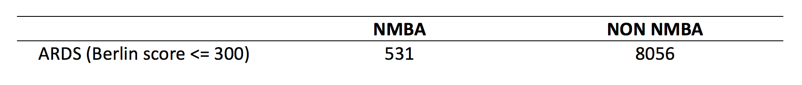
Experiment design
Available cohort from MIMIC

Slide 27
Causal diagram generation
NMBA
Demographic
variables
FO2
KG
Age
RR
MV
Berlin
PEEP
Sex
Mechanical ventilation setting value
SO2
PP
Chart values
PO2
PIP
PCO2
VT
pH
Y

Slide 28
Result summary
Observational studies
+/-
Intervention
RCTs
ARDSnet
(2000)
$P\left(y \right|do\left(V_{T}=high,PP=high\right),PEEP=low)$
$P\left(y \right|do\left(V_{T}=low,PP=low\right),PEEP=low)$
0.60
0.69
0.049
0.331
+
ARDSnet
(2004)
$P\left(y \right|do\left(PEEP=low\right),VT=low,PP=low)$
$P\left(y \right|do\left(PEEP=high\right),VT=low,PP=low)$
0.725
0.749
0.456
0.467
+
Papazian
(2010)
$P\left(y \right|do\left(NMBA=NO\right),VT=low,PP=low, PEEP=low)$
$P\left(y \right|do\left(NMBA=YES\right),VT=low,PP=low, PEEP=low)$
0.586
0.686
0.361
0.375
+
Others
$P\left(y \right|do\left(NMBA=YES\right),VT=low,PP=low, PEEP=high)$
$P\left(y \right|do\left(NMBA=YES\right),VT=high,PP=high, PEEP=high)$
$P\left(y \right|do\left(NMBA=NO\right),V_{T}=low,PP=low,PEEP=high)$
$P\left(y \right|do\left(NMBA=NO\right),VT=high,PP=high, PEEP=high)$
?
?
?
0.409
0.371
0.391
0.366
?

Slide 29
Revisit: architecture
Big Data
High Performance Computing
Analysis
Reproduce/Analysis
Publication
Publication
Evidence Based Medicine/FDA Approval

Slide 30
acknowledgement
Roger Mark, Professor, MIT
Alistair Johnson, Post-doctoral Researcher, MIT
Elias Bareinboim, Assistant Professor, Purdue University
Yonghan Jung, PhD Candidate, Purdue University
Yiyan Zhou, Undergraduate Student, Purdue University
Ananth Grama, Professor, Purdue University

Slide 31
Questions

