Slide 1




Big Data And AI in Health Sciences
Mohammad Adibuzzaman
Research Scientist, Purdue University
madibuzz@purdue.edu
@adibzaman
Notes:
Causally-driven Healthcare Science
From Observational and Experimental Studies to Personalized and Improved Patient Outcomes

Slide 2
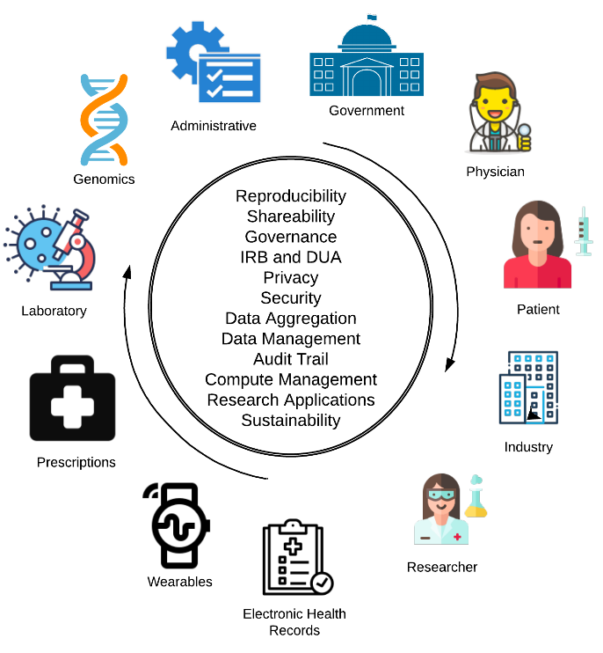
The Vision

Slide 3
Outline
My journey into healthcare
Major challenges
Data
Compute Framework
Artificial Intelligence methods

Slide 4
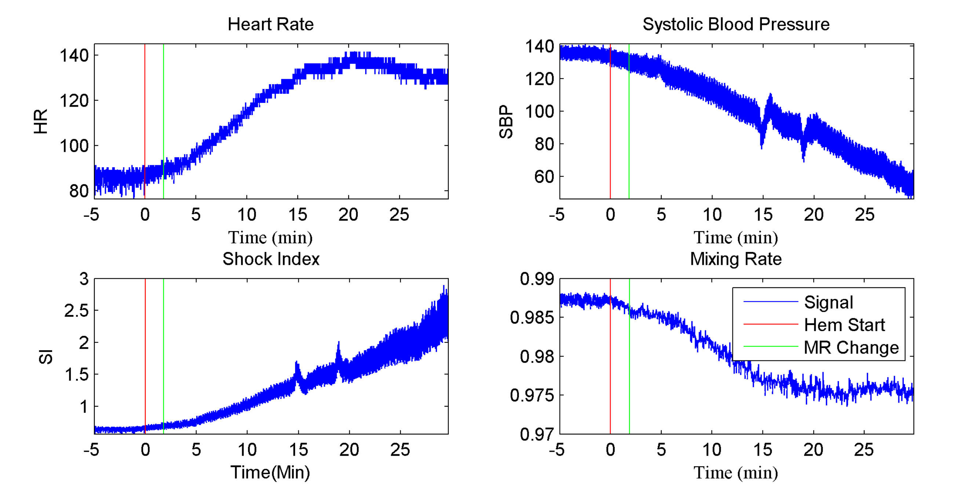
Hemorrhage Detection with animal study

Slide 5
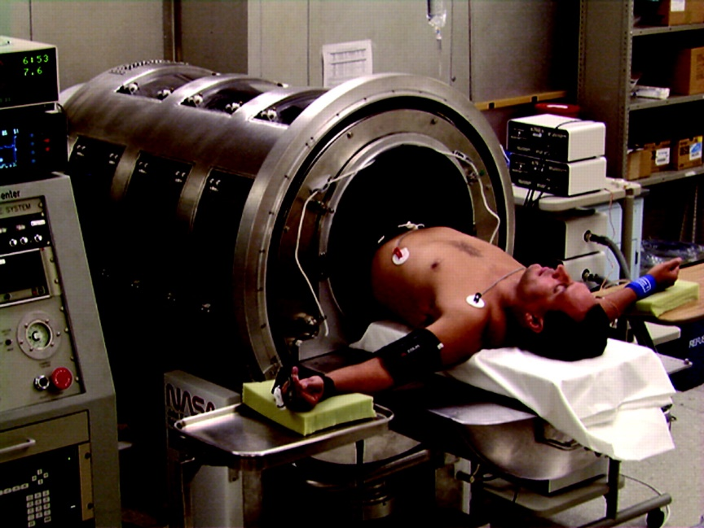
Reproducibility
Data
How do we test it in humans?
Simulated Hemorrhage
Data from hospitals
System
Reproducibility
Methods
Explainability
Risk and Benefit
Cooke, W. H., Ryan, K. L., & Convertino, V. A. (2004). Lower body negative pressure as a model to study progression to acute hemorrhagic shock in humans. Journal of Applied Physiology, 96(4), 1249-1261.

Slide 6

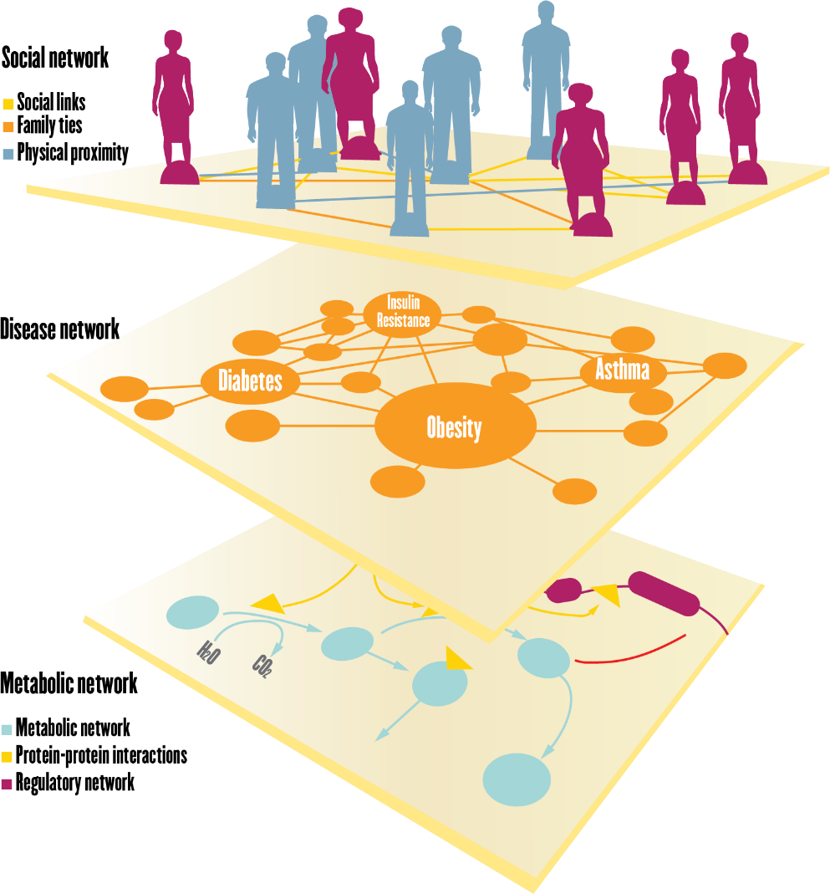
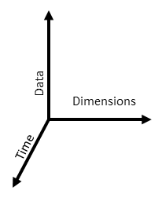
Big Picture
Dimensions of Life Sciences
Dimensions of Data Sciences

Slide 7
Data

Slide 8
Challenges with data
Hospital data is only a fraction of the data
Missing data
Automated data capturing to reduce physician burden and improve data quality
Data provenance
Data ownership
Data standardization

Slide 9
Computing Framework

Slide 10
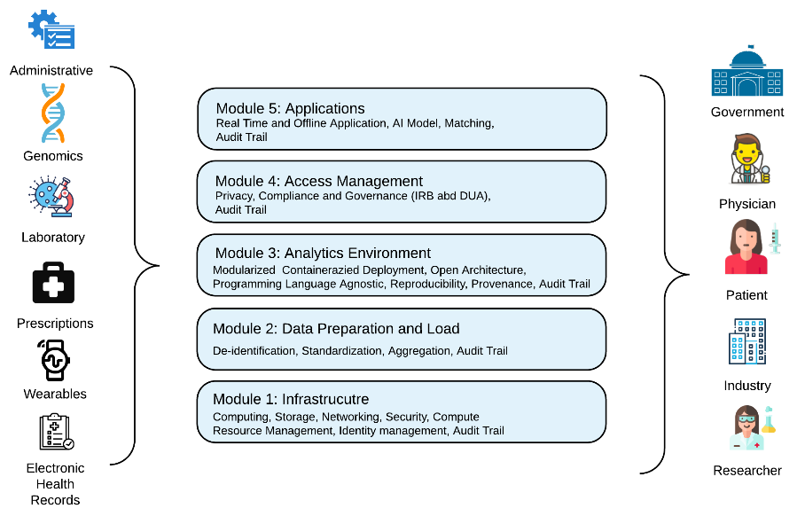
Computing framework

Slide 11



Computing framework: Current system
Open source technology
Scalable system
300TB data storage and computation
Currently supports SQL, images, time series
Demo
MULTIPLE DATA SOURCES
MIMIC III (Beth Israel Hospital EHR)
Cerner Health Facts (60M patients over 18 years)
Claims data
Indiana Medicaid (2012 to present)
Purdue Community (staff and families)

Slide 12
AI in Health Sciences

Slide 13
Key questions on Methods
Evaluation
Validation
Generalization
Risk and benefit
Explainability
What if/Counter-factual questions
Fairness and Digital Disparity

Slide 14
Randomized Controlled Trials
RCT: Randomized Controlled Trial
Ethical/safety issues
Limited samples
Cost
… or simply not possible

Slide 15
Structural Theory of Causation – Judea Pearl
Observational Study
RCT
Confounders
Confounders
Z
Mathematical Transformation
Z
Bias(Confounding)
Treatment
X
Y
Outcome
Treatment
X
Y
Outcome

Slide 16
Causal inference framework using observational data
Key Questions
1. How to derive structure (model)?
2. How do we scale the algorithms with thousands of variables (reduced order causal graph)?
3. How to compute hazard ratios, risk ratios with causal models (survival analysis)?
4. Optimal treatment with reinforcement learning with causal model.
5. Time varying causal effect with Structure causal model
6. Missing data handling with SCM

Slide 17
Acknowledgement
Ananth Grama, Professor, Computer Science, Purdue University
Paul Griffin, Director, Regenstrief Center for Healthcare Engineering, Purdue University
Elias Bareinboim, Associate Professor, Columbia University
Roger Mark, Professor, MIT
Fatemeh Rouzbeh, Graduate Student, Computer Science, Purdue University
Yonghan Jung, Graduate Student, Computer Science, Purdue University
And many others…..

