Slide 1


TERRORISM ANALYSIS WITH INSIGHTS
Presented By:-
Kratika Kothari
Muskan Chouhan
Sanya Tare
Sapnesh Khandelwal

Slide 2
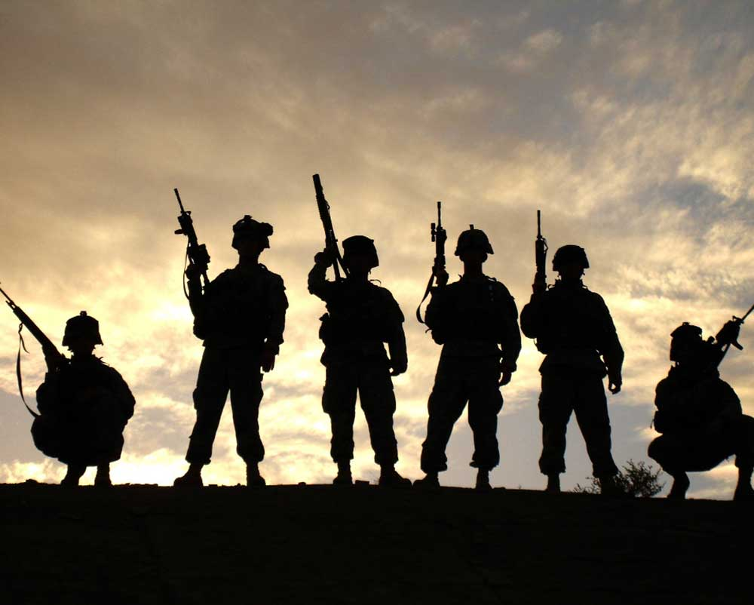
Topics to be Covered
Topics to be Covered:-
Problem Domain
Literature Survey
Feasibility Study
References

Slide 3
Problem Domain :-
Introduction
Data Analysis domain project with powerful visualisation.
Predictive analysis tool which helps to find trendline of each kind of attack (Bombing, hijacking) across the world.
Analysis, filtering and visualisation on 1.9 lakhs records.
It will help in proper allocation of resources like army, ED dogs, protective vehicles etc.
Social cause:- Save a lot of lives.

Slide 4
Problem Domain :-
Problem Statement
“TO GET INSIGHTS OF WORLD TERRORISM DATA”
Protective vehicles are less in numbers with the Army.
Explosive Detection Dogs ( ED Dogs ) are also less .
This tool will help in finding the concentration of attack type.
Visualizing the data gives clear patterns about the data and makes it easy for analysis.
Designing a Dashboard for Analysi

Slide 5
Literature Survey :-
Work done by others
Terrorism Research and Analysis Project (TRAP): A Collection of Research Ideas, Thoughts, and Perspectives, V. 1
Terrorism knowledge discovery project : A knowledge discovery approach to addressing the threats of terrorism

Slide 6
Literature Survey :-
Existing problem
Ever since the 9–11 incident, the multidisciplinary field of terrorism has experienced tremendous growth.
Recent advances in information technologies, more complex and challenging new issues have emerged from numerous counter-terrorism-related research communities as well as governments of all levels.
Designing a Dashboard for Analysi

Slide 7
Literature Survey :-
Proposed solution
Designing a Dashboard for Analysis and powerful visualisation.
Helps the client(military and government) to view and collect insights of the terrrosim analysis data.
Using multiple filters and dropdowns, the data is filtered as per user requirements and the data is shown in terms of maps and charts tools colorfully.

Slide 8
Literature Survey :-
Proposed solution
It helps in identifying different types of attacks in map tool and progression of attacks in chart tools with respect to year, month,country, date,day etc.
Year slider to filter data based on year.
The dataset we have used -Global Terrorism Database (GTD) documents (1970-2018)

Slide 9
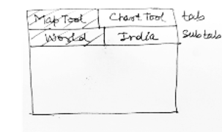
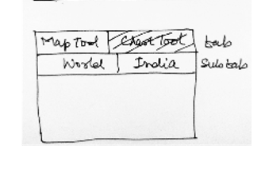
Literature Survey :-
Wireframe Model
Map Tool Chart Tool

Slide 10
Literature Survey :-
Technology Used
Python :-best emerging language as it is simple to learn and has various l libraries.
Dash framework :- Python framework for powerful visualization
HTML :- for structuring of GUI
CSS :- for styling of GUI

Slide 11
Literature Survey :-
System requirements
Processor Type: Intel i3, i5 or higher
RAM: 4 GB or above
Disc Space: 250 GB
Software requirements
OS : Microsoft Windows 7,8,10, Mac,Linux
Language: Python 3.x +
Python Framework: Plotly’s Dash
Python IDE or Command Prompt
Web Browser like Google Chrome etc.

Slide 12
Feasibility Study :-
Feasibility is defined as the practical extent to which a project can be performed successfully.
To analyze whether the software will meet organizational requirements.
To determine whether the software can be implemented using the current technology and within the specified budget and schedule.
To determine whether the software can be integrated with other existing software.

Slide 13
Feasibility Study :-
Technical Feasibility:-
It helps organizations determine whether the technical resources meet capacity and whether the technical team is capable of converting the ideas into working systems.
______________________________________________________________
Python is an emerging and demanding technology in IT world.
Python is an excellent tool for data analysis and visualisation.
Python is easy to use, powerful, and versatile, making it a great choice for beginners and experts alike.

Slide 14
Feasibility Study :-
Operational Feasibility:-
Determines whether the problems anticipated in user requirements are of high priority.
Determines whether the client is satisfied by the alternative solutions proposed by the software development team.
Our python script directly will directly open a web page in the browser with a Descent and Usable Interface.

Slide 15
Feasibility Study:-
:-
Economical Feasibility:-
Determines whether the required software is capable of generating financial gains for an organization.
Cost required for hardware, software, development team, and training.
_____________________________________________________________________
Python is free,open source and platform independent.
Also, it has very powerful libraries for data analysis and visualisation like pandas and dash framework.

Slide 16
References :-
https://www.python.org/
https://plotly.com/dash/
https://www.kaggle.com/START-UMD/gtd
https://bookstore.gpo.gov/products/terrorism-research-and-analysis-project-trap-collection-research-ideas-thoughts-and
https://link.springer.com/chapter/10.1007/978-3-540-71549-8_1

Slide 17



.

