Slide 1
DAM, AMD and CDN Architecture
Georgia Pacific

Slide 2
Definitions
DAM: Digital Asset Management system at Georgia Pacific based on the OpenText Digital Asset Management (OTMM, also known as SAP DAM) system.
AMD: Adaptive Media Delivery module provided by OTMM as a free feature that allows assets to be delivered directly from within OTMM repository. It is designed to be scalable, provides caching and integration into CDNs.
CDN: Content Delivery Network services that provide an efficient distribution of content to different physical parts of the work in order to speed the load times of content from end-user systems.

Slide 3
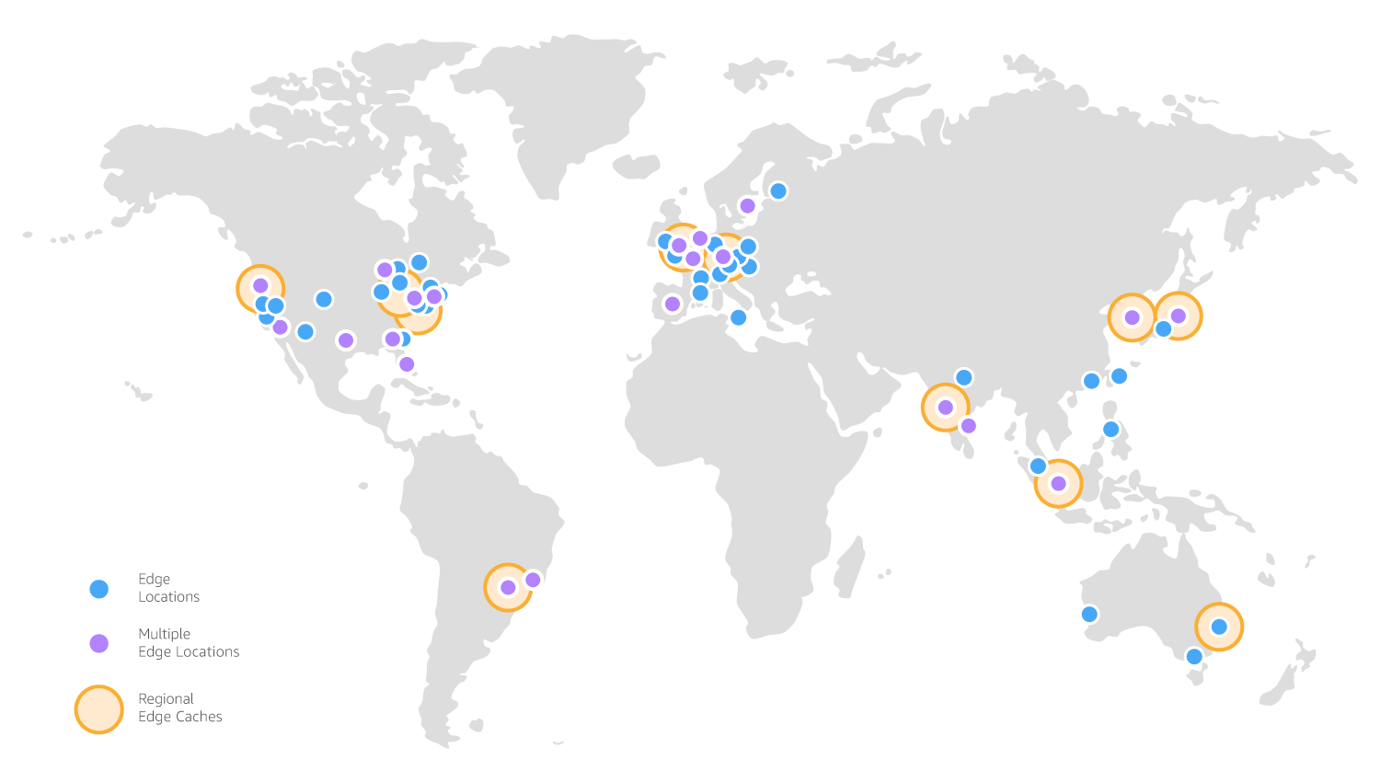
Commerce Site
Commerce Site
Commerce Site
Commerce Site
OTMM
AMD
Commerce Site
3
Edge Server
Edge Server
Edge Server
5
2
7
6
4
Edge Server
Local Cache
File Repository
Edge Server
8
1
Commerce Site

Slide 4
Data Flow
Email Recipient opens the email and the images are loaded by executing a GET request to the CDN URL. This is handled by the closes Edge server to the user.
Edge server checks the cached image and if it is not found, it requests it from the Origin server, which is the AMD server. If the image is cached, the image is returned immediately.
AMD checks its local cache. If it is not in the local cache, it requests the image from OTMM. If the image is in the local cache, it is delivered to Edge server.
OTMM retrieves the image from repository.
OTMM returns the original image to AMD where AMD converts the image to the format that is requested in the URL.
AMD stores the image in local cache for future requests.
AMD returns the image to the Edge server and caches it internally for future requests.
Edge server returns the image to the end client.

Slide 5
www.cyangate.com
Address : 8593 Concord Hills Cir Phone : + 1 (833) DAM XPRT
Cincinnati, OH, 45243, USA Email : info@cyangate.com

