Slide 1
Adi-Iris
Enhancing User Experience using eye tracking

Slide 2
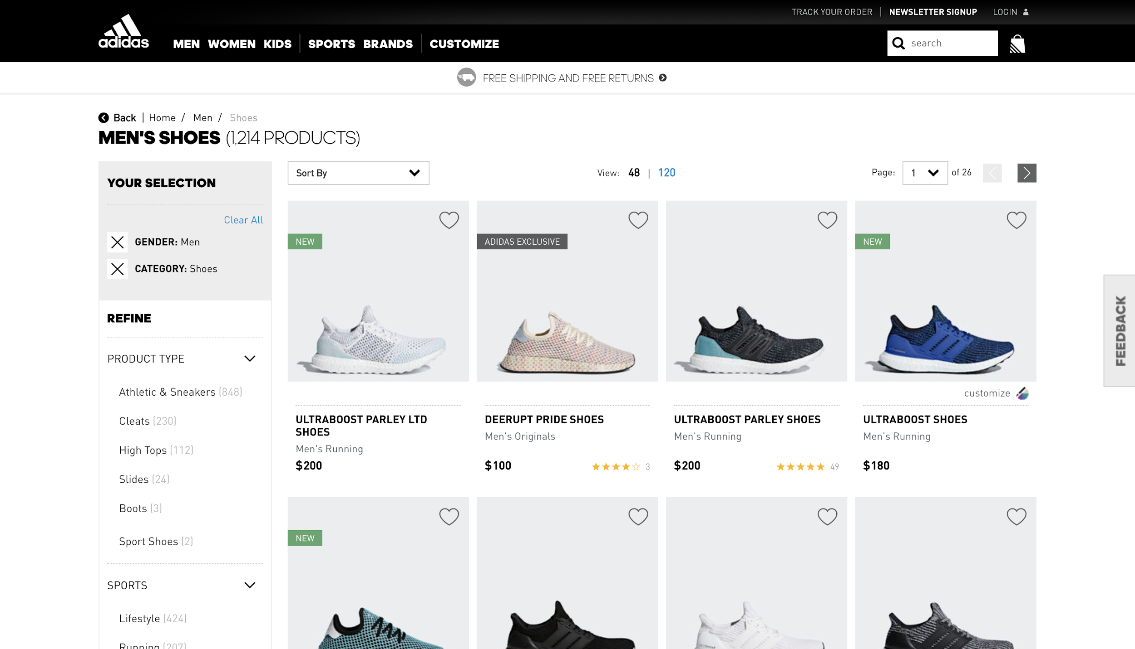
Current situation
Notes:
Seemless experience

Slide 3
About Adi-Iris
Using front camera to track users’ gaze

Slide 4
About Adi-Iris
Using front camera to track users’ gaze
Can detect preferences and trends

Slide 5
About Adi-Iris
Using front camera to track users’ gaze
Can detect preferences and trends
Emotion recognition

Slide 6
About Adi-Iris
Using front camera to track users’ gaze
Can detect preferences and trends
Emotion recognition
Multiple ways of personalizing the Shopping experience

Slide 7
About Adi-Iris
Using front camera to track users’ gaze
Can detect preferences and trends
Emotion recognition
Multiple ways of personalizing the Shopping experience
Uses no additional hardware

Slide 8
See it in action

Slide 9
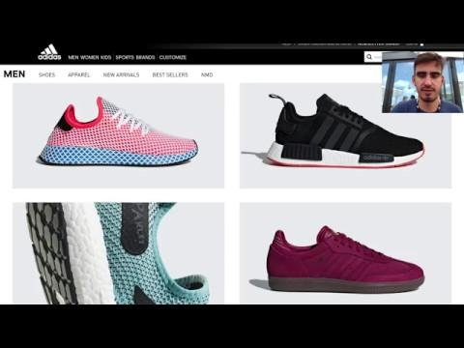

Slide 10
Visualizing the gaze

Slide 11
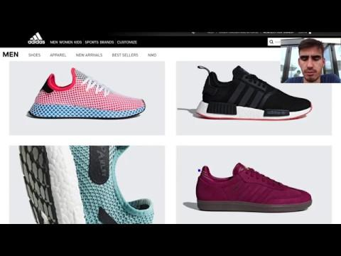

Slide 12
Emotions
Microsoft Emotion API

Slide 13
Emotions
Microsoft Emotion API
Map users’ emotions to products

Slide 14
Emotions
Microsoft Emotion API
Map users’ emotions to products
Better in-store personalization

Slide 15
Microsoft Emotion API
JSON: [ { "faceRectangle": { "top": 108, "left": 143, "width": 221, "height": 221 }, "scores": { "anger": 1.77309466E-05, "contempt": 2.764054E-08, "disgust": 8.893126E-06, "fear": 0.7983925, "happiness": 2.19102319E-07, "neutral": 3.776721E-06, "sadness": 0.003153762, "surprise": 0.198423117 } } ]

Slide 16
Privacy
Using front camera to track users’ gaze

Slide 17
Privacy
Using front camera to track users’ gaze
All data is client-side

Slide 18
Privacy
Using front camera to track users’ gaze
All data is client-side
Users can opt-out of data collection

Slide 19
Privacy
Using front camera to track users’ gaze
All data is client-side
Users can opt-out of data collection
Camera feed is never sent over the web

Slide 20
Ways of improving it
Use better Web cameras

Slide 21
Ways of improving it
Use better Web cameras
Lighting and surroundings

Slide 22
Ways of improving it
Use better Web cameras
Lighting and surroundings
Neater calibration

Slide 23
Ways of improving it
Use better Web cameras
Lighting and surroundings
Neater calibration
More advanced AI algorithms

Slide 24
Tech we’ve used
WebGazer JS - tracks eyes
HTML/CSS/JS - normalize the data from WebGazer, create the effects when gaze stays on a product
Lots of libraries for backend eye-tracking, but we would need to set up hosting, a backend framework, libraries that we need to use, possibly CI/CD - time consuming

Slide 25
Live Demo
Feel free to come to us after the presentations to see our idea in action!

