Slide 1

COMPETIZE
Amateur real-time sports
Streaming + Engagement

Slide 2
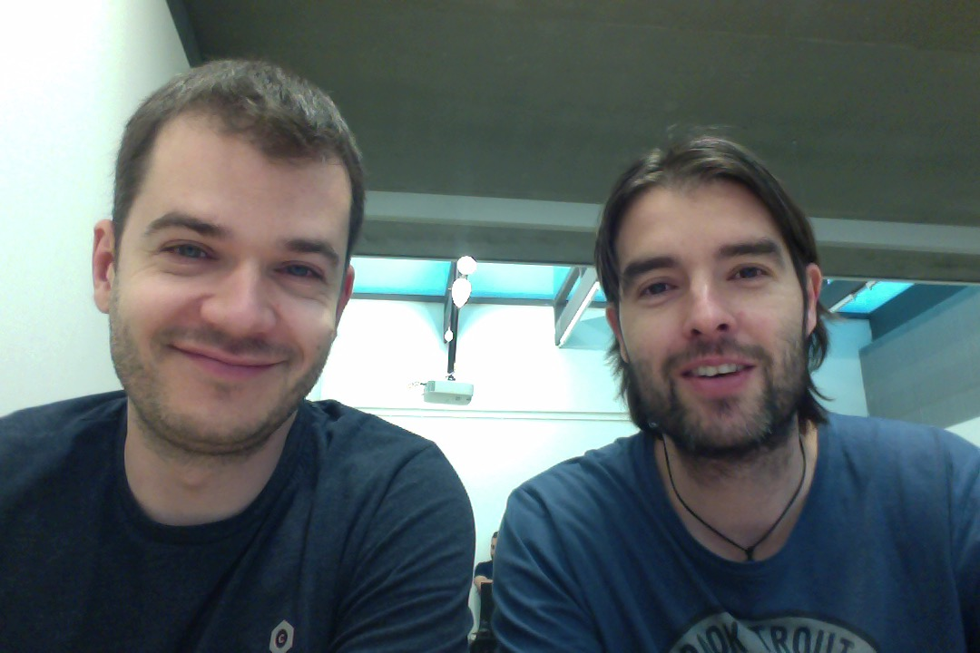
TEAM
Fran Rodríguez
(Telefónica R&D)
Jesús Gumiel
(Competize)

Slide 3
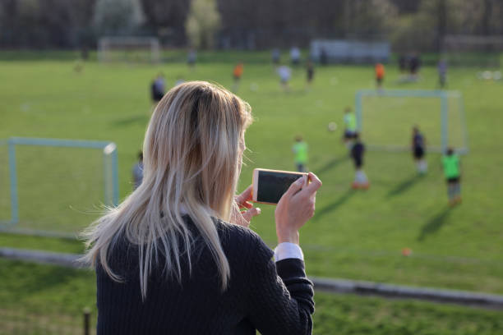
PROBLEMS OF AMATEUR SPORTS GAMES
Attending the games is difficult
No best moments of the game
Watching the full match…. so boring…

Slide 4




Custom TV channel for your games with easy highligths generation and social engagement
Don’t miss a goal
Share your achievement
Real-time streaming
Clips generation with the most important moments of the game
Sharing the highlights of the game on social networks is just one click ahead
Watch the game everywhere as it was a professional one

Slide 5
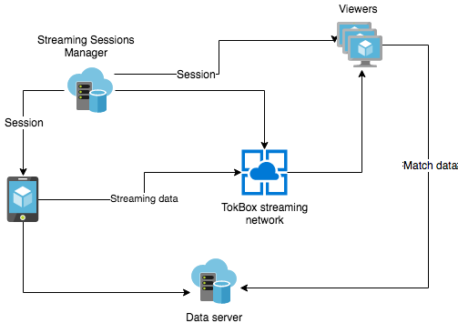
ARCHITECTURE
Web RTC
Streaming
Web RTC
Streaming

Slide 6
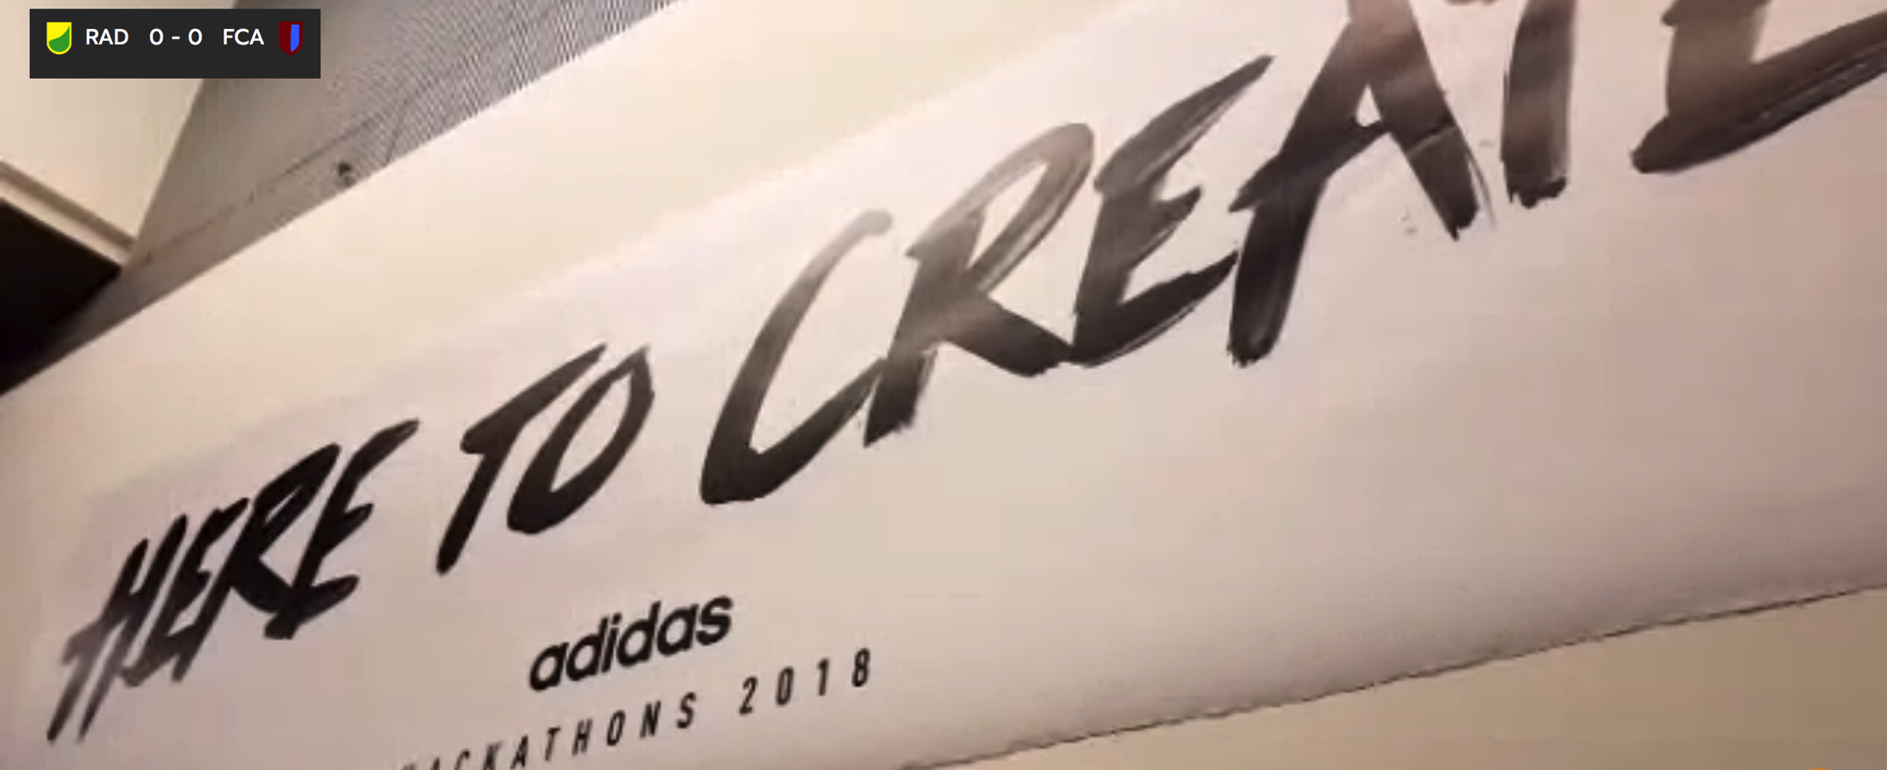
DEMO
https://goo.gl/39rbLr

Slide 7

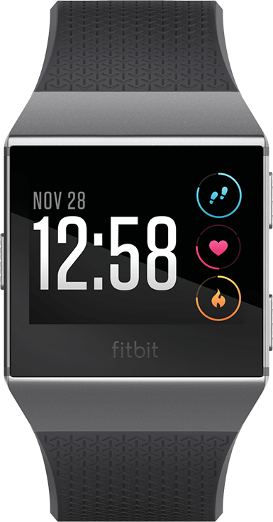
ROADMAP
Integration with Competize platform to add teams, players and competitions information.
Automatize data input using sensors and NFC technology.
Wearable integration to generate clips on your own.

Slide 8

jegumi@competize.com
franciscojrp@gmail.com
THANKS

