Slide 1
DATAIKU ASSESSMENT · DATA SCIENCE
Who Earns Over $50K?
Predicting Income from US Census Data
A Deep-Dive Into 347 Million Americans · 1994–1995 Census Bureau Data
199K+
40
347M
3
Training records
Features
Americans represented
Models compared
CONFIDENTIAL · 2026

Slide 2
OVERVIEW
Today's Agenda
01
Business Context
04
Modelling Approach
Why predict income? The allocation problem.
Three competing models: Logistic Regression, Random Forest, LightGBM.
02
The Dataset
05
Results & Interpretation
347M Americans, 40 signals, two years of census data.
ROC-AUC 0.955 · PR-AUC 0.677 · SHAP explainability.
03
Key Findings from EDA
06
Takeaways & Next Steps
Education, age, capital income, and demographic patterns.
Findings, honest limitations, and deployment considerations.
20 min presentation + 20 min Q&A — feel free to interrupt with questions at any point

Slide 3
SECTION 01 · BUSINESS CONTEXT
Why Predict Income? The Allocation Problem
$4T+
Federal funding allocated annually using Census income data — hospitals, schools, fire departments, infrastructure
Policy
A predictive model flags under-served populations and identifies data quality issues at scale
Question
What characteristics predict whether a person earns ≥ $50,000/year?
Dual Role
Both a classification problem and a policy analysis tool — technical rigor meets real-world impact

Slide 4
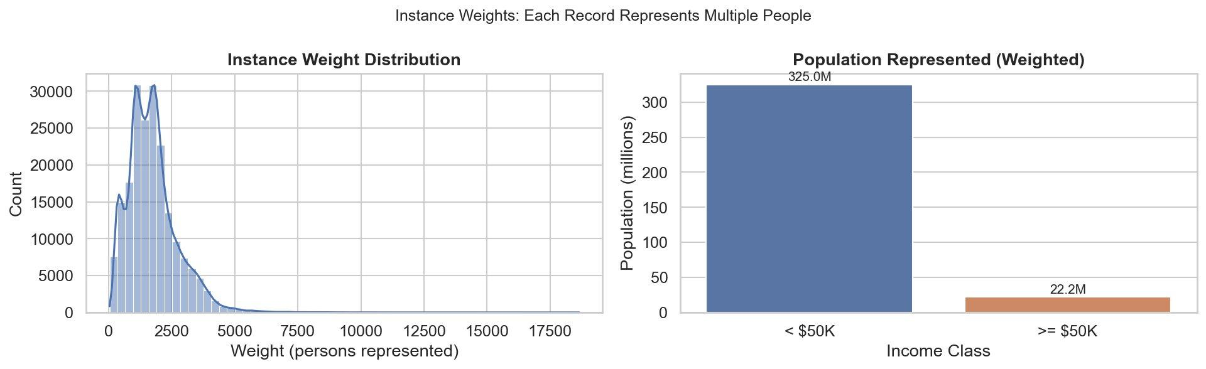
SECTION 02 · THE DATASET
The Data: 347 Million Americans in Two Years
199,523
99,762
40
347M
Training records
Test records
Features per individual
Americans represented
Feature Categories
Continuous
Age, weeks worked, wage/hr, capital gains, capital losses, dividends
Categorical
Education, marital status, occupation, industry, race, sex, citizenship, tax filing, household
Special
Instance weights (col 24): each record represents thousands of real Americans — used for population statistics, excluded from model features
Each record represents thousands of real people

Slide 5
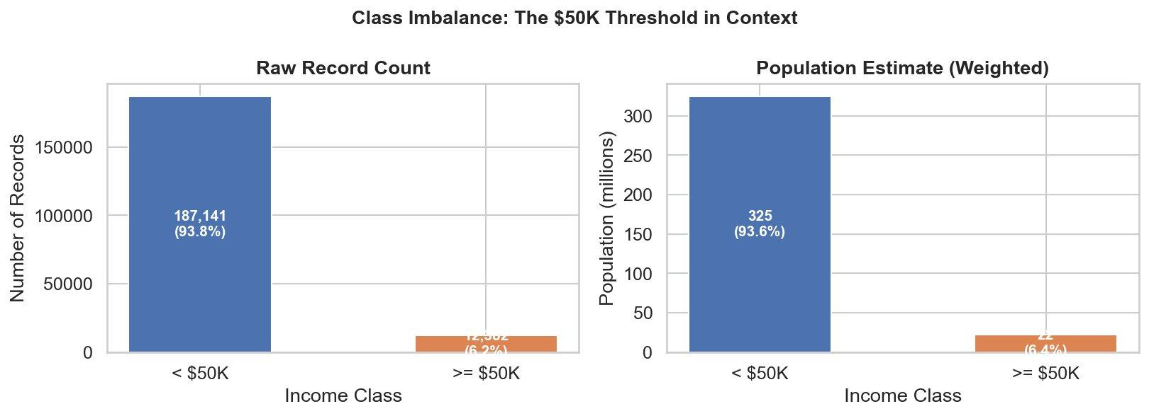
SECTION 02 · THE DATASET
The 6.2% Problem: Why Accuracy Is Misleading
93.8%
Income < $50K
6.2%
Income ≥ $50K (~22M Americans)
Use ROC-AUC & PR-AUC, not accuracy
KEY INSIGHT A model that always predicts '<$50K' scores 93.8% accuracy — and is completely useless. Class imbalance drives every modelling decision downstream.

Slide 6
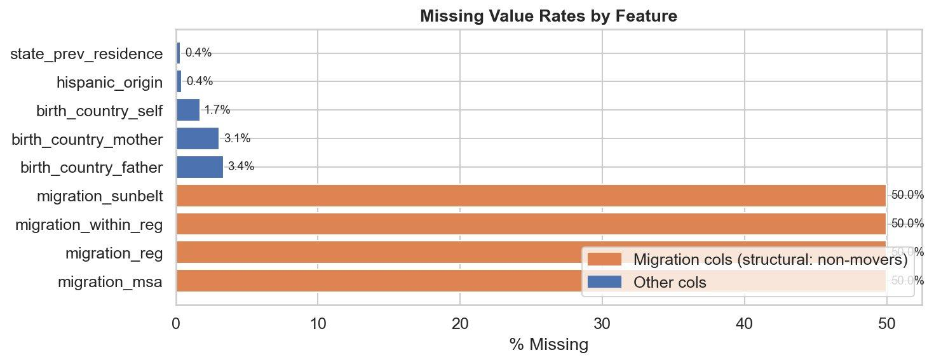
SECTION 02 · THE DATASET
Data Quality: Migration Columns Require Special Treatment
Migration cols (50%)
Structural missingness — these records belong to non-movers for whom migration data is undefined, not randomly absent. Imputation would be inappropriate.
Country of birth (1–3%)
Minor missingness, likely MCAR. Standard imputation (mode for categoricals) is appropriate.
Strategy
Migration columns: add binary 'is_mover' indicator + fill 'Not_in_universe'. Country cols: mode imputation. No imputation for model features that are fully observed.

Slide 7
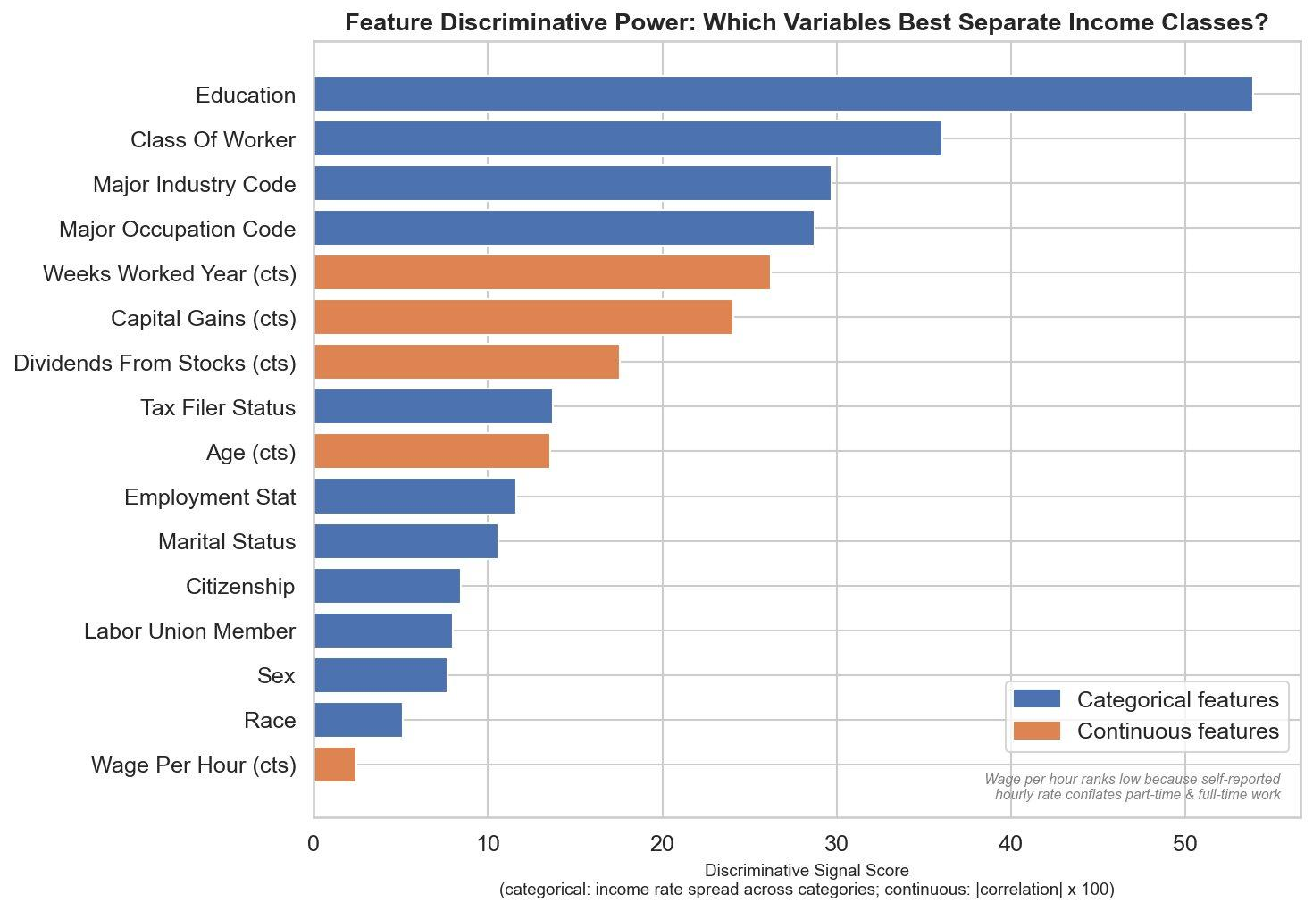
SECTION 03 · KEY FINDINGS FROM EDA
What Predicts Income? A Roadmap of the Top Signals
#1 Education
Largest single discriminator. The bachelor's degree is the structural inflection point.
#2 Class of Worker
Government vs self-employed vs private sector differ substantially.
#3–4 Industry & Occupation
Sector matters as much as seniority.
Capital Income
Despite covering only 3.7% of population, capital gains/dividends signal high earning with 6x lift.
Low: Wage/hr
Self-reported hourly rate conflates part-time and full-time — annual weeks worked is far more informative.

Slide 8
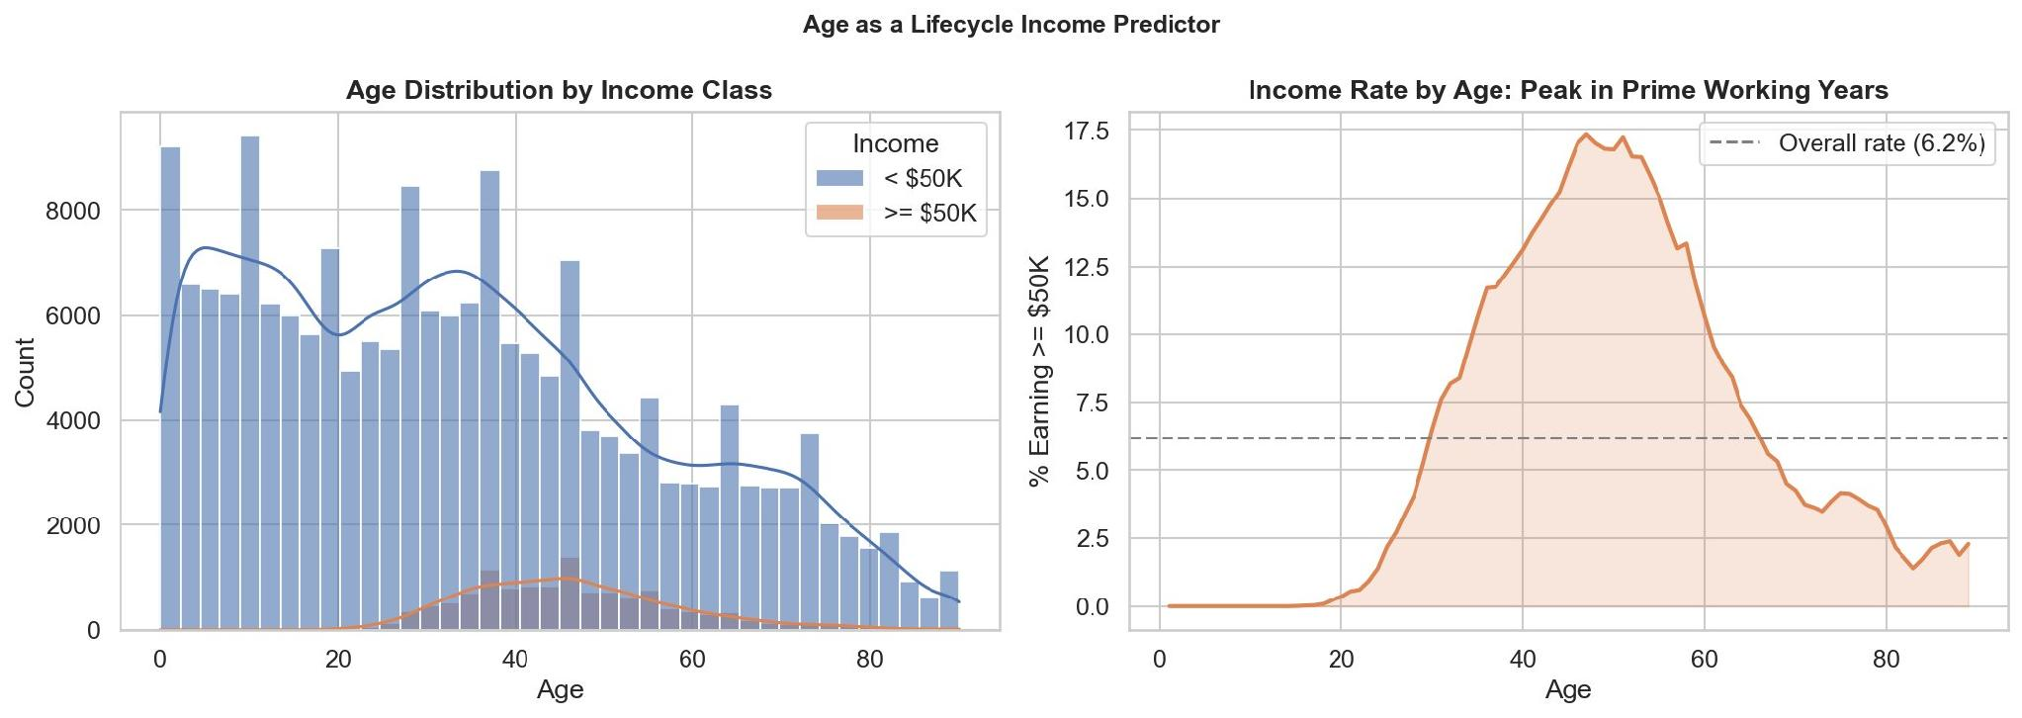
SECTION 03 · KEY FINDINGS FROM EDA
Portrait of a High Earner: Who Are the 22 Million?
Attribute | High Earner (≥$50K) | Typical American
Age | 45–54 years (peak income decade) | 35–44 years
Education | Bachelor's degree or higher | High school diploma
Marital Status | Married, civilian spouse present | Never married / other
Employment | Full-time, full year (52 weeks) | Variable
Capital Income | Present — gains or dividends | Absent (96% of population)
Weeks Worked | ~52 weeks (full year) | ~40 weeks
KEY INSIGHT High earning is not one trait — it's a compound of education, age, work attachment, and asset ownership that reinforce each other.Income rate peaks in the 45–54 age decade, then declines toward retirement

Slide 9
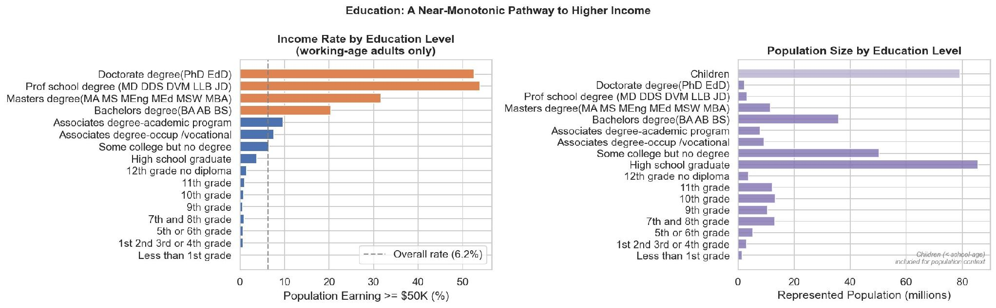
SECTION 03 · KEY FINDINGS FROM EDA
Finding 1 — The Education-Income Ladder
% Population earning >= $50k
3–4% · High school grad income rate (near population average of 6.2%)
~20% · Bachelor's degree — the major structural inflection point
~52% · Doctoral/professional degree — double the bachelor's rate

Slide 10
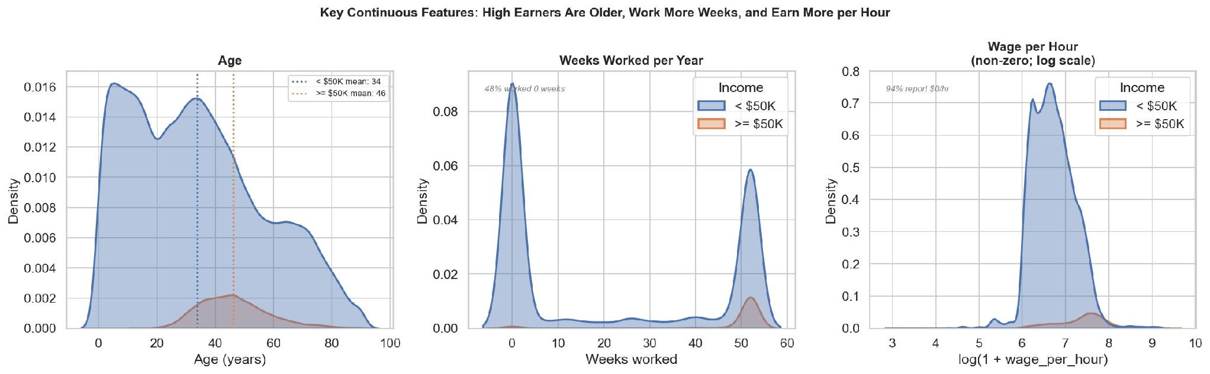
SECTION 03 · KEY FINDINGS FROM EDA
Finding 2 — Age as a Life cycle Income Predictor
KEY INSIGHT High earners are ~12 years older on average (mean 46 vs 34). They also work significantly more weeks per year — 48 vs 22. Age and work intensity compound each other.

Slide 11
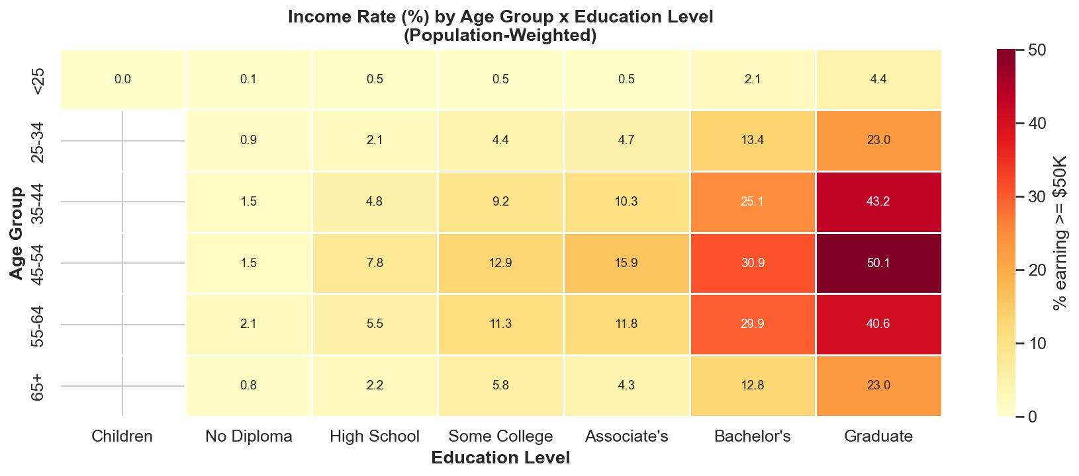
SECTION 03 · KEY FINDINGS FROM EDA
Finding 2b — Age × Education: The Compound Effect
KEY INSIGHT A 45–54 year old with a graduate degree has a 50.1% income rate — 8× the population average. Age and education interact multiplicatively, not additively.

Slide 12
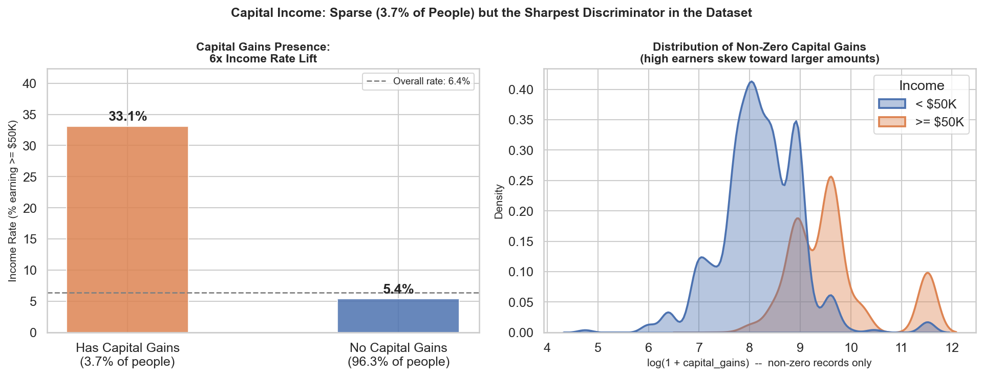
SECTION 03 · KEY FINDINGS FROM EDA
Finding 3 — Capital Income: Sparse but Extraordinarily Powerful
3.7%
33% vs 5%
Binary signal
Only 3.7% of records have capital gains
High Income rate for those with vs. without capital gains — 6.6× lift
Presence matters more than amount — a binary flag outperforms the raw value

Slide 13
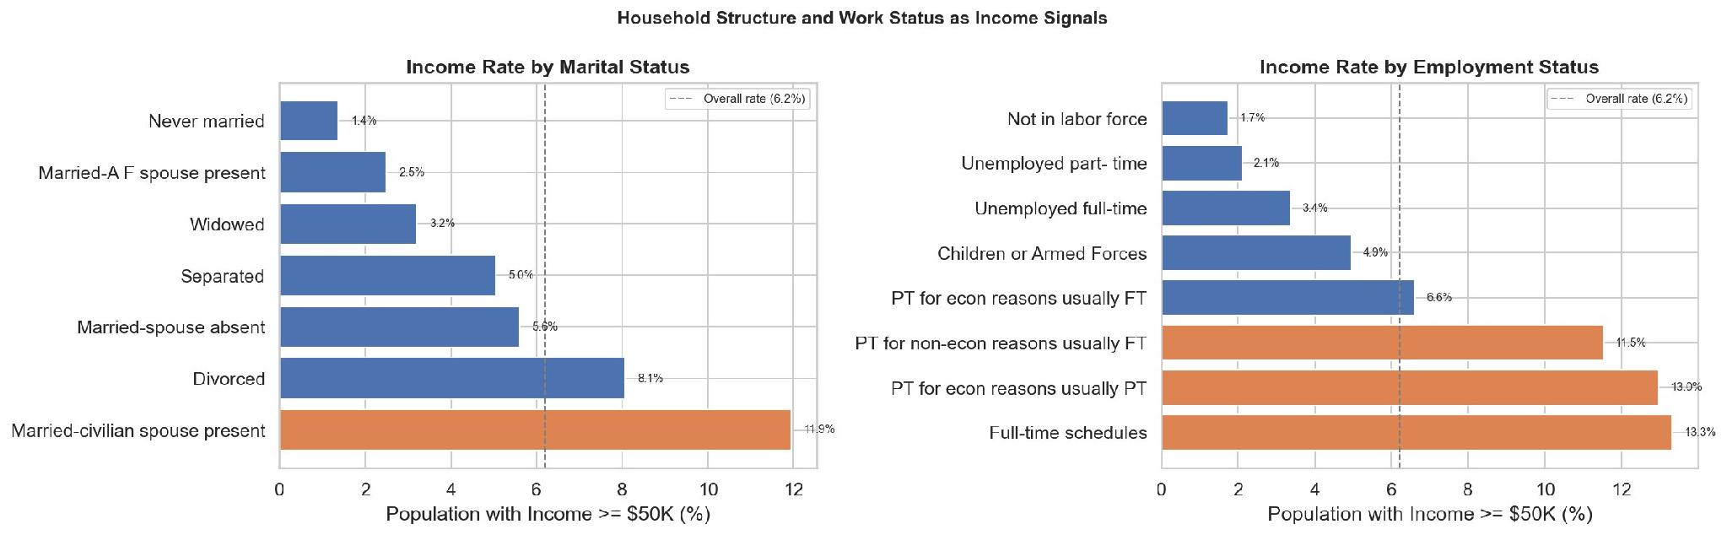
SECTION 03 · KEY FINDINGS FROM EDA
Finding 4 — Household Structure and Work Status as Income Signals
KEY INSIGHT Married-civilian-spouse-present households have 11.9% high income rate — nearly double divorced, and 8× never-married. Full-time workers at 13.3% vs not-in-labor-force at 1.7%. Household structure proxies for career stage and economic stability.

Slide 14
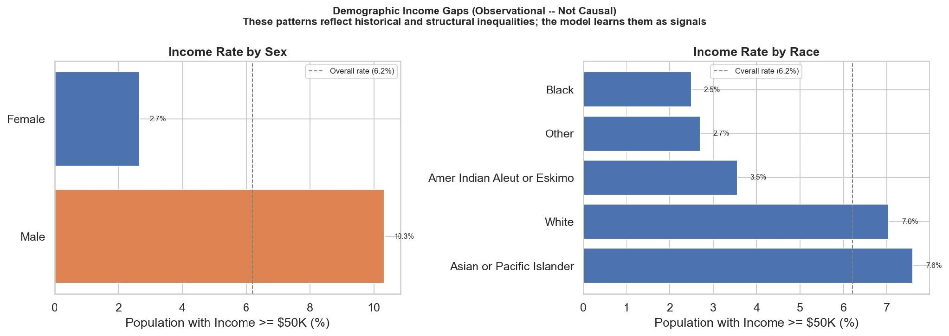
SECTION 03 · KEY FINDINGS FROM EDA
Finding 5 — Demographic Income Gaps (Observational, Not Causal)
⚠ Important caveat: These patterns reflect historical structural inequalities in 1994–95. The model learns them as statistical signals. In a real deployment, formal fairness audits (demographic parity, equal opportunity) and possible post-hoc recalibration would be required.

Slide 15
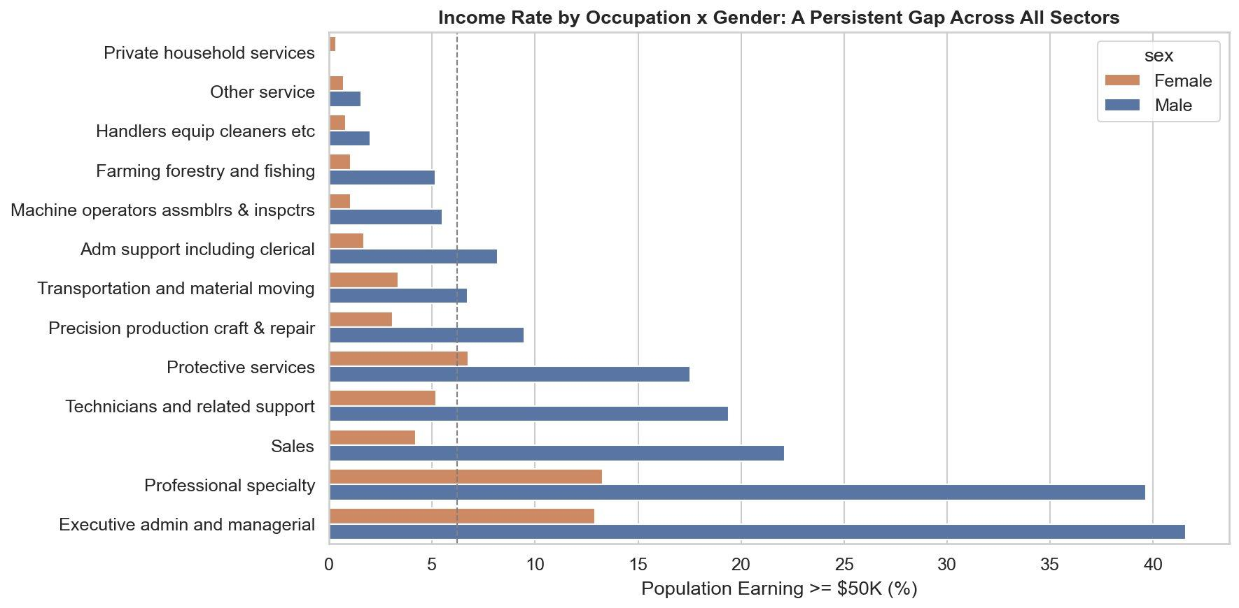
SECTION 03 · KEY FINDINGS FROM EDA
Finding 5 — Demographic Income Gaps (Observational, Not Causal)
⚠ Important caveat: These patterns reflect historical structural inequalities in 1994–95. The model learns them as statistical signals. In a real deployment, formal fairness audits (demographic parity, equal opportunity) and possible post-hoc recalibration would be required.

Slide 16
SECTION 04 · MODELLING APPROACH
Three Models: LightGBM Wins on What Matters
Model | ROC-AUC | PR-AUC | Notes
Logistic Regression | 0.946 | 0.607 | Linear baseline, fast to train, strong interpretability
Random Forest | 0.944 | 0.596 | Ensemble baseline, captures non-linearity
LightGBM (tuned) ★ | 0.955 | 0.677 | Gradient boosting, Optuna-tuned — selected model
Why PR-AUC is the decisive metric
All three models are close on ROC-AUC (0.944–0.955) — ROC is less informative on imbalanced data
LightGBM leads by +7 points on PR-AUC (0.677 vs 0.596–0.607)
PR-AUC directly measures the model's ability to rank the 6.2% minority class
5-fold stratified cross-validation used throughout to prevent data leakage
5-Fold CV ROC-AUC by model — tight variance confirms stability

Slide 17
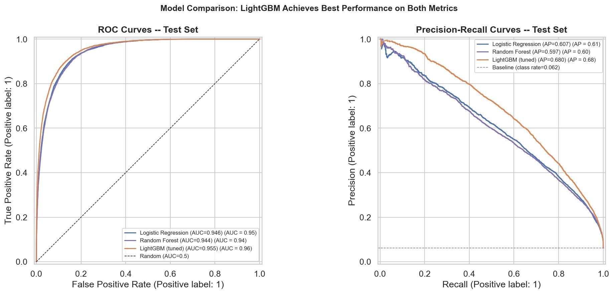
SECTION 05 · RESULTS & INTERPRETATION
LightGBM Results: ROC-AUC 0.955 · PR-AUC 0.677
0.955
ROC-AUC
0.677
PR-AUC
0.857
F1-optimal threshold
89.6%
Recall at threshold 0.857

Slide 18
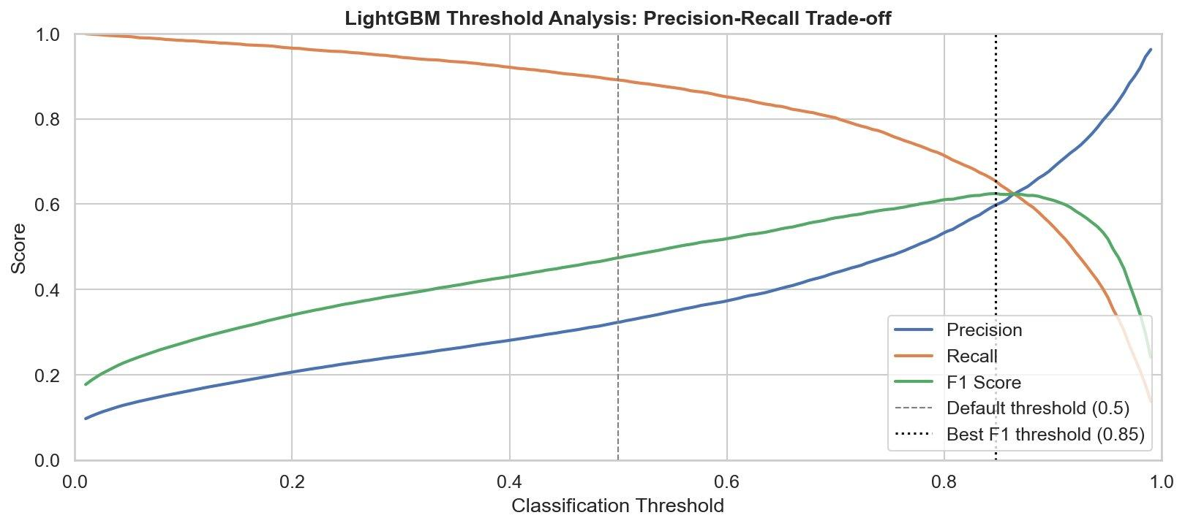
SECTION 05 · RESULTS & INTERPRETATION
Choosing the Operating Threshold: A Business Decision
Lower threshold → Higher Recall
Flag more qualifying households. More false positives, fewer missed cases.
Preferred for Census Bureau resource allocation — missing a qualifying household is costlier than a false positive that triggers manual review.
F1-optimal (0.857)
Best balance of precision and recall.
At 0.857: Recall 89.6%, Precision 31.7%, F1 0.468. High threshold reflects calibration — the model outputs low probabilities because positives are rare.
KEY INSIGHT Threshold choice is not purely technical — it reflects the cost of false negatives vs false positives for the specific use case.

Slide 19
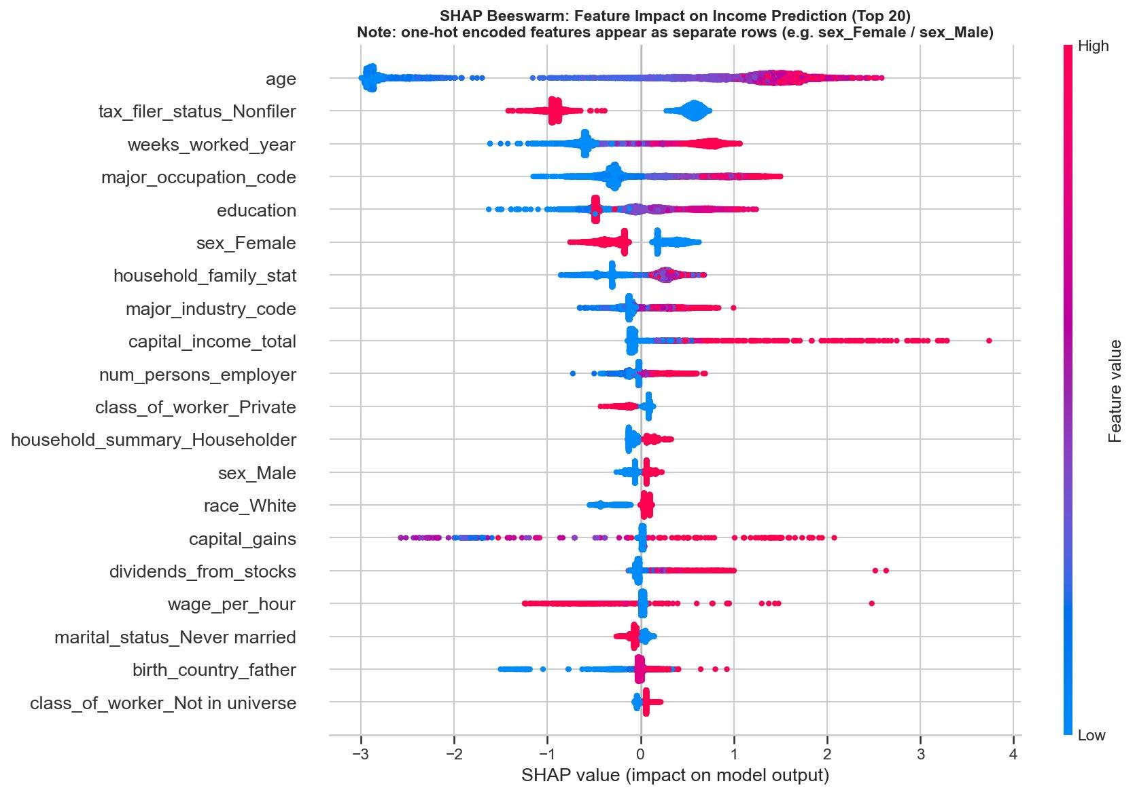
SECTION 05 · RESULTS & INTERPRETATION
What the Model Learned: SHAP Feature Importance
EDA ↔ SHAP alignment
Education, age, occupation dominate both — the model learned real patterns, not noise.
age (top feature)
Red = older → strong positive SHAP. Confirms the lifecycle S-curve from EDA.
Two surprises
Tax filer status and weeks_worked capture labor force attachment interactions invisible in univariate analysis.
Sex encoding
sex_Female and sex_Male appear as separate rows (one-hot artifact) — they represent one underlying signal.

Slide 20
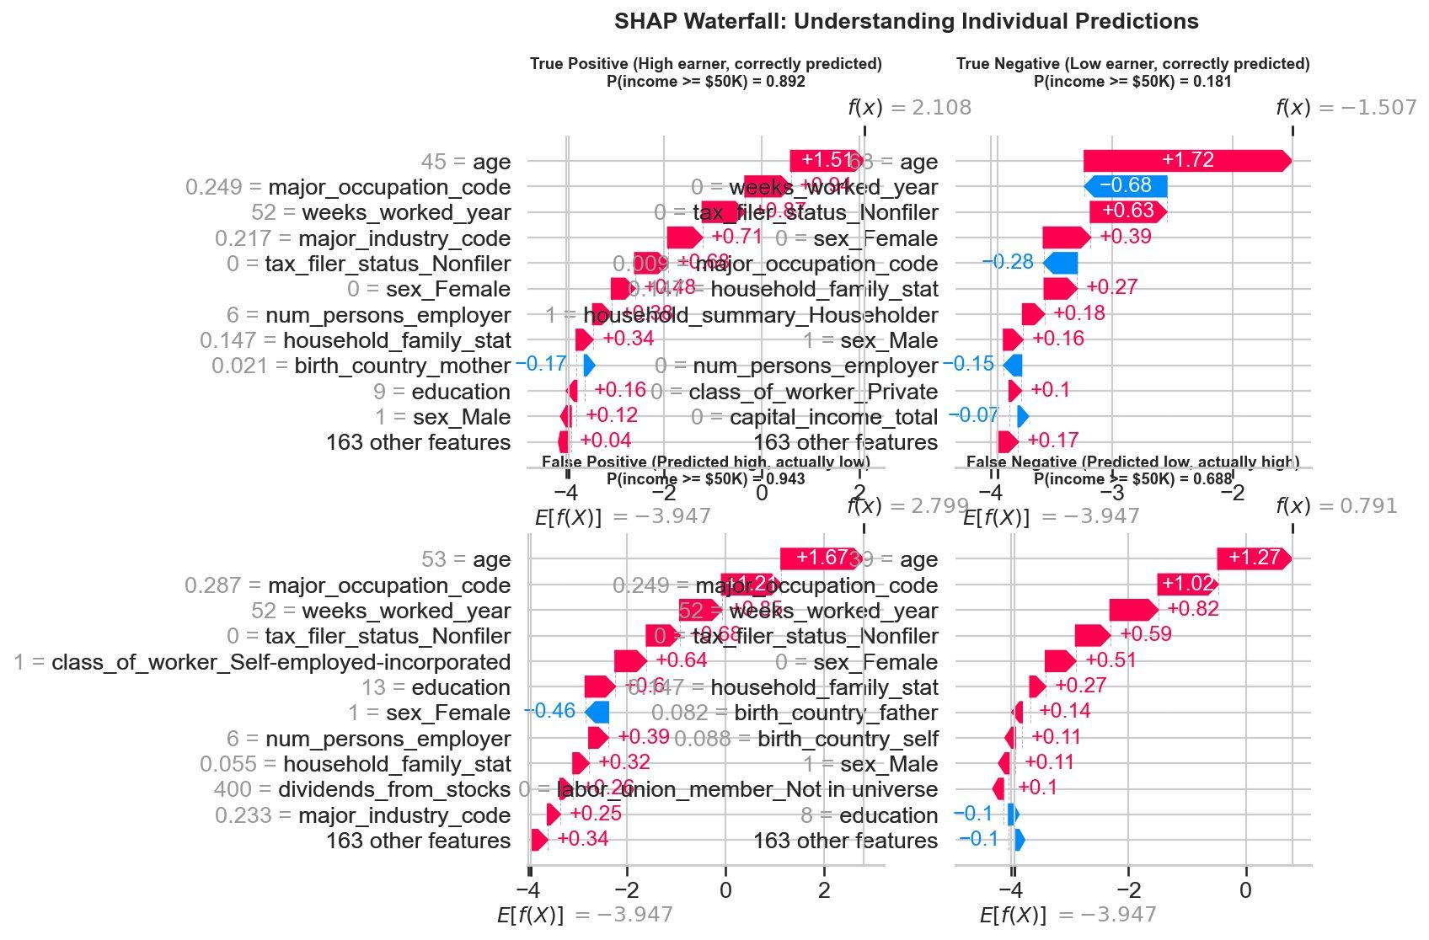
SECTION 05 · RESULTS & INTERPRETATION
Inside a Prediction: How the Model Explains Its Choices
Red bars push toward ≥$50K. Blue bars push toward <$50K. Starting point: 6.2% base rate. False negatives = early-career high earners whose income signal isn't yet visible in these features.

Slide 21
SECTION 06 · CONCLUSIONS
Key Takeaways and Limitations
✓ KEY FINDINGS
⚠ HONEST LIMITATIONS
1. Education is the clearest structural predictor
1. Data is 30 years old
The bachelor's degree jump is the single largest income threshold. Graduate degrees roughly double the odds again.
$50K in 1994 ≈ $100K in 2024 dollars. Findings are directionally valid but magnitudes and some demographic patterns have shifted considerably.
2. Capital income is the sharpest discriminator
2. All findings are observational associations
Binary flag with 6× lift, despite covering only 3.7% of records. Presence matters more than amount.
The model predicts income but makes no causal claims. Correlation ≠ causation, especially for demographic features.
3. LightGBM best captures compound effects
3. Random train/test split, not temporal
Age × work intensity × education interactions are invisible in univariate analysis but captured well by gradient boosting (ROC-AUC 0.955, PR-AUC 0.677).
A year-based split (1994 train / 1995 test) would better simulate real deployment conditions and is worth exploring as a robustness check.

Slide 22
Questions &
Discussion
Thank you for your time.

