Slide 1
COMPLEX EMBEDDED SYSTEMS
AUDIO RMS DISPLAY
Arduino-based sound level meter on a 10-segment LED bar
Presented by
Adideb Das,Solomiia Serant
Supervisor
Ahmad Menbari,Andreas Becher

Slide 2

OVERVIEW
Table of Contents
1
Task Description
5
Firmware Explanation
2
Design Approach
6
Problems Faced
3
Application Overview
7
Approach to the Problem
4
Hardware Setup
8
Summary
02
Audio RMS Display

Slide 3

1 · TASK DESCRIPTION
Build An Audio RMS Sound-level Meter
RMS DEFINITION
Show the real-time RMS level of sound on a 10-segment LED bar.
The UNO has too few pins for the bar ; shift registers are required
Provide a user interface to set sensitivity / relevant parameters.
RMS is computed over a buffer of audio samples
$$\sqrt{\frac{\sum{x_{i}^{2}}}{n}}$$
xRMS =
averaged over n samples in the audio buffer
HARDWARE USED
Arduino Uno
KY-038 sound sensor
10-segment LED bar
2 shift registers (74HC595)
Breadboard
03
Audio RMS Display

Slide 4
2 · DESIGN APPROACH
One Non-Blocking Signal Chain
KY-038 mic
analog A0
ADC 8 kHz
prescaler ÷32
High-pass
DC removal
RMS
128-sample window
▸
▸
▸
▸
10-LED bar
level display
Peak-hold
hold 1s + decay
Level map
÷ sensitivity → 0–10
2x 74HC595
shift registers
▸
▸
▸
Serial control '+' / '−’ to adjust the sensitivity live.
Serial telemetry RMS / peak / DC / mic-health streamed to a browser monitor at 115200 baud.
04
Audio RMS Display

Slide 5
3 · APPLICATION OVERVIEW
What the finished meter does
Louder sound lights more LEDs : a live bar that tracks the RMS level.
A peak marker floats above the bar, holds ~2 s, then falls back to 0.
Sensitivity is adjustable live over serial: '+' more, '−' less, in steps of 10.
A companion Web-Serial monitor mirrors the bar and shows RMS
Live mic-health check: reports signal alive / quiet / mic dead from the raw stream.
VU METER · SERIAL MONITOR
RMS 86.4
PEAK 9.0
LEDs 7
DC 512
PK-PK 148
sensitivity 120
● signal alive
05
Audio RMS Display

Slide 6
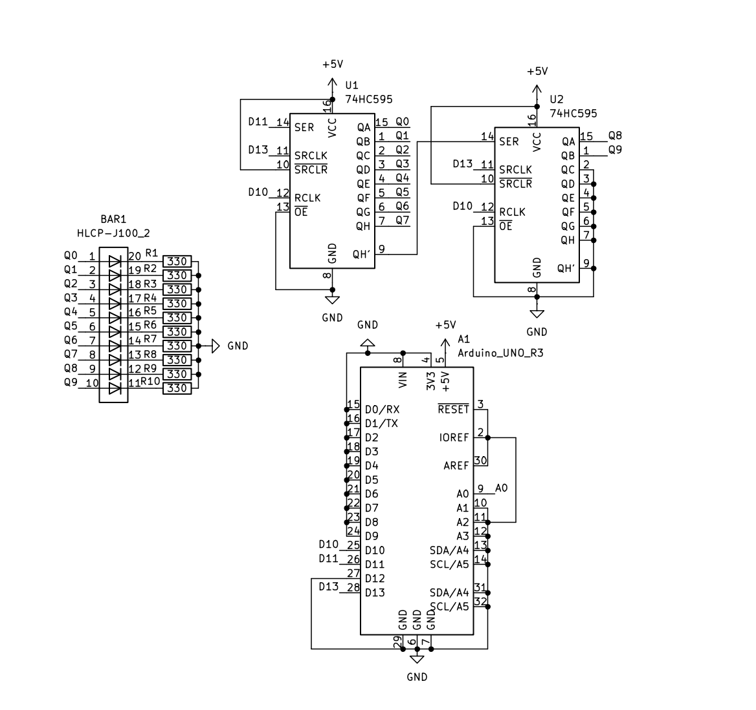
4 · HARDWARE SETUP
Two cascaded shift registers drive 10 LEDs
KY-038 analog out → A0.
Arduino → U1
D11→SER,
D13→SRCLK,
D10→RCLK.
Cascade: U1 QH′ → U2 SER : 3 pins now drive 16 outputs.
Q0–Q7 (U1) + Q8–Q9 (U2) → 10 LEDs, each via a 330 Ω resistor to GND.
Why: the UNO lacks 10 spare output pins, so the bar is serialised.
06
Audio RMS Display

Slide 7
5 · FIRMWARE — EXECUTION FLOW
One loop, three independent clocks
setup()
runs once · fast ADC · pins
▾
loop() · runs forever ; every block checked each pass
every pass
8 kHz
40 Hz
Serial UI
▸
Sample + DSP
▸
Display + output
'+' / '−' → sensitivity
analogRead → high-pass → RMS
level → peak-hold → writeLeds()
▴
loop repeats every pass
07
Audio RMS Display

Slide 8
5 · FIRMWARE : STRUCTURE & OUTPUT
setup() and writeLeds()
writeLeds(pattern) : push 16 bits to the LED bar
Latch LOW → shiftOut() high byte then low byte, MSB-first → latch HIGH.
First byte cascades into U2 (Q8–Q9), second lands in U1 (Q0–Q7): bit i = LED i+1.
setup() : one-time initialisation
Set the three shift-register pins as outputs.
Speed up the ADC: ADCSRA prescaler → ÷32 so an analogRead fits inside the 8 kHz budget.
Serial at 115200, clear the sample buffer, blank the bar, seed the timers.
08
Audio RMS Display

Slide 9
5 · FIRMWARE : SAMPLING & DSP
loop(): sample → high-pass → RMS
Fixed-rate sampling
Sample A0 every 125 µs (8 kHz), scheduled off micros().
If the loop falls > 4 periods behind, resync instead of chasing ; keeps timing stable.
DC removal = high-pass
dcEstimate is a fixed-point (Q8) leaky integrator: dcEstimate += (raw−dcEstimate) >> 9.
hp = raw − dcEstimate strips the ~2.5 V bias and low-frequency rumble
Running RMS
Sliding sum-of-squares over 128 samples: subtract the oldest², add the newest² ; O(1) per sample.
rms = √(sumSquares / 128), recomputed each display frame.
09
Audio RMS Display

Slide 10
5 · FIRMWARE - DISPLAY, UI & TELEMETRY
loop(): level → peak-hold → serial
Level mapping
level = RMS × 10 / sensitivity, clamped 0–10 and rounded to a bar height.
pattern gets one bit set per lit LED, then handed to writeLeds().
Peak-hold with decay
New peak snaps the marker up and freezes it for 2000 ms.
After the hold it decays; a guard stops it sinking into the live bar.
Serial UI + telemetry
'+' lowers sensitivity ,'−' raises it - steps of 10, echoed back.
Every 250 ms it prints RMS, sensitivity, LEDs + a health tag (alive / quiet / mic dead).
10
Audio RMS Display

Slide 11
6 · PROBLEMS FACED
The raw signal and the clock fight back
01 DC bias & rumble
02 ADC too slow for 8 kHz
The KY-038 sits on a ~2.5 V bias (ADC ≈ 512). RMS of the raw signal measures the bias, not the sound ; the bar pins near full and slow rumble / handling noise trips it.
At 8 kHz each sample has a 125 µs budget, but a default analogRead() takes ~112 µs. That leaves almost no time for the RMS math and the display update.
Net effect: without both fixes the meter is either stuck reading its own DC offset, or it can't keep a steady sample rate ; so the displayed level no longer reflects real loudness.
11
Audio RMS Display

Slide 12
7 · APPROACH TO THE PROBLEMS
Two small fixes, both in the sample loop
Adaptive high-pass
Faster ADC clock
dcEstimate += (raw−dc) >> 9
ADCSRA = (ADCSRA & 0xF8) | 0x05
An IIR leaky integrator tracks the DC level; subtracting it high-passes every sample.
Kills the bias and the low-frequency rumble
Fixed-point (Q8), so no floats in the hot sample path.
Sets the ADC prescaler to ÷32, cutting a conversion to ~26 µs.
Frees the loop to sample at 8 kHz and still run RMS + refresh the display.
Small accuracy trade-off, negligible for a level meter.
12
Audio RMS Display

Slide 13
8 · SUMMARY
A working RMS meter, end to end
Real-time RMS bar Louder sound → more LEDs, refreshed every 25 ms.
Pin shortage solved Two cascaded 74HC595s turn 3 pins into 16 outputs.
Clean level signal Fixed-point DC-removing high-pass + O(1) sliding-window RMS.
Interactive & robust Live sensitivity control, peak-hold-with-decay
Debuggable Web-Serial monitor mirrors the bar and flags mic health.
Deterministic timing Non-blocking firmware ; no delay() anywhere.
Audio RMS Display

