Slide 1
Project: Ant Colony Optimization and Greedy Algorithm to find best Tile to discard in Japanese Mahjong
Course: Optimization Methods for Engineers
Authors: Adil Sadikovic / Jarvi Lyrer

Slide 2
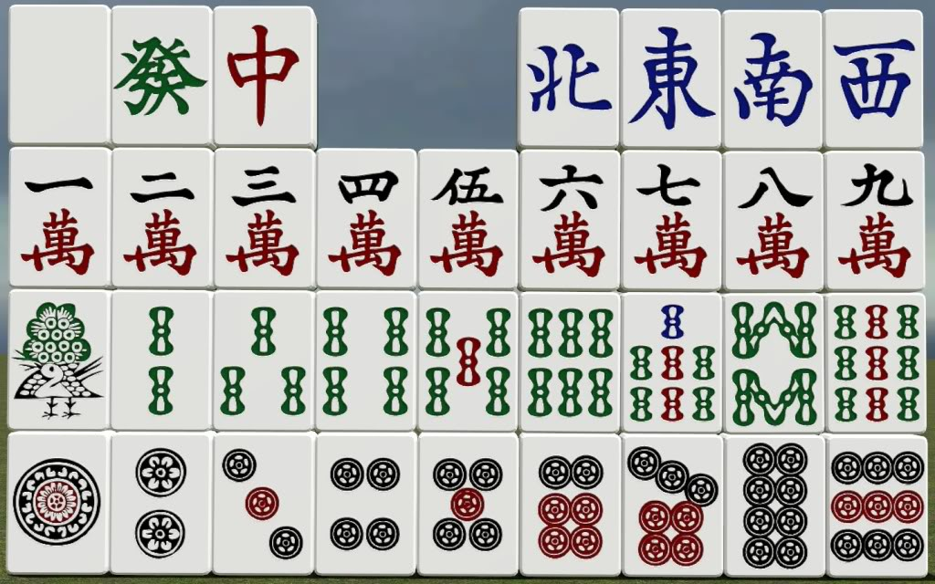
1. Introduction: Problem description
Given a random Hand consisting of 14 Tiles which all have a colour and a value, find the best Tile to discard to reach a desired Hand, so called Shanten
Tiles can either be grouped into Sequences or Groups of equals, when a Tile could be in a Group and a Sequence, we need to decide which grouping is more beneficial for the remaining Hand

Slide 3
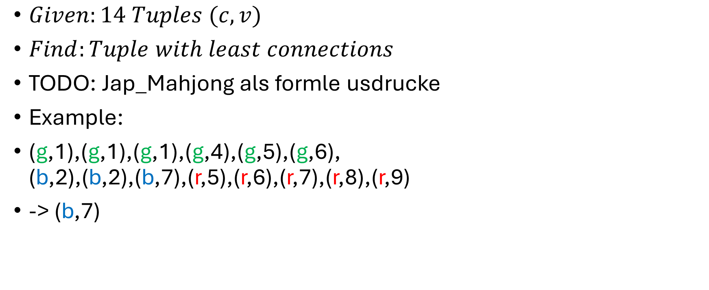
1. Introduction: In mathematical terms
$Given:14 Tuples (c,v)$
$Find:Tuple with least connections$
TODO: Jap_Mahjong als formle usdrucke
Example:
(g,1),(g,1),(g,1),(g,4),(g,5),(g,6), (b,2),(b,2),(b,7),(r,5),(r,6),(r,7),(r,8),(r,9)
-> (b,7)

Slide 4
1. Introduction: Graph abstraction
Game-states as nodes
Discard&Draw Tuples as Edges

Slide 5
References
Image1: https://riichi.wiki/Japanese_mahjong

