Slide 1

Loan Default Prediction
This presentation explores predicting loan defaults using machine learning. We will classify applicants to identify default risk, leveraging the Loan Prediction Problem dataset from Kaggle.
By :- Devansh Rai
Devansh Jadon
Jahnavi Singh
Mahi
Notes:
2

Slide 2




Project Goal and Objectives
Goal: Accurate Prediction
Build & Evaluate Models
Visualize Key Features
Illustrate features impacting default risk.
Precisely predict loan default probability.
Develop and compare classification models.
Notes:
3

Slide 3
Data Overview and Preparation
Data Source & Variables
Cleaning & Engineering
Kaggle's Loan Prediction Problem dataset includes loan amount, credit history, and income.
We will impute missing values and create new, relevant features as needed.
Notes:
4

Slide 4





Methodology: Classification Algorithms
Logistic Regression
Our baseline model.
Decision Trees
Interpretable for understanding.
Random Forest
Ensemble method for accuracy.
XGBoost/LightGBM
Gradient boosting for complex patterns.
Data will be split into 80% training and 20% testing sets. K-fold cross-validation will ensure model generalization.
Notes:
5

Slide 5

Model Evaluation Metrics
F1-score & AUC-ROC
Accuracy
Precision & Recall
Overall correctness of predictions.
Accuracy of positive predictions and ability to identify all actual positives.
Harmonic mean of precision/recall and area under the curve.
Notes:
6

Slide 6








Decision Tree Analysis
Visualizing Tree
Interpreting Rules
Sample decision tree visualization.
Rules like loan amount < $50K.
Identifying Key Factors
Tuning Parameters
Adjusting tree depth and complexity.
Pinpointing factors for default.
Notes:
7

Slide 7
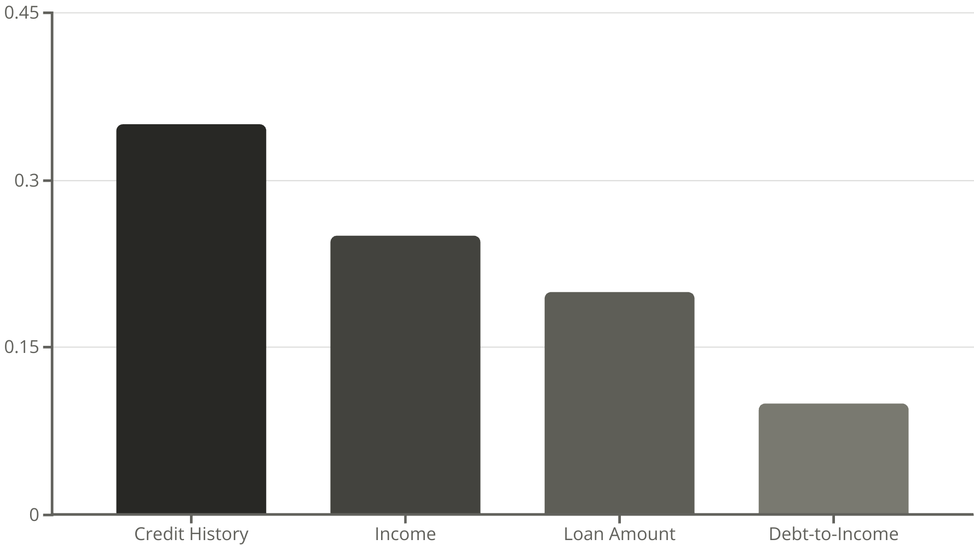
Feature Importance Visualization
The bar chart shows feature importances. Credit history, income, and loan amount are top factors. Understanding their impact reveals positive or negative correlation with default risk.
Notes:
8

Slide 8

Conclusion and Key Findings
Model Performance Summary
Overall high accuracy and precision in predictions.
Key Influencing Features
Credit history and income are critical indicators.
Loan Approval Implications
Improved risk assessment for lenders.
Further Improvements
More data and advanced algorithms can enhance models.
Notes:
9

