Slide 1
DIAG 2016 Machine Learning: Classification Techniques in R AJG Project adip@umich.edu

Slide 2
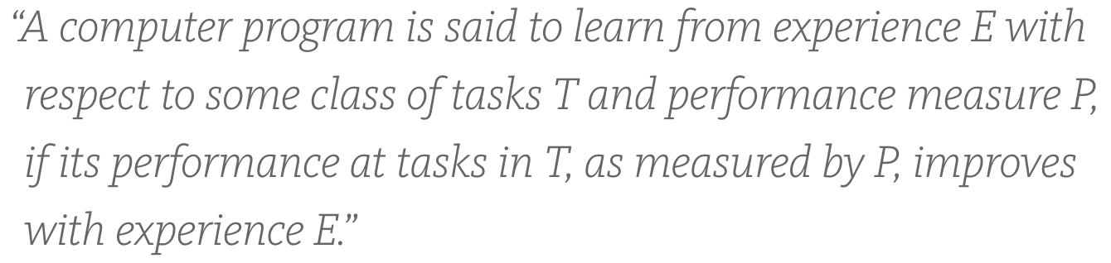
What is Machine Learning?
Tasks
Performance
Experience
The humans provide : definition of Tasks (T) and measure of Performance (P)
The machine leverages Experience (E) to get better at T as measured by P
ML is also known as ‘Statistical Learning’

Slide 3
What is Classification
In machine learning terms, categorizing data points is a classification task.
Binary Classification involves two classes e.g. 0 or 1
Multi-class Classification involves multiple classes
A classifier algorithm (procedure) implements a ‘loss function’ (performance) that is optimized using the training data (experience)
This is known as Supervised Learning as the data is labelled
Unsupervised learning is used in clustering (e.g. Market Segmentation)

Slide 4
Different Kinds of Classification Methods
Logistic Regression
Classification and Regression Trees (CART)
Also known as ’Decision Trees’ in some domains
SVM
Random Forest
Etc.

Slide 5
Overfitting is the WORST THING EVER
Overfitting is when your model ‘memorizes’ the data set and uses the data to predict itself! That is USELESS
To avoid this, data sets are split into three:
Training Set is a set of labelled data used to train a Machine Learning Model
Validation Set is a set of labelled data used to measure the Model Performance
Test Set is a set of un-labelled data used to make predictions via the trained and validated model

Slide 6
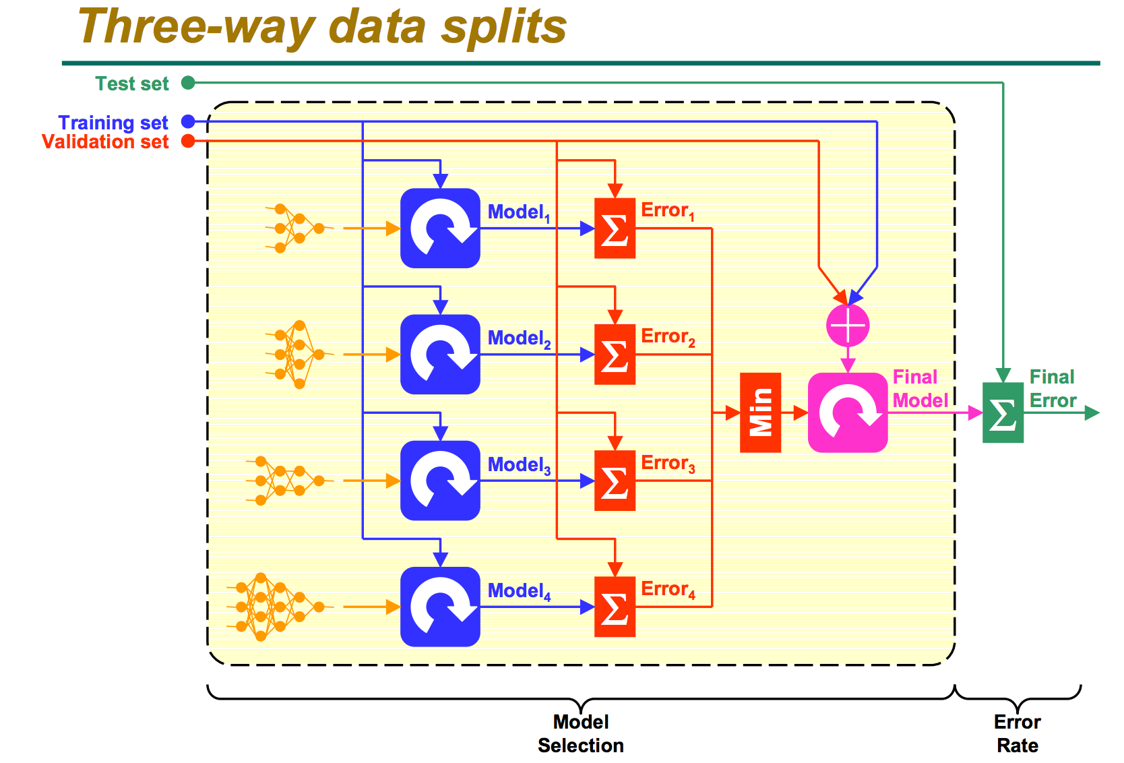

Slide 7
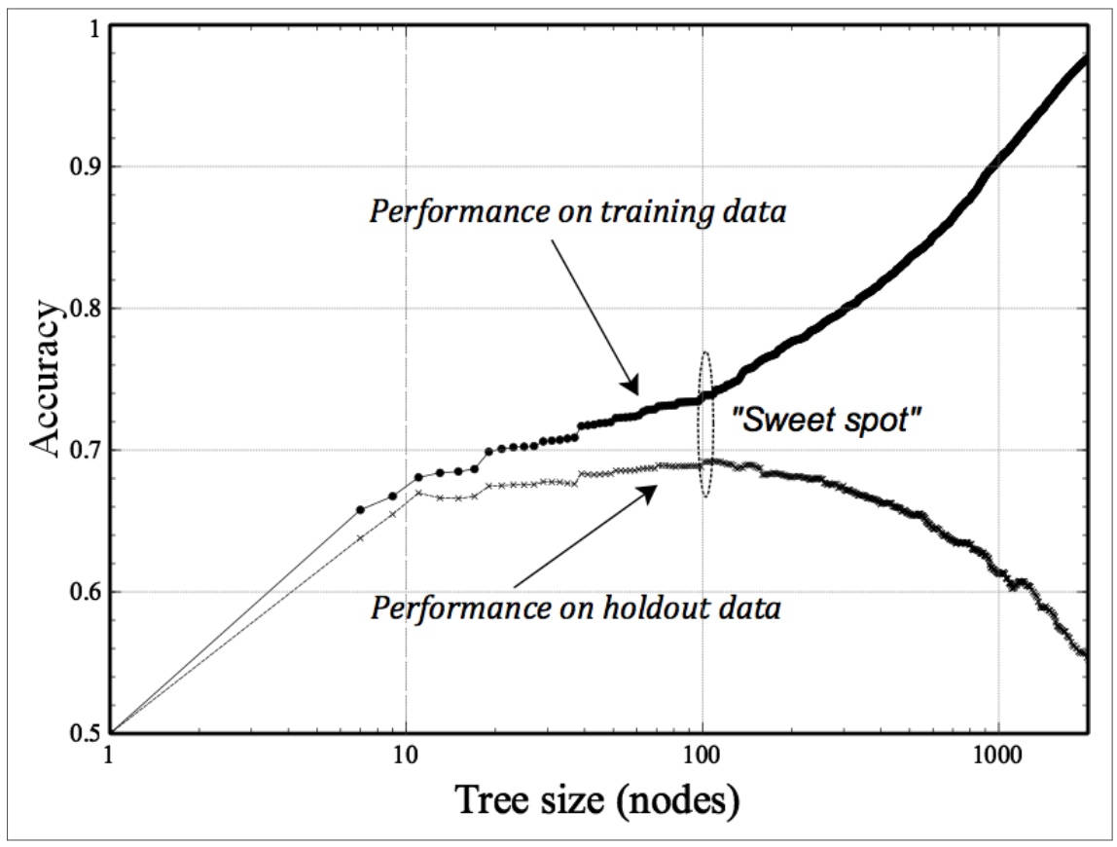
Tune to max(perf) && min(overfitting)

Slide 8
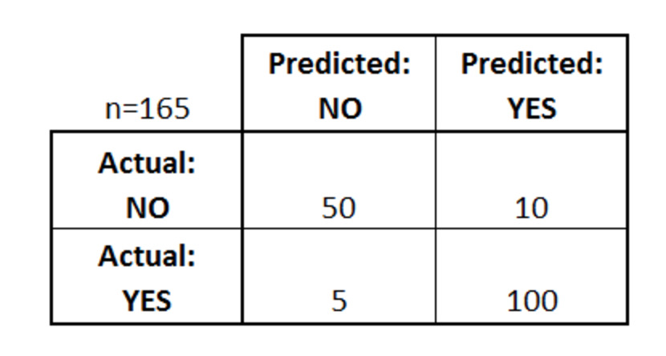
How to measure model performance
Confusion Matrix!
true positives (TP): These are cases in which we predicted yes (they have the disease), and they do have the disease.
true negatives (TN): We predicted no, and they don't have the disease.
false positives (FP): We predicted yes, but they don't actually have the disease. (Also known as a "Type I error.")
false negatives (FN): We predicted no, but they actually do have the disease. (Also known as a "Type II error.")
http://www.dataschool.io/simple-guide-to-confusion-matrix-terminology/

Slide 9
Model Performance
Accuracy: Overall, how often is the classifier correct?
(TP+TN)/total = (100+50)/165 = 0.91
Misclassification Rate: Overall, how often is it wrong?
(FP+FN)/total = (10+5)/165 = 0.09
equivalent to 1 minus Accuracy
also known as "Error Rate"
True Positive Rate: When it's actually yes, how often does it predict yes?
TP/actual yes = 100/105 = 0.95
also known as "Sensitivity" or "Recall"
False Positive Rate: When it's actually no, how often does it predict yes?
FP/actual no = 10/60 = 0.17
Specificity: When it's actually no, how often does it predict no?
TN/actual no = 50/60 = 0.83
equivalent to 1 minus False Positive Rate

Slide 10
Interactive Tutorial
Lets do the Kaggle ‘Titanic Challenge’
You can do it yourself later on www.kaggle.com
Predict which Passengers survived the Titanic disaster

Slide 11
Questions?
adip@umich.edu

