Slide 1
CSCI 338
Welcome to Computer Theory!

Slide 2
Instructor details
Adiesha Liyanage
Email: a.liyanaralalage@montana.edu
Office hours: TBD
Office: Barnard 349 (right next to conference room)

Slide 3
Let’s look at several problems

Slide 4
True or False?
Finding shortest path in a distance-weighted graph can be done in polynomial time

Slide 5
True or False?
Finding shortest path in a distance-weighted graph can be done in polynomial time
True

Slide 6
True or False?
Finding a simple path (no repeated vertices) of length k or more in given undirected graph can be done in polynomial time.

Slide 7
True or False?
Finding a simple path (no repeated vertices) of length k or more in given undirected graph can be done in polynomial time.
Unknown

Slide 8
True or False?
Can you build a program that will answer the question: ​ “Will this input code terminate eventually on a given input?”

Slide 9
True or False?
Can you build a program that will answer the question: ​ “Will this input code terminate eventually on a given input?”
Impossible regardless of the computer
(Unsolvable)

Slide 10
Mathematical model
A rigorous mathematical formulation of reality. ​
Used to make predictions.

Slide 11
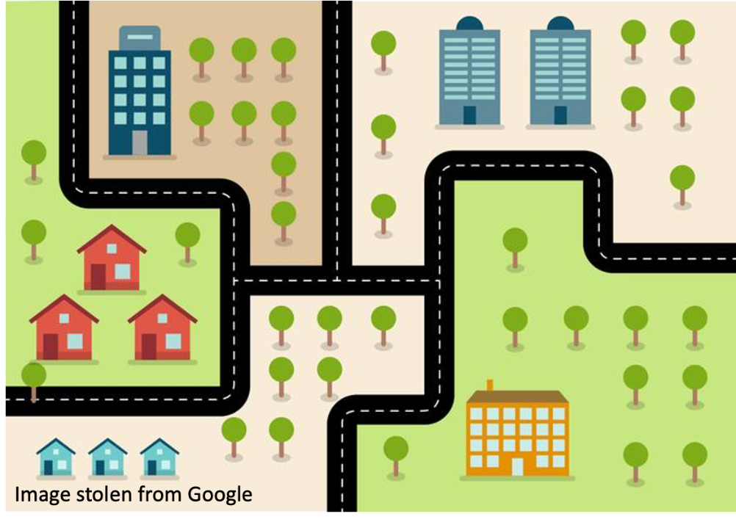
Can we represent a road network using a mathematical model?

Slide 12
Can we represent a road network using a mathematical model?
Graph?
Nodes/edges?
What should we use node for?
What should we use edges for?
Node for junctions?
Edges for road segments connecting junctions?

Slide 13
Can we represent a road network using a mathematical model?
Graph?
Nodes/edges?
What should we use node for?
What should we use edges for?
Node for junctions?
Edges for road segments connecting junctions?

Slide 14
Now, let’s see whether we can answer questions using this model

Slide 15
Each intersection requires a camera to monitor each road segment
1 cams
1 cam for the dead-end
3 cams

Slide 16
Can we build a road network such that required number of cameras is odd?
1 cams
Think about this
1 cam for the dead-end
3 cams

Slide 17
Can we build a road network such that required number of cameras is odd?
1
1
3
1
3
3
1
1

Slide 18
Can we build a road network such that required number of cameras is odd?
Number of cameras needed for this graph is the sum of degrees of all nodes in the graph.
1
1
3
1
3
3
1
$$1+1+1+1+3+3+3+1=14$$
Even
1

Slide 19
Can you answer this question for any road network?
Suppose all road networks can be represented as a graph
What can you say about the sum of the degrees of any graph?
Each edge is considered twice when we consider the sum of degrees.
Sum of degrees will always be even.
Therefore, the answer to the question “Can we build a road network such that required number of cameras is odd?” is NO

Slide 20
Summary
We considered an ill-defined thing.
We built a formal model to represent it.
Found limitations of the model, which translated to the limitations of the thing.
This is basically what we are going to do in this class.

Slide 21
We will learn fundamental capabilities and limitations of computers.
We will essentially learn about 3 things.
Automata theory
Automata theory deals with the definitions and properties of mathematical models of computation.
Ex: finite automaton, context-free grammar
Formal definitions of computers and what each types of computers (models) can do and cannot do.
Complexity theory
We will try to classify problems based on how hard the problem is to solve.
What makes some problems computationally hard and others easy?
Computability theory
Study of whether a particular problem is solvable or not using a computer.
We will try to classify problems by those that are solvable and those that are not.

Slide 22
Textbook
Introduction to the theory of computation by Michael Sipser.
This is a theory course; you MUST read the book.

Slide 23
Communication
Post your questions on MSU CSCI Discord channel.
CSCI-338-Computer-Science-Theory (CATEGORY)
I will post the material on D2L and class GitHub page.
I will use GitHub page for updating the schedule.
https://github.com/adiesha/CSCI338Spring2025/

Slide 24
Office hours
Instructor (Adiesha Liyanage)
Monday 12:15pm - 2:15 pm
Friday 12:15pm - 1:15pm
Email: a.liyanaralalage@montana.edu

Slide 25
TA
Gideon Popoola
Office hours:
Mondays, 2pm - 4pm
Email: gideon.popoola@student.montana.edu

Slide 26
Pre-requisites
CSCI 232 and CSCI 246
If you have forgotten what you learned in Discrete Structures class, then go through the notes of Discrete Structures.
https://github.com/adiesha/CSCI246Fall2024
This is a link to my notes in the previous semester’s discrete structure class.
It is important that you understand the basics in Discrete Structures before taking CSCI 338
I will do a recap of the basics in the first few lectures. (This is a quick overview; I will not take lot of time to explain)

Slide 27
Evaluation and grading
Grading | Weight of each category
Pop up Quizzes | 8%
Assignments | 42%
In class tests | 30%
Final exam | 20%
Total | 100%

Slide 28
Evaluation and grading
The final is optional. If you are happy with the grades of the 3 in-class tests, then the final test grade will be the average (in percentage) of the 3 in-class tests multiplied by 20. If you are not happy with the average of your in-class test, then you could choose to take the optional final.
The optional final cannot be taken early.
Note that quizzes are not an attendance counting, however, they will be graded lightly.
At the end of the semester, final grades will be determined based on your overall performance on assignments, quizzes, tests and the final exam.

Slide 29
Accommodations
If you have a documented disability and need or might need accommodations, please reach out to the Office of Disability Services as soon as possible and then talk to me.

Slide 30
Collaboration policy
For your homework assignments, you may discuss the problem with your peers.
However, you are not allowed to copy proofs from your peers or use generative AI to complete your assignments.
If you use resources from the internet to solve problems, you MUST cite them.

Slide 31
Latex
Assignments MUST be completed using LaTeX and submitted as a PDF. There will be no exceptions to this rule—grading handwritten proofs is extremely difficult, so I must enforce this for the sake of the TA's sanity.
You can create a free Overleaf account, which is a free platform for editing and compiling complex LaTeX documents online. This is very similar to Google Docs but with LaTeX.
Basic Overleaf latex tutorials.
If you do not know the LaTeX code for a specific mathematical symbol, you can use the following website: https://detexify.kirelabs.org/classify.html Draw the symbol that you want; it will provide you the necessary code for that symbol and the packages that you have to import.
Using LaTeX for mathematical writing is infinitely easier than using Word or handwriting the solutions once you get the hang of it.

