Slide 1
Introduction to Clustering
CSCI 347
Adiesha Liyana Ralalage

Slide 2
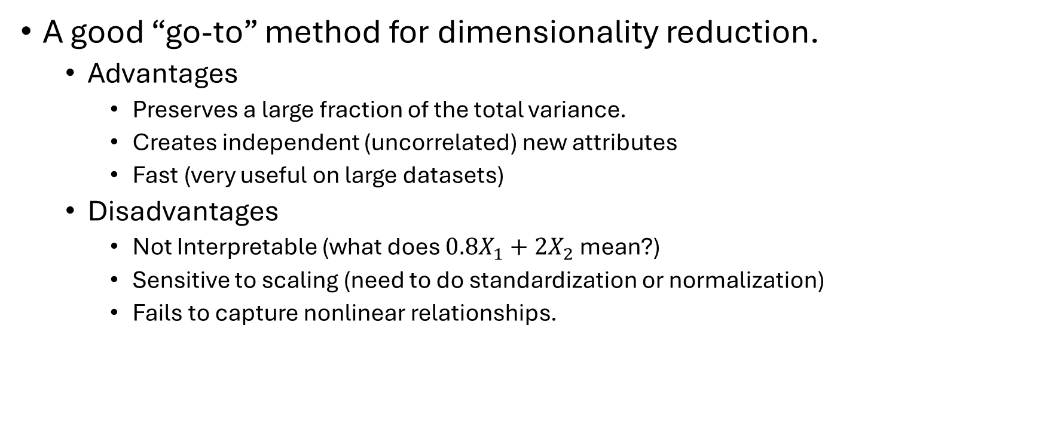
PCA summary
A good “go-to” method for dimensionality reduction.
Advantages
Preserves a large fraction of the total variance.
Creates independent (uncorrelated) new attributes
Fast (very useful on large datasets)
Disadvantages
Not Interpretable (what does ${0.8X}_{1}+2X_{2}$ mean?)
Sensitive to scaling (need to do standardization or normalization)
Fails to capture nonlinear relationships.
Notes:
Standardization
Method: Transforms data to have a mean of 0 and a standard deviation of 1.
Normalization
Method: Scales data to a specific range, typically between 0 and 1.

Slide 3
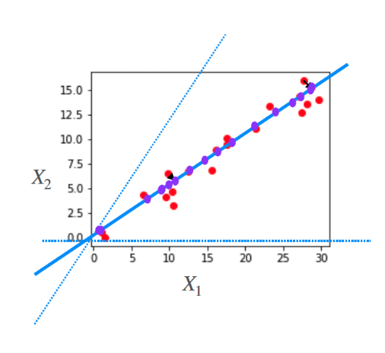
Data often lies close to one dimensional linear space

Slide 4
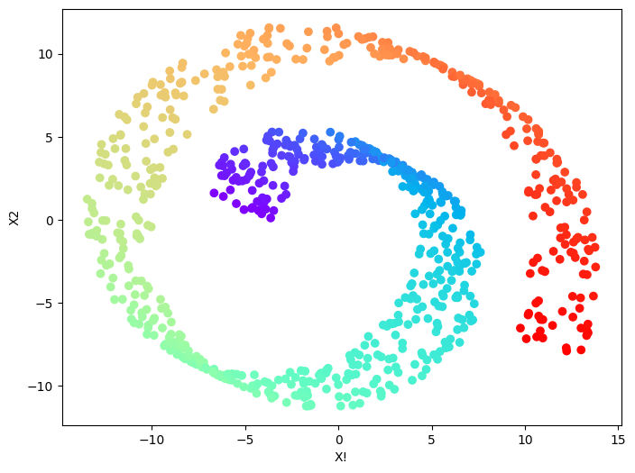
Data often lies close to one dimensional linear space

Slide 5
What can we use for nonlinear dimensionality reduction?
Kernel PCA
Laplacian eigenmaps
Locally linear embedding (*)
T-SNE (t-distributed Stochastic Neighbor Embedding)
Looks at local structure
It converts the high-dimensional Euclidean distances between data points into conditional probabilities that represent similarities.
UMAP (Uniform Manifold Approximation and Projection)
based on the idea that high-dimensional data often lies on or near a lower-dimensional manifold.
ISOMAP (Isometric Mapping)
Aims to preserve the geodesic distances between data points.
Geodesic Distance: measures the shortest distance along the curved manifold.
ISOMAP assumes that the data lies on or near a lower-dimensional manifold embedded in a high-dimensional space. It tries to "unfold" this manifold to reveal its true structure.
Notes:
How t-SNE Works (Simplified):
High-Dimensional Similarities:
For each data point, t-SNE calculates the conditional probability that other points are its neighbors in the high-dimensional space.
Low-Dimensional Similarities:
It then attempts to create a low-dimensional embedding where the conditional probabilities of neighbors are as similar as possible to those in the high-dimensional space.
Optimization:
t-SNE uses gradient descent to minimize the difference between the high-dimensional and low-dimensional probabilities.
laplacian eigenmaps
How Laplacian Eigenmaps Works:
Construct a Neighborhood Graph:
Create a graph from the data points. Connect nearby points based on Euclidean distance (or other similarity measures). You can use k-nearest neighbors or a radius-based approach.
Compute the Laplacian Matrix:
Calculate the Laplacian matrix (L) of the graph. There are different variants, but a common one is: L = D - W, where D is the degree matrix (diagonal matrix with node degrees), and W is the adjacency matrix (representing connections between nodes).
Compute Eigenvectors and Eigenvalues:
Find the eigenvectors and eigenvalues of the Laplacian matrix.
Select Eigenvectors:
Discard the eigenvector corresponding to the smallest eigenvalue (usually 0).
Select the eigenvectors corresponding to the next d smallest eigenvalues, where d is the desired dimensionality of the reduced space.
Construct Embedding:
Use the selected eigenvectors to create the low-dimensional embedding. Each data point's new coordinates are given by the corresponding values in the eigenvectors.

Slide 6
Locally linear embedding
Key Concepts:
Local Linearity: LLE assumes that the data is locally linear, meaning that each data point can be approximated as a linear combination of its neighbors.
Neighborhood Preservation: The primary goal of LLE is to preserve the local neighborhood relationships in the low-dimensional embedding.
Points that are close together in the high-dimensional space should remain close in the low-dimensional space.
Weight Matrix: LLE constructs a weight matrix that captures the contribution of each neighbor in reconstructing a data point from its neighbors.
Let’s look at an example for this.

Slide 7

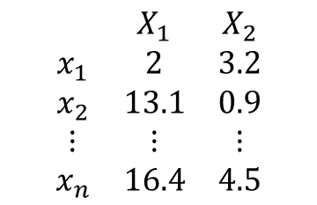


What are clusters in a dataset
$$\begin{matrix} & X_{1} & X_{2} \\ x_{1} & 2 & 3.2 \\ x_{2} & 13.1 & 0.9 \\ ⋮ & ⋮ & ⋮ \\ x_{n} & 16.4 & 4.5\end{matrix}$$
Data Matrix
$$x_{n}$$
$$x_{1}$$
$$x_{2}$$

Slide 8
Clustering
Clustering is the task of partitioning the points into natural groups.
These natural groups are called clusters.
Points within these clusters are very similar, whereas points across clusters are dissimilar as possible.

Slide 9
Applications of clustering
Movies
$$\begin{matrix} & X_{1} & X_{2} \\ x_{1} & 2 & 3.2 \\ x_{2} & 13.1 & 0.9 \\ ⋮ & ⋮ & ⋮ \\ x_{n} & 16.4 & 4.5\end{matrix}$$
Data Matrix
People
$$x_{n}$$
$$x_{1}$$
$$x_{2}$$

Slide 10
Applications of clustering
Samples
$$\begin{matrix} & X_{1} & X_{2} \\ x_{1} & 2 & 3.2 \\ x_{2} & 13.1 & 0.9 \\ ⋮ & ⋮ & ⋮ \\ x_{n} & 16.4 & 4.5\end{matrix}$$
Data Matrix
Genes
$$x_{n}$$
$$x_{1}$$
$$x_{2}$$

Slide 11
Applications of clustering
Words
$$\begin{matrix} & X_{1} & X_{2} \\ x_{1} & 2 & 3.2 \\ x_{2} & 13.1 & 0.9 \\ ⋮ & ⋮ & ⋮ \\ x_{n} & 16.4 & 4.5\end{matrix}$$
Data Matrix
Documents
$$x_{n}$$
$$x_{1}$$
$$x_{2}$$

Slide 12
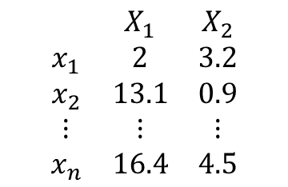
How do we find clusters in a dataset?
$$\begin{matrix} & X_{1} & X_{2} \\ x_{1} & 2 & 3.2 \\ x_{2} & 13.1 & 0.9 \\ ⋮ & ⋮ & ⋮ \\ x_{n} & 16.4 & 4.5\end{matrix}$$
Our goal is to gather data instances into groups with high within-group similarity
$$x_{n}$$
$$x_{1}$$
$$x_{2}$$

Slide 13
How do we find clusters in a dataset?
$$\begin{matrix} & X_{1} & X_{2} \\ x_{1} & 2 & 3.2 \\ x_{2} & 13.1 & 0.9 \\ ⋮ & ⋮ & ⋮ \\ x_{n} & 16.4 & 4.5\end{matrix}$$
Representative-based methods
Find a representative that best represents each cluster, and group points based on their closest representative.
$$x_{n}$$
$$x_{1}$$
$$x_{2}$$

Slide 14
How do we find clusters in a dataset?
$$\begin{matrix} & X_{1} & X_{2} \\ x_{1} & 2 & 3.2 \\ x_{2} & 13.1 & 0.9 \\ ⋮ & ⋮ & ⋮ \\ x_{n} & 16.4 & 4.5\end{matrix}$$
Density-based methods:
Find regions of high density (# points / some
small volume)
Low density around this point.
$$x_{n}$$
$$x_{1}$$
High density around this point.
$$x_{2}$$

Slide 15
How do we find clusters in a dataset?
$$\begin{matrix} & X_{1} & X_{2} \\ x_{1} & 2 & 3.2 \\ x_{2} & 13.1 & 0.9 \\ ⋮ & ⋮ & ⋮ \\ x_{n} & 16.4 & 4.5\end{matrix}$$
Density-based methods:
Find regions of high density (# points / some
small volume)
Low density around this point.
$$x_{n}$$
$$x_{1}$$
High density around this point.
$$x_{2}$$

Slide 16
How do we find clusters in a dataset?
$$\begin{matrix} & X_{1} & X_{2} \\ x_{1} & 2 & 3.2 \\ x_{2} & 13.1 & 0.9 \\ ⋮ & ⋮ & ⋮ \\ x_{n} & 16.4 & 4.5\end{matrix}$$
Hierarchical methods:
Clusters within clusters
$$x_{n}$$
$$x_{1}$$
$$x_{2}$$

Slide 17
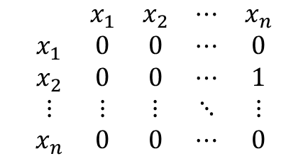
How do we find clusters in a dataset?
$$\begin{matrix} & X_{1} & X_{2} \\ x_{1} & 2 & 3.2 \\ x_{2} & 13.1 & 0.9 \\ ⋮ & ⋮ & ⋮ \\ x_{n} & 16.4 & 4.5\end{matrix}$$
$$\begin{matrix} & x_{1} & x_{2} & ⋯ & x_{n} \\ x_{1} & 0 & 0 & ⋯ & 0 \\ x_{2} & 0 & 0 & ⋯ & 1 \\ ⋮ & ⋮ & ⋮ & ⋱ & ⋮ \\ x_{n} & 0 & 0 & ⋯ & 0\end{matrix}$$
Graph based methods:
Find subgraphs with high edge connectivity
$$x_{n}$$
$$x_{1}$$
$$x_{2}$$

Slide 18
How do we find clusters in a dataset?
$$\begin{matrix} & X_{1} & X_{2} \\ x_{1} & 2 & 3.2 \\ x_{2} & 13.1 & 0.9 \\ ⋮ & ⋮ & ⋮ \\ x_{n} & 16.4 & 4.5\end{matrix}$$
Soft clustering or probabilistic clustering
Estimate the probability distribution that the
points come from
$$x_{n}$$
$$x_{1}$$
$$x_{2}$$

Slide 19
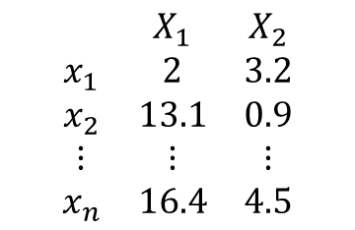
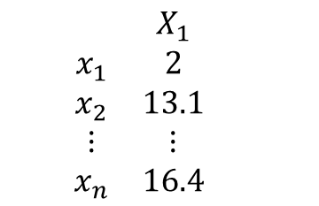
How do we find clusters in a dataset?
$$\begin{matrix} & X_{1} & X_{2} \\ x_{1} & 2 & 3.2 \\ x_{2} & 13.1 & 0.9 \\ ⋮ & ⋮ & ⋮ \\ x_{n} & 16.4 & 4.5\end{matrix}$$
$$\begin{matrix} & X_{1} & \\ x_{1} & 2 & \\ x_{2} & 13.1 & \\ ⋮ & ⋮ & \\ x_{n} & 16.4 & \end{matrix}$$
Spectral or subspace clustering methods:
Find a lower dimensional space
that better represents the
clusters
$$x_{n}$$
$$x_{1}$$
$$x_{2}$$

Slide 20
Clustering techniques
$$\begin{matrix} & X_{1} & X_{2} \\ x_{1} & 2 & 3.2 \\ x_{2} & 13.1 & 0.9 \\ ⋮ & ⋮ & ⋮ \\ x_{n} & 16.4 & 4.5\end{matrix}$$
$$\begin{matrix} & X_{1} & \\ x_{1} & 2 & \\ x_{2} & 13.1 & \\ ⋮ & ⋮ & \\ x_{n} & 16.4 & \end{matrix}$$
Spectral or subspace clustering methods:
Find a lower dimensional space
that better represents the
clusters
$$x_{n}$$
$$x_{1}$$
$$x_{2}$$

Slide 21
Clustering technique
Foundations
Representative-based method
Density-based methods
Hierarchical methods
Spectral methods
Graph-based methods
Advanced topics and applications
Subspace clustering
Core sets
Deep learning
Document clustering
Clustering for outlier detection
$$x_{n}$$
$$x_{1}$$
$$x_{2}$$
Notes:
Coresets in clustering are small, weighted subsets of a larger dataset that accurately approximate the clustering structure of the original data. They are used to speed up clustering algorithms and reduce memory usage, especially when dealing with massive datasets
Spectral: This term refers to the use of the spectrum of a matrix (its eigenvalues and eigenvectors) to analyze and cluster the data.
Spectral clustering methods often involve constructing a similarity matrix or a graph Laplacian from the data and then using the eigenvectors to find clusters.
Deep learning in clustering refers to the use of deep neural networks to perform or enhance clustering tasks. Here's a breakdown of what that entails:
Deep learning in clustering refers to the use of deep neural networks to perform or enhance clustering tasks. Here's a breakdown of what that entails:

Slide 22


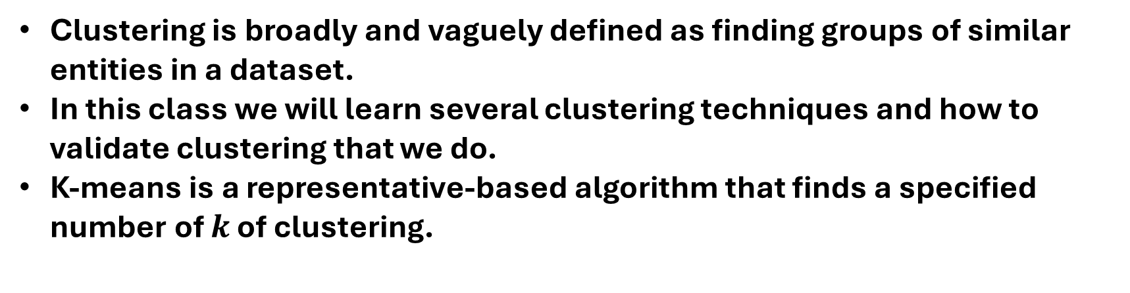

Clustering
Clustering is broadly and vaguely defined as finding groups of similar entities in a dataset.
In this class we will learn several clustering techniques and how to validate clustering that we do.
K-means is a representative-based algorithm that finds a specified number of $k$ of clustering.
$$x_{n}$$
$$x_{1}$$
$$x_{2}$$

