Slide 1
DBSCAN
Density based clustering

Slide 2
DBSCAN
Density-Based Spatial Clustering of Applications with Noise

Slide 3
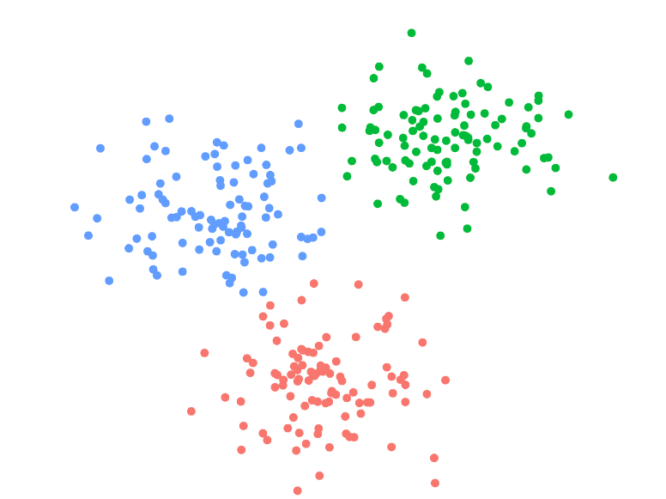
Look at this sample labeled dataset

Slide 4
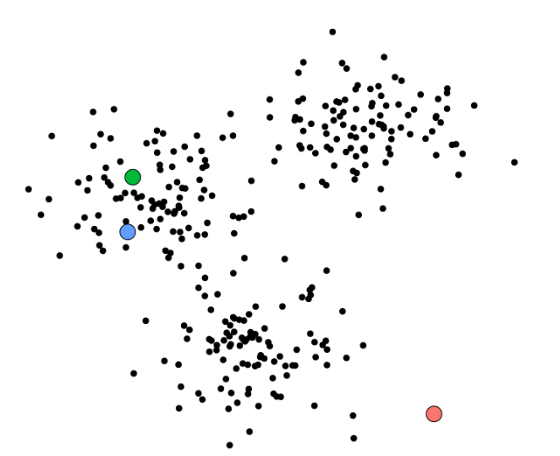
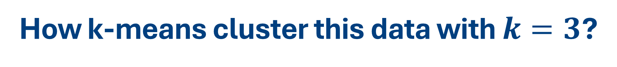
How k-means cluster this data with $k=3$?
Start with $k$ randomly chosen centroids

Slide 5
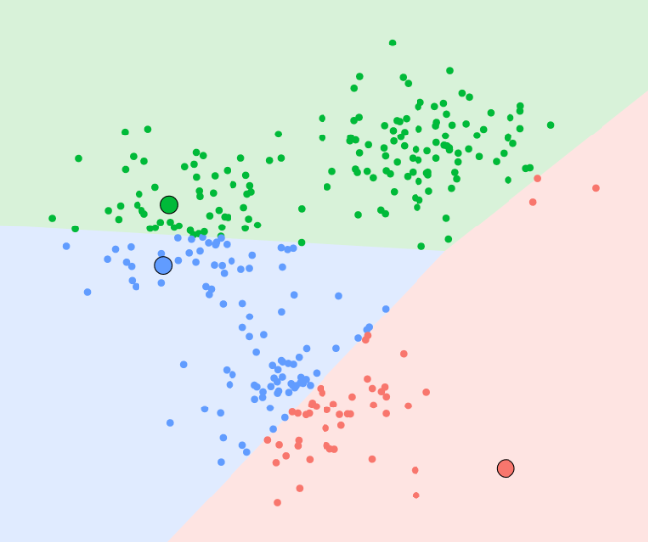
How k-means cluster this data with $k=3$?
Assign data points to clusters by the shortest distance to any mean
Notes:
intersection of half-spaces resulting from hyperplanes that bisect and are normal to the line segments that join pairs of cluster centroids.

Slide 6
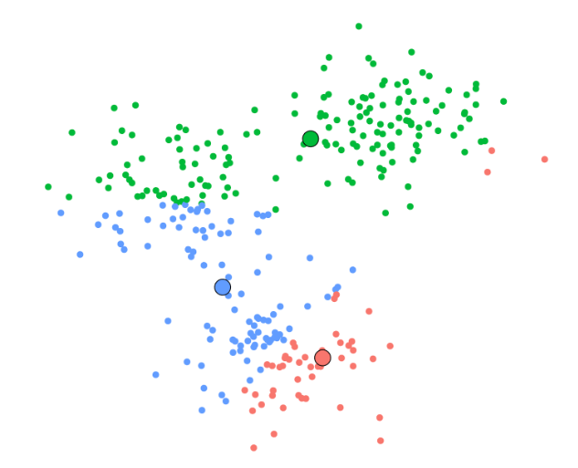
How k-means cluster this data with $k=3$?
Update the centroids

Slide 7
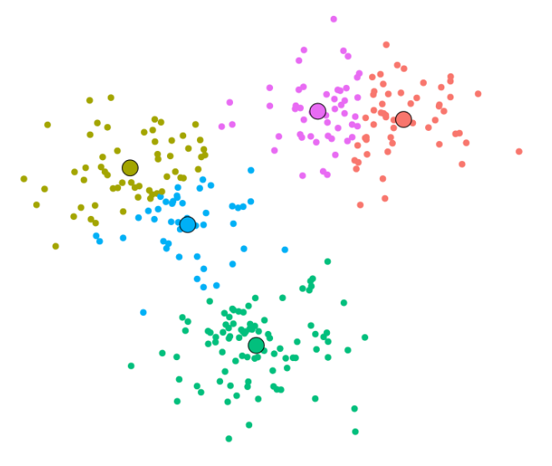

How k-means cluster this data with $k=5$?
Repeat the steps until convergence

Slide 8
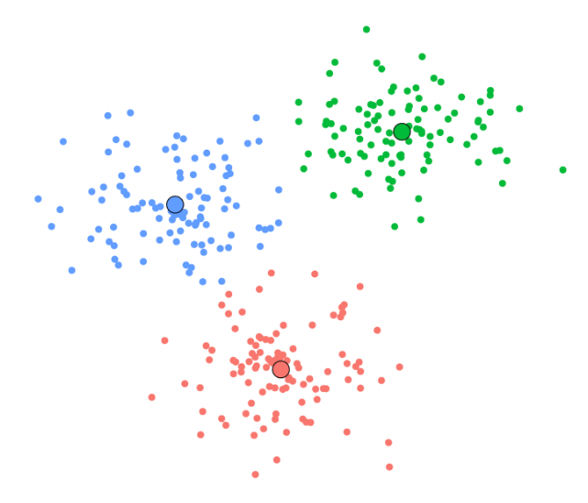
How k-means cluster this data with $k=3$?

Slide 9
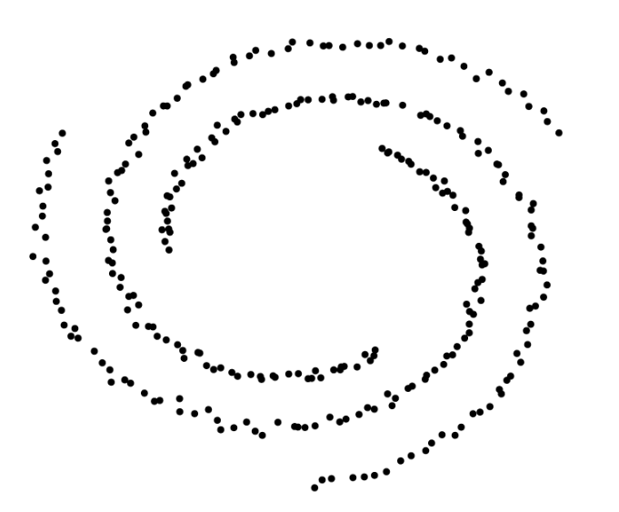
How about this dataset?

Slide 10
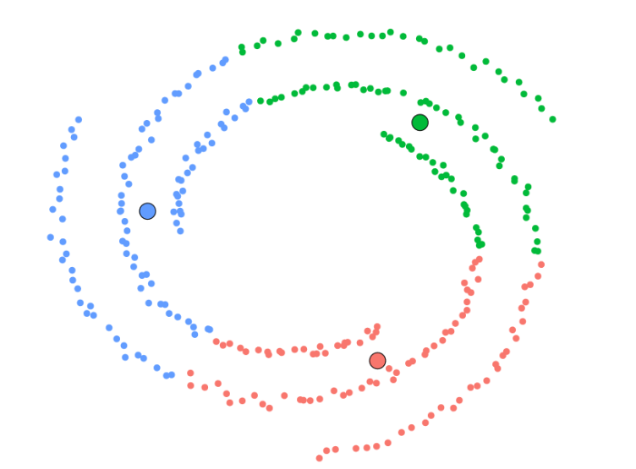
How about this dataset?

Slide 11
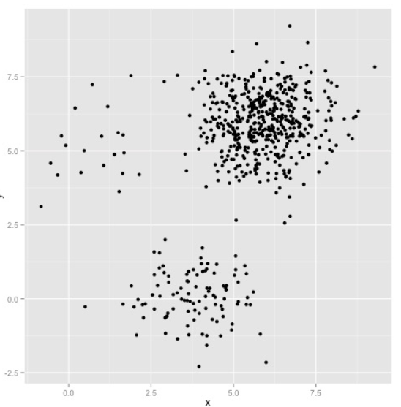
Let’s look at this example
How many clusters can you see in this plot?

Slide 12
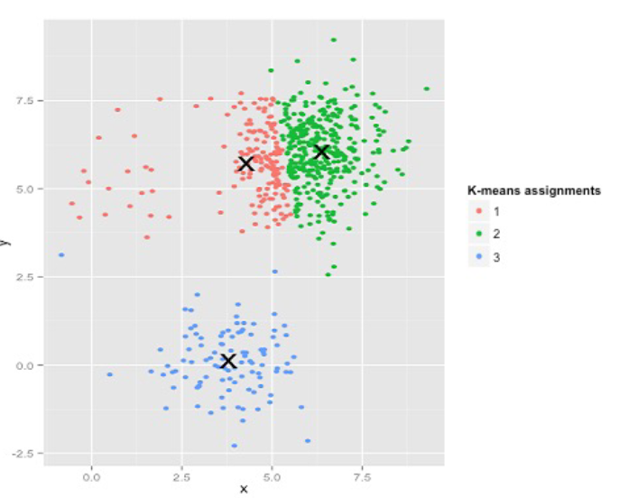
Let’s look at this example
K-means results

Slide 13
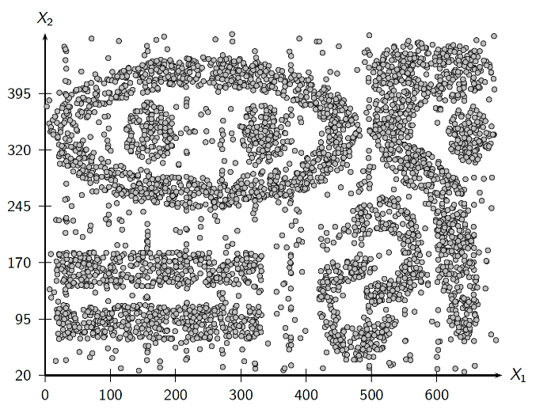
How about this synthetic dataset?
Notes:
Think about this dataset
Non convex data shapes
outliers

Slide 14
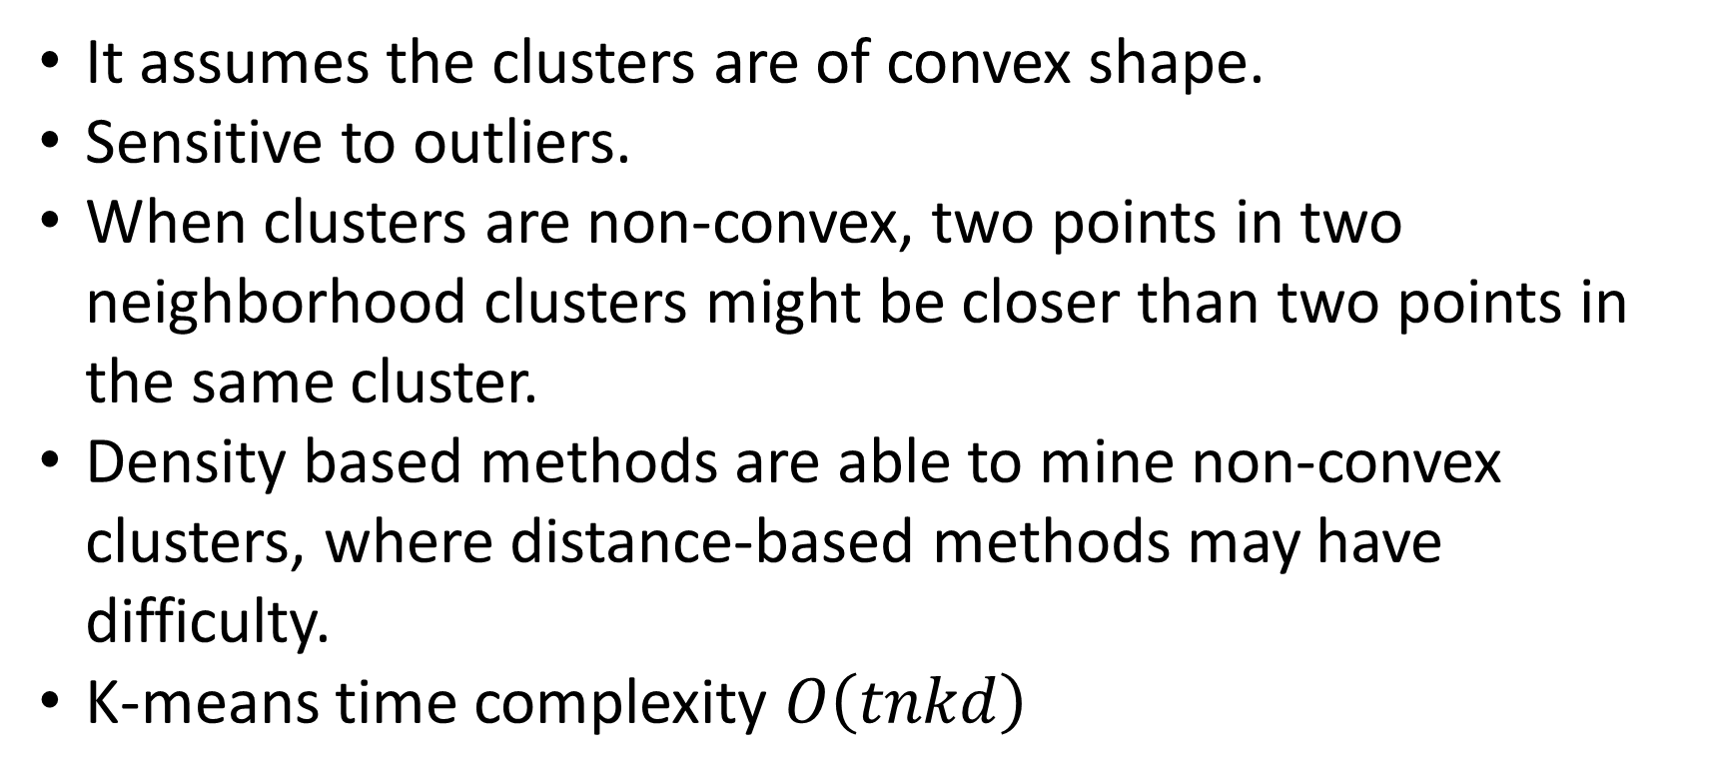
K-means limitations
It assumes the clusters are of convex shape.
Sensitive to outliers.
When clusters are non-convex, two points in two neighborhood clusters might be closer than two points in the same cluster.
Density based methods are able to mine non-convex clusters, where distance-based methods may have difficulty.
K-means time complexity $O\left(tnkd\right)$

Slide 15
K-means Demo
https://www.naftaliharris.com/blog/visualizing-k-means-clustering/

Slide 16

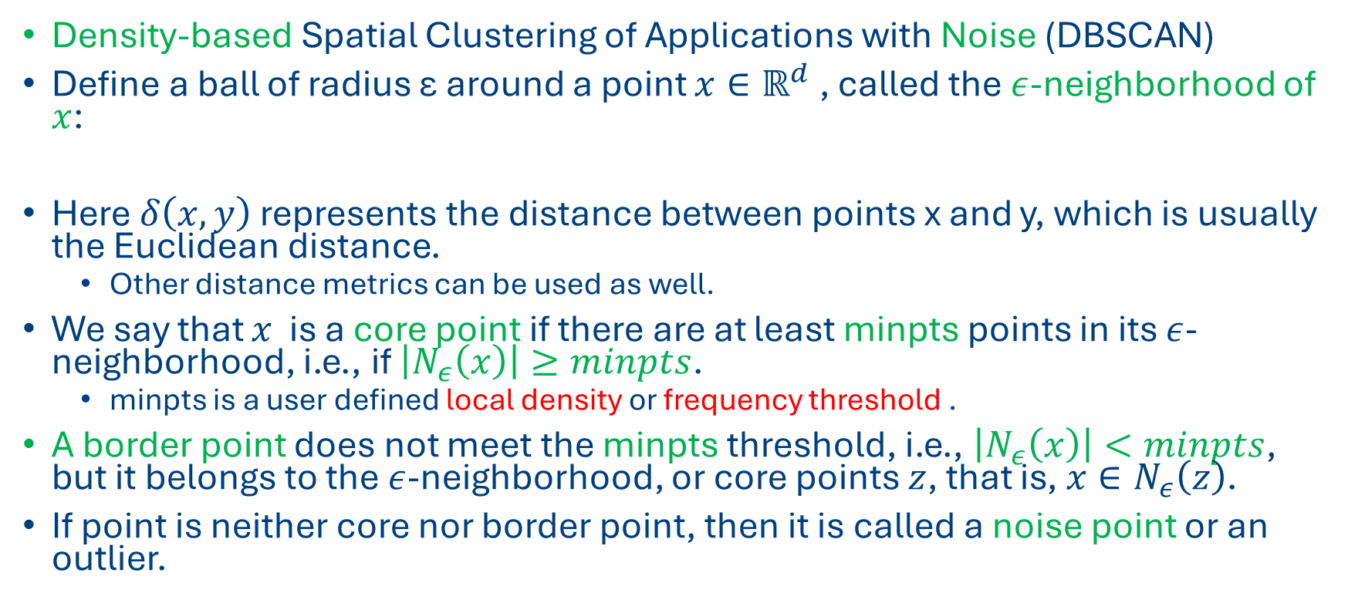
DBSCAN approach
Density-based Spatial Clustering of Applications with Noise (DBSCAN)
Define a ball of radius ε around a point $x∈ℝ^{d}$ , called the $ε$-neighborhood of $x$:
Here $δ\left(x,y\right)$ represents the distance between points x and y, which is usually the Euclidean distance.
Other distance metrics can be used as well.
We say that $x$ is a core point if there are at least minpts points in its $ε$-neighborhood, i.e., if $\left|N_{ε}\left(x\right)\right|≥minpts$.
minpts is a user defined local density or frequency threshold .
A border point does not meet the minpts threshold, i.e., $\left|N_{ε}\left(x\right)\right|<minpts$, but it belongs to the $ε$-neighborhood, or core points $z$, that is, $x∈N_{ε}\left(z\right)$.
If point is neither core nor border point, then it is called a noise point or an outlier.
$$N_{ε}\left(x\right)=B_{d}\left(x, ε\right)=\left\{y | δ\left(x,y\right)≤ε\right\}$$

Slide 17
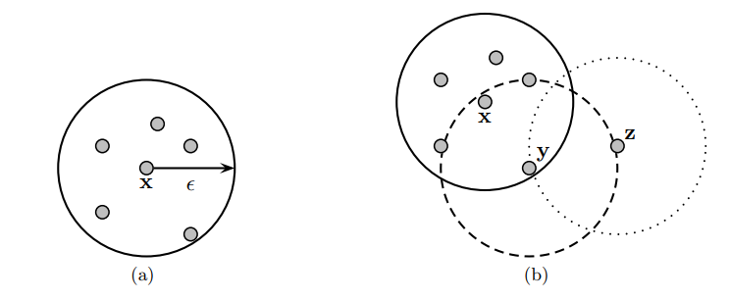
Core, border and noise points
Suppose minpts = 6
(a) Neighborhood of a Point
(b) Core, Border, and Noise Point

Slide 18
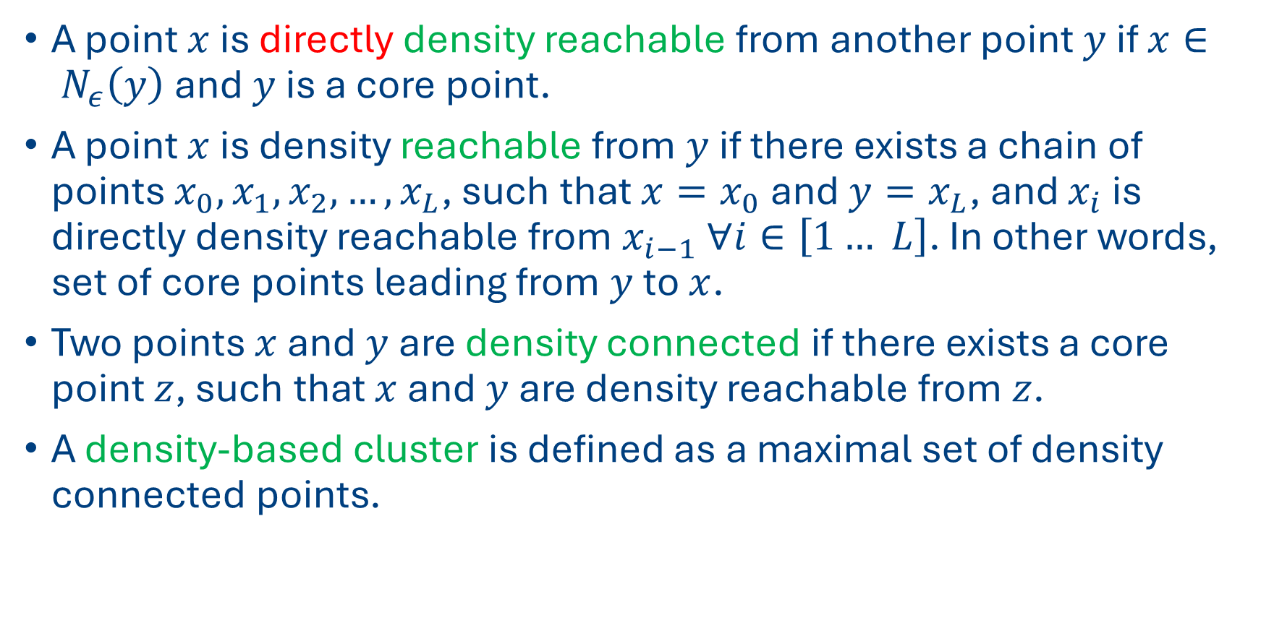
The DBSCAN approach
A point $x$ is directly density reachable from another point $y$ if $x∈ N_{ε}\left(y\right)$ and $y$ is a core point.
A point $x$ is density reachable from $y$ if there exists a chain of points $x_{0},x_{1},x_{2}, …, x_{L}$, such that $x=x_{0}$and $y=x_{L}$, and $x_{i}$ is directly density reachable from $x_{i−1}$ $∀i∈\left[1… L\right]$. In other words, set of core points leading from $y$ to $x$.
Two points $x$ and $y$ are density connected if there exists a core point $z$, such that $x$ and $y$ are density reachable from $z$.
A density-based cluster is defined as a maximal set of density connected points.

Slide 19
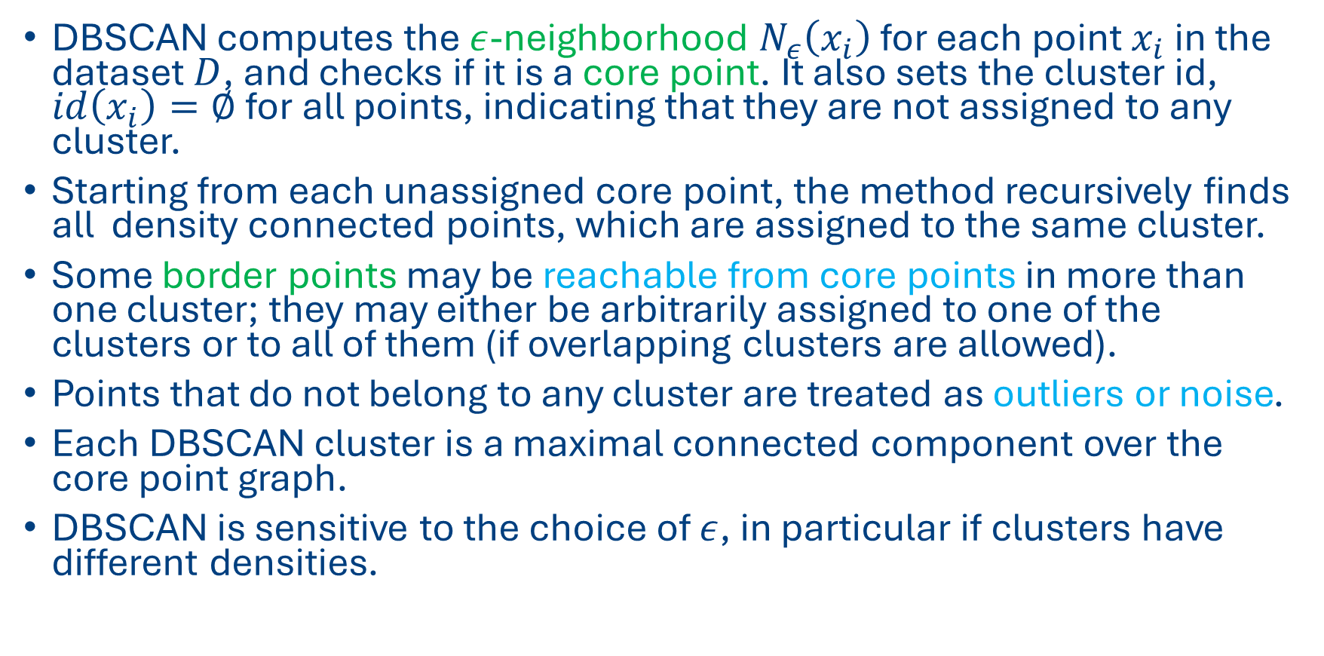
The DBSCAN approach
DBSCAN computes the $ε$-neighborhood $N_{ε}\left(x_{i}\right)$ for each point $x_{i}$ in the dataset $D$, and checks if it is a core point. It also sets the cluster id, $id\left(x_{i}\right)=∅$ for all points, indicating that they are not assigned to any cluster.
Starting from each unassigned core point, the method recursively finds all density connected points, which are assigned to the same cluster.
Some border points may be reachable from core points in more than one cluster; they may either be arbitrarily assigned to one of the clusters or to all of them (if overlapping clusters are allowed).
Points that do not belong to any cluster are treated as outliers or noise.
Each DBSCAN cluster is a maximal connected component over the core point graph.
DBSCAN is sensitive to the choice of $ε$, in particular if clusters have different densities.

Slide 20
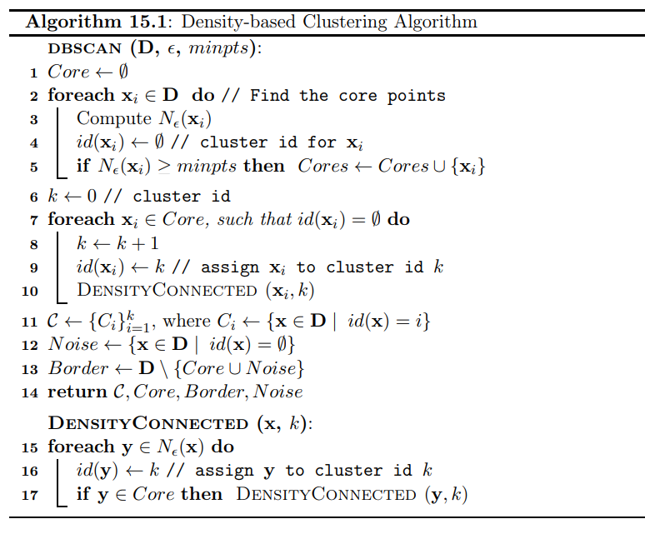
The DBSCAN algorithm

Slide 21
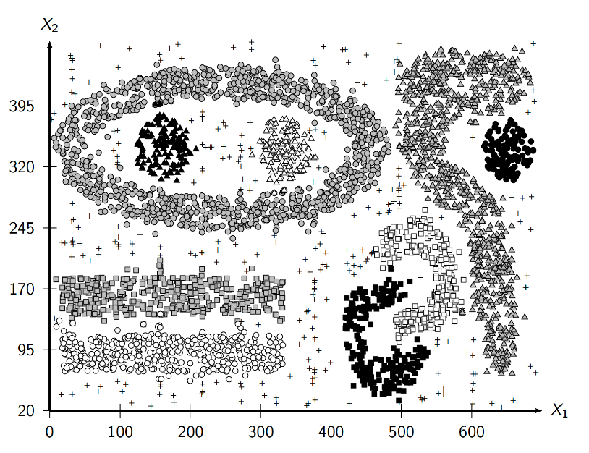

Density based clusters $ε=15$ and $minpts=10$

Slide 22
DBSCAN visualization
https://www.naftaliharris.com/blog/visualizing-dbscan-clustering/

Slide 23
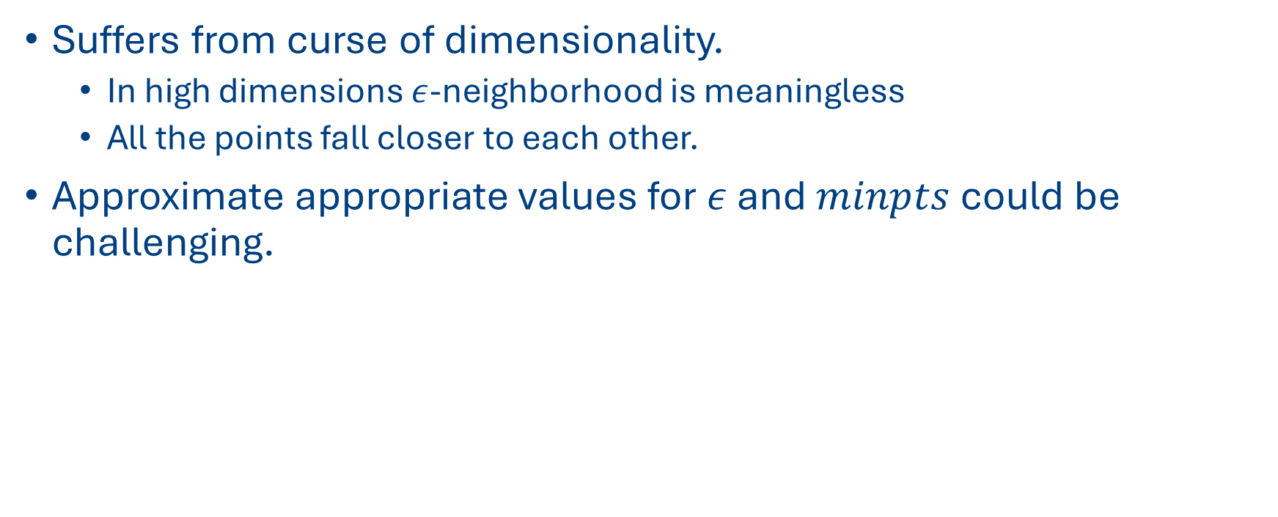
Disadvantages of DBSCAN
Suffers from curse of dimensionality.
In high dimensions $ε$-neighborhood is meaningless
All the points fall closer to each other.
Approximate appropriate values for $ε$ and $minpts$ could be challenging.

Slide 24
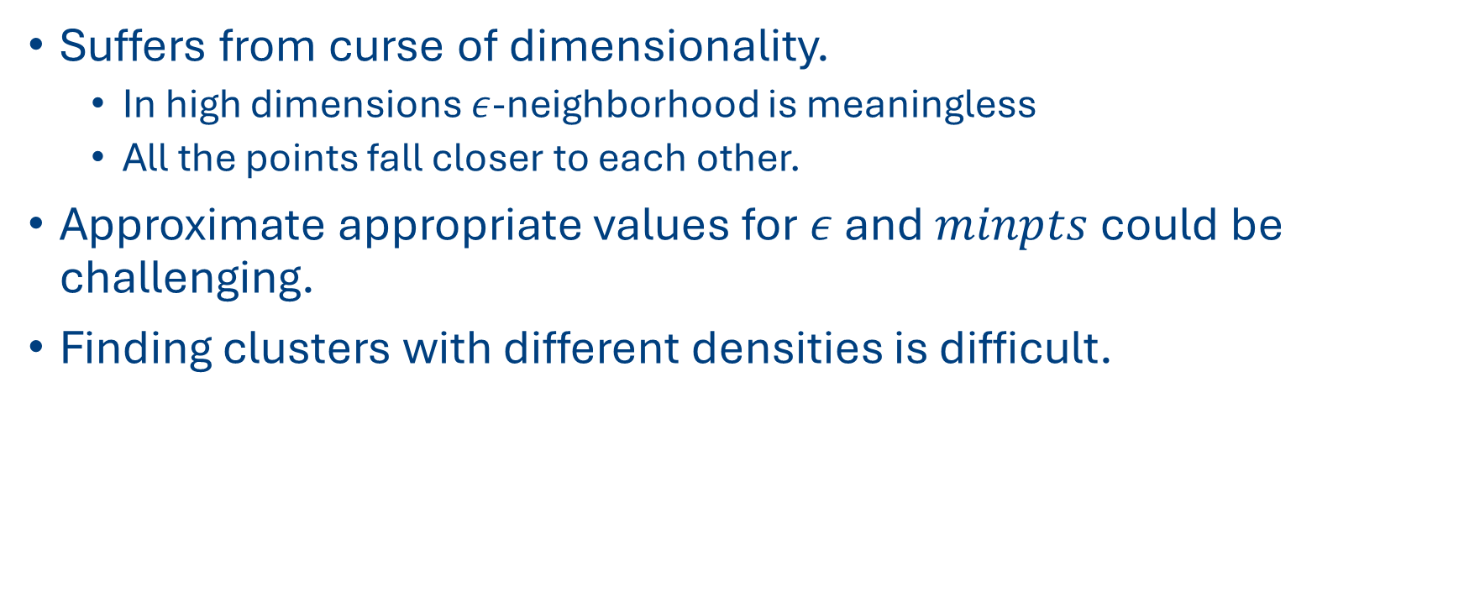
Disadvantages of DBSCAN
Suffers from curse of dimensionality.
In high dimensions $ε$-neighborhood is meaningless
All the points fall closer to each other.
Approximate appropriate values for $ε$ and $minpts$ could be challenging.
Finding clusters with different densities is difficult.

Slide 25
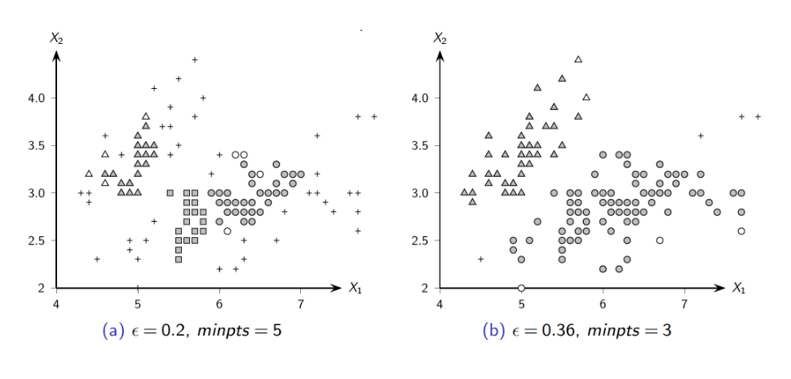
DBSCAN clustering IRIS dataset

