Slide 1
K-means
CSCI 347
Adiesha Liyana Ralalage

Slide 2
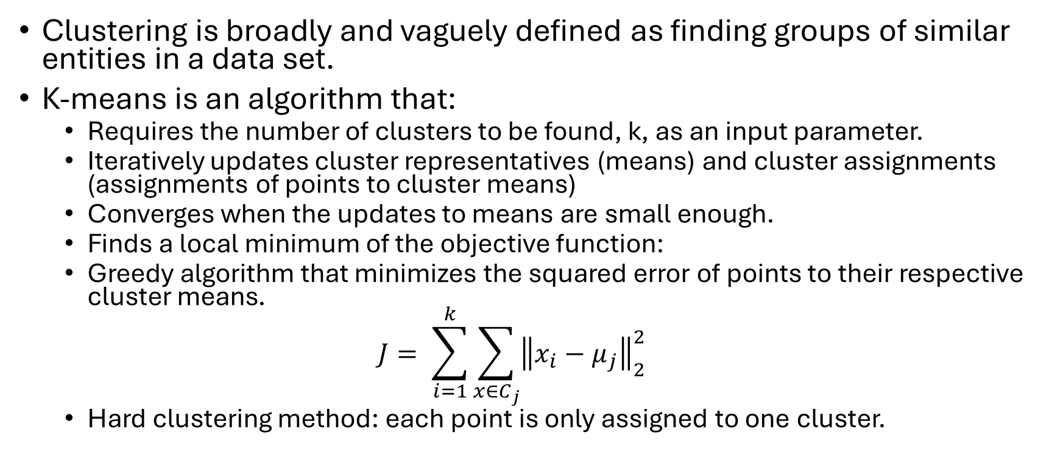
K-means clustering
Clustering is broadly and vaguely defined as finding groups of similar entities in a data set.
K-means is an algorithm that:
Requires the number of clusters to be found, k, as an input parameter.
Iteratively updates cluster representatives (means) and cluster assignments (assignments of points to cluster means)
Converges when the updates to means are small enough.
Finds a local minimum of the objective function:
Greedy algorithm that minimizes the squared error of points to their respective cluster means.
$$J= \sum_{i=1}^{k}{\sum_{x∈C_{j}}^{ }{{\left\|x_{i}−μ_{j}\right\|}_{2}^{2}}}$$
Hard clustering method: each point is only assigned to one cluster.

Slide 3
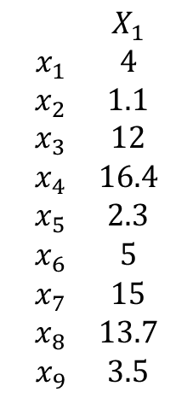
K-means clustering example
$1$-dimensional example with $k=2$
$$\begin{matrix} & X_{1} \\ x_{1} & 4 \\ x_{2} & 1.1 \\ x_{3} & 12 \\ x_{4} & 16.4 \\ x_{5} & 2.3 \\ x_{6} & 5 \\ x_{7} & 15 \\ x_{8} & 13.7 \\ x_{9} & 3.5\end{matrix}$$
-1
0
1
2
3
4
5
6
7
8
9
10
11
12
13
14
15
16
17
18
19
20
21
22

Slide 4
K-means clustering example
$1$-dimensional example with $k=2$
$$\begin{matrix} & X_{1} \\ x_{1} & 4 \\ x_{2} & 1.1 \\ x_{3} & 12 \\ x_{4} & 16.4 \\ x_{5} & 2.3 \\ x_{6} & 5 \\ x_{7} & 15 \\ x_{8} & 13.7 \\ x_{9} & 3.5\end{matrix}$$
-1
0
1
2
3
4
5
6
7
8
9
10
11
12
13
14
15
16
17
18
19
20
21
22
Looks like the true clusters.

Slide 5


K-means clustering example
$1$-dimensional example with $k=2$
$$\begin{matrix} & X_{1} \\ x_{1} & 4 \\ x_{2} & 1.1 \\ x_{3} & 12 \\ x_{4} & 16.4 \\ x_{5} & 2.3 \\ x_{6} & 5 \\ x_{7} & 15 \\ x_{8} & 13.7 \\ x_{9} & 3.5\end{matrix}$$
-1
0
1
2
3
4
5
6
7
8
9
10
11
12
13
14
15
16
17
18
19
20
21
22
Step 1: randomly initialize 2 means
-1
0
1
2
3
4
5
6
7
8
9
10
11
12
13
14
15
16
17
18
19
20
21
22
$$μ_{1}=11$$
$$μ_{2}=18$$

Slide 6
K-means clustering example
$1$-dimensional example with $k=2$
$$\begin{matrix} & X_{1} \\ x_{1} & 4 \\ x_{2} & 1.1 \\ x_{3} & 12 \\ x_{4} & 16.4 \\ x_{5} & 2.3 \\ x_{6} & 5 \\ x_{7} & 15 \\ x_{8} & 13.7 \\ x_{9} & 3.5\end{matrix}$$
-1
0
1
2
3
4
5
6
7
8
9
10
11
12
13
14
15
16
17
18
19
20
21
22
Step 1: randomly initialize 2 means
-1
0
1
2
3
4
5
6
7
8
9
10
11
12
13
14
15
16
17
18
19
20
21
22
Step 2: assign each point to the cluster with the closest mean
-1
0
1
2
3
4
5
6
7
8
9
10
11
12
13
14
15
16
17
18
19
20
21
22
Cluster 1
Cluster 1

Slide 7


K-means clustering example
$1$-dimensional example with $k=2$
$$\begin{matrix} & X_{1} \\ x_{1} & 4 \\ x_{2} & 1.1 \\ x_{3} & 12 \\ x_{4} & 16.4 \\ x_{5} & 2.3 \\ x_{6} & 5 \\ x_{7} & 15 \\ x_{8} & 13.7 \\ x_{9} & 3.5\end{matrix}$$
-1
0
1
2
3
4
5
6
7
8
9
10
11
12
13
14
15
16
17
18
19
20
21
22
Step 3: recompute the means based on the cluster membership
$μ_{1}=\frac{x_{1}+x_{2}+x_{3}+x_{5}+x_{6}+x_{8}+x_{9}}{8}=\frac{41.6}{8}=5.94$
$μ_{2}=\frac{x_{4}+x_{7}}{2}=\frac{31.4}{2}=15.7$
-1
0
1
2
3
4
5
6
7
8
9
10
11
12
13
14
15
16
17
18
19
20
21
22
Cluster 1
Cluster 1

Slide 8
K-means clustering example
$1$-dimensional example with $k=2$
$$\begin{matrix} & X_{1} \\ x_{1} & 4 \\ x_{2} & 1.1 \\ x_{3} & 12 \\ x_{4} & 16.4 \\ x_{5} & 2.3 \\ x_{6} & 5 \\ x_{7} & 15 \\ x_{8} & 13.7 \\ x_{9} & 3.5\end{matrix}$$
-1
0
1
2
3
4
5
6
7
8
9
10
11
12
13
14
15
16
17
18
19
20
21
22
Step 3: recompute the means based on the cluster membership
$μ_{1}=\frac{x_{1}+x_{2}+x_{3}+x_{5}+x_{6}+x_{8}+x_{9}}{8}=\frac{41.6}{8}=5.94$
$μ_{2}=\frac{x_{4}+x_{7}}{2}=\frac{31.4}{2}=15.7$
-1
0
1
2
3
4
5
6
7
8
9
10
11
12
13
14
15
16
17
18
19
20
21
22
Cluster 1
Cluster 1
Step 2: assign each point to the cluster with the closest mean
-1
0
1
2
3
4
5
6
7
8
9
10
11
12
13
14
15
16
17
18
19
20
21
22

Slide 9


K-means clustering example
$1$-dimensional example with $k=2$
$$\begin{matrix} & X_{1} \\ x_{1} & 4 \\ x_{2} & 1.1 \\ x_{3} & 12 \\ x_{4} & 16.4 \\ x_{5} & 2.3 \\ x_{6} & 5 \\ x_{7} & 15 \\ x_{8} & 13.7 \\ x_{9} & 3.5\end{matrix}$$
-1
0
1
2
3
4
5
6
7
8
9
10
11
12
13
14
15
16
17
18
19
20
21
22
Step 3: recompute the means based on the cluster membership
$μ_{1}=\frac{x_{1}+x_{2}+x_{5}+x_{6}+x_{9}}{5}=\frac{15.9 }{5}=3.18$
$μ_{2}=\frac{x_{3}+x_{4}+x_{7}+x_{8}}{4}=\frac{57.1}{4}=14.3$
-1
0
1
2
3
4
5
6
7
8
9
10
11
12
13
14
15
16
17
18
19
20
21
22
Cluster 1
Cluster 1
Step 2: assign each point to the cluster with the closest mean
No change: stop the iteration
-1
0
1
2
3
4
5
6
7
8
9
10
11
12
13
14
15
16
17
18
19
20
21
22

Slide 10
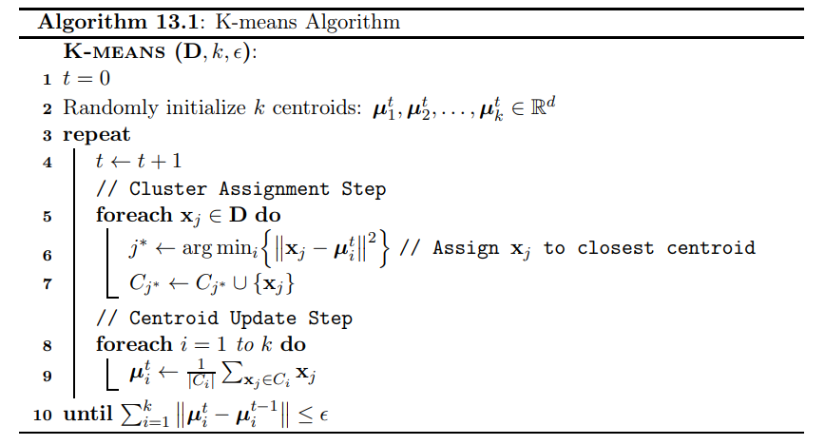
K-means algorithm

Slide 11
K-means
Given n points and a number d, is there a partition into k clusters such that the sum of squared distances between each point and the centroid of its cluster is at most d?
This problem is NP-hard
NP-hardness of Euclidean sum-of-squares clustering
https://link.springer.com/article/10.1007/s10994-009-5103-0
K-means algorithm finds a local optimum.

Slide 12
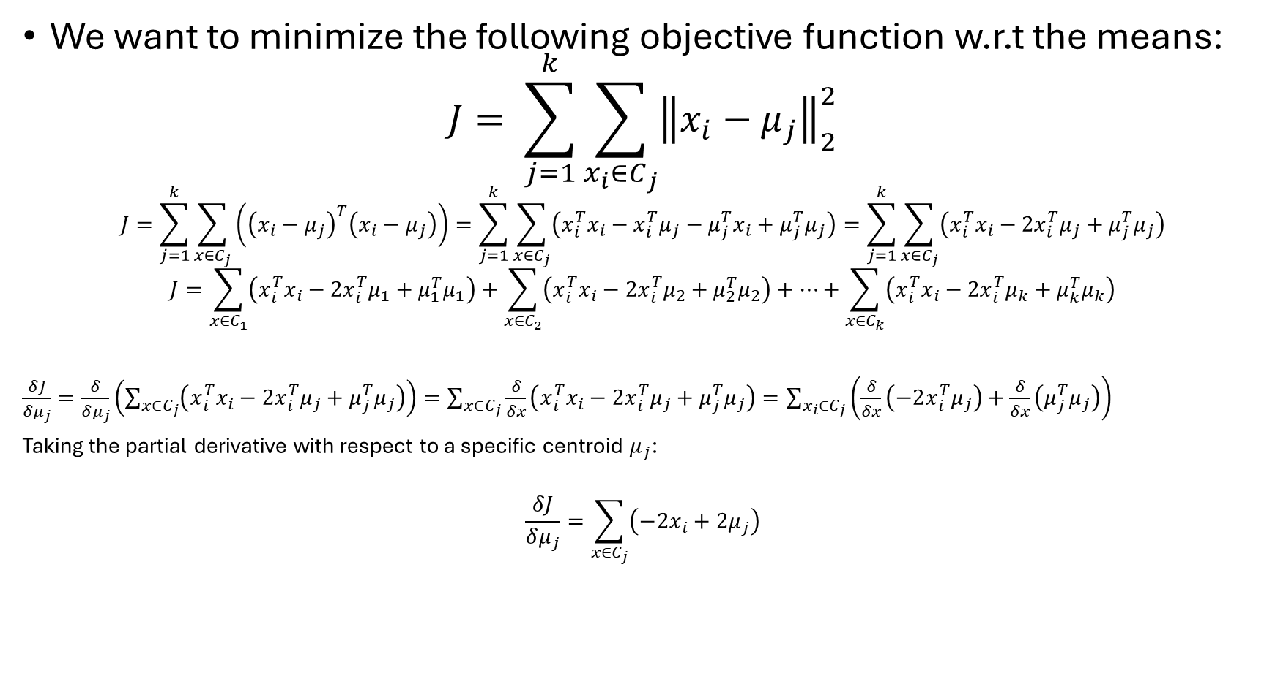
K-means objective
We want to minimize the following objective function w.r.t the means:
$$J= \sum_{j=1}^{k}{\sum_{x_{i}∈C_{j}}^{ }{{\left\|x_{i}−μ_{j}\right\|}_{2}^{2}}}$$
$$J=\sum_{j=1}^{k}{\sum_{x∈C_{j}}^{ }{\left({\left(x_{i}−μ_{j}\right)}^{T}\left(x_{i}−μ_{j}\right)\right)}}=\sum_{j=1}^{k}{\sum_{x∈C_{j}}^{ }{\left(x_{i}^{T}x_{i}−x_{i}^{T}μ_{j}−μ_{j}^{T}x_{i}+μ_{j}^{T}μ_{j}\right)}}=\sum_{j=1}^{k}{\sum_{x∈C_{j}}^{ }{\left(x_{i}^{T}x_{i}−{2x}_{i}^{T}μ_{j}+μ_{j}^{T}μ_{j}\right)}}$$
$$J=\sum_{x∈C_{1}}^{ }{\left(x_{i}^{T}x_{i}−{2x}_{i}^{T}μ_{1}+μ_{1}^{T}μ_{1}\right)}+\sum_{x∈C_{2}}^{ }{\left(x_{i}^{T}x_{i}−{2x}_{i}^{T}μ_{2}+μ_{2}^{T}μ_{2}\right)}+⋯+\sum_{x∈C_{k}}^{ }{\left(x_{i}^{T}x_{i}−{2x}_{i}^{T}μ_{k}+μ_{k}^{T}μ_{k}\right)}$$
$\frac{δJ}{δμ_{j}}=\frac{δ}{δμ_{j}}\left(\sum_{x∈C_{j}}^{ }{\left(x_{i}^{T}x_{i}−{2x}_{i}^{T}μ_{j}+μ_{j}^{T}μ_{j}\right)}\right)=\sum_{x∈C_{j}}^{ }{\frac{δ}{δx}\left(x_{i}^{T}x_{i}−{2x}_{i}^{T}μ_{j}+μ_{j}^{T}μ_{j}\right)}=\sum_{x_{i}∈C_{j}}^{ }{\left(\frac{δ}{δx}\left(−2x_{i}^{T}μ_{j}\right)+\frac{δ}{δx}\left(μ_{j}^{T}μ_{j}\right)\right)}$
Taking the partial derivative with respect to a specific centroid $μ_{j}$:
$$\frac{δJ}{δμ_{j}}=\sum_{x∈C_{j}}^{ }{\left(−2x_{i}+2μ_{j}\right)}$$

Slide 13
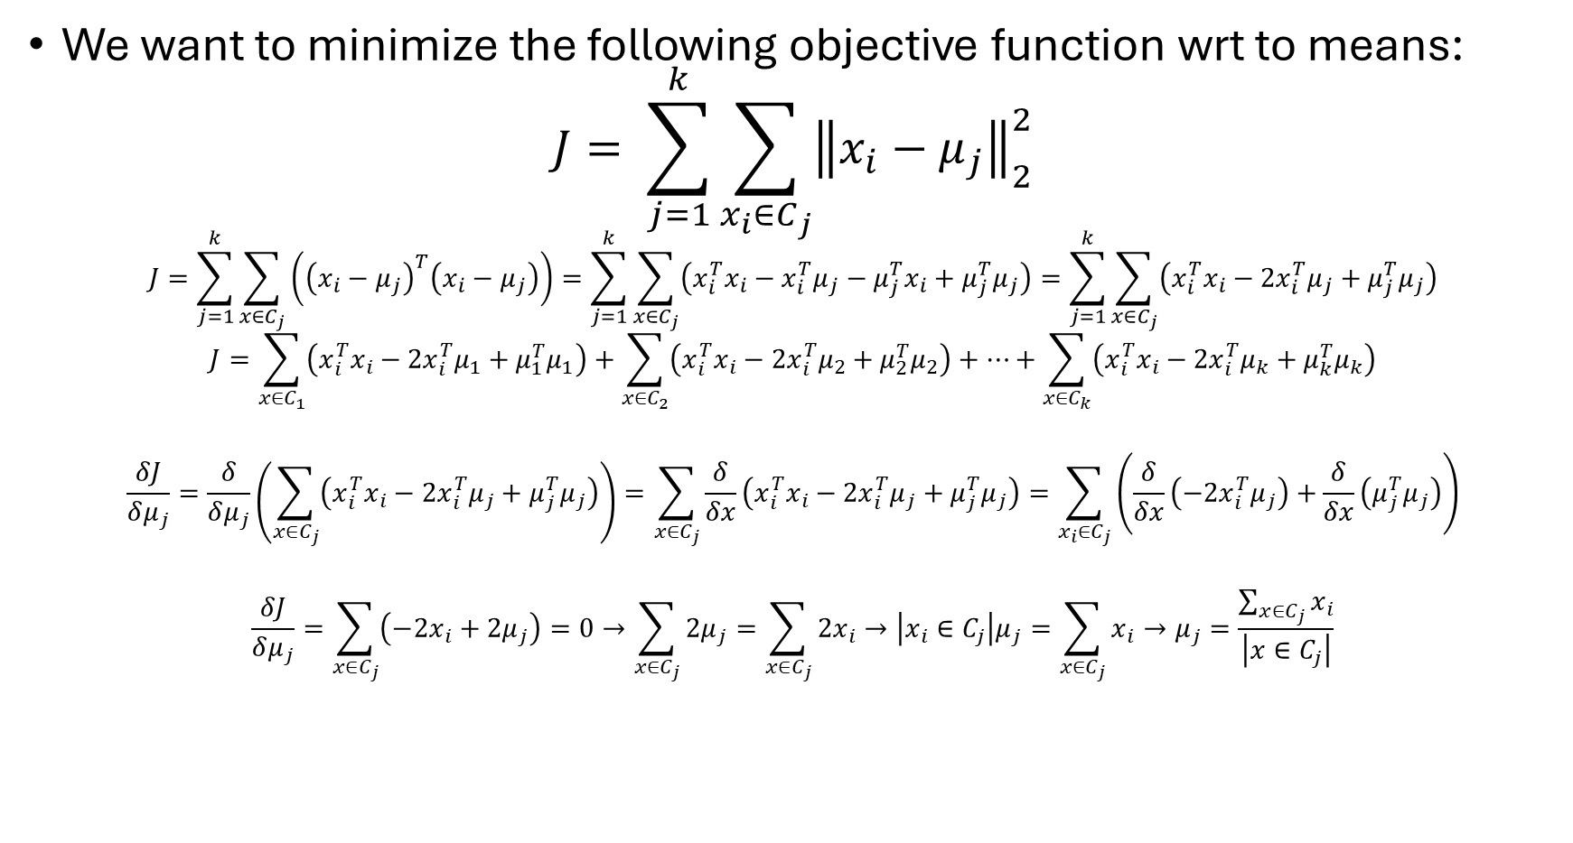
K-means objective
We want to minimize the following objective function wrt to means:
$$J= \sum_{j=1}^{k}{\sum_{x_{i}∈C_{j}}^{ }{{\left\|x_{i}−μ_{j}\right\|}_{2}^{2}}}$$
$$J=\sum_{j=1}^{k}{\sum_{x∈C_{j}}^{ }{\left({\left(x_{i}−μ_{j}\right)}^{T}\left(x_{i}−μ_{j}\right)\right)}}=\sum_{j=1}^{k}{\sum_{x∈C_{j}}^{ }{\left(x_{i}^{T}x_{i}−x_{i}^{T}μ_{j}−μ_{j}^{T}x_{i}+μ_{j}^{T}μ_{j}\right)}}=\sum_{j=1}^{k}{\sum_{x∈C_{j}}^{ }{\left(x_{i}^{T}x_{i}−{2x}_{i}^{T}μ_{j}+μ_{j}^{T}μ_{j}\right)}}$$
$$J=\sum_{x∈C_{1}}^{ }{\left(x_{i}^{T}x_{i}−{2x}_{i}^{T}μ_{1}+μ_{1}^{T}μ_{1}\right)}+\sum_{x∈C_{2}}^{ }{\left(x_{i}^{T}x_{i}−{2x}_{i}^{T}μ_{2}+μ_{2}^{T}μ_{2}\right)}+⋯+\sum_{x∈C_{k}}^{ }{\left(x_{i}^{T}x_{i}−{2x}_{i}^{T}μ_{k}+μ_{k}^{T}μ_{k}\right)}$$
$$\frac{δJ}{δμ_{j}}=\frac{δ}{δμ_{j}}\left(\sum_{x∈C_{j}}^{ }{\left(x_{i}^{T}x_{i}−{2x}_{i}^{T}μ_{j}+μ_{j}^{T}μ_{j}\right)}\right)=\sum_{x∈C_{j}}^{ }{\frac{δ}{δx}\left(x_{i}^{T}x_{i}−{2x}_{i}^{T}μ_{j}+μ_{j}^{T}μ_{j}\right)}=\sum_{x_{i}∈C_{j}}^{ }{\left(\frac{δ}{δx}\left(−2x_{i}^{T}μ_{j}\right)+\frac{δ}{δx}\left(μ_{j}^{T}μ_{j}\right)\right)}$$
$$\frac{δJ}{δμ_{j}}=\sum_{x∈C_{j}}^{ }{\left(−2x_{i}+2μ_{j}\right)}=0→\sum_{x∈C_{j}}^{ }{2μ_{j}}=\sum_{x∈C_{j}}^{ }{2x_{i}→\left|x_{i}∈C_{j}\right|μ_{j}=\sum_{x∈C_{j}}^{ }{x_{i}}→μ_{j}=\frac{\sum_{x∈C_{j}}^{ }{x_{i}}}{\left|x∈C_{j}\right|}}$$

Slide 14

K-means objective
$μ_{j}=\frac{\sum_{x_{i}∈C_{j}}^{ }{x_{i}}}{\left|x∈C_{j}\right|}$
Each centroid should be the average of the points in its cluster.

